Slide 1


District
Advisory Council
November 6, 2025
Brenda Cassellius, EdD
Superintendent

Slide 2


Presenter
Michael Harris
Chief of Staff
Office of the Superintendent
District
Advisory
Council

Slide 3
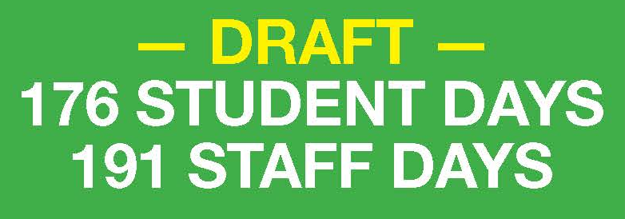
Proposed 2026–27 and 2027–28 Calendars
3 Options
176 student days
191 staff days
Meets WI Dept. of Public Instruction (DPI) Instructional requirements
Meets contractual requirements

Slide 4
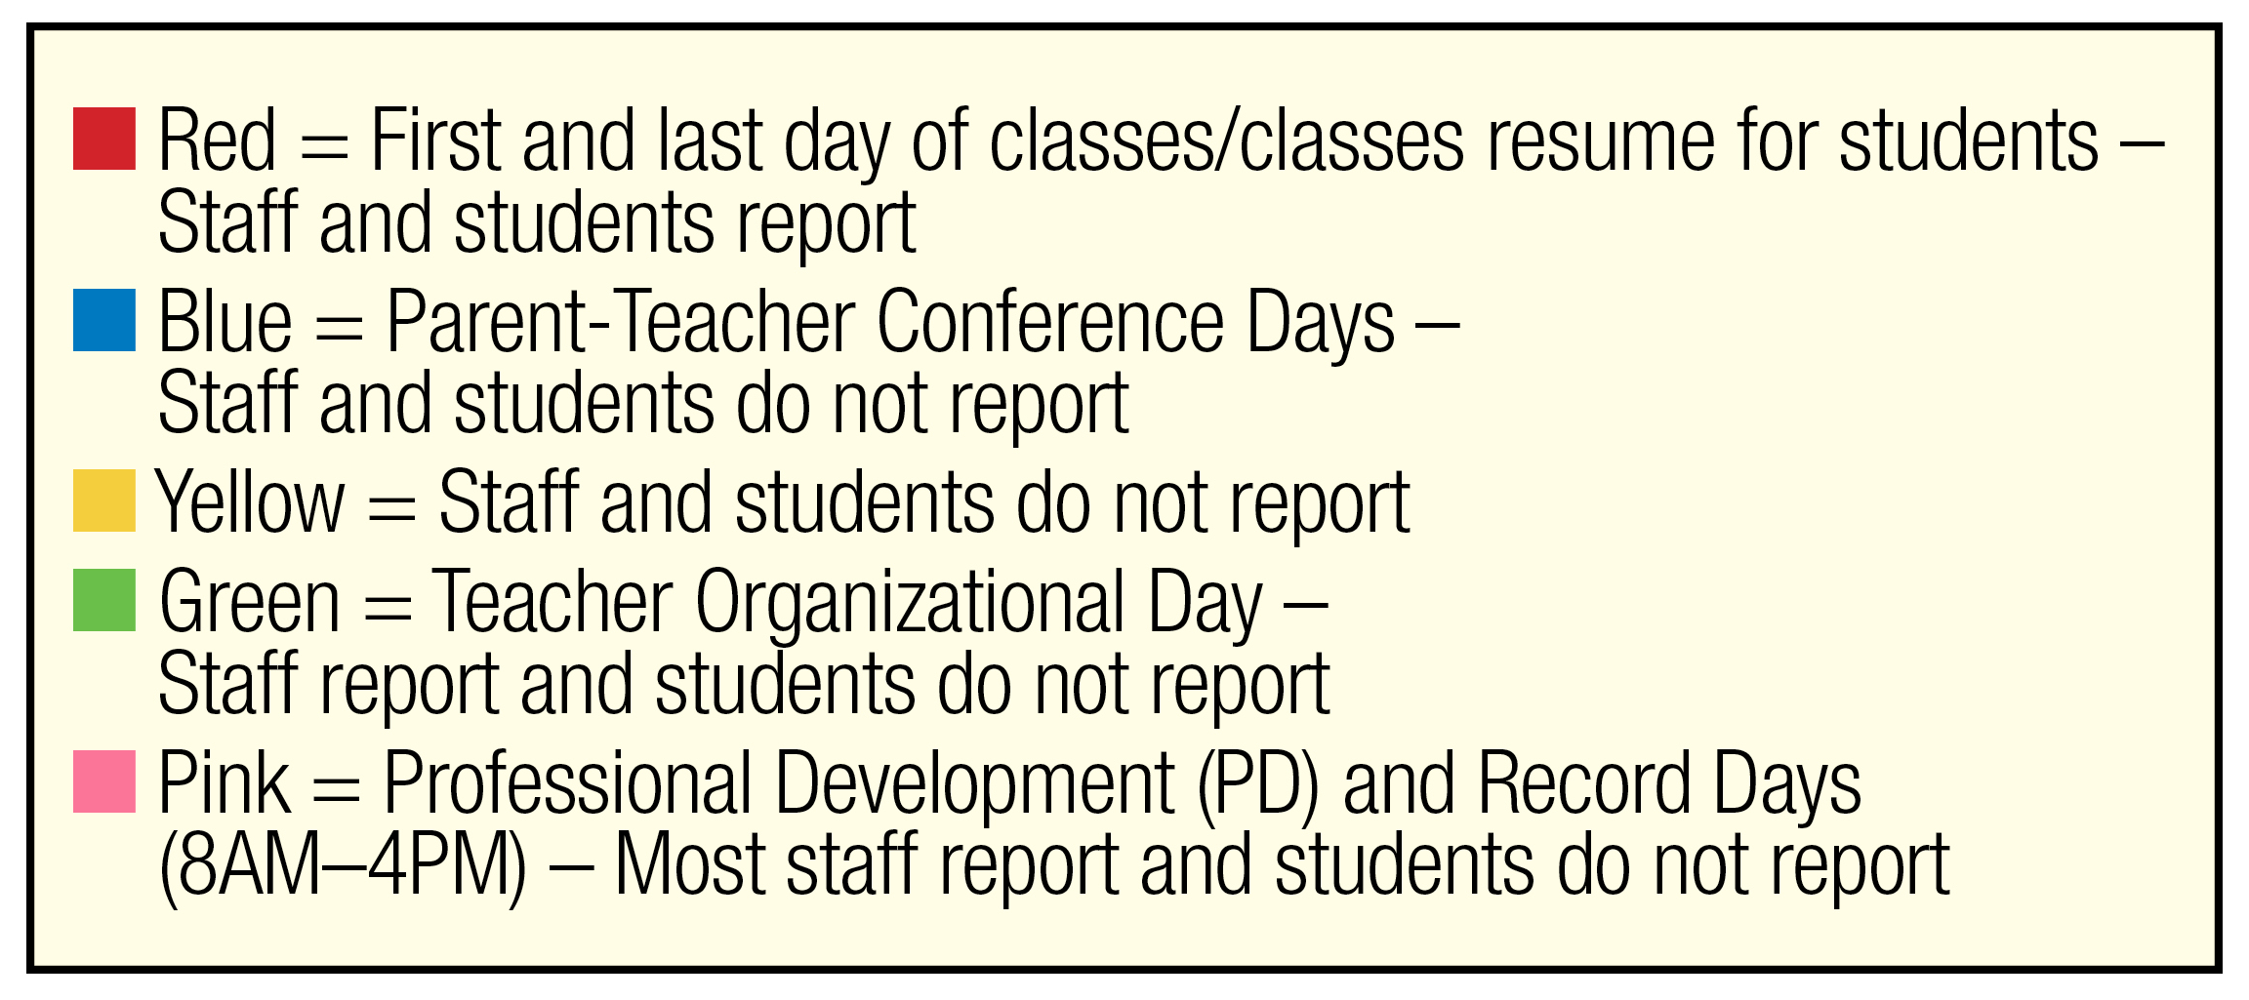
Legend

Slide 5
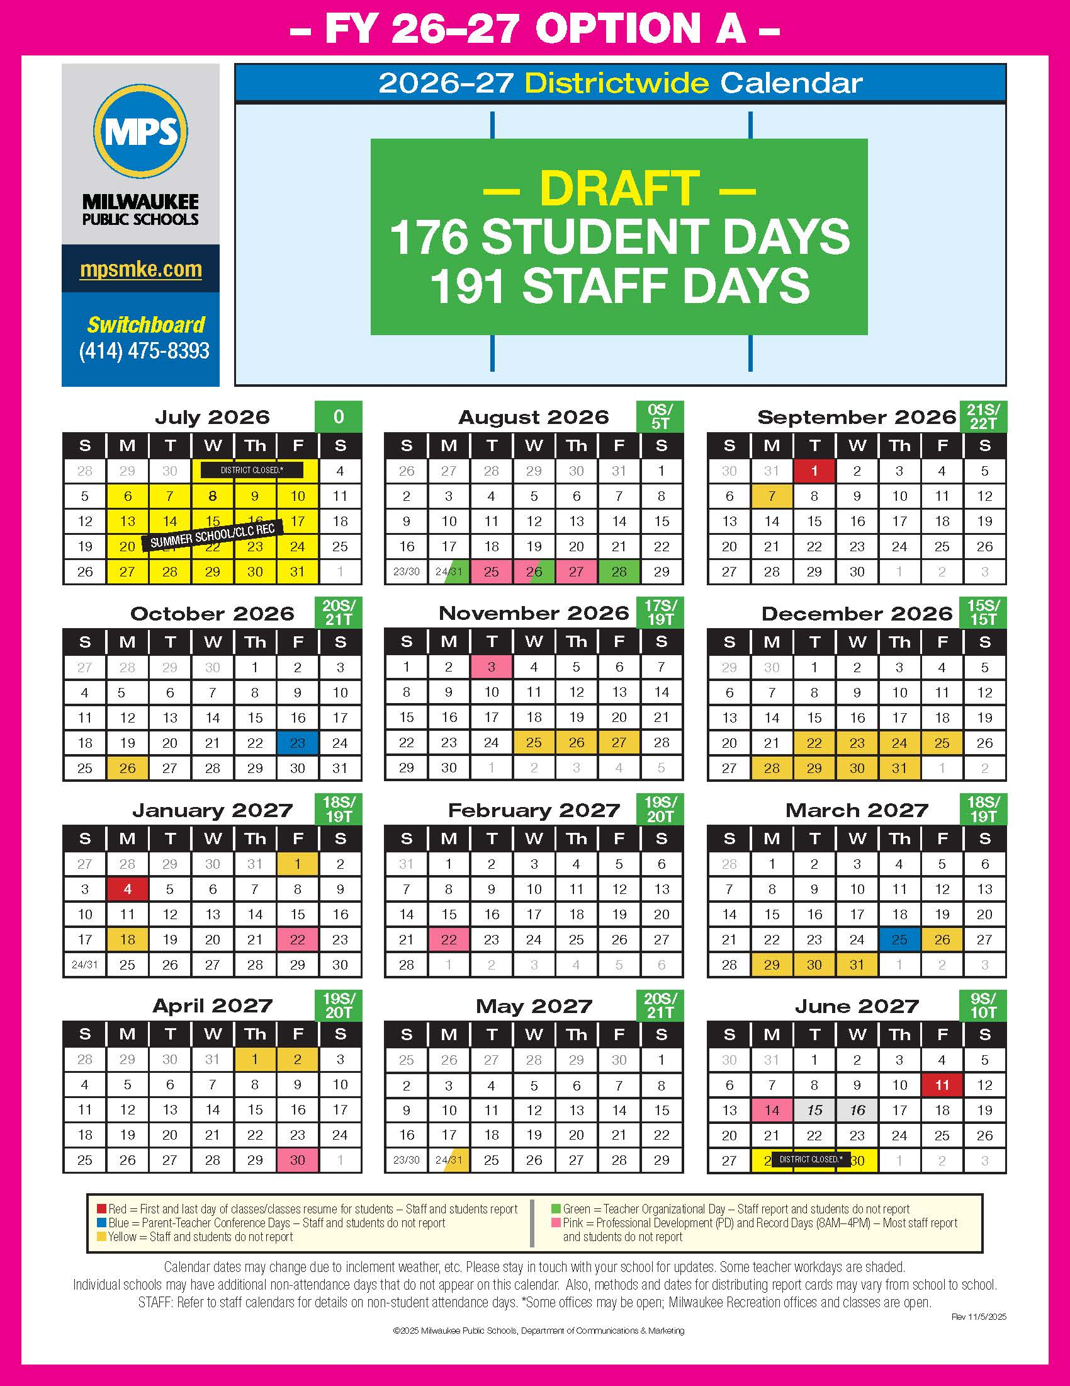
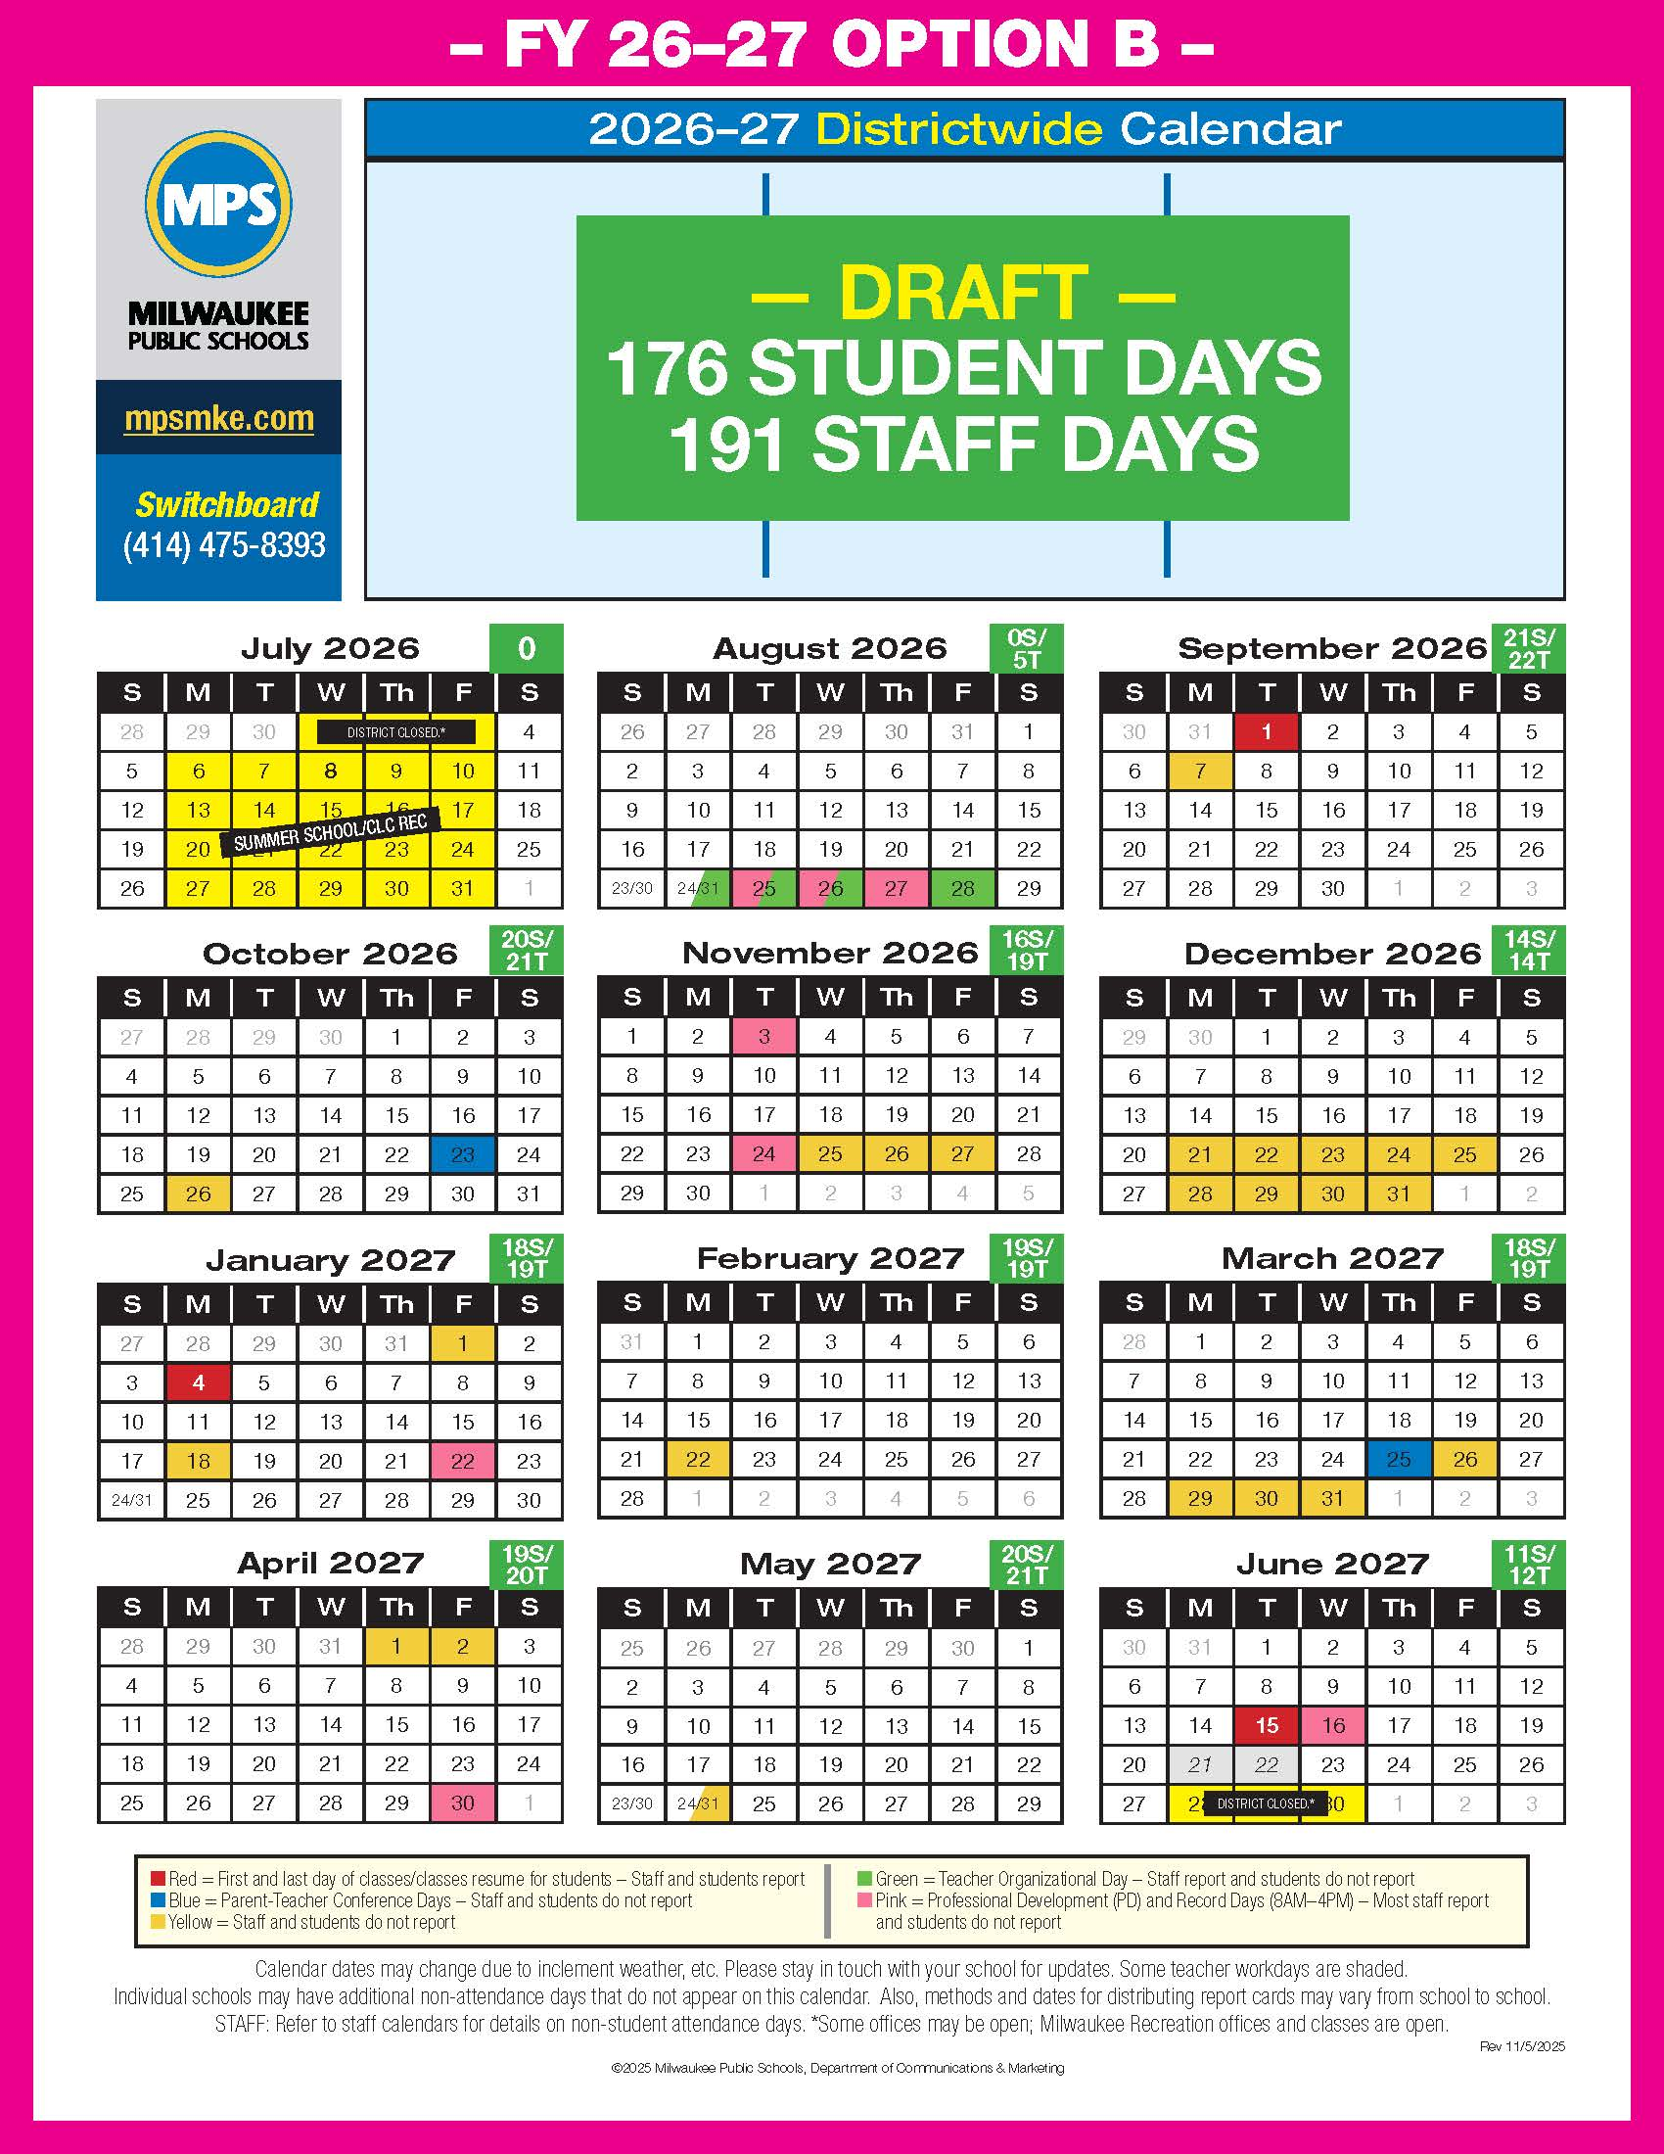

Proposed 2026–27 Calendar – 3 Options

Slide 6
Proposed 2026–27 Calendar – Option A

Slide 7
Proposed 2026–27 Calendar – Option B

Slide 8
Proposed 2026–27 Calendar – Option C

Slide 9
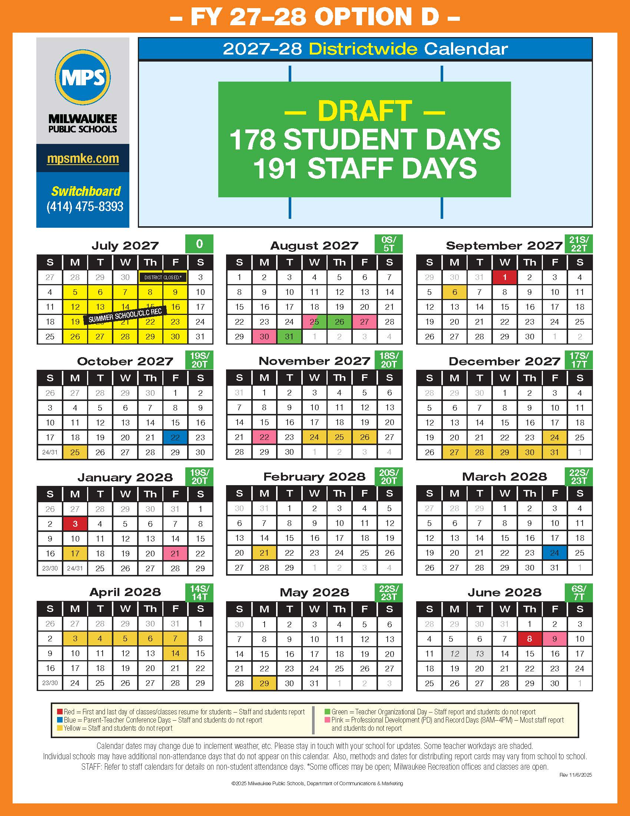
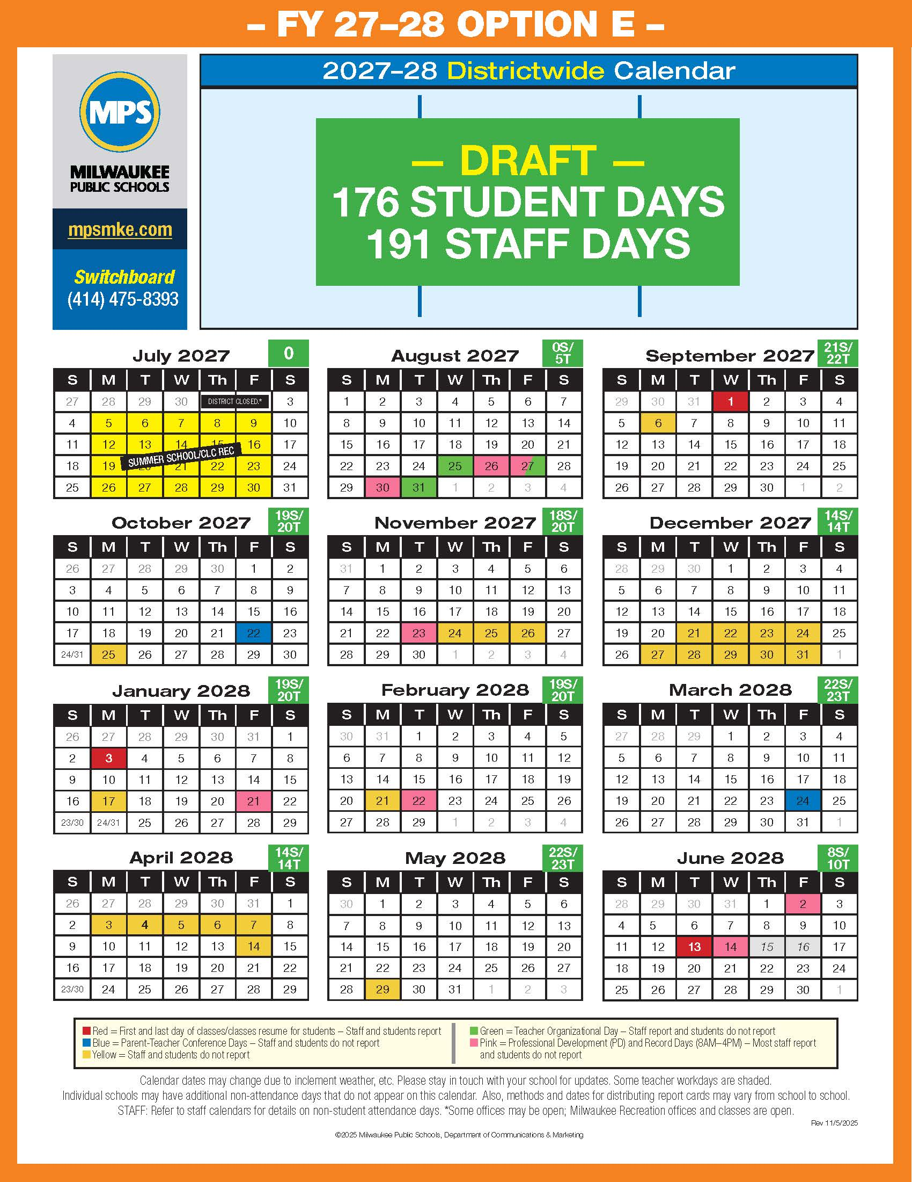
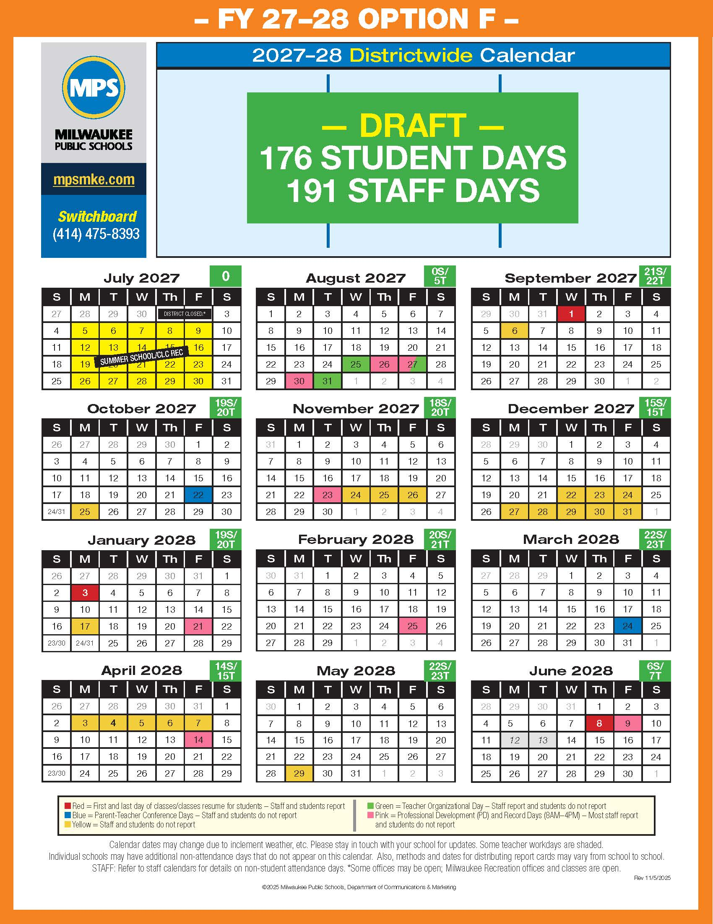
Proposed 2027–28 Calendar – 3 Options

Slide 10
Proposed 2027–28 Calendar – Option D

Slide 11
Proposed 2027–28 Calendar – Option E

Slide 12
Proposed 2027–28 Calendar – Option F

Slide 13


Slide 14

Thank
you!

Slide 15

Questions?

