Slide 1

Jarrell
Independent School District
Fall 2025 Enrollment and Housing Report

Slide 2


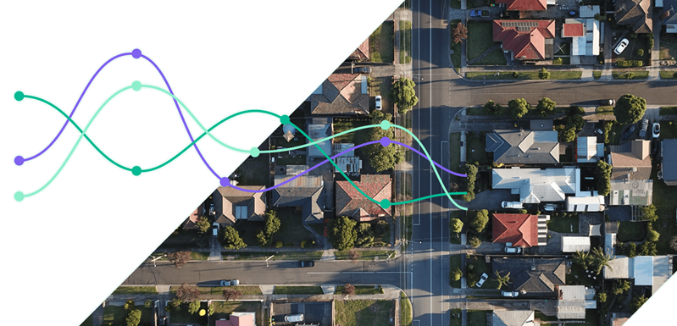
Zonda’s demographic division, formerly Templeton Demographics, was established in 2006 and has been assisting public schools with demographic services for over 18 years. From day one, our mission has been to continually improve and provide accurate and timely data combined with outstanding consulting services. The fusion of demographics with unparalleled housing data from Zonda has made us a leader in the market. The data provides an in-depth look at how the impact of housing and development influences decisions made now and in the future across the nation. The 12 dedicated employees in our division work diligently to provide the best possible data and enrollment projections to help you make informed decisions for your school system.
We are the #1 demographer in the state of Texas and now work with clients in Arkansas, Colorado, Georgia, Missouri, Oklahoma, North Carolina and South Carolina.
2

Slide 3
Table of Contents
Economic Conditions 4
Local Economic Data
Single-Family Housing 6
National Market Information & Area Sales Data
Single-Family Housing Construction 12
District Housing Activity Information
Multifamily 24
Student Yield Analysis
Enrollment –Data & Trends 27
Student Mobility & Birthrates
Enrollment Forecast 31
10 Year Forecast & Campus Projections

Slide 4
Economic Conditions
Local Economic Data
4

Slide 5
Local
Economic Conditions
Unemployment levels in the region have increased by about 0.2% from last year numbers
Approximately 7,400 jobs have been added in the area over the past 12 months
Largest employers in the area were related to Professional & Business Services sectors, as well as Trade, Transport & Utilities and Government
Sector with the greatest increases in job numbers over the past year was in the Government sector
The largest decline this past year was in Information
All Industry Sectors | Aug-2024 | Aug-2025 | YOY Change
(Austin-Round Rock MSA) Total Nonfarm Employment #s | 1,361,000 | 1,368,400 | 0.7%
Source: US BLS; US BEA

Slide 6
Single-Family Housing National Market Information & Area Sales Data
6

Slide 7
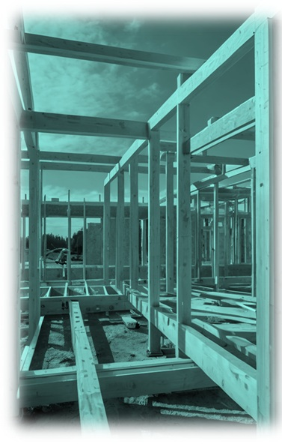
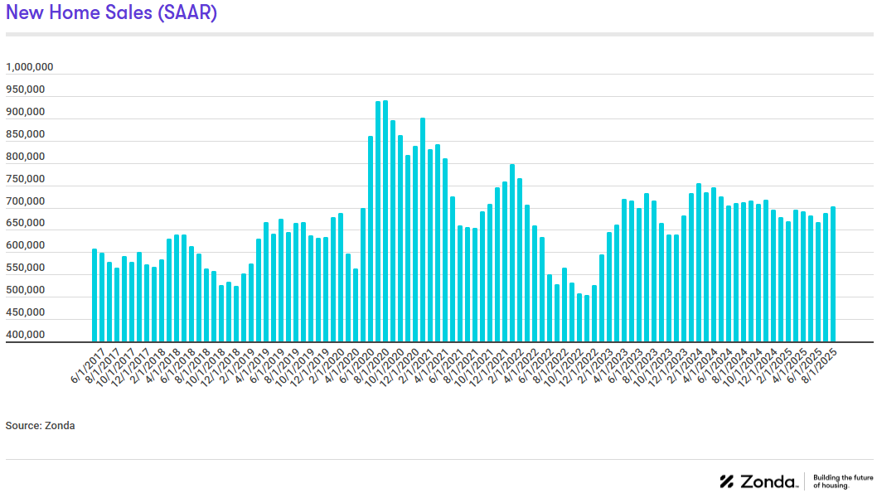
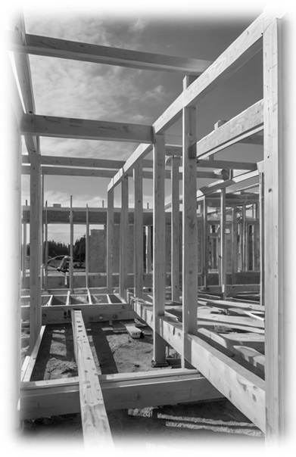
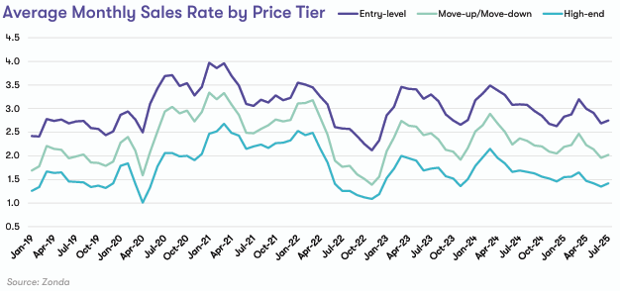
National Housing Market Conditions
Single-Family Housing
There were 703,000 new homes sold in August 2025 on a seasonally adjusted annualized rate. This is an increase of 2.1% from the July 2025 sales numbers and a drop of -1.2% from a year ago.
Among Zonda’s top 50 major markets across the country, 32% were overperforming, 42% were average, and 26% were underperforming.
Recent Market Moderation (past four months). Home sales for new communities have trended directionally together across different price points; entry level homes continuously sell at a higher rate than upper-level homes.
Monitoring Several Variables Impacting the Market Potential shifts in monetary policy, fiscal policy, international relations, investor sentiment, and consumer behavior are all being evaluated as to what impacts we may see in the coming months.
7

Slide 8
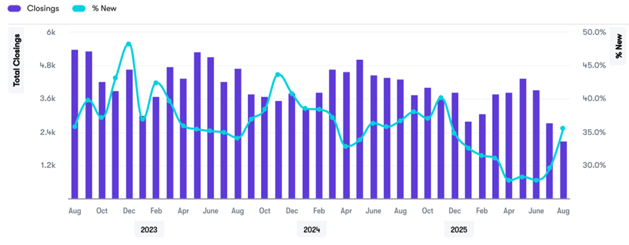
Regional Housing Market Conditions
Single-Family Housing
Austin maintains an average monthly sales rate of 1.9 net monthly sales per community among active projects.
Among Texas’ four major markets, one market (San Antonio) is overperforming, two markets (Dallas and Houston) are average, and one market (Austin) is underperforming in terms of new home sales adjusted for supply and seasonality.
The Austin-Round Rock-San Marcos MSA experienced 13,744 new home closings in the last 12 months, a decrease of -25.4%.
Total Monthly Home Closings and New Home % Share
Builder surveys report that affordability and consumer confidence are keeping consumers on the sidelines leading to tempering of new home activity.

Slide 9
Mortgage Rate Analysis
Single-Family Housing
The Federal Reserve Board cut its benchmark federal funds rate by 25 basis points on September 17 and October 29th, resulting in a reduction of the 30-year fixed rate mortgage average to 6.17% at the end of October, the lowest since October 2024.
The move was driven by signs of a softening labor market and weakening job growth.
Mortgage rates remain elevated compared to pre-2022 levels, reflecting ongoing inflationary pressures and cautious monetary policy.
Source: US FRED

Slide 10
Jarrell ISD New Home Activity
Single-Family Housing
Starts | 2018 | 2019 | 2020 | 2021 | 2022 | 2023 | 2024 | 2025 |  | Closings | 2018 | 2019 | 2020 | 2021 | 2022 | 2023 | 2024 | 2025
1Q | 51 | 55 | 155 | 313 | 327 | 102 | 292 | 226 |  | 1Q | 72 | 85 | 129 | 244 | 230 | 319 | 240 | 219
2Q | 121 | 129 | 135 | 339 | 413 | 239 | 388 | 293 |  | 2Q | 32 | 97 | 195 | 263 | 409 | 246 | 325 | 226
3Q | 112 | 248 | 241 | 288 | 324 | 350 | 374 | 194 |  | 3Q | 99 | 107 | 166 | 342 | 267 | 225 | 318 | 269
4Q | 81 | 160 | 251 | 406 | 92 | 188 | 204 |  |  | 4Q | 88 | 180 | 223 | 180 | 253 | 230 | 397
Total | 365 | 592 | 782 | 1,346 | 1,156 | 879 | 1,258 | 713 |  | Total | 291 | 469 | 713 | 1,029 | 1,159 | 1,020 | 1,280 | 714
Source: Zonda
10

Slide 11
Jarrell ISD New Home Activity by Elementary Zone
Single-Family Housing
Elementary | Annual Starts | Quarter Starts | Annual Closings | Quarter Closings | Under Const. | Inventory | Vacant Dev. Lots | Future
DOUBLE CREEK | 565 | 111 | 685 | 163 | 104 | 288 | 1611 | 12,513
IGO | 315 | 67 | 378 | 96 | 42 | 164 | 776 | 2,517
JARRELL | 37 | 16 | 48 | 10 | 16 | 27 | 387 | 0
Grand Total | 917 | 194 | 1,111 | 269 | 162 | 479 | 2,774 | 15,030
 | Highest activity in the category
 | Second-highest activity in the category
11

Slide 12
Single-Family Housing Construction
District Housing Activity Information
12

Slide 13
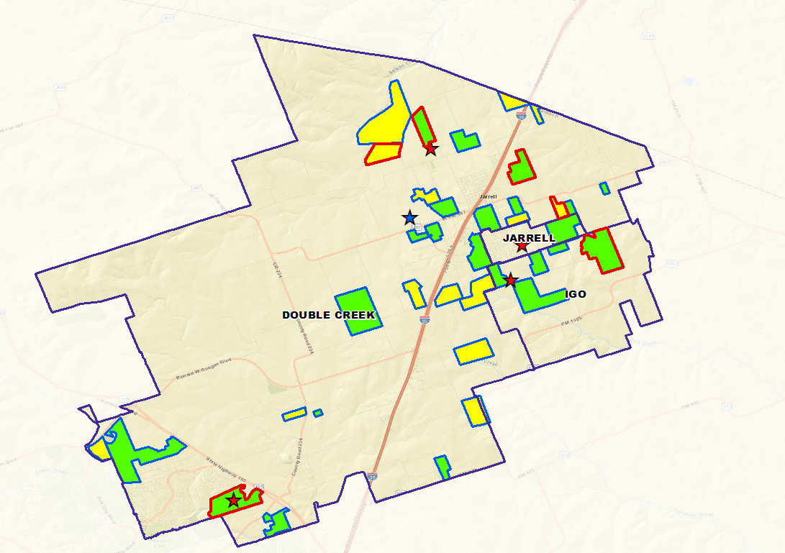
Key Terms
Active subdivision – a subdivision with lots prepped for building and homes completed
  Total lots – the total number of lots that have been approved for building
  Occupied – the home has been sold
  Under construction – the home is being built
  Vacant Developed Lot (VDL) – the lot has been cleared and prepped for building. This lot is ready for construction to begin.
  Future lot – the lot has not had any prep work done on it
  Built Out – the subdivision does not have any more lots for building
Future subdivision – a subdivision in which paperwork has been submitted and approved or waiting approval
Groundwork Underway – a subdivision that has infrastructure being installed but lots have not been prepped for building
Student Yield – the number of students per occupied home.
Example: 0.521 would be 5.21 students per 10 occupied homes.
13

Slide 14
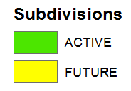

District Future Housing Overview
The district has 27 active subdivisions with approximately 160 homes under construction and over 2,700 lots ready to be built on
Within JISD there are currently 13 potential future subdivisions totaling appx. 15,000 single family lots
Groundwork is underway on more than 1,200 lots within 6 subdivisions
The following pages highlight major and new developments
14

Slide 15
5 Largest Active Subdivisions
Sonterra – West
Sonterra – Cool Water
Sonterra - Eastwood
Woodside
Rancho del Cielo
1. Sonterra - West
2. Sonterra – Cool Water
5. Rancho del Cielo
3. Sonterra – Eastwood
4. Woodside
15

Slide 16
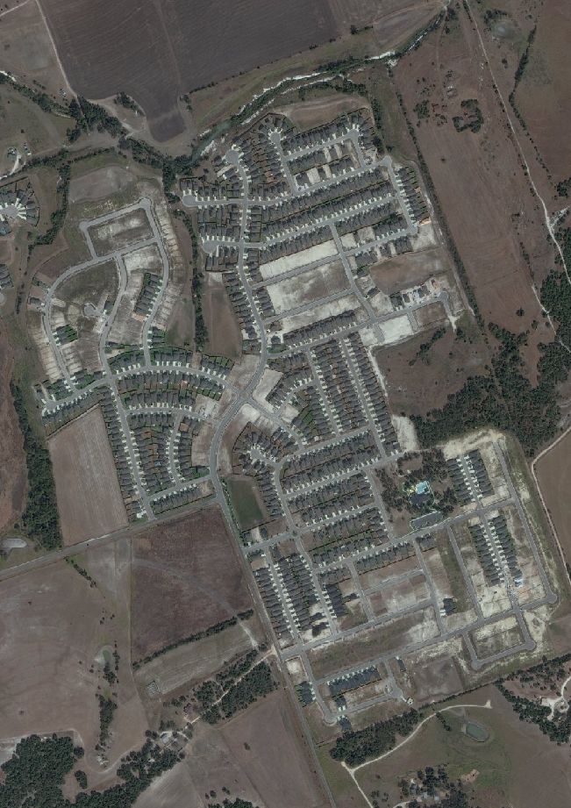
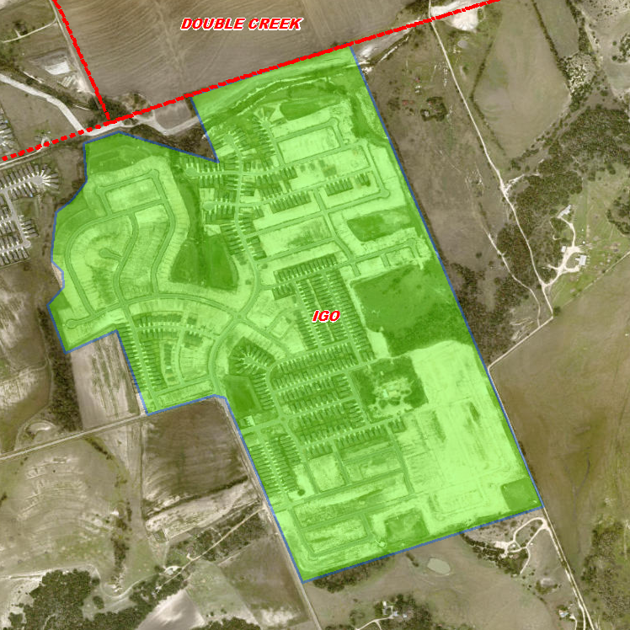
District Single-Family Activity
Single-Family Housing Construction
Sonterra Cool Water
1,525 total lots
139 future lots
670 vacant developed lots
22 homes under construction
611 occupied homes
Prices between $208,000 and $412,000
Builders: CastleRock Community, Centex Homes, KB Home
Groundwork underway on all remaining lots
Student Yield: 0.437
October 2025
16

Slide 17
17

Slide 18
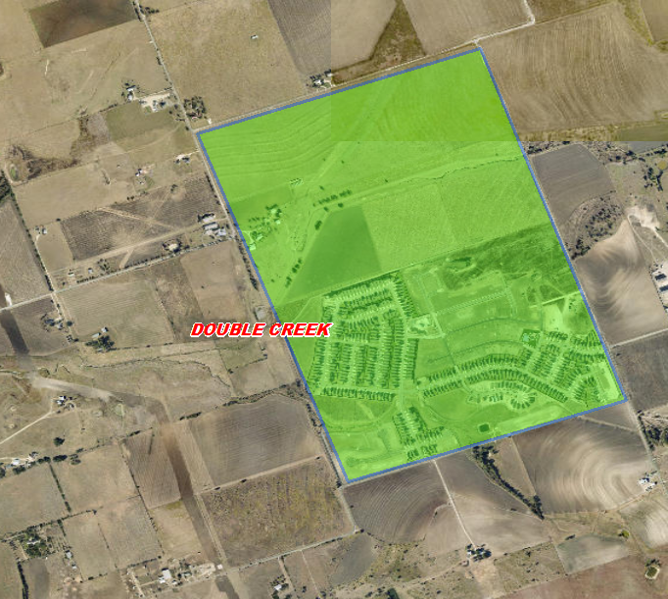
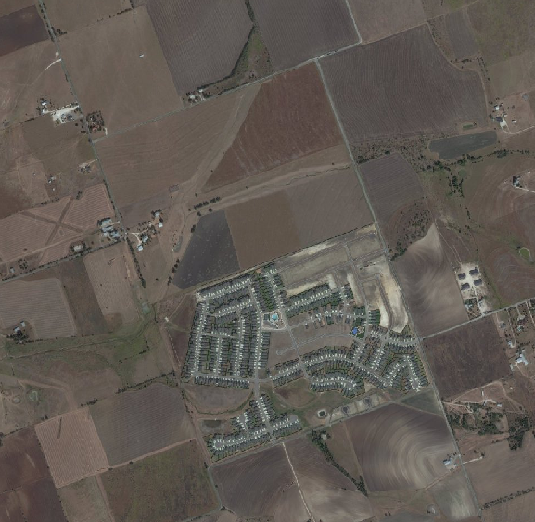
District Single-Family Activity
Single-Family Housing Construction
October 2025
Rancho del Cielo
942 total lots
327 vacant developed lots
25 homes under construction
571 occupied homes
Builder: Lennar
Student yield: 0.364
18

Slide 19
19

Slide 20
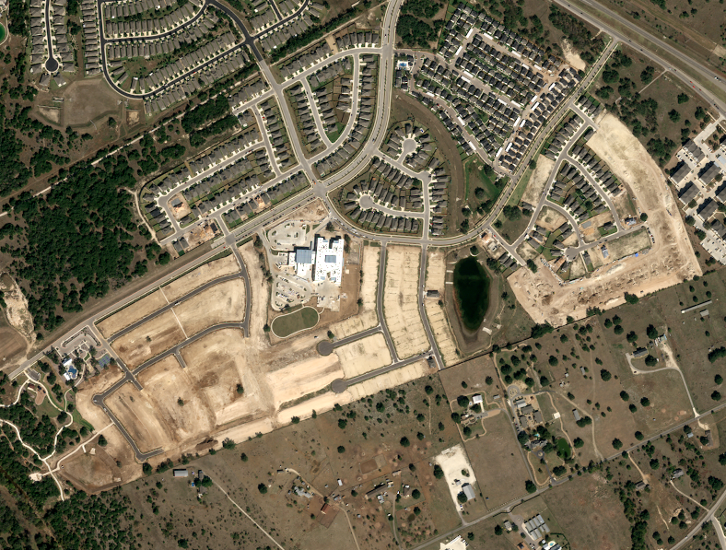
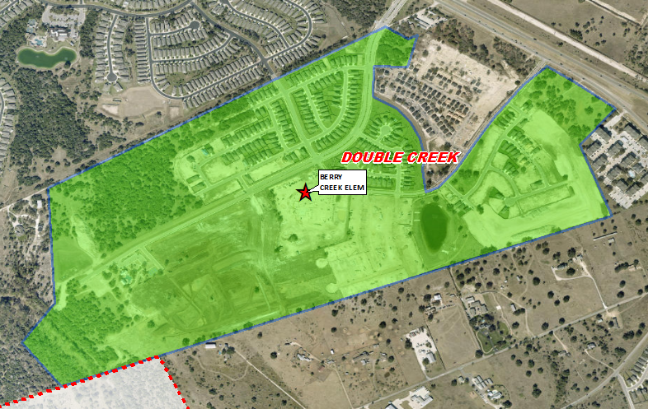
District Single-Family Activity
Single-Family Housing Construction
Berry Creek Highlands
758 total lots
264 future lots
250 vacant developed lots
14 homes under construction
222 occupied homes
Prices between $353,000 and $545,000
Builders: Ashton Homes, Chesmar Homes, David Weekley Homes
Groundwork underway on 99 lots
Student Yield: 0.068
November 2025
20

Slide 21
21

Slide 22
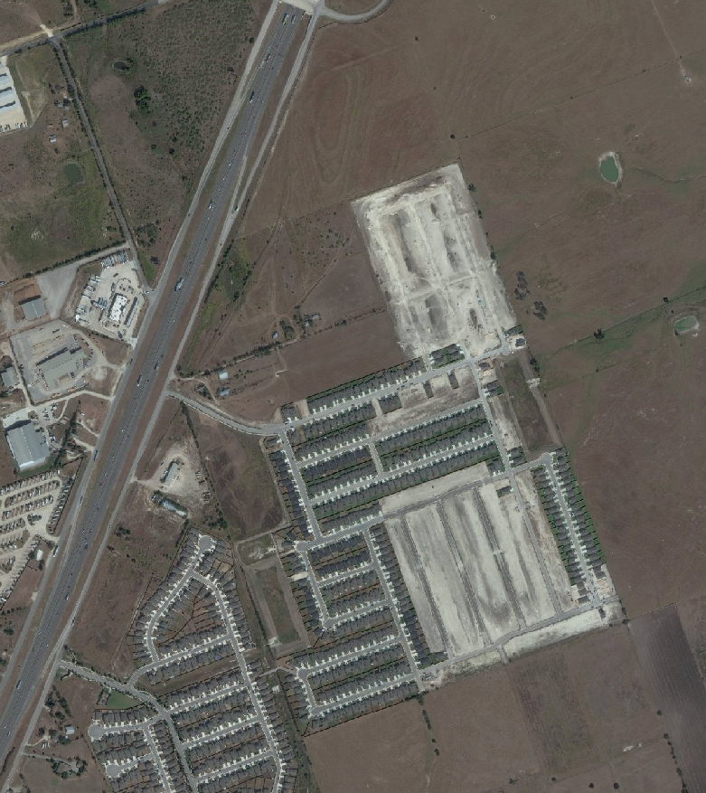
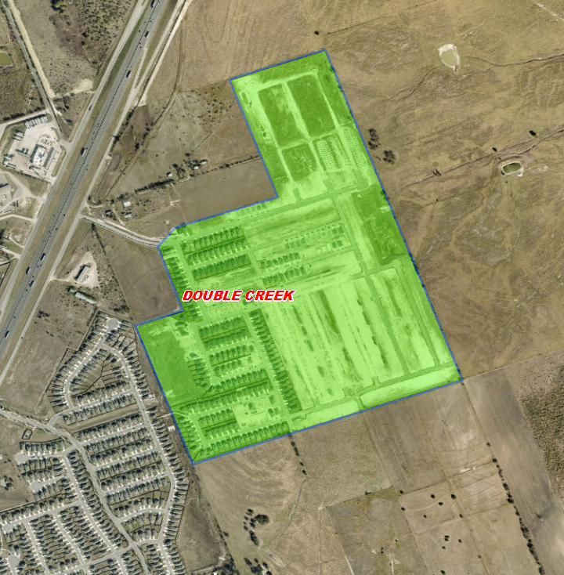
District Single-Family Activity
Single-Family Housing Construction
Eastern Wells
748 total lots
136 future lots
261 vacant developed lots
20 homes under construction
252 occupied homes
Prices between $249,000 and $347,000
Builder: DR Horton
Groundwork underway on all remaining lots
Student Yield: 0.353
October 2025
22

Slide 23
23

Slide 24
Multifamily Housing
Student Yield Analysis
24

Slide 25
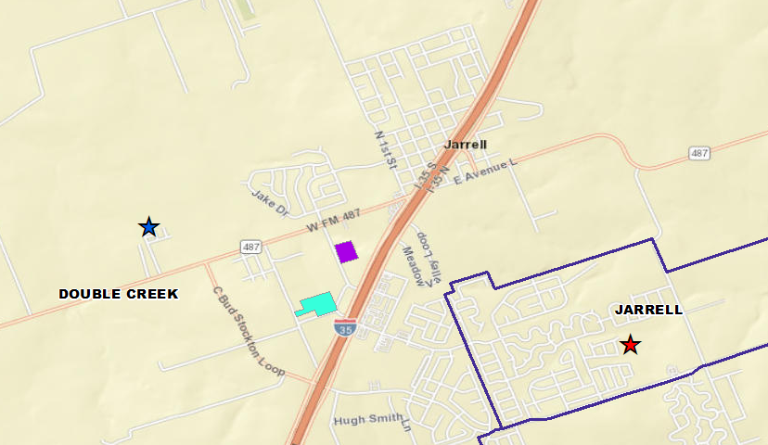
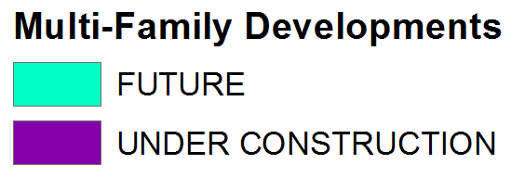
District Multifamily Overview
Multifamily Housing
There are 48 multifamily units under construction in the district
There are 80 age-restricted units in planning

Slide 26
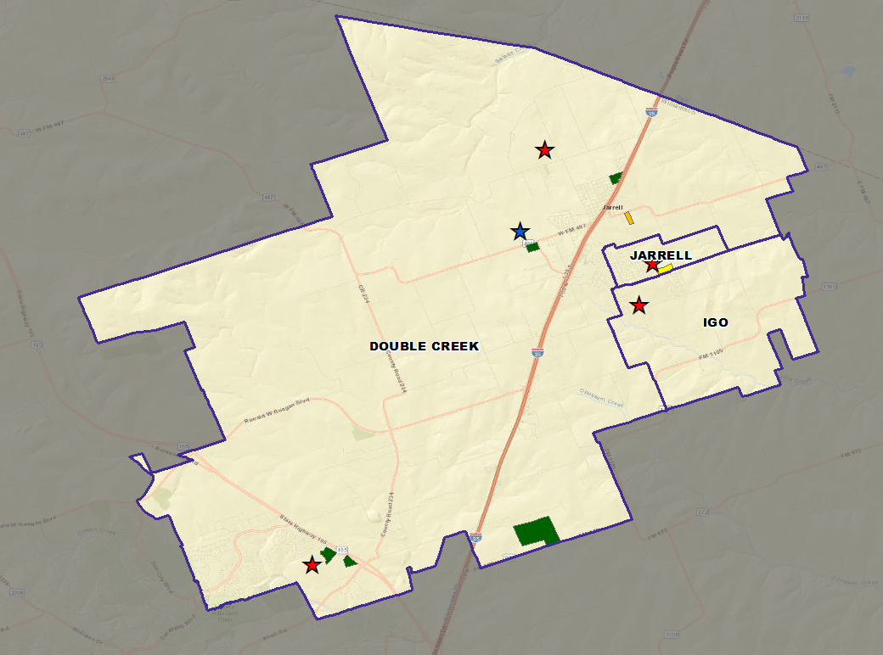
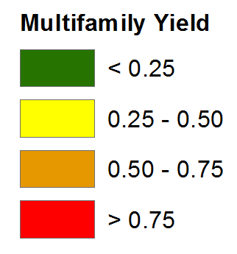
District Multifamily Yield Analysis
Multifamily Housing
There are 6,387 students residing in 33,897 total non-age restricted multifamily units.
The overall district multifamily yield is 0.188

Slide 27
Enrollment – Data & Trends
Student Mobility
27

Slide 28
Jarrell ISD – Birth Rate Analysis
Enrollment- Data & Trends
Birth Yr (School Yr) | District Births | Kindergarten Enrollment | Enrolled Ratio
2014 (2019/20) | 107 | 174 | 1.63
2015 (2020/21) | 131 | 182 | 1.39
2016 (2021/22) | 102 | 224 | 2.20
2017 (2022/23) | 139 | 263 | 1.89
2018 (2023/24) | 169 | 301 | 1.78
2019 (2024/25) | 175 | 301 | 1.72
2020 (2025/26) | 226 | 364 | 1.61
2021 (2026/27) | 289 | 376 | 1.30
2022 (2027/28) | 368 | 400 | 1.09
2023 (2028/29) | 396 | 428 | 1.08
2024 (2029/30) | 527 | 460 | 0.87
Average – 0.804
Source: Texas Dept. of Health and Human Services
28

Slide 29
Annual Enrollment Changes
Year | EE | PK | K | 1st | 2nd | 3rd | 4th | 5th | 6th | 7th | 8th | 9th | 10th | 11th | 12th | Total | Total Growth | % Growth
2021/22 | 6 | 151 | 224 | 241 | 244 | 222 | 219 | 209 | 208 | 209 | 193 | 221 | 192 | 205 | 141 | 2,885 | 580 | 25.2%
2022/23 | 18 | 173 | 263 | 271 | 267 | 264 | 255 | 248 | 263 | 240 | 238 | 229 | 236 | 202 | 197 | 3,364 | 479 | 16.6%
2023/24 | 25 | 159 | 301 | 282 | 297 | 280 | 292 | 279 | 287 | 271 | 281 | 276 | 235 | 244 | 204 | 3,713 | 349 | 10.4%
2024/25 | 34 | 193 | 301 | 333 | 329 | 319 | 328 | 316 | 313 | 306 | 280 | 317 | 288 | 273 | 224 | 4,154 | 441 | 11.9%
2025/26 | 37 | 178 | 364 | 346 | 382 | 352 | 350 | 363 | 346 | 333 | 323 | 313 | 308 | 278 | 256 | 4,529 | 375 | 9.0%
Yellow box = largest grade per year
Green box = second largest grade per year
 | EE | PK | K | 1st | 2nd | 3rd | 4th | 5th | 6th | 7th | 8th | 9th | 10th | 11th | 12th | Total
2025/26 | 37 | 219 | 340 | 349 | 375 | 370 | 361 | 363 | 359 | 341 | 329 | 320 | 334 | 315 | 259 | 4,671
 | 0 | 41 | -24 | 3 | -7 | 18 | 11 | 0 | 13 | 8 | 6 | 7 | 26 | 37 | 3 | 142
 | 0.0% | 18.7% | -7.1% | 0.9% | -1.9% | 4.9% | 3.0% | 0.0% | 3.6% | 2.3% | 1.8% | 2.2% | 7.8% | 11.7% | 1.2% | 3.0%
Cohort Table
Year | EE | PK | K | 1st | 2nd | 3rd | 4th | 5th | 6th | 7th | 8th | 9th | 10th | 11th | 12th | EE-PK | Elem | Mid | High
3-year Avg | 1.279 | 1.018 | 1.118 | 1.109 | 1.137 | 1.064 | 1.125 | 1.094 | 1.125 | 1.054 | 1.087 | 1.135 | 1.014 | 1.054 | 0.955 | 1.108 | 1.088 | 1.039 | 1.279
2022/23 | 3.000 | 1.146 | 1.174 | 1.210 | 1.108 | 1.082 | 1.149 | 1.132 | 1.258 | 1.154 | 1.139 | 1.187 | 1.068 | 1.052 | 0.961 | 1.142 | 1.184 | 1.067 | 3.000
2023/24 | 1.389 | 0.919 | 1.144 | 1.072 | 1.096 | 1.049 | 1.106 | 1.094 | 1.157 | 1.030 | 1.171 | 1.160 | 1.026 | 1.034 | 1.010 | 1.094 | 1.120 | 1.057 | 1.389
2024/25 | 1.360 | 1.214 | 1.000 | 1.106 | 1.167 | 1.074 | 1.171 | 1.082 | 1.122 | 1.066 | 1.033 | 1.128 | 1.043 | 1.162 | 0.918 | 1.100 | 1.074 | 1.063 | 1.360
2025/26 | 1.088 | 0.922 | 1.209 | 1.150 | 1.147 | 1.070 | 1.097 | 1.107 | 1.095 | 1.064 | 1.056 | 1.118 | 0.972 | 0.965 | 0.938 | 1.130 | 1.071 | 0.998 | 1.088
The highest cohort occurred in Kindergarten
Additional grades with higher cohorts include 1st, 2nd, and 9th grades

Slide 30
Annual Enrollment Changes
Year | EE | PK | K | 1st | 2nd | 3rd | 4th | 5th | 6th | 7th | 8th | 9th | 10th | 11th | 12th | Total | Total Growth | % Growth
2021/22 | 6 | 151 | 224 | 241 | 244 | 222 | 219 | 209 | 208 | 209 | 193 | 221 | 192 | 205 | 141 | 2,885 | 580 | 25.2%
2022/23 | 18 | 173 | 263 | 271 | 267 | 264 | 255 | 248 | 263 | 240 | 238 | 229 | 236 | 202 | 197 | 3,364 | 479 | 16.6%
2023/24 | 25 | 159 | 301 | 282 | 297 | 280 | 292 | 279 | 287 | 271 | 281 | 276 | 235 | 244 | 204 | 3,713 | 349 | 10.4%
2024/25 | 34 | 193 | 301 | 333 | 329 | 319 | 328 | 316 | 313 | 306 | 280 | 317 | 288 | 273 | 224 | 4,154 | 441 | 11.9%
2025/26 | 37 | 178 | 364 | 346 | 382 | 352 | 350 | 363 | 346 | 333 | 323 | 313 | 308 | 278 | 256 | 4,529 | 375 | 9.0%
Yellow box = largest grade per year
Green box = second largest grade per year
Cohort Table
Year | EE | PK | K | 1st | 2nd | 3rd | 4th | 5th | 6th | 7th | 8th | 9th | 10th | 11th | 12th | EE-PK | Elem | Mid | High
3-year Avg | 1.279 | 1.018 | 1.118 | 1.109 | 1.137 | 1.064 | 1.125 | 1.094 | 1.125 | 1.054 | 1.087 | 1.135 | 1.014 | 1.054 | 0.955 | 1.108 | 1.088 | 1.039 | 1.279
2022/23 | 3.000 | 1.146 | 1.174 | 1.210 | 1.108 | 1.082 | 1.149 | 1.132 | 1.258 | 1.154 | 1.139 | 1.187 | 1.068 | 1.052 | 0.961 | 1.142 | 1.184 | 1.067 | 3.000
2023/24 | 1.389 | 0.919 | 1.144 | 1.072 | 1.096 | 1.049 | 1.106 | 1.094 | 1.157 | 1.030 | 1.171 | 1.160 | 1.026 | 1.034 | 1.010 | 1.094 | 1.120 | 1.057 | 1.389
2024/25 | 1.360 | 1.214 | 1.000 | 1.106 | 1.167 | 1.074 | 1.171 | 1.082 | 1.122 | 1.066 | 1.033 | 1.128 | 1.043 | 1.162 | 0.918 | 1.100 | 1.074 | 1.063 | 1.360
2025/26 | 1.088 | 0.922 | 1.209 | 1.150 | 1.147 | 1.070 | 1.097 | 1.107 | 1.095 | 1.064 | 1.056 | 1.118 | 0.972 | 0.965 | 0.938 | 1.130 | 1.071 | 0.998 | 1.088
The highest cohort occurred in Kindergarten
Additional grades with higher cohorts include 1st, 2nd, and 9th grades

Slide 31
Enrollment Forecast
10 Year Forecast & Campus Projections
31

Slide 32
Ten Year Forecast by Grade Level
Enrollment Forecast
GRADE LEVEL ENROLLMENT HISTORY AND PROJECTIONS
Year | EE | PK | K | 1st | 2nd | 3rd | 4th | 5th | 6th | 7th | 8th | 9th | 10th | 11th | 12th | Total | Total Growth | % Growth
2021/22 | 6 | 151 | 224 | 241 | 244 | 222 | 219 | 209 | 208 | 209 | 193 | 221 | 192 | 205 | 141 | 2,885 | 580 | 25.2%
2022/23 | 18 | 173 | 263 | 271 | 267 | 264 | 255 | 248 | 263 | 240 | 238 | 229 | 236 | 202 | 197 | 3,364 | 479 | 16.6%
2023/24 | 25 | 159 | 301 | 282 | 297 | 280 | 292 | 279 | 287 | 271 | 281 | 276 | 235 | 244 | 204 | 3,713 | 349 | 10.4%
2024/25 | 34 | 193 | 301 | 333 | 329 | 319 | 328 | 316 | 313 | 306 | 280 | 317 | 288 | 273 | 224 | 4,154 | 441 | 11.9%
2025/26 | 37 | 178 | 364 | 346 | 382 | 352 | 350 | 363 | 346 | 333 | 323 | 313 | 308 | 278 | 256 | 4,529 | 375 | 9.0%
2026/27 | 37 | 195 | 447 | 408 | 393 | 406 | 383 | 384 | 401 | 365 | 353 | 366 | 317 | 314 | 266 | 5,035 | 506 | 11.2%
2027/28 | 37 | 209 | 553 | 503 | 456 | 426 | 442 | 419 | 424 | 422 | 383 | 396 | 369 | 323 | 295 | 5,657 | 622 | 12.4%
2028/29 | 37 | 224 | 592 | 602 | 547 | 499 | 471 | 487 | 470 | 449 | 450 | 431 | 396 | 369 | 305 | 6,329 | 672 | 11.9%
2029/30 | 37 | 235 | 704 | 644 | 654 | 598 | 544 | 521 | 532 | 496 | 476 | 507 | 431 | 376 | 349 | 7,104 | 775 | 12.2%
2030/31 | 37 | 248 | 765 | 752 | 689 | 701 | 644 | 586 | 571 | 553 | 524 | 535 | 507 | 405 | 355 | 7,872 | 768 | 10.8%
2031/32 | 37 | 260 | 804 | 818 | 804 | 738 | 753 | 694 | 635 | 599 | 586 | 590 | 535 | 488 | 383 | 8,724 | 852 | 10.8%
2032/33 | 37 | 271 | 843 | 854 | 867 | 850 | 777 | 795 | 755 | 664 | 630 | 660 | 590 | 509 | 461 | 9,563 | 839 | 9.6%
2033/34 | 37 | 282 | 857 | 874 | 894 | 888 | 870 | 796 | 859 | 781 | 697 | 709 | 660 | 561 | 481 | 10,246 | 683 | 7.1%
2034/35 | 37 | 292 | 880 | 884 | 902 | 923 | 911 | 894 | 865 | 891 | 820 | 784 | 709 | 631 | 530 | 10,953 | 707 | 6.9%
2035/36 | 37 | 298 | 904 | 908 | 912 | 932 | 949 | 935 | 966 | 897 | 935 | 923 | 784 | 675 | 596 | 11,651 | 698 | 6.4%
Yellow box = largest grade per year
Green box = second largest grade per year

Slide 33
Ten Year Forecast by Grade Level
Enrollment Forecast
GRADE LEVEL ENROLLMENT HISTORY AND PROJECTIONS
GRADE LEVEL ENROLLMENT HISTORY AND PROJECTIONS
Year | EE | PK | K | 1st | 2nd | 3rd | 4th | 5th | 6th | 7th | 8th | 9th | 10th | 11th | 12th | Total | Total Growth | % Growth
2021/22 | 6 | 151 | 224 | 241 | 244 | 222 | 219 | 209 | 208 | 209 | 193 | 221 | 192 | 205 | 141 | 2,885 | 580 | 25.2%
2022/23 | 18 | 173 | 263 | 271 | 267 | 264 | 255 | 248 | 263 | 240 | 238 | 229 | 236 | 202 | 197 | 3,364 | 479 | 16.6%
2023/24 | 25 | 159 | 301 | 282 | 297 | 280 | 292 | 279 | 287 | 271 | 281 | 276 | 235 | 244 | 204 | 3,713 | 349 | 10.4%
2024/25 | 34 | 193 | 301 | 333 | 329 | 319 | 328 | 316 | 313 | 306 | 280 | 317 | 288 | 273 | 224 | 4,154 | 441 | 11.9%
2025/26 | 37 | 178 | 364 | 346 | 382 | 352 | 350 | 363 | 346 | 333 | 323 | 313 | 308 | 278 | 256 | 4,529 | 375 | 9.0%
2026/27 | 37 | 195 | 447 | 408 | 393 | 406 | 383 | 384 | 401 | 365 | 353 | 366 | 317 | 314 | 266 | 5,035 | 506 | 11.2%
2027/28 | 37 | 209 | 553 | 503 | 456 | 426 | 442 | 419 | 424 | 422 | 383 | 396 | 369 | 323 | 295 | 5,657 | 622 | 12.4%
2028/29 | 37 | 224 | 592 | 602 | 547 | 499 | 471 | 487 | 470 | 449 | 450 | 431 | 396 | 369 | 305 | 6,329 | 672 | 11.9%
2029/30 | 37 | 235 | 704 | 644 | 654 | 598 | 544 | 521 | 532 | 496 | 476 | 507 | 431 | 376 | 349 | 7,104 | 775 | 12.2%
2030/31 | 37 | 248 | 765 | 752 | 689 | 701 | 644 | 586 | 571 | 553 | 524 | 535 | 507 | 405 | 355 | 7,872 | 768 | 10.8%
2031/32 | 37 | 260 | 804 | 818 | 804 | 738 | 753 | 694 | 635 | 599 | 586 | 590 | 535 | 488 | 383 | 8,724 | 852 | 10.8%
2032/33 | 37 | 271 | 843 | 854 | 867 | 850 | 777 | 795 | 755 | 664 | 630 | 660 | 590 | 509 | 461 | 9,563 | 839 | 9.6%
2033/34 | 37 | 282 | 857 | 874 | 894 | 888 | 870 | 796 | 859 | 781 | 697 | 709 | 660 | 561 | 481 | 10,246 | 683 | 7.1%
2034/35 | 37 | 292 | 880 | 884 | 902 | 923 | 911 | 894 | 865 | 891 | 820 | 784 | 709 | 631 | 530 | 10,953 | 707 | 6.9%
2035/36 | 37 | 298 | 904 | 908 | 912 | 932 | 949 | 935 | 966 | 897 | 935 | 923 | 784 | 675 | 596 | 11,651 | 698 | 6.4%
Yellow box = largest grade per year
Green box = second largest grade per year

Slide 34
Ten Year Forecast by Campus Level
Enrollment Forecast
 |  | History | Fall | ENROLLMENT PROJECTIONS
Campus | Capacity | 2024/25 | 2025/26 | 2026/27 | 2027/28 | 2028/29 | 2029/30 | 2030/31 | 2031/32 | 2032/33 | 2033/34 | 2034/35 | 2035/36
Igo Elementary | 800 | 647 | 742 | 870 | 990 | 1,129 | 1,270 | 1,436 | 1,557 | 1,655 | 1,695 | 1,740 | 1,756
Jarrell Elementary | 828 | 719 | 720 | 776 | 847 | 907 | 988 | 1,041 | 1,094 | 1,135 | 1,164 | 1,195 | 1,209
Double Creek Elementary | 900 | 787 | 910 | 1,007 | 1,208 | 1,423 | 1,679 | 1,945 | 2,257 | 2,504 | 2,639 | 2,788 | 2,910
ELEMENTARY SCHOOL TOTAL | 2,528 | 2,153 | 2,372 | 2,653 | 3,045 | 3,459 | 3,937 | 4,422 | 4,908 | 5,294 | 5,498 | 5,723 | 5,875
Elementary Absolute Change |  | 238 | 219 | 281 | 392 | 414 | 478 | 485 | 486 | 386 | 204 | 225 | 152
Elementary Percent Change |  | 12.43% | 10.17% | 11.85% | 14.78% | 13.60% | 13.82% | 12.32% | 10.99% | 7.86% | 3.85% | 4.09% | 2.66%
Jarrell Middle School | 1,000 | 899 | 526 | 598 | 669 | 735 | 817 | 908 | 1,024 | 1,171 | 1,357 | 1,510 | 1,646
Jarrell Ranch Middle School | 700 |  | 476 | 521 | 560 | 634 | 687 | 740 | 796 | 878 | 980 | 1,066 | 1,152
MIDDLE SCHOOL TOTAL |  | 899 | 1,002 | 1,119 | 1,229 | 1,369 | 1,504 | 1,648 | 1,820 | 2,049 | 2,337 | 2,576 | 2,798
Middle School Absolute Change |  | 62 | -373 | 72 | 71 | 66 | 82 | 91 | 116 | 147 | 186 | 153 | 136
Middle School Percent Change |  | 7.41% | -41.49% | 7.19% | 6.34% | 5.37% | 5.99% | 6.05% | 7.04% | 8.08% | 9.08% | 6.55% | 5.28%
Jarrell High School | 1,258 | 1,100 | 1,155 | 1,263 | 1,383 | 1,501 | 1,663 | 1,802 | 1,996 | 2,220 | 2,411 | 2,654 | 2,978
HIGH SCHOOL TOTAL |  | 1,100 | 1,155 | 1,263 | 1,383 | 1,501 | 1,663 | 1,802 | 1,996 | 2,220 | 2,411 | 2,654 | 2,978
High School Absolute Change |  | 143 | 55 | 108 | 120 | 118 | 162 | 139 | 194 | 224 | 191 | 243 | 324
High School Percent Change |  | 14.94% | 5.00% | 9.35% | 9.50% | 8.53% | 10.79% | 8.36% | 10.77% | 11.22% | 8.60% | 10.08% | 12.21%
Lott Detention Center |  | 2 | 0 | 0 | 0 | 0 | 0 | 0 | 0 | 0 | 0 | 0 | 0
ALTERNATIVE SCHOOL TOTAL |  | 2 | 0 | 0 | 0 | 0 | 0 | 0 | 0 | 0 | 0 | 0 | 0
DISTRICT TOTALS |  | 4,154 | 4,529 | 5,035 | 5,657 | 6,329 | 7,104 | 7,872 | 8,724 | 9,563 | 10,246 | 10,953 | 11,651
District Absolute Change |  | 441 | 375 | 506 | 622 | 672 | 775 | 768 | 852 | 839 | 683 | 707 | 698
District Percent Change |  | 11.88% | 9.03% | 11.17% | 12.35% | 11.88% | 12.25% | 10.81% | 10.82% | 9.62% | 7.14% | 6.90% | 6.37%
 |  |  |  |  |  |  |  |  | Green = w/in 5% of Capacity; Yellow = Over Capacity

Slide 35
Ten Year Forecast Range
Enrollment Forecast
School Year | Low Projections | Mid Projections | High Projections
2024/25 |  | 4,154
2025/26 |  | 4,529
2026/27 | 4,934 | 5,035 | 5,085
2027/28 | 5,544 | 5,657 | 5,742
2028/29 | 6,171 | 6,329 | 6,456
2029/30 | 6,926 | 7,104 | 7,246
2030/31 | 7,675 | 7,872 | 8,069
2031/32 | 8,506 | 8,724 | 8,942
2032/33 | 9,324 | 9,563 | 9,802
2033/34 | 9,990 | 10,246 | 10,502
2034/35 | 10,679 | 10,953 | 11,227
2035/36 | 11,360 | 11,651 | 11,942
Low Range Projections
Mid-Range Projections
High Range Projections
Slow down in Housing Starts & Closings
Increases in Homeschooling & Private School Enrollment
Lower Kindergarten & Early Elementary Grade Enrollment
School of Choice options lower overall housing yields
Economic Conditions remain stable
Continued population growth & Housing Activity
Minimal Impact from trends in Homeschooling & Private School Enrollment
Maintaining current housing yields
Current Transfer patterns remain
Future Interest Rate Cuts & Favorable Mortgage Rates
Surge in Housing Starts & Closings
Programs and Marketing Efforts increase Enrollment through Transfer Students
Slight increases in housing yields

Slide 36


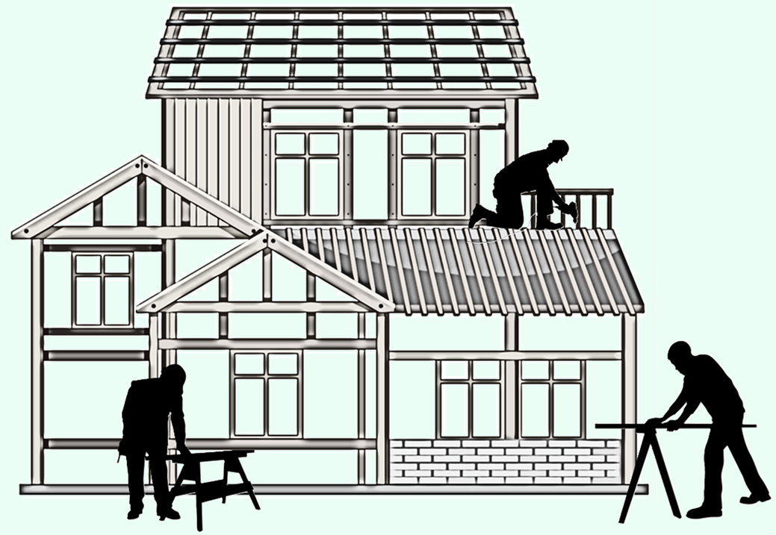

Key Takeaways
District Information -
Housing Market Conditions -
The District has seen enrollment rise this new 2025-26 school year by 375 students, and over 1,500 students over the last five years
JISD is currently falling behind 2024 totals in both annual new home starts and closings, due to the market tempering so far this year. Annual start rate for new homes is 917.
Housing Activity & Future Developments -
Enrollment Forecast -
The district currently has approximately 480 homes in active inventory, roughly 2,800 lots available to build on, and roughly 15,000 planned in the future.
JISD Enrollment is forecasted to reach over 7,872 students by the 2030/31 school year, and with additional housing growth enrollment is anticipated to surpass 11,650 students by the 2035/36 school year.
36

