Slide 1


PHARR-SAN JUAN-ALAMO INDEPENDENT SCHOOL DISTRICT
Liberty Middle School
Campus Improvement Plan
2025-2026

Slide 2
PSJA 2025 -2026 School Board
Dr. Cynthia Gutierrez
Carlos G. Villegas Jr.
Diana Serna
Yolanda Castillo
Ricardo Rodriguez
Griselda Quintanilla
Ramona Barron

Slide 3
Superintendent’s Cabinet
Dr. Alejandro Elias, Superintendent of Schools
Ranulfo Marquez, Assistant Superintendent for Academics
Rebecca Gonzales, Assistant Superintendent for Finance
Dr. Rebeca Garza, Assistant Superintendent for Human Resources
Rafael Gonzalez, Assistant Superintendent for School Operations
Dr. Orlando Noyola, Assistant Superintendent for Student Services
Dr. Lauro Davalos, Assistant Superintendent for Technology

Slide 4
PHARR-SAN JUAN-ALAMO INDEPENDENT SCHOOL DISTRICT
Vision
  Every PSJA student is prepared to participate, compete, and excel in a global society to foster multi-generational prosperity.
Mission
  As educational leaders, the PSJA team is engaged and empowered to connect all students with innovative instruction, outstanding facilities, technology, skills, and social-emotional support while prioritizing health and safety for all – from early childhood through their chosen career.
As one PSJA family, we build on our legacy of academic excellence, renowned college and career readiness, biliteracy and extracurricular programs, and our multicultural heritage to ensure every student has the experiences and resources necessary to achieve the highest levels of success

Slide 5
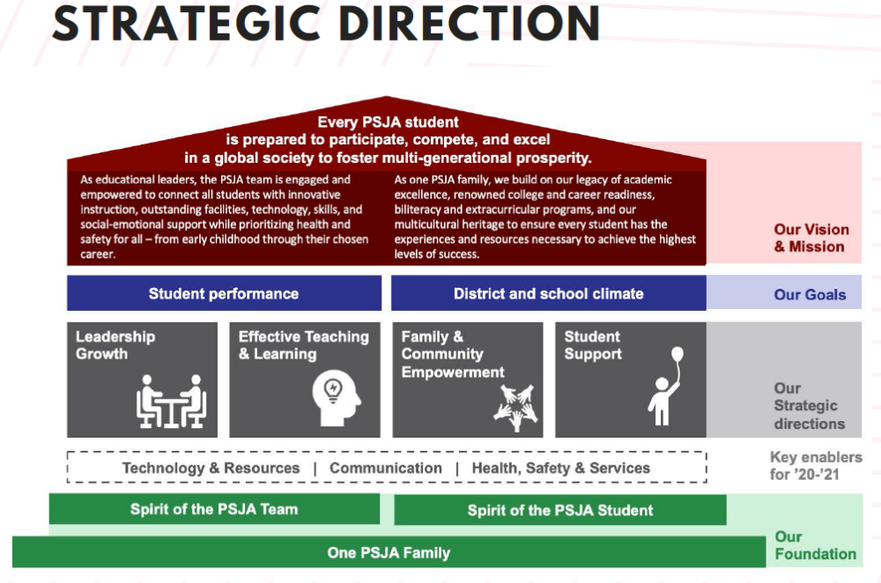
2025-2026
PHARR-SAN JUAN-ALAMO INDEPENDENT SCHOOL DISTRICT

Slide 6

PHARR-SAN JUAN-ALAMO INDEPENDENT SCHOOL DISTRICT
What We Believe In
Guiding Principles
Commitment to Greatness
Passion For our Work
Live the Golden Rule
No Excuses
Accountability
What We Want to Accomplish
Every student will graduate bi-literate, college ready, college connected, and college complete.

Slide 7

PHARR-SAN JUAN-ALAMO INDEPENDENT SCHOOL DISTRICT
LMS Vision
Our vision at LMS is to help develop and inspire students to be caring, principled, knowledgeable, well-rounded members of society who continue to be life-long learners.
LMS Mission
Our mission at LMS is to provide a safe and healthy community that fosters a well-balanced, multicultural experience; to prepare students with the 21st-century [Approaches to Learning (ATL)] skills required to succeed globally.
Revised and Revised by LMS IB Leadership Team (IBLT), 5/20/2025

Slide 8
2025-2026
Campus Leadership Team:
SBDM:
Site Based Decision Making/Leadership Team
ROLE | NAME
Principal | Michelle Fox
Dean of Instruction | Julia Mason
Asst. Principal 7th | Miguel Salinas
Asst. Principal 8th | Vianey Villegas
Asst. Principal 6th | Alicia Flores
Counselor | Anabelle Jaime
CLL | Jacquelyn Estrada
Librarian | Danica Simons
IB Representative | Emma Saenz
Math Dept. Head | Martin Chavez
Science Dept. Head | Mike Vargas
RLA Dept. Head | Debra Villarreal
Social Studies Dept. Head | Miguel Torres
SPED Representative | Tiffani Galaviz
Athletics Representative | Mark Gonzalez
Fine Arts Representative | Aldo Peralta
Language Representative | Gerardo Monrreal
MEMBERS:

Slide 9
PHARR-SAN JUAN-ALAMO INDEPENDENT SCHOOL DISTRICT
SBDM Quarterly Meetings:
Month | Date
1st Quarter | August 15, 2025
2nd Quarter | November 6, 2025
3rd Quarter | February 5, 2026
4th Quarter | June 11, 2026
* Campuses must post SBDM agenda and minutes to campus website within 10 days following meeting.

Slide 10

Executive Summary
Campus Improvement Plan: School Year 2024-2025
Campus Name: Liberty Middle School
Mission: At Liberty Middle School, we envision our students as principled, knowledgeable, well-rounded members of society who continue to be life-long learners. It is our mission to provide our students a safe and healthy community that fosters a well-balanced, multicultural experience and prepares students with the 21st century skills required to succeed globally.
Demographics Summary: The enrollment at Liberty Middle School as of September 1, 2025 is 710 students. Liberty’s student population is 99% Hispanic and 1% White. Our student population is largely economically disadvantaged (93.9%) and serve .7% of our students as migrants. Over 17% of our student population receives special education services, an additional 10% receive accommodations under 504 and an additional 8 % of our population is serviced through RtI. Our gifted and talented population accounts for approximately 10.3% of our student population. We serve an English Learner population of over 38.3%. For 2024-2025, the attendance rate for the campus was 93 %.
Comprehensive Needs Assessment Summary: Based on 2025 accountability, Liberty Middle School received an overall grade of 86 (B Rating) in the three domains. In the Student Achievement domain, which is based on performance on the STAAR, Liberty’s scaled score was 76. In the School Progress domain which measures student improvement from year to year and performance relative to similar campuses, Liberty’s score was an 89 due to Relative Performance and in the Closing the Gaps domain which measures student groups against annual targets, Liberty’s scaled score was a 78. Liberty earned 6 distinctions: ELA/Reading, Mathematics, Social Studies, Science, Comparative Closing the Gaps, and Post-Secondary Readiness.
Curriculum and Instruction and Assessment: Liberty Middle School is an authorized International Baccalaureate World School promoting a well-rounded education and the ten attributes of the Learner Profile. IB learners strive to be balanced, caring, communicators, inquirers, knowledgeable, open-minded, principled, reflective, risk takers, and thinkers. Teachers are encouraged to write and implement units of study that make natural connections within and among the content areas. Liberty boasts a strong commitment to the District’s Dual Language Enrichment and Academic UIL Programs as well as participation in athletics and the arts. In order to address achievement gaps in ELA/R and mathematics, all 6th , 7th and 8th graders have been scheduled to 90-minute blocks. Enrichment classes in 8th grade science and social studies have been created to serve English Learners and an intentional 8th grade cohort of students respectively. Liberty follows the District curriculum for the content areas and assesses regularly to monitor the performance and progress of students. Assessment data is used to determine direction in instruction and in planning appropriate interventions.
Summary of Goals: In our pursuit of excellence and student success, Liberty Middle School has identified the following three areas for improvement this year: to promote literacy across the content areas by engaging students in the receptive (listening and reading) and productive (speaking and writing) language domains consistently; to refine lesson planning to include details and specificity for engaging, rigorous and relevant instruction; to enrich our data analysis by consistent, continual progress monitoring by students, teachers, and administration and by appropriate responses to the data with interventions providing the necessary supports to students so they can be successful. In addition, our goal for Student Achievement is to have at least 75% of our students at the “approaches” level, 50% at the “meets” level and 25% at the “masters” level on STAAR. With regard to School Progress, our goal is to have at least 80% of our students show academic growth on STAAR. We believe that if we are successful in attaining the prescribed goals, we will be successful in Closing the Gaps.
_________________Principal Signature ___________________ _________Member Signature __________________ ________Parent Signature

Slide 11
PHARR-SAN JUAN-ALAMO INDEPENDENT SCHOOL DISTRICT
THE STATE OF TEXAS PUBLIC EDUCATION MISSION AND ACADEMIC GOALS
The mission of the public education system of this state is to ensure that all Texas children have access to a quality education that enables them to achieve their potential and fully participate now and the future in the social, economic, and education opportunities of our state and nation. That mission is grounded on the conviction that a general diffusion of knowledge is essential for the welfare of this state and for the preservation of the liberties and rights of citizens. It is further grounded on the conviction that a successful public education system is directly related to a strong, dedicated, and supportive family; and that parental involvement in the school is essential for the maximum educational achievement of a child.
THE STATE OF TEXAS PUBLIC EDUCATION GOALS
GOAL #1: The student in the public education system will demonstrate exemplary performance in the reading and writing of the English language.
GOAL #2: The students in the public education system will demonstrate exemplary performance in the understanding of mathematics.
GOAL #3: The students in the public education system will demonstrate exemplary performance in the understanding of science.
GOAL #4: The students in the public education system will demonstrate exemplary performance in the understanding of social studies.
THE STATE OF TEXAS PUBLIC EDUCATION OBJECTIVES
Objective #1: Parents will be full partners with educators in the education of their children.
Objective #2: Students will be encouraged and challenged to meet their full educational potential.
Objective #3: Through enhanced dropout prevention efforts, all students will remain in school until they obtain a high school diploma.
Objective #4: A well-balanced and appropriate curriculum will be provided to all students.
Objective #5: Qualified and highly effective personnel will be recruited, developed, and retained.
Objective #6: The state’s students will demonstrate exemplary performance in the comparison to national and international standards.
Objective #7: School campuses will maintain a safe and disciplined environment conducive to student learning.
Objective #8: Educators will keep abreast of the development of creative and innovative techniques as appropriate to improve student learning.
Objective #9: Technology will be implemented and used to increase the effectiveness of student learning, instructional management, staff development, and administration.

Slide 12
Liberty Middle School
Comprehensive Needs Assessment 2025-2026
PHARR-SAN JUAN-ALAMO INDEPENDENT SCHOOL DISTRICT
Based on 2025 accountability, Liberty Middle School received an overall grade of 86 (B Rating) in the three domains. In the Student Achievement domain, which is based on performance on the STAAR, Liberty’s scaled score was 76. In the School Progress domain which measures student improvement from year to year, Liberty's score was 73. In performance relative to similar campuses, Liberty’s score was an 89, and in the Closing the Gaps domain which measures student groups against annual targets, Liberty’s scaled score was 78.
Based on the district's attendance report, Liberty's yearly attendance increased from 93% to 94%. Plans of action for the 2025-2026 school year will be initiated with consistent progress monitoring to ensure Liberty increases in performance and attendance.

Slide 13
Liberty Middle School
Comprehensive Needs Assessment 2025-2026
PHARR-SAN JUAN-ALAMO INDEPENDENT SCHOOL DISTRICT
(Data from 2024-2025)
Area Reviewed | Summary of Strengths | Summary of Needs | Priorities
Domain 1: Student Achievement | Algebra continues to perform at 100%. Mathematics overall scored at the 71% Approaches level, 43% Meets, and 19 % Masters level Reading overall scored at the 76% Approaches, 51 % Meets, and 25% Masters level | 7th Grade Math Approaches was at 42%, Meets was at 17%, and Masters at 3%. 7th Grade Overall Scale Score was a 49 6th Grade Math Meets was at 32% dropping from 36% | Improve student learning outcomes in : Mathematics 7th Grade and 6th Grade Provide targeted small group instruction in mathematics
Domain 2: Student Progress | Math Algebra was at 93 % growth which gave a Scale Score of 97 7th Grade Reading was 71% growth which gave a Scale Score of 82 8th Grade Math was 79% growth which gave a Scale Score of 89 | 6th Grade Math was 46% growth which gave a Scale Score of 55 7th Grade Math was 49% growth which gave a Scale Score of 56 6th Grade Reading was 59% growth which gave a Scale Score of 67 | Address the needs of identified students to meet the progress measure in 2025- 2026 in Reading and Mathematics Campuswide use of consistent progress monitoring tool. Monitor all Continuous Enrolled and Special Education students.

Slide 14
Liberty Middle School
Comprehensive Needs Assessment 2025-2026
PHARR-SAN JUAN-ALAMO INDEPENDENT SCHOOL DISTRICT
(Data from 2024-2025)
Area Reviewed | Summary of Strengths | Summary of Needs | Priorities
Domain 3: Closing the Achievement Gap | Academic Achievement Status: ELA/Reading – Met all Targets Growth Status: ELA/Reading – Met all Targets Math – No Targets TELPAS met target with a 62 improving 23 points from previous year | Did not Meet targets: Academic Achievement Status: Did not Meet Targets Math Meets or Above Target All Students 43% 47% Cont. Enrolled 44% 49% Growth : Did not Meet Targets Component Score Target All Students 61% 67% Cont. Enrolled 60% 67% Hispanic 61% 64 % Student Success Status: Did not Meet Targets Component Score Target All Students 45% 47% Cont. Enrolled 46% 48% | EB, and Special Ed. population groups will receive additional support and intensive interventions in reading, writing, math, science, and social studies. Set and monitor goals for achievement, provide interventions.(approaches, meets, masters) Intentional interventions for EBs for listening speaking, reading, and writing.

Slide 15
Liberty Middle School
Comprehensive Needs Assessment 2025-2026
PHARR-SAN JUAN-ALAMO INDEPENDENT SCHOOL DISTRICT
(Data from 2024-2025)
Area Reviewed | Summary of Strengths | Summary of Needs | Priorities
Distinctions | Campus Distinctions (6) ELA/Reading Mathematics Science Social Studies Comparative Closing the Gaps Postsecondary Readiness | Not Earned (1) Academic Growth | Provide Professional development to ensure teachers understand the level of rigor on the state assessment for their content. Utilize strategies of the Common Instructional Framework Assess and Monitor frequently through common formative assessments Consistent progress monitoring

Slide 16
Liberty Middle School
Comprehensive Needs Assessment 2025-2026
PHARR-SAN JUAN-ALAMO INDEPENDENT SCHOOL DISTRICT
(Data from 2024-2025)
Area Reviewed | Summary of Strengths | Summary of Needs | Priorities
Family and Community Involvement | Communication in both English and Spanish Parent Liaison campus level Parent Volunteers Business Partnerships | Secondary parent involvement is low Low Average of parents with high school diplomas and/or postsecondary education | Create opportunities for parents to receive postsecondary training/education Create opportunities for parents to attend and become involved with the Parent Advisory Council (PAC)
Technology | Availability of technology resources for students and teachers, and staff. | Integration of technology in instruction and update the infrastructure, increase the use of student technology for instructional rigor. | Provide training on the implementation of technology integration; increase on-line resource use
School Culture and Climate | Collaborative Learning Communities with common planning periods Customer Service College for All Culture Safe and Civil Schools Initiative ARP- Attendance Recovery Program (37% recovery) | Student attendance Chronic Absences PD Culture Survey Revisit Vision statement | Build public relations Improve student retention Use Attendance Recovery Program Mentor students with high absenteeism Increase Social Media presence Celebrating student progress, achievement, and attendance
Staff Quality, Recruitment, and Retention | Highly Qualified Staff TTESS Evaluation Tool High retention rate

Slide 17
Liberty Middle School
Campus Timeline
PHARR-SAN JUAN-ALAMO INDEPENDENT SCHOOL DISTRICT
Date | Events
August 15, 2025 | Campus Leadership TEAM met to disaggregate STAAR data and to conduct Campus Needs Assessment.
August 19-20, 2025 | Campus Leadership TEAM met with Liberty staff to review campus data and results.
September 2025 | Campus Leadership TEAM present campus assessment results by Domain to teachers. Campus staff participated in goal setting for 20253-2025 academic year. Academic Success Committee meet to work on the Targeted Improvement Plan
September 2025 | Campus staff analyze STAAR data to plan interventions/support
September 2025 | Interventions begin. Teachers will use the STAAR 2025 data to group students according to student growth for Math and Reading, and Meets & Above for Science and Social Studies.
November 2025 | Members of the Campus Leadership TEAM revisit the goals, progress monitoring, and make any changes according to data findings.
January 2026 | Campus teachers conduct student conferences based on BM2 data, goal setting, and review tutorial lists.

Slide 18
Liberty Middle School
Campus Timeline
PHARR-SAN JUAN-ALAMO INDEPENDENT SCHOOL DISTRICT
Date | Events
February 2026 | Campus Leadership TEAM meets to disaggregate STAAR data and to conduct Campus Needs Assessment and keep ourselves accountable for using the Targeted Improvement Plan. TELPAS TESTING
March 2026 | Progress Monitoring check-in to ensure students are on their pathway to meet their goals.
April 2026 | STAAR Academies by content area
May 2026 | STAAR TESTING
June 2026 | Campus Leadership TEAM meets to disaggregate STAAR data and to conduct Campus Needs Assessment.

Slide 19
PHARR-SAN JUAN-ALAMO INDEPENDENT SCHOOL DISTRICT
School Profile-Demographics
 | ALL | MALE | FEMALE | SPED | LEP | M1 | M2 | MIGRANT | ECD | GT
Number | 710 | 365 | 345 | 119 | 272 | 49 | 27 | 5 | 667 | 73
Percent | 100% | 51.4% | 48.6% | 16.8% | 38.3% | 6.9 % | 3.8 % | 0.7% | 93.9 % | 10.3 %
 | ALL | HISPANIC | ASIAN | BLACK | WHITE | AMERICAN INDIAN/ALASKAN
Number | 710 | 705 | 0 | 0 | 5 | 0
Percent | 100% | 99 % | 0% | 0% | .7% | 0

Slide 20
PHARR-SAN JUAN-ALAMO INDEPENDENT SCHOOL DISTRICT
School Profile:
Liberty Middle School
Liberty Middle School is an IB: International Baccalaureate World Scholar, located in Pharr, Texas. The campus participates in a Title I program. Student enrollment is 710. Student demographics consist of 38.3% LEP, 93.9% Economically Disadvantaged, 99 % Hispanic/Latino, 0% Asian, 0 Black and 0.7% White. Liberty Middle School is TEA B – Rated Campus

Slide 21
School Profile
2025 Accountability Summary
PHARR-SAN JUAN-ALAMO INDEPENDENT SCHOOL DISTRICT
2019 ACCOUNTABILITY SUMMARY
Student Achievement Summary 2025
 | 2024 Performance | 2025 Performance
Domain 1 Student Achievement | 74 | 76
Domain 2 School Progress Academic Growth Relative Performance | Academic Growth: 67 (scaled score) Relative Performance: 86 (scaled score) | Academic Growth: 73 (scaled score) Relative Performance: 89 (scaled score)
Domain 3 Closing the Gap | 65 | 78
Distinctions | 4 | 6

Slide 22
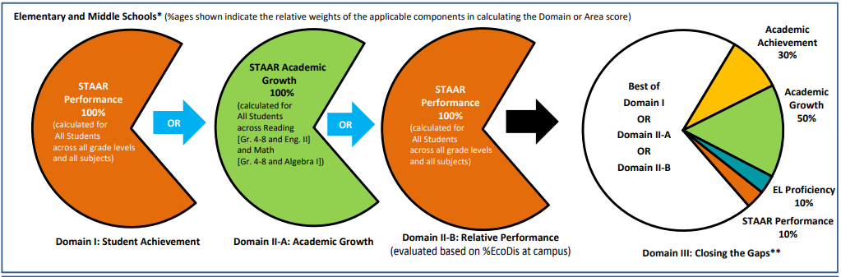
PHARR-SAN JUAN-ALAMO INDEPENDENT SCHOOL DISTRICT
Liberty Middle School / 20253-2025 Data
2025 Relative Performance 89 %
ECD 97.4% 2024 – 86%
2025 STAAR
Academic Achievement
76 %
2024- 74%
2025 STAAR
Academic Growth
73 %
2024- 67%
Domain | Scaled Score | Better of School Progress A or B | Better of Student Achievement or School Progress | Weight | Pts.
I - Student Achievement | 74
II - School Progress Part A | 67
II- Relative Performance Part B | 86 | 86 | 86 | 70% | 60.2
III- Closing the Gaps | 65 |  |  | 30% | 19.5
Domain | Scaled Score | Better of School Progress A or B | Better of Student Achievement or School Progress | Weight | Pts.
I - Student Achievement | 76
II - School Progress Part A | 73
II- Relative Performance Part B | 89 | 89 | 89 | 70% | 62.3
III- Closing the Gaps | 78 |  |  | 30% | 23.4
2024
Overall 79.7/80 = B
2025
Overall 86 = B

Slide 23
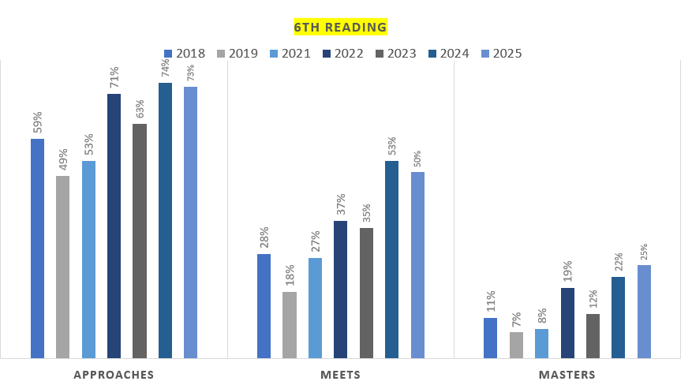

Slide 24
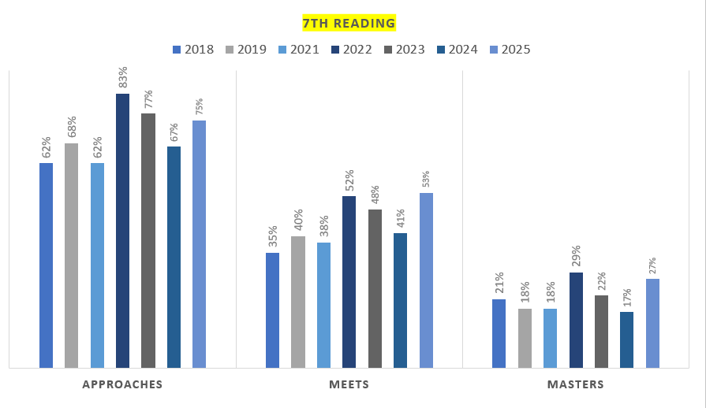

Slide 25
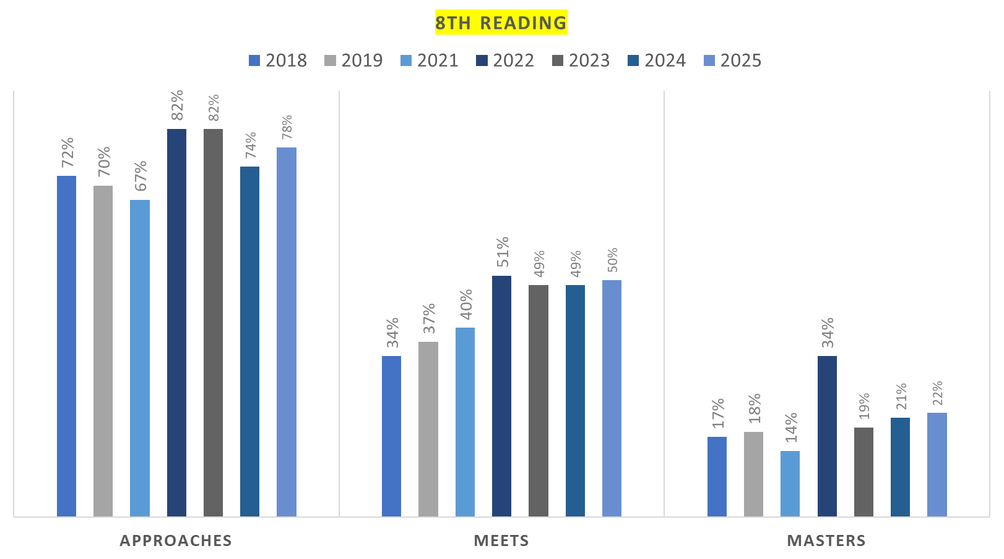

Slide 26
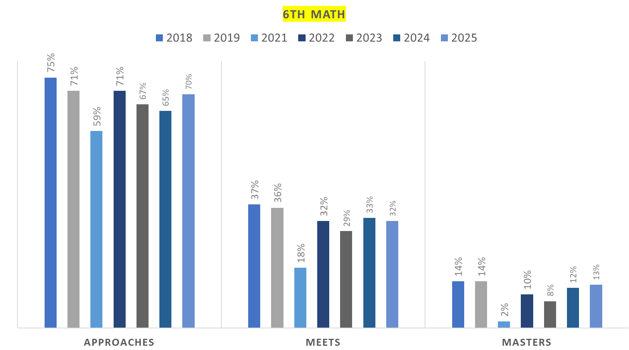

Slide 27
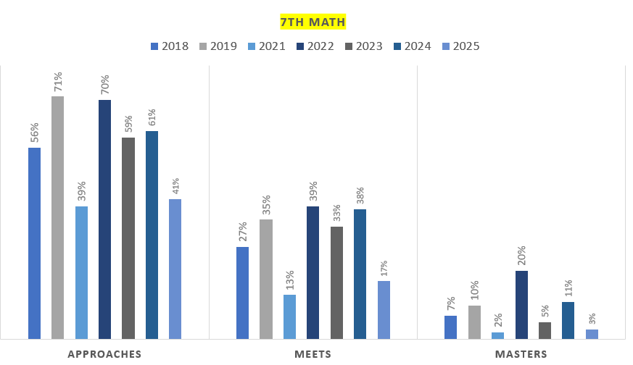

Slide 28
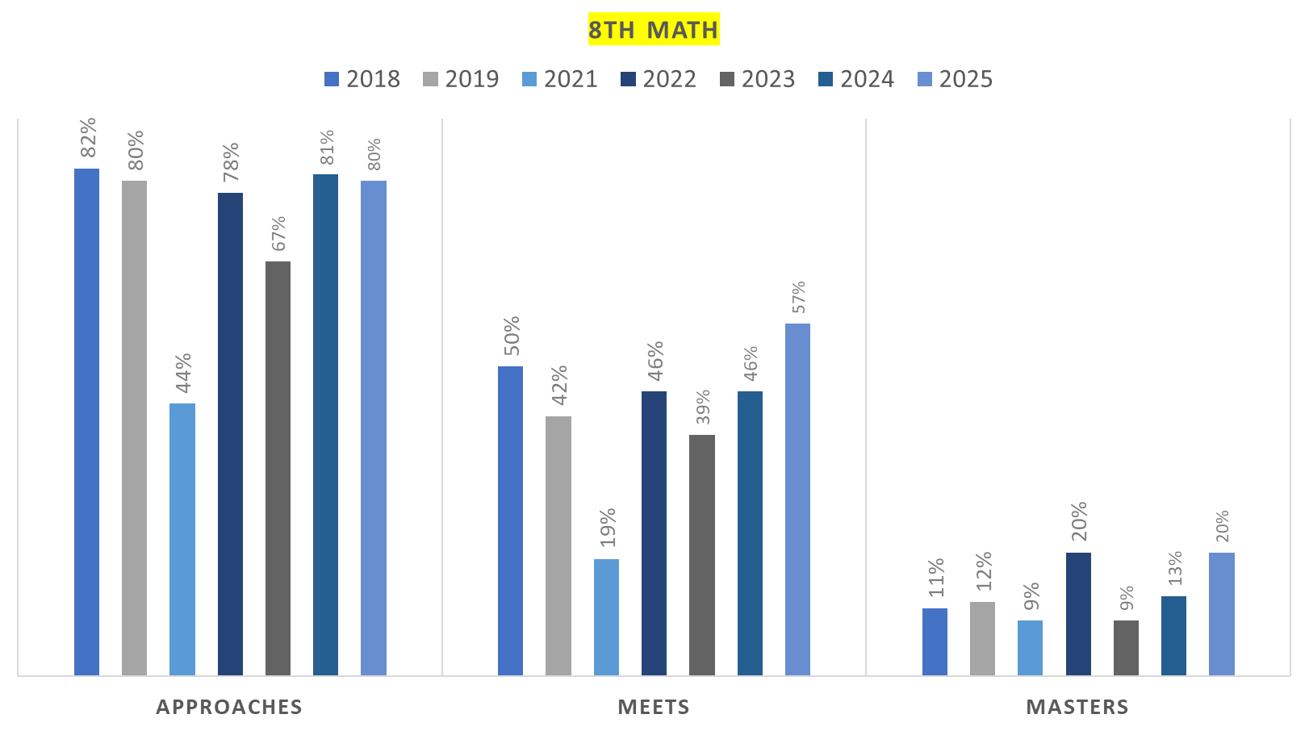

Slide 29
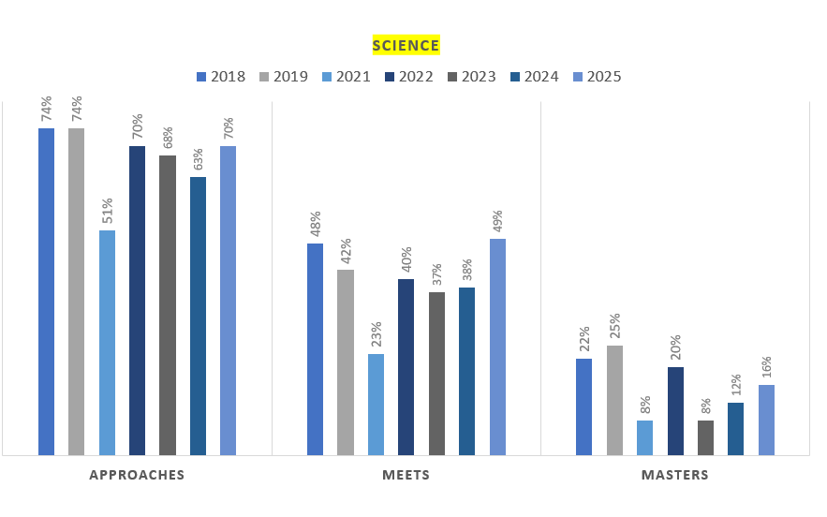

Slide 30
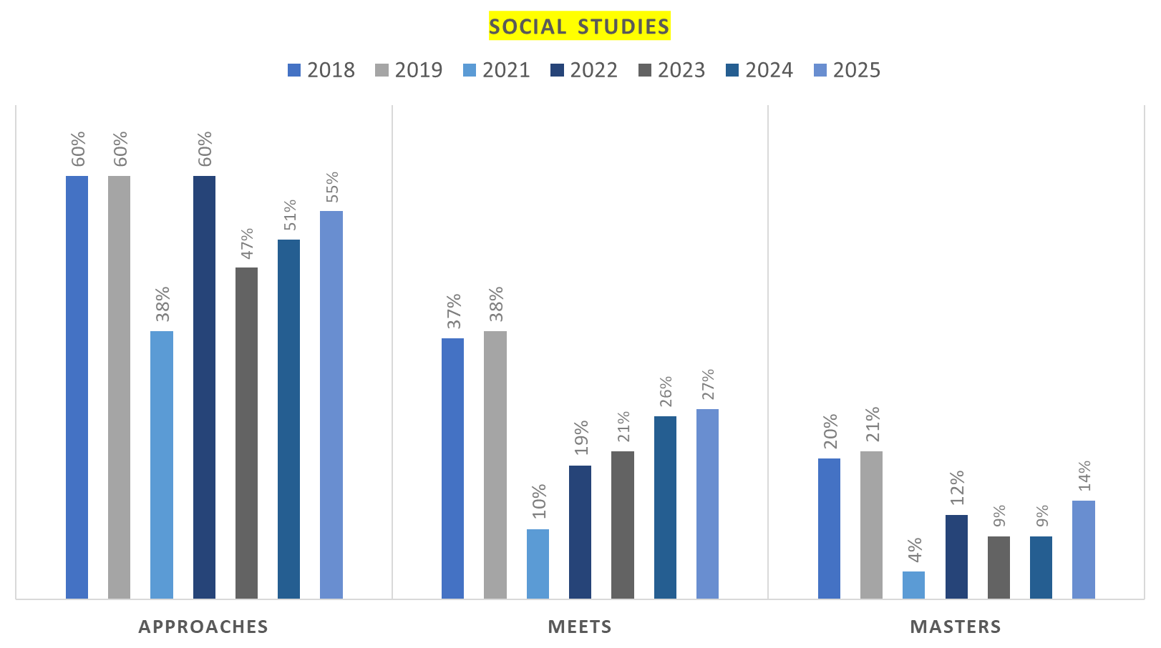

Slide 31



Slide 34
PHARR-SAN JUAN-ALAMO INDEPENDENT SCHOOL DISTRICT
Goal Area 1: Student Achievement

Slide 35
Goal Area 1: | Student Achievement
Annual Goal 1: | By June 2026, Liberty Middle School will improve to the following levels on STAAR Reading at least 80% at Approaches, 50% at Meets, 30% at Masters.
Objective:1 | By June 2026, all students will improve Reading performance in grades 6th, 7th, and 8th by implementing an effective systemic literacy plan across the content areas.
Strategy 1 | Persons Responsible/Title | Resources | Timeline | Evidence of Implementation | Evidence of Impact | Formative/ Summative Assessment | Title-I School- wide Component
Campus CLCs will serve as a vehicle to implement a systemic literacy plan. | Classroom Teachers AVID Teacher Life Coach/Department Chairs Librarian Administrators | Library and Collection STAR Reading Program/Data MyON/Accelerated Reader Data: STAAR 2025 and TELPAS 2025 Benchmark Data – 2025 and 2026 AVID Strategies Literacy Committee Planning/Meeting Times PearDeck,Google Classroom | August 2025 through August 2026 | Literacy Committee Documentation (Agendas/Attendance/Minutes) Literacy Plan CLC Agendas/Attendance Documentation Individualized Student Plans Walkthrough Documentation | Gains: Local Assessments Gains: STAAR Assessment Gains: AR Tests Gains: Class Performance Gains: STAR Reading Level | *Formative: Checks for Understanding Assignment Grades *Summative: Weekly Assessments CBAs Benchmarks STAAR AR Tests Lexiles | Title I - 4: High-Quality and Ongoing Professional Development a. Required: select professional development to meet the needs of teachers b. Best Practice: utilize profesional learning communities to meet the needs and schedules of teachers. c. Best Practice: Rearrange the school day to provide a block of time for collaborative planning. Title I,II,II State Compensatory Fund, Bilingual Funds Local Funds
Action Steps
Assemble a literacy committee for program implementation and development.
Analyze the results of the 2025 Reading STAR diagnostic assessment, STAAR 2025, TELPAS 2025, and 2025 benchmark data to personalize the instructional needs of all students.
Develop a plan to implement and monitor literacy (reading and writing) practices across all contents.
Strategy 2 | Persons Responsible/Title | Resources | Timeline | Evidence of Implementation | Evidence of Impact | Formative/ Summative Assessment | Title-I School- wide Component
Targeted interventions will be implemented and monitored based on identified areas of concern. | Classroom Teachers AVID Teacher Life Coach/Department Chairs Administrators Tutors | Planning Time Summit K12 Galaxy/Lexia Istation Google Classroom AVID Strategies Time/Schedule for Tutorials (before, during, or after school) Technology: computers, | October 2025 through August 2026 | Intervention Lists (appr/meets/masters) Attendance Lists for Tutorials Home Contact Logs Completion of Assignments/Lessons Reports (Education Galaxy, Lexia, Summit K12, Istation) Walkthrough Documentation | Gains: Local Assessments Gains: STAAR Assessment Gains: Class Performance | *Formative: Checks for Understanding Assignment Grades *Summative: Weekly Assessments CBAs Benchmarks STAAR Lexiles | Title I - 9: Effectively and Timely Assistance to Students Experiencing Difficulty Required: Analyze individual student data to identify needs and provide additional learning opportunities for all students who need it. and c. Best Practices: Provide individualized and small group learning sessions; incorporate computer-assisted instruction Title I,II,II
Action Steps
Conduct campus review sessions through CLCs to identify and immediately address areas of concern.
Use a blended learning approach for targeted interventions (Istation, Lexia, Education Galaxy, Summit K12, Progress Learning)
Use small group instruction to provide additional support to students in need (by classroom teachers, SE teachers, retired ELA/R teachers, university students).
Strategy 3 | Persons Responsible/Title | Resources | Timeline | Evidence of Implementation | Evidence of Impact | Formative/ Summative Assessment | Title-I School- wide Component
Close reading activities will be implemented across all contents | Classroom Teachers AVID Teacher Life Coach/Department Chairs Administrators Tutors | PLORE Class Posters Newsela Subscription Newsela Passages by Content Questions (STAAR Format) Writing Prompts for Passages AVID Strategies PearDeck Google Classroom | October 2025 through August 2026 | Lesson Plans Newsela Binders by Content Student Work/Annotations Walkthrough Documentation | Gains: Local Assessments Gains: STAAR Assessment Gains: Class Performance | *Formative: Checks for Understanding Assignment Grades Newsela Activity Grades *Summative: Weekly Assessments CBAs Benchmarks STAAR | Title I - 2: Reform Strategies a. Required: Review program documentation to ensure that all instructional programs/instructional strategies are supported by scientifically-based research. c. Best Practice: Identify scientifically- based research programs that increase the amount and quality of learning time. Title I,II,II State Compensatory Fund State Bilingual Funds Local Funds
Acrion Steps
Align close reading passages from Newsela to content area timelines.
Monitor the implementation of close reading.
Implement PLORE reading strategies across the disciplines.

Slide 36
Goal Area 1: | Student Achievement
Annual Goal 2: | By June 2026, 50% of Liberty Middle School EB students will improve TELPAS Writing performance by 1 level or more.
Objective: 1 | By June 2026, all students will improve in WRITING at every performance level by implementing differentiated data-driven instruction to meet the needs of all students.
Strategy 1 | Persons Responsible/Title | Resources | Timeline | Evidence of Implementation | Evidence of Impact | Formative/ Summative Assessment | Title-I School- wide Component
A plan will be developed to implement and monitor best practices in writing. | Literacy Committee Members ELA/R Teachers AVID Teacher Language Support Teachers Life Coach/Department Chairs Content Administrator | DMAC Access/Reports TELPAS Data - 2025 STAAR Data – 2025 and 2025 Mini-Assessment Data Benchmark Data Google Classroom SIOP Lesson Plans Common Instruction Framework 60/30 Instructional Framework | October 2025 through June 2026 | Literacy Plan CLC Agendas/Attendance Review Session Agendas/Findings Classroom Observations Walkthrough Documentation Use of AVID Strategies | Gains: Local Assessments Gains: STAAR Assessment Gains: Class Performance | *Formative: Checks for Understanding Assignment Grades Grades *Summative: Weekly Assessments CBAs Benchmarks STAAR | Title I - 8: Teacher Decision-Making Regarding Assessments a. Required: Include teachers in the decisions and planning regarding use of assessments. c. Best practice: Provide professional development on using data to make instructional decisions, improve curriculum, and design assignments.
Action Steps
A literacy committee will be assembled to for program implementation and development.
Teachers will analyze data from TELPAS 2025, STAAR 2025 to identify areas of concern; teachers will use mini-assessment and benchmark data (2025) to drive instructional practice in writing.
The campus will conduct a review session bi-weekly and at the end of the Six Weeks to identify areas of concern in: written composition; revising; editing.
Strategy 2 | Persons Responsible/Title | Resources | Timeline | Evidence of Implementation | Evidence of Impact | Formative/ Summative Assessment | Title-I School- wide Component
Writing exercises/activities will be implemented across the contents. | Classroom Teachers AVID Teacher Life Coach/Department Chairs Administrators | Lesson Plans Writing Prompts by Content AVID Strategies Designated Planning Time TELPAS Embedded Writing Common Instruction Framework 60/30 Instructional Framework | August 2025 through June 2026 | Lesson Plans/Annotations Student Work Use of AVID Strategies Walkthrough Documentation | Gains: Local Assessments Gains: STAAR Assessment Gains: Class Performance | *Formative: Checks for Understanding Assignment Grades Newsela Activity Grades *Summative: Weekly Assessments CBAs Benchmarks STAAR | Title I - 2: Reform Strategies a. Required: Review program documentation to ensure that all instructional programs/instructional strategies are supported by scientifically-based research. c. Best Practice: Identify scientifically- based research programs that increase the amount and quality of learning time. Title I,II,II State Compensatory Fund State Bilingual Funds Local Funds
Action Steps
Write-to-Learn exercises/activities will be incorporated into lessons across the contents.
Teachers will produce evidence of writing in their respective classes.
Strategy 3 | Persons Responsible/Title | Resources | Timeline | Evidence of Implementation | Evidence of Impact | Formative/ Summative Assessment | Title-I School- wide Component
Targeted interventions will be implemented and monitored based on identified areas of concern. | ELA/R Teachers AVID Teacher Life Coach/Department Chairs Language Support Teachers Tutors Content Administrator | Planning Time Summit K12/ Istation Education Galaxy Lexia AVID Strategies Google Classroom Time/Schedule for Tutorials (before, during, or after school; Saturdays) Technology: computers, document readers, slates, etc. | October 2025 through June 2026 | Intervention Lists (appr/meets/masters) Attendance Lists for Tutorials Home Contact Logs Completion of Assignments/Lessons Reports (Education Galaxy, Lexia, Summit K12, Istation) Use of AVID Strategies Walkthrough Documentation | Gains: Local Assessments Gains: STAAR Assessment Gains: Class Performance | *Formative: Checks for Understanding Assignment Grades *Summative: Weekly Assessments CBAs Benchmarks STAAR | Title I - 9: Effectively and Timely Assistance to Students Experiencing Difficulty Required: Analyze individual student data to identify needs and provide additional learning opportunities for all students who need it. and c. Best Practices: Provide individualized and small group learning sessions; incorporate computer-assisted instruction Title I,II,II State Compensatory Fund State Bilingual Funds Local Funds
Action Steps
Teachers will analyze classroom and assessment data to identify areas of concern.
Teachers will provide small group instruction to students within and beyond the class period
Tutors (retired ELA/R teachers and university students) will provide additional support to students within and beyond the class period.

Slide 37
Goal Area 1: | Student Achievement
Annual Goal 3: | By June 2026 Liberty Middle School students will improve to the following levels on the STAAR in MATHEMATICS: at least 80% at the Approaches level; 53% at the Meets level; and 25% at the Masters level.
Objective:1 | Students will improve student achievement to the given levels in mathematics through data-driven practices: planning, instruction, and interventions.
Strategy 1 | Persons Responsible/Title | Resources | Timeline | Evidence of Implementation | Evidence of Impact | Formative/ Summative Assessment | Title-I School- wide Component
Teachers will follow the lesson internalization guide to ensure consistency with: | Grade Level SE Teachers | Lead4Ward Resources | August 2025 | Lesson Plans with Annotations | Gains: Local Assessments | *Formative: | Title I - 4: High-Quality and Ongoing
TEK analysis Alignment to the assessed curriculum Scaffolding Lesson rehearsal | Life Coach/Department Chair Content | District Curriculum | through | Participation/Observation of Planning Time | Gains: STAAR Assessment | Checks for | Professional Development a.
 | Administrator | IB Unit Planners | June 2026 | TCLC Agendas |  | Understanding | Required: select professional development
 |  | Designated Planning Time |  | Walkthrough Documentation |  | *Summative: | to meet the needs of teachers
 |  | Google Classroom Blended Learning |  |  |  | Weekly Assessments | b. Best Practice: utilize professional
 |  | Small Group Instruction |  |  |  | CBAs | learning communities to meet the needs
 |  | Common Instructional Framework |  |  |  | Benchmarks | and schedules of teachers.
 |  | Common Instructional Framework |  |  |  | STAAR/EOC | Best Practice: Rearrange the school day to
 |  |  |  |  |  |  | provide a block of time for collaboration.
Teachers will use the planning time allotted to collaborate and determine best practices to use in lesson delivery
Teachers will consult resources that match the rigor of the state assessment to the rigor used in lesson assignments, activities, and projects.
Teacher will select assignments, activities, projects for implementation that reflect the given rigor match.
Strategy 2 | Persons Responsible/Title | Resources | Timeline | Evidence of Implementation | Evidence of Impact | Formative/ Summative Assessment | Title-I School- wide Component
Consistent monitoring of performance | Grade Level Math Teachers | LMS Monitoring Tool | October 2025 | Completed and Current Monitoring Forms | Gains: Local Assessments | *Formative: | Title I - 8: Teacher Decision-Making
and progress will be observed by | Grade Level Sp. Ed. Teachers | Student Portfolios/Graphs | through | Completed and Current Student Graphs | Gains: STAAR Assessment | Checks for | Regarding Assessments a.
teachers and students. | Students Department Chair/Leadership | DMAC Access/Reports STAAR Data | June 2026 | Teacher/Student Conferences Walkthrough Documentation | Student Ownership/Goals | Understanding Student Goal Setting | Required: Include teachers in the decisions and planning regarding use of assessments.
 | Content Administrator | Local Assessment Data |  |  |  | *Summative: | Title I,II,II State Compensatory Fund
 |  | Time for St. Conferences |  |  |  | Weekly Assessments | State Bilingual Funds Local Funds
 |  | Google Classroom 60/30 Model Small Group Instruction |  |  |  | CBAs
 |  |  |  |  |  | Benchmarks
 |  |  |  |  |  | STAAR/EOC
Action Steps
A consistent monitoring tool will be used and kept current by teachers and students to document performance and progress.
Data analysis will be conducted at given intervals, including , but not limited to CBA and Benchmarks, to identify areas of concern and to develop targeted interventions accordingly.
Strategy 3 | Persons Responsible/Title | Resources | Timeline | Evidence of Implementation | Evidence of Impact | Formative/ Summative Assessment | Title-I School- wide Component
Targeted interventions will be | Grade Level Math Teachers | Planning Time | October 2025 | Intervention Lists (appr/meets/masters) | Gains: Local Assessments | *Formative: | Title I - 9: Effectively and Timely Assistance to Students Experiencing Difficulty Required: Analyze individual student data to identify needs and provide additional learning opportunities for all students who need it. and c. Best Practices: Provide individualized and small group learning sessions; incorporate computer-assisted instruction Title I,II,II State Compensatory Fund
implemented and monitored based on | Grade Level Sp. Ed. Teachers | Google Classroom/Meet | Through | Attendance Lists for Tutorial/ Thriving Thursday | Gains: STAAR Assessment | Checks for
identified areas of concern | Students | Google Slides/Forms | June 2026 | Home Contact Logs | Gains: Class Performance | Understanding
synchronoysly and asynchronously | Department Chair/Leadership | Imagine Math/Education Galaxy/ Progress Learning |  | Completion of Assignments/Lessons |  | Assignment Grades
 | Administration | Time/Schedule for Tutorials |  | Imagine Math/Education Galaxy/ Progress Learning Reports |  | *Summative:
 | Tutors 6th Grade Intervention Teacher | (before, during, or after |  | Walkthrough Documentation |  | Weekly Assessments
 |  | school; Saturdays)Technology: |  |  |  | STAAR/EOC
 |  | computers, document readers, |  |  |  | Benchmarks
 |  | slates, etc. Newline Board
Acrion Steps
Teachers will provide virtual opprtunities for intervention, including, but not limited to Google Classroom/Slides/Meet and Imagine Math/ Education Galaxy
Teachers and tutors (retired teachers and/or university students) will provide small group instruction to students within and beyond the class period.

Slide 38
PHARR-SAN JUAN-ALAMO INDEPENDENT SCHOOL DISTRICT
Goal Area 2: Closing the Gaps

Slide 39
Goal Area 2: | Closing the Gap
Annual Goal 1: | By June 2026,75% of our identified student groups in the Academic Achievement component in the Closing the Gaps, will meet the STAAR performance targets in Reading and Math.
Objective 1: | All identified student groups in the Academic Achievement component will be monitored to ensure that at least 80% of the indicators are met in Reading and Math by June 2026.
Strategy 1 | Persons Responsible/Title | Resources | Timeline | Evidence of Implementation | Evidence of Impact | Formative/ Summative Assessment | Title-I School- wide Component
Collect and assess (all subgroup) student data to monitor the progress of weekly assessments by using "meets" level stanadard in reading and math. (Reg Ed, RTI,504,SPED,GT Migrants, EB's, EP) | Principal Dean of Instruction Asst. Principals Life Coach Department Head GL Chairs Teachers Counselor | Progress Monitoirng Tool STAAR Release Data IStation Reading Imagine Math/ Education Galaxy / Progress Learning Lexia District Curriculum 60/30 Instructional Framework STAR | August 2025 - August 2026 | Progress Monitoring Data Weekly Assessments TTESS Walkthroughs Student Work Sample | -Closing the achivement Gaps -Increase in academic Performance in Benchmarks and STAAR, TELPAS | Weekly Assessments BM1 & 2 STAAR TELPAS Reading Lexile measures | *Comprehensive Needs Assessment (A,B,C) *Reform stratagies (A,B,C) *Teacher Decison-Making Regarding Assessments (A,B,C) *Effective and Timely Assistance to Students Experiencing Difficulty (A,B,C) *Coordination and Intergration of Federal, State, and Local Services, Programs, and Funds (A) Title I,II,II State Compensatory Fund State Bilingual Funds Local Funds
Action Steps
1. Meet with Grade Level once a week to discuss progress monitoring.
2. Use ongoing district created formative assessments to track data.
3.Use data to drive instructional decsions and provide interventions related to students needs. Provide opportunities for small group instruction.
4. Provide diifferentiated instruction, accommodations, and intervention plans based on students IEPs.
Strategy 2 | Persons Responsible/Title | Resources | Timeline | Evidence of Implementation | Evidence of Impact | Formative/ Summative Assessment | Title-I School- wide Component
Implement action plans to ensure (all subgroup) students meet Reading and Math "Meets" Standards on district local assessments | Principal Dean of Instruction Asst. Principals Life Coach Department GL Chairs Teachers Counselor | Progress Monitoring Tool STAAR Release Data IStation Reading Imagine Math Education Galaxy/ Progress Learning Lexia STAR District Curriculum 60/30 Instructional Framework | August 2025 - August 2026 | Classroom Tracking Chart Progress Monitoring Data Weekly Assessments Professional Development Attendance for Accountability Updates TTESS Walkthroughs Student Work Sample Lesson Plans | Closing the achivement Gaps -Increase in academic Performance in Benchmarks and STAAR, TELPAS - Domain I & II | Weekly Assessments BM1 & 2 STAAR TELPAS | *Comprehensive Needs Assessment (A,B,C) *Reform stratagies (A,B,C) *Teacher Decison-Making Regarding Assessments (A,B,C) *Effective and Timely Assistance to Students Experiencing Difficulty (A,B,C) *Coordination and Intergration of Federal, State, and Local Services, Programs, and Funds (A) Title I,II,II State Compensatory Fund State Bilingual
Action Steps
1. Create an intervention plan that targets specific groups for skill and performance level targets.
2. Track student progress,by identifying current levels in STAAR assessments and set goals to show progress/growth.
3. Teachers hold conferences with student to identify, set goals and track progress virtually and or face to face.
4. Teacher will attend Professional Development related to updates on Accountability
Strategy 3 | Persons Responsible/Title | Resources | Timeline | Evidence of Implementation | Evidence of Impact | Formative/ Summative Assessment | Title-I School- wide Component
Monitor and evaluate the implementaiton of action plans to ensure that (all subgroups)students are progressing to meets standards in both reading and math. | Principal Dean of Instruction Asst. Principals Life Coach Department GL Chairs Teachers Counselor | Progress Monitoirng Tool STAAR Release Data IStation Reading Imagine Math/ Education Galaxy/ Progress Learning Lexia STAR District Curriculum | August 2025 - August 2026 | Classroom Tracking Chart Progress Monitoring Data Weekly Assessment TTESS Walkthroughs Student Work Sample Lesson Plans | -Closing the achivement Gaps -Increase in academic Performance in Benchmarks and STAAR, TELPAS | Progress Monitoring Tool, Action Plan, Weekly Assessments BM1 & 2 STAAR TELPAS | *Comprehensive Needs Assessment (A,B,C) *Reform stratagies (A,B,C) *Teacher Decison-Making Regarding Assessments (A,B,C) *Effective and Timely Assistance to Students Experiencing Difficulty (A,B,C) *Coordination and Intergration of Federal, State, and Local Services, Programs, and Funds (A) Title I,II,II State Compensatory Fund State Bilingual Funds Local Funds
Acrion Steps
1. Meet with Life Coach and leadership team to evaluate the use of resources for specific target groups.
2. Review lesson plans,discuss instructions and stratagies to target specific students needs.
3. Provide teachers with quality intentional planning during their confrence periods and TCLC's.

Slide 40
Goal Area 2: | Closing the Gap
Annual Goal 1: | By June 2026,75% of our identified student groups in the Academic Achievement component in the Closing the Gaps, will meet the STAAR performance targets in Reading and Math.
Objective 2: | All student groups will increase in the Growth component by at least 10 percentage points in Reading and Math performance level. In Reading from 31% to 41% and from 42% to 52% in Math.
Strategy 1 | Persons Responsible/Title | Resources | Timeline | Evidence of Implementation | Evidence of Impact | Formative/ Summative Assessment | Title-I School- wide Component
Identify all students in STAAR 2025 assessment who can potentially meet expected growth. | Principal Dean of Instruction Asst. Principals Life Coach Department GL Chairs Teachers Counselor | Progress Monitoirng Tool STAAR Release Data IStation Reading Imagine Math Education Galaxy/ Progress Learning Lexia STAR District Curriculum | August 2025 - August 2025 | STAAR Data 2026 Progress Monitoring Data Weekly Assessments TTESS Walkthroughs Student Work Samples Professional Development Attendance for Accountability Updates | -Closing the achivement Gaps -Increase in academic Performance in Benchmarks and STAAR, TELPAS - Domain I & II | Weekly Assessments Benchmarks 1 & 2 STAAR | *Comprehensive Needs Assessment (A,B,C) *Reform stratagies (A,B,C) *Teacher Decison-Making Regarding Assessments (A,B,C) *Effective and Timely Assistance to Students Experiencing Difficulty (A,B,C) *Coordination and Intergration of Federal, State, and Local Services, Programs, and Funds (A) Title I,II,II State Compensatory Fund State Bilingual
Action Steps
1. Schedule opportunities for blended learning ( IStation, Imagine Math, AR, Lexia, Education Galaxy)
2. Students will monitor/track their progress towards Meets or exceedes expected expected growth.
3. Campus will employ Intentionall flexible scheduling.
4. Teachers will attend Professional Development on Accountability Updates
Strategy 2 | Persons Responsible/Title | Resources | Timeline | Evidence of Implementation | Evidence of Impact | Formative/ Summative Assessment | Title-I School- wide Component
Create and develop a plan to ensure all teachers are delivering high-quality, best practice close reading activities during their instructional time. | Principal Dean of Instruction Asst. Principals Life Coach Department GL Chairs Teachers Counselor | Progress Monitoirng Tool STAAR Release Data IStation Reading Imagine Math Lexia District Curriculum | August 2025 - August 2025 | STAAR Data 2026 Progress Monitoring Data Weekly Assessments TTESS Walkthroughs Student Work Samples | -Student Growth - Closing the achivement Gaps -Increase in academic Performance in Benchmarks and STAAR, TELPAS - Domain I & II | Weekly Assessments Benchmarks 1 & 2 STAAR | *Comprehensive Needs Assessment (A,B,C) *Reform stratagies (A,B,C) *Teacher Decison-Making Regarding Assessments (A,B,C) *Effective and Timely Assistance to Students Experiencing Difficulty (A,B,C) *Coordination and Intergration of Federal, State, and Local Services, Programs, and Funds (A) Title I,II,II State Compensatory Fund State Bilingual
Action Steps
1. Scheduled advance courses to provide more rigorous curriculum and instruction.
2. Provide "close reading" professional development to engage the rigor of instruction at the meets and masters levevl.
3. Implement and monitor instruction through walkthroughs and effective feedback.
Strategy 3 | Persons Responsible/Title | Resources | Timeline | Evidence of Implementation | Evidence of Impact | Formative/ Summative Assessment | Title-I School- wide Component
Provide STAAR intervention block to teachers for Monitoring and evaluating student progress as well as reflecting on insturctional time to ensure high quality best practices are being delivered to the assigned "meets" and "masters" level groups of students. | Principal Dean of Instruction Asst. Principals Life Coach Department GL Chairs Teachers Counselor | Progress Monitoirng Tool STAAR Release Data IStation Reading Imagine Math/ Progress Learning Lexia District Curriculum Lesson Plans Scheduling 60/30 Instructional Framework | August 2025 - August 2026 | STAAR Data 2026 Progress Monitoring Data Weekly Assessments TTESS Walkthroughs Student Work Samples 60/30 Instructional Framework | -Student Growth - Closing the achivement Gaps -Increase in academic Performance in Benchmarks and STAAR, TELPAS - Domain I & II | Weekly Assessments Benchmarks 1 & 2 STAAR | *Comprehensive Needs Assessment (A,B,C) *Reform stratagies (A,B,C) *Teacher Decison-Making Regarding Assessments (A,B,C) *Effective and Timely Assistance to Students Experiencing Difficulty (A,B,C) *Coordination and Intergration of Federal, State, and Local Services, Programs, and Funds (A) Title I,II,II State Compensatory Fund State Bilingual
Acrion Steps
1. Implement STAAR alligned resrouces for whole group instrcutions for targeted intervention groups and tutoring.
2. Develop an action plan and the identification of who, when and what skill is being targeted.
3. Implement Close reading, informal/ formal assessments, STAAR released question stems, and open ended questions to track student progress.

Slide 41
Goal Area 2: | Closing the Gap
Annual Goal 2: | By June 2026, 75% of our identified student groups in the Academic Growth status component in the Closing the Gaps domain will meet the expected growth targets in reading and math.
Objective 2: | All student groups will meet or exceed growth expectations by at least 5% increase of academic growth in the area of Reading and Math by June 2026: from 61% to at least 66% in Reading and from 60% to at least 65% in Math.
Strategy 1 | Persons Responsible/Title | Resources | Timeline | Evidence of Implementation | Evidence of Impact | Formative/ Summative Assessment | Title-I School- wide Component
Target Emergent Bilingual student group to demonstrate at least 5% increase in academic growth in the areas of Reading and Math. | Principal Dean of Instruction Asst. Principals Life Coach Department GL Chairs Teachers Counselor | ELPS Stratagies Progress Monitoirng Tool STAAR Release Data IStation Reading Imagine Math Education Galaxy / Progress Learning Lexia 60/30 Instructional Framework District Curriculum | August 2025 - August 2026 | STAAR Data 2026 Progress Monitoring Data Weekly Assessments TTESS Walkthroughs Student Work Sample | -Closing the achivement Gaps -Increase in academic Performance in Benchmarks and STAAR, TELPAS - Domain I & II | Weekly Assessments Benchmarks 1 & 2 STAAR | *Comprehensive Needs Assessment (A,B,C) *Reform stratagies (A,B,C) *Teacher Decison-Making Regarding Assessments (A,B,C) *Effective and Timely Assistance to Students Experiencing Difficulty (A,B,C) *Coordination and Intergration of Federal, State, and Local Services, Programs, and Funds (A) Title I,II,II State Compensatory Fund State Bilingual Funds Local Funds
Action Steps
1. ELs will be monitored bi-weekly through the progress monitoring tool.
2. Teachers will be provided with quality training on how ELP Stratagies are embedded in weekly lesson plans to enhance the overall instructional program for ELs
3. Teachers will be trained and guided on the implementation of EL supplemental aids on provisions of routinely testing accommodations to personalize the need of every EL student in their classroom.
4. Teachers will use BIC/CALP vocabulary stratagies across all contents.
Strategy 2 | Persons Responsible/Title | Resources | Timeline | Evidence of Implementation | Evidence of Impact | Formative/ Summative Assessment | Title-I School- wide Component
Target and monitor our SPED student groups to demonstrate a 5% increase of academic growth in the area of Reading and Math. | Principal Dean of Instruction Asst. Principals Life Coach Department GL Chairs Teachers Counselor | Progress Monitoirng Tool STAAR Release Data IStation Reading Imagine Math Education Galaxy/ Progress Learning Lexia 60/30 Instructional Framework District Curriculum | August 2025 - August 2026 | STAAR Data 2026 Progress Monitoring Data Weekly Assessments TTESS Walkthroughs Student Work Sample | -Student Growth - Closing the achivement Gaps -Increase in academic Performance in Benchmarks and STAAR, TELPAS - Domain I & II | Weekly Assessments Benchmarks 1 & 2 STAAR | *Comprehensive Needs Assessment (A,B,C) *Reform stratagies (A,B,C) *Teacher Decison-Making Regarding Assessments (A,B,C) *Effective and Timely Assistance to Students Experiencing Difficulty (A,B,C) *Coordination and Intergration of Federal, State, and Local Services, Programs, and Funds (A) Title I,II,II State Compensatory Fund State Bilingual
Action Steps
1. Use progress monitoring tool and track student growth.
2.Provide Lexia reding intervention for struggling readers.
Strategy 3 | Persons Responsible/Title | Resources | Timeline | Evidence of Implementation | Evidence of Impact | Formative/ Summative Assessment | Title-I School- wide Component
Target and monitor our ECD student groups which will demonstrate a 10% increase in academic growth in the areas of Reading and Math. | Principal Dean of Instruction Asst. Principals Life Coach Department GL Chairs Teachers Counselor | Progress Monitoirng Tool STAAR Release Data IStation Reading Imagine Math Education Galaxy/ Progress Leartning Lexia District Curriculum Lesson Plans 60/30 Instructional Framework | August 2025 - August 2026 | Lesson Plans Progress Monitoring Data Weekly Assessments TTESS Walkthroughs Student Work Sample District Curriculim | -Student Growth - Closing the achivement Gaps -Increase in academic Performance in Benchmarks and STAAR, TELPAS - Domain I & II | Weekly Assessments Benchmarks 1 & 2 STAAR | *Comprehensive Needs Assessment (A,B,C) *Reform stratagies (A,B,C) *Teacher Decison-Making Regarding Assessments (A,B,C) *Effective and Timely Assistance to Students Experiencing Difficulty (A,B,C) *Coordination and Intergration of Federal, State, and Local Services, Programs, and Funds (A) Title I,II,II State Compensatory Fund State Bilingual
Acrion Steps
1. Use progress monitoring tool and track student growth.
2. Tailor interventions to each student's needs.
3. Communicate and reach out to parents for support and provide student with needed resources to suceed.

Slide 42
Goal Area 2: | Closing the Gap
Annual Goal 3: | By June 2026, 55% of Emergent Bilingual students will advance by at least one proficiency level of the composite rating from June 2025 to June 2026 in the TELPAS state assessment.
Objective 1: | In grades 6th-8th grade student will increase at least one proficiency level or maintain Adv High in the areas of Listening by at least 75%, in Speaking by at least 40% and in Reading by at least 60%.
Strategy 1 | Persons Responsible/Title | Resources | Timeline | Evidence of Implementation | Evidence of Impact | Formative/ Summative Assessment | Title-I School- wide Component
Develop, implement, and monitor a plan so all identified EB students can practice TELPAS Listening activities in their classroom | Principal Dean of Instruction Asst. Principals Life Coach Department GL Chairs Teachers Spanish Teachers | Summit K-12 TELPAS Data IStation Reading Imagine Math Education Galaxy/ Progress Learning Test Practice Items District Curriculum Scheduled Lab Time | August 2025 - August 2026 | TELPAS Data 2026 Weekly Assessment TTESS Walkthroughs Student Work Sample/ Sets | Closing the achivement Gaps Summit K-12 TELPAS Pracitce Sets Domian III Walkthorughs Classroom Student engagment/participation | Practice Sets Data Summit K-12 Reports Classroom Listening Activites CIF Protocols | *Comprehensive Needs Assessment (A,B,C) *Reform stratagies (A,B,C) *Teacher Decison-Making Regarding Assessments (A,B,C) *Effective and Timely Assistance to Students Experiencing Difficulty (A,B,C) *Coordination and Intergration of Federal, State, and Local Services, Programs, and Funds (A) Title I,II,II State Compensatory Fund State Bilingual
Action Steps
1. Provide professional development for all teachers on effective TELPAS listening activities that can be implemented across all subjects
2. Provide students with lab time to practice Listening activities using Summit K-12 program twice a week during spanish classess.
3. Incorportate CIF protocols, such as cold calling, to give students the opportunity to discuss in class.
Strategy 2 | Persons Responsible/Title | Resources | Timeline | Evidence of Implementation | Evidence of Impact | Formative/ Summative Assessment | Title-I School- wide Component
Develop, implement, and monitor a plan so all identified EB students can practice TELPAS Speaking activities throughout their classroom. | Principal Dean of Instruction Asst. Principals Life Coach Department GL Chairs Teachers Spanish Teachers | Summit K-12 TELPAS Data IStation Reading Imagine Math Education Galaxy / Progress Learning Test Practice Items District Curriiculum Scheduled Lab Time | August 2025 - August 2026 | TELPAS Data 2026 and 2025 Weekly Assessment TTESS Walkthroughs Student Work Sample/ Sets | Closing the achivement Gaps Summit K-12 TELPAS Pracitce Sets Domian III Walkthorughs Classroom Student engagment/participation | Practice Sets Data K- 12 Summit Reports Classroom Speaking Activites CIF Protocols | *Comprehensive Needs Assessment (A,B,C) *Reform stratagies (A,B,C) *Teacher Decison-Making Regarding Assessments (A,B,C) *Effective and Timely Assistance to Students Experiencing Difficulty (A,B,C) *Coordination and Intergration of Federal, State, and Local Services, Programs, and Funds (A) Title I,II,II State Compensatory Fund State Bilingual
Action Steps
1. Provide professional development for all teachers on effective TELPAS Speaking activities that can be implemented across al subjects
2. Provide students with lab time to practice Speaking activities using Summit K-12 program twice a week during spanish classess.
3. Incorportate CIF protocols, such as Think, Pair, Share to give students opportunities to speak in class discussions.
Strategy 3 | Persons Responsible/Title | Resources | Timeline | Evidence of Implementation | Evidence of Impact | Formative/ Summative Assessment | Title-I School- wide Component
Develop, implement, and monitor a plan so all identified EB students can practice TELPAS Reading activities throughout their classroom. | Principal Dean of Instruction Asst. Principals Life Coach Department GL Chairs Teachers Spanish Teachers | Summit K-12 TELPAS Data IStation Reading Imagine Math Education Galaxy/ Progress Learning Test Practice Items District Curriculum Scheduled Lab Time | August 2025 - August 2026 | TELPAS Data 2026 Weekly Assessment TTESS Walkthroughs Student Work Sample/ Sets | Closing the achivement Gaps Summit K-12 TELPAS Pracitce Sets Domian III Walkthorughs Classroom Student engagment/participation | Practice Sets Data K- 12 Summit Reports Classroom Reading Activites Close Reading Stratagy CIF Protocols | *Comprehensive Needs Assessment (A,B,C) *Reform stratagies (A,B,C) *Teacher Decison-Making Regarding Assessments (A,B,C) *Effective and Timely Assistance to Students Experiencing Difficulty (A,B,C) *Coordination and Intergration of Federal, State, and Local Services, Programs, and Funds (A) Title I,II,II State Compensatory Fund State Bilingual
Acrion Steps
1. Close reading strategies routinely used across the contents.
2. Provide student tutors for individualized reading interventions.
3. Train teachers on TELPAS Reading rubric
4. Provide students with lab time to practice Reading activities using Summit K-12 program twice a week during spanish classess.

Slide 43
PHARR-SAN JUAN-ALAMO INDEPENDENT SCHOOL DISTRICT
Goal Area 3: Improve Safety, Public Support, Culture & Climate

Slide 44
Goal Area 3: | Improve Safety, Public Support, Culture and Climate
Annual Goal 1: | To meet our annual goal of 95% attendance rate by June 2026
Objective 1: | To monitor daily student attendance to ensure students are in school actively learning daily
Strategy 1 | Persons Responsible/Title | Resources | Timeline | Evidence of Implementation | Evidence of Impact | Formative/ Summative Assessment | Title-I School- wide Component
Increase student attendance. | Grade level Administrator School Community Liaison Teachers Attendance Clerk Counselors Nurse Security Guard | Attendance Rosters Grade level incentive (snacks/prizes). Trophies Banners Attendance and Tardy Logs Sign in and Sign out Forms District Portal for Attendance Recovery | August 2025 - August 2026 | Attendance Reports PowerPoints Shared by District Student Profiles Completed Logs Teacher Logs Attendance Recovery Program (ARP) | Increase of student attendance Culture and Climate Survey Increase in Student Achievement | Weekly district attendance District six weeks attendance Attendance Recovery Participation (ARP) Certificates Sign-in/out sheets Yearly Attendance Rate of 97.5% | Reform Strategies 2A 2C Coordination and Integration of Federal, State, and Local Services, Programs and Funds 10 A 10 C Title I,II,II State Compensatory Fund State Bilingual Funds Local Funds
Action Steps
Make daily parent contact for students who are absent.
Disseminate policy awareness presentation/ information handouts to parents.
Require and enforce student sign-in at: front office, ccounselors, nurse
Require students to turn in written excuses for being absent to the attendance office/School Attendance Specialist.
Strategy 2 | Persons Responsible/Title | Resources | Timeline | Evidence of Implementation | Evidence of Impact | Formative/ Summative Assessment | Title-I School- wide Component
Enforce district/state attendance policies. | Grade Level Administrator School Community Liaison Teachers Attendance Clerk Counselors Nurse Security Guard | Non-Attendance Referral forms Warning letters. Telephone contact. Meeting date Hearing dates. Warning dates. Attendance and Tardy Logs Sign in and Sign out Forms District Portal for Attendance | August 2025 - August 2026 | Attendance Reports at the Campus Weekly District Attendance PowerPoints Shared by District Student Profiles Completed Logs Teacher Logs Attendance Recovery Attendance | Increase of student attendance Culture and Climate Survey Increase in Student Achievement | Non-attendance referral forms Attendance logs Warning letter copies Parent conference dates on file Hearing dates on file Attendance Action Plan | Reform Strategies 2A 2C Coordination and Integration of Federal, State, and Local Services, Programs and Funds 10 A 10 C
Action Steps
Provide attendance clerk with rosters of planned activities.
Encourage teachers to submit non-attendance referral forms after three unexcused absences
Issue warning letters to parent/guardian. Give verbal reprimands.
Make contact with students and parents after three unexcused absences.
Strategy 3 | Persons Responsible/Title | Resources | Timeline | Evidence of Implementation | Evidence of Impact | Formative/ Summative Assessment | Title-I School- wide Component
Enforce an Attendance Action Plan | Grade level Administrator School Community Liaison Teachers Attendance Clerk Counselors Nurse Security Guard | District/TEA attendance rate. Attendance and Tardy Logs Sign in and Sign out Forms District Portal for Attendance Recovery | August 2025 - August 2026 | Attendance Reports at the Campus Attendance Rate comparison with State PowerPoints Shared by District Student Profiles Attendance Recovery Application | Committee Input Culture and Climate Survey Increase in Student Achievement/Attendance | Campus Meeting Sign In Measured Goals | Reform Strategies 2A 2C Coordination and Integration of Federal, State, and Local Services, Programs and Funds 10 A 10 C
Acrion Steps
Create an Attendance Action Plan with: attendance procedures for parents, helpful tips for parents, automated phone system calls to parents to inform them about Attendance Recovery Program (ARP)

Slide 45
Goal Area 3: | Improve Safety, Public Support, Culture and Climate
Annual Goal 2: | By June 2026, student and staff perception for their physical and psychological safety will improve by 10%
Objective 1: | By June 2026, student social and emotional learning knowledge and skills will increase by 10%
Strategy 1 | Persons Responsible/Title | Resources | Timeline | Evidence of Implementation | Evidence of Impact | Formative/ Summative Assessment | Title-I School- wide Component
All students will be provided guidance lessons that build on the social emotional development of the student. | Principal Assistant Principals Counselors Teachers Security Guards School Liason | District Curriculum for Advisory Counseling and Guidance Curriculum Feedback Surveys District Training Materials Professional Development STOP IT Application District LPC | August 2025 - June 2026 | Walk Through Reports Lesson Plans Student SEL (Social Emotional Learning) profile Student Guidance Lessons Ongoing assistance of emotional needs | Culture and Climate Survey Increase in student attendance Inrease in student achievement | Benchmarks STAAR/EOC Campus Climate Survey Walk Through | Reform Strategies 2A 2C Effective and Timely Assistance to Students Experiencing Difficulty 9A Coordination and Integration of Federal, State, and Local Services, Programs and Funds 10 A
Action Steps
Schedule presentation of lessons in the classroom by counselors.
Contact appropriate personnel and schedule presentations.
Distribute pertinent infromation related to Social Emotional Learning for students and parents.
Strategy 2 | Persons Responsible/Title | Resources | Timeline | Evidence of Implementation | Evidence of Impact | Formative/ Summative Assessment | Title-I School- wide Component
All students and staff will be provided with information on various topics such as cyberbullying, bullying, social media, and emotional abuse. | Principal Assistant Principals Counselors Safety Committee Security Guards School Liaison Police Officer Crisis Team Threat Assessment Team | District Wraparound Services District LPC PowerPoint Presentation Student Survey STOP IT Application Training Material | August 2025 - June 2026 | Agendas Counselor Sign In Sheet PEIMS Discipline Data Student Survey Data | Decrease in behavior intervention forms Sudent perception of school safety improved Increase in student attendance and academics | Survey Safety Audits Six Week Behavior Reports | Reform Strategies 2A 2C Effective and Timely Assistance to Students Experiencing Difficulty 9A Coordination and Integration of Federal, State, and Local Services, Programs and Funds 10 A
Action Steps
Provide teachers and students training on de-escalation, bullying, cyberbullying, STOP IT application, and restorative practices
Conduct and collect student surveys to evaluate the student's perception on physical and psychological school safety
Implement the five social emotional learning competencies into lessons: self-awareness, self-management, social awareness, relationship skills, and responsible decision making.
Strategy 3 | Persons Responsible/Title | Resources | Timeline | Evidence of Implementation | Evidence of Impact | Formative/ Summative Assessment | Title-I School- wide Component
Increase student career awareness and promote college readiness/connection | Counselors Principal High School Principal Guidance and Counseling Department | PowerPoint Presentation School Pamphlets University Visual Packets (Website) High School pathway brochures/pamphlets AVID | August 2025 - June 2026 | University Visits High School Visits Student Career inventory Career Pathway Survey University Shirts Campus Website pictures of visits Agendas | Increase interest in college Increase in academic achievement Completion of careeer pathways | Participation Sheets Student Survey High School Graduation Data | Reform Strategies 2A 2C Effective and Timely Assistance to Students Experiencing Difficulty 9A Coordination and Integration of Federal, State, and Local Services, Programs and Funds 10 C
Action Steps
Contact appropriate personnel to schedule presentaions and/or visitations to high schools/university -(Virtual or in person)
Schedule Career Pathway surveys and provide parents information of selections/interest
Invite community speakers to provide career awareness to students such as bankers, managers, police officers, etc.
Promote college ready initiatives throughout all contents and grade levels. (Friday Spirit Day)

Slide 46
Goal Area 3: | Improve Safety, Public Support, Culture and Climate
Annual Goal 2: | By June 2026, student and staff perception for their physical and psychological safety will improve by 10%
Objective 2: | By June 2026, 100% of the district will implement safety and violence prevention protocols that will increase school safety
Strategy 1 | Persons Responsible/Title | Resources | Timeline | Evidence of Implementation | Evidence of Impact | Formative/ Summative Assessment | Title-I School- wide Component
Provide staff development for staff and students on safety procedures | Principal Assistant Principals Counselors Teachers Security Guards School Liaison Threat Assessment Team Crisis Team | Training Equipment Security Cameras Security and Safety Audits Feedback Surveys District Training Materials Professional Development Crisis Managemen Plan | August 2025 - June 2026 | Agendas Sign In Sheets Security Safety Audits School Lockdown Documentation Fire Drills Report District Crisis Audits | Incrase in student safety perception Results of audits Increase in sfaff survey results | Safety Audits Drill Reports Survey on Students Staff Survey | Reform Strategies 2A 2C Coordination and Integration of Federal, State, and Local Services, Programs and Funds 10 C
Action Steps
Schedule presentation for staff, practice drills with students, and become familiar with the crisis mangament plan.
Contact appropirate personnel and schedule presentations.
Distribute pertinent information related to school safety.
Conduct daily security/safety audits
Strategy 2 | Persons Responsible/Title | Resources | Timeline | Evidence of Implementation | Evidence of Impact | Formative/ Summative Assessment | Title-I School- wide Component
Promote school safety and train all staff in restorative practices. | Principal Assistant Principals Threat Assessment Team Teachers Counselors Safety Committee Security Guards School Liason Parental Involvement | Student Code of Conduct District Behavior Application Cameras Safety Audits Professional Development Community Speakers | August 2025 - June 2026 | Agendas Sign In Sheets Security Safety Audits District Six Week Reports Counselor classroom presentations on drug prevention Red Ribbon Week | Reduce disciplinary assignments Reduce hearing for placement Drug Prevention Material | District Six Week Reports Documented Referrals Behavior Management plan in place Sign In Sheets Student Survey | Reform Strategies 2A 2C
Action Steps
Invite community speakers and provide information on drug awareness.
Follow policies outlined by the distrct and in the student code of conduct manual.
Hold team conferences with students and parents, as needed.
Strategy 3 | Persons Responsible/Title | Resources | Timeline | Evidence of Implementation | Evidence of Impact | Formative/ Summative Assessment | Title-I School- wide Component
Ensure that all COVID 19 protocols and systems are established and followed to provide a safe and healthy environment for all stakeholders for the entire 2025-2026 school year. | Principal Nurse District Risk Management District Dierector for Health Services Assistant Principal Security Guards Custodial Staff Cafeteria Personnel Transportation Department | Center for Disease and Control Guidelines and Website District COVID 19 Resources Personal Protective Equipment Technology Visuals Cameras | August 2025 - June 2026 | Visuals on campus indicating safety standards and practices Classroom Structures Agendas Sign In Sheets PowerPoint TEA Guidelines COVID 19 Team (Campus) | Recommending face coverings and social distancing Accessability to hand sanitizer and other personal protective equipment | Distirct Audits COVID 19 Team Audits | Reform Strategies 2A 2C High Quality and ONgoing Professional Development 4A Coordination and Integration of Federal, State, and Local Services, Programs and Funds 10 C Title I,II,II State Compensatory Fund
Action Steps
Train staff, parents, and students on protocols and procedures at different phases of COVID 19 school openings
Conduct dailiy screening on all personnel and students on campus
Create a COVID 19 team that will ensure that all procedures, guidelines and safety standards are being followed

Slide 47
Goal Area 3: | Improve Safety, Public Support, Culture and Climate
Annual Goal 3: | By June 2026, 100% of our staff, students, and parents will engage and interact with the child's school
Objective 1: | Encourage and collaborate with all stakeholders to increase parental involvement and interactions with school community.
Strategy 1 | Persons Responsible/Title | Resources | Timeline | Evidence of Implementation | Evidence of Impact | Formative/ Summative Assessment | Title-I School- wide Component
Host campus information and training sessions on varying topics using different days and times | Parental Director Parental Educator Principal Assistant Principals Counselors School Liason Nurse Teachers IB Coach | Research Based Best Practices District and Campus Policy Handbook Student Code of Conduct Handbook ESL/GED Brochures School Messenger Reading Materials District Public Relations Department | August 2025 - June 2026 | Agendas Meetings Invites Campus Website Sign In Sheets PowerPoints Photos Facebook | Parent Survey Results Increase Parental Involvement Increase Student Attendance Increase Student Achievement | Participation Counts Event Performances Benchmark STAAR Attendance Comparison in District | Strategies to Increase Parental Invovlvement 6A, 6B, 6C Coordination and Integration of Federal, State, and Local Services, Programs and Funds 10 C Title I,II,II State Compensatory Fund State Bilingual Funds Local Funds
Action Steps
Provide campus sessions on multiple topics (Titile I, Campus Policy and Student Handbook, Home-School Compacts, Attendance, and State Assessments) and Have district public relations (KTRI) provide essential information.
Send letters home, provide updated information on the campus website and Facebook aksing parents to participate.
Provide certificates and acknowldgements to parental volunteers on campus (Marquee and Bulletin Boards),
Continually recruit parents to join parental program and equip parental involvement center with needed appliances and materials.
Strategy 2 | Persons Responsible/Title | Resources | Timeline | Evidence of Implementation | Evidence of Impact | Formative/ Summative Assessment | Title-I School- wide Component
Invite parents and community members to pariticpate in school activities and events. | Parental Director Parental Educator Principal Assistant Principals Counselors School Liason Nurse Teachers IB Coach | Research Based Best Practices District and Campus Policy Handbook Student Code of Conduct Handbook UIL School Messenger Reading Materials District Public Relations Department | August 2025 - June 2026 | Parental Participation at events Invites Campus Website Sign In Sheets PowerPoints Photos Facebook | Parent Survey Results Increase Parental Involvement Increase Student Attendance Increase Student Achievement Decrease in Disciplinary Actions | Participation Counts Event Performances Benchmark STAAR Attendance District Behavior Reports Attendance Reports in District | Strategies to Increase Parental Invovlvement 6A, 6B, 6C Coordination and Integration of Federal, State, and Local Services, Programs and Funds 10 C
Action Steps
Develop a monthly calendar with reminders, activities, and celebrations to have buy in from all stake holders
Sponsors will coordinate with administration and librarian to promote and effectively schedule all events taking place. Recognize parental support at the events.
Utlize all means of communications to promote and inform communitiy of events (marquee, Liberty website and Facebook page, District Public Relations)
Strategy 3 | Persons Responsible/Title | Resources | Timeline | Evidence of Implementation | Evidence of Impact | Formative/ Summative Assessment | Title-I School- wide Component
Action Steps

Slide 48
PHARR-SAN JUAN-ALAMO INDEPENDENT SCHOOL DISTRICT
Goal Area 4: Increase Staff Quality, Recruitment and Retention

Slide 49
Goal Area 4: | Increase staff quality, recruitment and retention
Annual Goal 1: | All teachers will be provided with resources and will be trained to deliver engaging and high-quality lessons to increase staff quality.
Objective 1: | Professional development will be offered to target research-based strategies for teachers to integrate in their classrooms.
Strategy 1 | Persons Responsible/Title | Resources | Timeline | Evidence of Implementation | Evidence of Impact | Formative/ Summative Assessment | Title-I School- wide Component
Integrate and provide effective professional development to implement research based strategies to enhance student learning. | Principal Assistant Principals Life Coach Dept. Heads Teachers | TCLC's Weekly Content Planning Grade Level Meetings | August 2025-2026 | Staff integrates research based strategies that are shared with them during TCLC's Teachers analyze student work. | Integration within lesson plans Observed in classroom walkthroughs Increase in student academic achievement through weekly progress monitoring tool. | Weekly Walkthroughs Observations | Title I-4 High Quality and Ongoing Profesisonal Development a. required- select professional development to meet th eneeds of all principals,teachers, paraprofessionals parents, and other as appropriate State Compensatory Fund State Bilingual Funds Local Funds
Action Steps
1. Will utilize campus and grade level data to identify area of needs and provide/address effective professional development opportunities.
Strategy 2 | Persons Responsible/Title | Resources | Timeline | Evidence of Implementation | Evidence of Impact | Formative/ Summative Assessment | Title-I School- wide Component
Intentional professonal development will be afforded based on data collected in the evaluation system to show growth. | Principal Assistant Principals Life Coach Department Heads Teachers | TCLC's Weekly Content Grade Level Meetings TTESS | August 2025-2026 | Walk-through data reviewAgendas Data Reports | Professional growth and high quality teaching Implementation of best practices Improved student performance. | Weekly walkthroughs Observations Data Student progress | Title I-4 High Quality and Ongoing Profesisonal Development a. required- select professional development to meet th eneeds of all principals,teachers, paraprofessionals parents, and other as appropriate State Compensatory Fund State Bilingual Funds Local Funds
Action Steps
1. All new teachers will be provided with a teacher mentor.
2. Collaborative instructional practices will be reviewed among staff. (e.g., instructional rounds, walkthroughs, observations, feedback)
Strategy 3 | Persons Responsible/Title | Resources | Timeline | Evidence of Implementation | Evidence of Impact | Formative/ Summative Assessment | Title-I School- wide Component
Acrion Steps

Slide 50
Goal Area 4: | Increase staff quality, recruitment and retention
Annual Goal 1: | By June 2026, all teachers will show growth in TTESS’s Performance Evaluation Report by one level to improve student achievement.lll
Objective 2 | Based on 2024-2025 TTESS’s Performance Evaluation Reports, by the end of the 2025-2026 school year, two of the developing rating teachers will improve to effective, and 20% of the 50 teachers at effective rating will increase to accomplished by providing Intentional professional development to all staff
Strategy 1 | Person Responsible/Title | Resources | Timeline | Evidence of Implementation | Evidence of Impact | Formatuve/ Summative Assessment | Titile I School Wide Component
Provide instructional coaching support for developing and proficient staff. | Principal Assistant Principals Life Coach Department Heads | -Teachers complete their TTESS Self-Assessments and submit their PD goals by September 8th - Analyze data to create, assess, and monitor Student Learning Objectives -Provide effective feedback based on walkthroughs and observations to identify teachers’ areas of needs - | August 2025 to June 2026 | Mentor/Coaching logs Sign-in sheets CLC's Walkthroughs Analyzing student work | -Increase in teacher satisfaction and moral improvement in student performance; better adjustments for new and all teacher personnel - TTESS Teacher Evaluation Proficiency level increase Increase in scores, academic achievement and closing the gaps. | Weekly Walkthroughs Observations TTESS Student Academic Performance Rigor/Relevance Rubric | Title I-4 High Quality and Ongoing Profesisonal Development a. required- select professional development to meet th eneeds of all principals,teachers, paraprofessionals parents, and other as appropriate State Compensatory Fund State Bilingual Funds Local Funds
Action Steps
1. Teachers participate in weekly TCLCs and job-embedded professional development on best practices.
2. Provide teacher with feedback through classroom walkthoughs.
3. Conduct at least 1 learning walk per teacher each semester.
Strategy 2 | Persons Responsible/Title | Resources | Timeline | Evidence of Implementation | Evidence of Impact | Formative/ Summative Assessment | Title-I School- wide Component
Implement and monitor staff PD goals for growth throughout the 2025 -2026 school year. | Principal Assistant Principal Life Coach Department Heads Teachers | TTESS Guide Book/Rubric Evaluation Tool District Instructional Focus Walkthrough Form TEEMS | August 2025 to June 2026 | Mentor/Coaching logs Sign-in sheets CLC's Walkthroughs Analyzing evidence in transformation from TCLC's student work. | Teacher growth in EOY TTESS ratings Student achievment Application | BOY, MOY, and EOY Conferences Walkthroughs and Effective Feedback | Title I-4 High Quality and Ongoing Profesisonal Development a. required- select professional development to meet th eneeds of all principals,teachers, paraprofessionals parents, and other as appropriate State Compensatory Fund State Bilingual Funds Local Funds
Action Steps
1. Teachers complete their TTESS Self-Assessments and submit their PD goals by September 30th.
2. Provide effective teacher feedback based on classroom walkthoughs and observations to identify teachers' areas of need.
3. Analyze data to create, assess, and monitor Student Learning Objectives.
Strategy 3 | Persons Responsible/Title | Resources | Timeline | Evidence of Implementation | Evidence of Impact | Formative/ Summative Assessment | Title-I School- wide Component
New teacher professional development and coaching support for those who need to improve delivery of classroom instruction. | Principal Assistant Principals Life Coach Department Heads | Coaching Cycle TTESS Rubic Walkthroughs and Effective Feeback TCLC | August 2025 to June 2026 | Mentor/coaching logs Sign-in sheets CLCs Walkthroughs Analyzing student work | Teacher growth in EOY TTESS ratings Student achievment Application | BOY, MOY, and EOY Conferences Walkthroughs and Effective Feedback | Title I-4 High Quality and Ongoing Profesisonal Development a. required- select professional development to meet th eneeds of all principals,teachers, paraprofessionals parents, and other as appropriate State Compensatory Fund State Bilingual Funds Local Funds
Acrion Steps
1. Teachers participate in weekly TCLCs and job-embedded professional development on best practices.
2. Provide effective teacher feedback based on classroom walkthoughs and observations to identify teachers' areas of needs.
3. Conduct at least 1 Learning walk per teacher each semester.

Slide 51
Goal Area 4: | Increase staff quality, recruitment and retention
Annual Goal 1: | By June 2026, all teachers will be highly qualified to teach their current assignment.
Objective 3 | 1a: All secondary ESL ELA teachers will be certified by May 2026
Strategy 1 | Persons Responsible/Title | Resources | Timeline | Evidence of Implementation | Evidence of Impact | Formative/ Summative Assessment | Title-I School- wide Component
Teachers will participate in district training. | Principal Dean of Instruction Content Administrator Teachers | Calendar of District Trainings Bilingual Department | August 2025 to June 2026 | Sign-in logs Registration documents on file ERO Printout Sheets | Professional growth High level teaching | Highly qualified teachers resulting in a stronger learning enviornment Student achievement | Title I-4 High Quality and Ongoing Profesisonal Development a. required- select professional development to meet th eneeds of all principals,teachers, paraprofessionals parents, and other as appropriate State Compensatory Fund State Bilingual Funds Local Funds
Action Steps
1. Provide a calendar of meaningful district professional development.
2. Teachers will participate in trainings offered by the district.
Strategy 2 | Persons Responsible/Title | Resources | Timeline | Evidence of Implementation | Evidence of Impact | Formative/ Summative Assessment | Title-I School- wide Component
Action Steps
Strategy 3 | Persons Responsible/Title | Resources | Timeline | Evidence of Implementation | Evidence of Impact | Formative/ Summative Assessment | Title-I School- wide Component
Acrion Steps

Slide 52
Goal Area 4: | Increase staff quality, recruitment and retention
Annual Goal 3: | By June 2026, all teachers will be highly qualified to teach their current assignment.
Obective 2 | Campus recruitment and retention of highly qualified and certified teadchers in all assignments by June 2026.
Strategy 1 | Persons Responsible/Title |  |  | Resources | Timeline | Evidence of Implementation |  | Evidence of Impact |  | Formative/ Summative Assessment | Title-I School- wide Component
Promote strategies for attracting/retaining highly qualified staff. | -Principal Dean of Instruction Content Administrator | - | - | -Survey forms -Surveys -Staff Development Plan | August 2025 to June 2026 | -Highly qualified teachers resulting in a stronger learning enviornment and student achievement. |  | -Professional growth High level teaching | - | Survey results - Staff Development Plan - Teacher Evaluations of presentations - Effective trainings in higher STAAR scores | Title I-4 High Quality and Ongoing Profesisonal Development a. required- select professional development to meet th eneeds of all principals,teachers, paraprofessionals parents, and other as appropriate State Compensatory Fund State Bilingual Funds Local Funds
Action Steps
1. Distribute staff development needs surveys.
2. Review survey findings and target exact areas of staff development needs.
3. Monitor progress of staff development plan
4. Coordinate quality on-going professional development.
Strategy 2 | Persons Responsible/Title |  |  | Resources | Timeline | Evidence of Implementation |  | Evidence of Impact |  | Formative/ Summative Assessment | Title-I School- wide Component
Seek reasearch-based professional development opportunities for all staff members. | -Principal -Dean of Instruction -Content Administrator -Life Coach Department Heads |  |  | Professional Development -Research Based Strategies | August 2025 to June 2026 | Sign-in logs Registration documents on file ERO Printout Sheets | - - | -Professional growth and high level teaching |  | Registration documents on file -ERO Print-outs - Master Schedule - Highly qualified Staff resulting in a stronger learning environment -Walkthroughs | Title I-4 High Quality and Ongoing Profesisonal Development c.Best Practices rearrange the school day to provide a block of tiem for collaboration planning.
Action Steps
1. Register for training in their content areas.
2. Allow common planning periods for teachers to share strategies learned.
3. Conduct vibrant TCLCs for all teachers.
Strategy 3 | Persons Responsible/Title |  |  | Resources | Timeline | Evidence of Implementation |  | Evidence of Impact |  | Formative/ Summative Assessment | Title-I School- wide Component
Provide new teacher professional development and coaching support for those who need to pass certification exams | Principal, Assistant Principal, Life Coach, Grade level chairs, ACP |  |  | TTESS Rubric, Provide effective feedback based on walkthroughs and observations to identify teachers’ areas of needs. Use walkthroughs and observations evaluations to provide effective coaching and professional development for all teachers. | August 2025 to June 2026 | Mentor/Coaching logs, Sign-in sheets, CLCs,walkthroughs, Analyzing student work |  | Increase in Teacher Performance and TTESS Teacher Evaluation Proficiency level, Increase in Student Achievement and Closing the Gaps. |  | Weekly walkthroughs, Observations, TTESS Student Academic Performance Rigor/Relevance Rubric | Title I-4 High Quality and Ongoing Profesisonal Development a. required- select professional development to meet th eneeds of all principals,teachers, paraprofessionals parents, and other as appropriate State Compensatory Fund State Bilingual Funds Local Funds
Acrion Steps
1. Schedule TTESS trainings for all new teachers.
2.Provide coaching support for all new teachers
3. Provide meaningful opportunities for professional develpment to all new teachers

