Slide 1
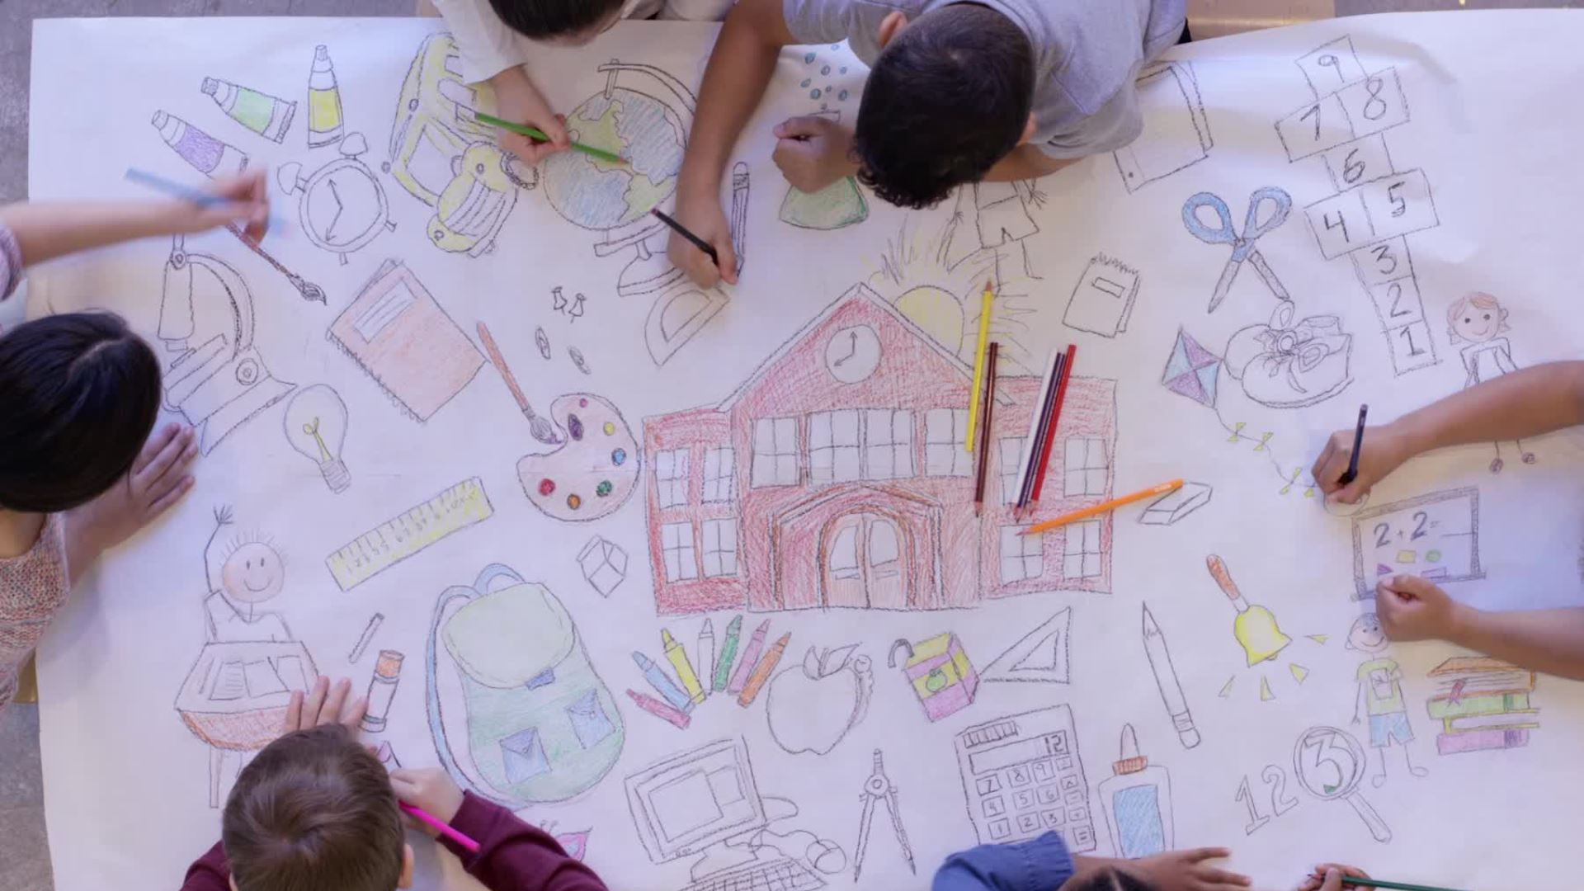
Multimedia Tools for Student Creativity
November 19, 2025

Slide 2

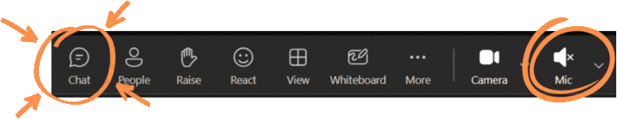

Welcome and Norms
Engage fully with the content, prompts, and each other
Use the Chat to ask questions, share ideas, or get support
Say hello in Chat now!
  What are you hoping to take away today?
Click the Raise hand if you'd like to come off mute
Use React during the meeting or tap-back emojis in chat
Keep your camera on if you're able, it's fun to see everyone!
Please mute your mic to reduce background noise

Slide 3
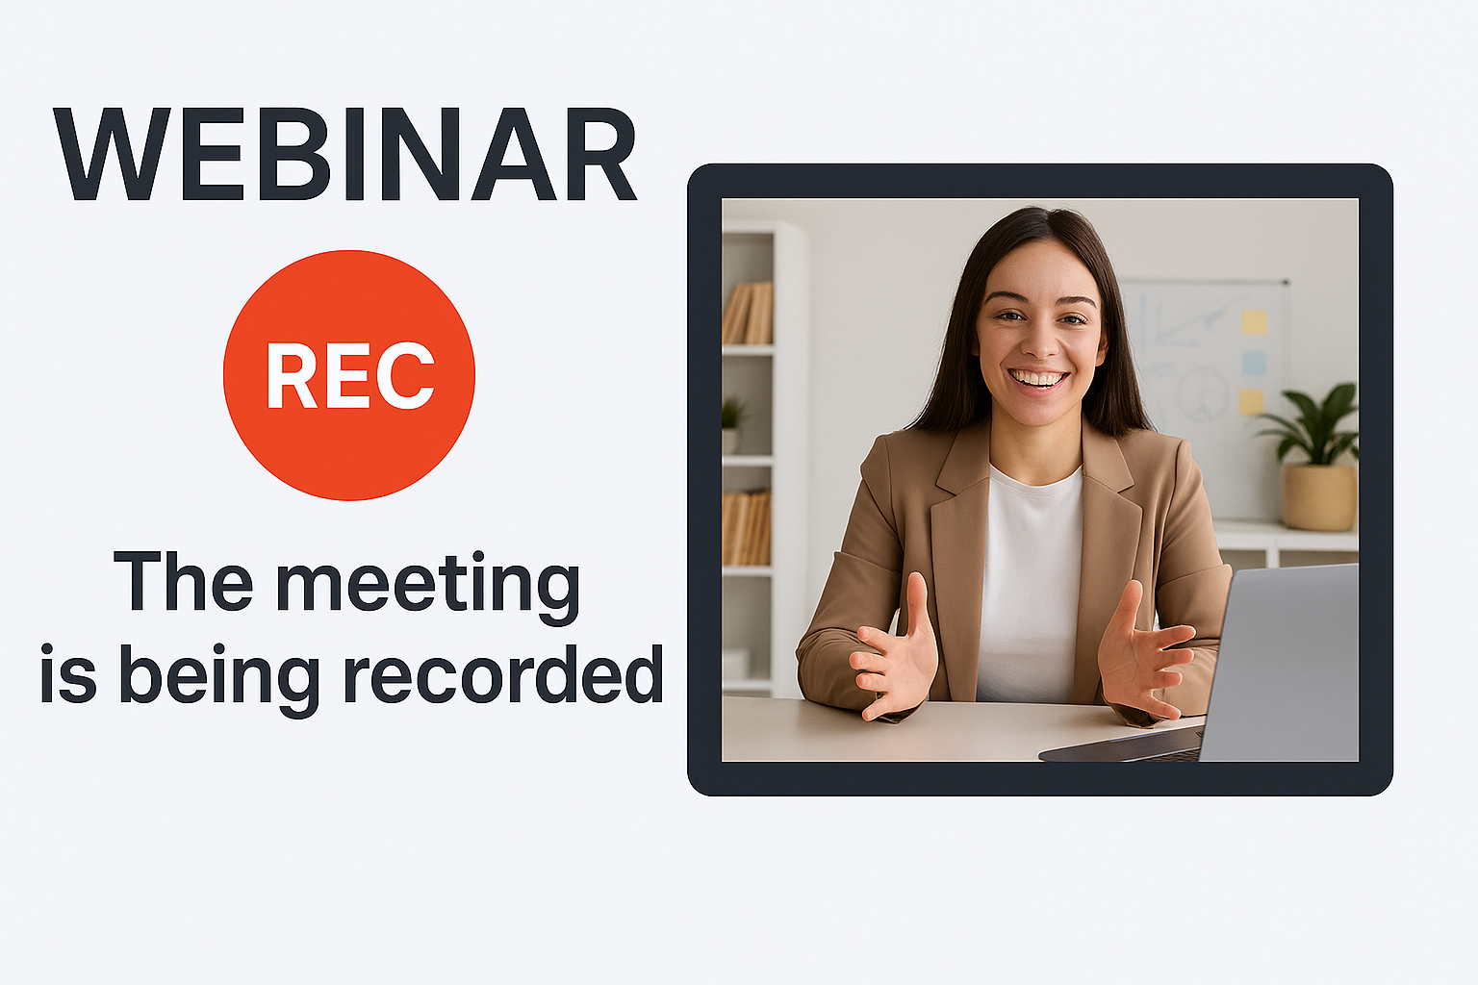
Session is being Recorded

Slide 4



Meet the Presenters
Matthew Schwartz - EdTech
Brian Dvorak - EdTech

Slide 5
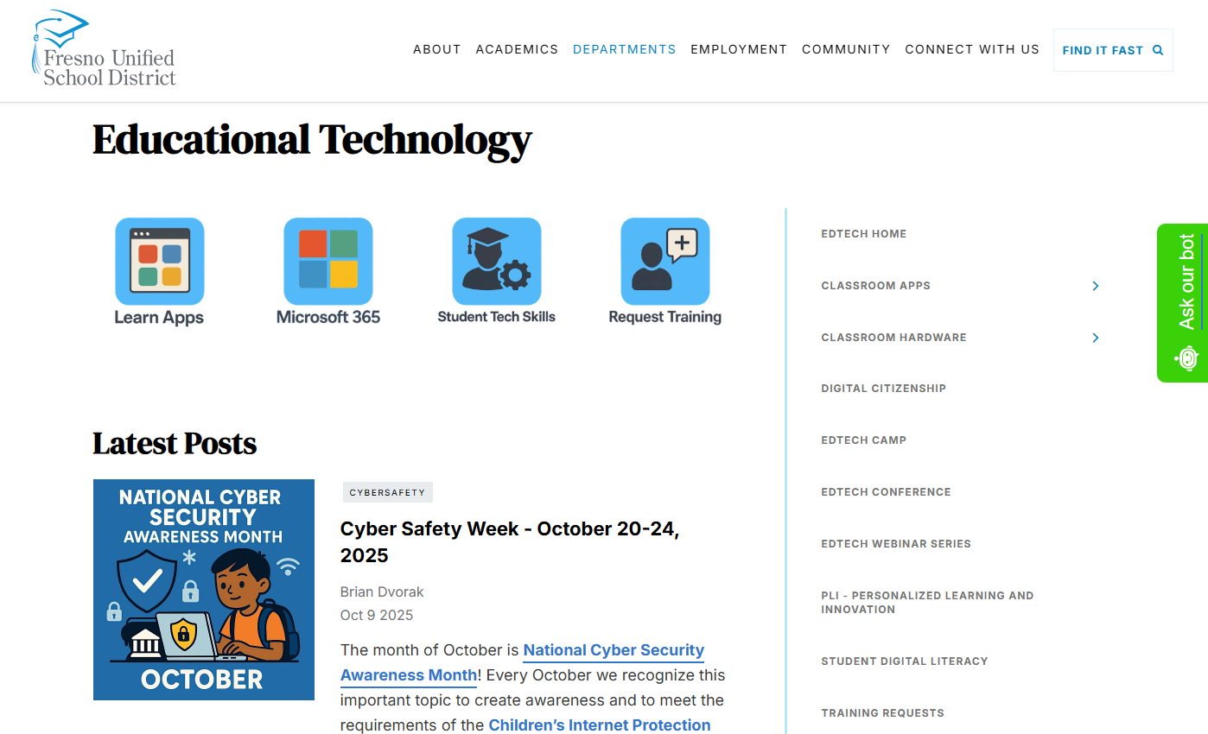
Fresno EdTech Website (go.fresnou.org/edtech)
Sign up for our Weekly Blog Posts
Try our new Chat Bot
Student Digital Literacy – Updated Tech Scope and Sequence
Reminder: EdTech Webinar Resources
Notes:
Educational Technology - Fresno Unified School District

Slide 6
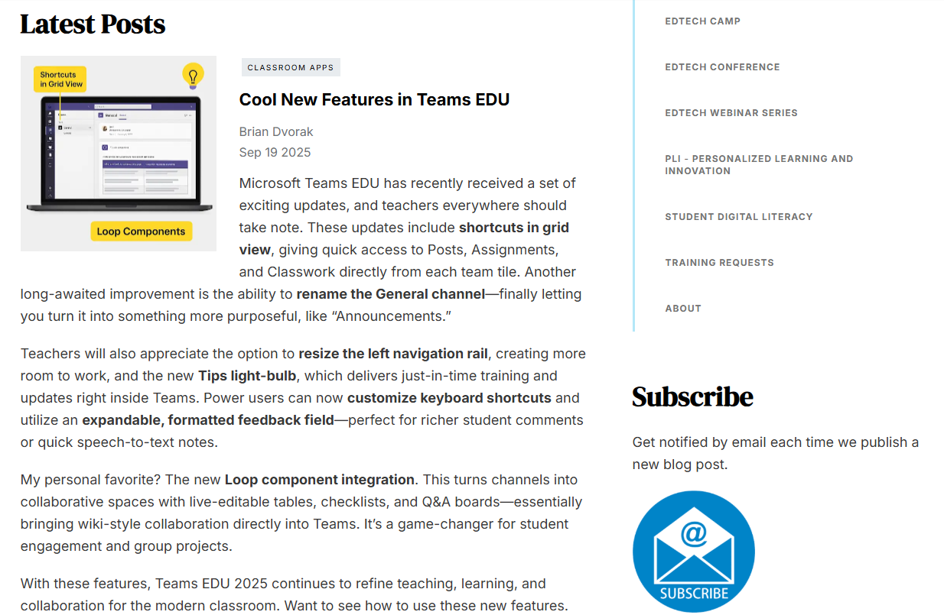
EdTech
Blog

Slide 7
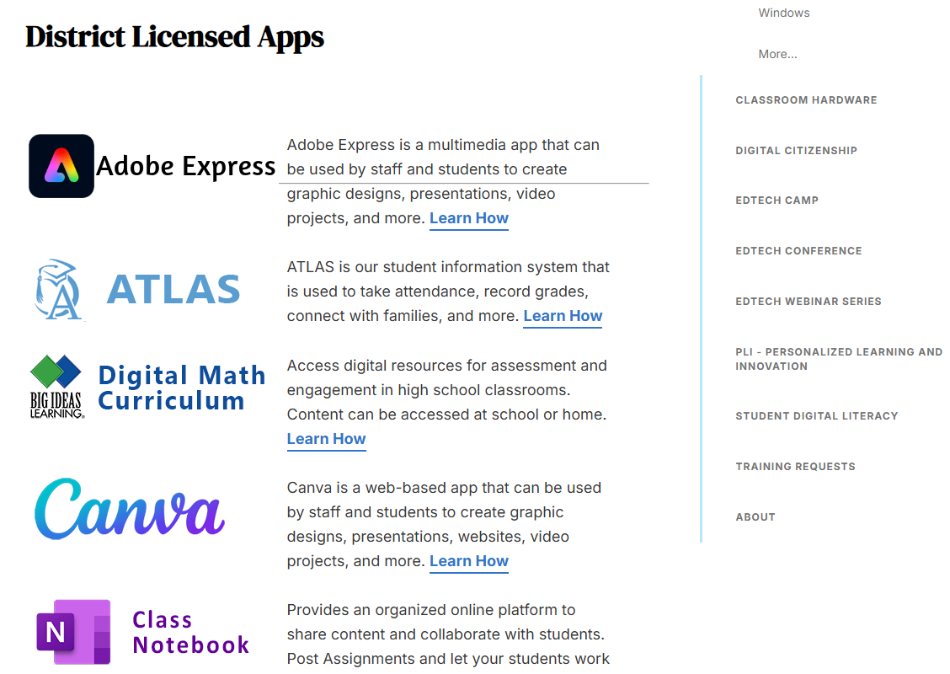
Learn Tech Tools
Canva
Learn Page

Slide 8
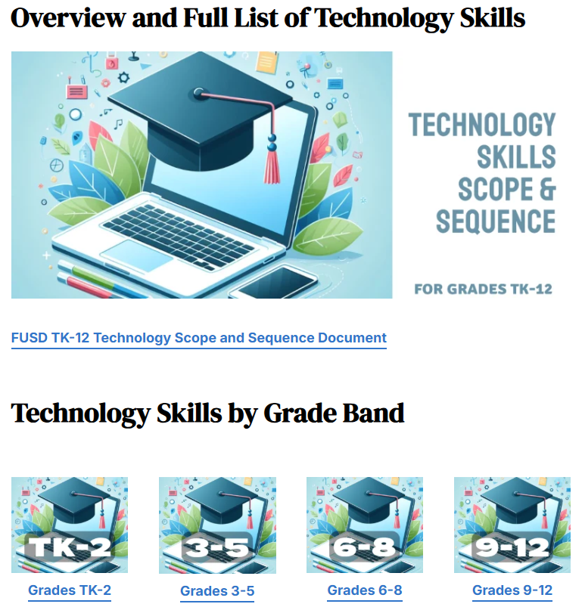
Student Digital Literacy

Slide 9
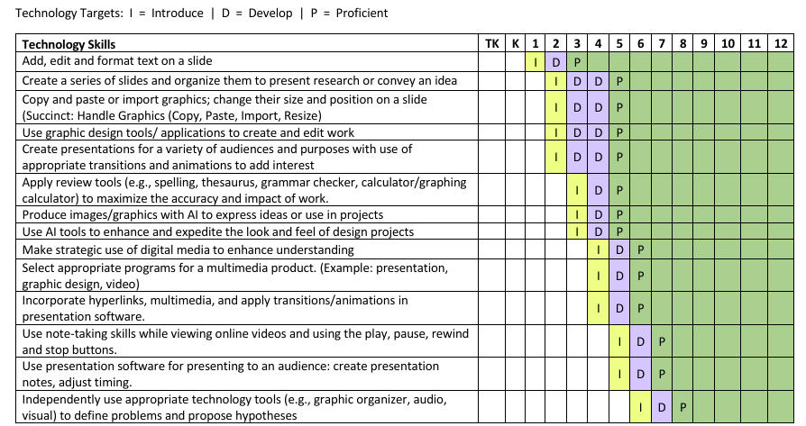
Digital Literacy Alignment
Use of multimedia tools provide opportunity for students to develop skills called out in our Technology Scope and Sequence, especially under Innovative Designer:

Slide 10
Grade Level Considerations
The examples we provide during this session are not a one-size-fits-all solution.
Please consider how you might adapt for your grade-level, subject area, and your students.

Slide 11

Learning Intentions
Learn
Learn how to use FUSD District Multimedia Tools (Clipchamp, Canva, Teams Video Response) to support student creativity and expression.
Gain
Gain confidence in assigning instructional activities that incorporate student use of multimedia tools.
Experience
Experience hands-on opportunities to create with Canva and Clipchamp, building teacher familiarity and skill.
Discover
Discover support resources (e.g., Help Chat in Canva, webinar materials) to continue learning and implementation beyond the session.

Slide 12
Agenda
Welcome, EdTech Resources & Learning Intentions
Microsoft Teams – Video Response Demo
Canva for Education
Clipchamp – Video Editing Tools
Q&A and Survey

Slide 13
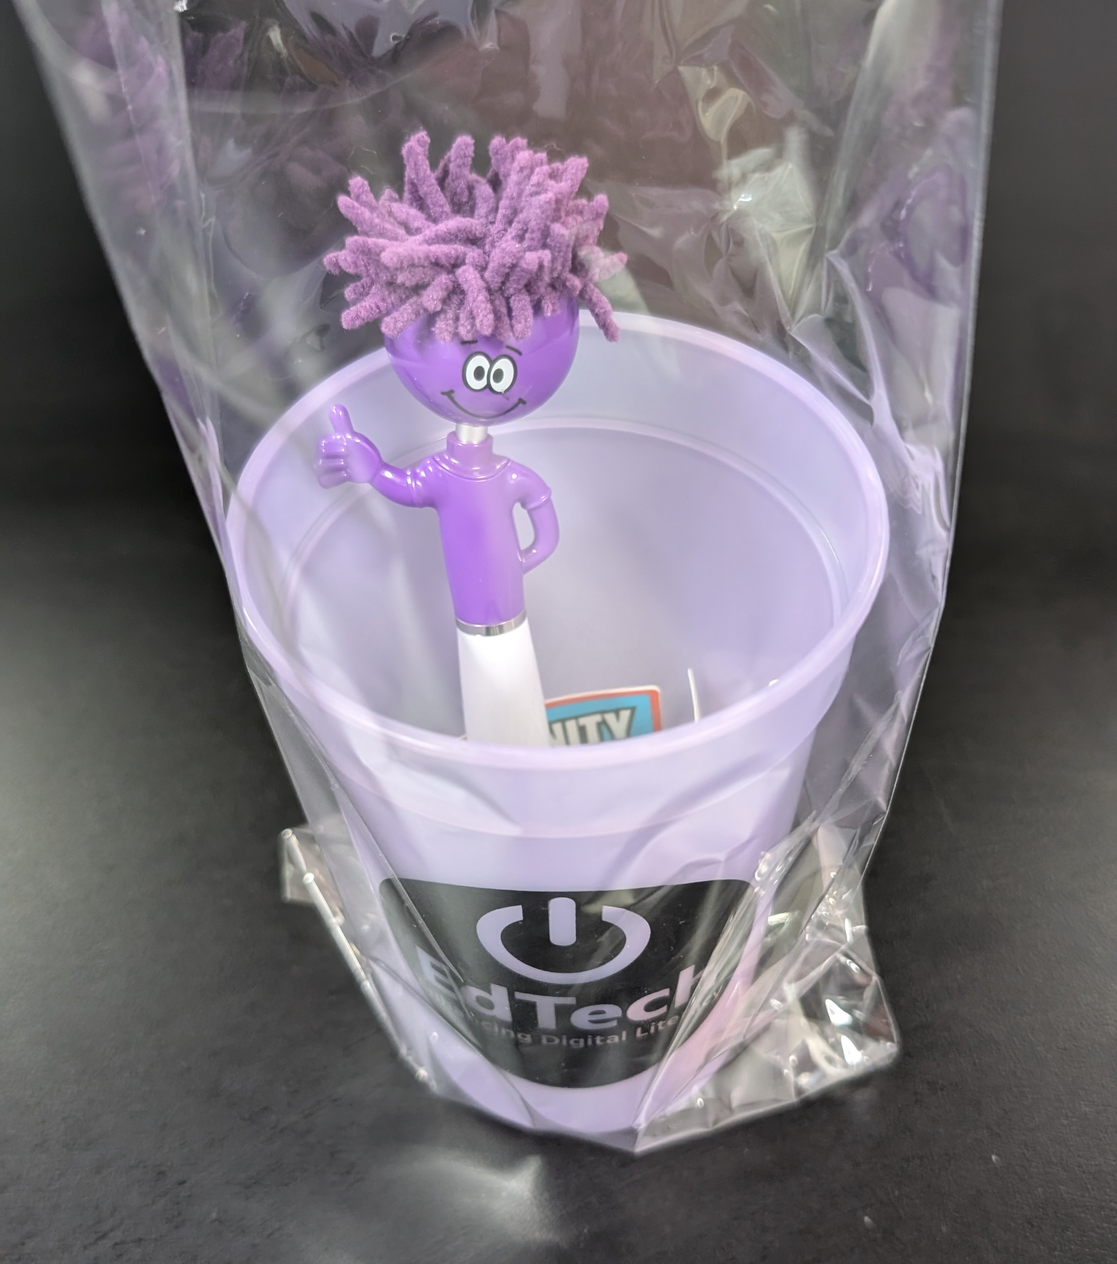

Don't miss the Raffle!

Slide 14
Class Teams Assignment – Video Response with Flip Video Recording
Teacher & Student Demonstration

Slide 15
Why use Video in Assignments?
Builds speaking and listening skills
Encourages student expression and reflection
Supports multimodal learning for all grade levels

Slide 16
Live Teacher & Student Demo
Teacher Demo
Create a Class Teams Assignment for Video Response from Students.
Use Flip Video Recording to add video to assignment instructions
Student Demo
Student responds to Assignment using Flip Video Recording
Review Completed Assignment in Teams Speed Grader

Slide 17
Student Assignment
Show and Tell – Video Response
Instructions:
  In this assignment, click + New.
  Choose Flip video recording from the list.
  Record a short video (1–2 minutes) sharing your plans during Thanksgiving Break.
  Click Attach to add your video.
  Submit your assignment when ready!
Tip: You can re-record before attaching if needed.

Slide 18
Video Assignment Ideas
Language practice (ELD, World Languages)
Science demos or experiments
Book talks or reflections
SEL check-ins
Project presentations

Slide 19
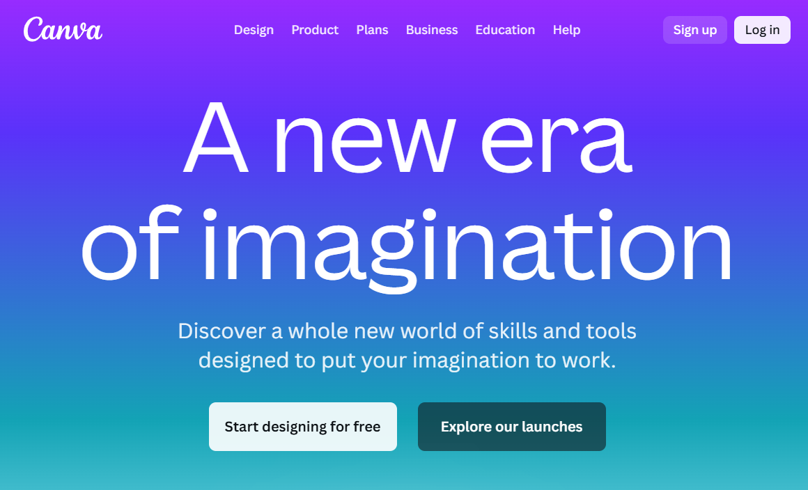
Let’s Explore Canva
http://canva.com

Slide 20
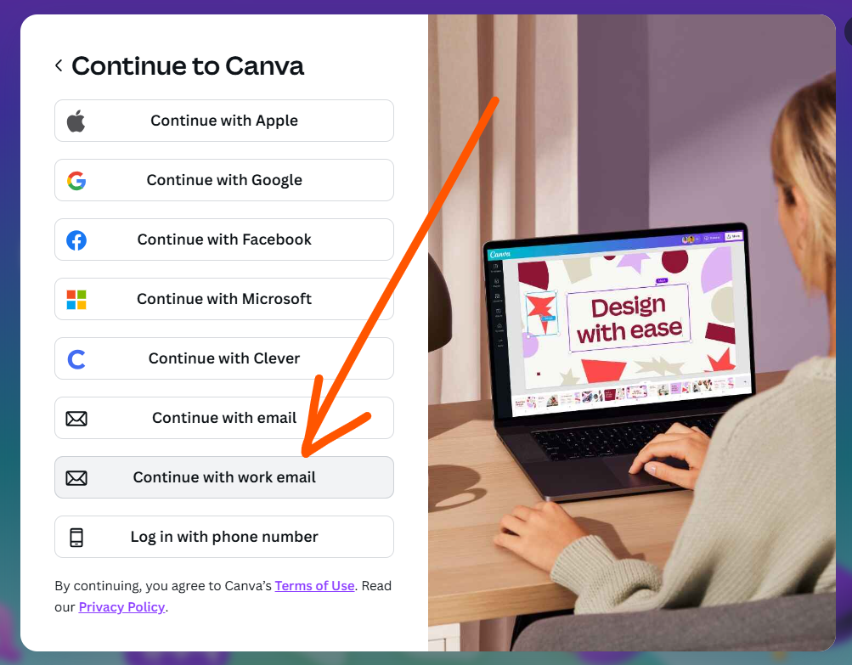
Sign in to Canva
Canva.com
  Use Work Email Address
Access Canva through Clever

Slide 21
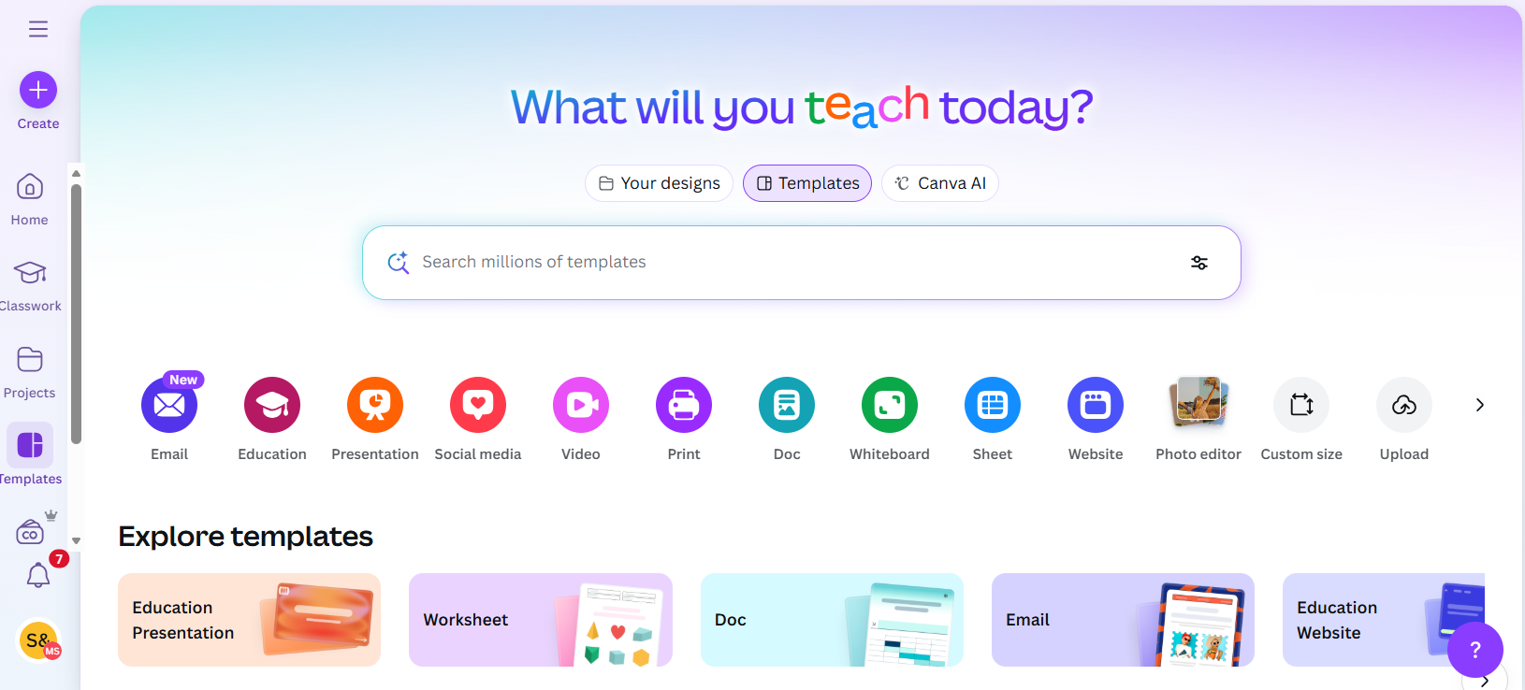
Navigating Canva
Home Screen
Edit Screen

Slide 22
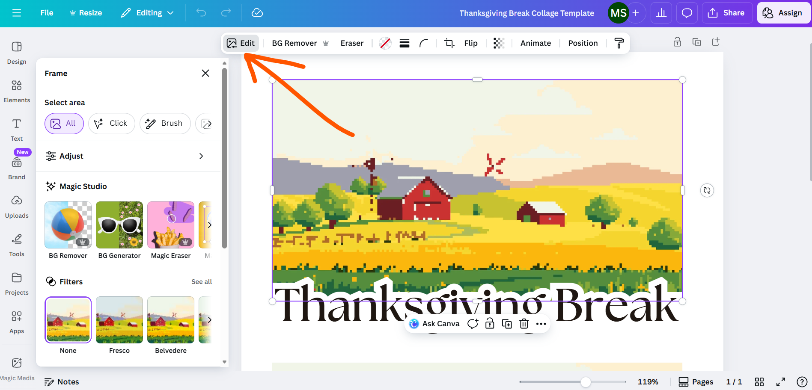
Navigating Canva
Home Screen
Edit Screen

Slide 23
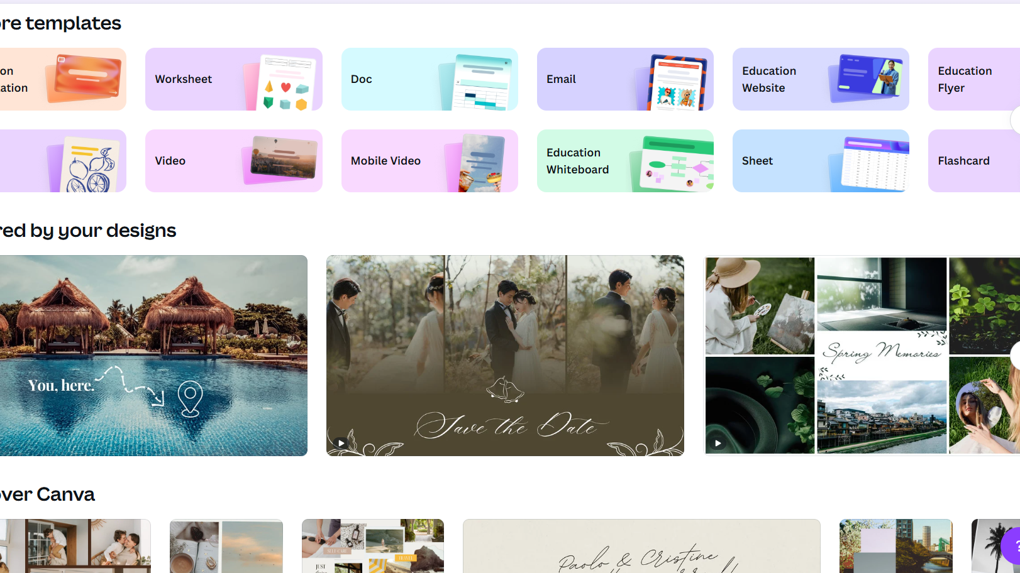
Using Templates to get Started

Slide 24
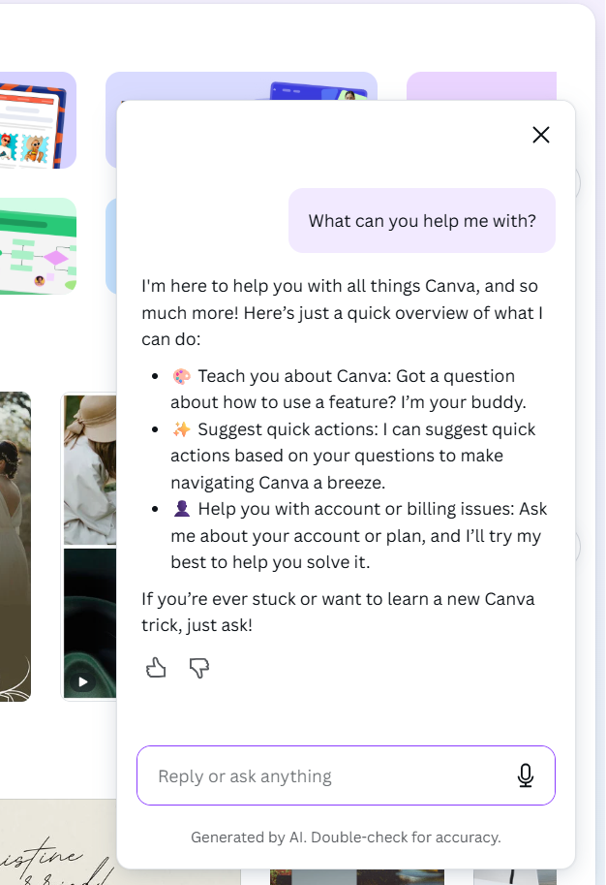
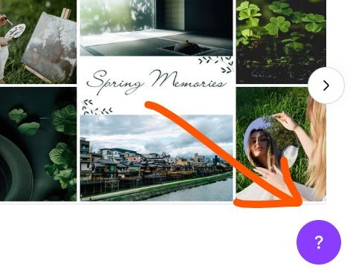
Getting Help

Slide 25
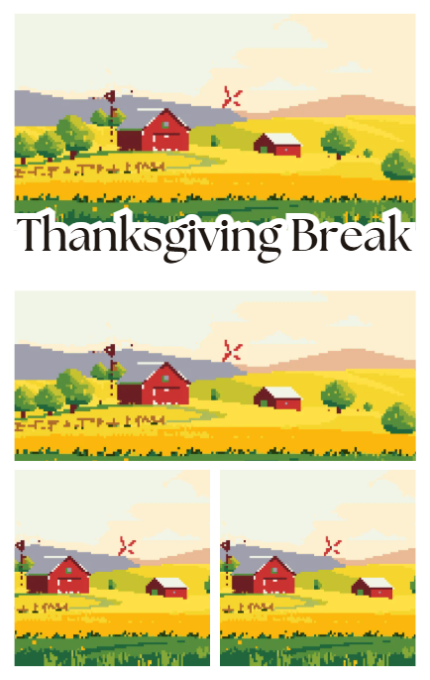
Let’s try a Canva Assignment
Create a visually appealing design using the provided Canva template themed around Thanksgiving Break. This activity will help you explore Canva’s creative tools and practice customizing templates for classroom or personal use.

Slide 26
Let’s try a Canva Assignment
Instructions
Open the Assigned Template
  Click the link or access the template in your Canva account.
Customize the Design
  Replace all default images in the template with new media from Canva’s Elements library.
  Update text using Canva’s Text options to make it relevant to Thanksgiving Break (e.g., greetings, fun facts, or event details).
Keep the Theme Consistent
  Use colors, fonts, and images that reflect the Thanksgiving season (fall colors, leaves, food, family themes).
Save and Submit
  When finished, click Share → Download (choose PNG or JPG).

Slide 27
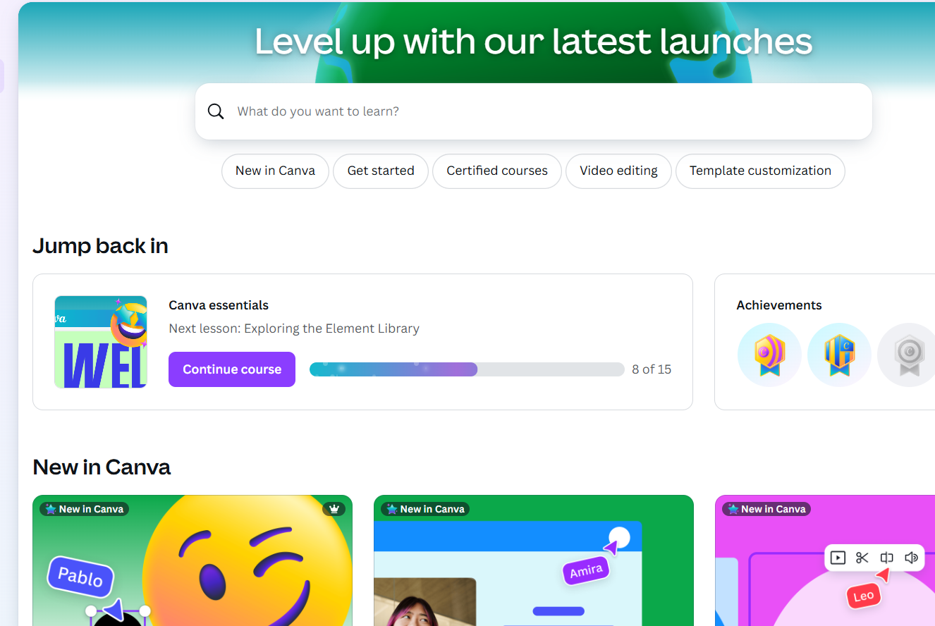
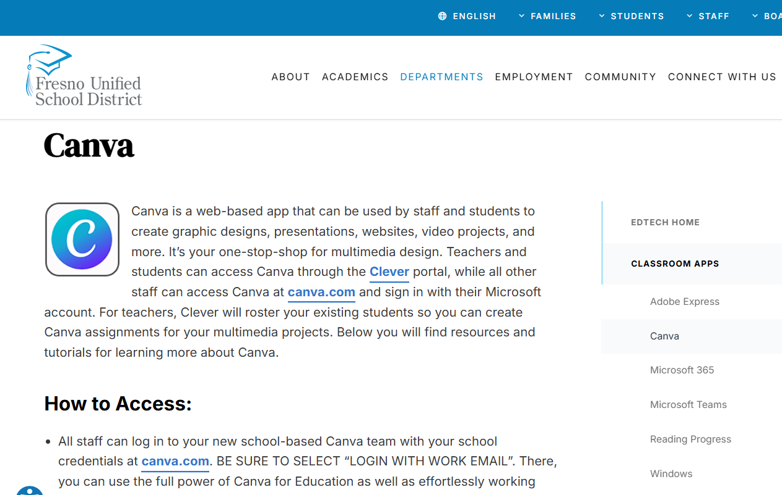
Canva Tutorials and EdTech Resources
Design School - Learn design with Canva - Canva - Fresno Unified School District

Slide 28

Clipchamp – Video Editor
Mix video clips, images, audio, and text callouts
Integrated into Microsoft 365
Easily pull existing content from OneDrive
Create screen recordings and webcam videos

Slide 29
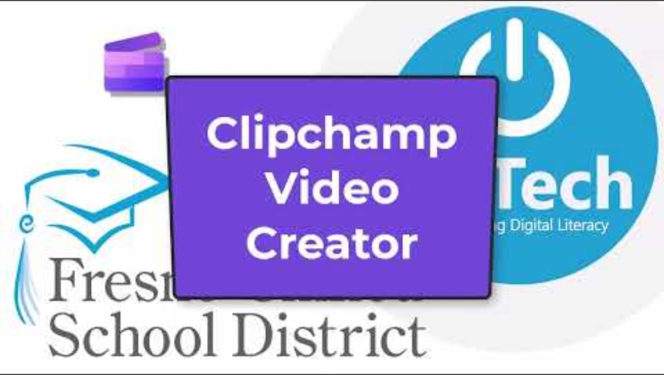
Clipchamp Tutorial

Slide 30

Hands-on exploration
Add Images
Add Text
Record Narration
Add Music
Add Screen Recording
Explore more

Slide 31
How might you work Clipchamp into a student task?

Slide 32

Questions
Raise your Virtual Hand or share your questions in the meeting chat.

Slide 33



Closing and Raffle
Notes:
https://forms.office.com/r/nV6RUFyJ4Q

Slide 34
Raffle Time!

Slide 35
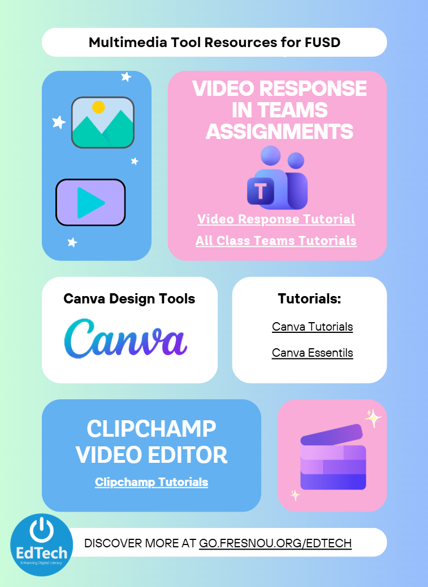
Multimedia Tool Resources
Click here for the interactive one-pager

