Slide 1

Building Scholars, Shaping Careers
David W. Carter P-TECH
Steering Committee Meeting #2
October 21, 2025

Slide 2


Welcome & Objective
03
Review Current Engagements
05
Agenda
Brainstorming Sessions
07
Categorize & Prioritize Ideas
09
Action Planning
10
Wrap-Up & Next Steps
12

Slide 3


Using Building Blocks
This activity will help us understand the basics of coding through simple, block-based programming. Using interactive games, students will learn how computers follow coded instructions while developing problem-solving, creativity, and critical-thinking skills. This lays a strong foundation for future learning in computer science.

Slide 4

Carter P-TECH
Business Pathway
Associates of Arts
Our Mission: Striving to cultivate an educational environment where every student thrives, every system endures, and every educator is equipped to excel.
Our Vision: To achieve student academic excellence in an ever-evolving global society, ensure long-term system success, foster positive relationships within the community and beyond, and service as a hub for ongoing enriching educational experiences.
Our Motto: Embrace Pride, Foster Respect, Uphold Responsibility
Criminal Justice Pathwasy
Associates of Arts
Information Technology Pathway
Associates of Applied Sciences

Slide 5

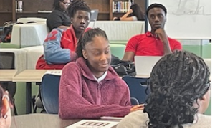
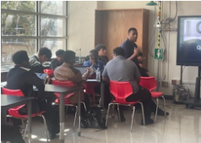
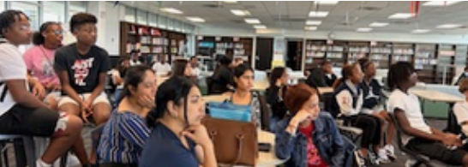
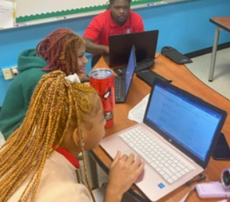
P-TECH Highlights
Call Me MiSTER
Tailgate & TeamUP
Parent Meetings
Time Management
FASFA Camp!!!
Business students adding an additional skill to the resume.
Class of 2026 completed at 100%
Male mentorship program where our young men become men
Giving expectations as well as having family, food, and fun.

Slide 6

Action Plan
Carter P-TECH
  Apple
  Best Buy
  Dell
  District
  Google
  Microsoft
Industry Partners
SMART: Specific, Measurable, Achievable, Relevant, and Time-bound

Slide 7

Brainstorming Session
Identify solutions and strategies to help early college students succeed in online IT courses by strengthening technical support, engagement, and skill development.

Slide 8
Pathways to Success
for IT Pathway
What could be a short-term and long-term experience P-TECH can develop?
Short Term Experiences
Long Term Experiences
Quick, low-barrier activities that build confidence and spark interest.
Idea: IT Student Help Desk
Extended projects where students apply and deepen their skills.
Idea: The Clubhouse Network

Slide 9
Categorize & Prioritize Ideas
IT Student Help Desk Framework
Objective: Provide students with hands-on IT experience while supporting faculty, staff, and peers in troubleshooting and managing technology.
Define the Program Structure
Assign Roles and Responsibilities
Establish Workflow
Training & Development
Evaluation & Improvement
Recognition & Advancement

Slide 10
Categorize & Prioritize Ideas
IT Student Help Desk
Objective: Provide students with hands-on IT experience while supporting faculty, staff, and peers in troubleshooting and managing technology.
Step 2
Assign Roles & Responsibilities
Who will oversee the program? Who will provide the technical guidance? Who will handle the request?
Step 3
Establish Workflow
What is the request system? How will assignments be assigned? What is the resolution process? How will the students document? What is the follow-up?
Step 1
Defining the Program Structure
What are the goals ? What could the help desk cover? Who are the participates?

Slide 11
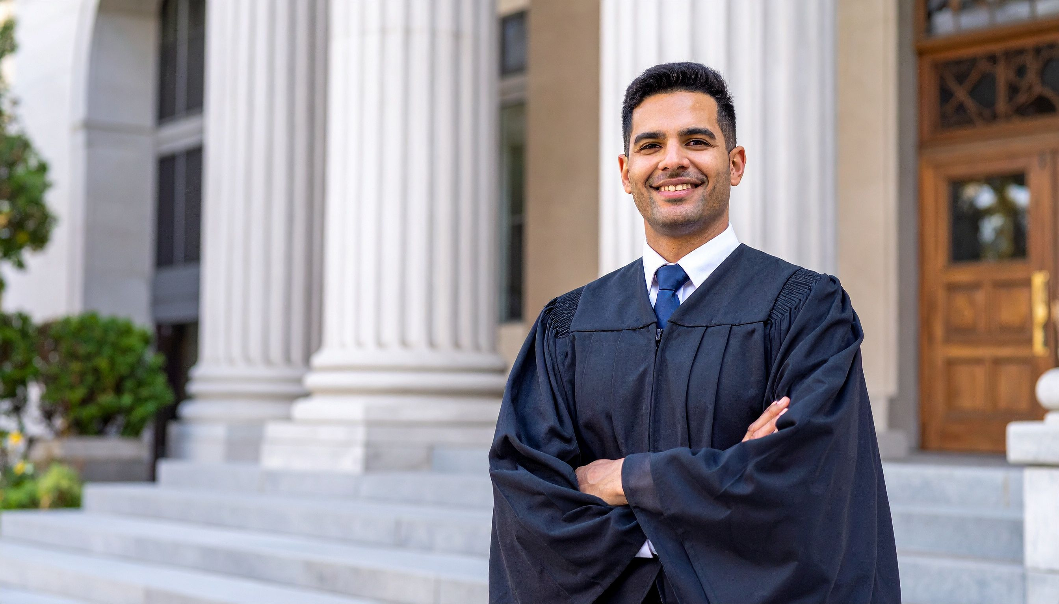
Additional Needs
Internship Opportunities
  Shannon Green: sgreen1@dallasisd.org
  Project Manager III
  Dallas ISD Internship Program
Workplace Challenges
Resume Workshops
  Proposed dates: 11/21 or 12/12
Mock Interviews
  1/30/26 & 2/6/26

Slide 12
Wrap Up & Next Steps
Organize the notes and expand with details for step 1 to step 3
  Define the Program Structure
  Assign Roles and Responsibilities
  Establish Workflow
Prepare to brainstorm step 4 to step 6.
  Training & Development
  Evaluation & Improvement
  Recognition & Advancement
SMART: Specific, Measurable, Achievable, Relevant, and Time-bound

