Slide 1



Partnership with the Ringgold School District

Slide 2

AIU Mission & Vision
Our Mission
We are an educational community that advocates and advances equitable opportunities for every learner.
Our Vision
Through equitable access, all learners
achieve their full potential.

Slide 3

Waterfront Learning
Waterfront Learning is an online learning service offered by the Allegheny Intermediate Unit. The program has developed a menu of diverse options for students and schools. We are excited to welcome the Ringgold School District to our program!

Slide 4
Imagine Learning
Flexible online curriculum that meets the needs of middle & high school students.
Courses are built using an instructional model grounded in research and aligned to state standards.
Rigorous assignments, performance tasks and assessments.

Slide 5

Engaging Courses and Curriculum for grades 6-12
Videos
Direct Instruction
Interactive Tasks & Assignments
Formative & Summative Assessments
Testing for Mastery
Interactive Learning Tools
Model Strategic Thinking
Make Real-World Connections
Reading & Writing
Explore & Create
Practice, Predict & More
Develop Analytical & Critical Thinking Skills
Providing Immediate Direct, Actionable Feedback
Text to Speech
Text Translation
Guided Notes
eNotes
Students Can Monitor Progress
Teachers Use Data to Provide Additional Support

Slide 6
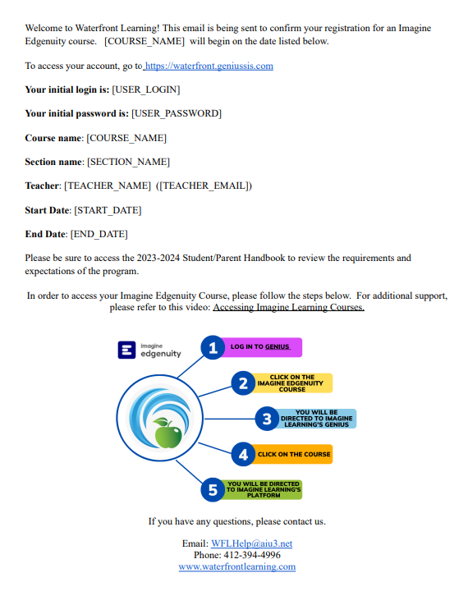
Logging into your
Imagine Learning Courses
Step 1: You will receive your course registration email.
Step 2: Using your username and password, you will click on the link and login to Genius by going to:
www.waterfrontlearning.com

Slide 7
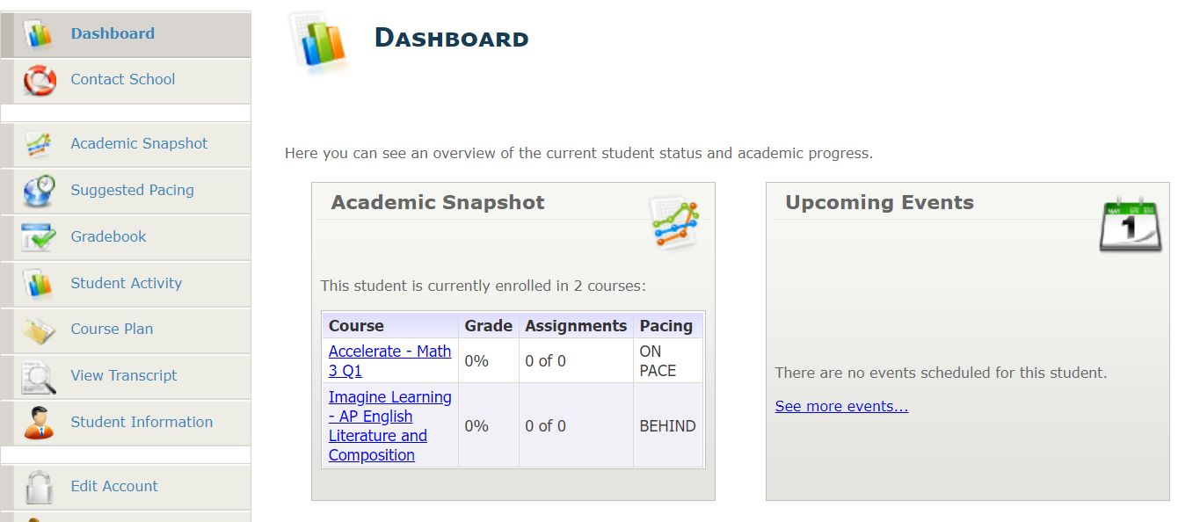
Step 3: On your dashboard, click on the course. You will be directed to the platform. Click on the course in Imagine Learning.

Slide 8
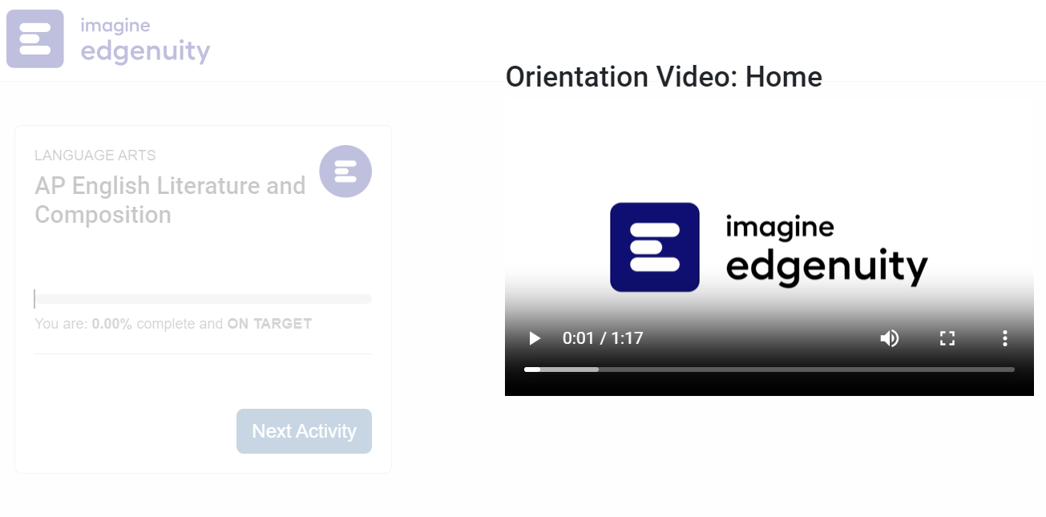
Step 4: Once you have accessed your course, you will be prompted to watch a brief orientation video.
You must review the orientation video before moving onto the next activity.
Imagine Learning also has a
variety of helpful videos on
their website to reference:
https://help.imagineedgenuity.com/hc/en-us/articles/360043037074-Video-Library-

Slide 9
Imagine Learning Grades
There are 3 types of grades you will see in Imagine Learning:
Overall
Actual
Relative
The grade of only what has been completed by the student to this point.
This grade factors in 0s for work that should have been completed to this point. This is the grade you see in Genius.
This grade factors in 0s for any work that has not been completed for the entire course.

Slide 10
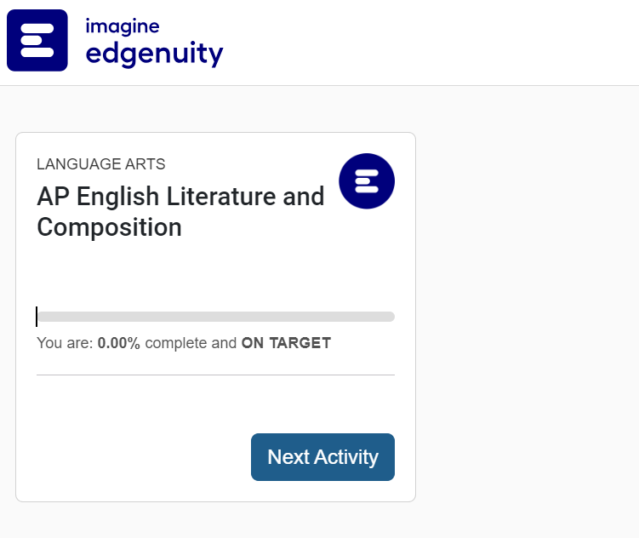
Imagine Learning Dashboard

Slide 11
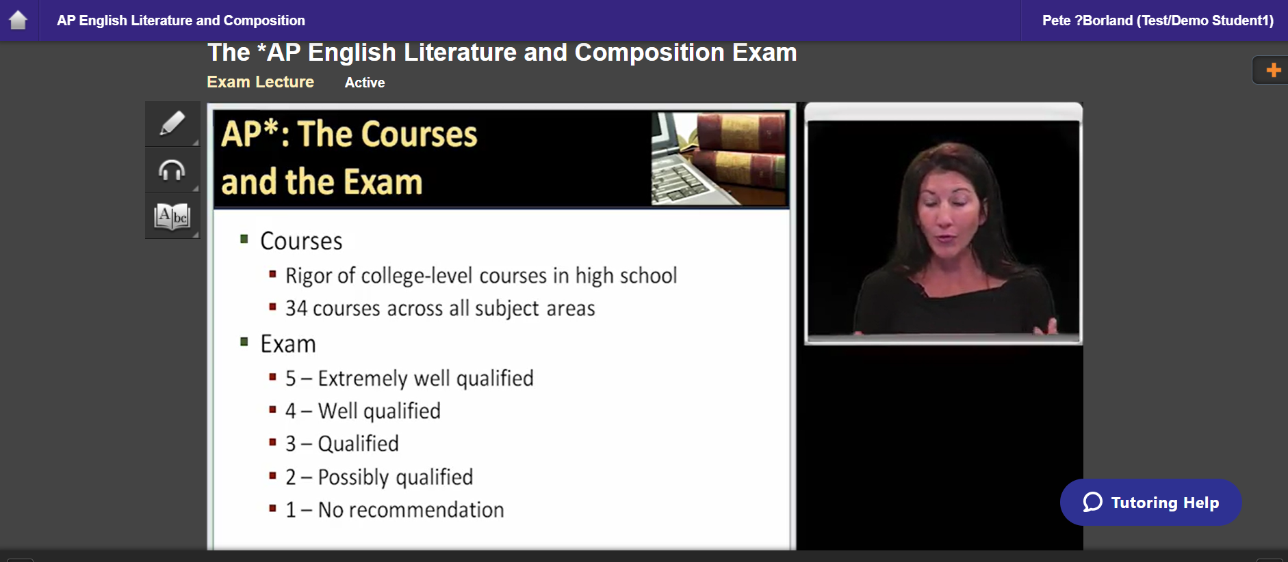
Imagine Learning Dashboard

Slide 12
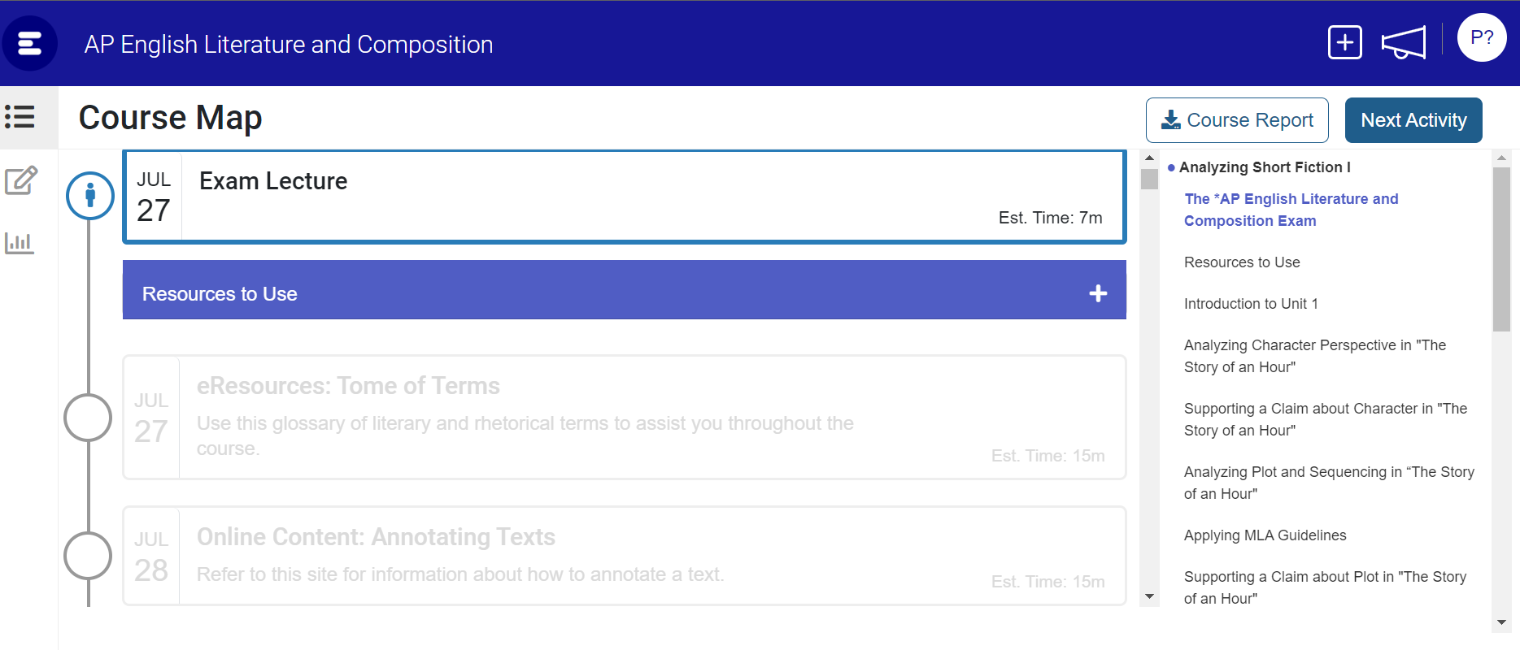
Support

Slide 13
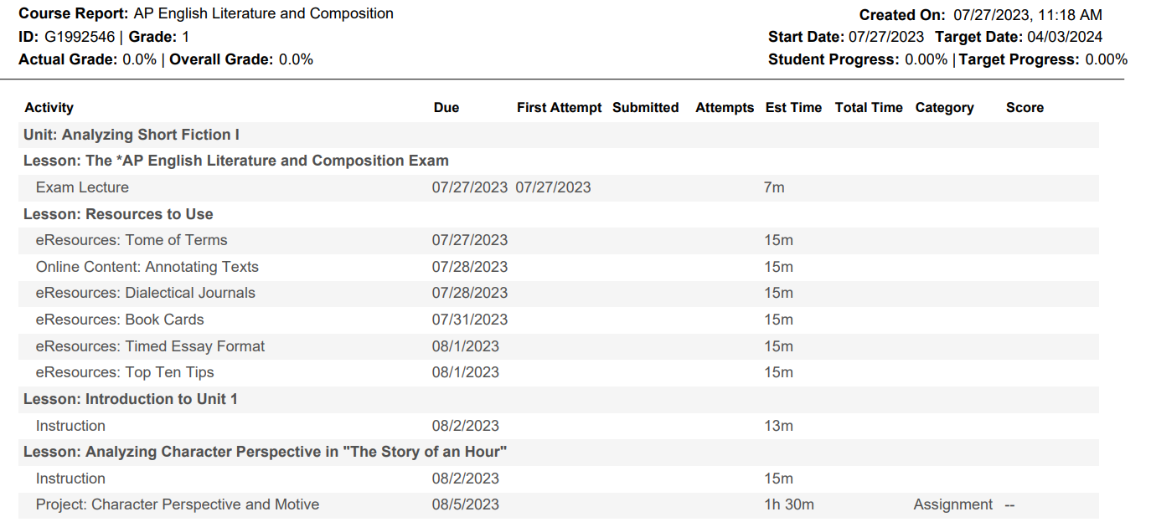
Course Report

Slide 14
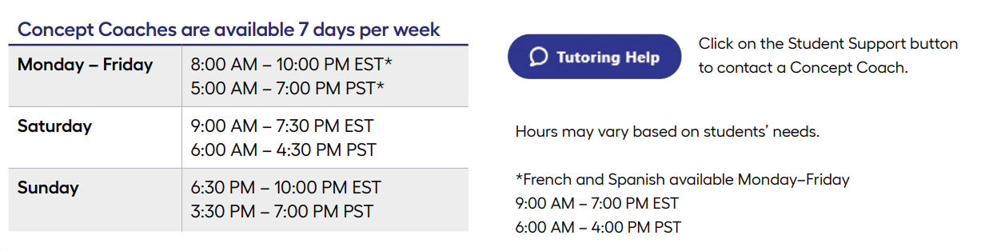
Live Help Feature
Concept coaches for core subject areas available for live support 7 days a week through online chat and interactive whiteboards
  Available for Language Arts, Math, Science, Social Studies, 6-12 French and Spanish,

Slide 15
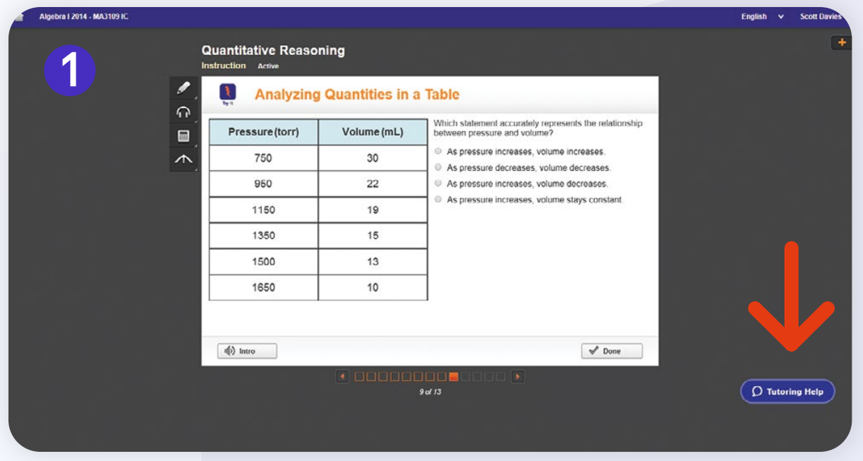
Using the Live Help Feature

Slide 16
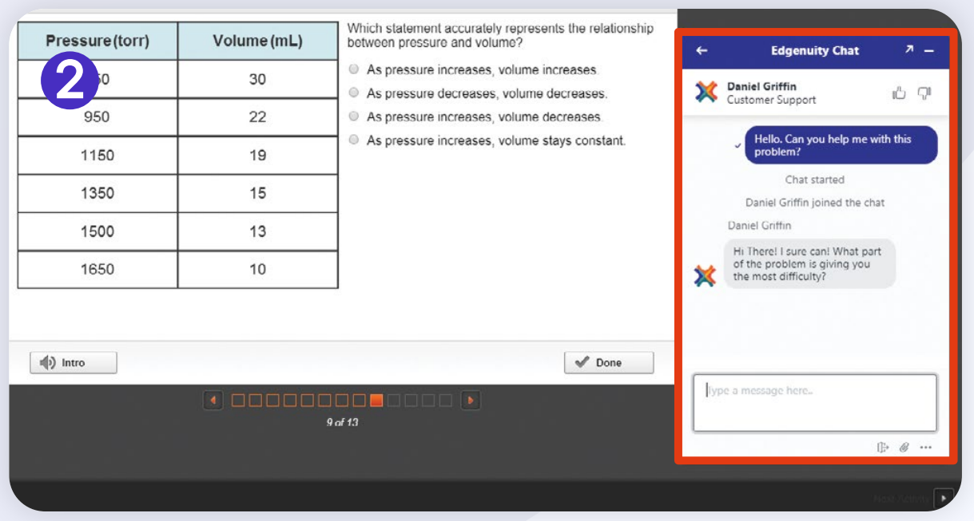
Using the Live Help Feature

Slide 17

Teacher Collaboration
Students can reach their teachers by email or phone
Easily schedule a virtual meeting through the “Book A Meeting” link

Slide 18
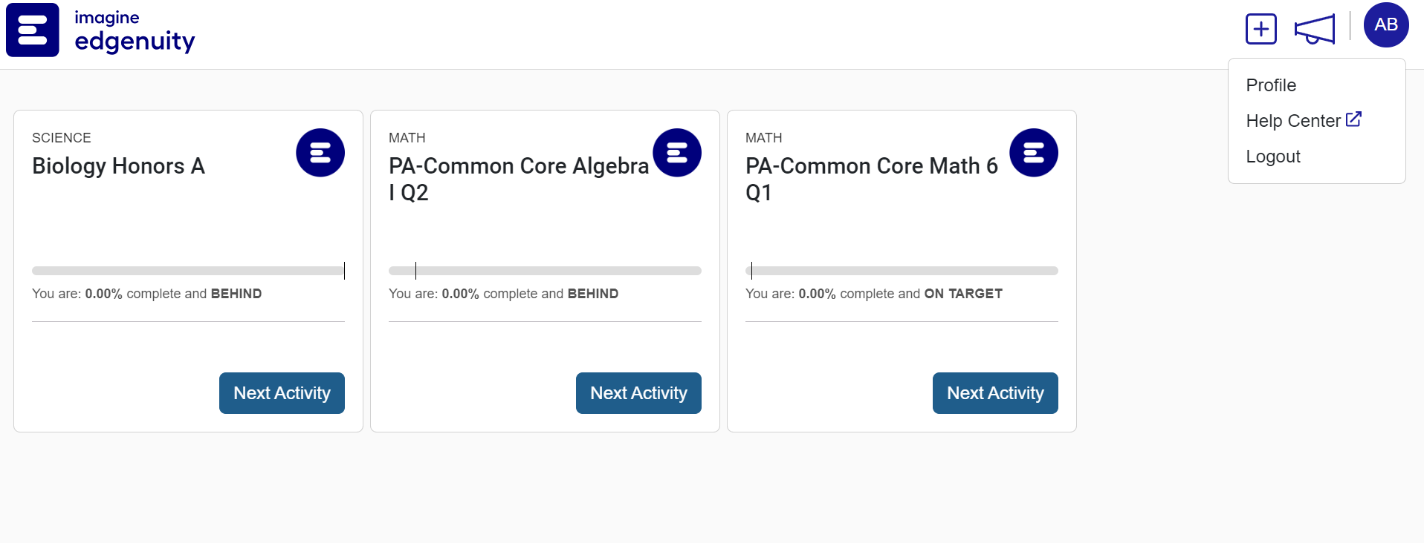
Imagine Learning Help Center

Slide 19
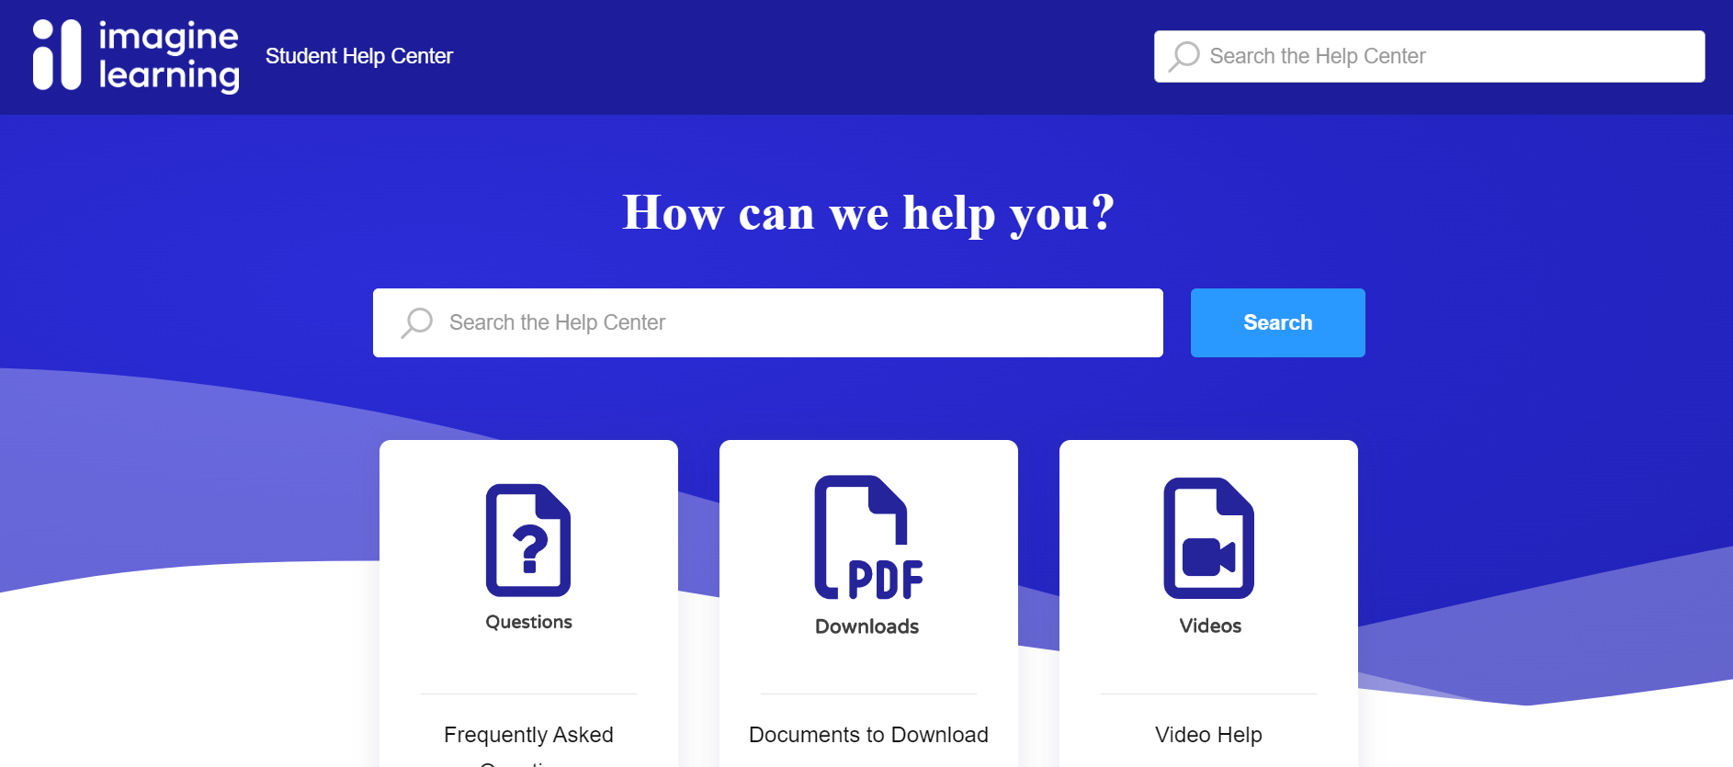
Imagine Learning Help Center

Slide 20
Finding Success this School Year
Students are expected to work 1 hour per course, per day to be successful
Make a plan! Pick a time each week to sit down and plan out when you will work. Make sure your plan is visible and check off your work as you complete it.
Learning coaches – Follow-up on your student regularly using your guardian account to ensure they are keeping on track.
Engage - Reach out to your teachers regularly for support and feedback. Schedule a meeting as needed to review any areas you might need help with.

Slide 21

Waterfront Learning Team
Jill Manczka
Program Director
jill.manczka@aiu3.net
Lori Keener
Supervisor of Special Populations
& Student Services
lori.keener@aiu3.net
Sarah Johnston
Coordinator of Instructional Learning
& Technology
sarah.johnston@aiu3.net
Erin Haburjak
Virtual Learning Outreach Specialist
erin.haburjack@aiu3.net
Craig Sinning
WFL Systems Admin
craig.sinning@aiu3.net
Debbie Sevcik
Data Enrollment Specialist
debra.sevcik@aiu3.net
Marsha Shively
Administrative Support
marsha.shively@aiu3.net
https://filecabinet1.eschoolview.com/60D259C2-268B-4DFA-B6A7-33BF805C2A6B/df517260-2894-4daf-b4ce-df183ede6f6b.jpg

