Slide 1
Pattonville
District Wellness Committee
November 19, 2025

Slide 2
Agenda
Welcome
  Introductions
  Purpose of Committee
  Public Comment

Slide 3
High School PE/Health Update -
Anna Braswell, PE/Health Department Leader
Health Classes completed CPR and Stop the Bleed Training - both led by the Pattonville Fire Department
Outdoor Adventure Class implemented camping survival skills on their overnight camping trip
Power Walking classes have discussed snacks to help fuel their bodies. These classes are also working on increasing their cardio endurance through ongoing 1 and 2 mile timed walks.
PE classes on fridays have been offered a variety of movement activities including tennis, basketball, flag football, walking, fitness center, hockey, corn hole, and soon Pickleball.

Slide 4
Middle School PE/Health Update -
Travis Williams, Middle School PE/Health Lead
We have been starting to conduct our fitness testing. We have run the timed mile and will be starting our other fitness tests this week.
We have continued to have our health lessons.
6th grade–puberty
7th grade—DARE
8th grade—Nutrition

Slide 5
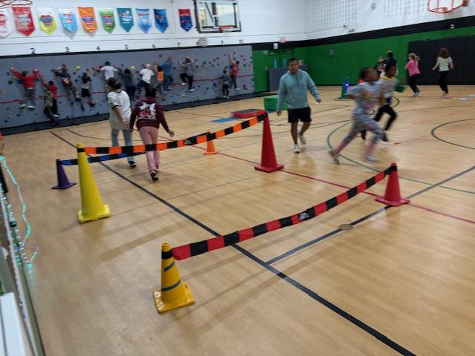
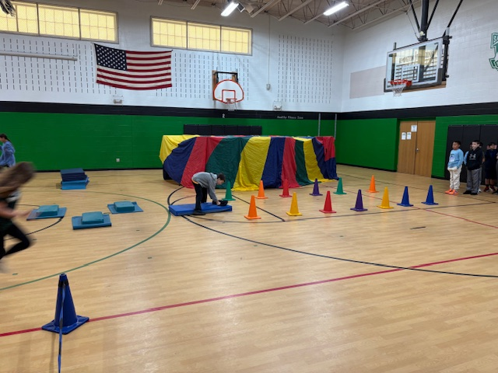
Elementary PE/Health Update -
Denise Grimshaw, Elementary PE/Health Lead
K-5 schools have mostly finished fitness testing for the Fall
Some schools had intermediate grades participate in running events like the Turkey Trot at Rose Acres and Parkwood, Dragon Run at Drummond
At Remington, staff members have been encouraged to participate in Staff Fitness Testing and had a Fall obstacle courses in the gym for PE classes. Grades 2-8 were introduced to Lacrosse through Lou Fusz Lacrosse today! It was so fun!
Bridgeway had the Cardinals visit to encourage good sportsmanship, hard work and an active lifestyle and they had a cup stacking tournament
Parkwood also had the Street Blues visit to introduce the sport of hockey

Slide 6
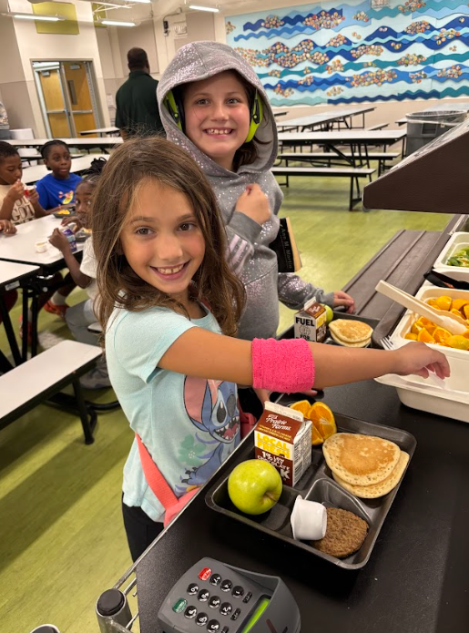
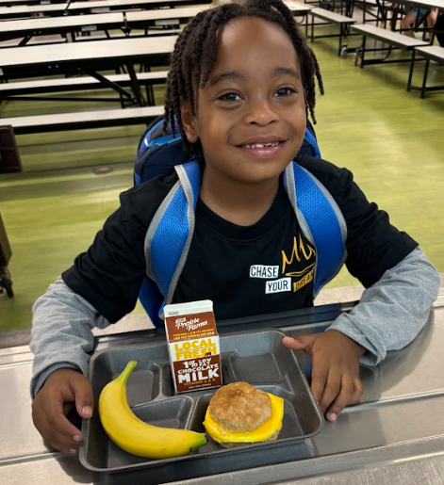
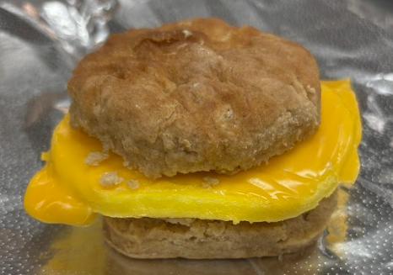
Food Service update
Audrey Westrich, Director of Food Service
Breakfast
NEW Breakfast Items SY25-26
Breakfast Sandwiches
Yogurt Cups
Smoothies

Slide 7
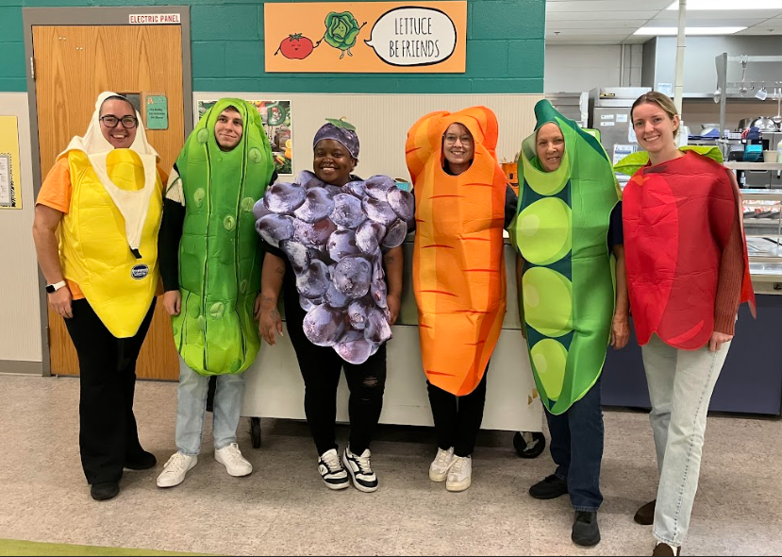
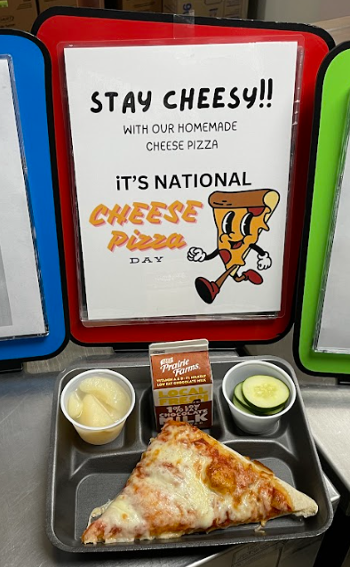
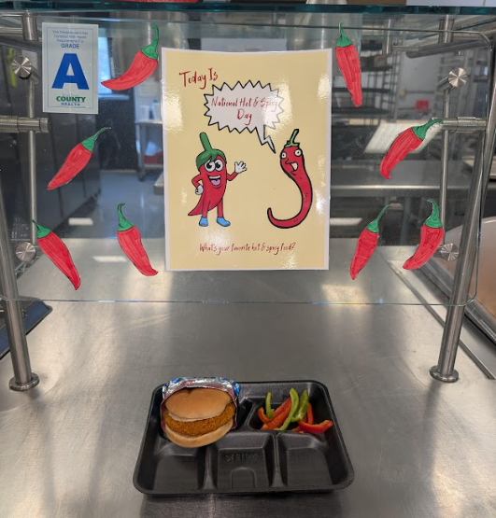
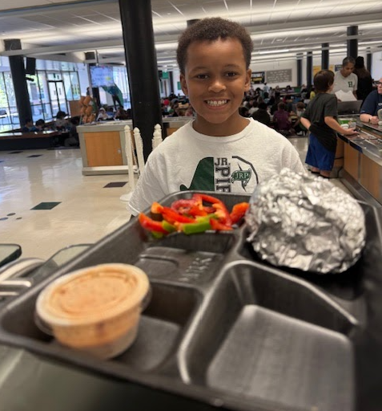
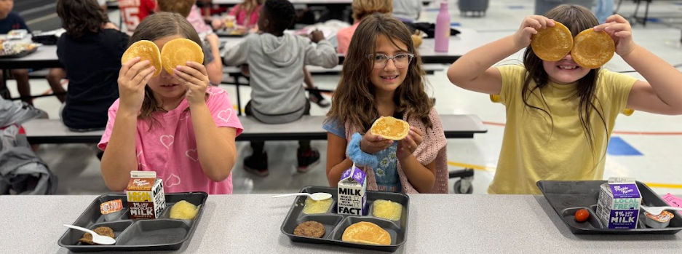
Food Service update
Audrey Westrich, Director of Food Service
Fun Days
Celebrate 2 - National Food Days a Month

Slide 8
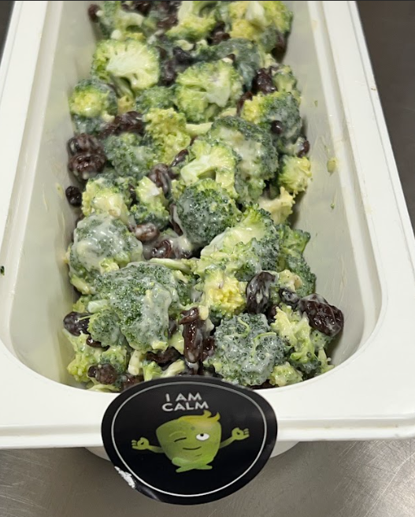
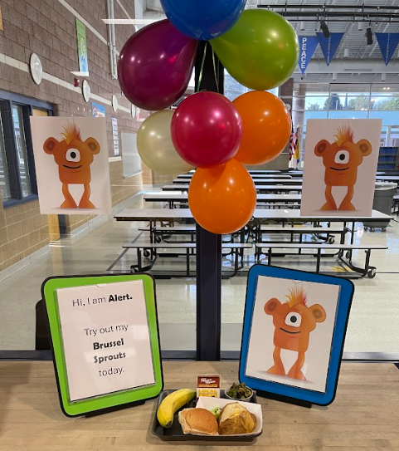
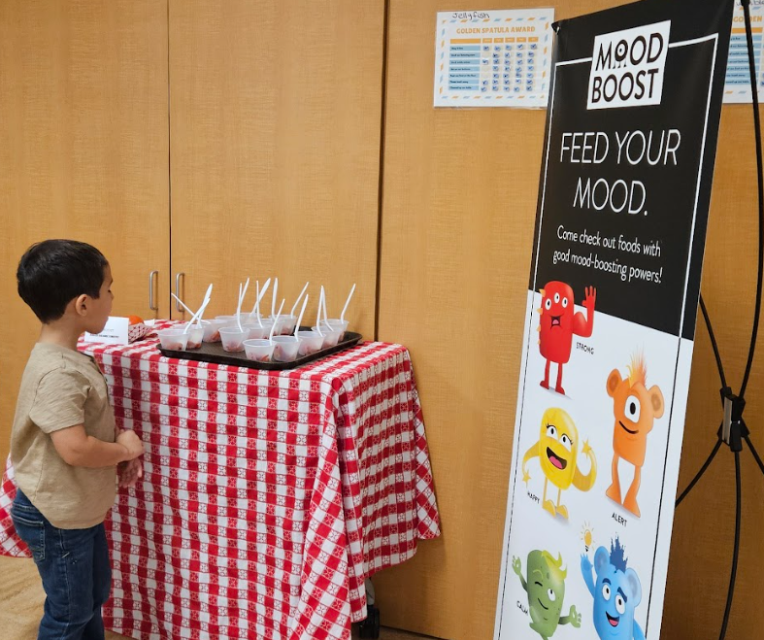
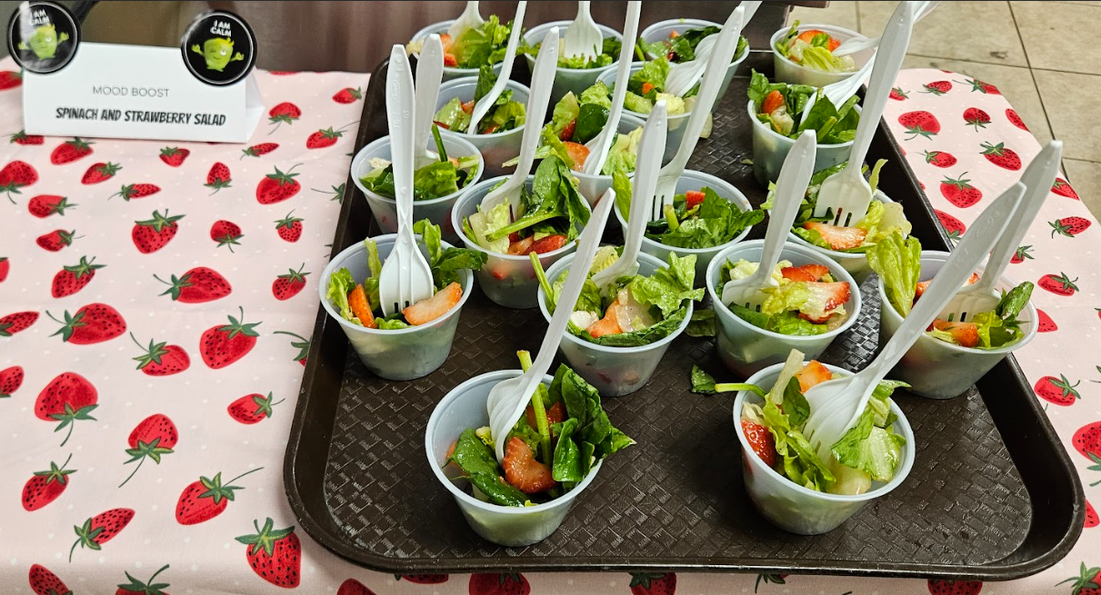
Food Service update
Audrey Westrich, Director of Food Service
Mood Boost
Every Thursday - Sample a NEW Fruit or Vegetable recipe!

Slide 9
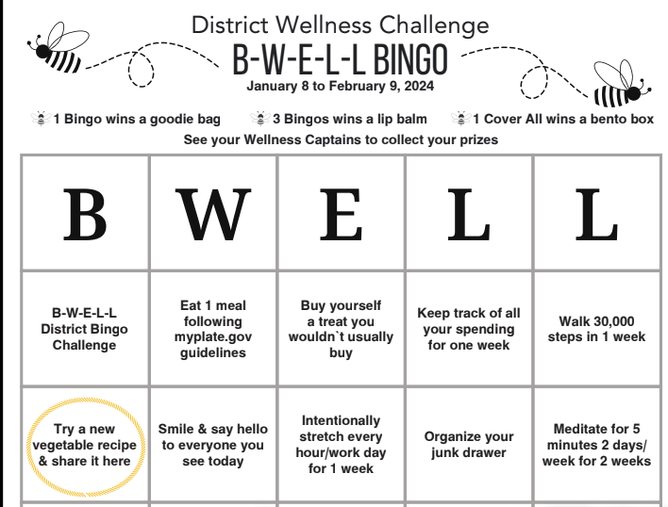

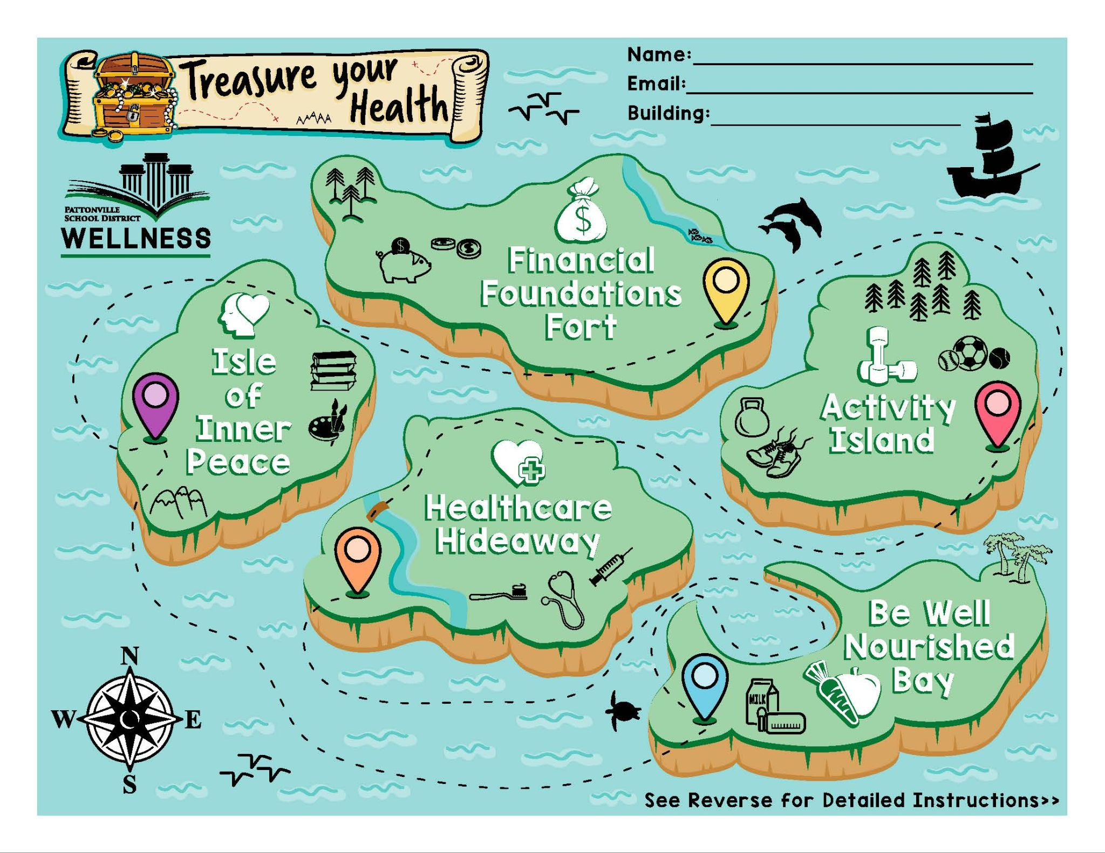
District Staff Wellness Initiatives
District Wellness Initiative
January 2024 - Be Well Bingo
  150 employees participated - 15% of staff
January 2025 - Sail into Wellness
  245 employees participated - 24% of staff
January 2026 - Soundtrack to Wellness
District Walktober Challenge
October 2024 - Spook Walktober
  226 Staff participated
  155 completed 120,000 step goal
October 2025 - Show Me Your Steps
  224 Staff currently participating
  189 completed 140,000+ steps
Case Study 02
Presentations are tools that can be used as lectures.
Case Study 01
Presentations are tools that can be used as lectures.

Slide 10


Staff Wellness update
JoAnn Greenwell, Director of Community and Staff Engagement

Slide 11
K-8 Athletics
JoAnn Greenwell, Director of Community and Staff Engagement
Collaboration with high school athletics
Middle School teams to High School games
Host Middle School Instructional League (MSIL) games and meets with the high school teams
  Track and Field at Heights
  Volleyball at Heights
  Cross Country at Tiemeyer Park

Slide 12
K-8 Athletics
JoAnn Greenwell, Director of Community and Staff Engagement
Pirate Pentathlon - New this year
  Middle Schools Winter Sports Clinic
  Opportunity for students to try new sports
  Curriculum speakers from Shape America
  Additional practice times for skill development
  Assisted by High School Coaches & Students
  Skills Development & Exposure to a Variety of Sports

Slide 13
MO Healthy Schools/CDC Grant
JoAnn Greenwell, Director of Community and Staff Engagement
Ongoing incentives
  K-12 Physical Education and Health Curriculum revisions
  Staff attended MOShape conference
  Focus on areas where we struggle to fill teams
  Assisted health services - Nurses manual revised this summer
  Supplies and materials for greenhouse and culinary class at the high school

Slide 14
Questions?
Next meeting
February 4, 2026

