Slide 1

Sophomore
Presentation
Fall 2025

Slide 2

Office Staff at Tracy Charter
Office Hours
8am to 4pm Daily
Site Secretary: Priya Rajarathinam
Attendance Secretary: Nicole Galli
Registrar: Marta Marquez
Principal: Annabelle Lee
Counselor: Troy Edwards
Please email for an appointment: tedwards@tusd.net

Slide 3

Mental Health Resources
Community Medical Center provides appointments for individual and group counseling services at Tracy Charter.
In-Person or Virtual sessions are available.
Therapists:
Melanie Deschine (mdeschine@cmcenters.org)
Alexis Serrano
(alserrano@cmcenters.org)

Slide 4
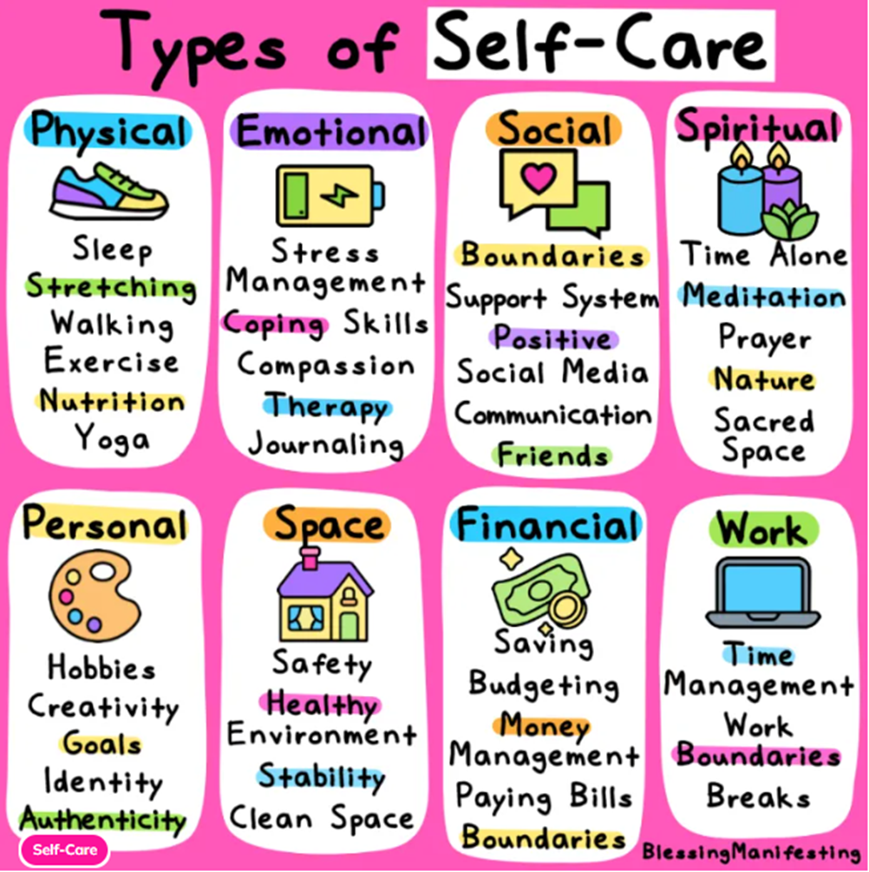
Mental Health Resources
NATIONAL SUICIDE PREVENTION LIFELINE
1-800-273-8255
The National Suicide Prevention Lifeline provides free and confidential emotional support to people in suicidal crisis or emotional distress 24 hours a day, 7 days a week, across the United States. The Lifeline is comprised of a national network of over 170 local crisis centers, combining custom local care and resources with national standards and best practices.
THE CRISIS TEXT LINE
The Crisis Text Line is the only 24/7, nationwide crisis-intervention text-message hotline. The Crisis Text Line can be reached by texting HOME to 741-741.

Slide 5

Support Services

Slide 6
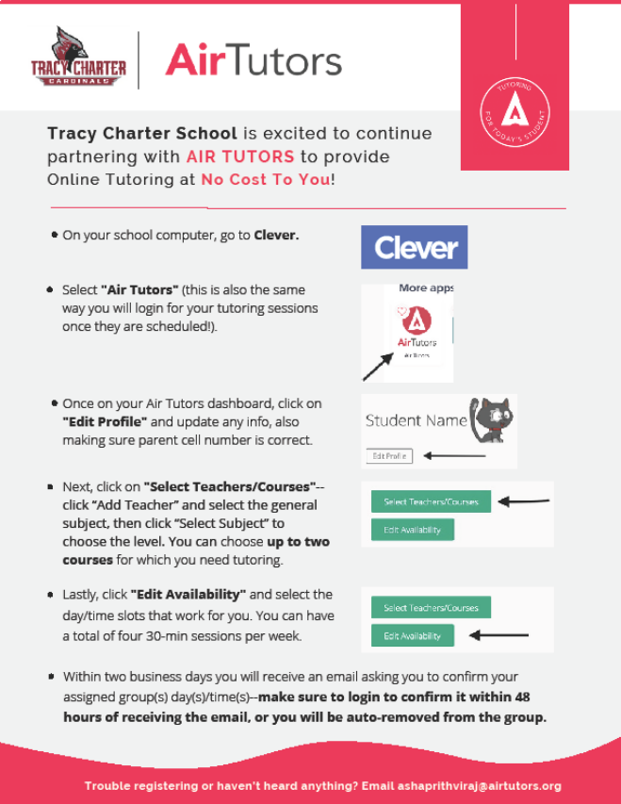
Air tutors………
2 (1 hour) sessions a week

Slide 7
GRADUATION REQUIREMENTS
Each year you are enrolled in 6 classes, you earn 5 credits per class per semester for a total of 30 credits a semester. There are 2 semesters in a year.
You must take and pass specific subject courses.
It is important that you pass your classes each semester, so you do not need to go to summer school or night school to make up the credits you are missing to graduate on time.
English……………………...40 credits
World HISTORY…………...10 CREDITS
US HISTORY………………….10 CREDITS
GOV/ECON………………...10 CREDITS
ALGEBRA……….……………10 CREDITS
Math………………………...10 CREDITS
BIOLOGY…………………….10 CREDITS
CHEM/Physics…………….10 CREDITS
3rd Science……………….10 CREDITS
Art or Language……...10 credits
P.E. …………………………..20 credits
Electives ………………….70 credits
Total ………………………..220 credits

Slide 8


A-G Requirements
Courses that students must complete (with a grade of C or better) to be minimally eligible for admission to the University of California (UC) and California State University (CSU).
A – History 2 years
B – English 4 years
C – Math 3 years (4 years recommended)
D – Lab Science 2 years
E – World Language 2 years (3 years recommended)
F – Visual & Performing Arts 1 year
G – College Prep Elective 1 year
*Must earn a C- or better in all A-G courses!

Slide 9
Plans after high school
Choose Your Path
Community College
Military
University
Trade & Technical Program
Employment

Slide 10









SYSTEMS of HIGHER EDUCATION
CALIFORNIA & OUT of STATE
Community Colleges
4 Year Universities / Colleges
Out of State Universities
*WUE
Historically
Black Colleges
And Universities
Private California Colleges
Private & Public Out of State Colleges
Community Colleges
CSU
UC

Slide 11
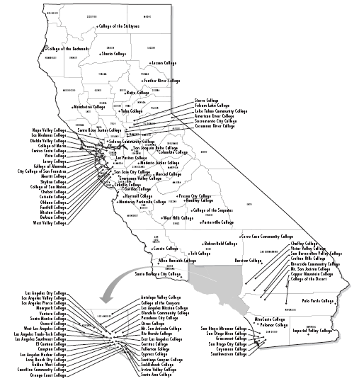
CALIFORNIA COMMUNITY COLLEGES
NUMBER OF CAMPUSES:
116
REQUIREMENTS:
Complete high school and/or be 18 years old
Apply and register for classes
WHAT THEY OFFER:
Transfer Options (UC/CSU/Other)
Associate’s Degree
Trade and/or Technical Training
WEBSITE:
www.cccapply.org

Slide 12

23 California State Universities (CSU)
Are placement tests required? Please refer to the CSU website for updates.
Are SAT/ACT required for admission? NO however…
If accepted to a CSU campus, ACT or SAT test scores can be used as one of the measures to place students in the proper mathematics and written communication courses
Are A-G courses required for admission? YES
A-G required courses must be completed with grades of C or better
Is there a GPA minimum for admission? YES
2.5 GPA is a minumum
2.0-2.49 GPA each campus will have its own supplemental requirements for this GPA range.
Is there an application for admission? YES
Click this LINK to launch the CSU Application
www.calstate.edu

Slide 13

9 University of California (UC)
Are placement tests required? Please refer to the UC website for updates.
Are SAT/ACT required for admission? No
Are A-G courses required for admission? YES
A-G required courses must be completed with grades of C or better
Is there a GPA minimum for admission? YES
Admission GPA 3.00 or above.
Is there an application for admission? YES
Click this LINK to launch the UC Application
PIQ’s (Personal Insight Questions) are part of the UC Application. Click this LINK for more information about PIQ’s
https://www.universityofcalifornia.edu/campuses-locations

Slide 14
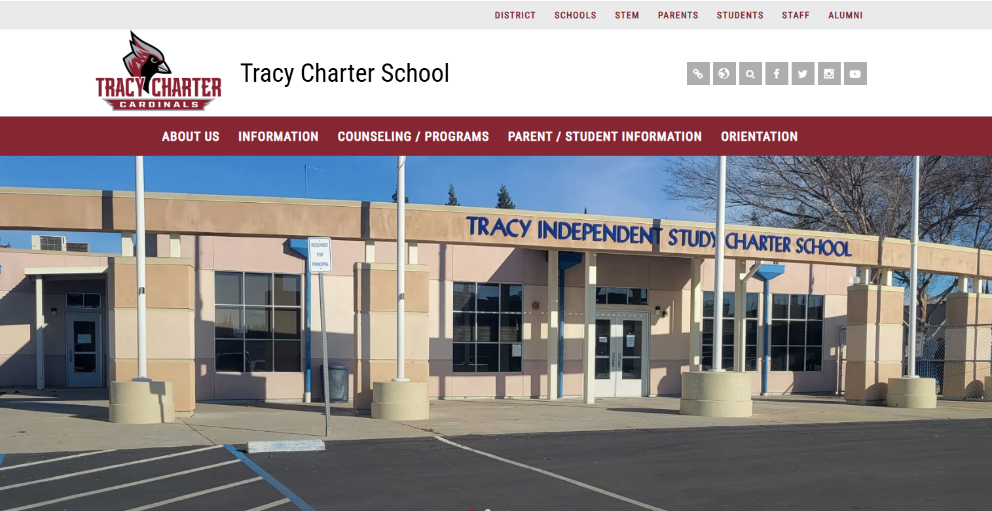
Website Resources

Slide 15
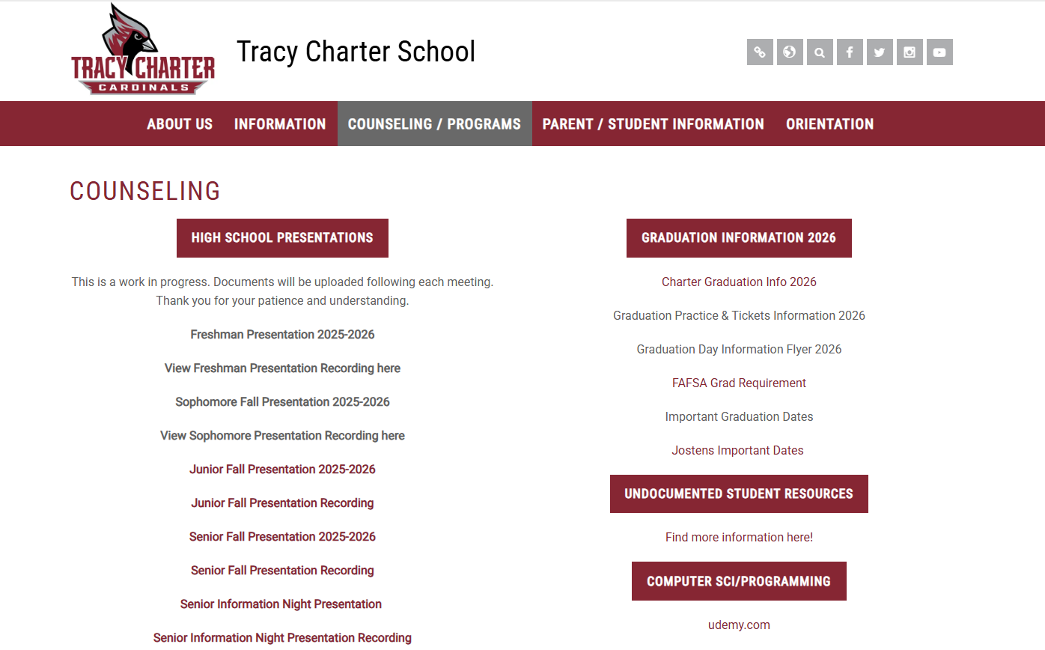

Slide 16
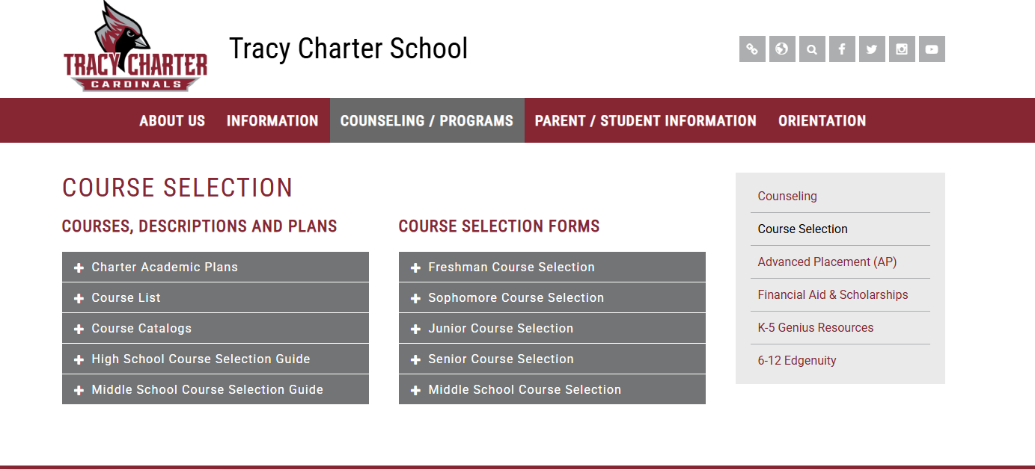

Slide 17
Questions?

