Slide 1
CITY Center for Collaborative Learning
Monthly Financial Report
FY26 as of Sept 30, 2025

Slide 2
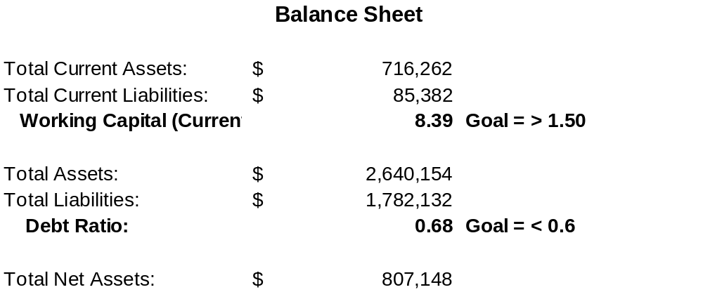
Executive Summary & Highlights
As of September 30, 2025, CCCL continues to demonstrate a strong financial position at the close of the first fiscal quarter. Current assets total $601K against current liabilities of $55K, maintaining an excellent current ratio of 10.9, well above the industry benchmark of 1.5. Total assets stand at $2.63M, with total liabilities of $1.76M, resulting in net assets of approximately $870K, an increase of $71K since June.
Cash and equivalents increased by $48K over the quarter, driven by timely state payments and effective cash management. Accounts Receivable declined modestly, indicating continued improvement in collections, while Accounts Payable remained low at $15K, reflecting efficient payment cycles.
Overall liquidity remains strong, debt levels stable, and unrestricted net assets continue to build, providing a solid foundation for the remainder of FY26.

Slide 3
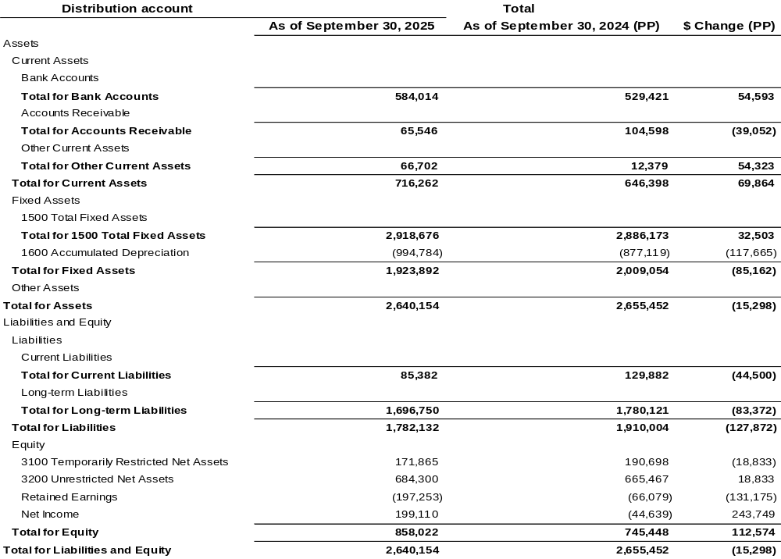
Statement of Financial Position
Cash and equivalents increased by $48K over the quarter, driven by timely state payments and effective cash management.
Accounts Receivable declined modestly, indicating continued improvement in collections.
Accounts Payable remained low at $15K, indicating timely settlement of obligations.
Equity strengthened with a net income of $41K for September, bringing total net assets close to $870K.

Slide 4
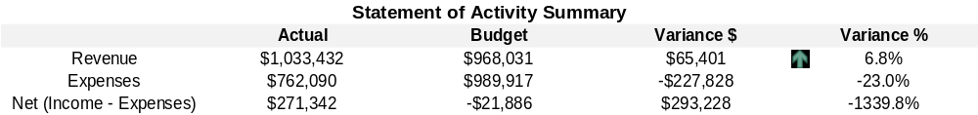
Current Performance vs YTD Budget
Total income for the first quarter was $1.02M, slightly above budget by $18K (1.8%), and expenditures totaled $762K, at $41K (5.1%) below budget.

Slide 5
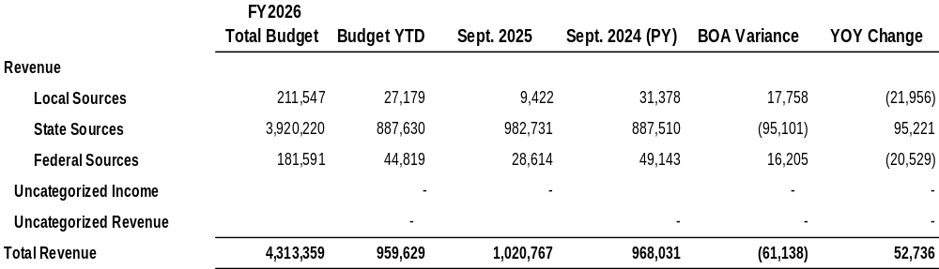
Revenue - Key drivers and Variances
State revenue was strong at $982.7K, tracking slightly above budget and up 10.7% from the prior year, largely due to increased State Equalization Assistance and Prop 123 funding.
Local sources totaled $9.4K, reflecting lower lunch and fundraising income compared with last year.
Federal sources came in at $28.6K, moderately below the prior year due to the timing of reimbursements. Overall, total income increased 5.5% from the same period last year, driven by state revenues and steady donor support.

Slide 6
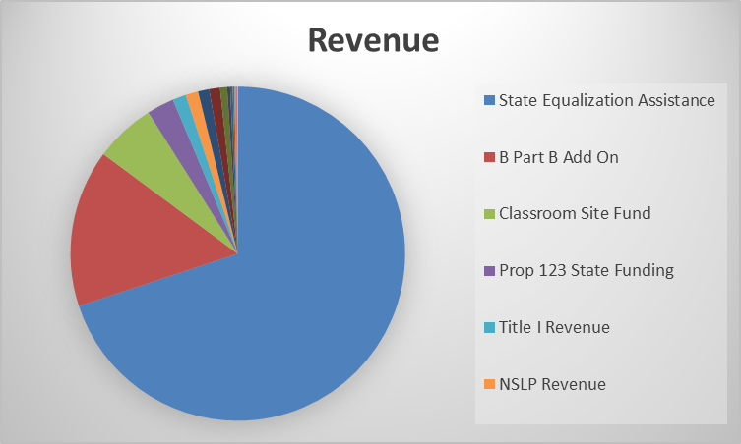
Revenue – Income Mix

Slide 7
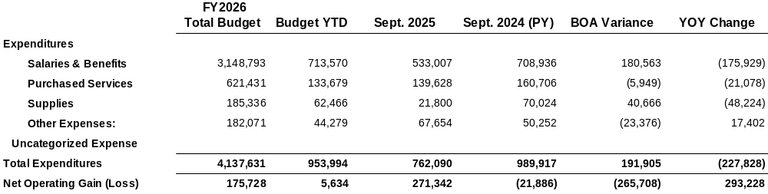
Expenses - Key drivers and Variances
.
Salaries & Benefits totaled $533K, down 17% from the prior year ($639K), reflecting lower staffing costs and delayed hiring.
Purchased services were $139.6K, down 13% from last year ($160.7K), mainly due to timing of professional fees and reduced contract service spending.
Supplies totaled $21.8K, a sharp reduction from the prior year ($70K) as operations returned to pre-pandemic levels.
Overall expenses of $762K are 23% below last year’s Q1 total of $990K, reflecting tight cost control and deliberate expense management.

Slide 8
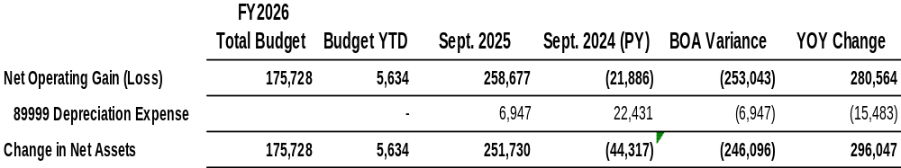
Net Results
The organization generated a net operating surplus of $259K, a significant improvement from the prior year’s Q1 deficit of ($21.9K).
After accounting for depreciation of $6.9K, the change in net assets was $252K, compared to a loss of ($44.3K)** in September 2024.

Slide 9
Key Takeaways for the Board
  CCCL is starting FY26 with strong cash flow and positive net results. Liquidity is excellent, budget performance is favorable, and expenses are well managed.

