Slide 1
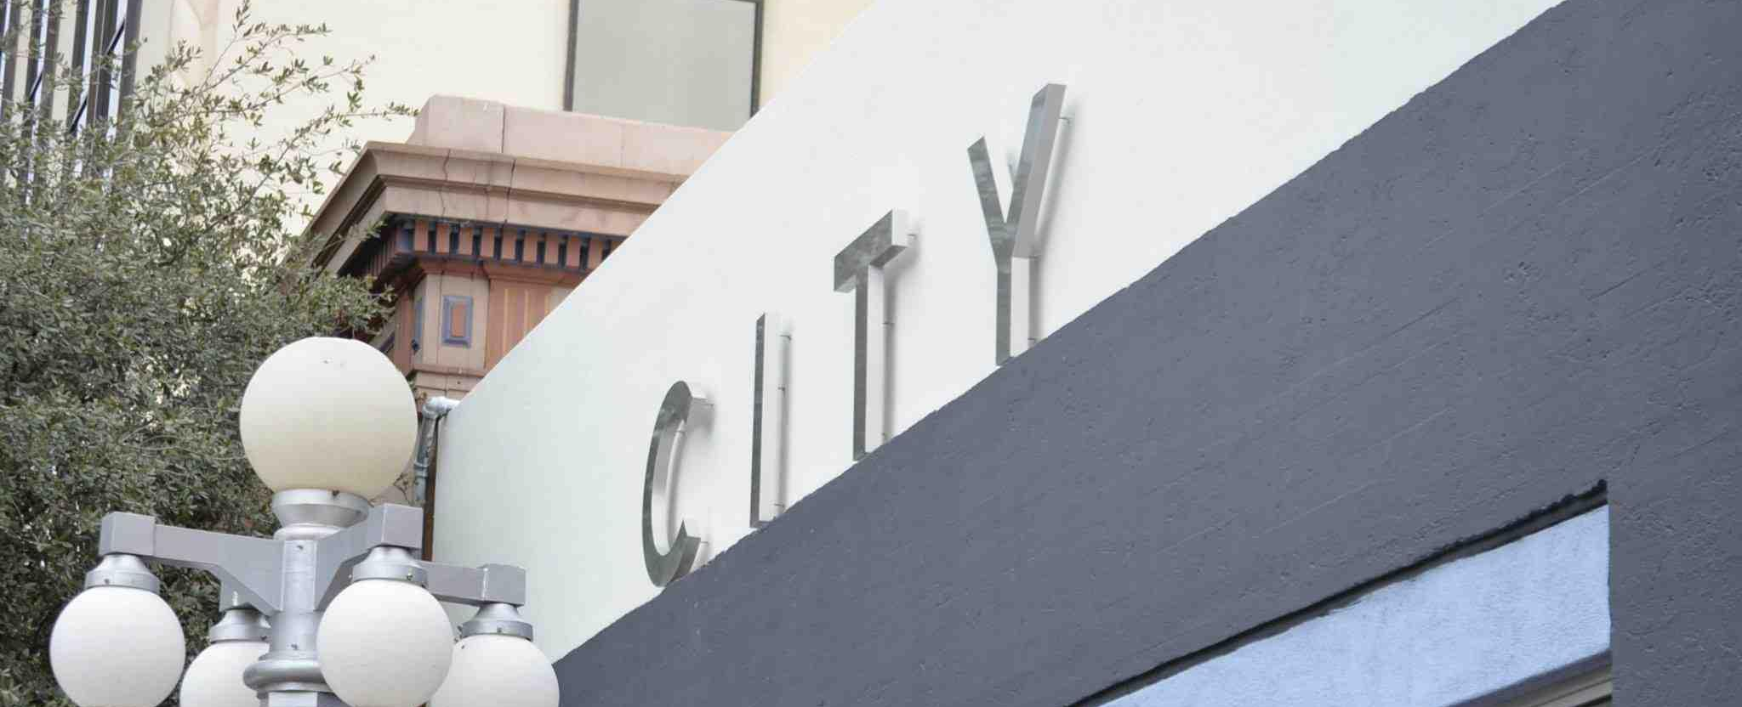
CITY Center for Collaborative Learning
October 2025 Report to the CCCL Board of Directors by the Executive Director

Slide 2

Enrollment
Audit Updates
College Multi-Day Field Trip
CHS Art Collaboration
Block Party
Tax Credits + Fundraising

Slide 3
Enrollment
City High School | Paulo Freire - Downtown | Paulo Freire - University
Current: 179 | Current: 42 | Current: 71
Budget: 179 | Budget: 36 | Budget: 74

Slide 4
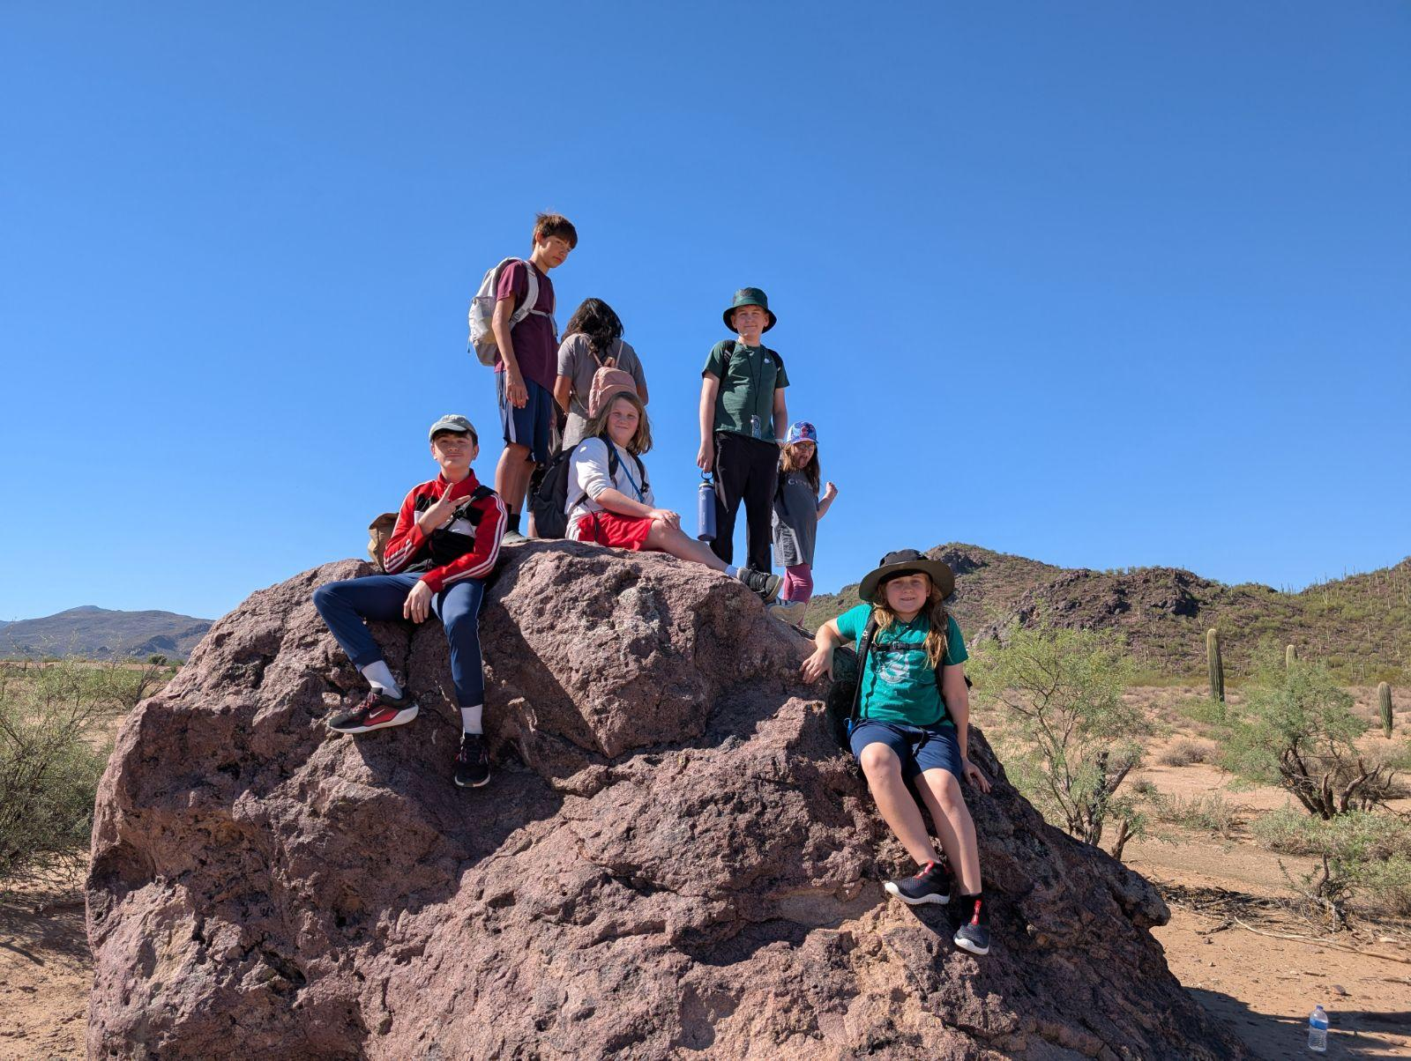
Audit Progress
Holcomb and Shreeve PC
Due Nov. 15th (Oct. 30th)
Despite delays, still on target for Oct. 30th

Slide 5
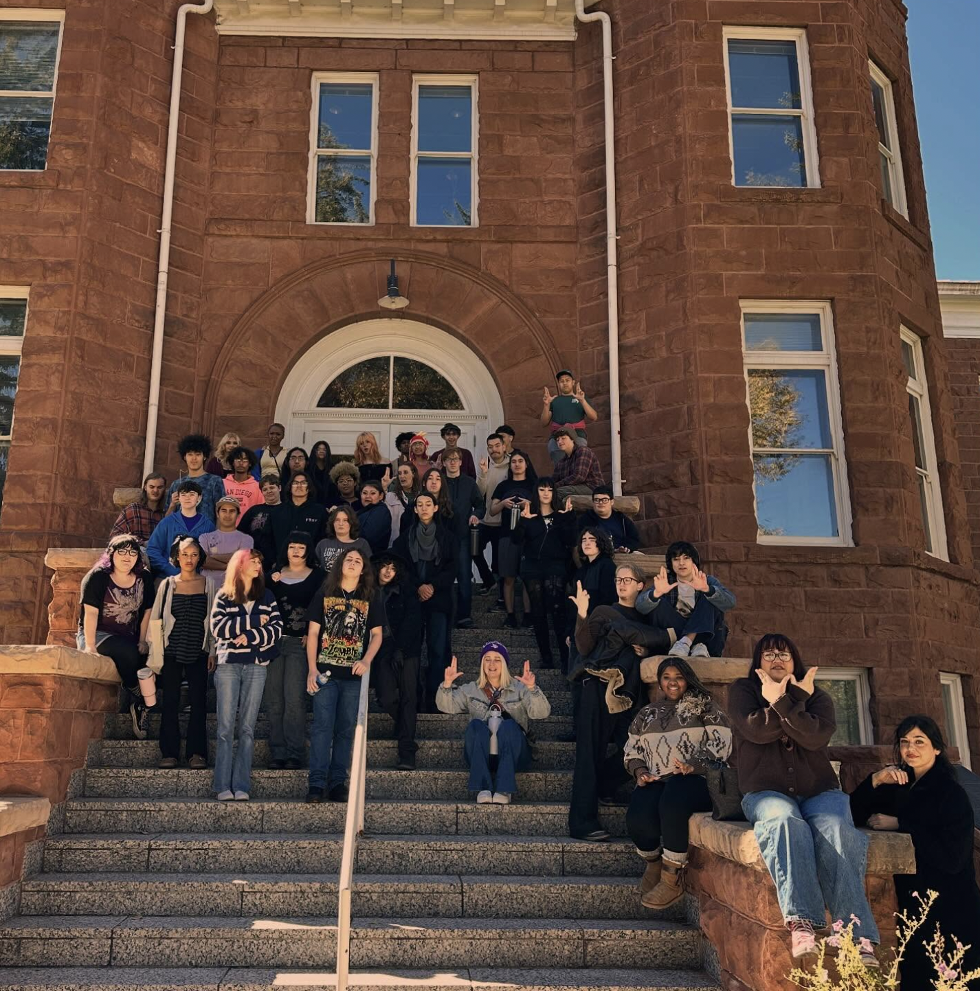
City High School Junior Trip
College Tours
ASU, Prescott, NAU
Exceptional Learning
Exceptional Behavior

Slide 6
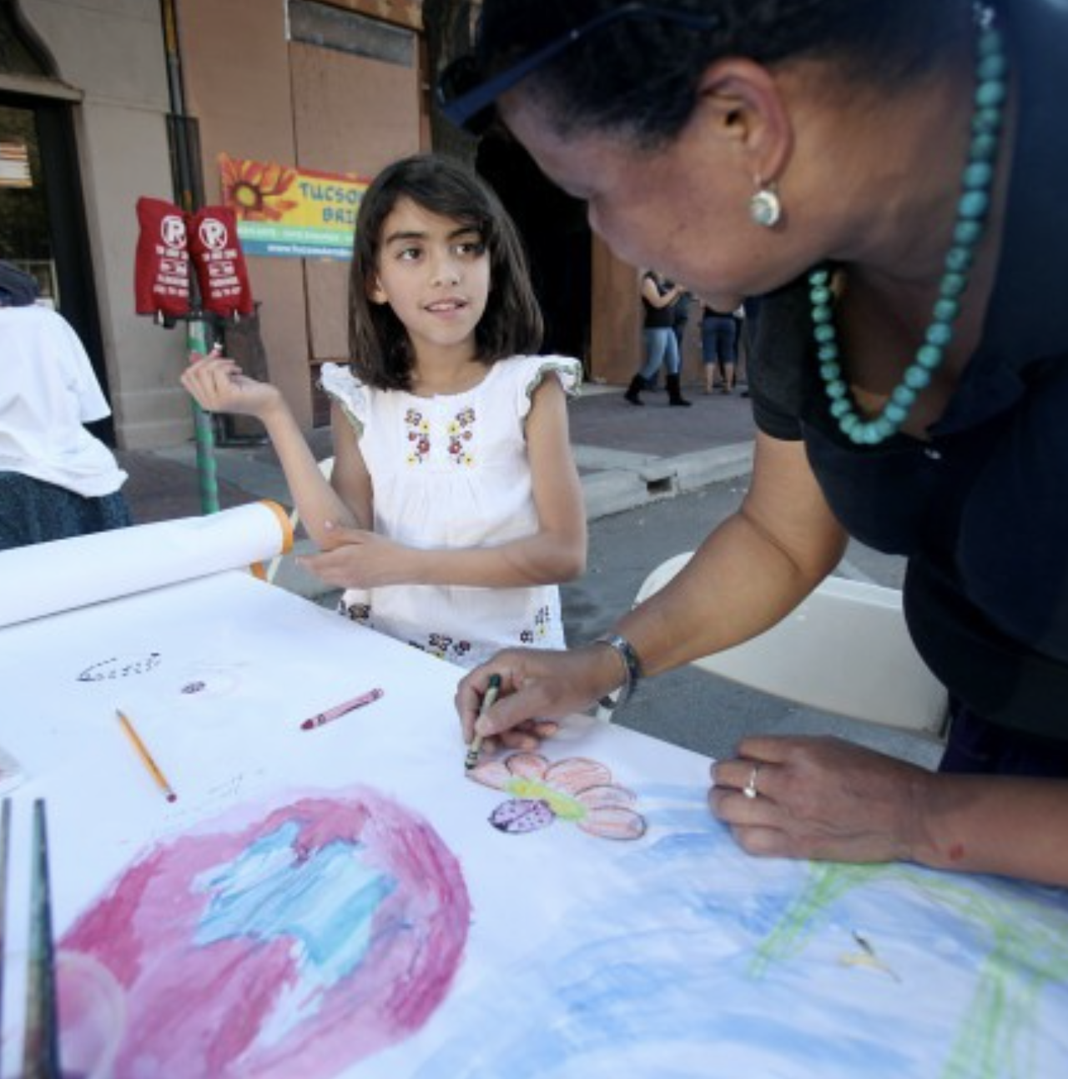
Pennington St. Block Party
April 2026
Tucson Hispanic Chamber:
Palo Verde Bloom Festival
Student Work, Community Partners, Family Engagement, Sponsorships
Marketing, Sponsorship, and Fundraising Opportunities

Slide 7
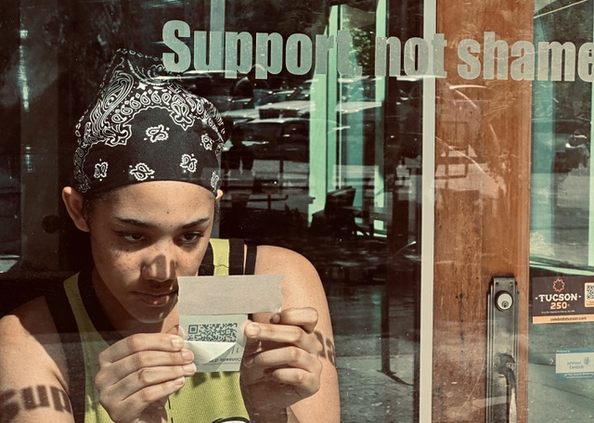
CHS Art Collaboration
City High students Chloe and Annalie had the opportunity to collaborate with artist Elizabeth (Liz) Burden and former City High student Dorothy Acevedo Green to help install a new public art piece as part of the SaludArte initiative.
The installation features quotes directly from members of the City High community collected earlier this school year. Each quote reflects personal experiences and understandings of recovery, resilience, and healing, highlighting the strength found in shared stories. The artwork also incorporates QR codes that link to audio recordings so visitors can hear voices behind the words and experience the power of storytelling in an immersive way! It’s super subtle and easy to miss, but when you notice and read the translucent words on the window you’re met with your own reflection. Shadows are cast by the quotes in different parts of the interior of 37 depending on the time of day.

Slide 8
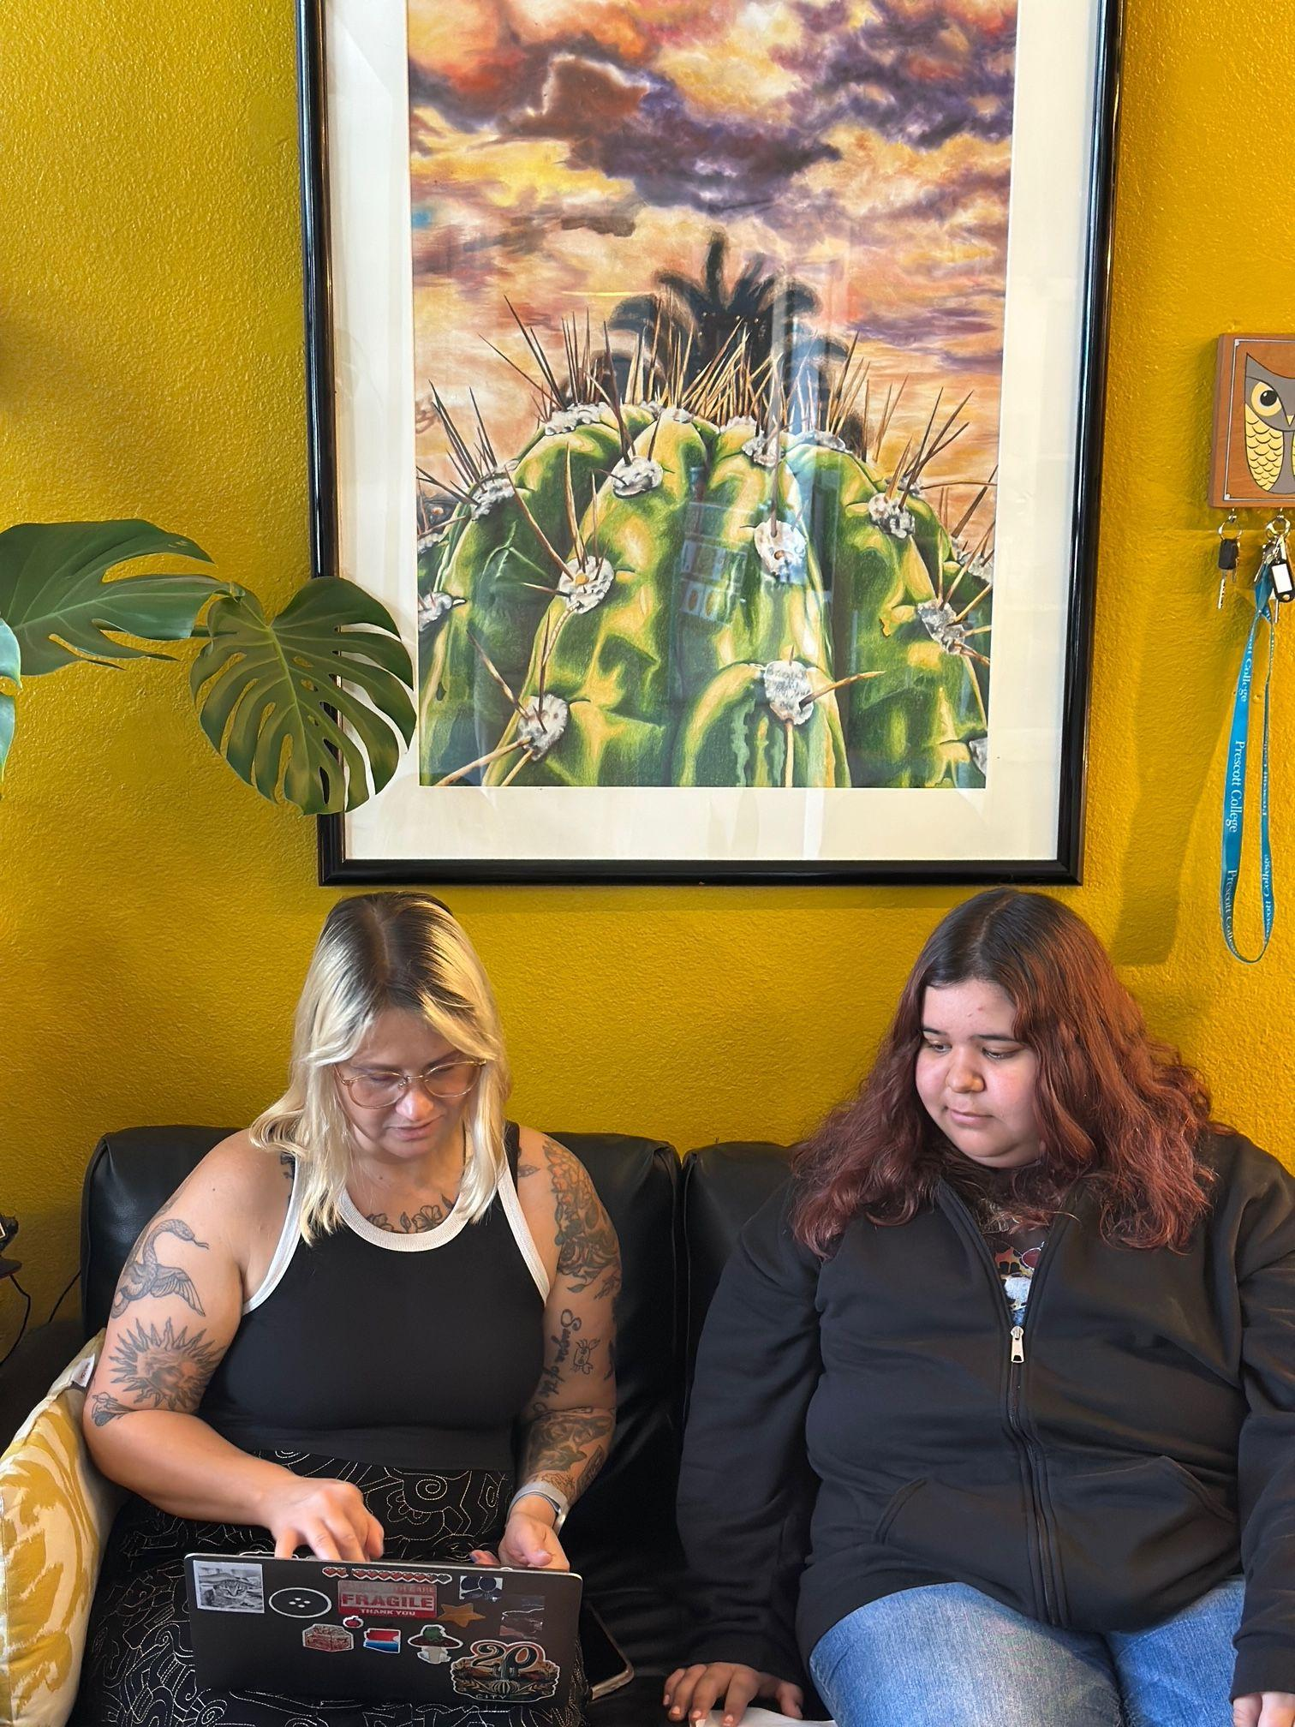
Tax Credits and Fundraising
Board Tax Credit
Goal: $3,000
Ask friends + relatives to list you as their ambassador
Annual Fund
Goal: $12,000

