Slide 1

Why is Bond Oversight so important?
The Law (California Constitution and Education Codes)
Huge amount of construction and related activity
Potential for influence via construction and consultant contracts
Holds Districts accountable and to set priorities
Just because it is legal does not make it proper

Slide 2
What is the magnitude of School Bond Debt (since 2001)?
San Diego County: $9.6 Billion ($6.9 Billion Local Schools, $2.7 Billion Community College)
San Diego County Total School/Community College Debt Per Capita: $3,067
Number of local Districts/Community College Districts with Bonds: 32
Total Local School District Debt per Student: $13,850 (Excludes Community College)
California: $94.8 Billion ($71.6 Billion Local Schools, $ 23.2 Billion Community Colleges)

Slide 3
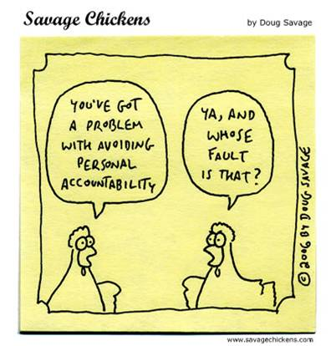
Proposition 39: School Facilities. 55% Local Vote. Bonds, Taxes. Accountability Requirements.
55% vote on school bonds for Districts and Community Colleges
Accountability was the number one priority
Accountability Tools (Performance and Financial Audits)
Quid Pro Quo for 55%-Independent Citizens Bond Oversight Committee
Funds only for construction/rehab

Slide 4
Proposition 39: School Facilities. 55% Local Vote. Bonds, Taxes. Accountability Requirements.
(cont.)
List of projects required
Safety, class size reduction, IT be considered
Charter Schools provided
No bond proceeds for salaries/operating expenses

Slide 5
What is the Legal Role of a Bond Oversight Committee?
Inform the public concerning the proper expenditure of bond revenues
Actively review and report on the proper expenditure of taxpayers’ money for school construction
Does not approve expenditures, project priorities, or contracts

Slide 6
What is the Committee Makeup (Seven minimum)?
Business organization
Senior Citizen Organization
Taxpayers Organization
Parent Guardian student enrolled in District or student for Community College
Parent Guardian with Parent Organization or student with Student Organization
Community At large and/or appointed by an Organization
Board of Trustees Approve

Slide 7

What are the areas specified for review?
Receive and review annual independent financial and performance audits
Inspect facilities
Receive and review deferred maintenance proposals or plans
Cost savings measures (professional fees, site preparation, joint use, school design, reuse of facilities)

Slide 8

What are the key issues in Bond Oversight?
Mentality of independent vs. being part of staff/District
Brown Act (Open Meeting Law)
Detailed Performance Audit
District provides resources
No time limits on review period

Slide 9

What are the key issues in Bond Oversight?
Mentality of independent vs. being part of staff/District
Brown Act (Open Meeting Law)
Detailed Performance Audit
District provides resources
No time limits on review period

Slide 10
What are the key issues in Bond Oversight?
(cont.)
Member Selection process to assure independence
Trust but verify all expenditures
Comparison of Ballot Language with actual expenditures and projects
Priority setting process for projects
Transparent information
Review of major initiatives and projects/agenda items

