Slide 1
Strategic Compensation and TIA:
Rewarding Excellence

Slide 2


TIA vs. Strategic Compensation

Slide 3
Our Collective Why as Leaders
The essence of leadership is holding your people to the highest possible standard while taking the best possible care of them.

Slide 4

What is the goal of a TIA designation system?
In Irving ISD, we want to Recruit, Develop, and REWARD our teachers with all levels of experience, leading to higher teacher retention and improved student outcomes.

Slide 5
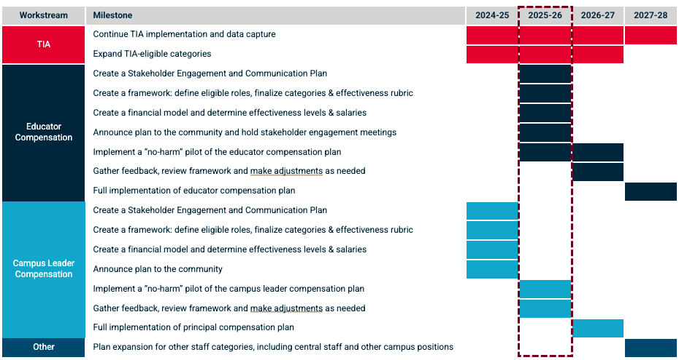
Strategic Compensation: Irving ISD's Roadmap
Assistant Principals

Slide 6




Modeling What We Expect by Going First
Operational Effectiveness | Principals are evaluated based on their operational effectiveness in areas such as student attendance, climate, safety and security, and parent engagement
Components of a principal’s annual evaluation
Operational Effectiveness
Leadership Definition
Leadership Definition | Principals are evaluated and receive feedback on the T-PESS rubric, supplemented with the Leadership Definition competencies
Student Outcomes | Campus-level achievement measures capture growth and proficiency on state and local assessments (e.g., MAP for growth and STAAR for proficiency)
Student Outcomes
Instructional Leadership Priorities | Principals are evaluated on their implementation of the three instructional priorities: evidence of HQI, data-driven instruction, and teacher coaching
Instructional Leadership Priorities

Slide 7
Our Focus as Your Leadership Team
Stakeholder Engagement
Student Growth
Teacher Observation

Slide 8

To Submit Questions During Data Capture Year
https://forms.office.com/r/bq81XJEZQK

