Slide 1
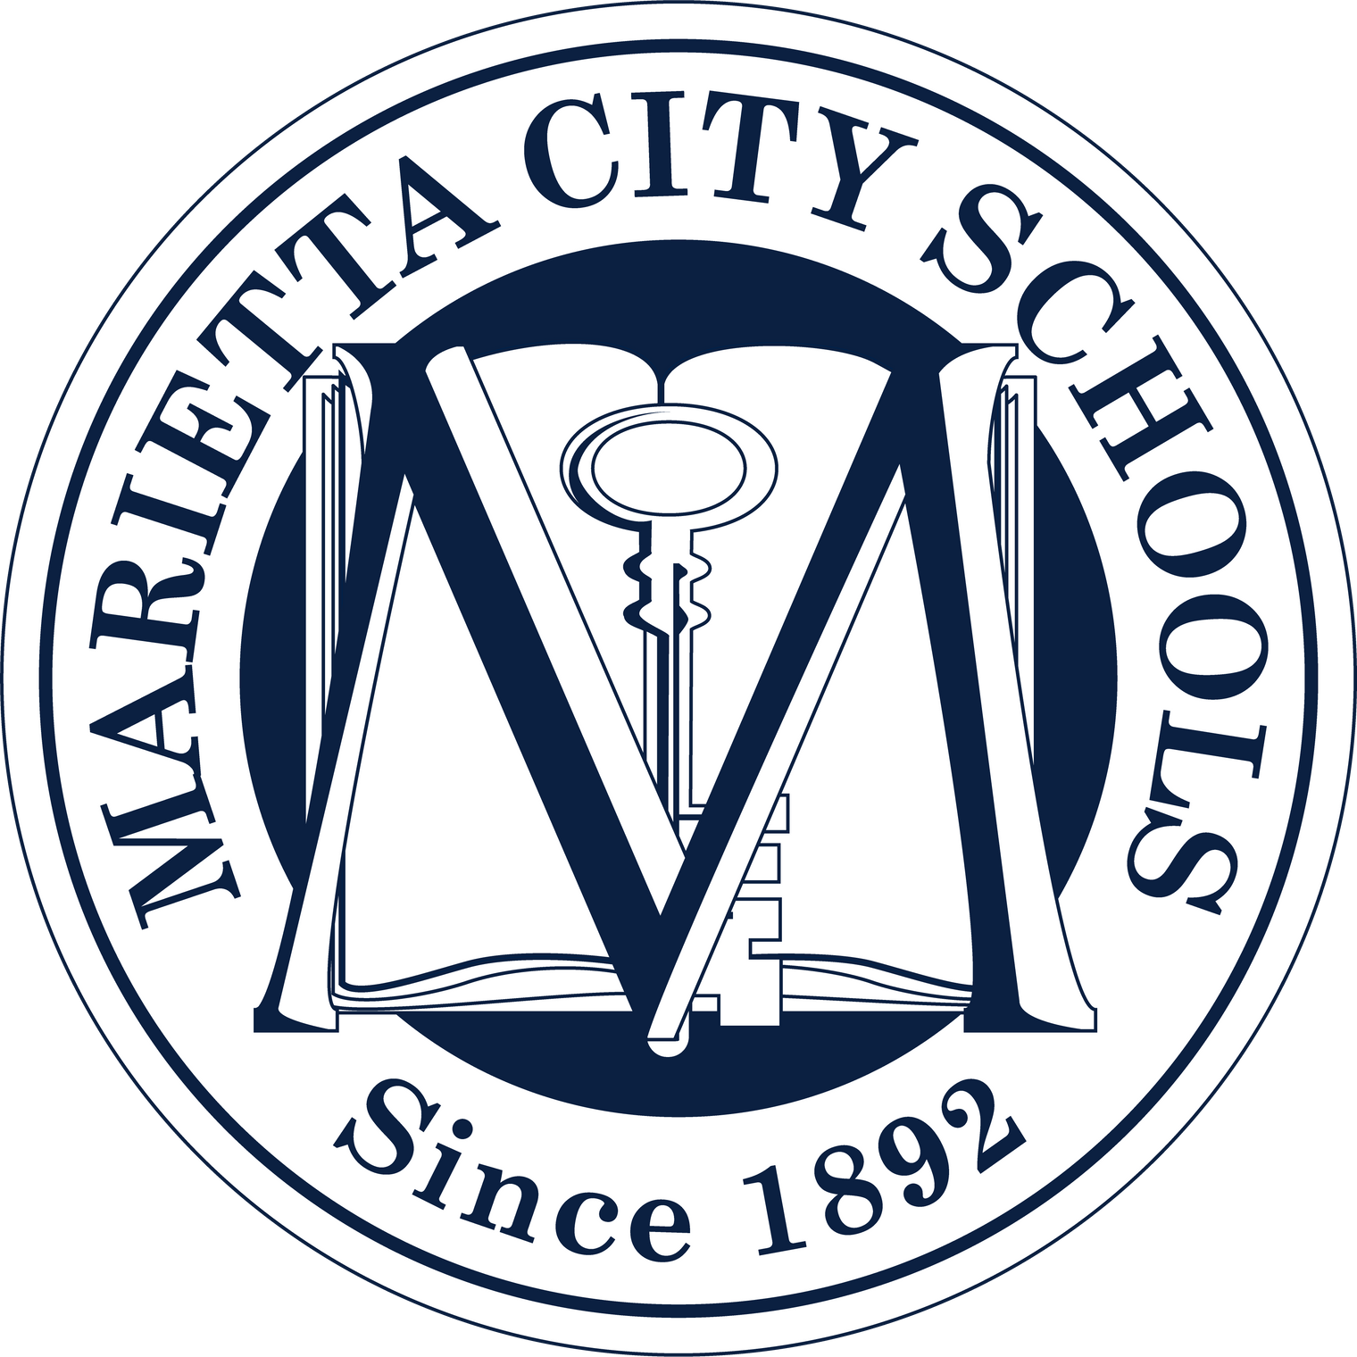
Marietta City Schools
Tradition Rich – Future Focused

Slide 2

The Beginning…
  On September 5, 1892, about 730 Marietta children attended their first day of classes in the city’s free and public school system.
  Culmination of years of work by the citizens of the city, who, since the 1830s, had operated private schools to educate boys and girls of all races.
  Picture – Graduating Class of 1907

Slide 3
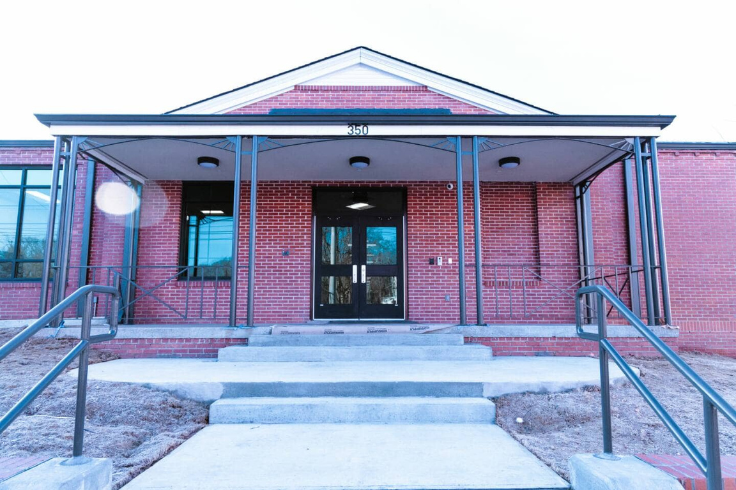
Lemon Street Grammar School
  The Lemon Street grammar school opened in 1951 and closed in 1970. The school served Marietta’s Black students until the district integrated in 1965.
  It was briefly used as a junior high school, and later served as the home of the Hattie G. Wilson Library until the county shut it down in January 2013.
  In 2022, the building was selected to receive an Excellence in Rehabilitation Award from the Georgia Trust for Historic Preservation.
  The building was added to the National Register of Historic Places in 2024.
Notes:
3

Slide 4
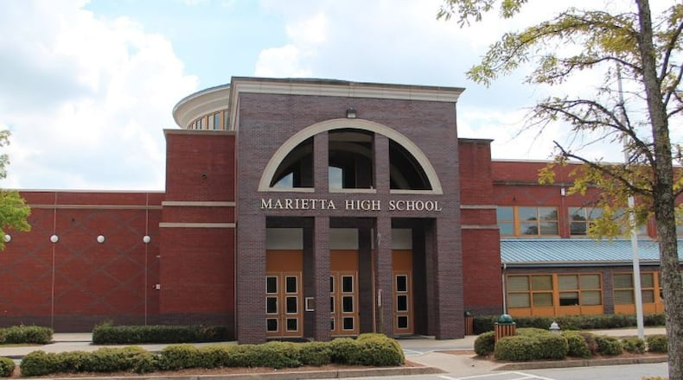
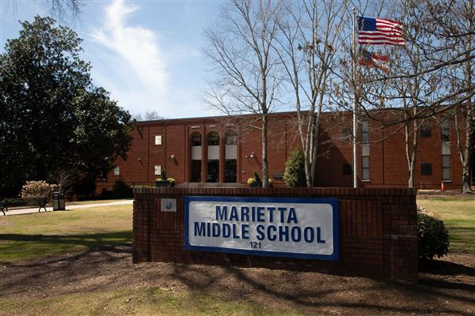
History of Marietta High School
Marietta Middle School is the former site of the high school.
The new high school opened in 2001 as the most expensive high school ever built in Georgia.
The MHS football stadium is still on the campus of MMS.

Slide 5
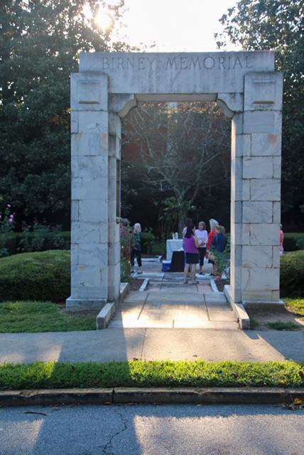
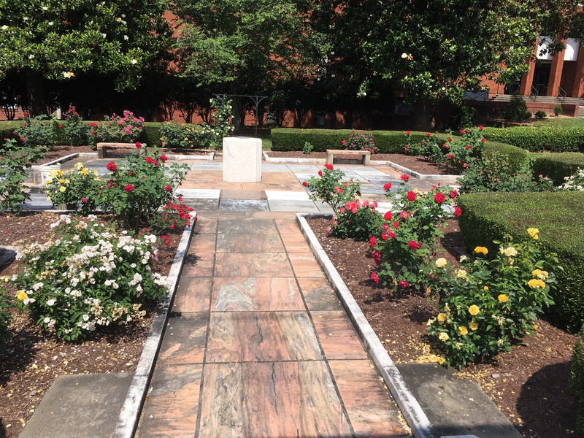
Founding of the Parent Teacher Association
  In 1897, Alice McClellan Birney spearheaded the organization of the first Parent Teacher Association, originally known as the National Congress of Mothers – and she served as the organization's president until 1902.
  The Birney Memorial Rose Garden was dedicated on the grounds of then Marietta High School—occupied today by Marietta Middle School—on September 27, 1942, to commemorate the PTA's founding.
  The sundial, made of Georgia marble, is centered in a square of stone slabs, contributed by PTAs from each of the United States.

Slide 6
Where We Are Now…
  8,700 Students in 12 Schools
  ELC, 8 Elementary Schools, MSGA, MMS, and MHS
  The student body is about 38 percent Hispanic, 37 percent African American, 20 percent White, with approximately 65 percent of our students qualifying for free or reduced-price lunch.
  Diversity is our strength and we all stand, together, as Marietta Blue Devils.

Slide 7
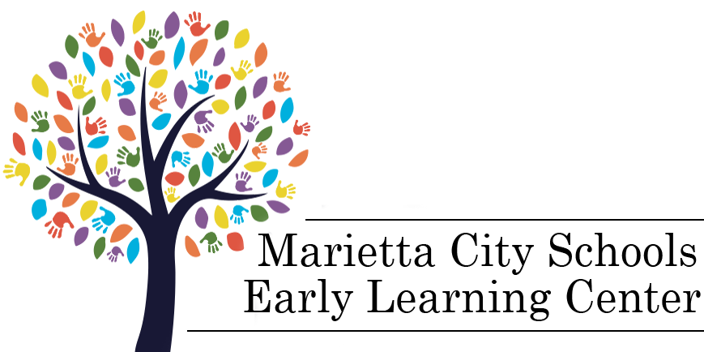
The ELC
  Established in 2018
  Free Pre-Kindergarten
  Accepts Employees’ Children

Slide 8



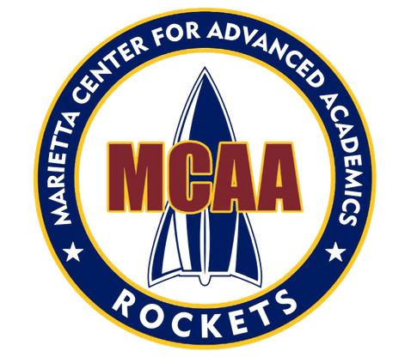
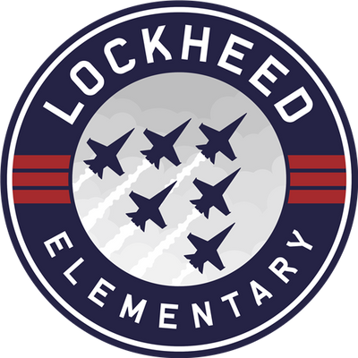


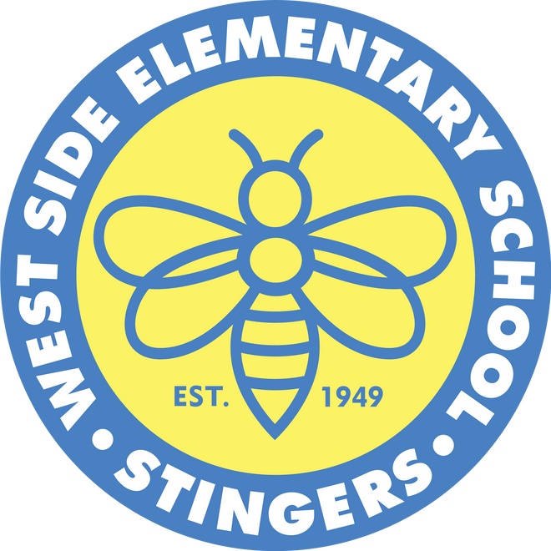
Eight Elementary Schools

Slide 9
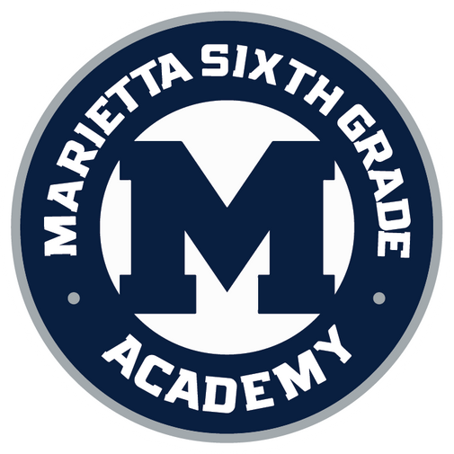
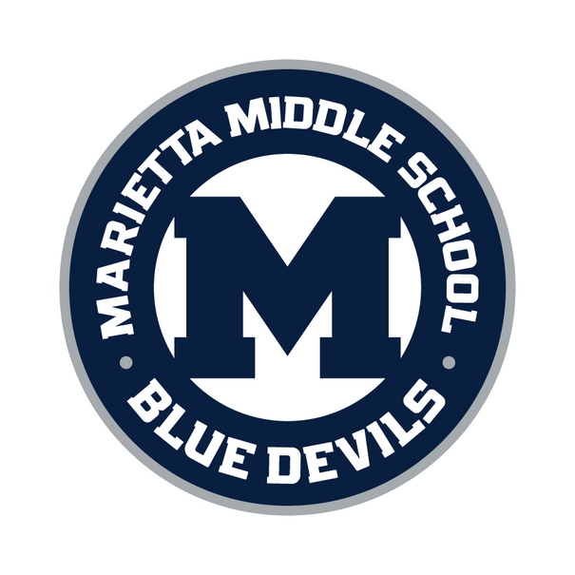
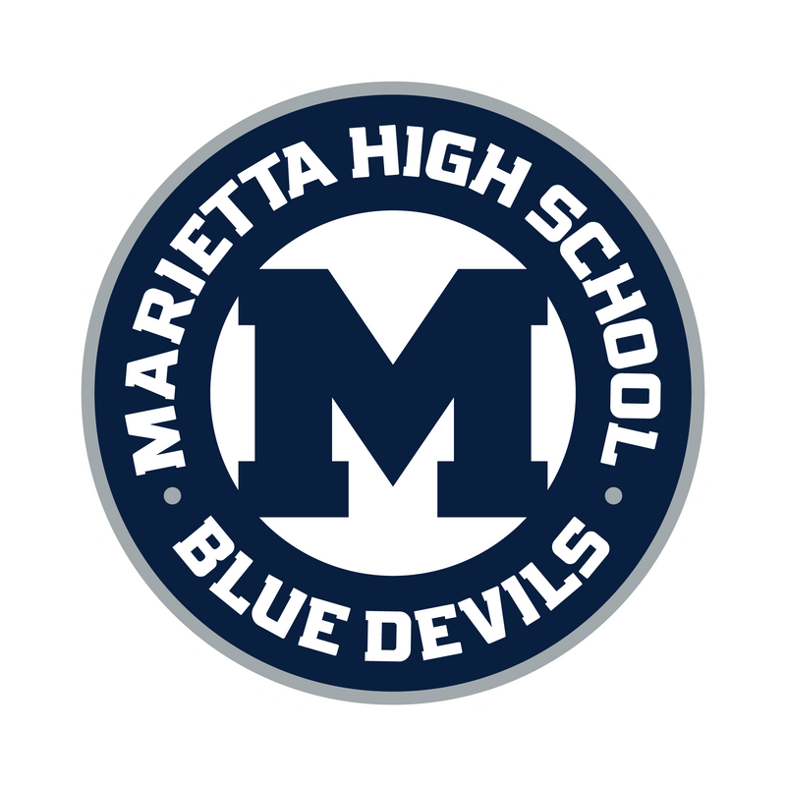

Three Secondary Schools
  Woods-Wilkins at Lemon Street Campus
  Marietta Performance Learning Center
  Marietta Evening School Hours
  Marietta Alternative Program and Services
Notes:
9

Slide 10
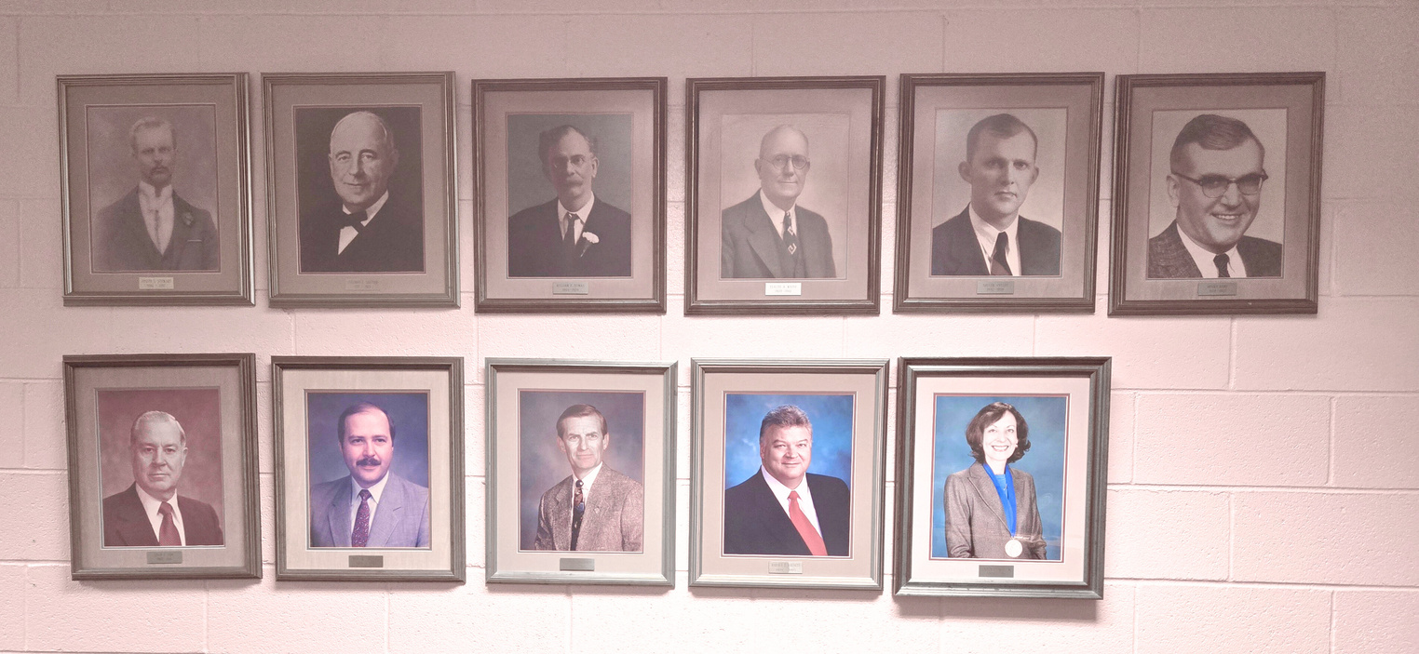
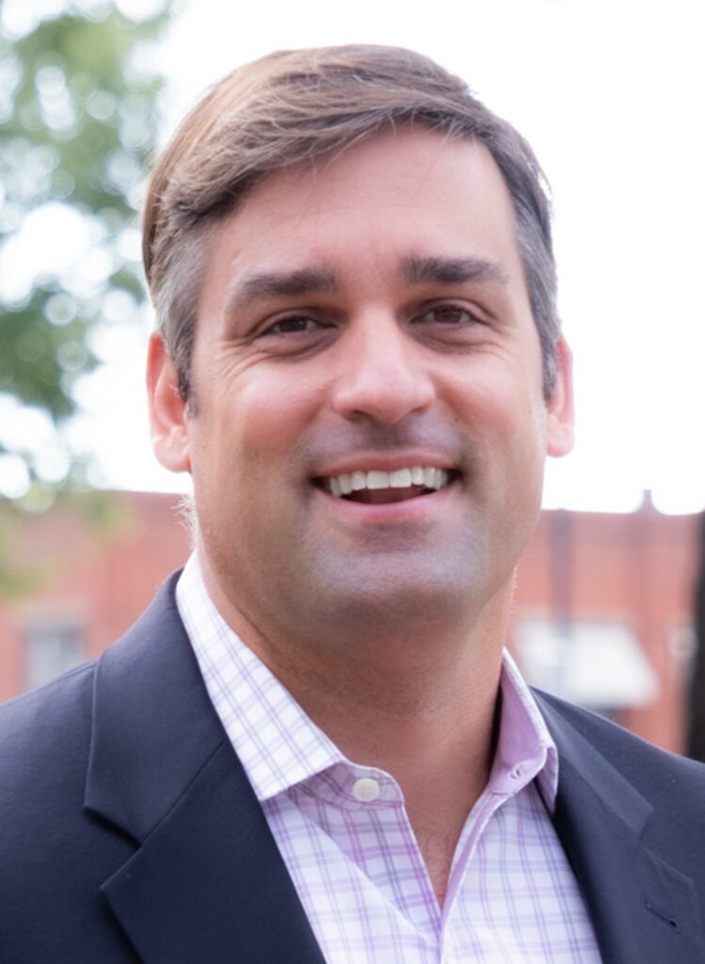
History of Superintendents
  Significant Stability in Leadership
  13 Superintendents Have Led MCS Since 1892
  Dr. Grant Rivera, Current Superintendent Since 2016

Slide 11
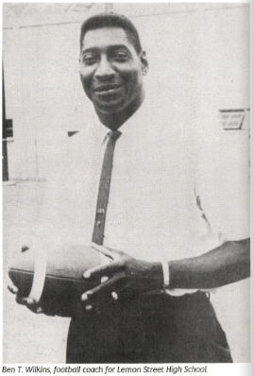
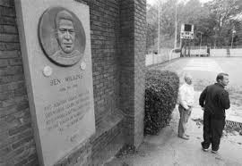
“Be Somebody” Motto
  Ben T. Wilkins (1934-1984) was a teacher, coach, and assistant principal in the Marietta City Schools. According to school officials, he was instrumental in assisting in the smooth transition from segregated to integrated schools in 1966.
  Coach Wilkins built his reputation urging Marietta High School students to “Be Somebody.”
  The “Be Somebody” has remained the MCS motto
for decades.

Slide 12
Significant Recent Events
  1995 – Obtained MHS IB World Certification
  2008 – Named First IB World School District in Georgia
  2008 – Became One of Georgia’s First Charter School Systems
  2012 – MCAA Became First STEM-Certified School in Georgia
  2018 – Opened ELC, Offering Free Pre-Kindergarten Classes
  2019 – Opened the College and Career Academy at Marietta High School
  2021 – Launched Nationally Recognized Literacy Initiative

Slide 13
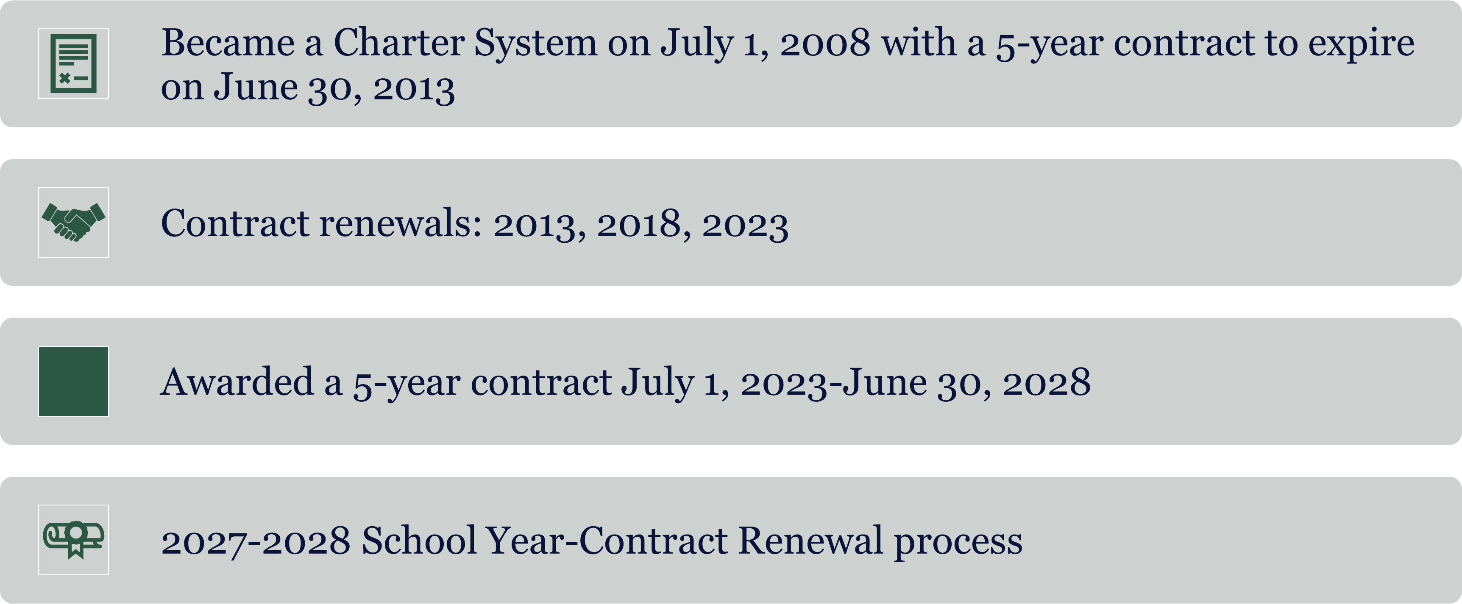
Marietta City Schools- Charter System Journey

Slide 14
What is a Charter System?
Created by the Charter System Act of 2007
Contractual Agreement between Local Board of Education and State Board of Education:
State BOE agrees to:
  Grant Broad Flexibility from most laws and regulations
  Include additional funding in state funding allotment (subject to appropriation by legislature)
Local BOE agrees to implement:
    Local School Governance and to provide annual training for School Governance Teams
    Use flexibility to implement innovations
    Increased student achievement

Slide 15

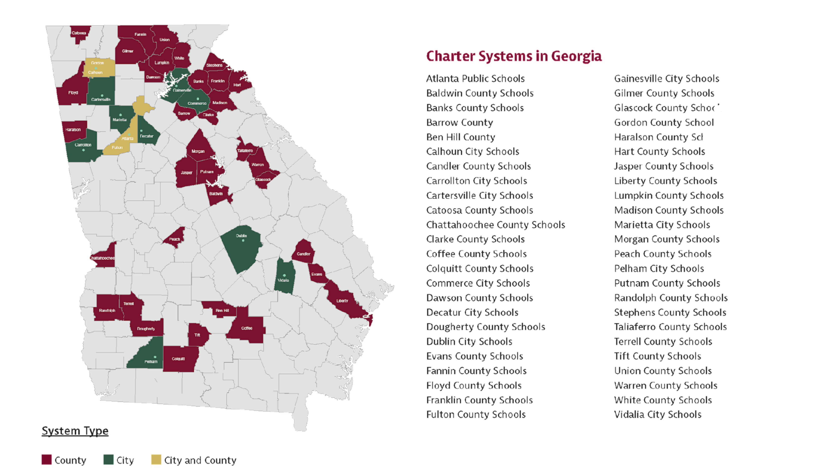
Charter System Foundation

Slide 16
What is School Level Governance?
Involvement of parents, teachers, and community members in decisions that focus on school improvement and student success
School Governance Teams provide input into decisions in these areas:
  School Improvement planning and monitoring
  Selection of principal in case of vacancy
  School budget/use of resources that support the school improvement plan
  Identifying instructional programs, resources, operational processes, and innovations that support school improvement plan
Each charter system defines the School Governance Team’s role in providing input into decision-making

Slide 17
What is the Role of the BOE and Superintendent in Charter System Governance?
Georgia law makes it clear that schools within gadoe.org a charter system remain under the control and management of the Local Board of Education
[See O.C.G.A. 20-2-2065(b)(2)]
This means that, although the Superintendent and LBOE give consideration to the recommendations and input of LSGTs, the LBOE ultimately retains its constitutional authority.

Slide 18
What Does Flexibility Mean for a Charter System?
Freedom from most state laws and rules that govern K-12 public education
Intended to be used in designing and implementing innovations that will support and advance student achievement
What is NOT included:
Federal Laws
Any law that falls into one of these categories:
    Safety
    Civil Rights
    Accountability
    A state law that expressly states that it is not subject to flexibility

Slide 19

Charter System Supplemental
Funding
Subject to appropriation by the General Assembly
Amount varies, dependent upon state budget
Used for any expenditure that supports charter system work
Can be carried over from year to year
Use is determined by the district

Slide 20
How does Marietta City School System benefit from being a Charter System?
Local Control-Broad Flexibility from most state laws and rules that govern K-12 public education
Additional state funding (as appropriated by the General Assembly)
Shared governance model based on a variety of key stakeholder perspectives
Ability to create and implement innovative practices that meet the needs of YOUR students and community/region
Ability to leverage partnerships with community, parents, business/industry, post-secondary institutions and other partners that are important to your community and schools
Shared ownership/commitment for providing and supporting high-quality educational opportunities for all students

Slide 21
The System Contract and By-Laws Define How the SGT will Operate
  By-Laws
  How members are selected
  How many members are on a team
  How SGT will participate in helping to make decisions
  How Term length and term limits are structured
  What are the meeting protocols
  How meetings will operate so that they in compliance with open records and open meetings laws
  How chair-person and other officers are selected
Contract
  Governance Matrix--contract

Slide 22
Best Practices for Effective SGT Meetings
Principal provides guidance to SGT
Common agenda items from month to month for all schools embedded with agenda items specific to the school
Open Records and Open Meetings Laws
      Agendas, minutes
Agenda Items align with School Improvement Planning/Monitoring
SGT By-Laws and Handbook, Code of Conduct and Conflict of Interest review early in the school year
SGT awareness of district protocols
Annual training for ALL SGT members on roles and responsibilities of Superintendent, BOE, principal and SGT in Charter System work

Slide 23


Tradition Rich – Future Focused
Keep the Focus on Student Achievement and School Improvement

Slide 24
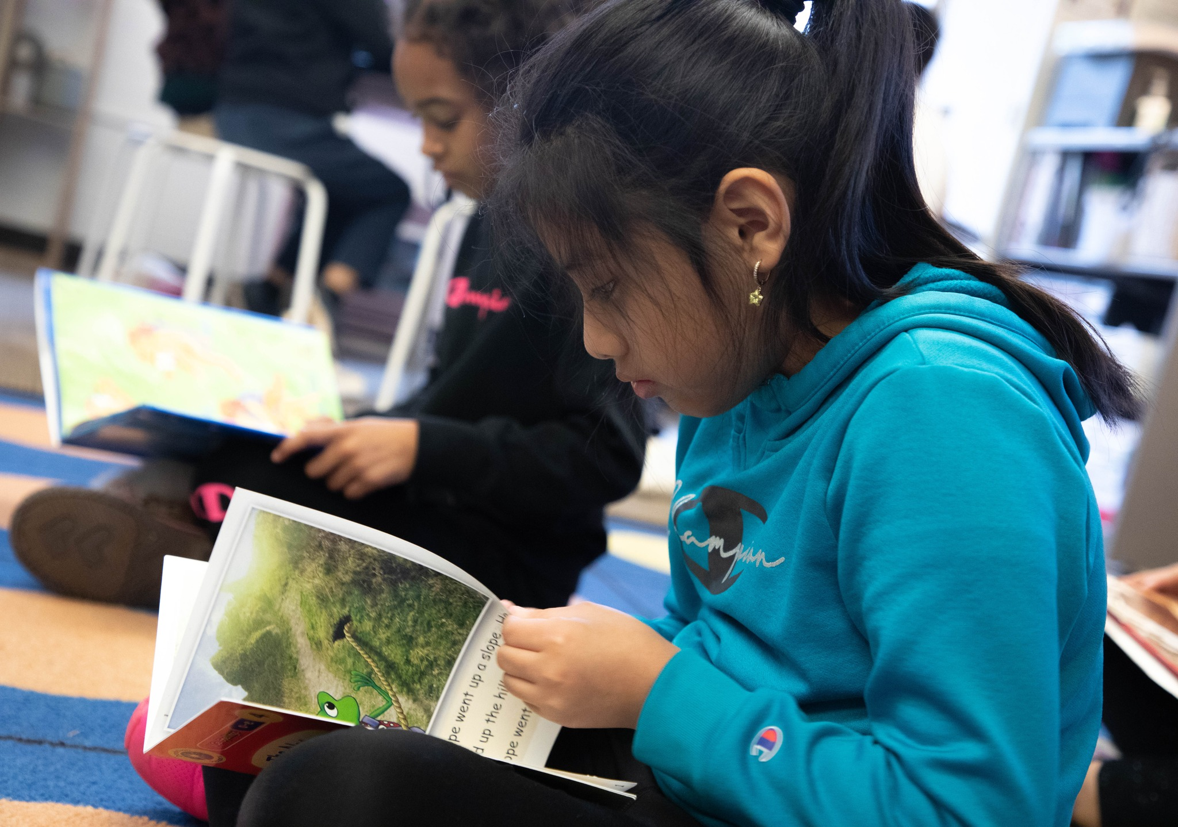
Focus on Literacy
Challenge: Post-pandemic students experienced learning loss and achievement gaps. The need for literacy became the priority.
Innovation: Literacy and Justice for All (LJFA)- Collaborative between United Way, Atlanta Speech School, Learn4Life, Cobb Collaborative, Wellstar, and early learning providers to support every child in Marietta to reach their fullest reading potential.
Flexibilty: 40 additional full-time reading specialists in grades 1-5. These reading specialists will provide intensive reading instruction, delivered through a 1:10 teacher-student ratio, during the reading block to all students in grades 1-5 who are reading below grade level.

Slide 25
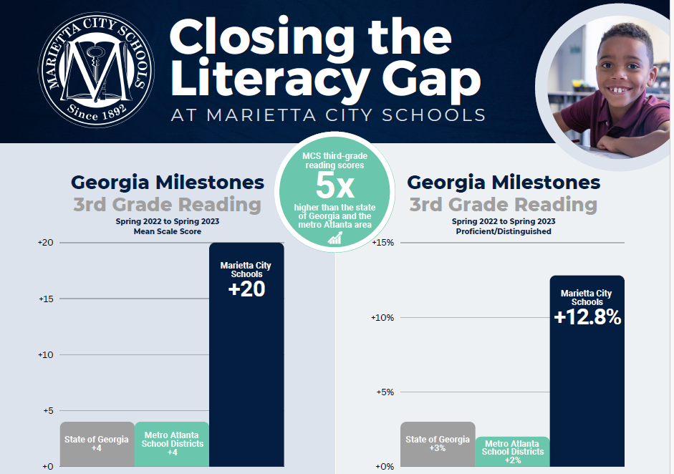
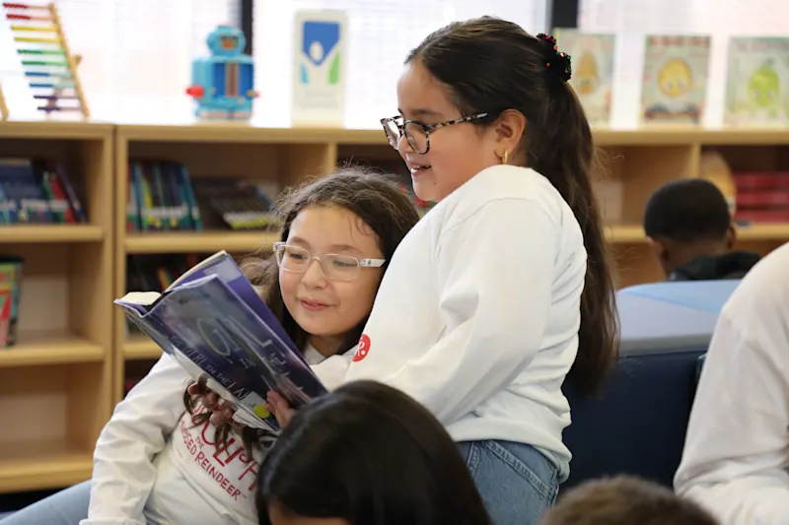
Focus on Literacy
Marietta City Schools’ focus on literacy creates long-term, district-wide success

Slide 26

Focus on Family
Challenge: Following isolation and remote learning due to COVID-19 restrictions, never has the significance of relationships been more important in the education setting.
Innovation: MCS piloted Marietta Parent University (MPU) at Dunleith Elementary School in the Fall of 2022. MPU is focused on Raising Highly Capable Kids (RHCK), which is a 10 session, evidence-based parenting program developed to build stronger families by empowering parents with the confidence, tools, and skills they need to raise healthy, caring, and responsible children. Our program increases parents’ knowledge and skill level of the essential building blocks every child needs — the 40 Developmental Assets from Search Institute, which are proven to increase childhood resiliency and academic achievement.
Flexibilty: Parent liaisons worked in the evenings from 6-8 p.m. to facilliate sessions. Each session families were provided dinner, gas cards, groceries, and childcare. MPU concludes with a graduation ceremony for parents who completed the required sessions.

Slide 27
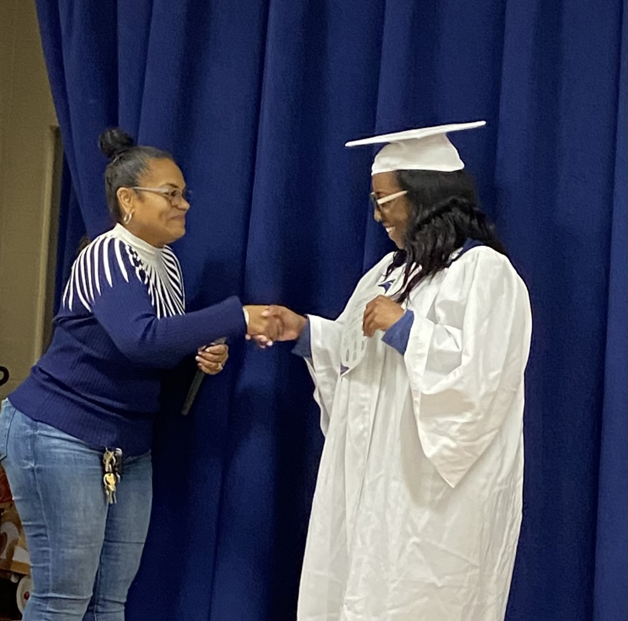
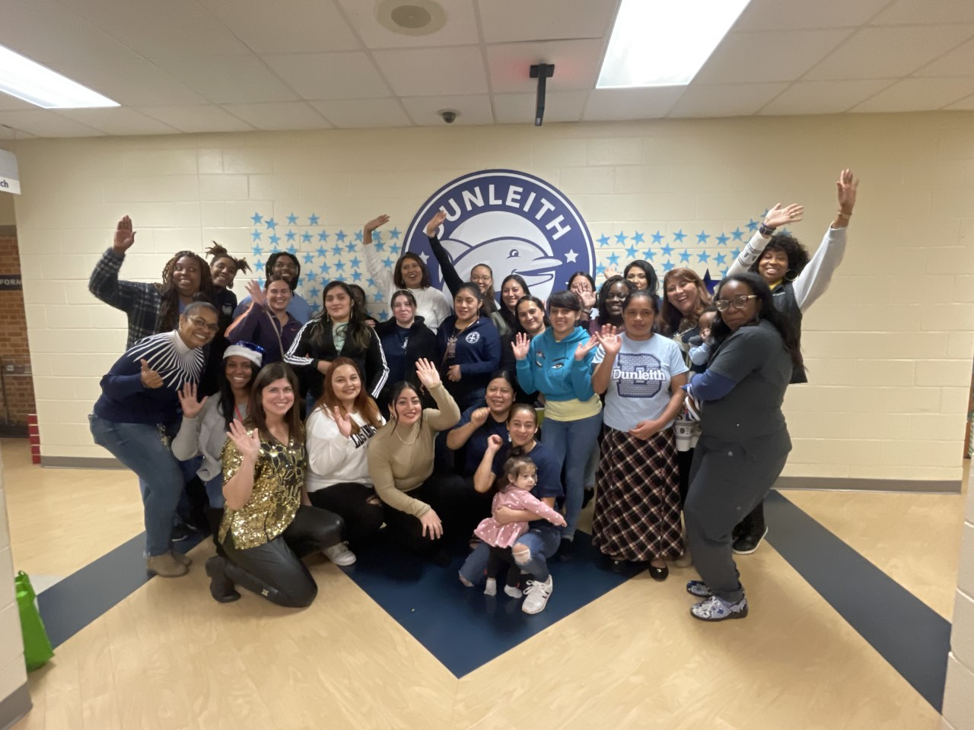
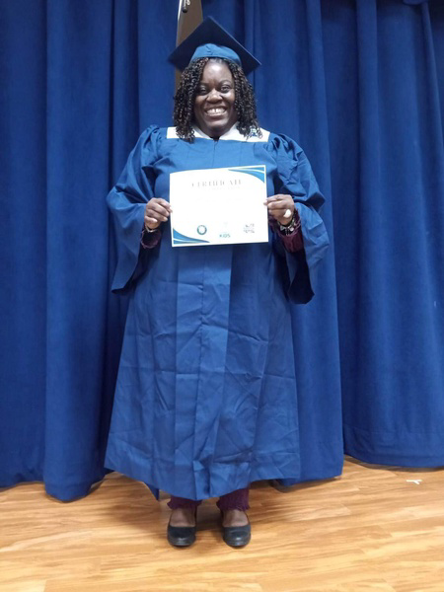
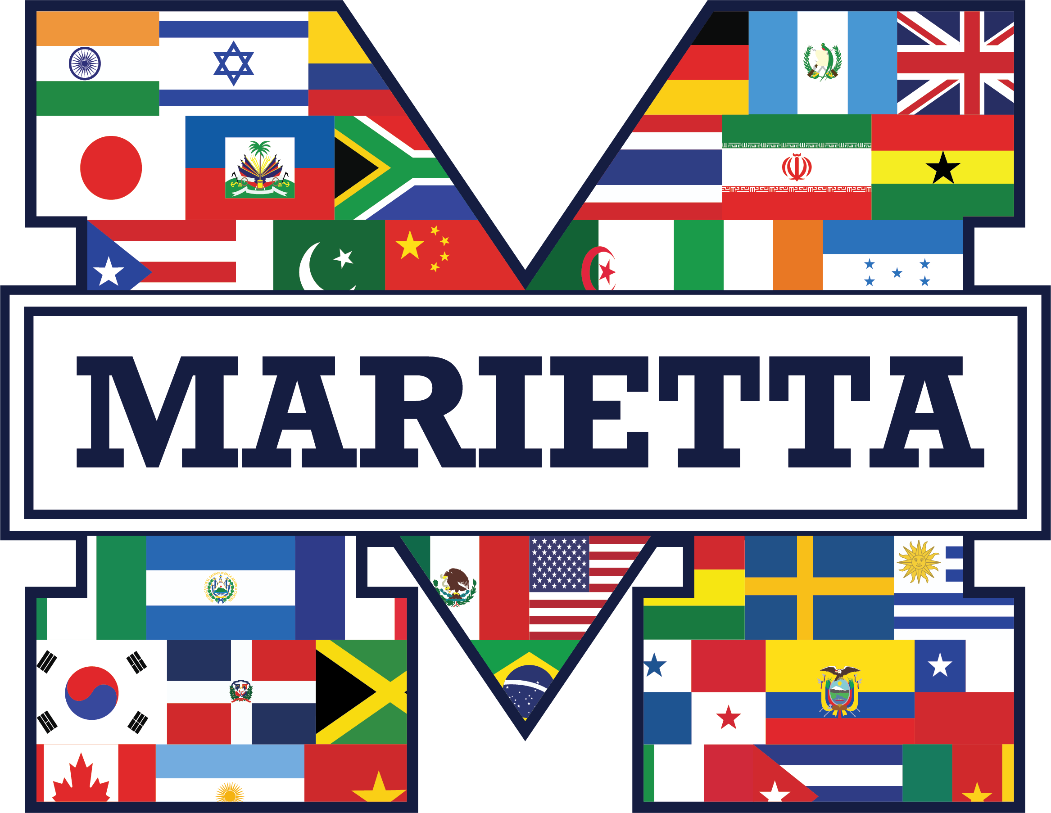
Focus on Family
Marietta Parent University (MPU) was a huge success. Of the 40 families that attended 32 completed all required sessions. MCS has continued MPU at Park Street Elementary School, Marietta Middle School, Sawyer Road, MSGA, and is currently at Hickory Hills. The number of graduates in six schools is over 100!
*MPU even created their own specialized logo to represent the diversity of our students and families.

Slide 28
Tradition Rich – Future Focused
MCS and United Way Continues Free Preschool Program for Early Learners
New “Be Somebody” fund will award $1,000 grants to Marietta graduates
Marietta students lead metro Atlanta with highest SAT growth
Marietta High School achieves the highest graduation rate in school history
Marietta City Schools leads Georgia in school meal innovation through new pilot program
Bridging Classroom and Industry: Marietta High's New Pathway to Career Success

Slide 29
Special. Different. Better.
Contact: Dr. Brittney Bridges
brittneybridges@marietta-city.org

