Slide 1

ENVIRONMENTAL CONTROLS
National City Middle School
Demolition Activities

Slide 2
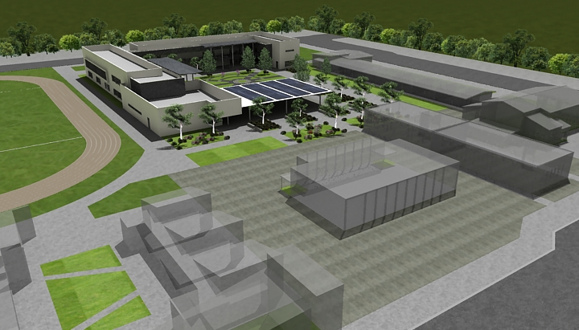
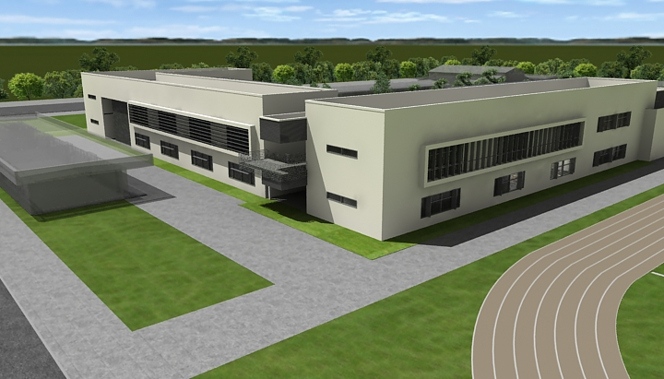
National City Middle School—Phase II
September 18th 2013
SITE PLAN
“GREEN SPACE” - Restore existing modulars
TEACHER PARKING – Fenced and gated
COURTYARD – New Quad

Slide 3
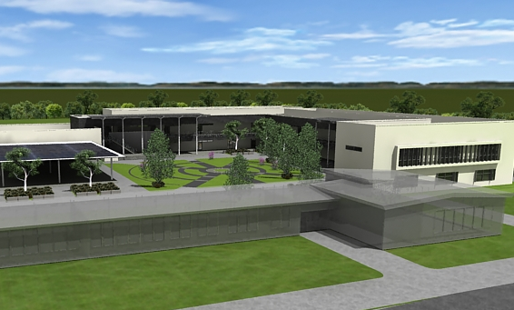
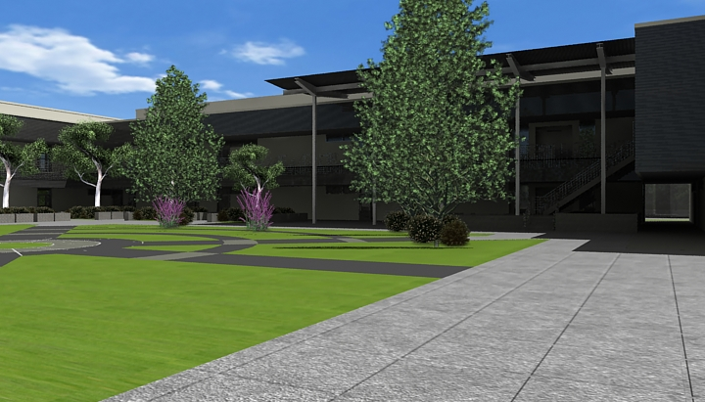
National City Middle School—Phase II
September 18th 2013
FLOOR PLAN
10 CLASSROOMS
ASB ROOM
TEACHER BREAK ROOM
COPY – STORAGE ROOM
COMPUTER LAB
VIDEO PRODUCTION STUDIO

Slide 4
National City Middle School—Phase II
September 18th 2013
QUESTIONS
1) Why was there no baseline before the demo and continual measurements of the dust particle concentration during the demolition?
Baseline testing was performed for the project. GHD was contracted by the District to perform industrial hygiene testing prior to and during demolition. Based upon the known existing hazards, and applicable environmental and safety regulatory requirements, baseline testing of the air was performed for asbestos, and baseline samples of soil adjacent to the buildings being demolished were collected for potential lead determination. An industrial hygienist has also been on the construction site daily, monitoring the air and the release of particulates, both during abatement of hazards and during demolition.
Please also note that the San Diego Air Pollution Control Board (SDAPCD) came to the school site twice before the school administration received complaints regarding health and safety (on 7-24-13 and again on 8-30-13). The July visit was in response to the Project’s Asbestos Abatement notification, while the August visit was in response to the Project’s Demolition notification.
Every air sample collected by GHD during the project work, regardless of whether it was for asbestos, lead, total dust, or respirable dust, has been well below the respective clearance standard or permissible exposure limit.

Slide 5
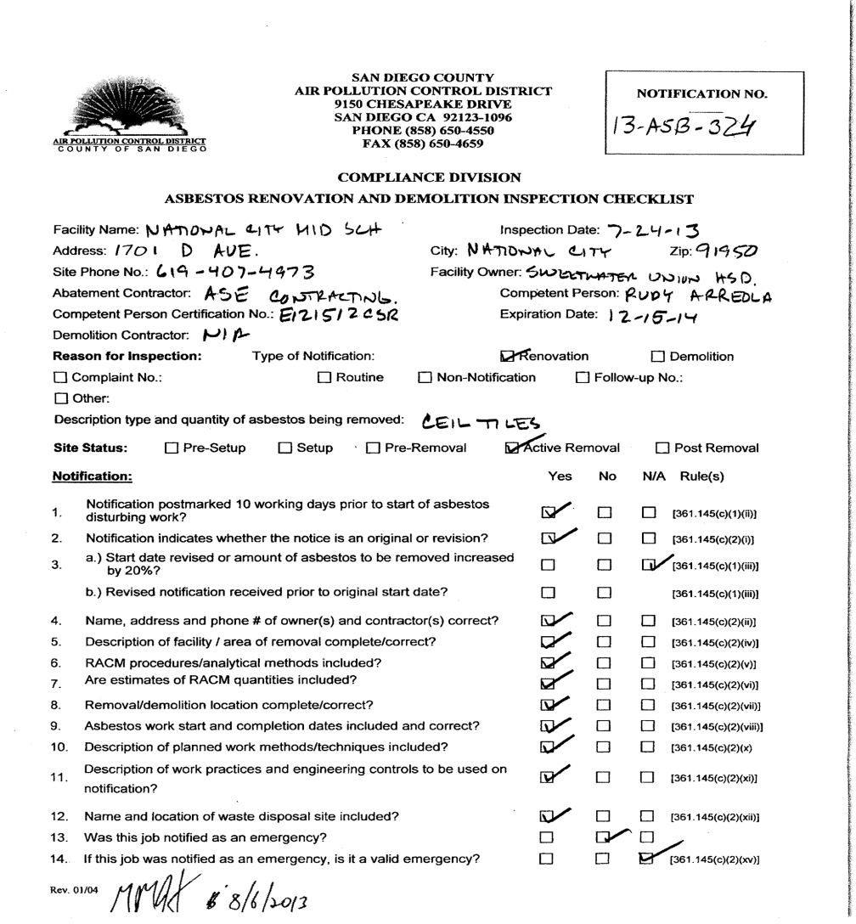
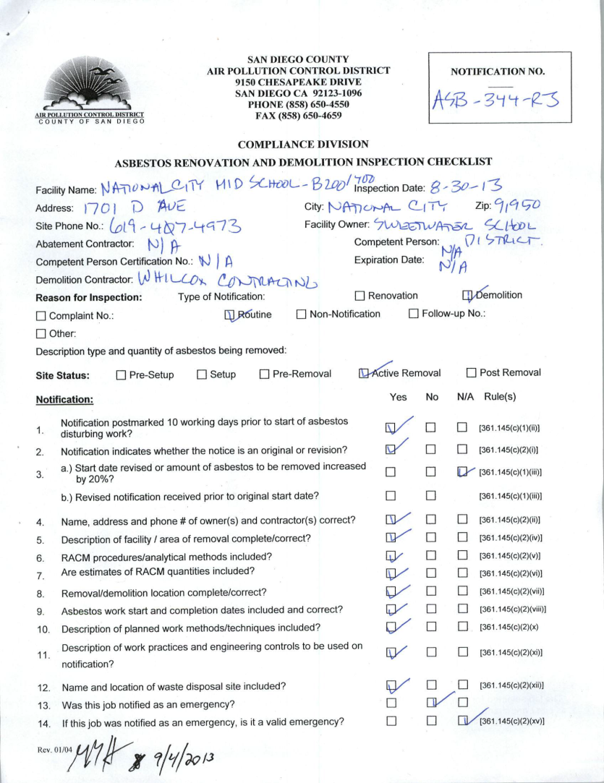

Slide 6
National City Middle School—Phase II
September 18th 2013
QUESTIONS
2) What process has been taken to analyze the soil samples?
To date, no soil sample analysis has occurred. During preliminary investigations, there were no environmental hazards identified with the site, other than the potential for lead from exterior paints being subjected to weathering over the life of the project. There was no reason to believe, for instance, that there had ever been a gas station in the area that may have contaminated the soil with petroleum hydrocarbons.
Lead air samples have been taken during both abatement and demolition, but there has not been one lead air sample that has detected airborne lead (with the detection limit for those samples measured in micrograms of lead per cubic meter of air).
As was mentioned before, baseline samples were collected for lead in soil, but they will not be analyzed unless there is an issue with achieving final clearance following the completion of all demolition activities.

Slide 7
National City Middle School—Phase II
September 18th 2013
QUESTIONS
3) What analysis has been done to determine dust particle size? (Again, the more harmful particles are smaller, able to penetrate deep within the lungs)
Air sampling for nuisance dusts are broken-up into total dust and respirable dust. Total dust, as the name implies, is the total mass (weight) of all dust in the air, while respirable dust is PM10, that is, particulate matter 10 microns in diameter or smaller. The PM10 is the dust I believe you are referring to.
When the first complaints for dust were lodged with the administration, GHD collected total dust air samples and submitted them to a laboratory for analysis. This is standard protocol, since, if total dust is at or below acceptable standards for respirable dust, there is no way that the respirable fraction can exceed the respirable dust standard. Please keep in mind that the total dust usually outweighs the respirable fraction, simply because it makes-up the “heavier” portion of the sample.
Total nuisance dust sampling has been performed on 9 September; sample data was below the detection limit of 0.38 mg per cubic meter of air. By comparison, the OSHA permissible exposure limit for total dust is 10.0 mg per cubic meter of air, while the respirable dust standard is 5.0 mg per cubic meter of air. The results were well below construction standards.

Slide 8
National City Middle School—Phase II
September 18th 2013
QUESTIONS
To go into a bit further detail on the matter of respirable dust, please note the following:
The SDAPCD’s rule regarding dust emissions at a construction site relate to two main points, including how dense the dust cloud is, and whether or not visible dust is leaving the property. There is no requirement to perform air monitoring, unless a concern has been raised (and even then, the testing is voluntary, unless an SDAPCD order is issued).
There has never been an issue of the dust being too dense (there is a standard, called the Ringleman Scale, which the SDAPCD utilizes). The SDAPCD have now been to the site a total of five times (the two mentioned, prior, and three more times since the initial complaints), and they have indicated that the airborne dust levels were acceptable each time.
The air testing that has been performed since 9 September has really been “above-and-beyond”, and is not required, by the SDAPCD, Cal/OSHA, or any other regulatory agency. SUHSD has continued GHD’s work at the site for more than a week, now, to continue monitoring dust and to ensure there is a third party monitoring the demolition work. To date, all airborne results have been orders of magnitude lower than the permissible standards.

Slide 9
National City Middle School—Phase II
September 18th 2013
QUESTIONS
4) What analysis has been done to determine if mold or fungus is present?
Mold is naturally occurring, and there were no visible staining nor was there significant growth to present a hazard. As per even the USEPA’s guidance document on Mold in Schools, there is no need to perform testing related to mold unless there is a visible hazard. A visual inspection of the two buildings which have been demolished was performed prior to demolition, when GHD was performing the clearance visual inspections following both asbestos and lead abatement, and there were no visible signs of mold noted.
Please also note that the District does take mold seriously. In fact, there was a mold incident in Building 200, years ago, and the District had the mold removed by a licensed contractor, and post-abatement testing was performed, then., however, individuals with immunodeficiency diseases may be more susceptible to the symptoms of mold.
To summarize, no mold testing was performed, because there was no identified reason to perform such testing. Airborne sampling can be performed on any given day, in almost any location that isn’t a clean room, and mold will be found in those samples. There was no reason to believe that mold levels inside the structure were any different than the levels that would be anticipated outdoors.

Slide 10
National City Middle School—Phase II
September 18th 2013
QUESTIONS
5) As concrete is broken, what tests are being done to monitor silica particles? (which is happening right now and I see no monitoring taking place)
To take the end of the question, first, there has been an industrial hygiene technician on-site every day that work has occurred since the first day or the project. Since 9 September, there has been air sampling specific to dust being performed, all shift long.
You are correct that the natural aggregates found in cement will make-up a proportion of the dust found in the air while demolition is occurring. Please note, however, that when the total or respirable dust levels are below the Silica Standards, testing specifically for silica is not necessary, since even if it was all silicate-related, it would be within the applicable standard.
The OSHA standard for silica dust exposure is based on personal respiratory monitoring of a specific employee. If deemed necessary, the teacher can be connected to a pump for the full 8 hour work day, and we can get a total test for what they’re breathing. This would involve wearing a small pump on your belt, with tubing running up your back and over your shoulder, so that the cassette utilized for testing is within six inches of the teacher’s mouth and nose area (the breathing zone). Given the results inside or at the fence line of the demolition work areas, this has not been deemed necessary.

Slide 11
National City Middle School—Phase II
September 18th 2013
QUESTIONS
6) Why were the students/staff/community not informed of the possible dangers?
First and foremost, please note that the first several weeks of this project, which began while school was not in session, were spent performing asbestos and lead-based paint removal. Several other hazards, ranging from fluorescent lighting tubes (which can contain mercury vapor), lighting ballasts (which might contain PCBs), and refrigerants, were also removed from the project site during this time. Had this work been performed while school was in session, written notifications would have preceded the work, but then again, this work was the known hazardous work, and the District scheduled this work to take place while school was not in session.
By the time teachers and students returned to the site, based on the sampling data and site monitoring, there was not enough evidence to determine a presence of a hazard that would compromise the health and safety of the staff and students. Though it may be irritating, the fact is that the levels of airborne dust at the project site is not considered a hazard.
As a final note, this project will take more than a year to complete, so it is not possible to perform all of the work which may be annoying to staff or students while school is out of session.

Slide 12
National City Middle School—Phase II
September 18th 2013
QUESTIONS
7) Why are students allowed to eat right next to demolition being done at the same time?
Simply put, the issue of moving the lunch area was not considered because levels of respirable and total dust concentrations were believed to be well below hazardous levels. As it turns-out, this assumption was correct, as has been proven by, as of today, seven-plus days of air monitoring. To complete this response, though, please note the response to Question Number 9, below.
8) Why couldn’t the demolition have been done when no students/staff were present?
As was mentioned in the response to Question Number 6, the abatement of hazardous materials was performed during the break, while students and teachers were not present on the site. Simply put, the project cannot possibly be completed in a timely or cost-effective manner if all work that students and staff might find annoying. The District scheduled the project start in such a manner that the truly hazardous work WAS performed while no students or staff were present.
We would also note, since the question was asked internally by the Project Team, and this is a good question, that local noise ordinances forbid us from working from 3:00, into the evening. There would be no way to get a full shift in, between the end of the school day and the onset of local noise ordinances.

Slide 13
National City Middle School—Phase II
September 18th 2013
QUESTIONS
9) Demolition will not occur during the morning break 9:30—9:45 and lunch 11:30—12:45
The District has given direction to stop demolition and jack-hammering during nutrition breaks (0930-0945) and the lunch breaks (1137 to 1242). This actually creates a burden on the District, since it is restricting the Contractors’ hours of work, but it was decided that it was the correct thing to do, moving forward.
10) Why do the demolition crew wear the white suits.
The white Tyvek suits that you see being worn by some workers is not something that Code requires; they are disposable suits, and at this point, some of the workers wear them to keep clean. It is true that these are the same type of protective suits that were required to be worn by asbestos abatement workers, but to be clear, all asbestos-containing materials (ACMs) in Buildings 200 and 400 were removed by 12 August.
You will note that only a few of the workers on the site are seen wearing them, now (on some days, nobody wears them). If there was hazardous abatement occurring, and the suits were required, they would be required of everyone working in the “hazardous” work area.

