Slide 1

Solid Waste Handling at City-Designated Properties:
Request for Proposals
City of Medford
Committee of the Whole
February 15, 2023

Slide 2

Kit Collins
Steve Dattero
John Doherty
Lois Grossman
Angelica Ortiz
Dina Smith
Jim Shuman
Jaclyn Torres
Yvette Wilks
Solid Waste Citizen Task Force
Met frequently during the fall
Helped draft survey
Conducted outreach
Reviewed results
Made process recommendations
Recommended service levels
Vetted assumptions
Strategy Zero Waste Solutions - Jeremy Drake, Gary Liss
Notes:
Mention that Steve passed away while on the committee; met about 15 times during the summer & fall.

Slide 3
Agenda:
Background
Waste Today in Medford
Process To-Date
Timeline
RFP Goals + Content
RFP Evaluation Criteria + Process Details
Key Questions
Solid Waste Handling: RFP Review

Slide 4
Background:
2010 - signed 13 year contract with Waste Management to provide curbside trash & recycling services
*Contract covers weekly trash, bi-weekly recycling, yard waste and dumpster removal for residents, schools, portions of Medford Housing Authority and some business districts
2021 - City selected Garbage to Garden as recommended curbside composting provider
2022 - City extended WM contract to June 2024
2022 - HandUp selected as preferred mattress hauler, Helpsy as preferred textile collection hauler
Solid Waste Handling: RFP Review
The needs of Medford residents are evolving, as are the solid waste, recycling, and food waste markets

Slide 5
Waste Today in Medford: What
One 64 gallon trash toter, collected weekly
One 96 gallon recycling toter, collected bi-weekly
Yard waste, collected 15 weeks | one Christmas tree collection week
$26 fee for curbside white goods pickup
Up to 3 bulk items per household, collected bi-weekly (costs city $25/item, $400K/year)
Weekly collection of public recycling overflow compactor at City Yard
Solid Waste Handling: RFP Review
Notes:
20 weeks is Best practice for yard waste from DEP
Bulk items, 10-20% no shows

Slide 6
Waste Today in Medford: Who
All one to three family homes
All municipal buildings
All schools, including Catholic schools
Most Houses of Worship, some service
Five business districts (Medford Square, Haines Square, West Medford, South Medford, & Hillside)
Scattered business throughout the city
At least twenty-five condominium buildings
Four Housing Authority sites (Walkling Court, La Prise Village, Willis Ave, Fellsway)
Solid Waste Handling: RFP Review

Slide 7
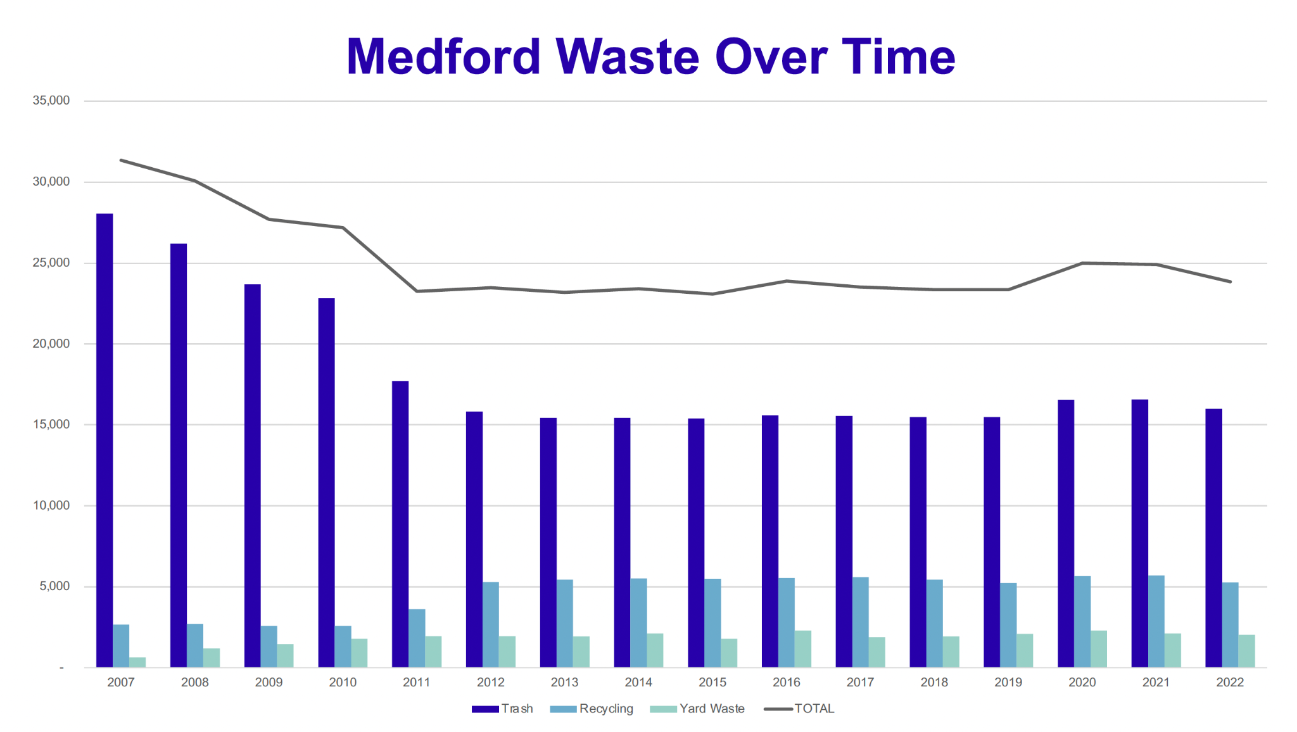
Solid Waste Handling: RFP Review
Single-stream recycling introduced in 2012

Slide 8
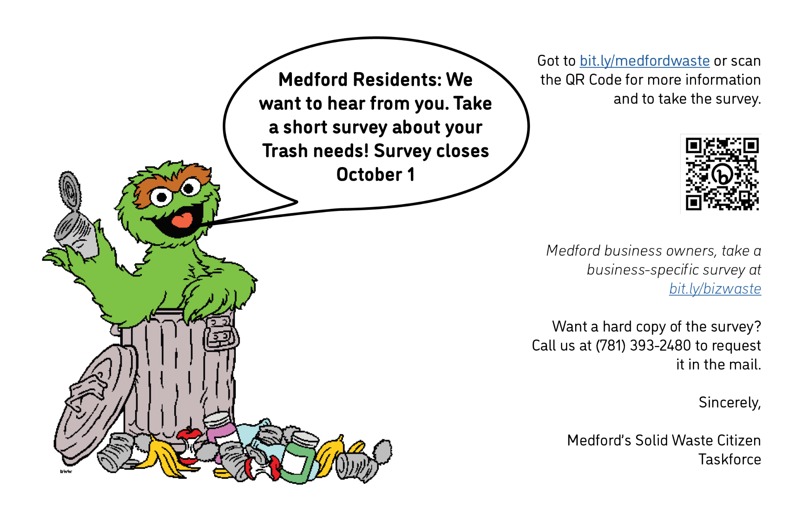
RFP Process To-Date
Community wide survey (750+ responses), translated 4 languages
Tabled at 10+ community events and public spaces
2 public meetings
Participation in NE Regional Working Group (MassDEP)
SZWS initial conversations with 10 regional haulers, all major players express interest in proposing
Strategized on RFP approaches and options
Solid Waste Handling: RFP Review
Notes:
Strategy Zero Waste Solutions

Slide 9
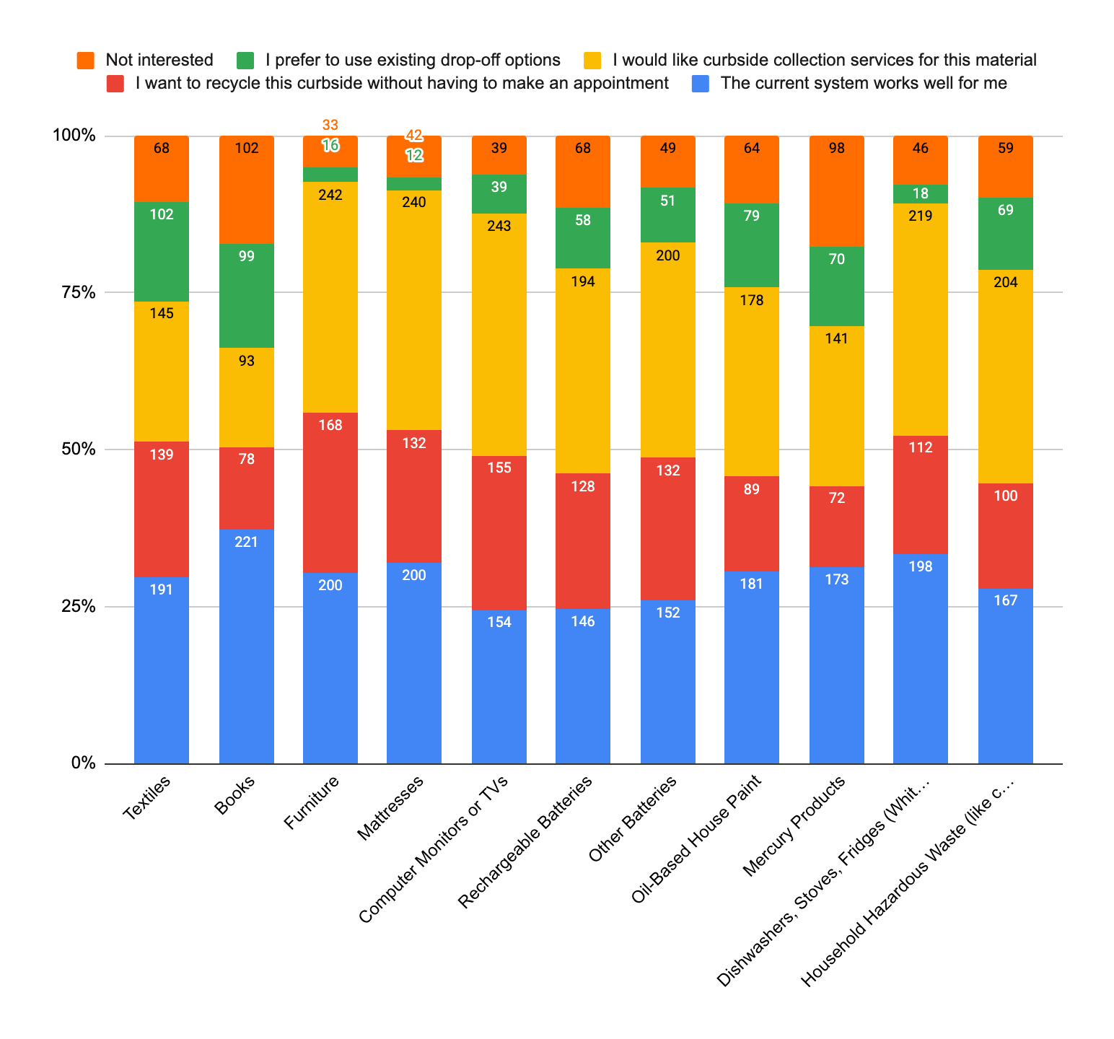
Key Survey Takeaways
Desire for more education + clarity on waste
Desire for increased recycling, yard waste, and organics collection
Desire for more options and events to dispose of different types of waste (hazardous waste, bulk, clothing, etc.,)
Concern about Rodents

Slide 10
Looking Ahead: What’s Next?
March 2023
May/June 2023
June/July 2023
July 1, 2024
Solid Waste Handling: RFP Review
Release + Distribute RFP, Pre-Proposal Meeting with Haulers
Receive Proposals
Award Contract
New Contract Begins

Slide 11
RFP Goals
Control costs for solid waste and recycling collection services
Create fairness and transparency regarding service recipients
Expand recycling and composting services
Provide services comparable to neighboring communities
Streamline transition ensuring continuity of service without interruptions
Move Medford toward Zero Waste
Decrease multiple haulers in business districts to reduce road wear, reduce emissions, and increase overall collection system efficiency
“The City of Medford sees its solid waste and recycling system as both an essential day-to-day operation to provide equitably and as an opportunity to support and enhance its sustainability efforts. With this Request for Proposal, the City seeks to create a solid waste and recycling system that will…”
Notes:
Using current contract as a baseline, mimic what we’re doing in a more fair and transparent way.

Slide 12




Solid Waste Handling: RFP Review
RFP Procurement Notes
Waste services are exempt from procurement regulations:
  “A contract for the collection, transportation, receipt, processing or disposal of solid waste, recyclable materials or compostable materials contracts are exempt from Chapter 30B”
Formal bid process not required
Asking for pricing for different versions, allow price comparisons
Allow competition
Can negotiate service and price
Contract longer than 3 years, will require City Council approval

Slide 13
RFP Content
3 scopes of work, proposals can address one scope or a combination, work with subcontractors
Scope A is core of contract
Scope A – Trash/Recyclables/CRTs/White Goods/Yard Trimmings/Preferred Hauler
Scope B – Organics - curbside
Scope C – Bulky Items
Notes:
The City encourages vendors to partner on proposals and will give preference to vendors who can handle as many of the city’s discarded material streams as possible, whether collecting and disposing and/or processing themselves, or through utilization of trusted subcontractors.

Slide 14

Preferred Hauler
Standard rates for all Medford entities
Create efficiency
Service buildings not covered by municipal contract
Economies of scale - reduced cost to all Medford entities
Bundled recycling & trash
Level playing field
Notes:
Document explaining here: https://docs.google.com/document/d/1WqjOPvkBooZDeKIZtrv4dOUuRXl4h16Xri_PqsnizcE/edit
Note - mandatory recycling is the main focus of the hauler ordinance

Slide 15






Scope A - Who
Includes:
Residential dwelling units in residential properties of 1-4 units
Commercial buildings up 2500 SF
+ 5 business districts*
All houses of worship
All K12 schools
All municipal facilities
Medford Housing Authority properties
*Medford Square, South Medford Square, West Medford Square, Haines Square, and Hillside
Notes:
Talk about change from current services? Using current contract as a baseline, mimic what we’re doing in a more fair and transparent way.

Slide 16


Scope A - What
Service levels requesting pricing
Minimum 20 weeks Yard Waste
Bi-Weekly Recycling + Bi-Weekly Trash
Weekly Recycling + Weekly Trash
Bi-Weekly Recycling + Weekly Trash
CRT/White Goods Collection
64 gal trash & 96 gal recycling containers
Notes:
Getting pricing on multiple service letters for budgeting purposes - highlight which is our goal service level. Research shows that more frequent recycling pickups doesn’t measurably increasing recycling rate. We believe we need every other week trash to afford new organics service.

Slide 17
RFP Evaluation Criteria
Experience
References
Key Personnel Qualifications
Transition & Implementation Plan
Plan of Services
Financial Responsibility
Customer Service
Outreach & Education
Environmental benefits
Value-added offerings
Other
Notes:
Page 16 of the RFP

Slide 18

Acknowledgements
March 2023 - release RFP
May/June 2023 - receive proposals
June/July 2023 - award contract
July 1, 2024 - start service
We’d like to recognize the key people who have been a part of this process:
Citizen Task Force:
Kit Collins
Steve Dattero
John Doherty
Lois Grossman
Angelica Ortiz
Dina Smith
Jim Shuman
Jaclyn Torres
Yvette Wilks
The Office of Planning, Development, and Sustainability:
Madeleine Levin
Alicia Hunt
Theresa Dupont
Department of Public Works:
Tim McGivern
Mary Menezes
The Office of Procurement:
Fiona Maxwell
StrategyZero Waste Solutions
Jeremy Drake
Gary Liss

Slide 19
SLIDES BELOW are reference documents if needed, no need to format.

Slide 20
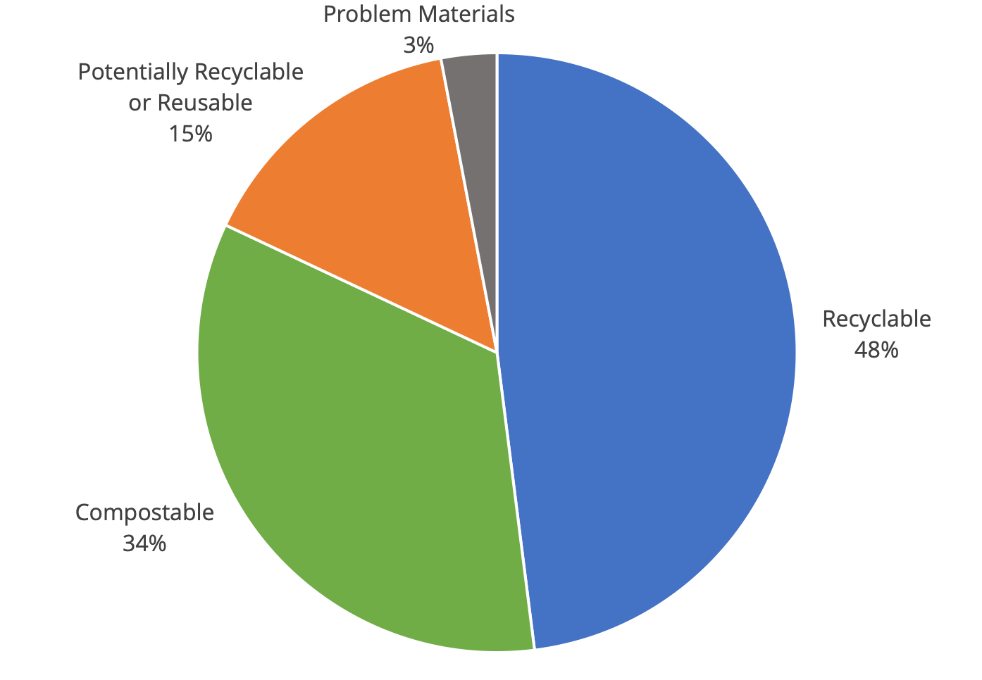
Source: US EPA 2018

Slide 21
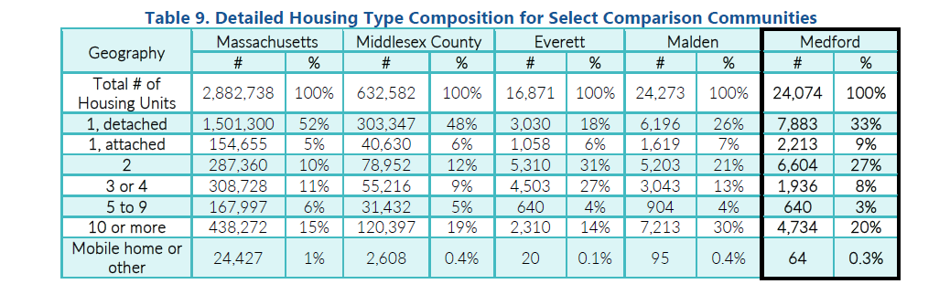
4 units and fewer = 78% of population
5 units and more = 22% of population
Source: US Census American Community Survey 2018

Slide 22
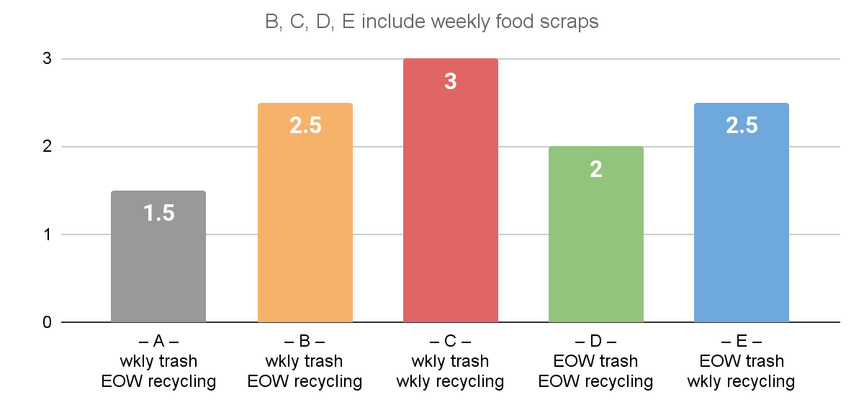
Trucks per Week by Scenario
Notes:
All trucks, trash, recycling & organics

Slide 23
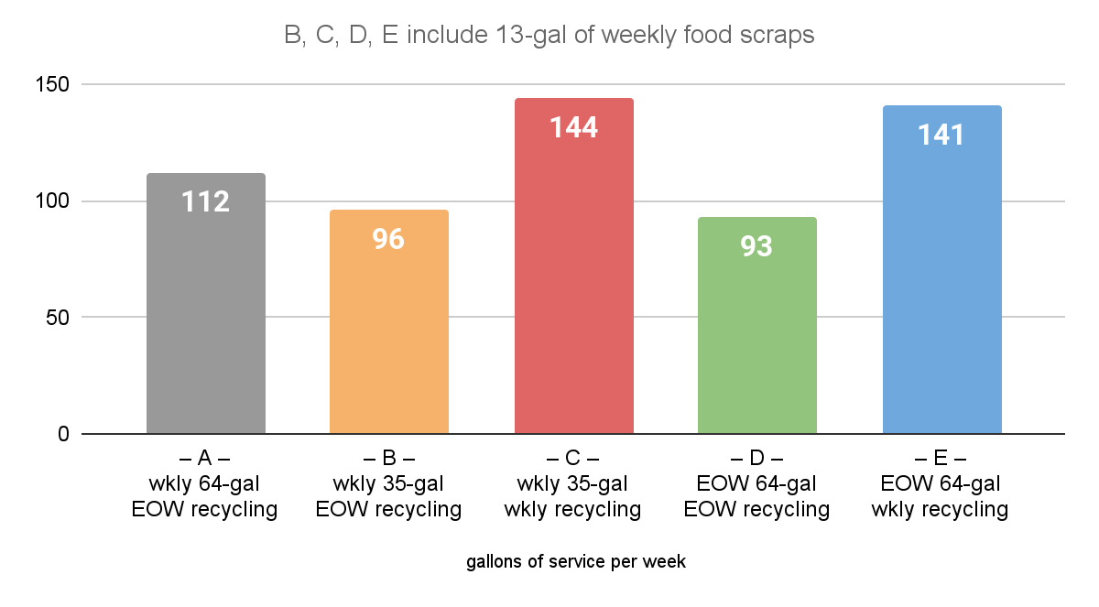
Volume of Service by Scenario

Slide 24
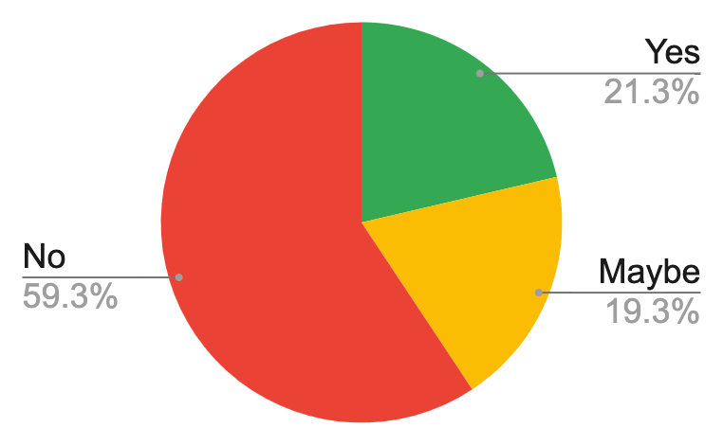
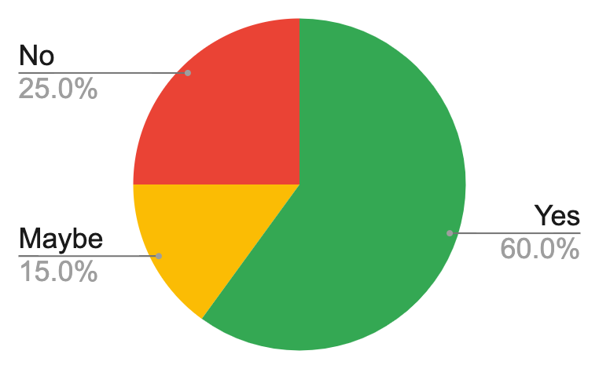
Attitudes about Bi-Weekly Trash
Would you be interested in moving to every other week trash collection if you had weekly food scraps collection?
Online Survey
Workshop Poll #2

