Slide 1
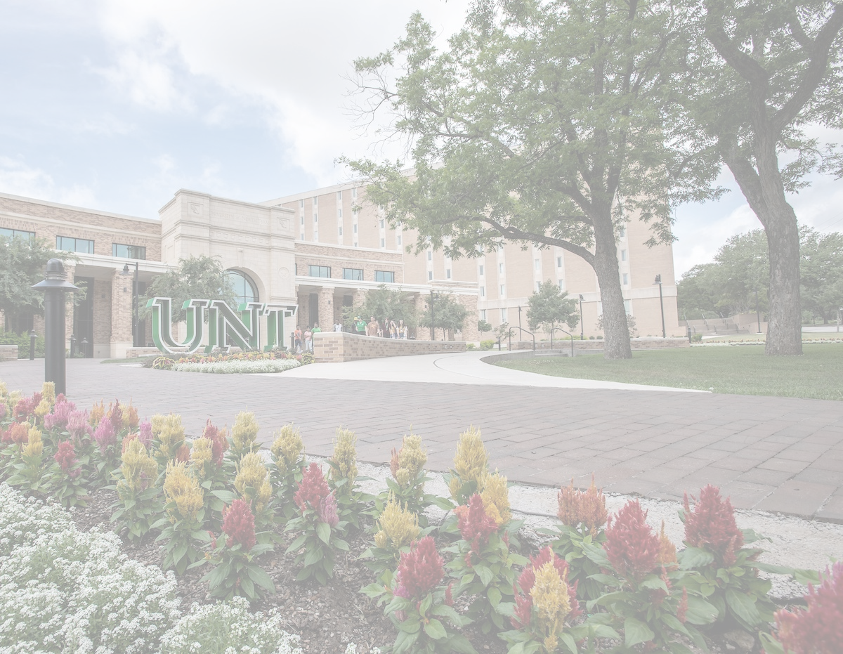

Financial Aid Night
PRESENTED BY:

Slide 2
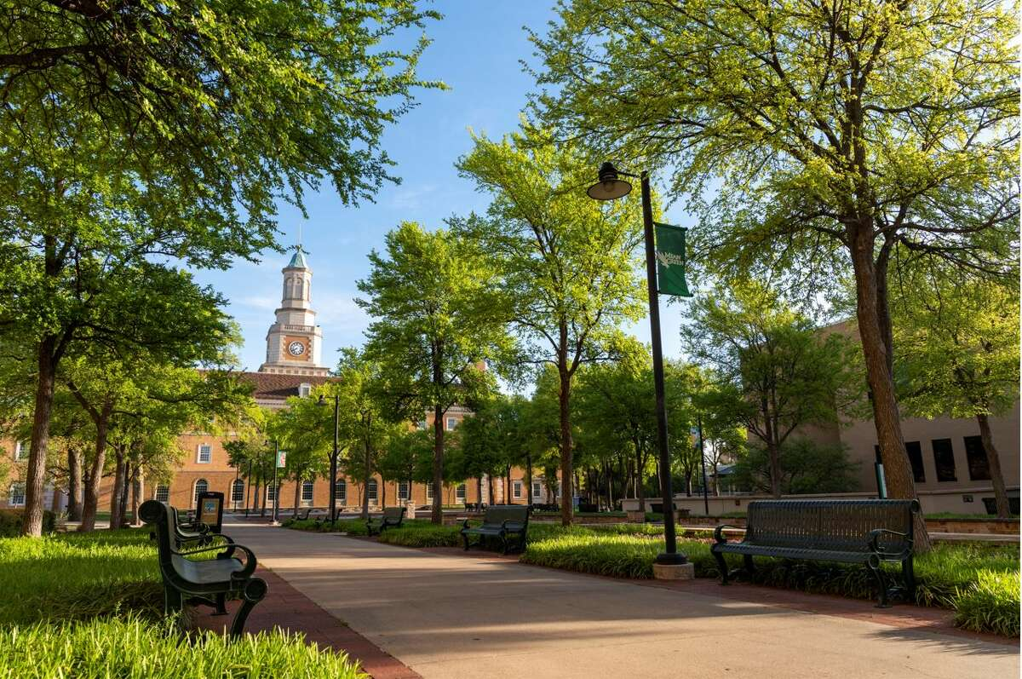




Principles of Financial Success
Apply Early
Be aware of Deadlines
Be aware of Options
Be aware of Resources

Slide 3

COMPLETE A FINANCIAL AID APPLICATION
Complete a financial aid application:
Once a year – every year!
2026-2027 applications available now!
FAFSA: fafsa.gov
eTASFA: highered.texas.gov/students-families/tasfa
Use Prior Prior** income information
UNT’s 26-27 Priority Date: Jan 15, 2026*
FAFSA & TASFA
FREE APPLICATION FOR FEDERAL STUDENT AID
TEXAS APPLICATION FOR STATE FINANCIAL AID
**Use 2024 income information to complete
the 2026-2027 FAFSA or TASFA.

Slide 4
FAFSA or TASFA?
Free Application for Federal Student Aid – FAFSA
Students with one of the following residency statuses should complete the FAFSA to qualify for federal, state, and institutional aid:
US citizen
US national
US permanent resident (Form I-551 or I-151)
US conditional permanent resident (I-551C)
Eligible noncitizen with an Arrival/Departure Record (I-94)
Eligible noncitizen with T nonimmigrant status (T-visa)
Eligible noncitizen whose parent holds a T-1 nonimmigrant status
Citizens of the Federated States of Micronesia, the Republic of the Marshall Islands, or the Republic of Palau
Texas Application for State Financial Aid – TASFA
Students do not meet the residency requirements to receive aid through FAFSA may be eligible to receive aid through the TASFA. Eligible students should complete an application to qualify for state and institutional aid. To be eligible for aid through the TASFA, students:
Must be classified as a Texas resident and lawfully present in the U.S.
Must have graduated from a Texas high school or obtained a GED in Texas
Must have lived in Texas at least 12 months prior to enrolling in a public college/university (in Texas)

Slide 5

PREPARING TO APPLY
WHAT YOU WILL NEED TO COMPLETE THE 2026-2027 FAFSA:
A verified StudentAid.gov account
Contributor Information Email address 2024 Tax and Income Information UNT’s School Code: 003594 Federal Income Tax Return for 2024 2024 Records of Untaxed Income (if applicable) 2024 Records of Financial Assets (if applicable)
FINANCIAL AID
Notes:
Things to have ready and complete by the time you apply!

Slide 6
FAFSA Steps
Create an FSA ID (both student and parent/contributors)
Log in at fafsa.gov to start online application and select “Start New Form”
Determine Dependency Status
  FAFSA will ask a series of questions that determine whether you are dependent or independent student for the purposes of applying for federal aid.
(If Dependent) – Report Parent’s Information
  FAFSA will ask series of questions to determine which parent will need to provide further information.
  Based on answers, student will be prompted to provide further parent email so that parent can be invited to complete their portion of the FAFSA. Identified contributors will receive an email from FAFSA with instructions.*
Student Demographics – Does Not Impact Eligibility and can select “Prefer not to answer” for any question.
High School Completion Status
Student Financial Information
List at least one school to receive your FAFSA information (UNT code is 003594)
Review Information and Sign*
*Parents/Contributors that are invited to complete FAFSA must complete their portion before the full FAFSA can be submitted. After student signs their portion, they will be able to see invited contributors and whether the contributors have completed their portions.

Slide 7

THINGS TO KEEP IN MIND
Not using student’s legal name
Incorrect Social Security Number
Guessing income earned by contributor(s)
Incorrect household size
Not provide Consent of Information
Not signing the application
Saving but not submitting the application
COMMON ERRORS
Notes:
Legal name = name as it appears on SSN Card
Income earned by contributors – use exact numbers as they appear on W2s if prompted to manually enter info.
Household size – include all members in the household who are part of the family unit
Authorizing consent to transfer IRS information and send to schools.

Slide 8
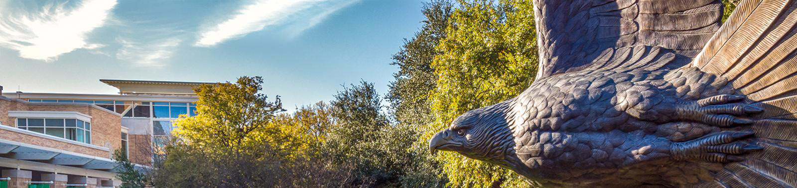
I submitted a FAFSA – now what?
Post-Processing Experience for Students
Students who applied online will receive an email to access their FAFSA Submission Summary by logging in to StudentAid.gov once available. Students will receive an email to their UNT email, EagleConnect, once UNT has received their FAFSA. Additional action items will be posted on your myUNT TASK List to continue processing your application.

Slide 9
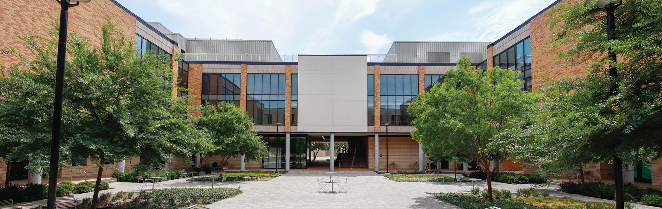
Special Circumstances
CHANGES IN INCOME
EXTRAORDINARY EXPENSES
  Loss of job
  Separation or divorce
  Loss of parent
  Loss of benefits
  (child support, social security)
  Medical/Dental expenses
  Elementary/ Secondary school tuition
  Elder care expenses
The 2026-2027 Special Circumstances Form will be available online at in 2026!
https://financialaid.unt.edu/financial-aid-forms.html
Notes:
26-27 form available Spring 2026. If you already have a Student Aid Index (SAI) of "0" or less, indicating you are already receiving the maximum amount of financial aid you qualify for that was available at the time of you being awarded.

Slide 10
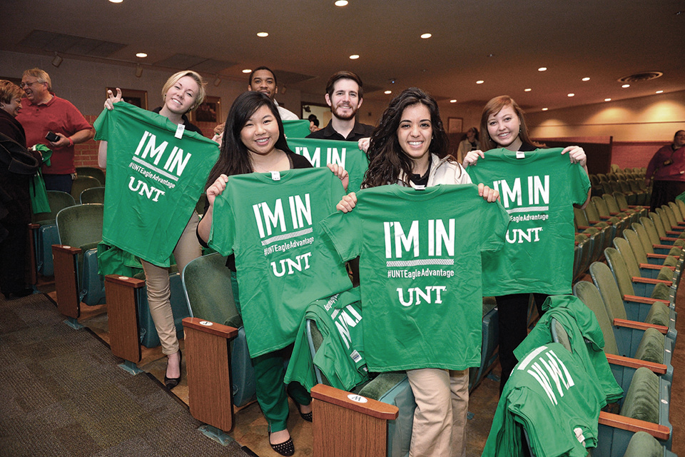
THINGS TO KEEP IN MIND
Apply for financial aid and scholarships annually through all available sources
Monitor studentaid.gov for application updates.
Monitor my.unt.edu and your EagleConnect email frequently for updates!
Keep signed copies of tax returns and W-2s in case you are required to submit them to the financial aid office for verification
Complete any outstanding TO DO List or TASK List items as soon as possible!
IMPORTANT REMINDERS

Slide 11

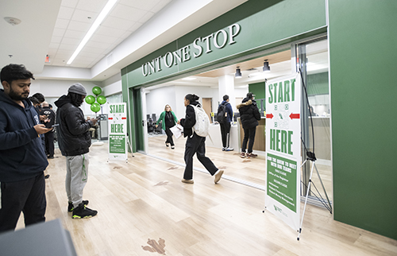
NEED HELP AFTER TONIGHT?
UNT One-Stop Office Hours
CONTACT INFORMATION
Monday-Friday, 8:00 a.m.-5:00 p.m.
2nd Level of the Eagle Student Services Center (ESSC)
  (940) 565-2302 Direct
  (940) 565-2738 FAX
Questions? Scrappy has answers!
ScrappySays.unt.edu
Federal Student Aid Information Center
  1-800-433-3243
  Live Chat available online
  Email available online
  studentaid.gov/help-center/contact
financialaid.unt.edu – scholarships.unt.edu
Notes:
Students should be encouraged to contact us via a webform via the ScrappySays.unt.edu website. This has taken the place of our email account.

