Slide 1



College Money Ready
Join DATCU your Local Credit Union

Slide 2
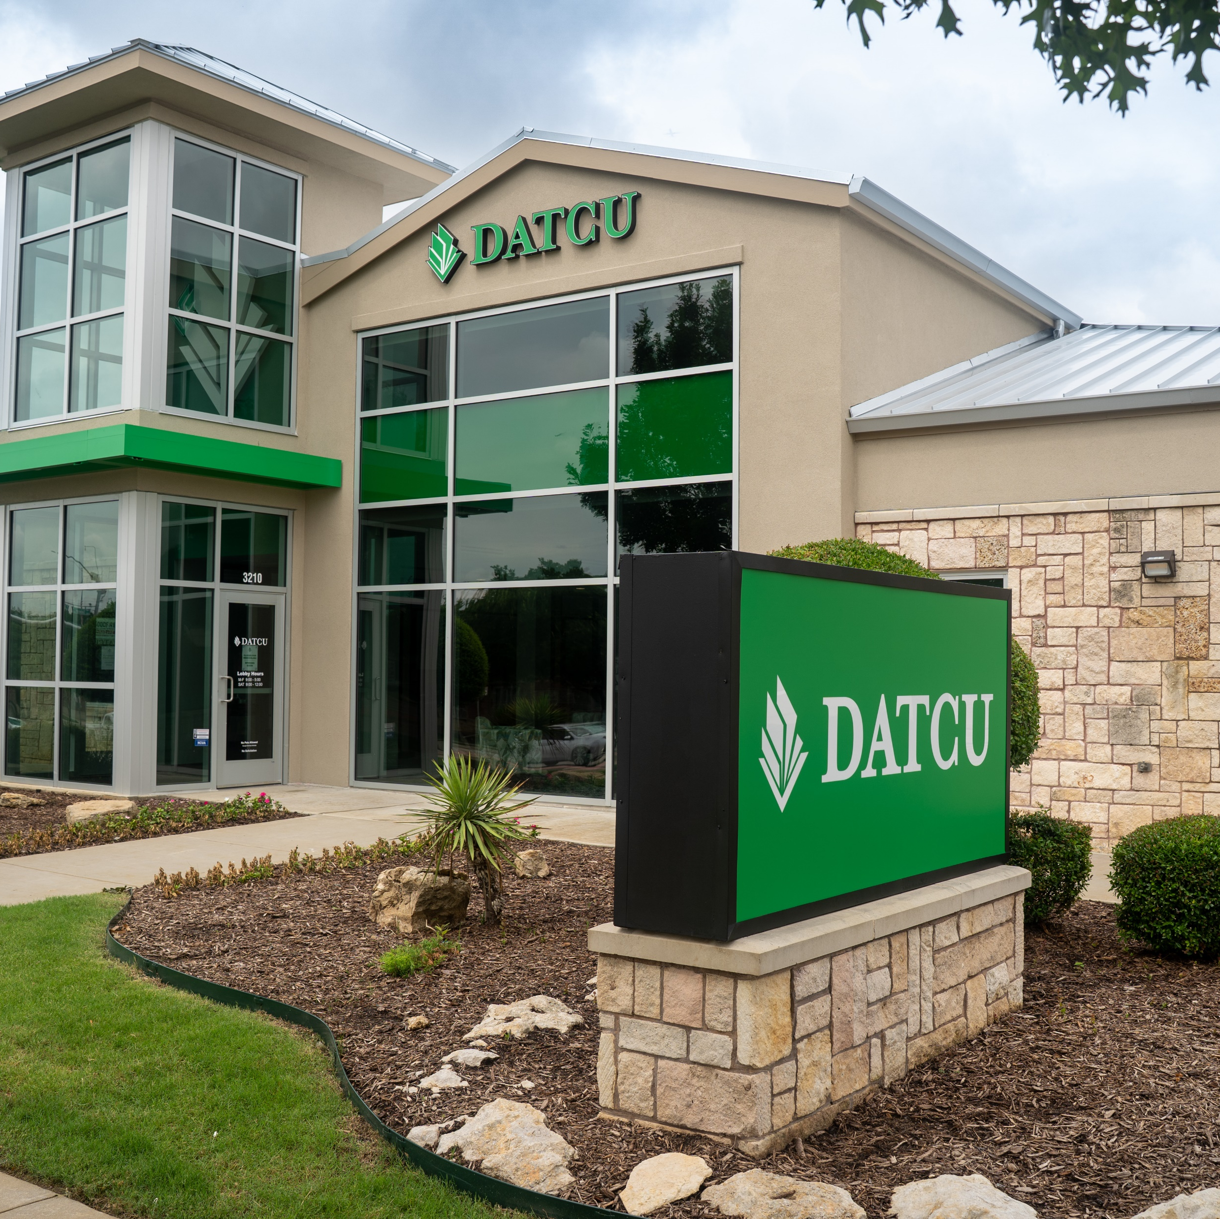

DATCU
Since 1936
DATCU has served Denton and surrounding communities with financial products and services.

Slide 3

Forms of Money
Despite the misconception of kids throughout time, money doesn’t grow on trees. Over the years money has changed into many forms…
Cash
  Easy to track your money
  Spends at MOST places
  If it’s lost, it’s lost
Checks
  Checks are getting less common
  Checks can take longer to clear your account
  Checks can open you up to fraud

Slide 4
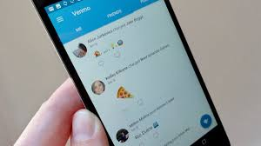
Forms of Money
Gift Cards
  If lost gift cards can be reported to the issuing company and many times losses can be stopped
  Can be restrictive to certain merchants
  Unused balances can go away over time
  Hard to manage remaining balances
Venmo/Zelle/Debit and Credit Cards
  Transfer funds quickly from person to person or person to merchant
  Apps like Apple Pay and Google Pay allow you to connect your phone to a debit card or credit card and make purchases through an encrypted method

Slide 5
Types of Accounts

Slide 6

Types of Accounts
Savings Accounts
Interest earning account
You must have a savings account at a Credit Union. Your primary account at a Credit Union is your membership (savings) account. All of your other services and accounts will be attached to your membership account

Slide 7

Types of Accounts
Checking/Debit Accounts
Unlimited Transactions
Funds can be accessed by in person transactions, checks, debit cards and Zelle
DATCU FREE Checking for your student

Slide 8
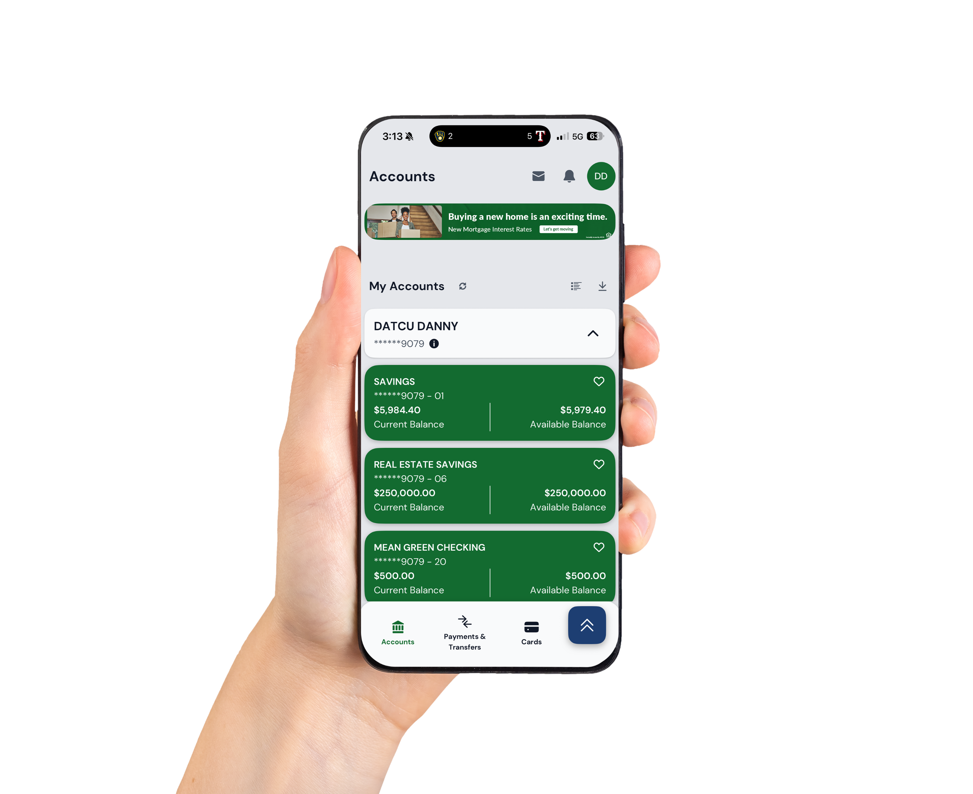
DATCU APP
Banking in your pocket
Connect in the blink of an eye.
Our digital banking tools offer round-the-clock convenience.

Slide 9

DATCU
CARDS on
CARDS
Debit and Credit Cards- how your student uses them matters

Slide 10
Ways to pay for college
Savings Account- create a separate savings account for college expense: 529 Savings plans, Money Market, Investment accounts all can be used to save for college-consult your financial advisor for options
Scholarships- many school districts are supported by education foundations that provided scholarships to graduating seniors- the Lewisville ISD Education Foundation is available to LISD seniors-applications open on November 3rd-January 9th- one application over $350,000 scholarships awarded annually-check with your school counselor for more details
National Grants- not paid back- need based
FASFA- Financial Aid/Student Loans

Slide 11
Other Things to Consider…
Discuss/set a budget for your student while at college
Set expectations for what expenses will be paid for by parents and student
Part-time job options- will your student work while at college?
Discuss use of borrowing/credit while in college

Slide 12
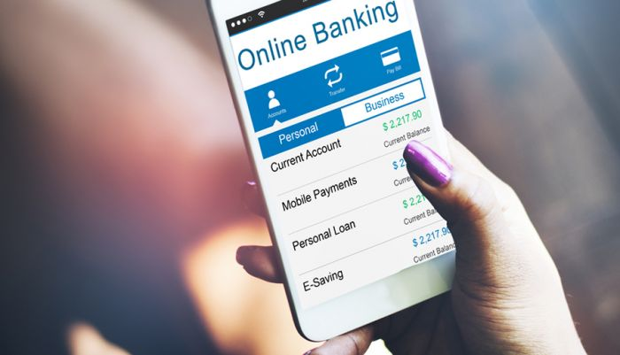
Tools
Online Banking
Online Banking allows you to view and make transaction on your own accounts.
E-Statements
Instead of receiving your bank statements in the mail, your statement is published on your online banking and may be printed. This is a faster and safer option to receive your bank statements.
Bill Pay
You can set up your monthly payments such as loans, utilities and rent in a very efficient payment method. Payments can be set up on manual pay or automatic payment.
Transfer Balances
You can quickly transfer money between your different accounts. Many financial institutions allow you to transfer money to other individual accounts through their online banking.

Slide 13
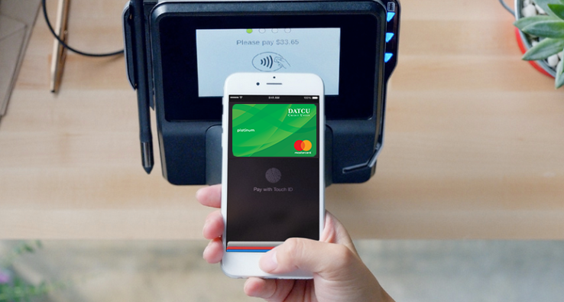

Tools
Mobile Application
Most financial institutions offer online banking through a mobile application. Most of the mentioned tools are available to you through the offered app.
Remote Deposit Capture
This tool allows you to use a mobile device to take a picture of the front and back of a check and deposit that item through the financial institutions mobile app.
Account Alerts
Set up alert to let you know when anything happens on your account such as low balance alerts, large transaction alerts, deposit notification, etc.

Slide 14
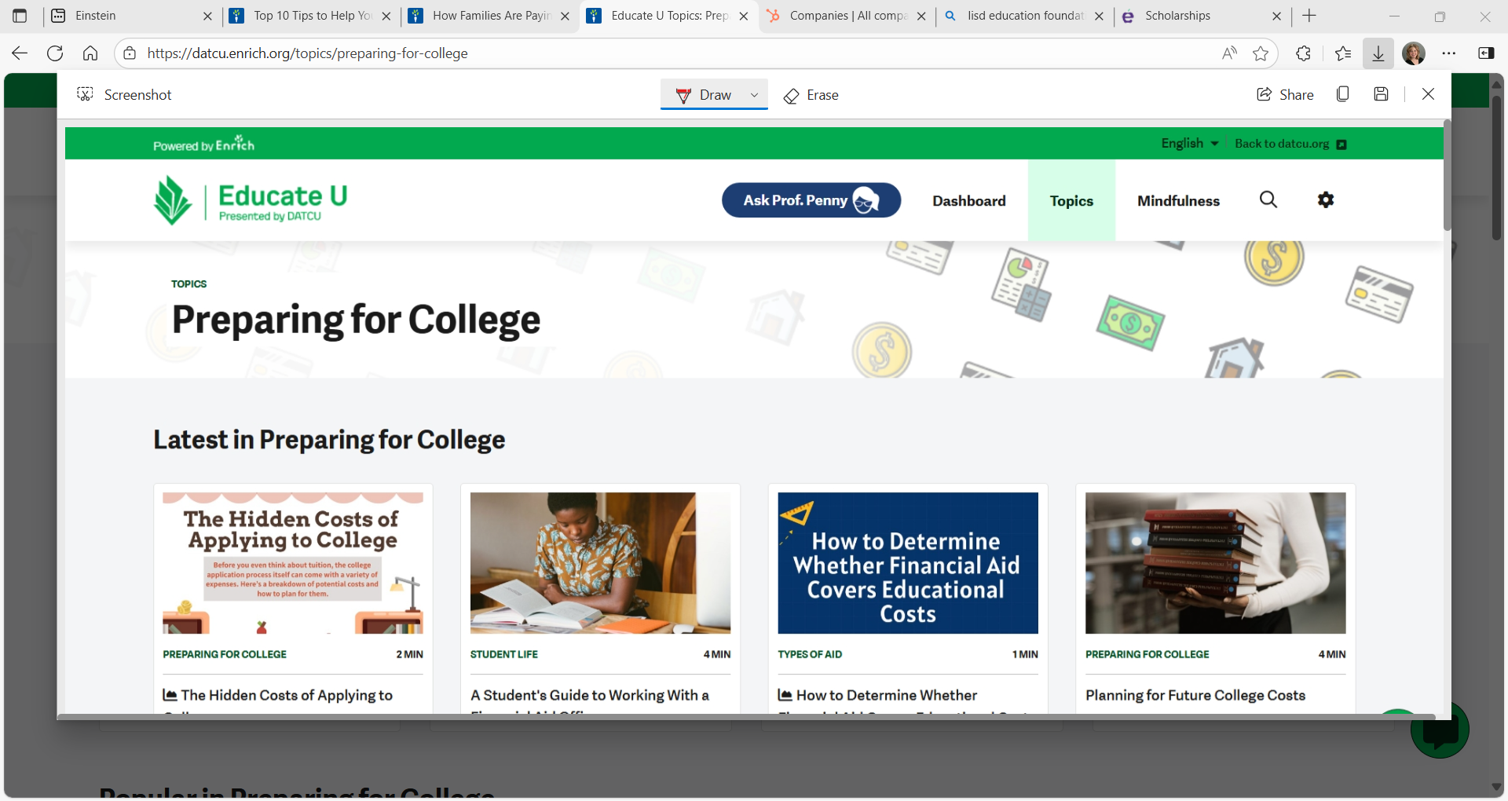
www.datcu.enrich.org

Slide 15


Slide 16
Thank
You
For Joining This Presentation

