Slide 1
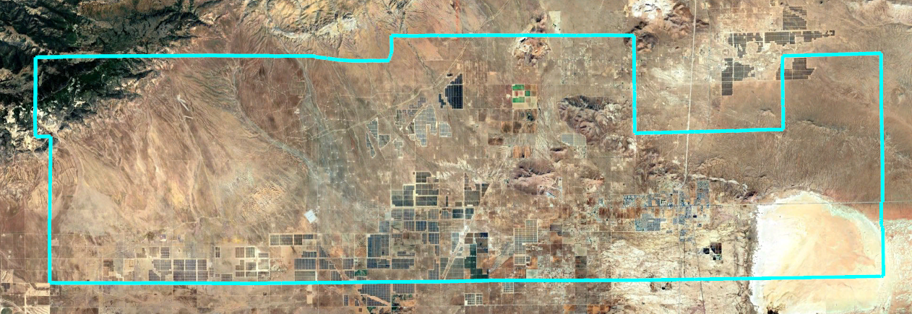
Southern Kern Unified School District
Introduction to Districting

Slide 2
Election Systems
“At Large”
“From District” or “Residence” Districts
“By District”
The California Voting Rights Act was written to specifically encourage by-district elections.

Slide 3
California Voting Rights Act (CVRA)
Under the Federal Voting Rights Act (passed in 1965), a jurisdiction must fail 4 factual tests before it is in violation of the law.
The California VRA makes it significantly easier for plaintiffs to force jurisdictions into “by-district” election systems by eliminating two of the US Supreme Court Gingles tests:
  Can the protected class constitute the majority of a district?
  Does the protected class vote as a bloc?
  Do the voters who are not in the protected class vote in a bloc to defeat the preferred candidates of the protected class?
  Do the “totality of circumstances” indicate race is a factor in elections?
Liability is now established by just the presence of racially polarized voting and dilution of the protected class’s ability to elect or influence the outcome of elections.

Slide 4
CVRA Impact
Switched (or in the process of switching) since CVRA passage:
  At least 343 school districts
  46 Community College Districts
  209 cities
  1 County Board of Supervisors
  78 water and other special districts.
Cases So Far:
  Palmdale and Santa Clara lost at trial.
  Santa Monica is awaiting a new trial. Burbank and Huntington Beach trials are upcoming.
  Modesto and Palmdale each spent about $1.8 million on their defense (in addition to the attorney fee awards in those cases).
  Santa Monica has spent an estimated $8 - $10 million so far. Plaintiffs in Santa Monica requested $22 million in legal fees after the original trial.
Key settlements:
  Palmdale: $4.7 million
  Modesto: $3 million
  Highland: $1.3 million
  Anaheim: $1.1 million
  Whittier: $750,000
  Santa Barbara: $600,000
  Tulare Hospital: $500,000
  Camarillo: $233,000
  Compton Unified: $200,000
  Madera Unified: about $170,000
  Hanford Joint Union Schools: $118,000
  Merced City: $42,000
An estimated $16 million in total settlements and court awards so far.

Slide 5
Districting Process
Step | Description
Two Initial Hearings November 5 & 19 | Held prior to release of draft maps. Education and to solicit input on the composition of districts.
Release draft maps By November 21 | Maps must be posted at least 7 days prior to 3rd hearing.
Two hearings on draft maps December 10 and 17 | Two meetings to discuss and revise the draft maps and to discuss the election sequence.
Final Hearing & Board Action January 14, 2026 | Special meeting for Board selection of a map and election sequence.
County Committee Hearing To be determined | Following the Board’s selection of a preferred map, the County Committee on School District Organization will hold a hearing and must approve a map.

Slide 6

Districting Rules and Goals
1. Federal Laws
2. California Criteria
2. California Prohibition
Equal Population
Federal Voting Rights Act
No Racial Gerrymandering
In prioritized order:
Geographically contiguous
Avoid division of neighborhoods and “communities of interest”
(Socio-economic geographic areas that should be kept together)
Cities and CDP’s
Easily identifiable boundaries
Compact
(Do not bypass one group of people to get to a more distant group of people)
“Shall not adopt election district boundaries for the purpose of favoring or discriminating against an incumbent, political candidate, or political party.”
3. Other Traditional Redistricting Principles
Future population growth
Other local considerations

Slide 7
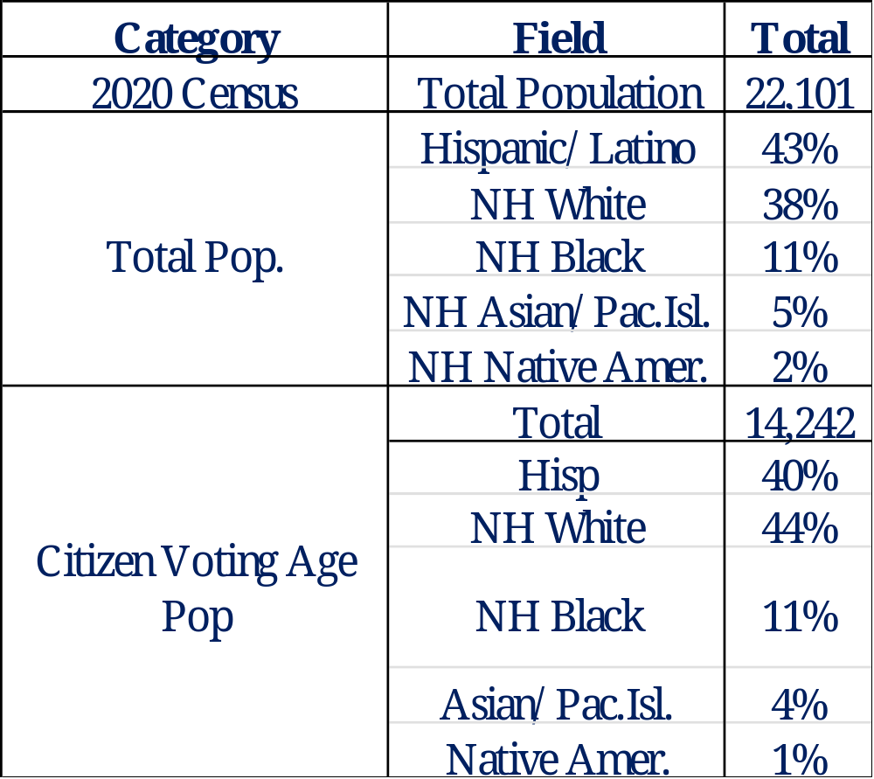
Key Demographics
“Citizen Voting Age Population” data from the Census Bureau’s American Community Survey is considered the best available data on “eligible voters.”

Slide 8
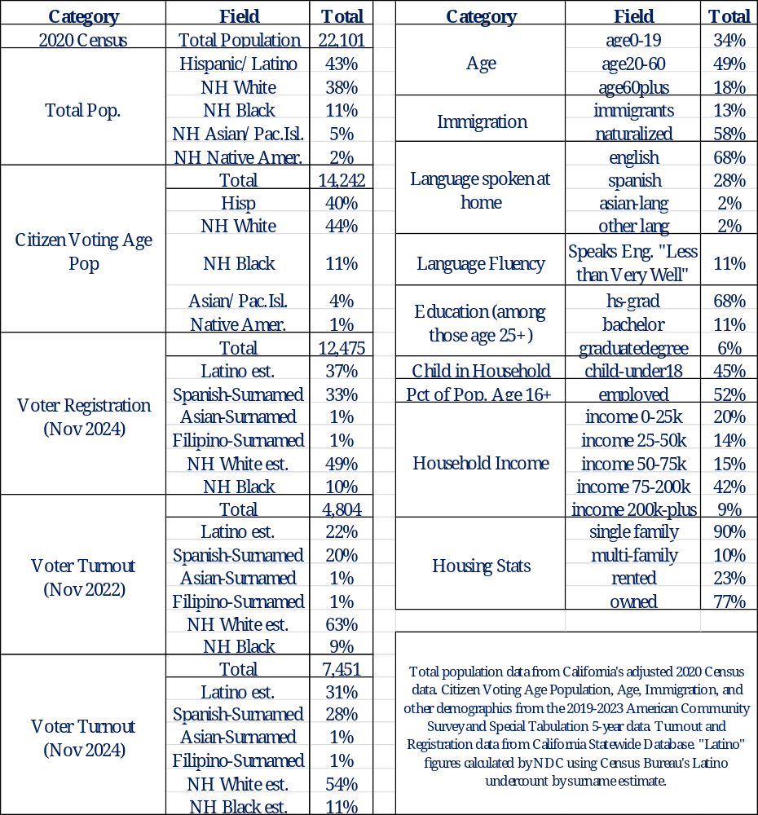
Demographic Details
Each of the 5 trustee areas must contain about 4,420 people.

Slide 9
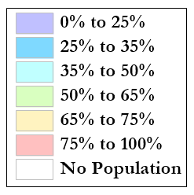
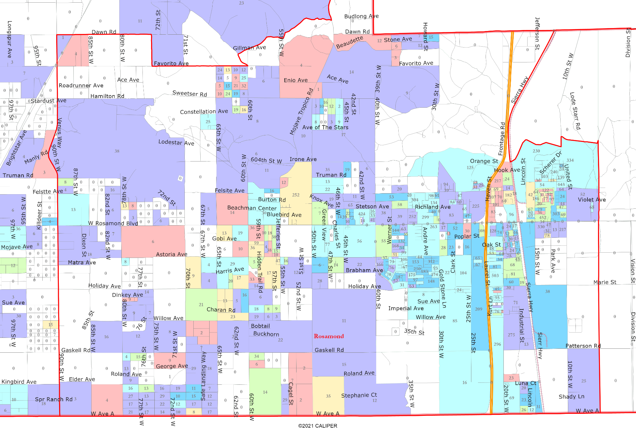
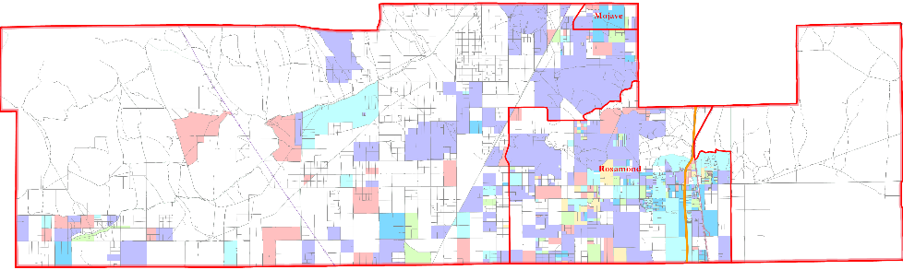
Latino CVAP
Latinos are geographically concentrated along Rosamond around both 60th St W and east of the Highway.

Slide 10
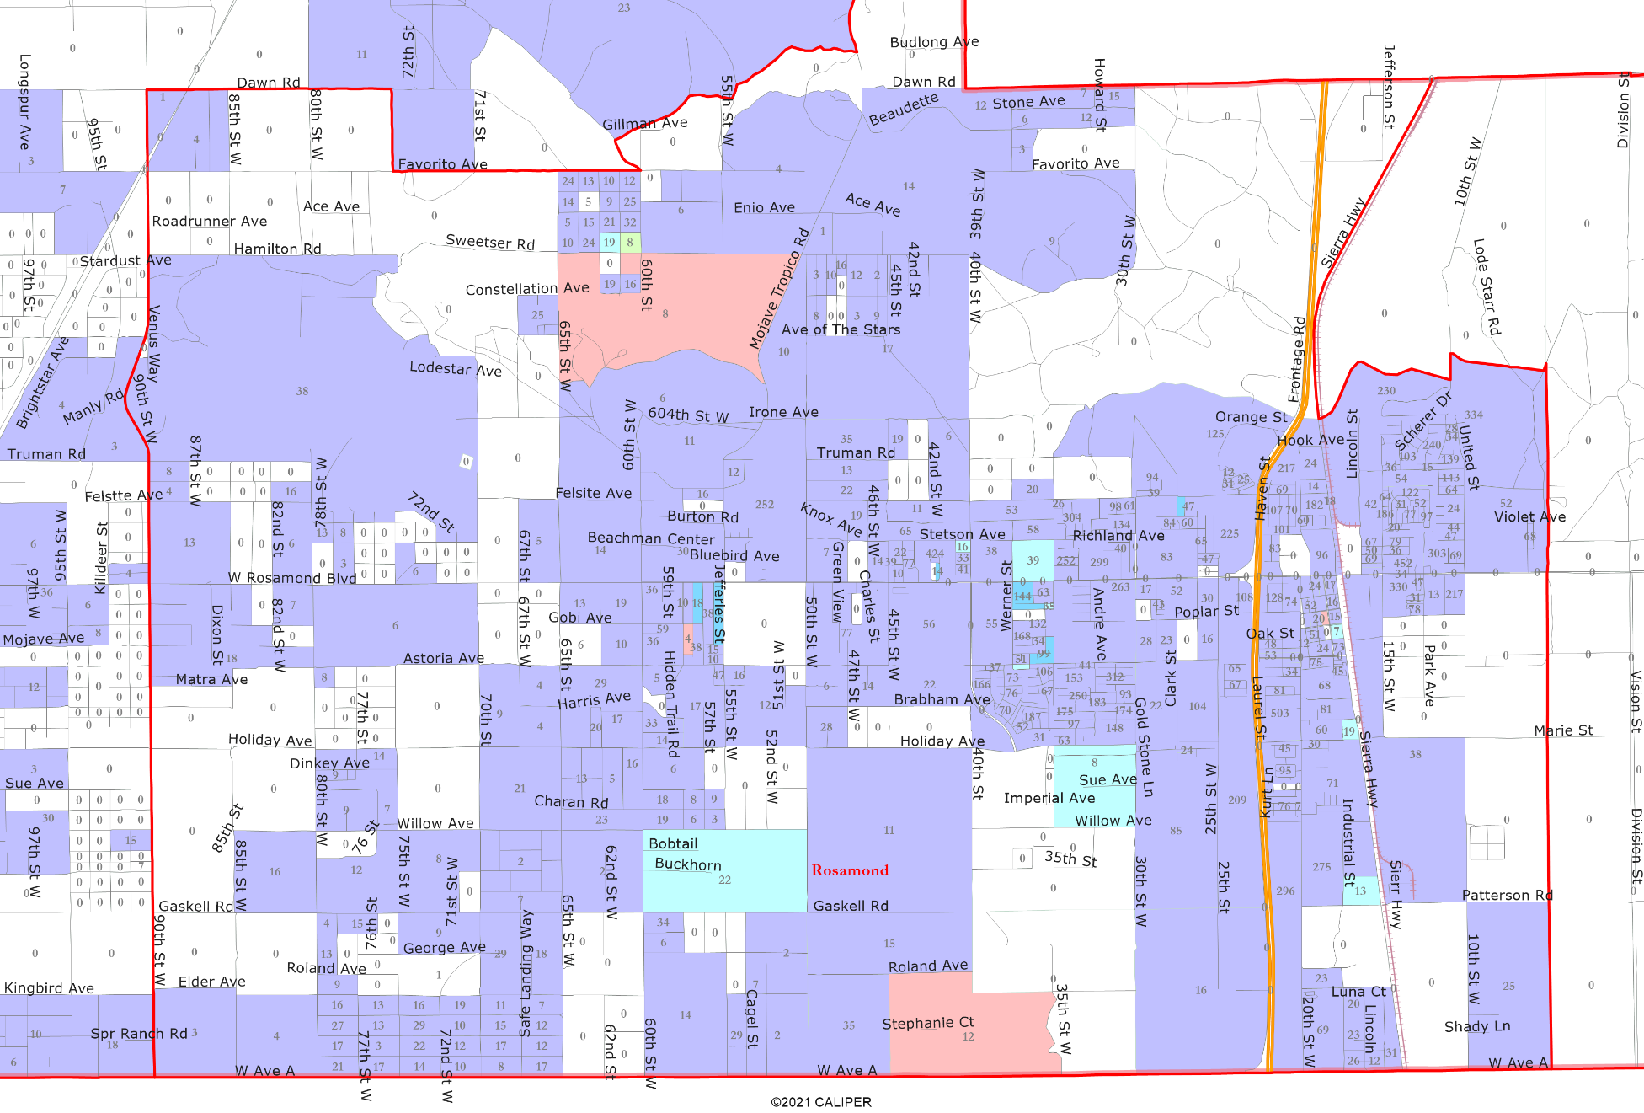
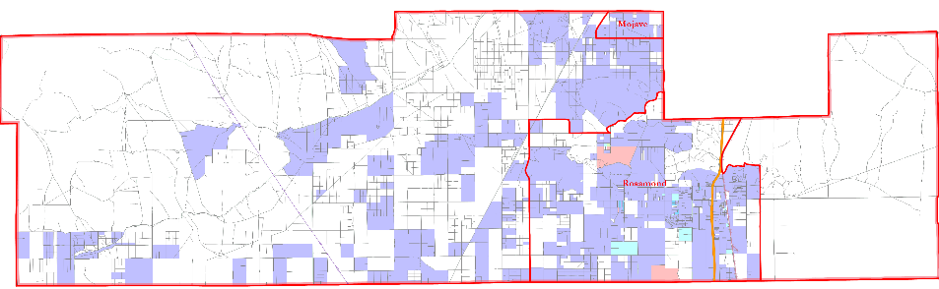
Asian-American CVAP
Asian-Americans are not concentrated anywhere in the District.

Slide 11
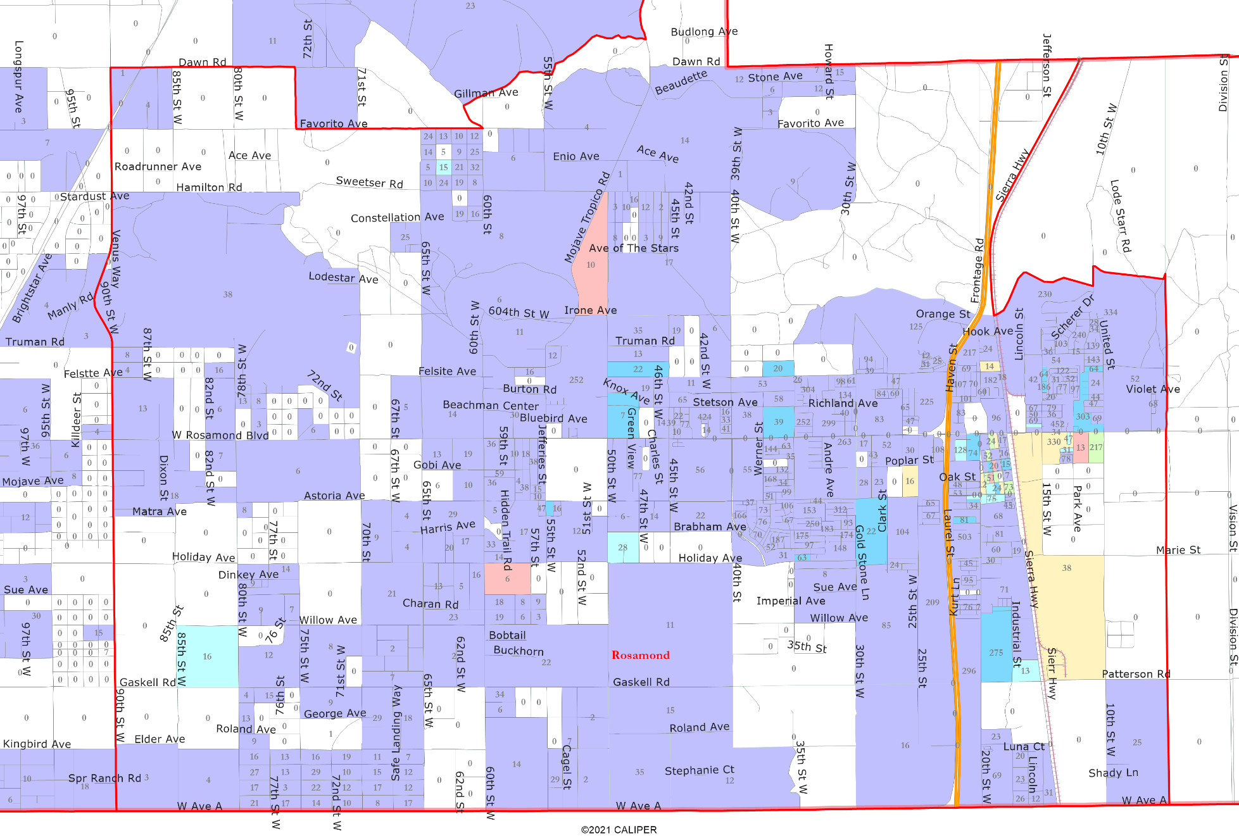
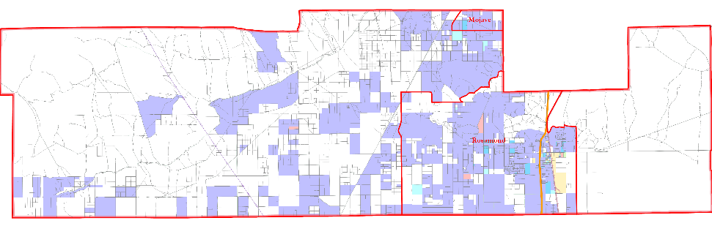
African-American CVAP
African-Americans are concentrated east of Sierra Highway south of Rosamond Blvd.

Slide 12
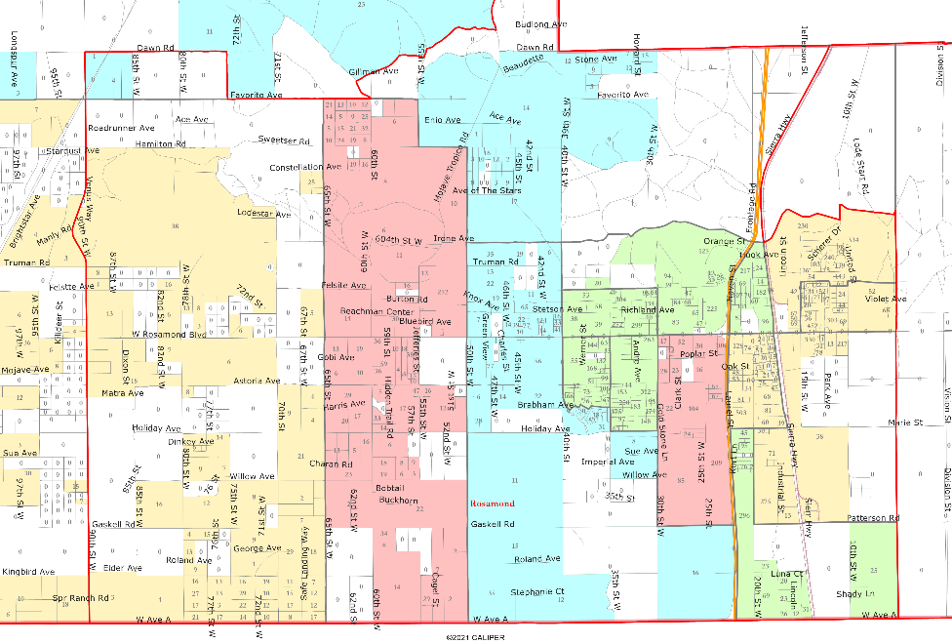
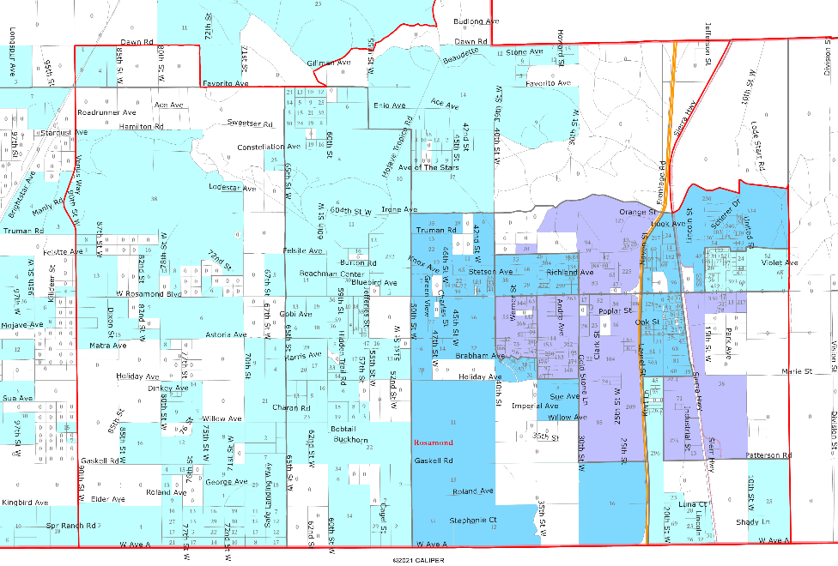
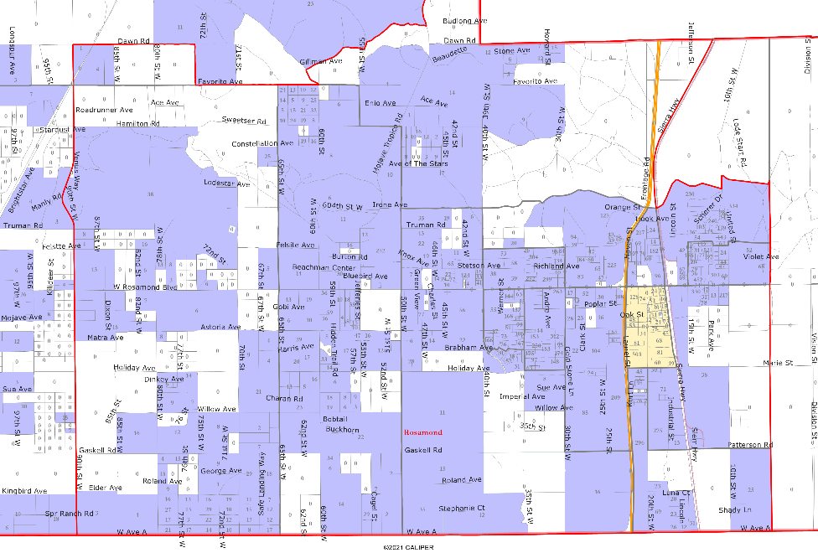
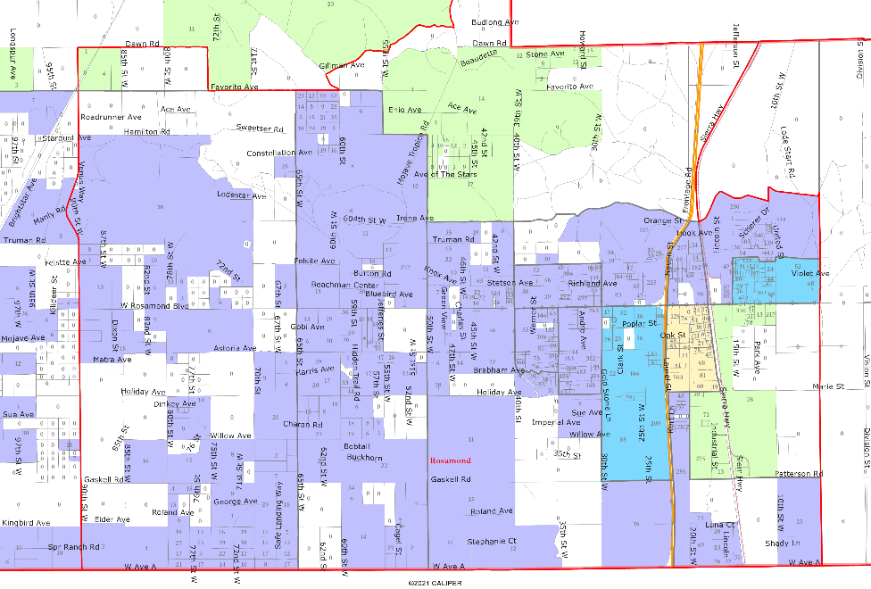
Other Socio-Economic Demographics
Child at Home
Spanish Spoken at Home
Multi-Family Housing
Renters

Slide 13
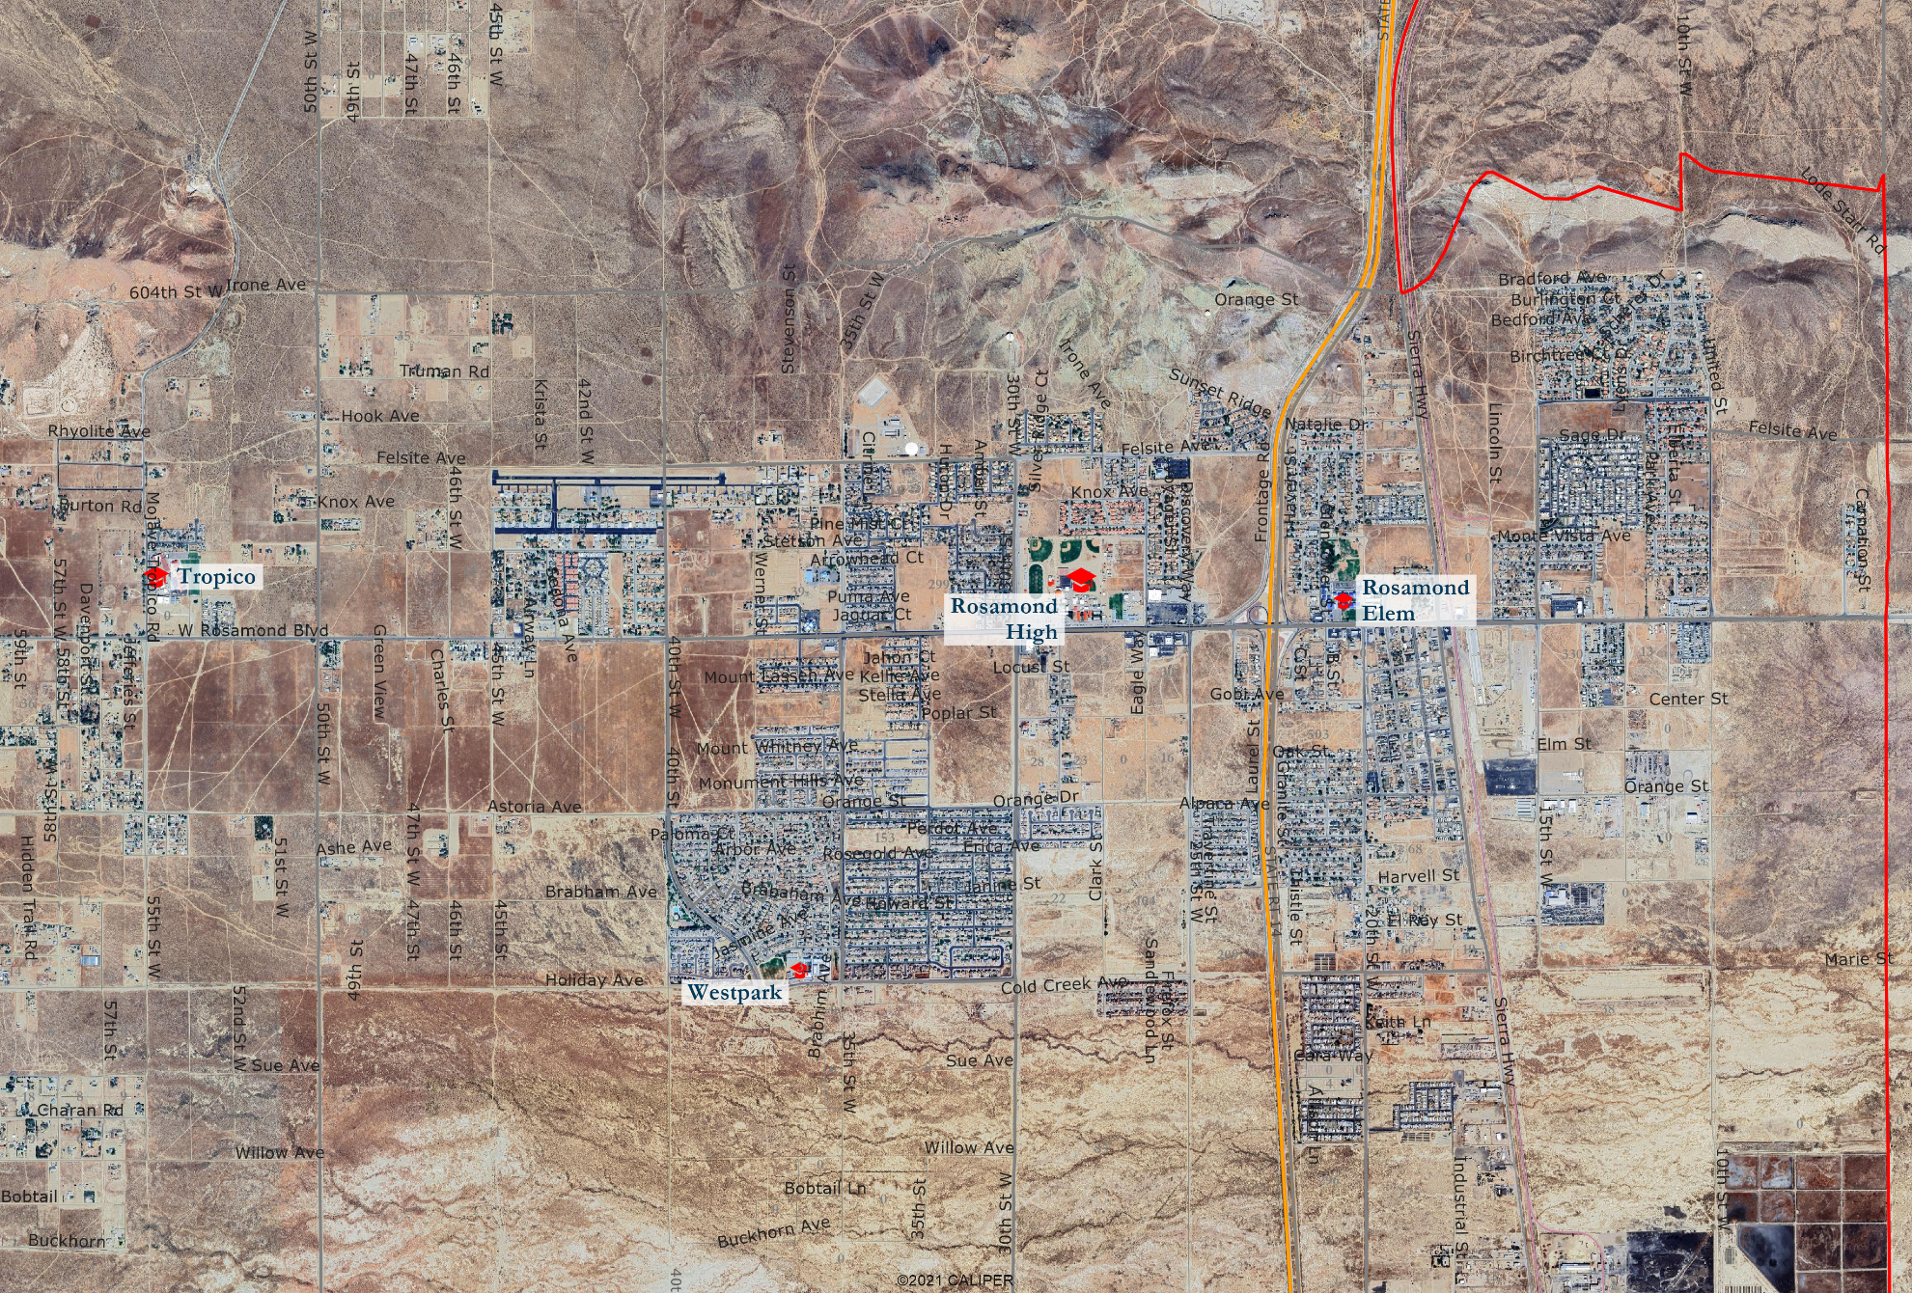
Satellite View

Slide 14

Defining Neighborhoods
1st Question: What do you consider your neighborhood?
2nd Question: What are its geographic boundaries?
Examples of physical features defining a neighborhood boundary:
Natural neighborhood dividing lines, such as highway or major roads, rivers, canals and/or hills
Areas around parks or schools
Other neighborhood landmarks

Slide 15
Beyond Neighborhoods:
Defining Communities of Interest
1st Question: What defines your community?
Geographic Area, plus
Shared issue or characteristic
  Shared social or economic interest
  Impacted by county policies
Tell us “your community’s story”
2nd Question: Would this community benefit from being “included within a single district for purposes of its effective and fair representation”?
Or would it benefit more from having multiple representatives?
Definitions of Communities of Interest may not include relationships with political parties, incumbents, or political candidates.

Slide 16
Public Hearing & Board Discussion
What is your neighborhood and what are its boundaries?
What are communities of interest in the District, and what are their boundaries?

Slide 17
Districting Process
Step | Description
Two Initial Hearings November 5 & 19 | Held prior to release of draft maps. Education and to solicit input on the composition of districts.
Release draft maps By November 21 | Maps must be posted at least 7 days prior to 3rd hearing.
Two hearings on draft maps December 10 and 17 | Two meetings to discuss and revise the draft maps and to discuss the election sequence.
Final Hearing & Board Action January 14, 2026 | Special meeting for Board selection of a map and election sequence.
County Committee Hearing To be determined | Following the Board’s selection of a preferred map, the County Committee on School District Organization will hold a hearing and must approve a map.

