Slide 1
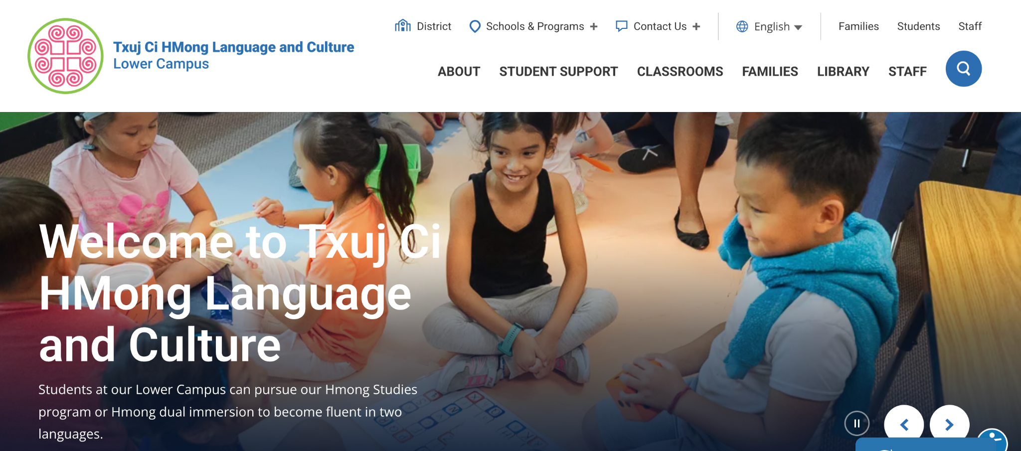
[Name of Your School]
Title I Annual Meeting
IMPORTANT: Meetings may be conducted using these slides or interactive alternatives found HERE
Make a copy of slides and edit to reflect your school community
Designate a notetaker prior to the meeting. Discussion notes are required for Crate.

Slide 2
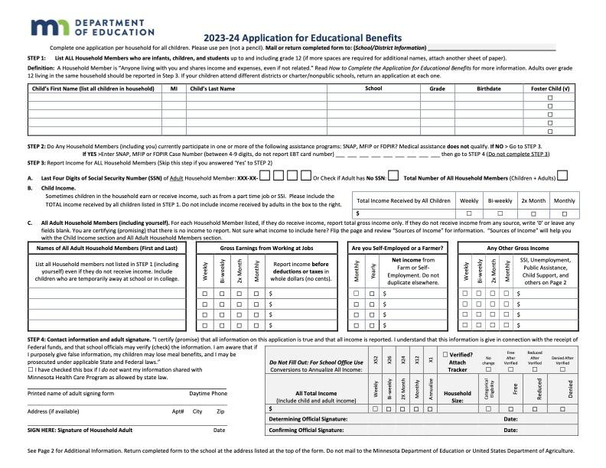

Have you ever heard (school name) described as a “Title I school”?
54 schools in SPPS receive federal funds to increase student achievement. (see Presenter Note below slide)
This money is based on the Application for Educational Benefits (the form we ask you to fill out each year) and qualification for SNAP benefits. (see Presenter Note below slide)
These extra dollars help us provide a high quality education for all students, regardless of family income.
No longer required for free school meals but still important for our school!
Notes:
Presenter Notes:
In SY24-25, SPPS schools with a concentration of 48% or more eligible students receive Title I funding. This percentage can change each year.
The Application for Educational Benefits is always available online or on paper. Each fall before school starts, Nutrition Services sends an email with the link to the application and sends a paper copy with a prepaid return envelope to all families not eligible for SNAP. Paper copies are also available at Back to School (formerly iUpdate) help sessions and open houses.

Slide 3
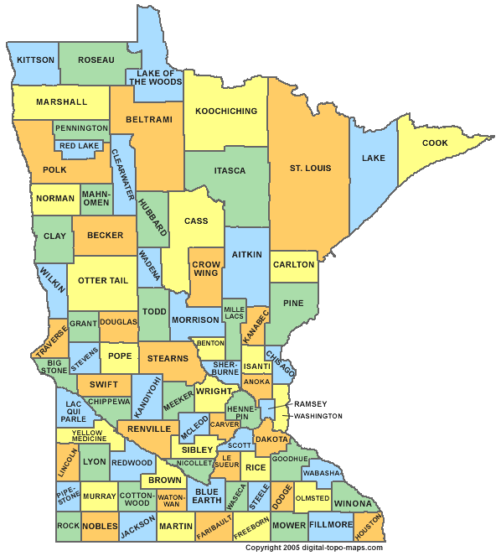
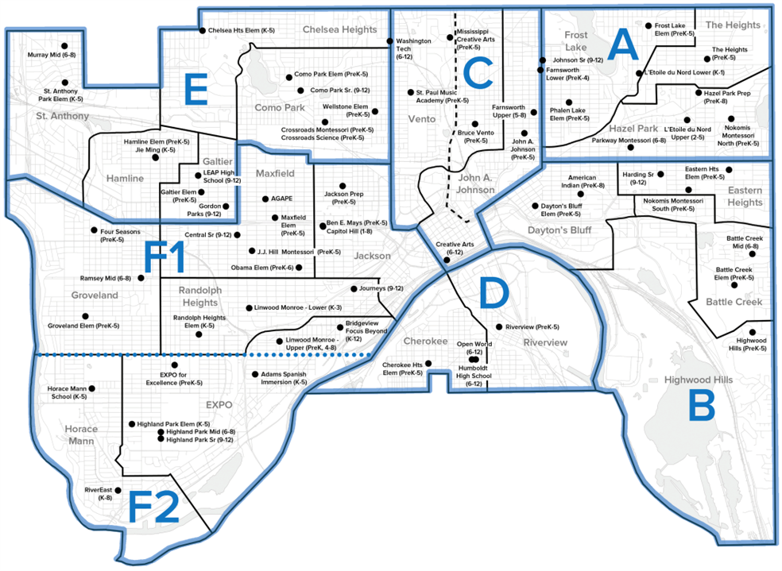


How does Title I money get to our school?
Federal Government
MN Dept of Education
Saint Paul Public Schools
Individual SPPS Schools

Slide 4

How does Title I support students at our school?
Describe (as simply as possible)
1) how your school uses Title I funds to support student learning
2) how these funds support your school’s improvement goals (SCIP)
Examples: instructional support, school counselors and social workers, learning materials
Customize this slide

Slide 5

How does Title I support families at our school?
Describe how your school uses Title I funds to support family engagement
Examples: Family engagement staff, Cultural Specialists, food and child care at family gatherings, stipends for staff to support family engagement activities
District-level funds address barriers so all families can participate
Transportation to family meetings at school, when needed*
Cost of volunteer background checks*
On-Call Interpreters and Language Line**
*Paid for by district Title I funds **Paid for by district general funds
Customize this slide

Slide 6

What are the rights of families in Title I schools?
To be informed on how your child is doing in school
To be involved in your child’s education
To provide school improvement input
To request information about the qualifications of your child’s teacher
To be notified if your child is being taught for more than four consecutive weeks by a teacher not licensed in the area of instruction

Slide 7





How does our school share
student learning and progress with you?
Customize this slide
Describe how your school communicates what students are learning and how progress is shared
Examples: 2-way communication with staff, classroom and school newsletters, conferences, report cards, technology tools (Seesaw, Schoology)

Slide 8

How can you be involved in
your child’s education?
Describe opportunities for family-school partnerships
Examples: Support regular attendance, talk about school with your child, communicate regularly with teachers, attend conferences, volunteer, participate in family organizations and programs (Parent-Teacher Home Visits, Academic Parent-Teacher Teams (APTT), Parent Academy, Coffee with the Principal, etc.)
Customize this slide

Slide 9

How can you help make our school even better?
Family input is essential to our
Improvement Plan (SCIP)
Family Engagement Plan (FEP)
Family-School Compact and
Title I Budget Planning
Describe how families are invited to share their input, ideas and perspectives throughout the year.
Customize this slide
Show families where they
can find these documents
Examples: Responding to the Question of the Month, participating in discussions at family gatherings, communication with staff via email, Talking Points, phone conversations

Slide 10


Conversation & Questions
Share an example of how communication from school is working well for you.
(October Question of the Month)
Examples: Classroom and school newsletters, 2-way communication with staff, email, text, Seesaw, Talking Points, phone calls
Pro Tip: More families will join the conversation if you use a Talking Piece vs. the Popcorn Technique

