Slide 1
Financial Aid 101

Slide 2

About MEFA
State authority created by the Commonwealth of Massachusetts in 1982, helping families plan, save, and pay for college
Notes:
MEFA has a public service mission to help families navigate planning for college
Bookmark mefa.org, follow MEFA on Facebook, Twitter, and LinkedIn, and sign up for MEFA emails on mefa.org)
All webinars can be found at mefa.org/events

Slide 3

Webinar Topics
Types & Sources of Financial Aid
The Application Process
How Financial Aid Decisions Are Made
Paying for College
What You Can Do Now
Notes:
Agenda slide – introduce the topics to be discussed during the seminar

Slide 4
Types and Sources of
Financial Aid

Slide 5

What is Financial Aid?
Financial aid is money to help students pay for college
3 main types:
  Grants and scholarships (gift aid)
    Merit or Need-Based
  Federal work-study
  Federal student loans
Notes:
Financial aid is simply money to help students pay for college
THREE main types of financial aid
Grants and scholarships are allocations of free money, also known as gift aid, which do not need to be repaid
Work-study does not come off the student’s bill and is a set amount of funding saved for a student to earn while on campus working in a part-time job
Work-study earnings are paid in paycheck form
Earnings from a co-op program or a work-study position are taxable but excluded from total income within the federal financial aid calculation
Federal student loans are considered financial aid because of their special repayment terms. As well, they are the only option for a college student to borrow a loan without a co-signer at a low, fixed interest rate
Student loans must be repaid
You do not have to accept loans or work-study

Slide 6
Federal Direct Student Loans
Student is the sole borrower
No credit check
Subsidized and Unsubsidized
6.39% fixed interest rate for 2025-26
Repayment:
  No payments due while enrolled
  Multiple options (many tied to income)
  Total borrowed for 4 years: $27,000 max
  Estimated payment: $300/month for 10 years
  Estimated total debt: $32,000-$34,000
  Deferment, forbearance, and forgiveness opportunities
Annual Loan Limits
Freshman Year
$5,500
Sophomore Year
$6,500
Junior Year
$7,500
Senior Year
$7,500
Notes:
The interest rate for 2025-26 Federal Direct Student Loans will be set in May
Federal loan options should ALWAYS be considered before private options. If you do not use the eligible amount in any given year, you will not be able to borrower that amount in future years. i.e. If a student does not borrow freshman year loan of $5,500, they will not be able to borrow the $5,500 in sophomore year. Use it or lose it.
Direct Loans are student loans
Subsidized loans count within the total financial aid that is filling in the financial need, so they can’t cover the SAI
Go over loan details and limits:
Student Direct Loan: $5,500 FR, $6,500 SO, $7,500 JR & SR – these all include a $2,000 Unsub DL Loan each year
Tell families that even students with NO financial need can receive a $5,500 Unsubsidized Direct Loan
Start the kitchen table conversations now as a family about affordable monthly payments and debt that students will be able to afford based on future earnings.
$300 is the approximate monthly payment for a student who borrows $27,000, which is the amount of 4 years of maximum Direct Loans
$32,000-$34,000 is the APPROXIMATE amount in total debt, including interest, if someone borrowed $27,000.
Student will need to sign a Master Promissory Note and complete entrance counseling on StudentLoans.gov
Direct Loan – all U.S. citizens/permanent residents are eligible
Students whose parents are denied for the PLUS loan are automatically eligible for a $4K (FR & SO) or $5K (JR & SR) Unsub Direct Loan – these amounts are in addition to the limits above
Many repayment options are available for borrowers, including those tied to the new grad’s income. Forgiveness provisions exist for certain professions. See StudentLoans.gov for details. All Direct Loans don’t have to be repaid until after the student leaves school.
What is reasonable student loan debt? On average, student borrowers in Massachusetts who graduated in 2020 owed $33,457 according to TICAS: https://ticas.org/interactive-map/
Additional Loan Options:
NIL: A MA state loan for low-income students; not available at all schools
Parents who want loans will have to apply for them separately and will need to be credit-worthy (a PLUS Loan is a federal parent loan but still requires a credit-worthy borrower and an application)
Students who want an additional loan will need to apply through a private source and will need a credit-worthy co-borrower
Many private loans offer multiple repayment options allowing families to start make payments while the student is in school or to defer payments until after the student graduates

Slide 7
Sources of Financial Aid
Federal
Massachusetts
Grants, work-study, loans, tax incentives
StudentAid.gov
Grants, scholarships, tuition waivers, loans
mass.edu/osfa
College/University (institutional aid)
Other Agencies
Grants, scholarships, loans
Scholarships: Search through mefapathway.org and fastweb.com, and check with your school counselor
$190 billion*: The total amount of aid undergraduate students received in 2023-24
*Trends in Student Aid 2024, The College Board
Notes:
Financial aid comes from four primary sources. Each source has different requirements for eligibility.
Federal: Most federal grants are allocated for lower income families; work-study is reserved for students with financial need; Every student eligible to apply for federal financial aid can receive federal student loans; tax incentives are credits on federal tax returns
State: Most state grants are allocated for lower income families; MA also offers scholarships and tuition waivers for students who meet certain criteria Recipients must be MA residents for at least one year. Visit mass.edu/osfa for more details on MA state aid
College/University: some colleges or universities do have their own student loan programs
By submitting your financial aid applications, you are applying for federal, MA, and institutional financial aid
Start looking online for outside/private scholarships now. You must find and apply for these separately. mefa.org has an entire page devoted to private scholarships with links to different search engines. Check with your guidance counselor for local/high school scholarships. Also check with the parent employers and any membership groups or affiliations of which parents are members. NEVER pay for a scholarship search or application – those are scams. And students can start looking for scholarships EARLY (as young as Elementary School!)
You may want to ask the school counselor before the seminar beings if he/she wants to speak about local outside scholarships and how the information is available through the guidance office
You can mention the College Board Opportunity Scholarships: students complete college planning steps and students that complete all 6 steps can enter to win $40,000
The total amount of aid listed is the total amount of undergraduate aid

Slide 8
The Application Process
Notes:
Getting organized with the process is so important – write down for every college the forms needed and the deadlines, which are usually different from admissions deadlines

Slide 9
Financial Aid Timeline
Check deadlines and required applications on each college’s website now
You will likely apply for financial aid before you receive the admissions decision
Early Action/Decision deadlines are often in October or November
Standard deadlines are typically in February or March
MEET APPLICATION DEADLINES!
Use MEFA’s College Application Manager to stay organized
  mefa.org/college-application-manager
Notes:
Each college could have a different financial aid deadline
Many schools’ deadlines have changes so check each school’s website for 2025-26 applicants
Check each school’s financial aid webpage.
Missing a deadline could mean missing out on tens of thousands of dollars in free money!
If you have multiple children in school, make sure you treat them separate in your personal organization system (even if they happen to be the same year in high school)
Make sure to look at the admissions and financial aid deadlines separately! Find your earliest deadline and (as homework) start working on that one first.

Slide 10
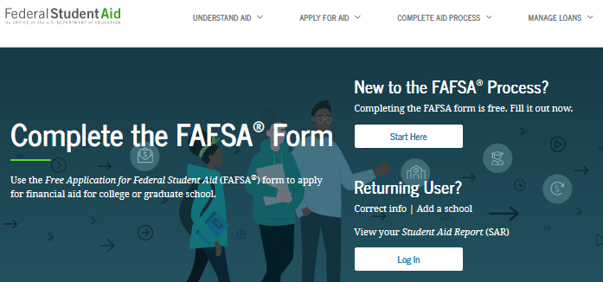
FAFSA®
Free Application for Federal Student Aid (FAFSA)
Required by all colleges
Must complete every year
Available on Oct 1st
Steps to complete:
Go to fafsa.gov and select the 2026-27 FAFSA
Have student start the FAFSA (highly recommended) and then invite all other contributors (parents)
Each contributor will complete their own separate section
Last contributor to complete can submit the FAFSA
Incomplete FAFSAs are deleted after 45 days of no activity
Watch MEFA’s Understanding the FAFSA webinar at mefa.org/webinars for step-by-step guidance
Notes:
FAFSA:
Discuss the benefits of completing the FAFSA online: skip logic, saved info year-to-year, etc.
The website for the FAFSA is FAFSA.gov and it’s FREE to apply
The application usually opens October 1st but it will be December 1st this year
Stress that meeting the deadline is VERY IMPORTANT- Some schools may run out of money after their priority deadline.
If you are filling out the FAFSA early for EA or ED deadlines, you can always do a FAFSA correction later on to add more schools that were not initially on the students list.
Student and all parents on the FASFA need an FSA ID to log in to the FAFSA (except if parents filed taxes together, and then only one needs an FSA ID)
Getting an FSA ID takes several minutes (and for some reason can create some difficulty for families, so encourage families to get it NOW before the FAFSA even opens so it’s all ready)
Keep the FSA ID and password in a safe place so it is easy to retrieve. It can be cumbersome to reset or request a new FSA ID.
Families will need to set up answers to challenge questions
The FAFSA will pull their tax data from the IRS into the FAFSA though the family will not be able to VIEW the income tax information (for security purposes). If there are big discrepancies between income data from year to year, families should talk to the college financial aid offices
Must complete the FAFSA each year
Mention FAFSA Day as resource for free help completing the application
Federal and MA state financial aid eligibility will be based exclusively on the SAI from the FAFSA. The FAFSA must be completed for MA state aid by May 1!
The FAFSA webinar goes page by page through the application – provides a lot of detail
Student does not see parent information and vice versa

Slide 11

FSA ID
FSA ID = username and password for the FAFSA
Must have an FSA ID to log in
Can set up your FSA ID now at
studentaid.gov/fsa-id/create-account
Must have an email address
Who needs an FSA ID?
    Student
    Every parent listed on the FAFSA
      If parents filed taxes jointly, only one parent needs one
    Student’s spouse (if applicable) if filed taxes separately or didn’t file
Those without an SSN will answer knowledge-based questions pulled from credit history

Slide 12
What’s Reported on the FAFSA?
General Information
Student citizenship status
  All U.S. citizens and eligible non-citizens can receive federal financial aid
  Undocumented students may be eligible for MA in-state tuition and state aid
Colleges where student is applying (each one will receive your FAFSA)
Parents
  Married, including same-sex parents, include both
  All parents who live together, married or not
  Divorced/Separated: parent who provided more financial support in last 12 months & current spouse
    If parents provided equal support, use the parent with greater income and assets
  Legal guardians are NOT a parent
# in household: will pull from IRS but family can update
# of children in college: will not be used in calculation
Notes:
What’s on the FAFSA:
Citizenship status – student must be a U.S. citizen or eligible non-citizen to receive financial aid (parent citizenship status is irrelevant). Eligible non-citizens: U.S. nationals & permanent residents, those with an Arrival-Departure Record (I-94), students with a T-visa or who have a parent with a T-visa, “battered immigrant-qualified aliens,” and citizens of the Federated States of Micronesia, the Republic of the Marshall Islands, or the Republic of Palau
Undocumented students are eligible for MA in-state tuition if: 1. Have been admitted to a public MA college/university/community college, and 2. Not a nonimmigrant alien within the meaning of 8 U.S.C. 1101(1)(15)(A) to (S), inclusive, and 3. Have attended at least 3 years of HS in MA, and 4. Have graduated from a MA HS or received the equivalent in MA, and 5. Have applied for miliary selective service if eligible, and 6. Provide a completed affidavit stating will file an application to become a citizen or legal perm resident within 120 days of becoming eligible to do so
Will do 1 form and send it to up to 20 schools at a time – you list your schools. Colleges cannot see the other colleges that students listed on the FAFSA.
Students and parents answer questions and provide data
Information from both parents will be required on the FAFSA, regardless of parents’ gender or marital status, if 1. Both parents are legal parents, defined as biological or adoptive parents; and 2. The student’s legal parents live together. Same-sex parents who live together and parents who have never been married who live together BOTH report information on the FAFSA.
If parents are divorced or separated, only the parent that provides more financial support and that parent’s spouse (if there is one) report information on the FAFSA. The other parent does not appear anywhere on the FAFSA
# of children in college (as of 24-25) will no longer affect eligibility for aid though it is still asked. Some schools are still using this figure for institutional aid which is why the question is still asked.

Slide 13
What’s Reported on the FAFSA?
Financial Information
Parent and student income (2024 income for the 2026-27 FAFSA)
  Will pull in federal tax data from the IRS (must give consent)
  Both taxed and untaxed income that appears on the tax return
Parent and student assets
  Include value of savings, checking, investments, larger businesses except commercial fishing businesses, other property
  Include education savings accounts as a parent asset and don’t report the ones for other children
  Do not include primary home, value of retirement, life insurance, family farms, small businesses, or commercial fishing businesses
  Child support received is considered an asset
Debt is not reported except debt on reported assets
Notes:
What’s on the FAFSA:
Income asked about is from two years prior to the year of the beginning of the academic year.
Only the untaxed income that appears on the tax return goes on the FAFSA
The PDF of the paper FAFSA (found online) will show all possible questions – this will also list the exact assets that people should include
The FAFSA does not have a space to write in special circumstances, but families can write a letter and mail it to each financial aid office. The way that financial aid offices handle this information will vary.
All contributors must provide consent in order for the student to be eligible for federal aid, even if the contributor(s) do not file taxes.
Students/parents will be able to decline consent and then manually enter their tax income information - BUT THE STUDENT WILL STILL BE INELIGIBLE for any federal aid.

Slide 14
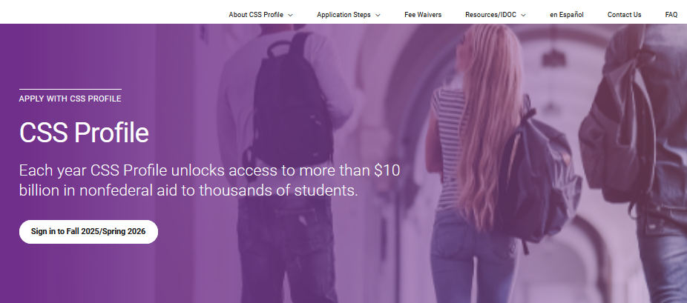
Other Financial Aid Applications
CSS Profile®
cssprofile.org
Required by some colleges and universities
$25 for 1st school, $16 for each additional
Fee waivers if parent income is $100k or less or family meets certain other criteria
Becomes available October 1st
Noncustodial parent submits a separate profile
What to Know about the CSS Profile webinar
College Financial Aid Application
Required by some colleges and universities
Notes:
CSS Profile
Only some colleges and universities require this (mostly private)
Will also ask for income from two years prior as its main income information but ask for other basic income totals from other years
The Profile provides colleges more information to award institutional funds
There is a fee for the Profile: $25 for first, $16 for every additional school
If student is applying Early Decision/Early Action, the Profile may be required earlier than the regular financial aid deadline
The Profile student dashboard will provide important information, such as deadlines and next steps
The Profile Registration step has been eliminated. Applicant information will be saved as soon as the family begins completing the form
There is no longer a separate Noncustodial Profile. If parents are divorced or separated, both parents must complete a CSS Profile. The custodial parent should complete a Profile first, as the noncustodial parent will not be able to complete the application until the student (on the custodial’ parent’s Profile) selects a college that requires a CSS Profile from a noncustodial parent.
Schools have an entire process by which a family can appeal the requirement for the noncustodial parent to submit a Profile. A noncustodial parent’s unwillingness or refusal to complete the application will not exclude the student from the requirement to have the noncustodial parent submit a Profile.
MEFA provided a webinar for families on the CSS Profile in late September. The recording is on mefa.org.
It does not matter if you fill out the FAFSA or the Profile first. Easiest to fill them both out one after the other while the information is fresh and all the documents have been gathered.
Families can also be reminded that the Social Security Number, while still an optional field on the Common App and the Profile, is often used by schools as the identifier when compiling all student data and applications, and it is helpful for families to therefore report the student’s SSN on all applications when requested.
Also, some colleges and universities may have additional financial aid application requirements (separate forms, etc.). Remind families to check application requirements carefully and to return all school requests for additional information or a callback.
The CSS Profile now allows a person to indicate a topic for a special circumstance. The person can check the box for that topic but must also include a narrative in the box provided about the special circumstance.
College/University Financial Aid Application
Institutions can ask anything
Not many colleges require this at all - check with the college for details
More common for returning students
As part of the original financial aid application (and not simply for Verification), some schools may require families to provide the corresponding tax return when submitting the financial aid application(s).

Slide 15
After You Apply
Colleges and the state receive data electronically
Student will receive a FAFSA Submission Summary (FSS) by email
Colleges may request additional documentation due to (mandatory) Verification
Colleges review applications and determine the financial aid offer
Financial aid may be sent with the admissions decision or after
Review college websites to learn about each school’s timing
Notes:
Explain what happens with the applications once they are submitted
Information is sent off electronically and processed by a central processing center and data is sent to selected colleges as well as the Massachusetts Office of Student Financial Assistance
Students will receive a FAFSA Submission Summary (FSS) with a summary of FAFSA answers via email
For FAFSA corrections, students should go back onto fafsa.gov, make corrections, and re-submit the FAFSA to the appropriate schools
For Profile corrections, they can log in and make corrections once or contact the colleges directly
Students should be sure to review all answers and make sure they are accurate
Explain Verification process. U.S. Department of Education requires that schools verify data on certain FAFSAs. Explain what documents might be required
Tell families to READ THEIR EMAILS and check student portals from the financial aid office, to comply with requests, and to stay organized
Remind parents that colleges communicate with the students directly, and mostly electronically (so students should keep on top of email – some families set up a separate email address for all college communication that both students and parents can access)
Can let folks know to contact the financial aid office if something changes (a job loss) or if there are special circumstances (student wants to petition to be independent, etc.)

Slide 16

Verification
Colleges verify data on financial aid applications
Students selected by Department of Education or college
Must comply with all requests to receive financial aid
Families must submit additional documentation as requested:
  Tax Return Transcript
  Verification Worksheet
  Asset Account Statements
Review all correspondence from colleges
Log into college web portal for communications
Create a family email address for the financial aid process so no requests are overlooked
Notes:
Families are nervous about being selected for verification, reassure them it is a routine process, it’s not because they did something wrong.

Slide 17
Financial Aid Office
Learn about Your Financial Aid
Financial aid renewability criteria (financial, academic)
How will a private scholarship affect my financial aid?
Ask about Special Considerations
Changes in family circumstances
Can I appeal my offer? How?
Phone call
Email
Chat (if offered)
How to Contact the Financial Aid Office
Notes:
The college admitted you, so they want to help you find a way to afford it
Ask what is required to renew the financial aid in future years
Find out how scholarships are treated
Special circumstances: you may be able to appeal your award (meaning, ask for additional financial aid): Some colleges can provide some (small) additional grant funding if you ask. Some may require you to present a reason for the needed additional funds, which may include a recent job loss or family expense, such as a medical bill or home repair. You also may have had a one-time increase in your income in the past year, which raised your income unrealistically
Contact your financial aid counselor to ask for additional funds. You will need to submit documentation of your situation

Slide 18
How Financial Aid
Decisions are Made

Slide 19
Cost of Attendance (COA)
Tuition & Fees
+
Food & Housing
COA = Total Expenses for
One Year of College
+
= Billed or Direct Expenses
Books & Supplies
+
= Non-Billed or Indirect Expenses
Transportation
+
Personal Expenses
Notes:
The Cost of Attendance is comprised of both the billed and unbilled costs. Cost of Attendance is used in the formula to determine financial aid and it includes tuition, fees, food & housing, travel expenses, books, supplies, and personal expenses.
Note that the COA can include health insurance if the student uses the college’s insurance plan

Slide 20
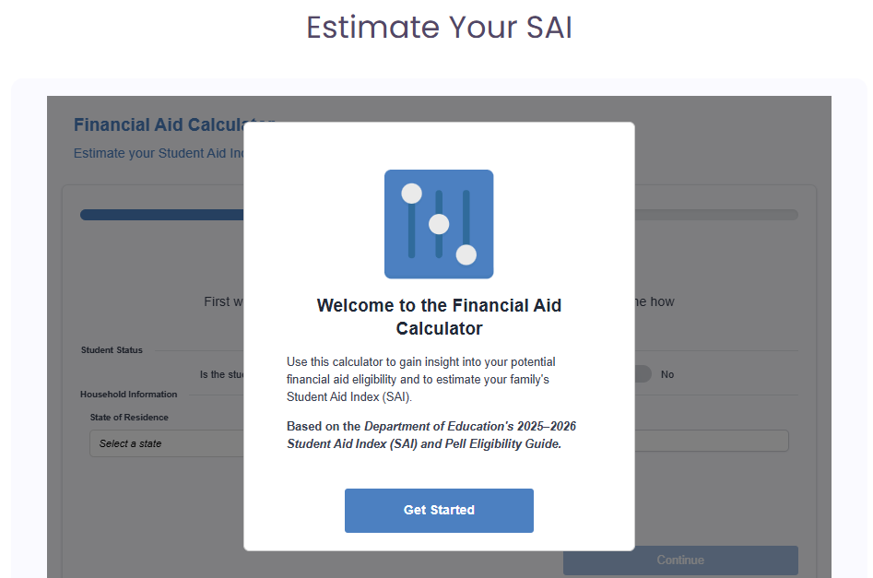
Student Aid Index (SAI)
Number that represents a family’s financial strength
Same federal formula used for every family
Income weighs much more heavily than assets
Some colleges also use an institutional formula
Family has the primary responsibility for paying
Not necessarily what the family will pay
SAI Calculator at mefa.org/sai-calculator
Notes:
The SAI is formerly the EFC
The SAI reflects the family’s ability to absorb educational expenses (a family’s financial strength), but makes no particular assumptions about how the family will finance that contribution
The SAI is calculated using a standard formula for all families for the federal SAI
Some colleges (those that require another financial aid application – usually the CSS Profile) use an institutional formula for the distribution of their own college funds
The SAI is only for one year of college, and is re-calculated every year
The family has the primary responsibility to pay for the student’s education, and families have choices about how to do that
Families often pay more for college than the SAI
The SAI formula protects a portion of income and assets
0-5.6% of parent assets could be included in the SAI
Parent and student information is treated differently in the formula
20% of student assets is included in the SAI
After taxes and an income protection allowance, 50% of student income is included in the SAI
The formula does not take into account personal debt (credit card debt, car loan, personal debt)
Some colleges use two formulas (FM – federal, IM – institutional) if they collect two financial aid applications
MEFA has an SAI Calculator
The College Board Big Future webpage usually has an SAI Calculator for both FM & IM (it’s not yet updated)
Juniors: getting an estimate of your family’s SAI is something you can do now.
The formula is complicated – we can’t tell families what certain income and asset cutoffs will make them ineligible for financial aid

Slide 21
Financial Aid Formula
Cost of Attendance (COA)
Colleges fill in Financial Aid Eligibility with financial aid from
all sources
-
Student Aid Index (SAI)*
=
Financial Aid Eligibility
*Note that a negative SAI is treated as zero in this formula
Notes:
All colleges use this preliminary calculation to determine eligibility for financial aid
SAI stays the same regardless of institution
Explain that COA varies
The amount the family can contribute is taken into consideration before determining a financial aid award

Slide 22
Financial Aid Awarding
Unmet Need
$5,000
College
Cost of Attendance
Work-Study
$2,000
Student Loans
$5,500
$45,000
Grant
Scholarship
$17,500
$10,000
Unmet need and SAI are the FAMILY’s responsibility
SAI
$5,000
Notes:
Colleges use the SAI to determine eligibility for financial aid, then try to meet the eligibility (or fill the barrel) with financial aid from all resources
Most colleges are not going to be able to fill the barrel
The SAI always goes into the barrel first
Unmet need is more common than not
Explain what happens to SAI when there is unmet need. In this example, if the student decides to attend this institution, the family will need to contribute the SAI plus unmet need ($5000 + $3000 = $8000) for the student to attend
Use this as an example to demonstrate how the SAI is often the MINIMUM contribution for a family, not necessarily a MAXIMUM
Explain the difference between direct and indirect costs in the COA and that even though the college won’t bill the student for indirect costs, the family still needs to determine how they will be met
Explain ways that students can reduce indirect costs, such as used books and cheaper travel
Explain how outside scholarships may affect the financial aid
The work-study pool varies drastically from school to school
If you’re given work-study, you usually still have to apply for a work-study position

Slide 23

Offer Letters: Totals Can Vary
College
Cost of Attendance
College A
College B
College C
$45,000
Grants/Scholarships
$32,500
$25,500
$17,500
Student Aid Index (SAI)
Student Loans
$5,500
$5,500
$5,500
$5,000
Work-Study
$2,000
$2,000
$2,000
Total Eligibility
$40,000
Total
$40,000
$33,000
$25,000
Unmet Need
$0
$7,000
$15,000
Use MEFA’s College Cost Calculator to compare awards: mefa.org/college-cost-calculator
Notes:
Use MEFA’s College Cost Calculator to compare awards: https://www.mefa.org/college-cost-calculator
Unmet need can vary greatly from college to college even when the COA is constant
Explain the differences and possible reasons for the variance
College A, B and C could also represent 3 different students at the same institution (students with the same eligibility at the same school may still receive different financial aid based on the different strengths of the admissions applications or enrollment goals of the school, or maybe one student missed the college’s financial aid application deadline)
When comparing financial aid award letters, families should consider the total number of years the student plans to be enrolled
Encourage families to visit mefa.org after receiving award letters to take advantage of the online, interactive My College Cost Calculator to compare financial aid awards
Remind families that deadlines are so important – the student may receive less aid because the financial aid application was late
Although this example assumes the same COA, remember this will not be the case with most schools! It’s important to really consider those different COAs.
College Cost Transparency Initiative: https://www.collegeprice.org/home
About the College Cost Transparency Initiative
The higher education community is committed to providing students financial aid information about the cost of college that is clear, accurate, and transparent. This goal has never been more important as students and families grapple with college affordability in an increasingly complex financial aid system consisting of multiple grant and loan programs with different eligibility requirements.
In the fall of 2022, the leaders of 10 higher education associations representing college presidents, financial aid offices, and admissions and school counselors announced the formation of a task force — the College Cost Transparency Initiative (CCT) — to improve the clarity, accuracy, and understanding of student financial aid offers by producing a set of guiding principles and minimal standards to be used when communicating aid offers.
The CCT task force’s sole focus and mission was to courage and assist efforts by institutions to communicate with students and families about college costs in a way that is clear, accurate and helpful. Broader issues and concerns of importance to colleges and students, such as cost of attendance and sources of financial support for students, were not discussed or considered by the task force.
This work is generously sponsored by a grant from Strada Education Foundation.

Slide 24
Offer Letters: Types Can Vary
College A
College B
College C
College
Cost of Attendance
$27,500
Grants/Scholarships
$17,500
$7,500
$45,000
Student Loans
$5,500
$5,500
$5,500
Student Aid Index (SAI)
Parent Loans
$0
$10,000
$20,000
$5,000
Work-Study
$2,000
$2,000
$2,000
Total Eligibility
$40,000
Total
$35,000
$35,000
$35,000
Unmet Need
$5,000
$5,000
$5,000
Use MEFA’s College Cost Calculator to compare awards: mefa.org/college-cost-calculator
Notes:
When comparing award letters, you can’t just look at the bottom line. You need to compare what’s making up each financial aid award
Here are three examples of awards from colleges with the same Cost of Attendance
Might want to start out by asking the audience what’s different about these award letters (Parent Loan – you can explain the PLUS Loan here)
You can see that even though three hypothetical colleges have the same total financial aid, the funds making up that award vary greatly
Explain the differences and possible reasons for the variance
Talk about the different kinds of loans a family might see on an award letter
College C might have not offered any grants or scholarships because the student submitted the financial aid applications late
What should a family do if offered a parent loan?
Although this example assumes the same COA, remember this will not be the case with most schools! It’s important to really consider those different COAs.
College Cost Transparency Initiative: https://www.collegeprice.org/home
About the College Cost Transparency Initiative
The higher education community is committed to providing students financial aid information about the cost of college that is clear, accurate, and transparent. This goal has never been more important as students and families grapple with college affordability in an increasingly complex financial aid system consisting of multiple grant and loan programs with different eligibility requirements.
In the fall of 2022, the leaders of 10 higher education associations representing college presidents, financial aid offices, and admissions and school counselors announced the formation of a task force — the College Cost Transparency Initiative (CCT) — to improve the clarity, accuracy, and understanding of student financial aid offers by producing a set of guiding principles and minimal standards to be used when communicating aid offers.
The CCT task force’s sole focus and mission was to courage and assist efforts by institutions to communicate with students and families about college costs in a way that is clear, accurate and helpful. Broader issues and concerns of importance to colleges and students, such as cost of attendance and sources of financial support for students, were not discussed or considered by the task force.
This work is generously sponsored by a grant from Strada Education Foundation.

Slide 25
Paying for College

Slide 26

Net Price Calculators
Online tool found on each institution’s website
Asks questions about family finances and student academics
Provides personal, estimated net college price
Displays federal & institutional aid
Merit-based aid may also be included
Notes:
The information you get from the calculator is only as accurate as the information you put in
Different schools have different questions on their calculators
The NPCs do include the full cost of college, so commuters will see housing costs within the NPC output
MEFA has helpful tips on how to use NPCs at mefa.org/using-net-price-calculators

Slide 27
Filling SAI and Unmet Need
Balance Due:
$20,000
Past Income (Savings)
Student Savings
-$1,000
Parent Savings
-$4,000
Present Income (Current Wages)
Parent Contribution to Payment Plan
-$5,000
Future Income (Borrowing College Loans)
Education Loan
-$10,000
$0
Notes:
Families decide the best plan to meet the balance due at the college based on their own personal finances. The options fall under three major categories: past, present, and future income. Families don’t need to choose just one option (past, present, or future income) to pay the balance due, and combination plans can save money in the long run. Encourage families to visits mefa.org to access a Loan Payment Calculator, which allows families to understand the full cost of borrowing a loan
Reiterate that this is only for one year
Past Income: savings or other investments such as college saving plans
Present Income: Explain payment plan, e.g., owe $1,000? pay $100 per month for 10 months. Better than ANY loan
Future Income: borrowing loans. This will be in addition to student loans that are offered in the financial aid award. If families are considering financing any portion of the student’s education, they should take advantage of federal student loans first
You can speak here to wise borrowing, looking at interest rates and repayment options on private loans, not borrowing too much, and pointing out that students won’t be able to borrow private loans alone. Private loans are offered through banks, credit unions, lenders, and state authorities like MEFA. You can explain the PLUS Loan here as well.
Families need to be thinking about a long-term plan when deciding what options to use. This includes the total number of years the student plans to be enrolled as well as multiple children who plan to attend college
Colleges who use institutional methodology often expect the student to contribute from savings and/or summer work. Students are able to contribute to the payment plan along with the parents.
For families who are not receiving aid, you can still use these same steps. You will not be able to subtract aid, but if you have outside scholarships be sure to subtract them from direct costs.
Outside Scholarships can also be used as present income to help pay direct and indirect costs.
Remind families to think about the entire cost of the educational experience, not just the 1st year.
Along the same lines, remember to consider all children in the household and potential college costs for them.
It’s Important to keep all options on the table, including lower cost institutions.

Slide 28

Family Conversations on Affordability
What is each school’s net price?
Who will pay for college costs?
Consider community college first (free tuition and fees in MA)
Consider the number of children in the family going to college
Make a 4-year financing plan
Federal PLUS Loan caps as of 7/1/26: $20k/year, $65k in total
  2026-2027 PLUS Loan interest rate = 8.94%
Think in terms of family total debt (4+ years of school) and student’s potential starting salary
Notes:
It’s best not to commit and buy the school sweatshirt until a financial strategy is in place before the decision due date.

Slide 29
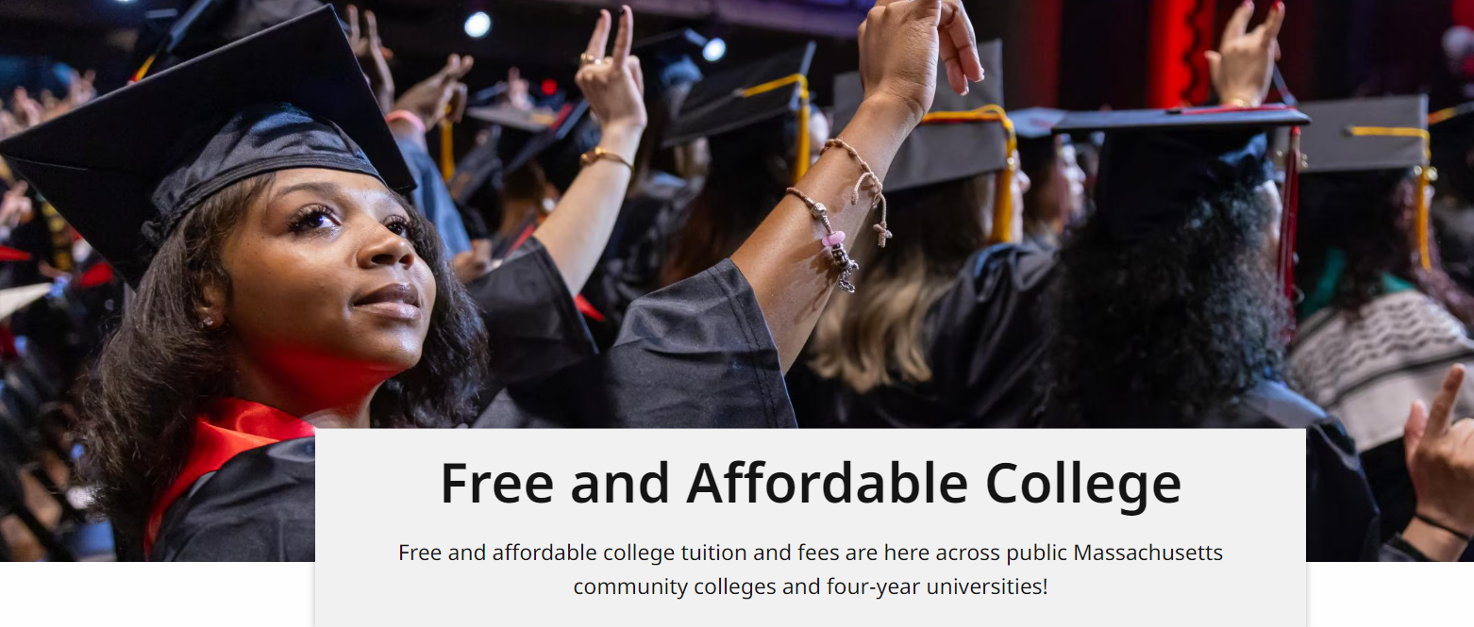
Paying for College in MA
To apply for MA state financial aid, complete the FAFSA ASAP after Oct 1st
https://www.mass.gov/free-and-affordable-college
MassEducate: Free community college (tuition & fees and potential book allowance) for all students
Mass Reconnect: Free community college for adults over 25 years of age
MASSGrant Plus & MASSGrant Plus Expansion: Free or reduced tuition & fees for low & middle-income students and potential book allowance (Expansion only)
Tuition Equity Law: Some undocumented students can receive MA state aid and in-state tuition rates by submitting the MASFA (https://www.mass.edu/tuitionequity/home.asp)
MassTransfer: Makes transferring from a MA community college to a 4-year MA public college more affordable
Tuition Break: Reduction on out-of-state tuition costs at New England colleges for certain programs (https://nebhe.org/)
mefa.org/paying-college-massachusetts
Notes:
New functionality is added to the FAFSA for 24-25 that indicates when a student lists a school in a state that needs to be listed in a certain order. The student is instructed about that state’s rules and has the opportunity to easily reorder the schools using arrows next to the listed schools.
The student will receive a text message or email from OSFA encouraging the student to log in to the MASSAid Portal but the student may have NO eligibility for MA state aid

Slide 30
What You Can Do Now

Slide 31


Connect with MEFA: Emails
Scan the QR code to sign up for MEFA emails on relevant college planning topics.
Don’t Miss MEFA’s Guidance!
Upcoming webinars
Financial aid tips
Important deadlines
Scholarship lists
Key articles
And much more

Slide 32
Staying on Track Through Senior Year
Spring/Summer Junior Year
Winter Senior Year
Research colleges
Visit campuses and college fairs
Ask teachers for letters of recommendation
Take the SAT/ACT
Start writing the college essay
Submit admissions applications
Apply for private scholarships
Send in mid-year grade reports
Fall Senior Year
Spring Senior Year
Retake the SAT/ACT
Secure letters of recommendation
Finalize the college essay(s)
Attend MEFA’s Financial Aid 101 webinar
Complete all admissions applications
Submit early admissions applications
Get an FSA ID and submit the FAFSA
Submit the CSS Profile if required
Receive admissions and financial aid offers
Attend MEFA’s Financial Aid Offers & the College Bill webinar
Attend college open house programs
Choose your college by May 1st
View an extended timeline at: mefa.org/college-admissions-and-financial-aid-timeline
Notes:
Mention that MEFA emails will keep families on track with this calendar
Mention that there is a similar timeline on the handout
Many colleges have moved up their FA deadlines to an earlier date; some have done so mid-year.
Check college websites for details on all deadlines.

Slide 33



Your Next Steps
Get an FSA ID for the student and parent(s)
Research deadlines and required applications
Complete the FAFSA and CSS Profile (if needed) starting Oct 1st
Reference MEFA’s Timeline for College Admissions and Financial Aid
Register for other
MEFA webinars
Sign up for
MEFA’s emails
Notes:
Families should research financial aid deadlines and requirements now to begin the financial aid process.
Families (both student and parent) should get an FSA ID now.
Families should talk together about college costs and how the family together will plan to pay for college
Remind families to use Net Price Calculators on college websites
Families can sign up for upcoming webinars on mefa.org/events and also watch webinar recordings (listed in the right-hand sidebar)
Also on this slide, you can point to the timeline in the handout, which will guide parents on the next steps within this process.
Families can find the Timeline for College Admissions and Financial Aid by using the search bar at the top of the mefa.org homepage

Slide 34

Thank You!
(800) 449-MEFA (6332)
collegeplanning@mefa.org
Questions?

