Slide 1

Whale Branch Early College High School
Testing Program

Slide 2

Assessments
EOCEP
ACT
Pre-ACT
SAT
PSAT
PSAT
ASVAB
CATE

Slide 3

The College Prep Process
Many students and parents begin the college application process by deciding which test to take, ACT or SAT, or both.
Two of the most common questions they ask are:
- Is the ACT easier than the SAT?
- Do colleges prefer scores from the SAT or ACT?
So, how are they different and what factors might make one or the other a better choice? Here are some general thoughts that you’ll want to consider.
Which Test Is Easier, the ACT or SAT? Questions on the ACT and SAT have very similar levels of average difficulty – so it really comes down to student preference.

Slide 4
What do the ACT and the SAT
Tests Measure?
In general, the ACT and the SAT tests attempt to measure college readiness and predict future academic success. But they do so in very different ways.
The ACT test measures what a student already knows. It covers material that the student should have learned during high school.
The SAT test is used more as a predictor of what a student is capable of learning. It deals with material that the student may NOT have learned in high school.
For this reason, some students do better on the ACT test especially if they tend to struggle with standardized tests and other students do better on the SAT test.
Most colleges accept either test score, so many students take both exams to improve their chances of being admitted.

Slide 5
What do the ACT and the SAT
Tests Measure?
The ACT is an assessment that tests students on their understanding of their high school curriculum and covers coursework in English, reading, math, and science. The ACT offers an optional essay component that can highlight your writing skills to provide a more well-rounded assessment of your academic abilities.
The SAT has traditionally been considered more of an aptitude test that includes only English, reading, and math; it does not have a science section.

Slide 6
More Information about the ACT and the SAT?
ACT – https://www.act.org/content/act/en/students-and-parents/south-carolina.html
SAT - https://www.collegeboard.org/

Slide 7
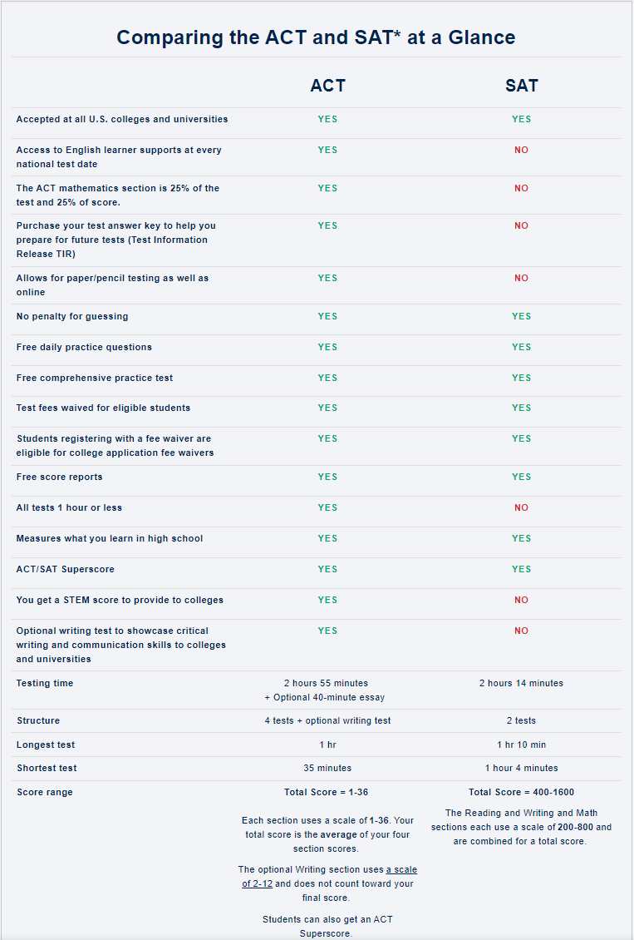

Slide 10

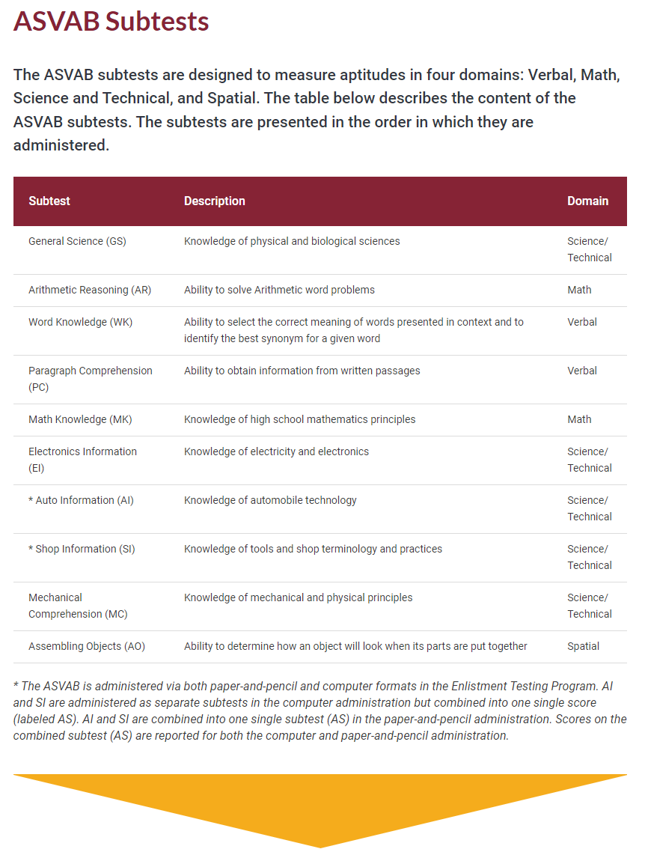
ASVAB
–
Armed Services Vocational Aptitude Battery Test
The Armed Services Vocational Aptitude Battery (ASVAB) is a multiple-aptitude battery that measures developed abilities and helps predict future academic and occupational success in the military.

Slide 11



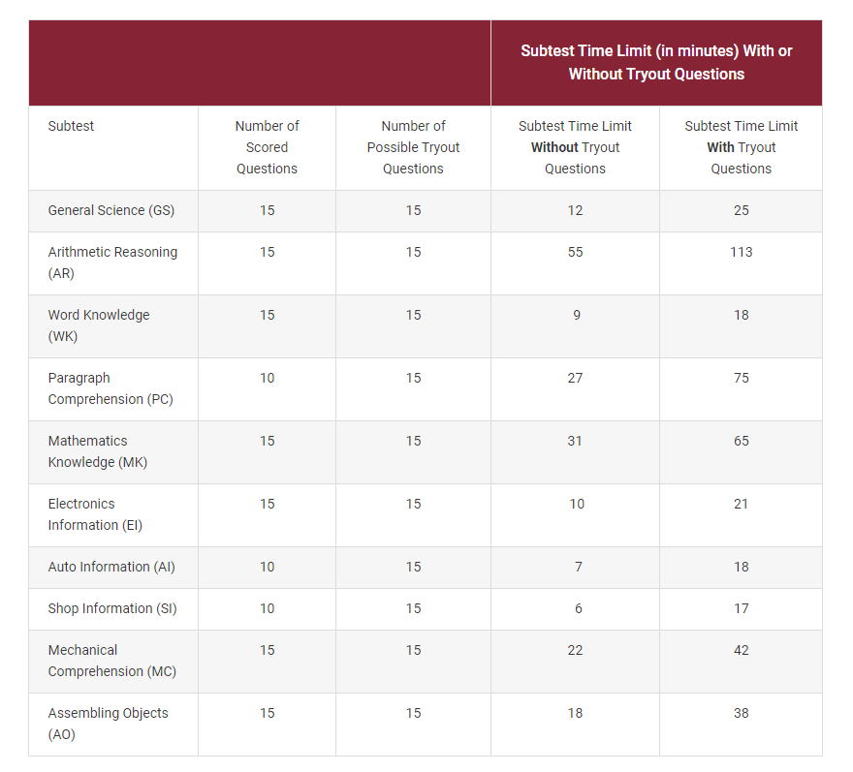
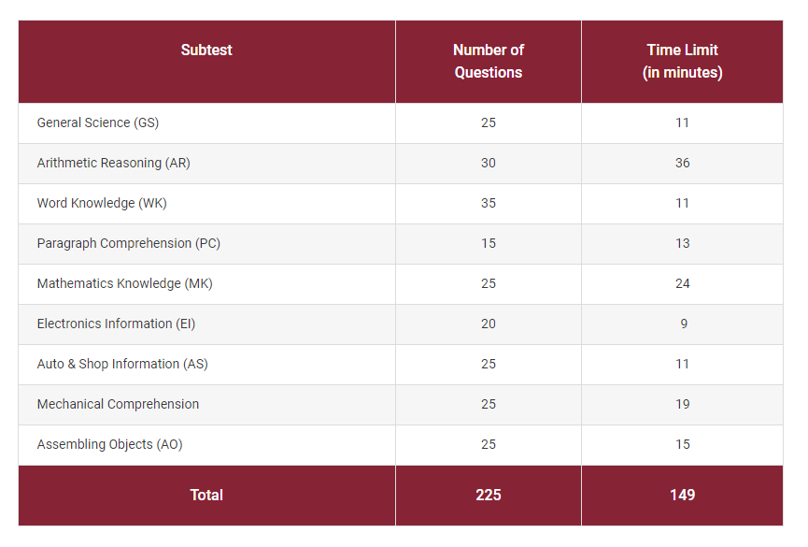
ASVAB – Computer Administration vs. Paper and Pencil Administration

Slide 12
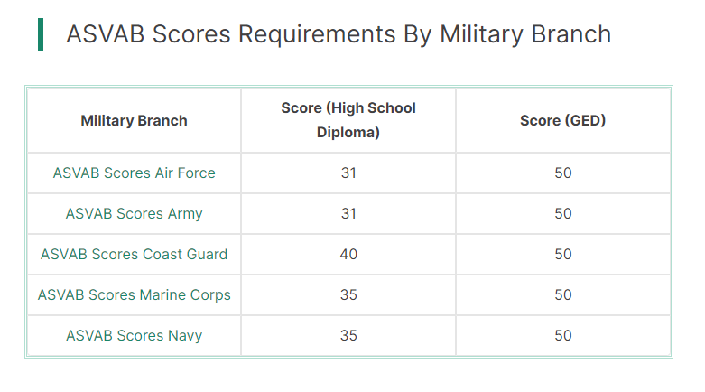
The minimum score is different depending if you have a High School Diploma or GED.

Slide 13
Grading
Discuss purpose of grades
Review report card format
Outline grading process and timetable
Discuss any other means of evaluation

Slide 14
Parent Conferences
Review conference schedule
Distribute sign-up sheet
Review expectations for parent conferences
Explain how you can be reached to discuss concerns

Slide 15
Q&A
Invite questions from parents/students

Slide 16
Summary
Discuss topics covered
Reiterate welcome
Wrap-up

