Slide 1


Zionsville Community Schools Retirement Planning
Presented by: Erik Leighton
info@AxiaAdvisory.com | www.AxiaAdvisory.com | 888-609-2942

Slide 2
Planning Considerations
  Early Career
  Mid Career
  Late Career
Retirement & Your 403(b)/401(a)

Slide 3
Mid Career Planning Considerations
Review Financial Goals (short-term, mid-term, and long-term)
Protect with Insurance (disability and life focus)
Plan for Retirement (review asset allocation)
Cash Flow / Liquidity / Loans & Withdrawals
Balance College Funding with Other Financial Goals
Maximize Tax Sheltered Accounts (50 and older catch up)
  Roth or Pre-tax (review)
Review Beneficiary Designations
Review the Estate Plan (guardian, will, POA, healthcare POA)

Slide 4
Insurance Considerations
Disability Insurance
  ZCS provides LT coverage for eligible employees
Life Insurance (insurable need or can you self insure)
    Mutual (You have ownership stake) vs Public
    Great ratings (solid financially)
    Track record of keeping promises
  Types
    Term (does the need go away?) – ZCS provides $50,000
    Whole Life / Permanent (opportunity cost)

Slide 5
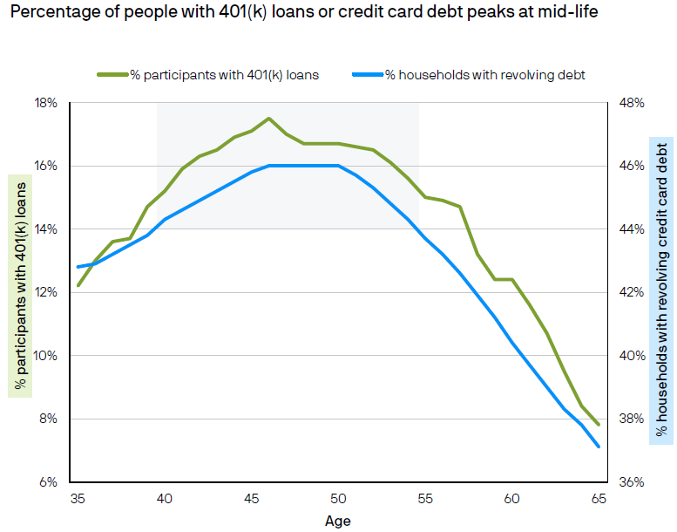
Liquidity Needs Peak at Mid-life
Source: J.P. Morgan retirement research, percentage of people with 401(k) loan is based on 2021 Retirement by the Numbers study (2018-2019 trends); J.P. Morgan Asset Management, percentage of people with credit card revolving debt is based on 2016-2024 internal select credit card data from JPMorgan Chase Bank, N.A. and its affiliates (collectively “Chase”).

Slide 6
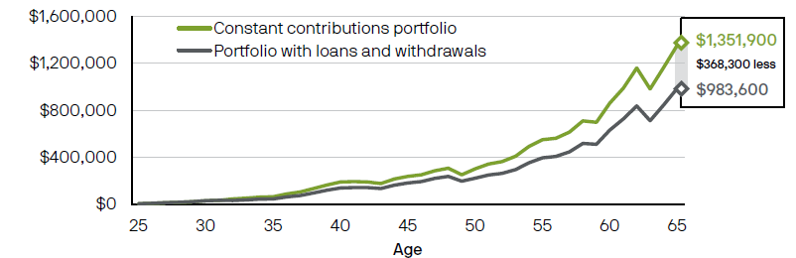
Toxic Effect of Loans and Withdrawals
Growth of 403(b) investment
Source: J.P. Morgan Asset Management. For illustrative purposes only. Hypothetical portfolio is assumed to be invested 60% in the S&P 500 and 40% in the Bloomberg Capital U.S. Aggregate Index from 1984-2024. Starting salary of $30,000 increases by 2.4% each year. Loan and withdrawal amounts are assumed to be $10,000. Loan interest rate is assumed to be 7.5% and is paid off over 4 years.

Slide 7
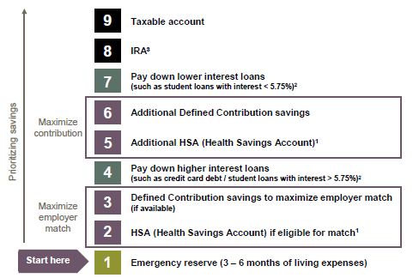
Prioritize Long-term Retirement Savings
¹Must have a high-deductible health insurance plan that is eligible to be paired with an HSA. Those taking Social Security benefits age 65 or older and those who are on Medicare are ineligible. Tax penalties apply for non-qualified distributions prior to age 65; consult IRS Publication 502 or your tax professional.
²This assumes that a diversified portfolio may earn 5.75% over the long term. Actual returns may be higher or lower. Generally, consider making additional payments on loans with a higher interest rate than your long-term expected investment return.
³Income limits may apply for IRAs. If ineligible for these, consider a non-deductible IRA or an after-tax 401(k) contribution. Individual situations will vary; consult your tax professional.

Slide 8
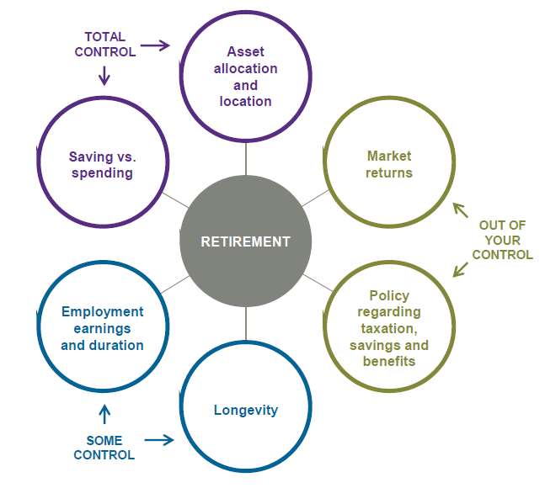
Retirement Equation
Make the most of the things you can control!

Slide 9
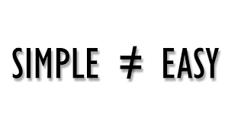
Retirement Challenges
Retirement is still a fairly new concept
Retirement concepts are simple, but not easy
We’re all human
  People are not objective when it comes to decisions or events that involve emotions
  Money is one of the most emotionally sensitive issues on the planet

Slide 10
Why Is Saving For Retirement Important?
  67% of Americans are confident about having enough money to retire (up from only 50% just a few years ago)
  We are living longer
Social Security may change in the future
Healthcare costs aren’t going down
  Married couple age 65 may spend $295,000 on healthcare in retirement*
Because you deserve to retire on your own terms!
    It buys you the most valuable asset in the world … Time
    Provides a Margin of Safety when life gets in the way of your best laid plans
*Source: Fidelity Investments, https://institutional.fidelity.com/app/item/RD_13569_42402/retirement-planning-health-care-costs.html, 4/20/21

Slide 11

Retirement Income
Personal savings
Including: 403(b)/401(a)/HRA/457 retirement plans
Social Security
Pension: Teachers Retirement Fund (TRF)

Slide 12
Who Contributes to Which Accounts?
 | Employee | Zionsville
Social Security | ☑ | ☑
403(b) | ☑ | ☑
401(a) |  | ☑
HRA |  | ☑
HSA* | ☑ | ☑
TRF |  | ☑
*With CDHP/HDHP (Eagle Health Plan) Zionsville contributes $250 for single and $500 for family in January and September

Slide 13
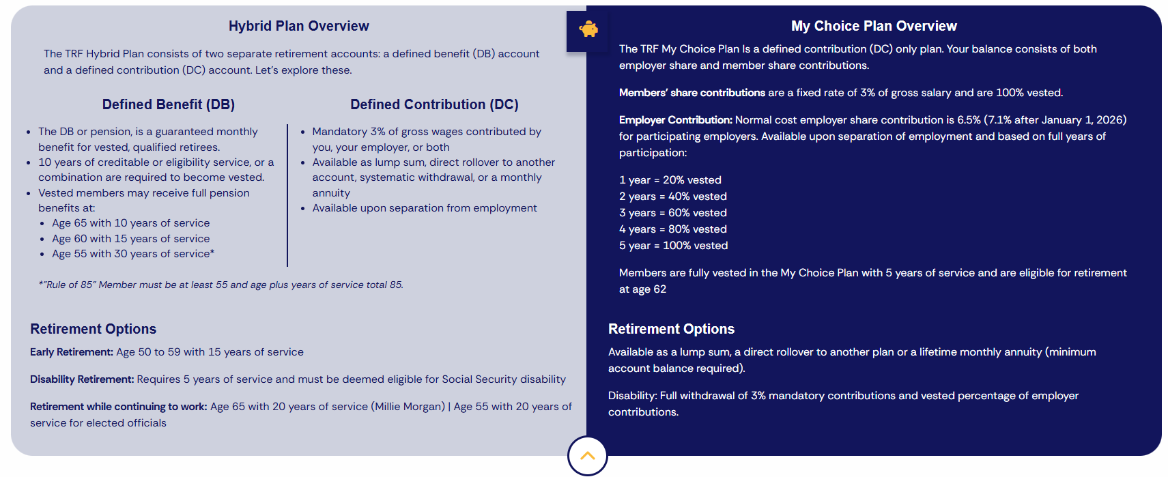
Teachers Retirement Fund – (in.gov/inprs/)

Slide 14
Roth After-Tax Contributions
  Roth contributions are taxed at your current tax rate
  In exchange, Roth contributions and the earnings they generate are tax-free in retirement
  Roth contributions must be invested for 5 years before you benefit from free earnings
Who Should Consider Roth Contributions?
Assumption | Strategy | Best Option
Tax rate will be lower in retirement | Pay taxes later | Pre-Tax
Tax rate will be higher in retirement | Pay taxes now | Roth
Tax rate will be the same | Pay now or later | Same benefit

Slide 15
Retirement Savings Checkpoints
AGE
30
40
50
60
67
1x
3x
6x
8x
10x
The replacement annual income target is defined at 45% of pre-retirement annual income and assumes no pension income. This target is based on Consumer Expenditures Survey 2016 (BLS), Statistics of Income 2016 TaxStat, IRS 2014 tax brackets and Social Security Benefits Calculators. These statistics were developed using salary multipliers through multiple market simulations based on historical market data, assuming poor market conditions to support a 90% confidence level of success.

Slide 16
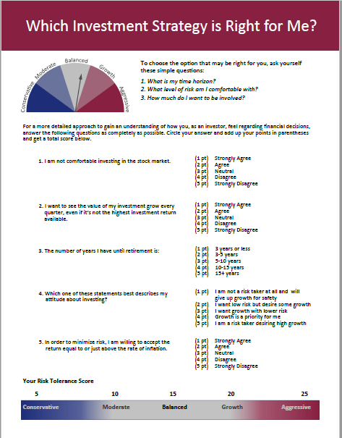
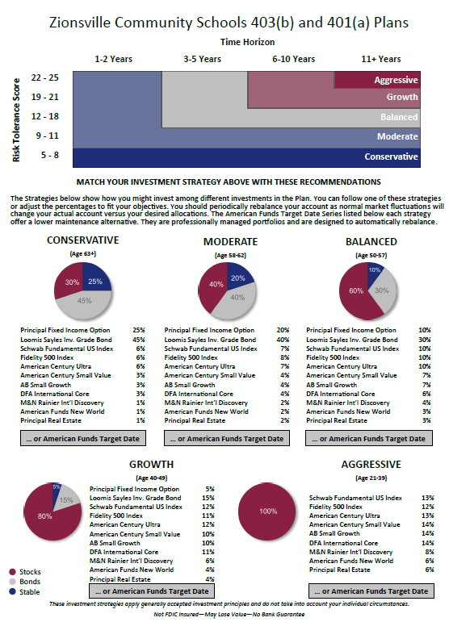
Review Your Asset Allocation
Step One: Review your risk tolerance first
Step Two: Decide how much you want to be involved:
Select your own investment allocations
Follow an Investment Strategy comprised of individual mutual funds
Use a target-date fund - American Funds
Step Three: Use Principal Financial’s procedures for any updates

Slide 17
Reviewing Your Options
 | Core Funds “Do it myself” | Strategies “Show me how” | American Funds “Do it for me”
Proper Allocation
Automatic Rebalancing
Contribution Amount
✓
✓
✓
How much you save is the most important decision

Slide 18

Who To Contact
To view or make changes to your 403(b) or 401(a) account:
  Contact Principal (the plans’ recordkeeper)
    principal.com or 800.547.7754
To view or make changes to your HRA account:
  Contact Daybright Financial (the plan’s recordkeeper)
    mymidamerica.com or 855.329.0095
To review your TRF (Teachers Retirement Fund) benefits:
  Contact INPRS (Indiana Public Retirement System)
    In.gov/inprs/my-fund/teachers or 844.464.6777
If you have questions regarding the investments:
  Contact Axia Advisory (the plans’ investment advisor)
    info@AxiaAdvisory.com or 317.630.2800

