Slide 1


Zionsville Community Schools Retirement Planning
Presented by: Keith Shadrick
info@AxiaAdvisory.com | www.AxiaAdvisory.com | 888-609-2942

Slide 2
Planning Considerations
  Early Career
  Mid Career
  Late Career
Retirement & Your 403(b)/401(a)

Slide 3
Late Career Planning Considerations
Project and Adjust Your Expenses
Protect with Insurance (long-term care focus)
Plan for Retirement (review asset allocation-risk reduction)
Consolidate Tax Sheltered Accounts (focus on fees)
Review Lifetime Income Sources
  Start mulling your social security strategy (opensocialsecurity.com)
  Review TRF provisions and options (844) GO-INPRS or questions@inprs.in.gov
Review Medicare Options
Think About Withdrawal Sequencing
Review the Estate Plan (trusts, charitable gifting)

Slide 4
Reduce Your Risk As You Approach Retirement
Stocks
Bonds
Stable
High
Aggressive
Growth
Return
Balanced
Age | Risk-Based Fund
18-39 | Aggressive
40-49 | Growth
50-57 | Balanced
58-62 | Moderate
63 + | Conservative
Moderate
Low
Conservative
Low
Risk
High

Slide 5
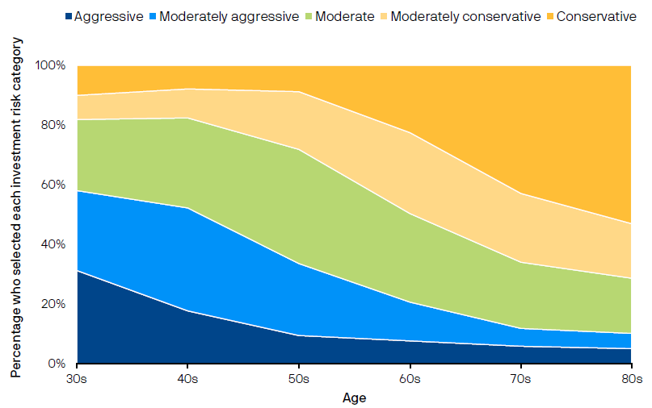
Taking Risk is More Difficult with Age
Participants risk tolerance preferences decrease as they near retirement
“How would you describe your investment risk tolerance at these points in time?”

Slide 6
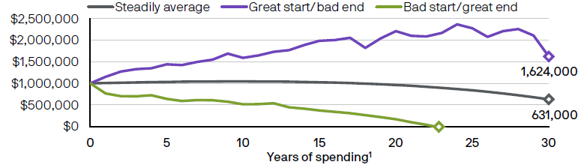
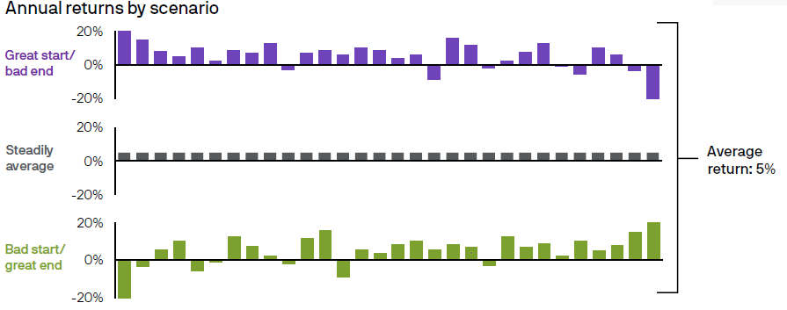
Sequence of Return Risk: Retirement Spending
Source: J.P. Morgan Asset Management. Hypothetical return scenarios are for illustrative purposes only and are not meant to represent an actual asset allocation. 1Years of spending assumes an initial $1,000,000 and a 4% withdrawal adjusted annually for 2.4% inflation.

Slide 7
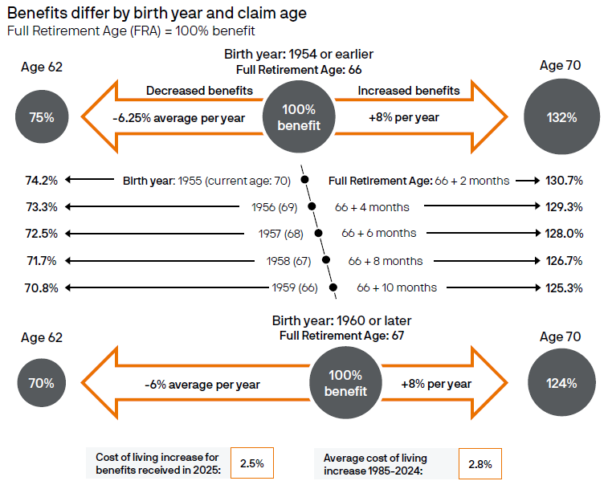
Social Security Timing Tradeoffs

Slide 8
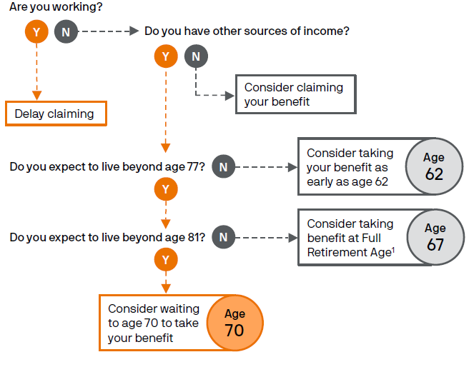
Claiming Social Security: Decision Tree
This material should be regarded as educational information on Social Security and is not intended to provide specific advice.

Slide 9
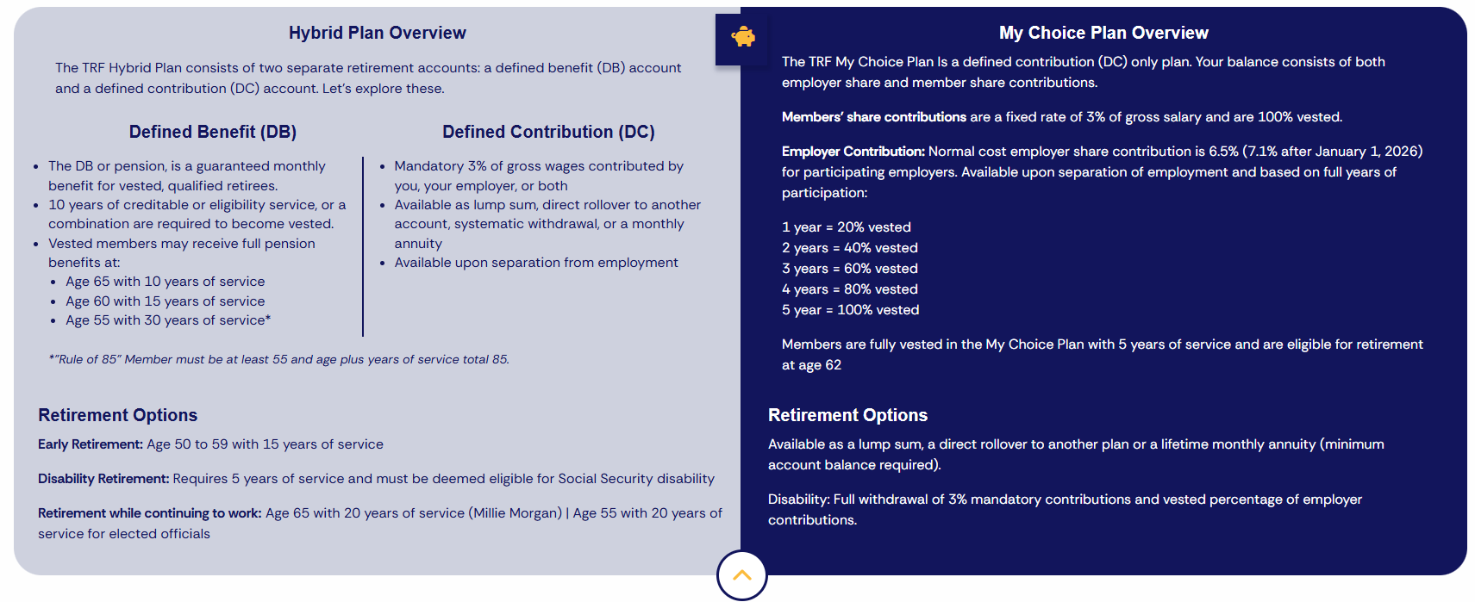
Teachers Retirement Fund – (in.gov/inprs/)

Slide 10
TRF – Hybrid Distribution Options
TRF Hybrid Plan – Defined Benefit (DB) Account
  Monthly lifetime benefit based on:
    Age, years of service, average annual compensation (5 highest yearly salaries), multiplier of 1.1%.
TRF Hybrid Plan – Defined Contribution (DC) Account (distribution amount determined by account balance, taxes withheld, and distribution option chosen)
  May choose monthly payment for the lifetime benefit
  May defer payment until RMD (Req. Min. Distribution) age
  May choose direct payment or rollover distribution

Slide 11
TRF – My Choice Distribution Options
My Choice Plan – Defined Contribution Account
  May defer payment until RMD (Req. Min. Distribtion) Age
  May choose lump sum or rollover distribution
  May choose a partial withdrawal
  May choose a partial withdrawal with deferment until RMD
  May choose a monthly payment for annuity
  May choose to split DC and/or rollover pre-tax contribution balance

Slide 12
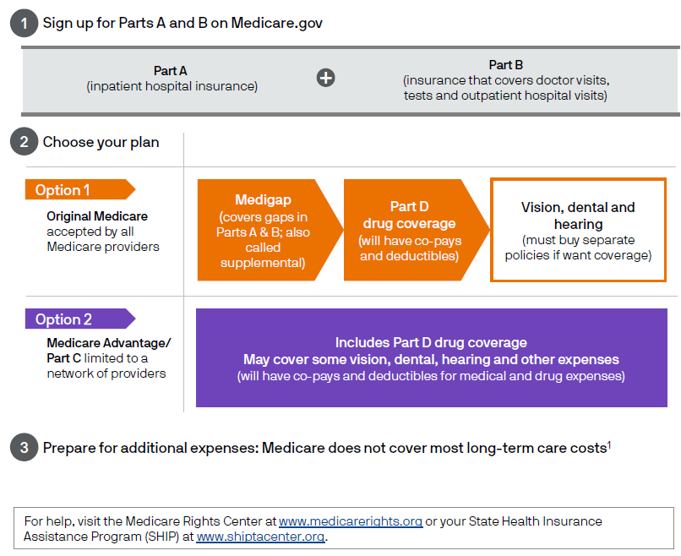
Three Steps for Medicare Coverage
1Medicare does pay for medically necessary skilled nursing facility or home health care, with strict requirements that are difficult to meet on a limited basis, and for some hospice care. If you transfer assets to others there is a five-year “look back” where the government will recover the assets transferred if you go on Medicaid. This is not personal advice. Consult an elder care attorney if you have questions.
Source: Medicare.gov as of December 31, 2024; J.P. Morgan Asset Management.

Slide 13
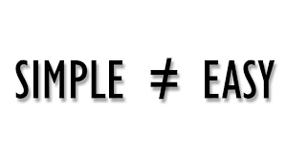
Retirement Challenges
Retirement is still a fairly new concept
Retirement concepts are simple, but not easy
We’re all human
  People are not objective when it comes to decisions or events that involve emotions
  Money is one of the most emotionally sensitive issues on the planet

Slide 14

Retirement Income
Personal savings
Including: 403(b)/401(a)/HRA/457 retirement plans
Social Security
Pension: Teachers Retirement Fund (TRF)

Slide 15
Who Contributes to Which Accounts?
 | Employee | Zionsville
Social Security | ☑ | ☑
403(b) | ☑ | ☑
401(a) |  | ☑
HRA |  | ☑
HSA* | ☑ | ☑
TRF |  | ☑
*With CDHP/HDHP (Eagle Health Plan) Zionsville contributes $250 for single and $500 for family in January and September

Slide 16
Roth After-Tax Contributions
  Roth contributions are taxed at your current tax rate
  In exchange, Roth contributions and the earnings they generate are tax-free in retirement
  Roth contributions must be invested for 5 years before you benefit from free earnings
Who Should Consider Roth Contributions?
Assumption | Strategy | Best Option
Tax rate will be lower in retirement | Pay taxes later | Pre-Tax
Tax rate will be higher in retirement | Pay taxes now | Roth
Tax rate will be the same | Pay now or later | Same benefit

Slide 17
Retirement Savings Checkpoints
AGE
30
40
50
60
67
1x
3x
6x
8x
10x
The replacement annual income target is defined at 45% of pre-retirement annual income and assumes no pension income. This target is based on Consumer Expenditures Survey 2016 (BLS), Statistics of Income 2016 TaxStat, IRS 2014 tax brackets and Social Security Benefits Calculators. These statistics were developed using salary multipliers through multiple market simulations based on historical market data, assuming poor market conditions to support a 90% confidence level of success.

Slide 18
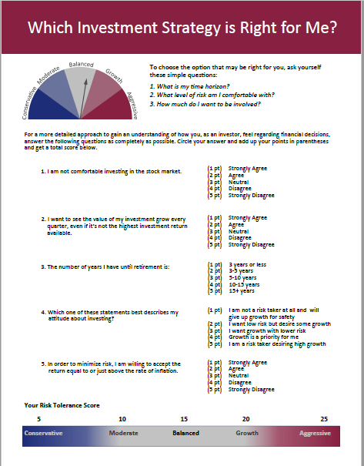
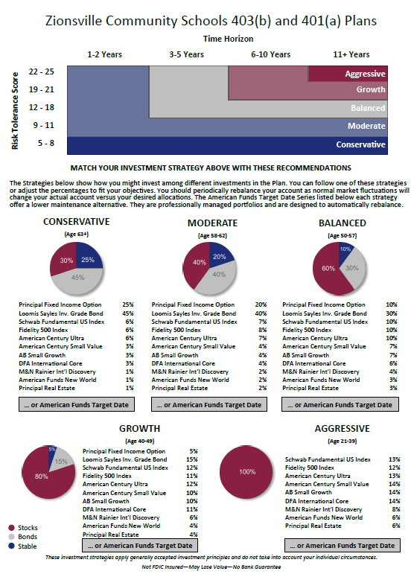
Review Your Asset Allocation
Step One: Review your risk tolerance first
Step Two: Decide how much you want to be involved:
Select your own investment allocations
Follow an Investment Strategy comprised of individual mutual funds
Use a target-date fund - American Funds
Step Three: Use Principal Financial’s procedures for any updates

Slide 19
Reviewing Your Options
 | Core Funds “Do it myself” | Strategies “Show me how” | American Funds “Do it for me”
Proper Allocation
Automatic Rebalancing
Contribution Amount
✓
✓
✓
How much you save is the most important decision

Slide 20

Who To Contact
To view or make changes to your 403(b) or 401(a) account:
  Contact Principal (the plans’ recordkeeper)
    principal.com or 800.547.7754
To view or make changes to your HRA account:
  Contact Daybright Financial (the plan’s recordkeeper)
    mymidamerica.com or 855.329.0095
To review your TRF (Teachers Retirement Fund) benefits:
  Contact INPRS (Indiana Public Retirement System)
    In.gov/inprs/my-fund/teachers or 844.464.6777
If you have questions regarding the investments:
  Contact Axia Advisory (the plans’ investment advisor)
    info@AxiaAdvisory.com or 317.630.2800

