Slide 1


Zionsville Community Schools Retirement Planning
Presented by: Ben Cloud
info@AxiaAdvisory.com | www.AxiaAdvisory.com | 888-609-2942

Slide 2
Planning Considerations
  Early Career
  Mid Career
  Late Career
Retirement & Your 403(b)/401(a)

Slide 3
Early Career Planning Considerations
Set Financial Goals (short-term, mid-term, and long-term)
  Specific-Measurable-Action Oriented-Reachable-Time Bound
  Habits > Goals
Create a Budget (fixed and discretionary expenses vs. income)
Review and Work on Your Credit Score
Build an Emergency Fund
Protect with Insurance (health and disability focus)
Plan for Retirement (power of compounding - never too early to start)
Focus on Tax Sheltered Accounts - 403(b) / 401(a) / 457
Create an Estate Plan (not just for the ultra wealthy)

Slide 4
Creating a Budget
  Add up your income
    Look at total monthly take-home pay (net pay)
  Estimate your expenses
    Necessary expenses
      Rent, car payment, insurance, gas, utilities
    Discretionary expenses
      Dining out, entertainment, vacations
  Figure out the difference
    Income – Expenses = Disposable Income
  Track your spending
Necessary Expenses
+ Discretionary Expenses
= Total Expenses
Income
- Expenses
= Disposable Income
Spoiler Alert: Total Expenses should be less than your Income

Slide 5
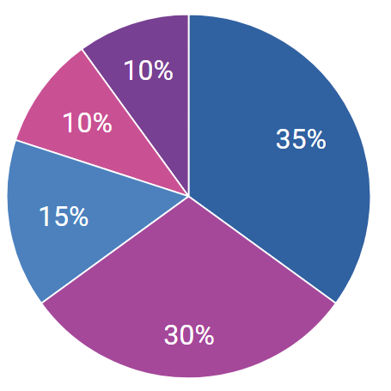
FICO Score Weightings
New credit
Number of recent hard inquiries
Types of credit used
Variety of types of credit used
Payment History
Length of credit history
Pay all your bills on time, every time
Longer credit history is better
Amounts owed on credit and debit
Credit Utilization Ratio
Source: www.Experian.com

Slide 6
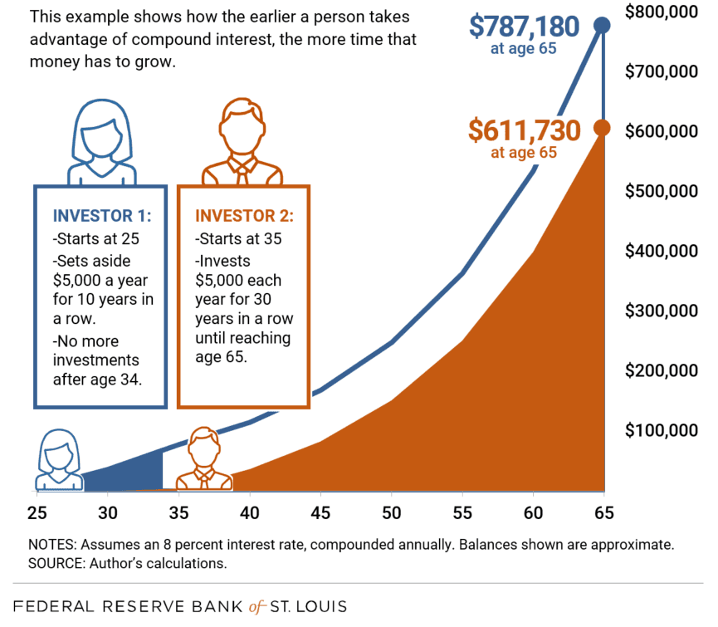
Power of Compounding

Slide 7
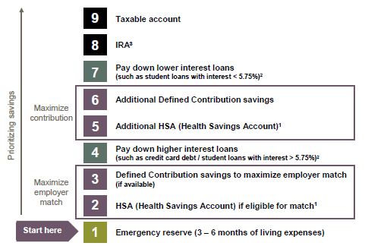
Prioritize Long-term Retirement Savings
¹Must have a high-deductible health insurance plan that is eligible to be paired with an HSA. Those taking Social Security benefits age 65 or older and those who are on Medicare are ineligible. Tax penalties apply for non-qualified distributions prior to age 65; consult IRS Publication 502 or your tax professional.
²This assumes that a diversified portfolio may earn 5.75% over the long term. Actual returns may be higher or lower. Generally, consider making additional payments on loans with a higher interest rate than your long-term expected investment return.
³Income limits may apply for IRAs. If ineligible for these, consider a non-deductible IRA or an after-tax 401(k) contribution. Individual situations will vary; consult your tax professional.

Slide 8
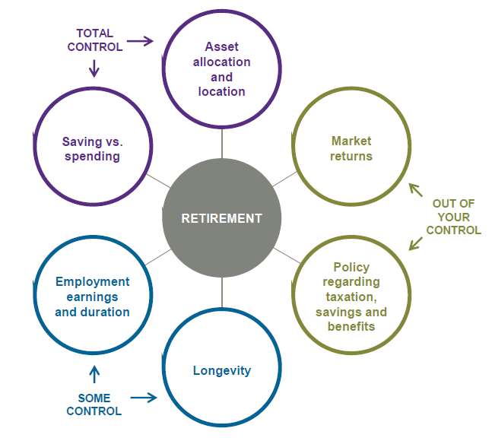
Retirement Equation
Make the most of the things you can control!

Slide 9
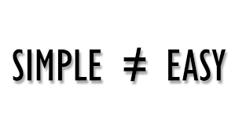
Retirement Challenges
Retirement is still a fairly new concept
Retirement concepts are simple, but not easy
We’re all human
  People are not objective when it comes to decisions or events that involve emotions
  Money is one of the most emotionally sensitive issues on the planet

Slide 10

Retirement
3 big things you need to get right to give yourself a chance at financial independence one day
Save at least 10% of your income (preferably 15%-20%)
Make your saving and investing automatic
Think and act for the long term

Slide 11
Why Is Saving For Retirement Important?
  67% of Americans are confident about having enough money to retire (up from only 50% just a few years ago)
  We are living longer
Social Security may change in the future
Healthcare costs aren’t going down
  Married couple age 65 may spend $330,000 on healthcare in retirement*
Because you deserve to retire on your own terms!
    It buys you the most valuable asset in the world … Time
    Provides a Margin of Safety when life gets in the way of your best laid plans
*Source: https://www.fidelity.com/learning-center/wealth-management-insights/how-to-prepare-for-health-care-costs-in-retirement, 4/16/25

Slide 12

Retirement Income
Personal savings
Including: 403(b)/401(a)/HRA/457 retirement plans
Social Security
Pension: Teachers Retirement Fund (TRF)

Slide 13
Who Contributes to Which Accounts?
 | Employee | Zionsville
Social Security | ☑ | ☑
403(b) | ☑ | ☑
401(a) |  | ☑
HRA |  | ☑
HSA* | ☑ | ☑
TRF |  | ☑
*With CDHP/HDHP (Eagle Health Plan) Zionsville contributes $250 for single and $500 for family in January and September

Slide 14
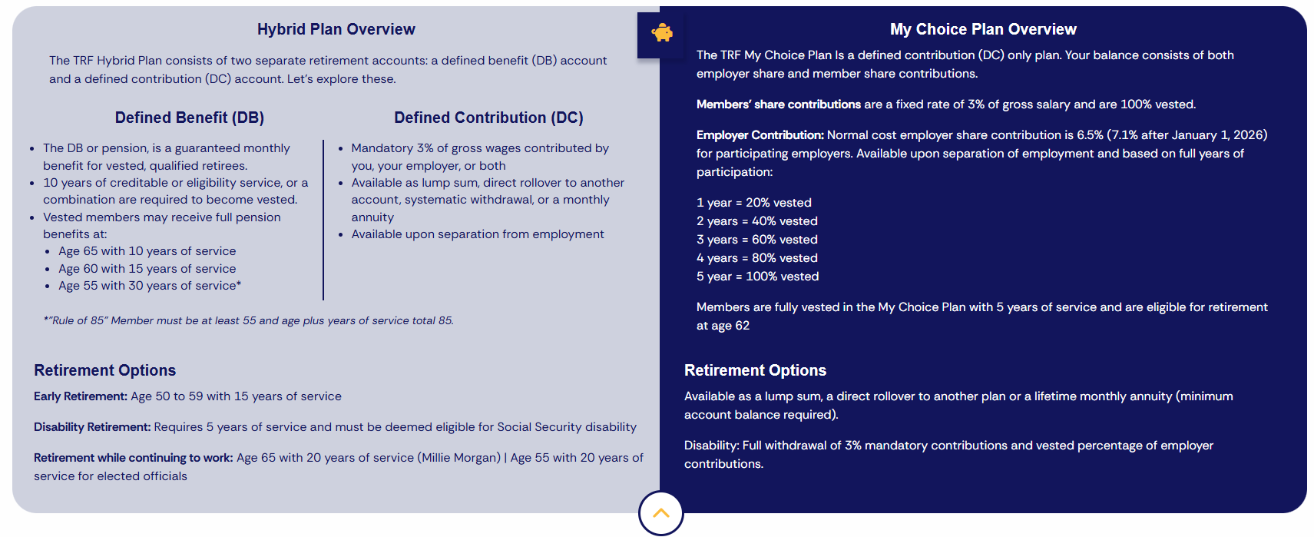
Teachers Retirement Fund – (in.gov/inprs/)

Slide 15
Roth After-Tax Contributions
  Roth contributions are taxed at your current tax rate
  In exchange, Roth contributions and the earnings they generate are tax-free in retirement
  Roth contributions must be invested for 5 years before you benefit from free earnings
Who Should Consider Roth Contributions?
Assumption | Strategy | Best Option
Tax rate will be lower in retirement | Pay taxes later | Pre-Tax
Tax rate will be higher in retirement | Pay taxes now | Roth
Tax rate will be the same | Pay now or later | Same benefit

Slide 16
Retirement Savings Checkpoints
AGE
30
40
50
60
67
1x
3x
6x
8x
10x
The replacement annual income target is defined at 45% of pre-retirement annual income and assumes no pension income. This target is based on Consumer Expenditures Survey 2016 (BLS), Statistics of Income 2016 TaxStat, IRS 2014 tax brackets and Social Security Benefits Calculators. These statistics were developed using salary multipliers through multiple market simulations based on historical market data, assuming poor market conditions to support a 90% confidence level of success.

Slide 17
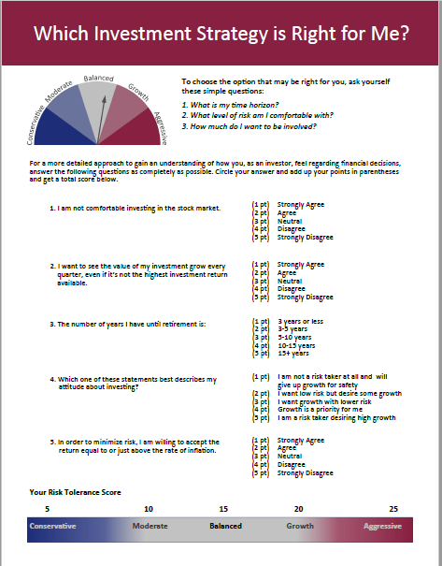
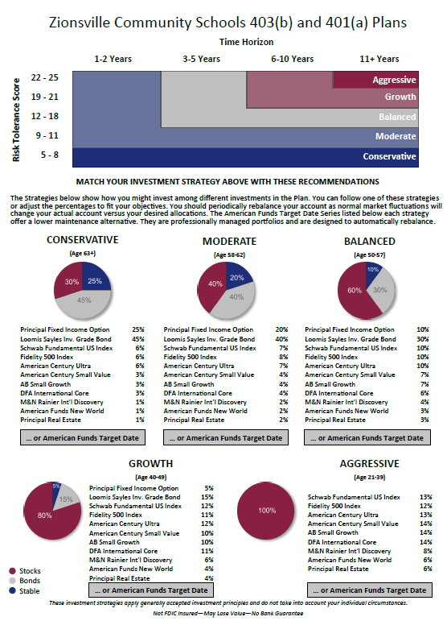
How To Get Invested
Step One: Determine your risk tolerance first
Step Two: Decide how much you want to be involved:
Select your own investment allocations
Follow an Investment Strategy comprised of individual mutual funds
Use a target-date fund - American Funds
Step Three: Use Principal Financials procedures for any updates

Slide 18
Reviewing Your Options
 | Core Funds “Do it myself” | Strategies “Show me how” | American Funds “Do it for me”
Proper Allocation
Automatic Rebalancing
Contribution Amount
✓
✓
✓
How much you save is the most important decision

Slide 19

Who To Contact
To view or make changes to your 403(b) or 401(a) account:
  Contact Principal (the plans’ recordkeeper)
    principal.com or 800.547.7754
To view or make changes to your HRA account:
  Contact Daybright Financial (the plan’s recordkeeper)
    mymidamerica.com or 855.329.0095
To review your TRF (Teachers Retirement Fund) benefits:
  Contact INPRS (Indiana Public Retirement System)
    In.gov/inprs/my-fund/teachers or 844.464.6777
If you have questions regarding the investments:
  Contact Axia Advisory (the plans’ investment advisor)
    info@AxiaAdvisory.com or 317.630.2800

