Slide 1

2025-2026
Course Selection
Northern Lebanon High School

Slide 2
Counseling Office
Secretaries
Mrs. Heagy & Mrs. Houser
Counselors
Miss Bartell: 7th-9th Last names: A-L
Mrs. Tavani: 7th-9th Last names: M-Z
Mr. Shewell: 10th-12th Last names: A-Me
Mrs. Kline: 10th-12th Last names: Mi-Z & CTC

Slide 3
Counseling Services
Visit the guidance webpage often
  https://www.norleb.org/high-school-home/principal/guidance
  Career resources
Financial Aid/Scholarships
CTC Program details
Transcript request form
Course Selection
      CAREER PLANNER/COURSE DESCRIPTIONS
      ELECTRONIC COPY OF COURSE SELECTION FORMS

Slide 4

Lebanon County Career & Technical Center
(CTC)
Most programs are half day; Junior and Senior Year
Priority will be given to 11th grade applicants for half day programs
Only Culinary and Pastry Arts are full day, Senior-only programs
Acceptance into the CTC is based on attendance, GPA, discipline record, and time that applications are received by Mrs. Kline.

Slide 5

Graduation Requirements
Language Arts…………………………………........4.0 credits
Social Science……………………………………...3.0 credits
Mathematics………………………………………3.0 credits
Natural Science…………………………………......3.0 credits
Financial Literacy…………………………………..0.5 credit
Physical Education…………………………..................1.5 credits
Health…………………………………………….0.5 credit
Other Electives……………………………………..8.5 credits
Total 24.0 credits

Slide 6
Career Development Graduation Project
High School components of the Career Development Graduation Project will be completed in 11th grade, during the Financial Literacy course.
If a student happens to not be enrolled Financial Literacy during their 11th grade year, the Graduation Project assignments still must be completed.
If a student fails the Financial Literacy course, they will still be responsible for completing the Graduation Project assignments during their 11th grade year.

Slide 7
Keystone Exam Requirement
Students must pass the Keystone Exams in order to graduate. The exams will be taken at the conclusion of the following courses:
              Algebra (8th, 9th, or 10th grade)
              Biology (10th grade)
              Literature (10th grade)

Slide 8
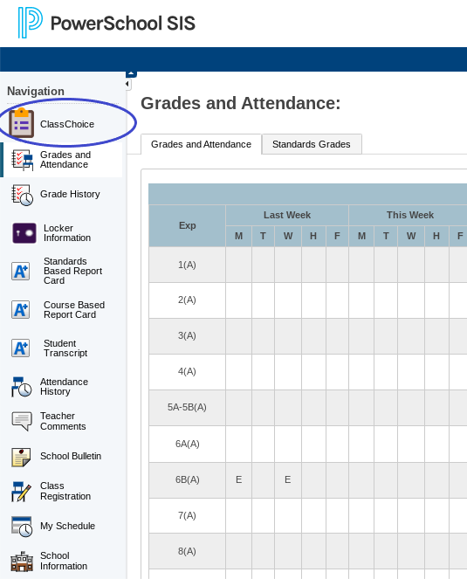
ClassChoice on PowerSchool
Log on to PowerSchool:

Slide 9
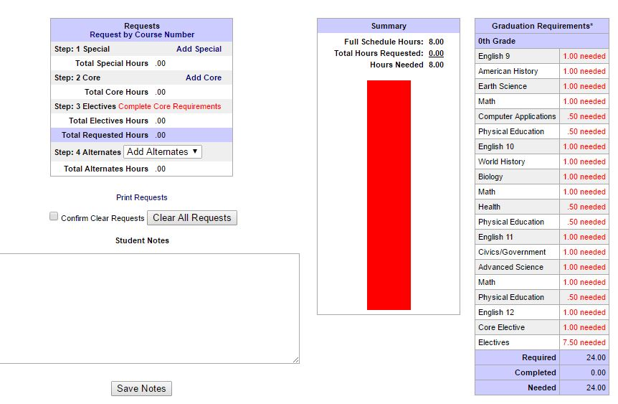
Scheduling Steps
REQUESTS
Click on Add Core in the top left corner of the screen
Choose Core Classes
Make elective selections and get bar to green
Use the color graph as a guide
ADD 4 ALTERNATES

Slide 10

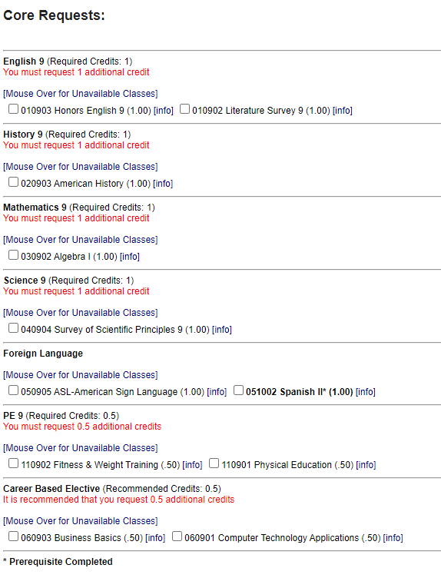

Selecting Classes
You must choose one course from each area.
If you do not see a course that you think you should, raise your hand.

Slide 11
Tips
Add 4 Alternates
Right column: Be sure graduation requirements are being met
        See counselor with discrepancies
Each student is required to carry 7.0 credits
Add Core
Always click on “Save Requests” to go back
Go green
**See counselor with questions about specific courses and prerequisites.**

Slide 12

Class Choice Closing Date:
January 9th
If you have any questions, see your counselor
After January 9th, ClassChoice will be locked .
One-on-one meeting with counselor
If you do not have internet access at home, it will be your responsibility to complete your requests at school
Please review your course selections with your parents

