Slide 1


Welcome Families!
Title 1A School Wide Program
Annual Meeting
Jefferson County
Middle School

Slide 2
Purpose of Today’s Meeting
Provide information about our school’s Title I-A program for parents of students participating in the program

Slide 3
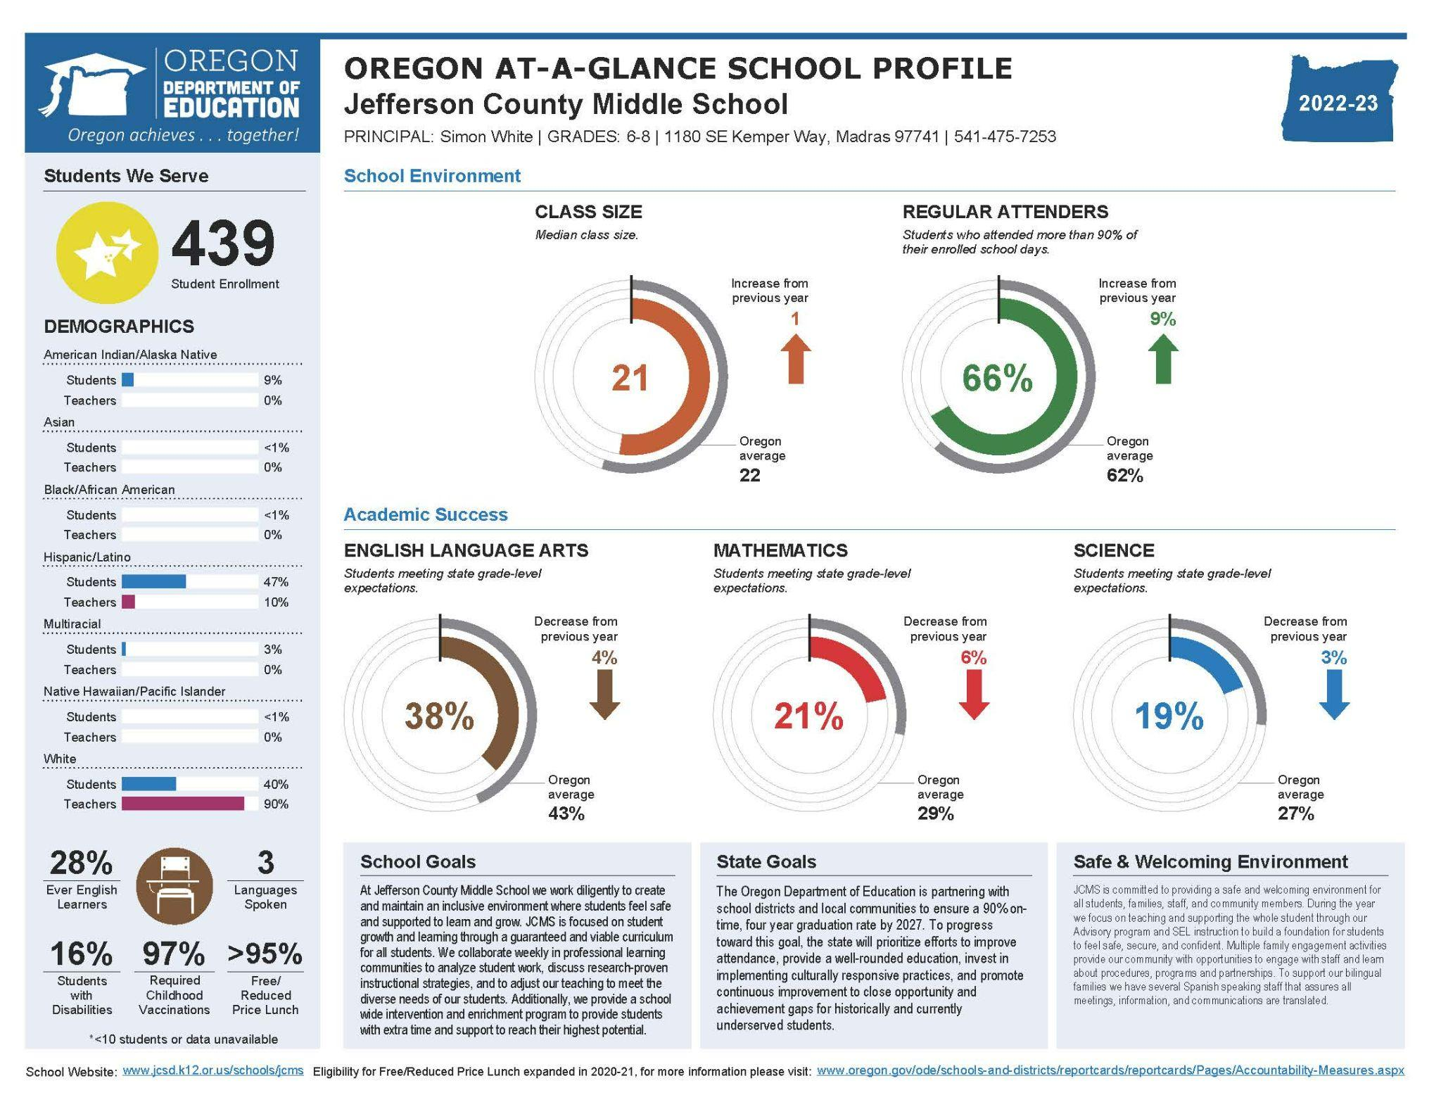
Update on School’s Progress
Notes:
If Priority, Focus or Model school, share current status and what does that mean to parents?

Slide 4
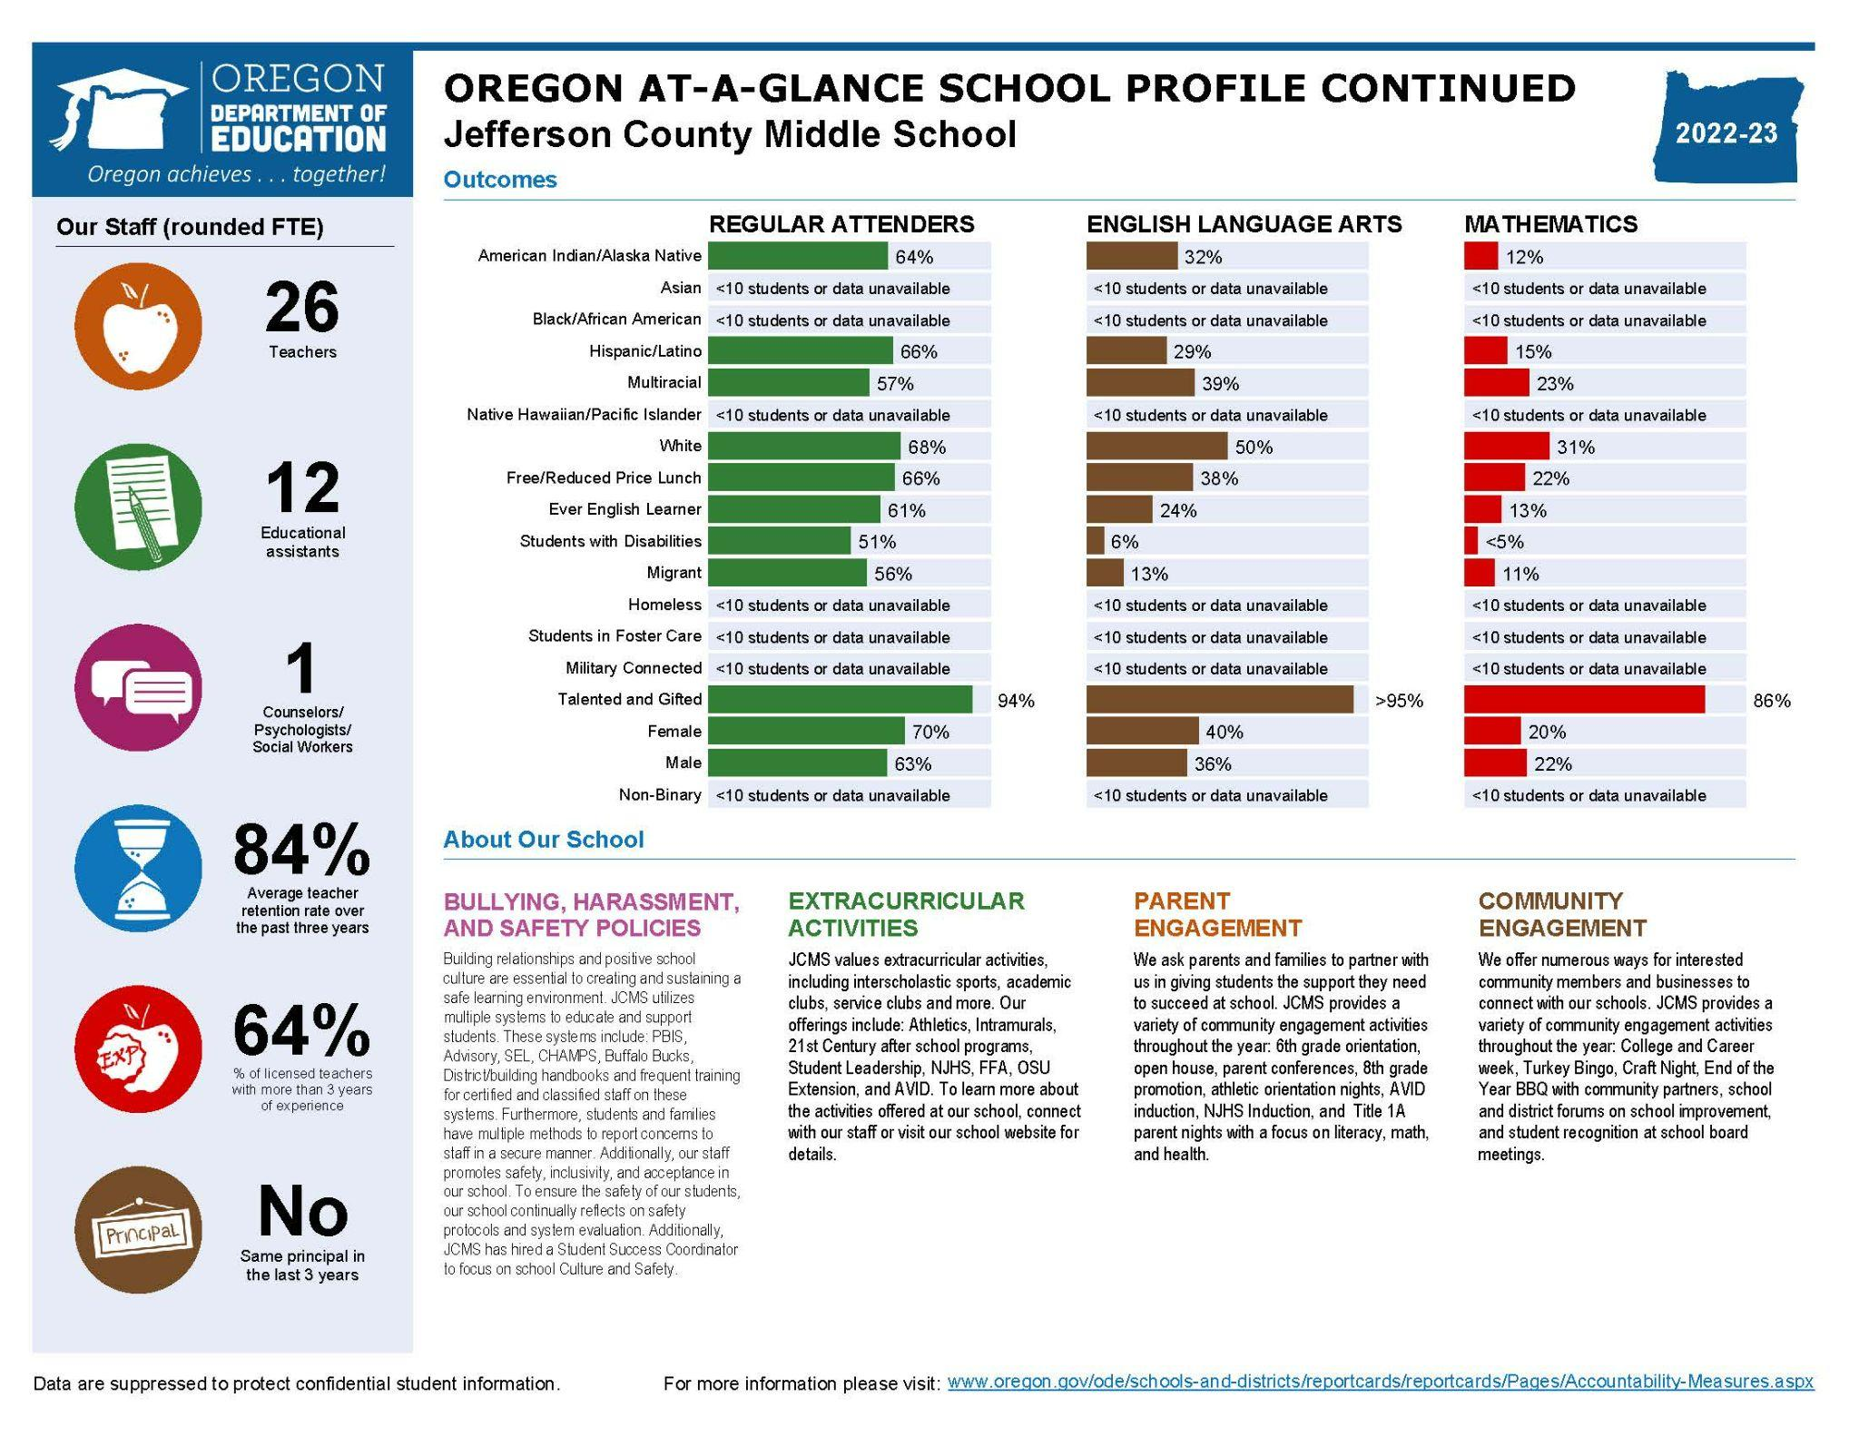
Update on School’s Progress
Notes:
If Priority, Focus or Model school, share current status and what does that mean to parents?

Slide 5
Title I-A Program
What is “Title I-A”?
  Title I-A is United States Government’s largest education assistance program for schools.
  Funds are used to provide programs to help children who are struggling in reading and math.
  Extra help (in addition to what they learn during math and reading time in the classroom)
  Funding provided under ESEA

Slide 6
Title I-A Program Components
Design of Program
Annual Review
Assessments & Monitoring
Parent Involvement
Notes:
Design of Program – What does the program look like? What interventions are in place? What curriculum are we using? What’s the goal?
Assessments & Monitoring – How are we assessing our students? How are we monitoring our students to see if there’s any progress?
Parent Involvement – One of the key components is the involvement of our families. Not only in ensuring that we are addressing all the rights of our families, but providing opportunities for our families to learn more about our curriculum and possible strategies that they can use at home to help their students.
Annual Review – Annually review and evaluating the plan to see if its working . Determining what’s working, what needs to changes and adjusting the plan based on feedback from district personnel and our community.

Slide 7
Design of our Program
Targeted Assistance Program
    Targeted – students identified for the program based on performance on assessments
      Discuss Targeting criteria
What does our program look like?
    Curriculum & Interventions
      Read 180/Systems 44 for targeted students
      Math intervention class
    Assessments
      MAPGrowth Math & Reading Sceener
    Additional Supports like REACH and 21st Century

Slide 8
Assessments & Monitoring
Assessments our school uses:
  SMARTER Balanced, MAP Growth Reading and Math in-program checkpoints like SRI
Notification of your child’s assessment results
  SMARTER Balanced: reports sent home
  MAP Growth Reading & Math checkpoints: distributed by mail?
Progress monitoring process

Slide 9
Parent’s Rights under ESEA
Right to request teacher qualifications
Participate in decisions affecting your child
Participate in school activities
Request opportunities to meet regularly with staff for parent involvement
Review school’s Title I-A plan and make suggestions
Notes:
Within the district policy and school plan, parents have the following rights:

Slide 10
Important Dates / Upcoming Events
Open House
Literacy Nights
Math Nights
Guardian/Teacher Conferences
Other
Avid Night
Incoming 6th Grade Night

Slide 11
Annual Review & Evaluation
Review plan
Request feedback
Provide any clarification
Discuss plans for upcoming year

Slide 12
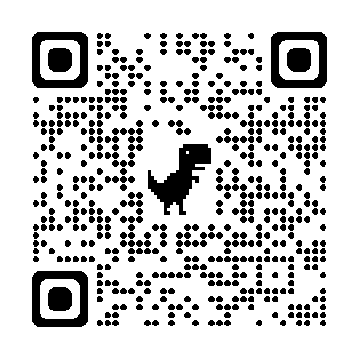
Questions and Input?

