Slide 1

Jarrell Independent
School
District
1Q22
Demographic Report

Slide 2
Local Economic Conditions

Slide 3
State Enrollment Trends

Slide 4
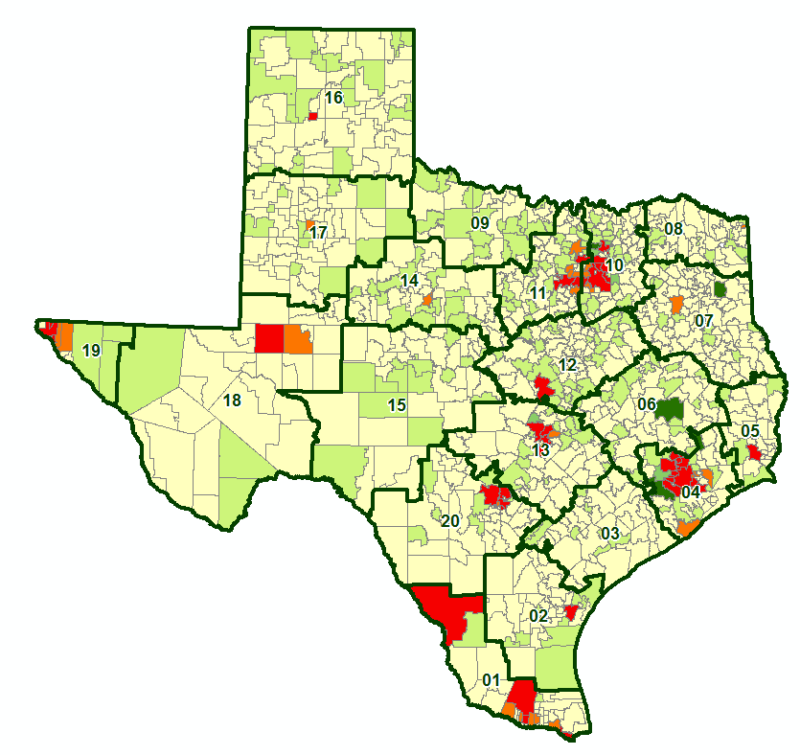
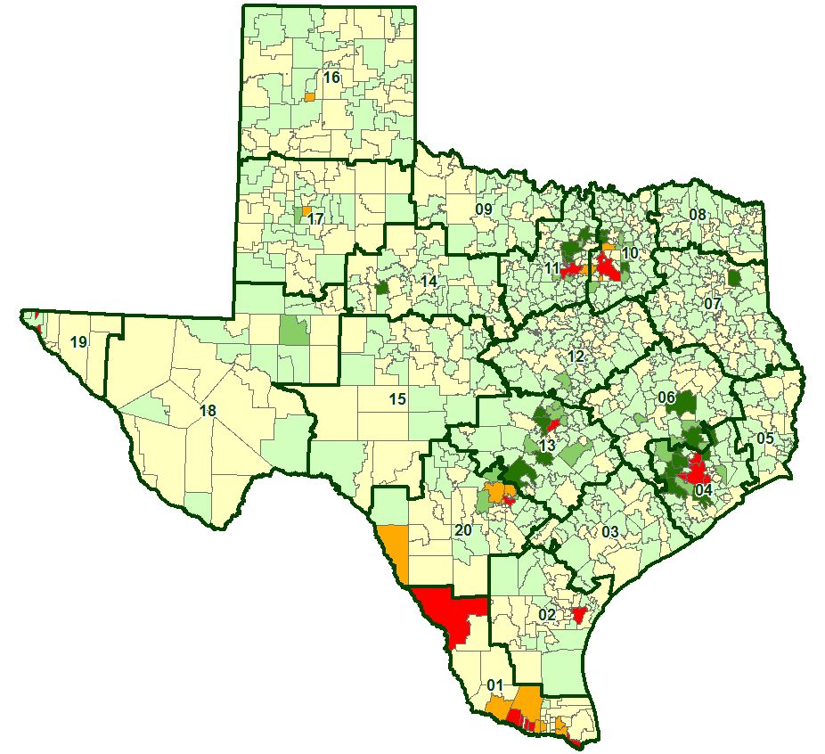
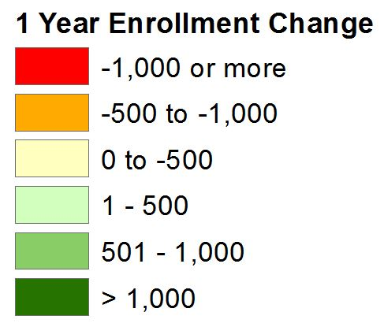
State Enrollment Trends
2020/21 State Enrollment
Total Enrollment 5,371,590
Total Growth -122,350
2021/22 State Enrollment
Total Enrollment 5,427,370
Total Growth 55,780

Slide 5
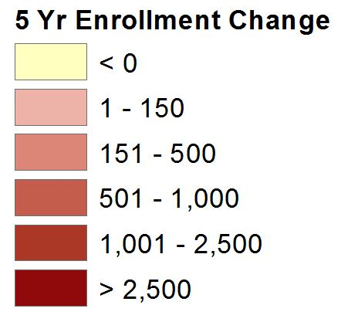
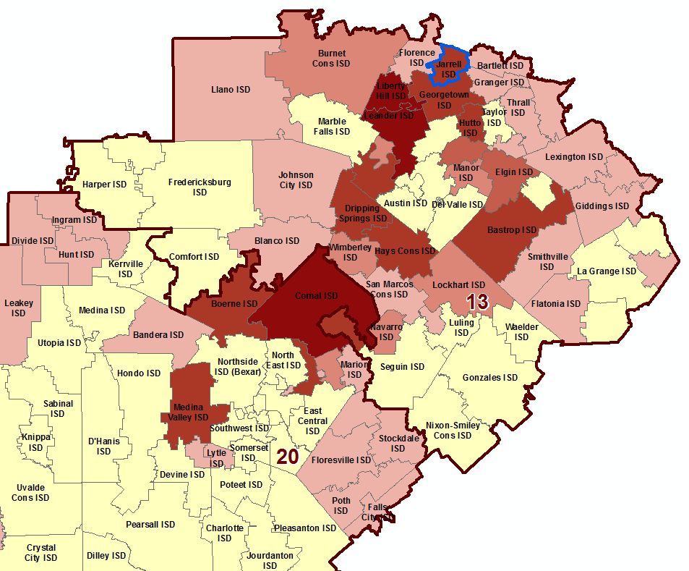
Region 13 & 20 Enrollment Trends
Jarrell ISD enrollment increased by 1,394 students between 2016/17 and 2021/22, an increase of 93.5%
2021/22 JISD enrollment is up 580 students from 2020/21, an increase of 25.2%
Region 13 has seen an overall enrollment increase of 8,406 students from 2020/21, a increase of 2.3%
Region 20 enrollment has decreased -0.01% from 2020/21, a decrease of 40 students

Slide 6
Jarrell ISD Home Price Analysis
 | Avg New Home | Avg Existing Home
2010 | $176,203 | $148,206
2011 | $201,547 | $170,897
2012 | $162,264 | $178,128
2013 | $166,792 | $178,718
2014 | $181,398 | $197,676
2015 | $192,883 | $192,272
2016 | $199,152 | $212,268
2017 | $208,578 | $215,709
2018 | $251,055 | $239,558
2019 | $234,325 | $246,839
2020 | $235,052 | $249,976
2021 | $257,634 | $304,319
2022 YTD | $343,259 | $344,335
The average new home sale price in Jarrell ISD has increased by approx. 95% since 2010, an increase of nearly $167,056
The average existing home sale price within Jarrell ISD has increased by $196,129 since 2010, an increase of 132%

Slide 7
Austin New Home Ranking Report
ISD Ranked by Annual Closings – 1Q22
Rank | District Name | Annual Starts | Annual Closings | Inventory | VDL | Future
1 | LEANDER ISD | 2,859 | 2,400 | 1,993 | 2,547 | 8,064
2 | GEORGETOWN ISD | 2,736 | 2,277 | 1,916 | 3,791 | 15,417
3 | HAYS CISD | 3,422 | 2,192 | 2,443 | 3,607 | 43,216
4 | LIBERTY HILL ISD | 2,284 | 1,991 | 1,433 | 2,460 | 11,086
5 | PFLUGERVILLE ISD | 1,312 | 1,406 | 988 | 838 | 9,458
6 | HUTTO ISD | 2,028 | 1,359 | 1,216 | 1,274 | 8,851
7 | AUSTIN ISD | 2,145 | 1,159 | 2,418 | 1,420 | 9,772
8 | DEL VALLE ISD | 1,164 | 1,087 | 771 | 1,051 | 24,443
9 | JARRELL ISD* | 1,340 | 998 | 761 | 1,024 | 12,593
10 | MANOR ISD | 1,230 | 923 | 986 | 1,406 | 14,843
11 | DRIPPING SPRINGS ISD | 1,005 | 844 | 780 | 776 | 7,901
12 | BASTROP ISD | 984 | 716 | 599 | 2,721 | 16,039
13 | LAKE TRAVIS ISD | 853 | 661 | 748 | 804 | 4,133
14 | ROUND ROCK ISD | 779 | 529 | 667 | 1,136 | 5,186
15 | SAN MARCOS CISD | 1,121 | 466 | 896 | 926 | 5,577
16 | ELGIN ISD | 419 | 342 | 214 | 498 | 9,410
17 | TAYLOR ISD | 271 | 230 | 109 | 263 | 976
18 | LAGO VISTA ISD | 274 | 194 | 208 | 435 | 4,048
19 | LOCKHART ISD | 77 | 69 | 42 | 38 | 18,717
20 | WIMBERLEY ISD | 23 | 19 | 13 | 55 | 0
* Based on additional Zonda Education housing research

Slide 8
District New Home Starts and Closings
Starts | 2016 | 2017 | 2018 | 2019 | 2020 | 2021 | 2022 |  | Closings | 2016 | 2017 | 2018 | 2019 | 2020 | 2021 | 2022
1Q | 36 | 44 | 51 | 55 | 155 | 306 | 327 |  | 1Q | 45 | 85 | 72 | 85 | 129 | 244 | 230
2Q | 62 | 111 | 121 | 129 | 135 | 339 |  |  | 2Q | 45 | 53 | 32 | 97 | 195 | 263
3Q | 82 | 103 | 112 | 248 | 241 | 285 |  |  | 3Q | 62 | 109 | 99 | 107 | 166 | 342
4Q | 86 | 73 | 81 | 160 | 251 | 406 |  |  | 4Q | 45 | 98 | 88 | 180 | 223 | 180
Total | 266 | 331 | 365 | 592 | 782 | 1,336 | 327 |  | Total | 197 | 345 | 291 | 469 | 713 | 1,029 | 230

Slide 9
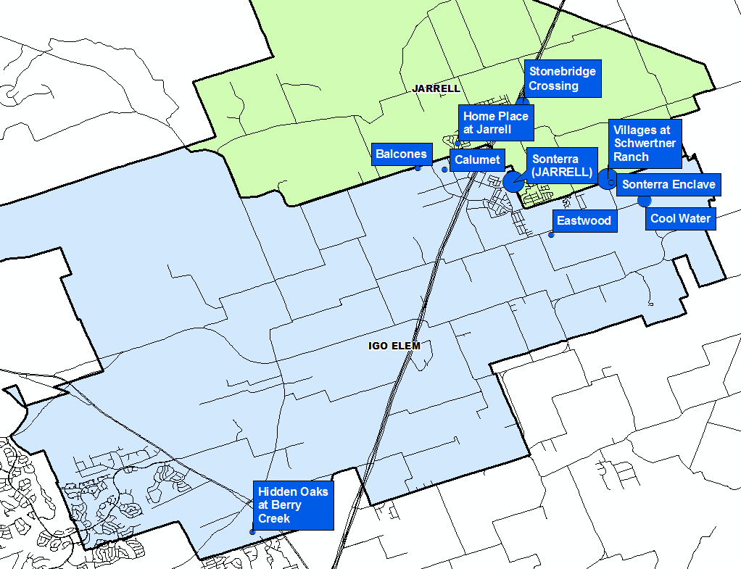
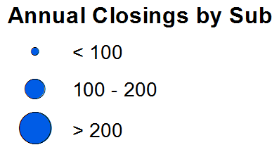
Annual Closing Distribution
Top 10 Subdivisions – 1Q22 (Ranked by Annual Closings)
Rank | Subdivision | Annual Closings | Quarter Closings | VDL | Future
1 | Sonterra (JARRELL) | 293 | 6 | 0 | 1,179
2 | Villages at Schwertner Ranch | 208 | 74 | 7 | 710
3 | Stonebridge Crossing | 199 | 27 | 122 | 10
4 | Cool Water | 106 | 89 | 149 | 1,200
5 | Sonterra Enclave | 76 | 3 | 0 | 0
6 | Hidden Oaks at Berry Creek | 28 | 12 | 41 | 88
7 | Calumet | 20 | 7 | 65 | 100
8 | Home Place at Jarrell | 16 | 1 | 29 | 0
9 | Balcones | 9 | 9 | 7 | 109
10 | Eastwood | 2 | 2 | 272 | 639
 | TOTALS | 957 | 230 | 692 | 4,035

Slide 10
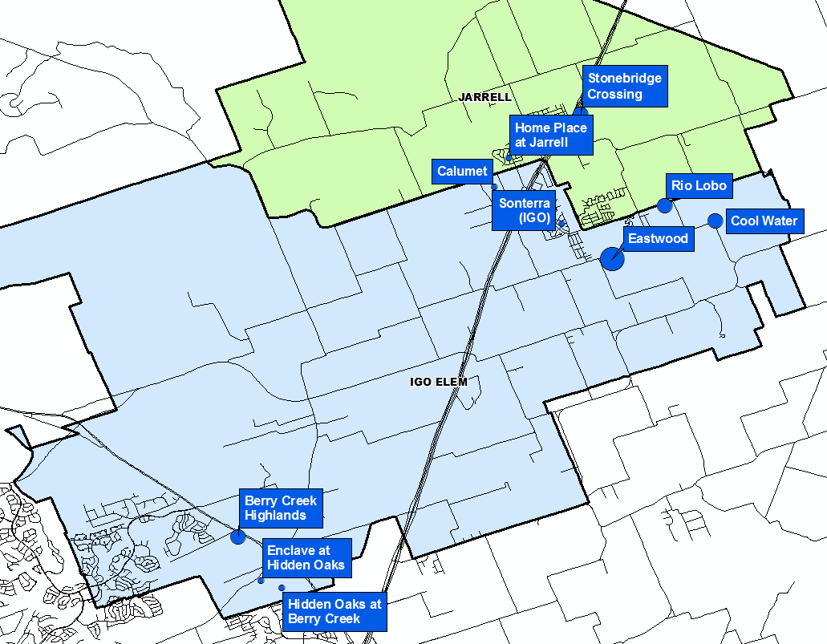
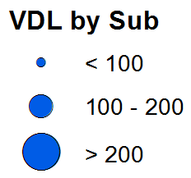
VDL Distribution
Top 10 Subdivisions – 1Q22 (Ranked by remaining VDL)
Rank | Subdivision | Annual Closings | Quarter Closings | VDL | Future
1 | Eastwood | 2 | 2 | 272 | 639
2 | Rio Lobo | 0 | 0 | 156 | 0
3 | Cool Water | 106 | 89 | 149 | 1,200
4 | Stonebridge Crossing | 199 | 27 | 122 | 10
5 | Berry Creek Highlands | 0 | 0 | 110 | 1,087
6 | Calumet | 20 | 7 | 65 | 100
7 | Enclave at Hidden Oaks | 0 | 0 | 49 | 0
8 | Hidden Oaks at Berry Creek | 28 | 12 | 41 | 88
9 | Home Place at Jarrell | 16 | 1 | 29 | 0
10 | Sonterra (IGO) | 1 | 0 | 16 | 1,181
 | TOTALS | 372 | 138 | 1,009 | 4,305

Slide 11
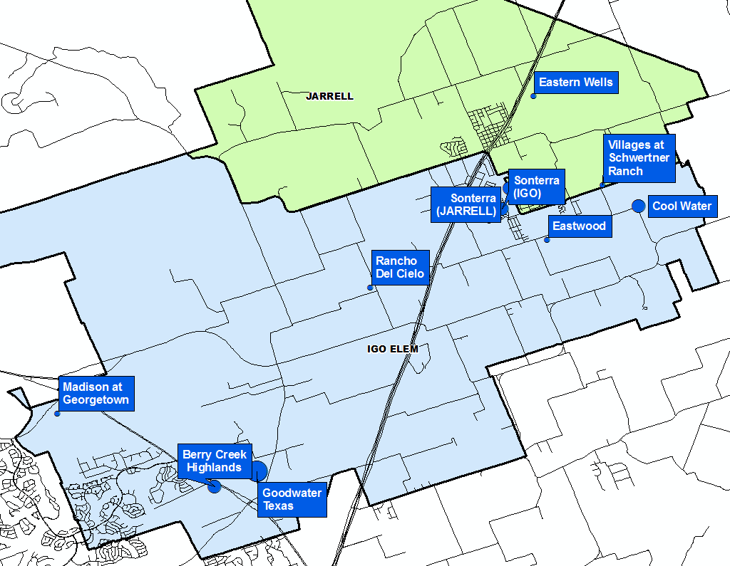
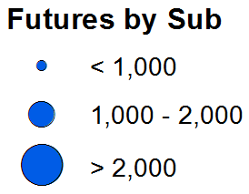
Futures Distribution
Top 10 Subdivisions – 1Q22 (Ranked by Future Inventory)
Rank | Subdivision | Annual Closings | Quarter Closings | VDL | Future
1 | Goodwater Texas | 0 | 0 | 0 | 2,500
2 | Cool Water | 106 | 89 | 149 | 1,200
3 | Sonterra (IGO) | 1 | 0 | 16 | 1,181
4 | Sonterra (JARRELL) | 293 | 6 | 0 | 1,179
5 | Berry Creek Highlands | 0 | 0 | 110 | 1,087
6 | Rancho Del Cielo | 0 | 0 | 0 | 942
7 | Madison at Georgetown | 0 | 0 | 0 | 936
8 | Eastern Wells | 0 | 0 | 0 | 712
9 | Villages at Schwertner Ranch | 208 | 74 | 7 | 710
10 | Eastwood | 2 | 2 | 272 | 639
 | TOTALS | 610 | 171 | 554 | 11,086

Slide 12
District Housing Overview by Elementary Zone
Elementary | Annual Starts | Quarter Starts | Annual Closings | Quarter Closings | Under Const. | Inventory | Vacant Dev. Lots | Future
IGO | 729 | 229 | 243 | 122 | 500 | 551 | 866 | 9,204
JARRELL | 601 | 98 | 716 | 108 | 129 | 210 | 158 | 3,389
Grand Total | 1,330 | 327 | 959 | 230 | 629 | 761 | 1,024 | 12,593

Slide 13
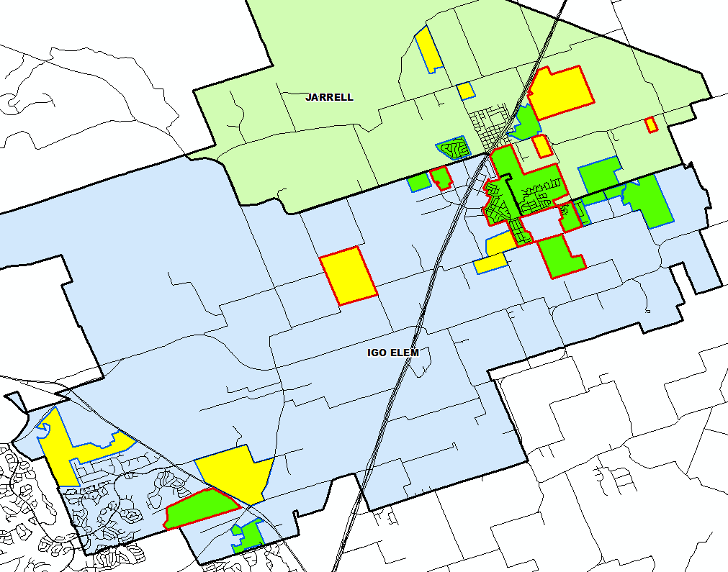
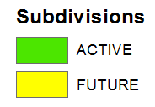

District Housing Overview
The district has 15 actively building subdivisions
Within JISD there are 10 future subdivisions
Groundwork is underway on nearly 1,250 lots within 7 subdivisions

Slide 14
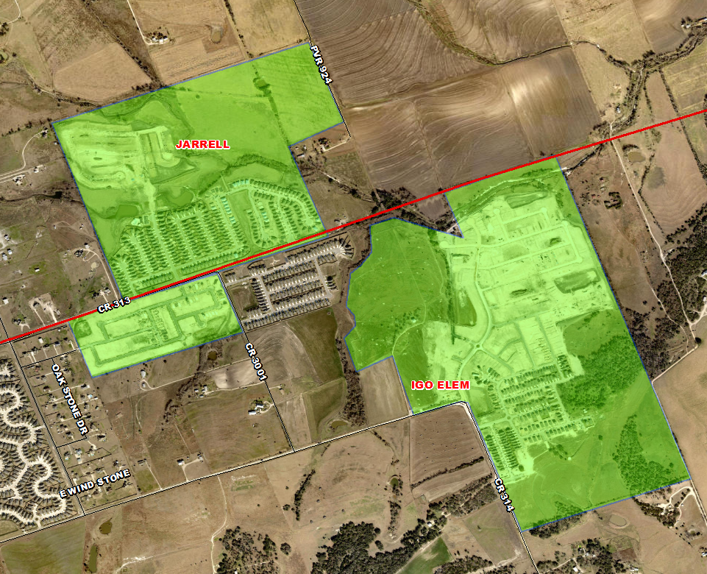
Residential Activity
Schwertner Ranch
990 total lots
710 future lots
208 occupied homes
7 VDL and 37 homes under construction
28 finished vacant homes
Started 205 homes and closed 208 homes in the last 12 months
Jarrell Elementary Zone
Rio Lobo
237 total lots
156 VDL and 81 homes under construction
Started 70 homes in the first quarter
Igo Elementary Zone
Cool Water
1,546 total lots
1,200 future lots
106 occupied homes
149 VDL and 82 homes under construction
Started 197 homes and closed 106 homes in the last 12 months
Igo Elementary Zone

Slide 15
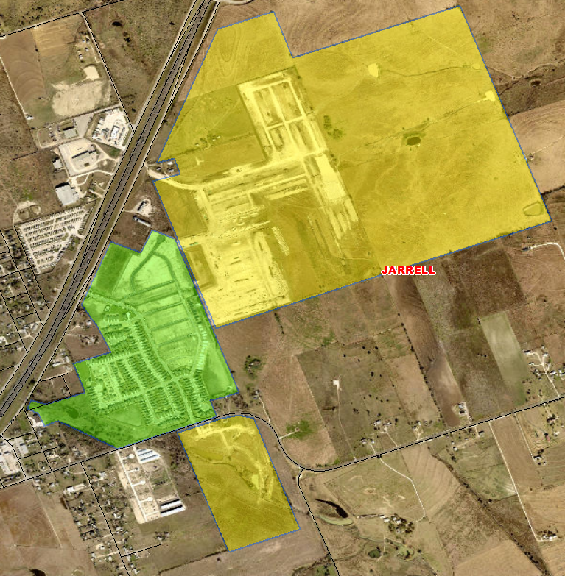
Residential Activity
Eastern Wells
712 total future lots
Groundwork is underway on Phase 1 (235 lots)
Jarrell Elementary Zone
Stonebridge Crossing
449 total lots
205 occupied homes
122 VDL and 64 homes under construction
47 finished vacant homes
Started 271 homes and closed 199 homes in the last 12 months
Jarrell Elementary Zone
Stone Crown
125 total future lots
Groundwork is underway on all lots
Centauro Homes
Jarrell Elementary Zone

Slide 16
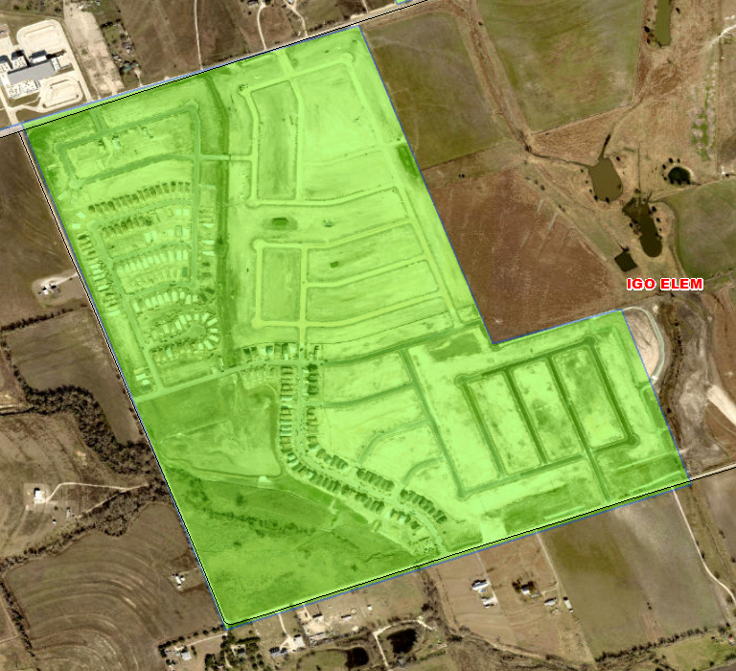
Residential Activity
Sonterra Eastwood
1,140 total lots
639 future lots
2 occupied homes
272 VDL and 220 homes under construction
Started 229 homes in the last 12 months
77 of those starts were in the first quarter
Groundwork is underway on 490 lots
Igo Elementary Zone

Slide 17
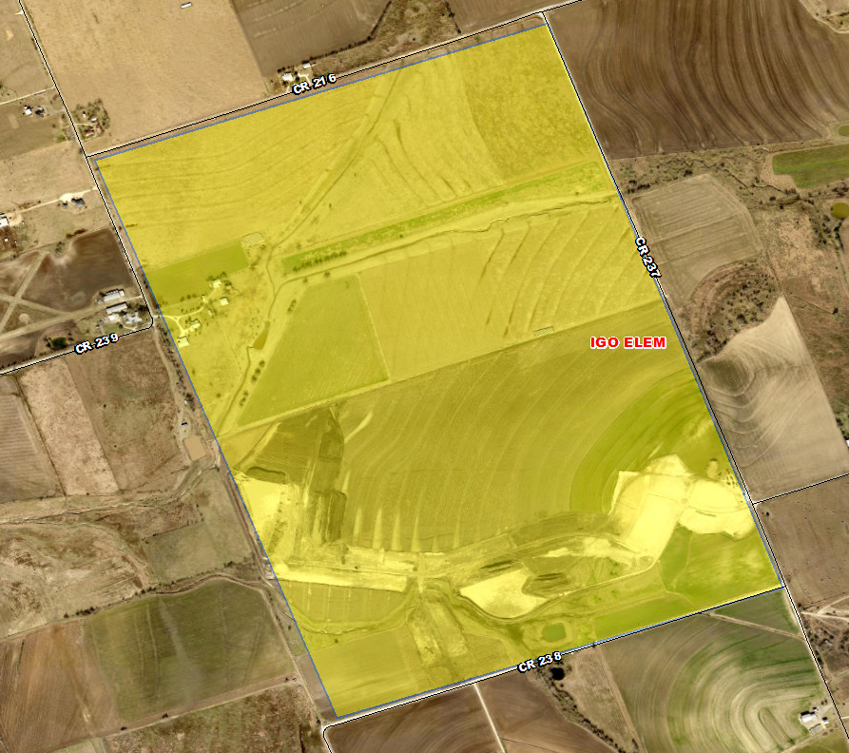
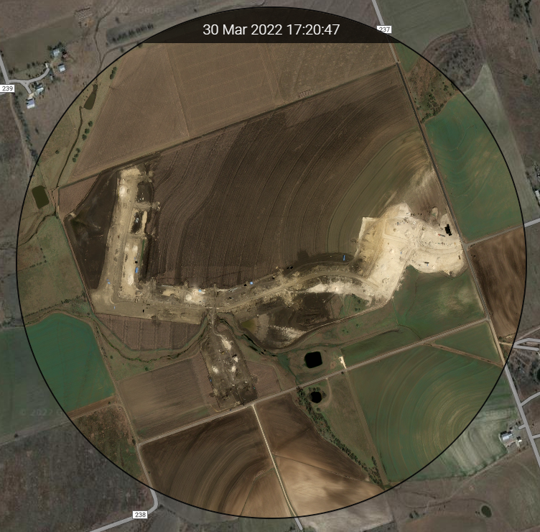
Residential Activity
Rancho de Cielo
941 total future lots
Groundwork is underway on 100 lots
Home construction expected to start Fall 2022
Igo Elementary Zone

Slide 18
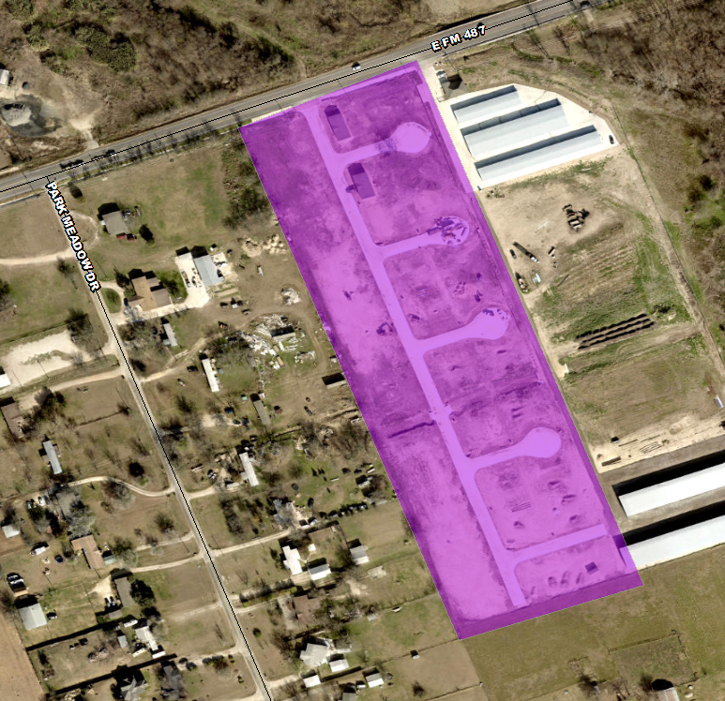
Multi-Family Activity
Jarrell Mobile Home Park
68 total units under construction
~15 units installed
Multi-Family Developments
Under Construction
Future Development

Slide 19
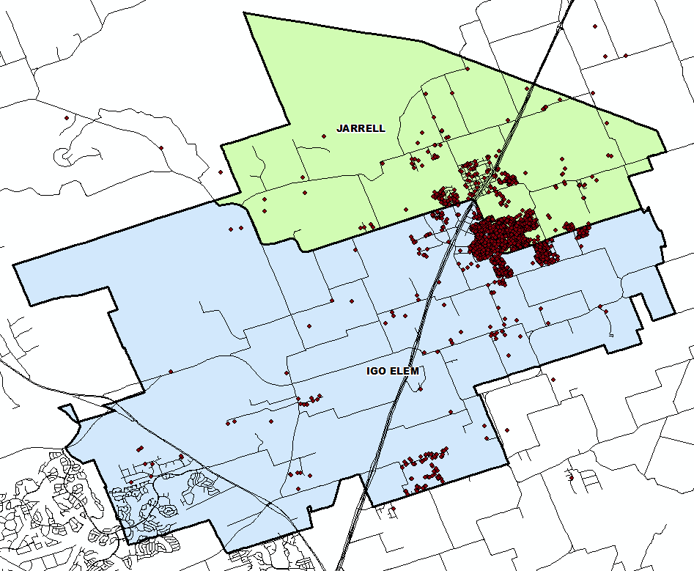
Student Density
80 students reside outside of the district
This represents 2.8% of the total student population
228 students, approx. 7.9% of the total student population, reside within Jarrell city limits

Slide 20
TEA Transfer Report
Transfers In | 2016/17 | 2017/18 | 2018/19 | 2019/20 | 2020/21 | 2021/22 | 5 Yr. Change
Bartlett ISD | 16 | 23 | 23 | 19 | 12 | 10 | -6
Florence ISD | 7 | 10 | 10 | 3 | 3 | 11 | +4
Georgetown ISD | 11 | 21 | 21 | 24 | 16 | 22 | +11
Salado ISD | 8 | 0 | 3 | 11 | 14 | 10 | +2
Total Transfers In* | 58 | 85 | 90 | 94 | 84 | 80 | +22
Transfers Out | 2016/17 | 2017/18 | 2018/19 | 2019/20 | 2020/21 | 2021/22 | 5 Yr. Change
Georgetown ISD | 14 | 20 | 19 | 16 | 29 | 38 | +24
Goodwater Montessori School | - | 3 | 11 | 16 | 20 | 22 | +22
Hallsville ISD | - | - | 3 | 3 | 11 | 16 | +16
Idea Public Schools | - | 3 | 3 | 0 | 3 | 11 | +11
Meridian World School LLC | 7 | 3 | 10 | 12 | 11 | 14 | +7
Orenda Charter School | 17 | 24 | 27 | 29 | 22 | 18 | +1
Priority Charter Schools | 3 | 14 | 3 | 16 | 40 | 32 | +29
Salado ISD | 24 | 19 | 17 | 18 | 20 | 16 | -8
University of TX Charter | 12 | 3 | 3 | 3 | 3 | 3 | -9
Total Transfers Out* | 97 | 135 | 134 | 162 | 210 | 231 | +134
* Totals include additional districts due to TEA rounding rules

Slide 21
Ten Year Forecast by Grade Level
Year (Oct.) | EE | PK | K | 1st | 2nd | 3rd | 4th | 5th | 6th | 7th | 8th | 9th | 10th | 11th | 12th | Total | Total Growth | % Growth
2017/18 | 10 | 80 | 133 | 146 | 133 | 127 | 131 | 120 | 119 | 135 | 108 | 124 | 124 | 113 | 100 | 1,703
2018/19 | 13 | 90 | 142 | 153 | 154 | 138 | 144 | 146 | 141 | 129 | 142 | 136 | 126 | 122 | 121 | 1,897 | 194 | 11.4%
2019/20 | 5 | 108 | 174 | 164 | 171 | 161 | 168 | 159 | 159 | 169 | 143 | 172 | 125 | 120 | 104 | 2,102 | 205 | 10.8%
2020/21 | 4 | 87 | 182 | 198 | 181 | 171 | 170 | 184 | 167 | 170 | 176 | 183 | 177 | 137 | 118 | 2,305 | 203 | 9.7%
2021/22 | 6 | 151 | 224 | 241 | 244 | 222 | 219 | 209 | 208 | 209 | 193 | 221 | 192 | 205 | 141 | 2,885 | 580 | 25.2%
2022/23 | 21 | 200 | 277 | 276 | 292 | 301 | 270 | 270 | 259 | 262 | 255 | 259 | 232 | 221 | 209 | 3,604 | 719 | 24.9%
2023/24 | 23 | 235 | 336 | 338 | 325 | 350 | 361 | 326 | 329 | 316 | 314 | 332 | 272 | 248 | 221 | 4,326 | 722 | 20.0%
2024/25 | 23 | 265 | 381 | 395 | 382 | 368 | 394 | 419 | 394 | 401 | 379 | 408 | 340 | 269 | 243 | 5,061 | 735 | 17.0%
2025/26 | 23 | 280 | 440 | 445 | 461 | 442 | 426 | 458 | 457 | 450 | 431 | 498 | 418 | 337 | 264 | 5,830 | 769 | 15.2%
2026/27 | 23 | 310 | 498 | 519 | 503 | 521 | 507 | 495 | 499 | 503 | 488 | 562 | 510 | 414 | 330 | 6,682 | 852 | 14.6%
2027/28 | 23 | 350 | 555 | 583 | 582 | 561 | 589 | 573 | 532 | 544 | 545 | 586 | 551 | 505 | 406 | 7,485 | 803 | 12.0%
2028/29 | 23 | 370 | 611 | 643 | 637 | 631 | 617 | 648 | 616 | 580 | 588 | 693 | 604 | 545 | 495 | 8,301 | 816 | 10.9%
2029/30 | 23 | 400 | 656 | 703 | 691 | 692 | 694 | 679 | 697 | 671 | 628 | 740 | 701 | 598 | 534 | 9,107 | 806 | 9.7%
2030/31 | 23 | 400 | 705 | 739 | 755 | 750 | 761 | 764 | 730 | 760 | 726 | 781 | 745 | 694 | 586 | 9,919 | 812 | 8.9%
2031/32 | 23 | 400 | 742 | 794 | 779 | 820 | 825 | 837 | 821 | 796 | 823 | 913 | 794 | 738 | 680 | 10,785 | 866 | 8.7%
Yellow box = largest grade per year
Green box = second largest grade per year

Slide 22
Ten Year Forecast by Campus
 |  |  | Fall | ENROLLMENT PROJECTIONS
Campus | Capacity | 2020/21 | 2021/22 | 2022/23 | 2023/24 | 2024/25 | 2025/26 | 2026/27 | 2027/28 | 2028/29 | 2029/30 | 2030/31 | 2031/32
Igo Elementary | 800 | 720 | 845 | 1,031 | 1,250 | 1,476 | 1,725 | 2,021 | 2,344 | 2,609 | 2,869 | 3,118 | 3,351
Jarrell Elementary | 608 | 457 | 671 | 876 | 1,044 | 1,151 | 1,250 | 1,355 | 1,472 | 1,571 | 1,669 | 1,779 | 1,869
ELEMENTARY SCHOOL TOTAL | 1,408 | 1,177 | 1,516 | 1,907 | 2,294 | 2,627 | 2,975 | 3,376 | 3,816 | 4,180 | 4,538 | 4,897 | 5,220
Elementary Absolute Change |  | 67 | 339 | 391 | 387 | 333 | 348 | 401 | 440 | 364 | 358 | 359 | 323
Elementary Percent Change |  | 6.04% | 28.80% | 25.79% | 20.29% | 14.52% | 13.25% | 13.48% | 13.03% | 9.54% | 8.56% | 7.91% | 6.60%
Jarrell Middle School | 764/1,004 | 513 | 610 | 776 | 959 | 1,174 | 1,338 | 1,490 | 1,621 | 1,784 | 1,996 | 2,216 | 2,440
MIDDLE SCHOOL TOTAL |  | 513 | 610 | 776 | 959 | 1,174 | 1,338 | 1,490 | 1,621 | 1,784 | 1,996 | 2,216 | 2,440
Middle School Absolute Change |  | 42 | 97 | 166 | 183 | 215 | 164 | 152 | 131 | 163 | 212 | 220 | 224
Middle School Percent Change |  | 8.92% | 18.91% | 27.21% | 23.58% | 22.42% | 13.97% | 11.36% | 8.79% | 10.06% | 11.88% | 11.02% | 10.11%
Jarrell High School | 995/1,258 | 615 | 759 | 921 | 1,073 | 1,260 | 1,517 | 1,816 | 2,048 | 2,337 | 2,573 | 2,806 | 3,125
HIGH SCHOOL TOTAL |  | 615 | 759 | 921 | 1,073 | 1,260 | 1,517 | 1,816 | 2,048 | 2,337 | 2,573 | 2,806 | 3,125
High School Absolute Change |  | 94 | 144 | 162 | 152 | 187 | 257 | 299 | 232 | 289 | 236 | 233 | 319
High School Percent Change |  | 18.04% | 23.41% | 21.34% | 16.50% | 17.43% | 20.40% | 19.71% | 12.78% | 14.11% | 10.10% | 9.06% | 11.37%
DISTRICT TOTALS |  | 2,305 | 2,885 | 3,604 | 4,326 | 5,061 | 5,830 | 6,682 | 7,485 | 8,301 | 9,107 | 9,919 | 10,785
District Absolute Change |  | 203 | 580 | 719 | 722 | 735 | 769 | 852 | 803 | 816 | 806 | 812 | 866
District Percent Change |  | 9.66% | 25.16% | 24.92% | 20.03% | 16.99% | 15.19% | 14.61% | 12.02% | 10.90% | 9.71% | 8.92% | 8.73%
Yellow box = over 105% capacity
Green box = within 5% capacity

Slide 23
Key Takeaways
Jarrell ISD enrollment increased by 1,394 students between 2016/17 and 2021/22, an increase of 93.5%
2021/22 JISD enrollment is up 580 students from 2020/21, an increase of 25.2%
The district has 15 actively building subdivisions and 10 future subdivisions in the planning stages
Groundwork is underway on nearly 1,250 lots within 7 subdivisions
JISD may enroll over 6,600 students by 2026/27 and approx. 10,700 students by 2031/32

