Slide 1

Understanding the Basics:
What You Need to Know About
Financial Aid
Christopher Mowl
Director of Financial Aid
Harrisburg University

Slide 2
Topics We Will Discuss
What is financial aid?
Determining financial need
Categories and sources of financial aid
Free Application for Federal Student Aid (FAFSA®)
Special circumstances
Financial aid offer

Slide 3

What Is Financial Aid?
Financial aid consists of funds provided to students and families to help pay for postsecondary educational expenses.
Includes grants, scholarships, loans, and student employment

Slide 4
What Is Financial Need?
Cost of attendance (COA) – Student Aid Index (SAI) = Financial need

Slide 5




What Is Cost of Attendance (COA)?
Tuition and fees
Housing and food
Books and supplies
Transportation
Miscellaneous personal expenses

Slide 6
Important Note
Do not rule out an institution based on cost without going through the financial aid process.
Many institutions no longer require an application fee
The FAFSA is free
Many private institutions are offering generous grants and scholarships

Slide 7
Categories of Financial Aid
Need-based aid
Non-need-based aid

Slide 8
Types of Financial Aid
Scholarships
Grants
Work-Study Employment
Loans
Self-Help Aid
Gift Aid

Slide 9
Sources of Financial Aid
Federal Government
Employers
States
Private Sources
College and Universities

Slide 10
Federal Government
Largest source of financial aid
Aid provided primarily based on financial need
Must apply each year using the FAFSA
Eligibility requirements must be met

Slide 11
Federal Student Aid Programs
Federal Pell Grant
Federal Supplemental Educational Opportunity Grant (FSEOG)
Teacher Education Assistance for College and Higher Education (TEACH) Grant
Federal Work-Study (FWS)
Federal Direct Student Loans (Direct Loans)
Federal PLUS Loans

Slide 12
Federal Direct Student Loans
Subsidized (Sub):
Based on financial need
Interest-free while enrolled
Unsubsidized (Unsub):
Interest accrues while enrolled
Fixed Interest Rate 2025-26 – 6.39% and 1.057% origination fee (up front
fee)
Borrowing Limits
Freshmen
$3,500 sub + $2,000 unsub
Sophomore
$4,500 sub + $2,000 unsub
Junior and Senior
$5,500 sub + $2,000 unsub
Aggregate max for undergraduate degree is $31,000 ($23,000 in sub)
Repayment begins 6 months after graduation

Slide 13
PA State Grant - PHEAA
PA Residency requirements apply – DE, MA, WV, DC, OH, VT are reciprocal states
Grant provided based on need
Use information from the FAFSA
and State Grant Form
Deadline to file FAFSA is May 1

Slide 14
Colleges and Universities
Aid provided based on both merit and need
Aid may be gift aid or self-help aid
Use information from the FAFSA and/or institutional applications
Deadlines and application requirements vary by institution

Slide 15
Private Sources
Foundations, businesses, churches, civic, and charitable organizations
Deadlines and applications procedures vary
Begin researching private sources early – High School Counseling Office is a great resource

Slide 16
Free Application for Federal Student Aid (FAFSA®)
Collects demographic and financial information
Information used to calculate the Student Aid Index (SAI)
Colleges use SAI to determine financial need
Available in 11 different languages.

Slide 17
What Is Student Aid Index(SAI)?
Measurement of student’s and family’s ability to pay postsecondary educational expenses
Student contribution
Parent contribution
(for dependent students)

Slide 18
Free Application for Federal Student Aid (FAFSA®)
Contributors: Parent, Parent’s Spouse (bio parent or step-parent), Student Spouse, etc.
Contributors will receive invite once student completes their portion of the FAFSA.

Slide 19
Free Application for Federal Student Aid (FAFSA®)
Dependent or Independent Student?
  Generally, students under the age of 24 are considered “dependent” and therefore parent information is required on the FAFSA.
  Certain conditions can grant a student “independent” status if under the age of 24. Examples: Foster care, legal guardianship, homeless status, veteran, married, has dependents.
  “Special Circumstances” can allow a financial aid office to grant a student independent status. Parent refusal to complete a FAFSA is not one of these special circumstances.

Slide 20
Free Application for Federal Student Aid (FAFSA®)
For the 2026-27 academic year, the FAFSA may be filed beginning on October 1st, 2025
Colleges may set FAFSA priority dates
Two ways to complete the FAFSA:
  Online at studentaid.gov
  Paper FAFSA

Slide 21
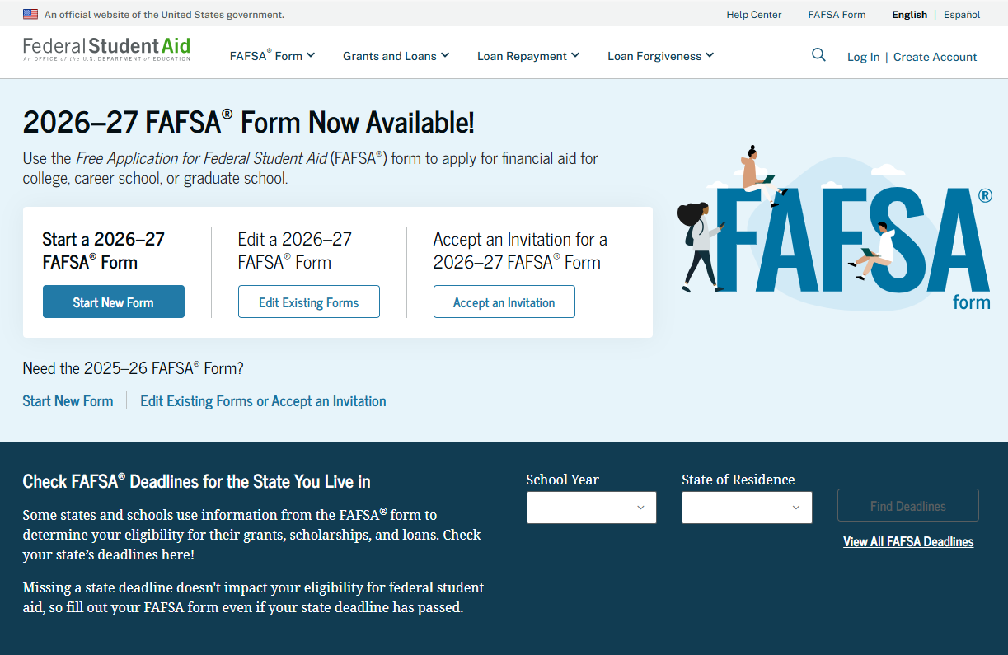
FAFSA Online
Website: https://studentaid.gov

Slide 22
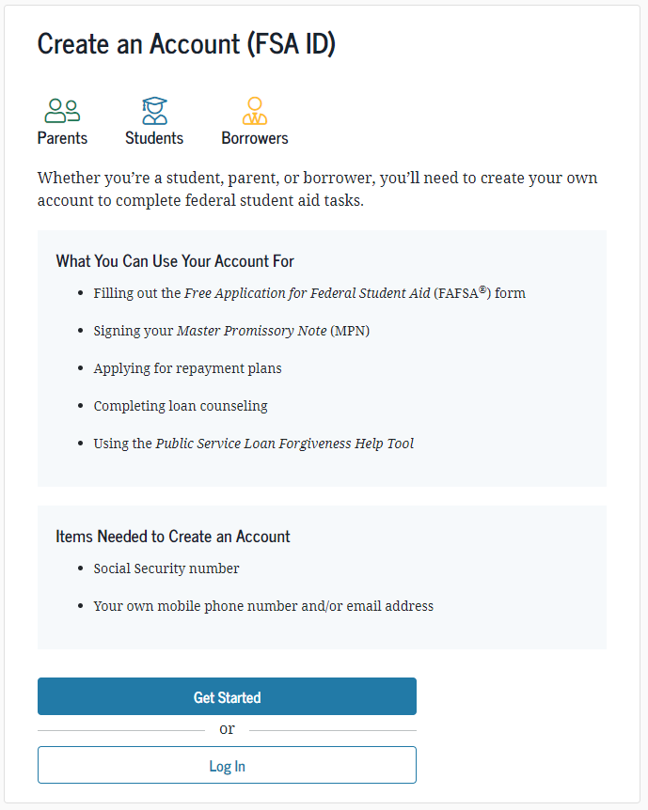
FSA User ID
Used for FAFSA completion
and allows access to
certain U.S. Department
of Education websites
May be used by students
and contributors throughout
financial aid process,
including subsequent
school years
Students and contributors should create their FSA ID 4 days prior to filing the FAFSA
Apply at https://studentaid.gov/fsa-id/create-account/launch

Slide 23
Information About Parents of
Dependent Students and the Student
Tax, income, and other financial information – For 2026-27 FAFSA, 2024 figures are used.
Tax info imported into FAFSA electronically
Family size
Assets – business and farm no longer included
Fewer untaxed income questions
Can list up to 20 schools

Slide 24
Assets
Report as of the day you file the FAFSA and do not update
  Exclude primary residence, qualified retirement plans, value of insurance policies, personal property
  Include value of college savings plans/529 or pre-paid tuition plan for only the child going to college
  Child support received reported as asset, not income.
  Student assets weigh more heavily on SAI calculation

Slide 25
Verification
Student FAFSAs may be selected by the Department of Education for verification.
Review is performed by the Financial Aid Office of the school.
Possible Requested Documents:
  2024 Tax Transcripts
  Verification Worksheet
  Identity Verification Documents

Slide 26
Marital Status
Report current marital status
Divorced/Separated/Never Married
  Parent who provides the greater portion of student’s financial support files the FAFSA (even if the student does not live with them)
If remarried, stepparent’s information must be included.

Slide 27
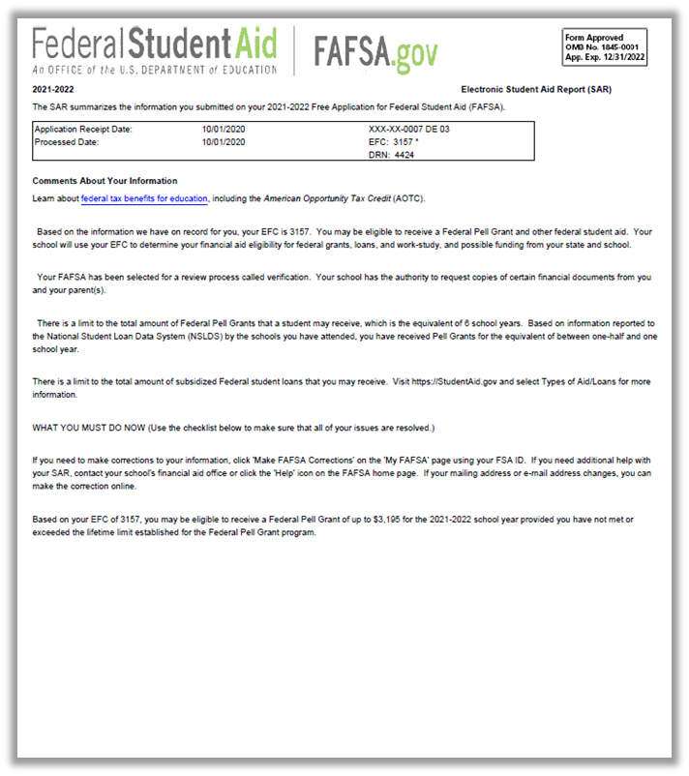
Email Notification of FSS Processing
Provides access to electronic FSS
FAFSA Submission Summary.
Sent to student email.
Retain this notification.

Slide 28
Special Circumstances & Professional Judgment
Conditions exist that cannot be documented with the FAFSA
Send written explanation and documentation to your college’s financial aid office
College will review and request additional information if necessary
Decisions are final and cannot be appealed to U.S. Department of Education

Slide 29
What Is Cost of Attendance (COA)?
Tuition and fees – Direct Cost
Housing and food – Direct or Indirect Cost
Books and supplies – Indirect Cost
Transportation - Indirect Cost
Miscellaneous personal expenses - Indirect Cost

Slide 30
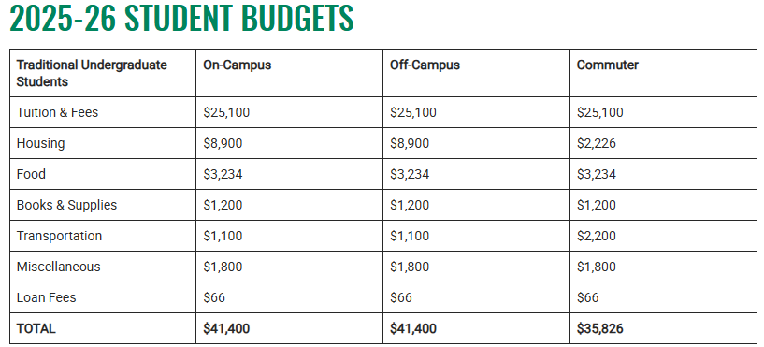
What Is Cost of Attendance (COA)?

Slide 31
Financial Aid Offer
Beginning winter of senior year, institutions will begin sending/releasing financial aid offers to students who are
  Admitted AND completed all aid applications
The aid offer will detail the types and amounts of aid for which the student is eligible to receive
Be sure to compare both out-of-pocket expenses and types of aid

Slide 32
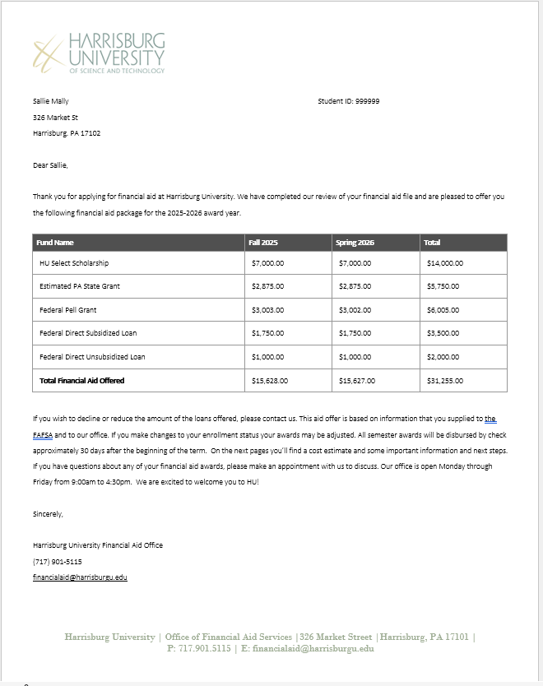
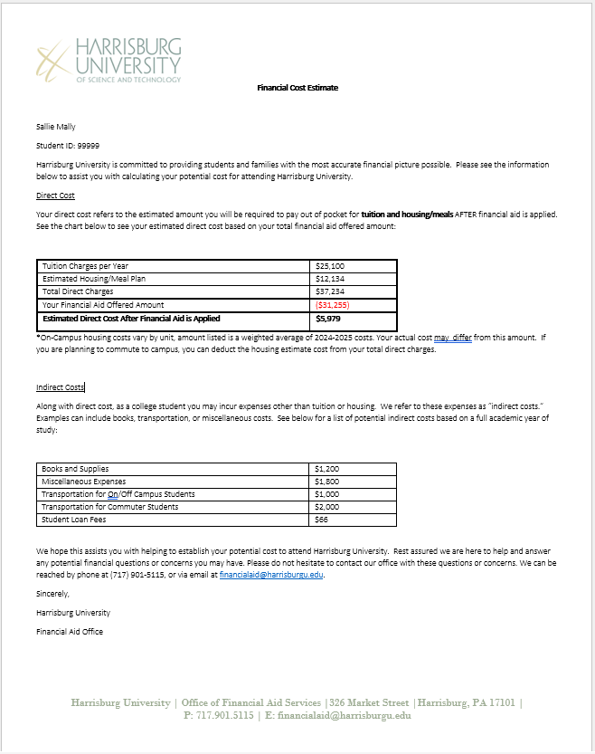

Slide 33
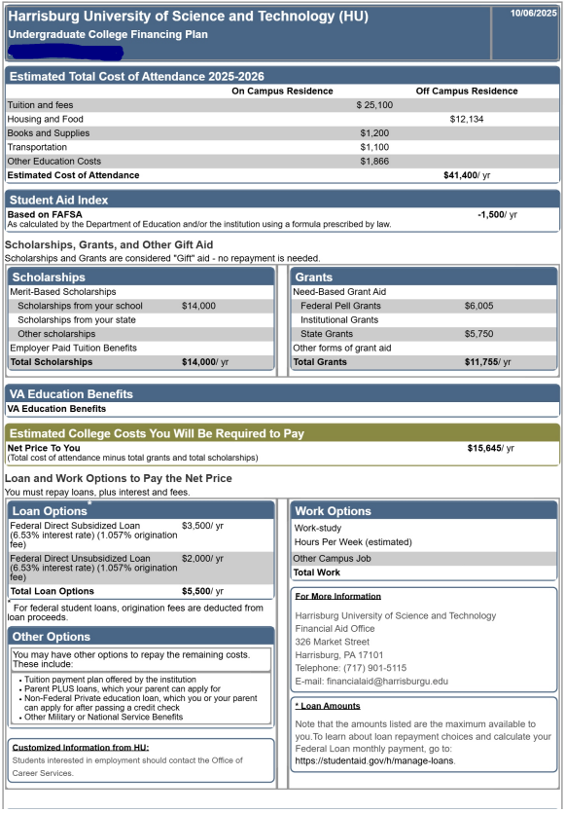
College Financing Plan

Slide 34
Financing Options
Payment Plan
Federal Parent PLUS Loan
  8.94% fixed interest rate (25-26) resets July 1
  4.2% origination (up front) fee
Private Student Loan
  Student is the borrower, credit-worthy cosigner required
  Fixed and variable rates available from banks/credit unions
  Institution may provide a list of recommended lenders

Slide 35
Maintaining Financial Aid Eligibility
Make Satisfactory Academic Progress (SAP)
Meet scholarship GPA requirements
File the FAFSA/institutional applications each year by the deadlines
The Financial Aid Office is a great resource!
WE ARE HERE TO HELP YOU!

Slide 36

Thank you for attending!
Christopher Mowl
Director of Financial Aid
Harrisburg University
P: 717-901-5115
E: cmowl@harrisburgu.edu

