Slide 1

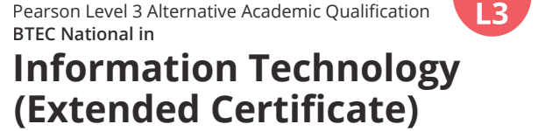
Welcome to
Level 3 BTEC IT

Slide 2
BTEC Nationals
BTEC Nationals are widely recognised by higher education and industry as the vocational qualification of choice at Level 3.
They provide students with meaningful and practical learning experiences across a range of career sectors to prepare them to progress to higher education as a route to graduate-level employment.
Recent data has shown that one in five adults of working age in the UK has a BTEC qualification. What’s more, well over 90,000 BTEC students apply to UK universities every year and their BTEC Nationals are accepted by over 150 UK universities and other higher education institutions for relevant degree programmes either on their own or in combination with A Levels.

Slide 3
Why are BTECs so successful?
BTECs embody a fundamentally student-centred approach to the curriculum, with a flexible, unit-based structure and knowledge applied through a balanced combination of assignments and examinations. They enable the holistic development of the practical, interpersonal and thinking skills required to succeed in higher education and employment.

Slide 4
Transferable Skills
Managing Yourself:
(1) Taking personal responsibility; (2) Personal strengths and resilience;
(3) Career orientation planning; (4) Personal goal setting
Effective Learning:
(1) Managing own learning; (2) Continuous learning;
(3) Secondary research skills (4) Primary research skills
Interpersonal Skills:
(1) Written communications; (2) Verbal and non-verbal communications;
(3) Teamwork; (4) Cultural and social intelligence
Solving Problems:
(1) Critical thinking (2) Problem solving; (3) Creativity and innovation

Slide 5
How the course is graded
Exam Units
Coursework
Grade | Points
U | 0
Near Pass | 8
Pass | 12
Merit | 20
Distinction | 32
Grade | Points
U | 0
Pass | 6
Merit | 10
Distinction | 16

Slide 6
Overall Grading – Aug 2025
Grade | Points
U | 0
Pass | 36
Merit | 52
Distinction | 74
Distinction * | 90

Slide 7
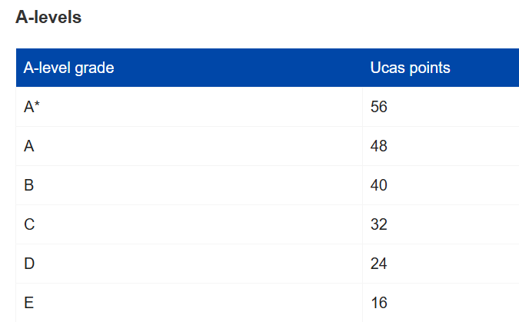
Does a BTEC award UCAS points?
The BTEC Nationals extended certificate awards the exact same UCAS points as a full A level course.
So, if you are planning on attending university, no need to worry!
BTEC and UCAS points | Pearson qualifications
Notes:
Grade
Points
U
0
Pass
36
Merit
52
Distinction
74
Distinction *
90

Slide 8
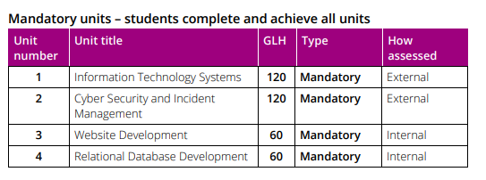
What will I be doing?

Slide 9
Information Technology Systems
2hr 15min 90mark EXAM
Students will study the role of Information Technology (IT) systems and the implications of their use in personal and professional situations. Students will gain knowledge and understanding of issues relating to the use of IT in personal and professional situations.
AO1 Demonstrate knowledge and understanding of information technology systems, terminology, concepts and processes.
AO2 Apply knowledge and understanding of information technology systems, terminology, concepts and processes.
AO3 Analyse and evaluate the factors and implications of information technology systems.

Slide 10
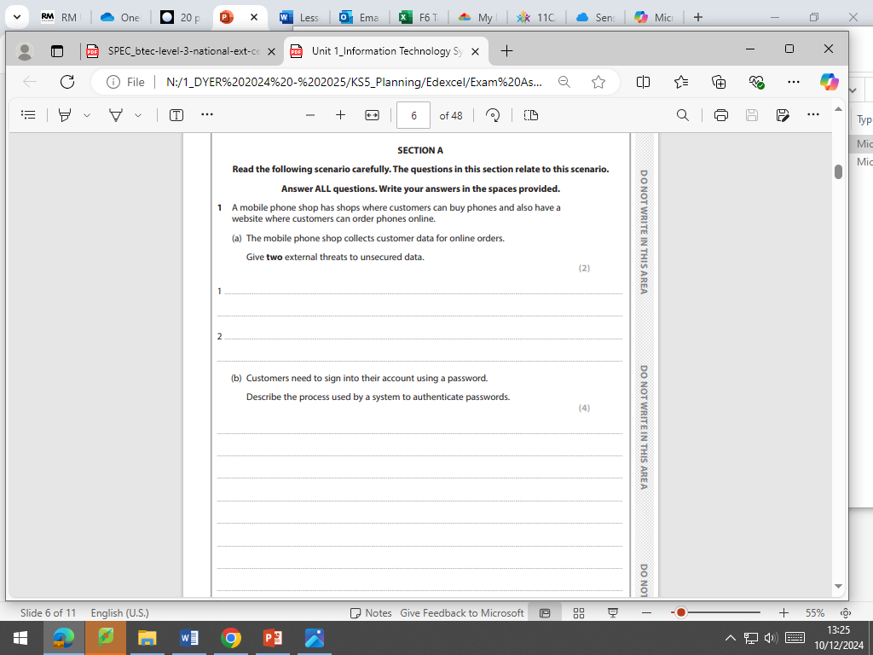
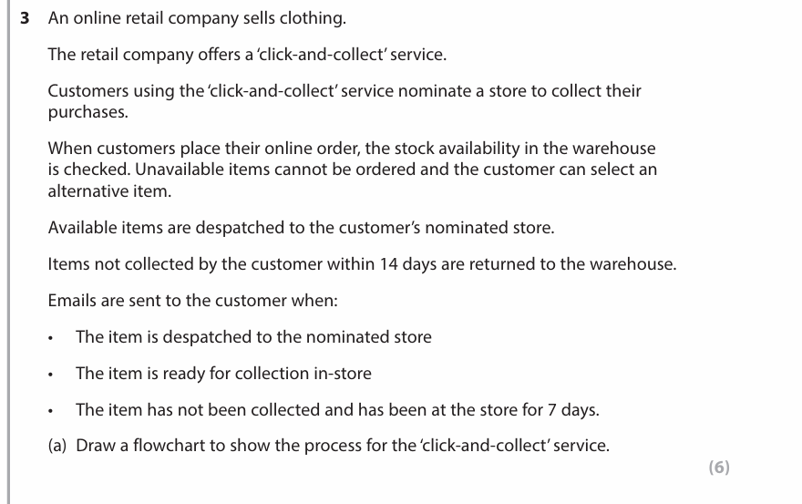
Exam Questions example

Slide 11
Cyber Security and Incident Management
EXAM
Students will study cyber security threats and vulnerabilities, the methods used to protect organisations against threats and managing security incidents.
AO1 Demonstrate knowledge and understanding of cyber security terms, security threats, system vulnerabilities and security protection methods, forensic procedures and implications resulting from threats.
AO2 Apply knowledge and understanding to security threats, system vulnerabilities and security protection methods, forensic procedures and implications by selecting appropriate security tools and methods.
AO3 Analyse and evaluate security threats, system vulnerabilities and security protection methods, forensic procedures and implications for cyber security scenarios.

Slide 12
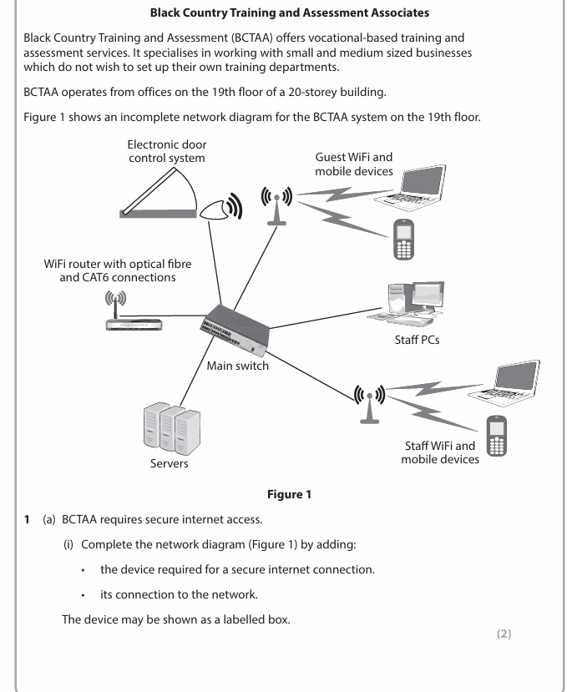
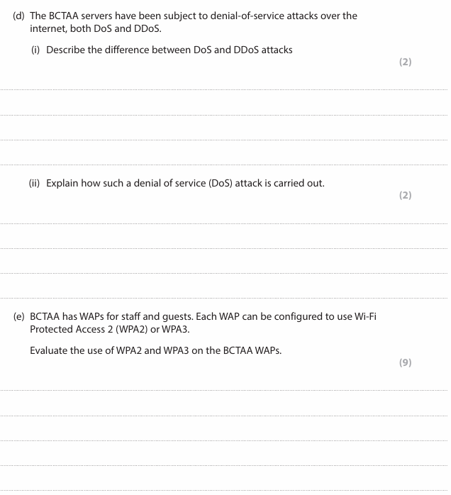
Exam Question example

Slide 13
Website Development
NEA
Students will investigate fundamental principles in website development. They will design and develop a website in response to a client brief.
In this unit you will:
A Understand how the principles of website development are used to create effective websites.
B Explore website design skills and techniques to meet client requirements.
C Develop a website to meet client requirements.

Slide 14
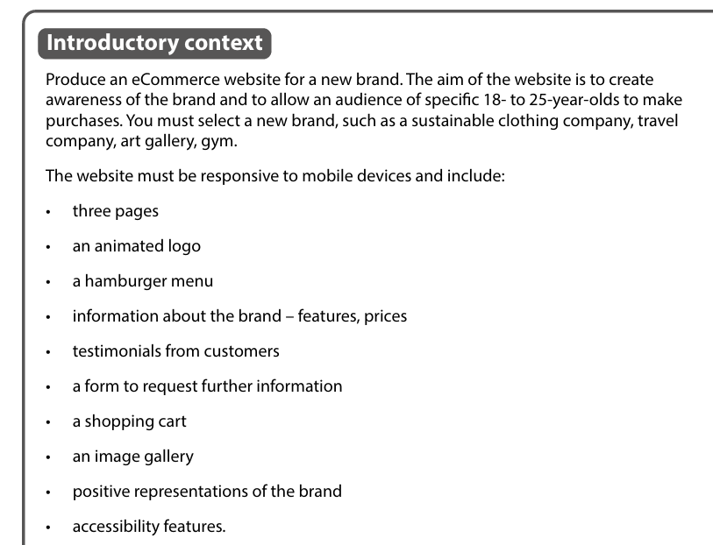
NEA scenario
Task 1 – PLAN (understand)
Explore the purposes and principles of website development.
Research existing websites.
Consider legal & ethical constraints.
Produce an annotated site map and report (written, presentation or video) showing your proposed website solution.
Task 2 - DESIGN (explore)
Use web design skills and techniques to plan a website in response to a client brief.
Show visual representations of the web pages– a wireframe for each web page– the visual style of the website.
Task 3 BUILD & TEST (develop)
Develop a website in response to a client brief.
Implement your designs. Use development tools to create the site. Carry out testing & reviewing of the site.

Slide 15
Relational Database Development
NEA
Students will examine relational database development principles to understand the importance of data storage and normalisation techniques and apply their skills to design and develop data storage solutions to meet a client’s requirements.
In this unit you will:
A Understand how the principles of relational database models, data storage and normalisation are used to create effective relational database solutions.
B Design a relational database solution to meet client’s requirements.
C Develop a relational database solution to meet client’s requirements.

Slide 16
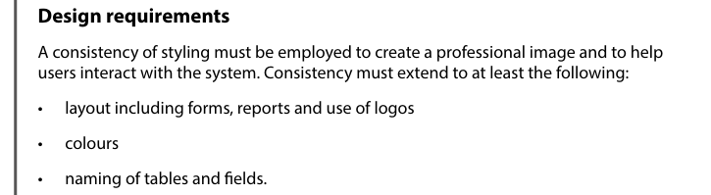
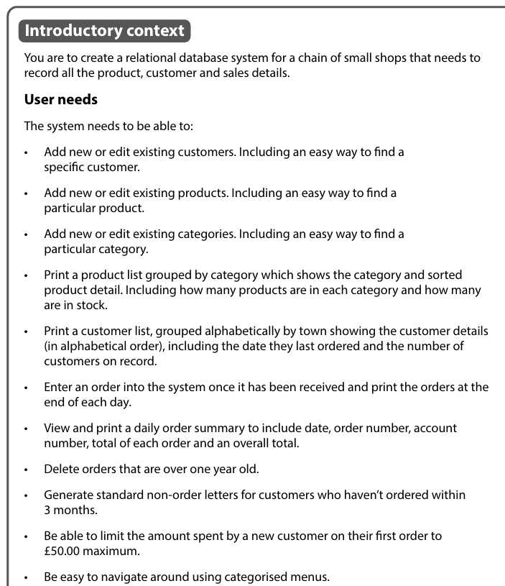
NEA scenario
Task 1 Understand
Understand how the principles of relational database models, data storage and normalization are used to create effective relational database solutions.
Task 2 Design
Design a relational database solution to meet client requirements.
Task 3 Develop & Test
Develop a relational database solution to meet client requirements.
Notes:
Normalization is a process used in relational databases to organize data to minimize redundancy and improve data integrity.

Slide 17
Summer Project
It is important that you gain an introductory knowledge to the main concepts of IT.
The booklet provided is aimed at embedding what you already know with ensuring you carry out some additional research for areas you may be more unfamiliar with.
The booklet also serves as a revision tool so it is imperative that you carry out the tasks
The booklet must be returned completed in your first lesson.
If you lose the booklet then a copy will be available on the Y12 blog
Do not just copy someone else's as it will be clear in the test if you have taken the time to do the work set

Slide 18
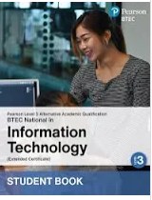
Resources
Books are available to buy from Amazon at £38.

Slide 19
Entry requirement
Level 3 Alternative Academic Qualification (AAQ) in Information Technology (extended Certificate- Pearson
A Merit at OCR Cambridge nationals’ level 2 if previously studied. As per the Sixth Form general entry criteria, students must achieve the minimum requirements of at least five GCSEs at Grade 4 or above, including both English and Maths.

