Slide 1
Access to Disability Evaluations
Family Council for ACPS
Sept 2025
Notes:
Me – HGB, Officer of FC.
Decades of experience as strategy consultant to education organizations, so will be using my consultant voice tonight.
Will go through slides at an alarmingly fast pace, knowing that you will have access to these slides afterwards.
Background –
Heard for years from families that they aren’t getting access to special education services.
Anecdotal, so hard to pinpoint the problem area & understand if issues are prevalent or just experienced by a few families.

Slide 2
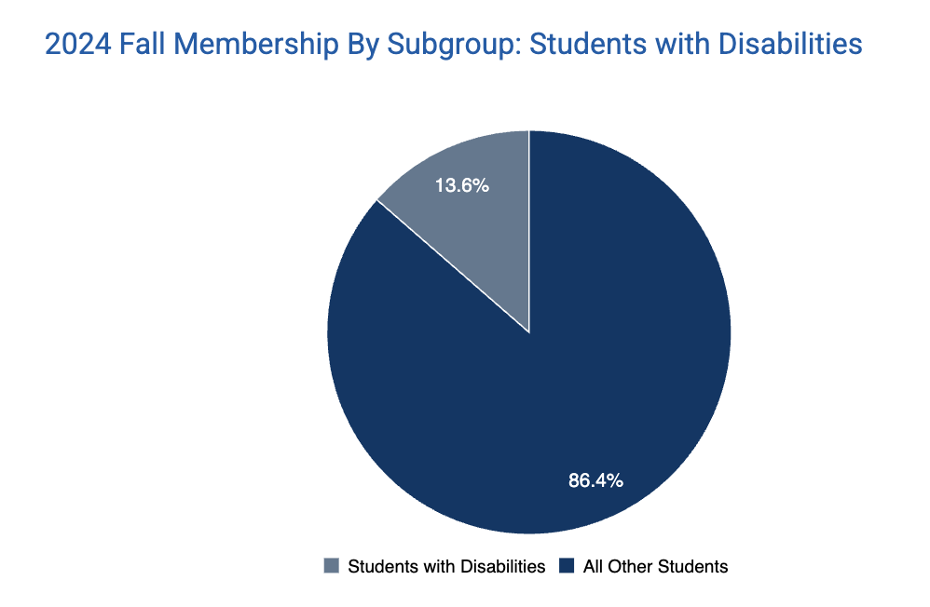
Data … is there a story?
13.6% of ACPS students are diagnosed with a disability.
That’s lower than the statewide level, which is 14.7%.
Not sure of reasons, but that 1.1% difference = 156 students.
Notes:
I did a quick review of the data.
Is this a problem? I don’t know.
PC/FC had been told this is a SEAC issue.
SEAC had been told they only deal with students who are already diagnosed or receiving services.

Slide 3


Consulting Partnership
Project
Fall 2024 – data & preliminary expert interviews
Spring 2025:
  Survey Design
  Response Review
  IDIs with volunteer respondents
  IDIs with experts
  IDEA legal review
  Final presentation
  Permission for quotes
Community Organization and Social Enterprise Clinic
Dr. Sarah Shalf
& team of law students
Notes:
Family Council engaged UVA Law Clinic led by Dr. Shalf.
SEAC was consulted for expertise.
Structured to provide families with confidence re: confidentiality.

Slide 4
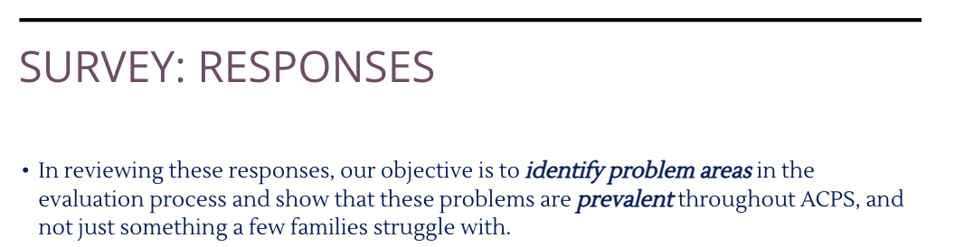
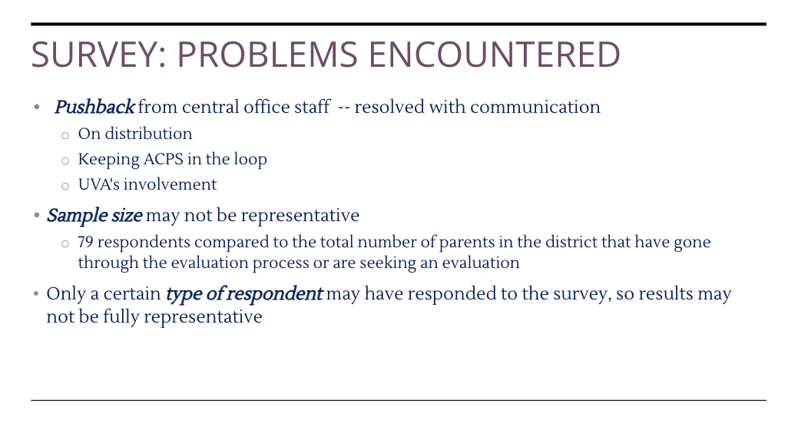
Survey Details
From UVA Team Final Presentation
Notes:
The students created a survey that was sent out by Family Council.
Decent sample size, but perhaps not representative.
Idea was to ask whether the issues are prevalent & not just a few squeaky wheels.

Slide 5
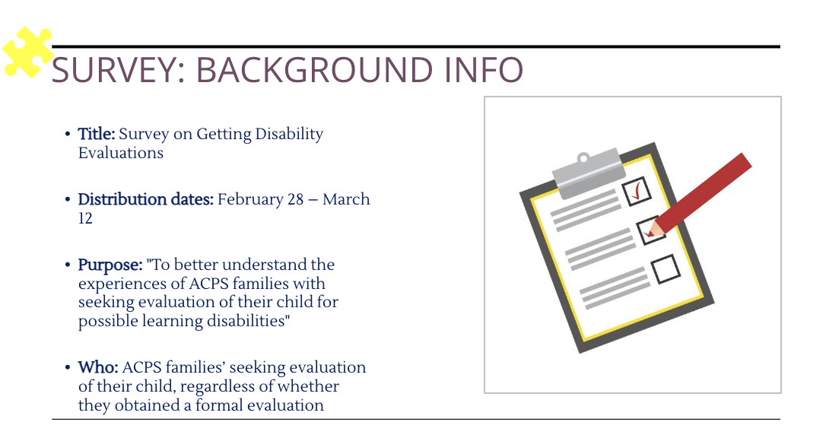
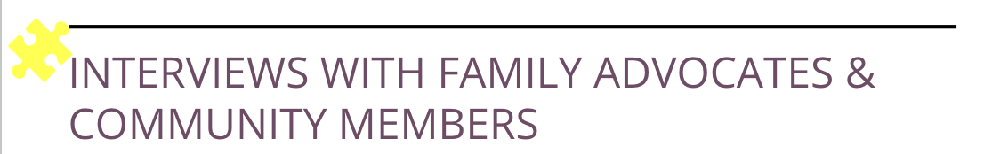
Survey Details
From UVA Team Final Presentation
Notes:
Survey targeted families who had sought an evaluation, whether or not they received an IEP or a 504.
Survey itself generated volumes of qualitiative data, some of which you’ll see tonight with explicit permission from parents.
Supplemented with set of in-depth interviews with family members, professional IEP advocates and knowledgeable community experts.

Slide 6



Key System Issues
1 – Unclear Referral Procedure.
2 – Delays, including SBIT.
3 – Denials.
Problem = Contributor to less-positive outcomes for children, and massive family distrust & frustration.
Notes:
Here are the findings, according to the UVA team. (1 2 3)
We will go through each one of these in detail.
The problem of course is that … and definitely…

Slide 7
System Issue #1
Unclear Referral Procedure
Child Find: “Each school shall have procedures to process in a timely manner all referral requests for a child suspected of having a disability.”
Notes:
FC frequently requests that ACPS improve operating procedures.
In this case, want to remind you that having clear procedures is a federal Child Find requirement.

Slide 8
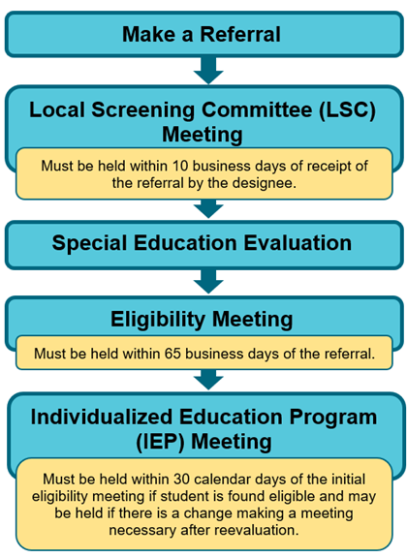
Unclear Referral Procedure
How should the IEP process work?
Courtesy of Fairfax Co PS
Notes:
How the process is supposed to work, courtesy of Fairfax County PS.
As UVA law students put it, the first problem is getting to first base.

Slide 9
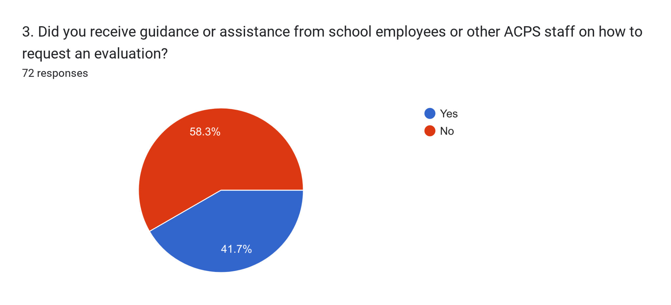
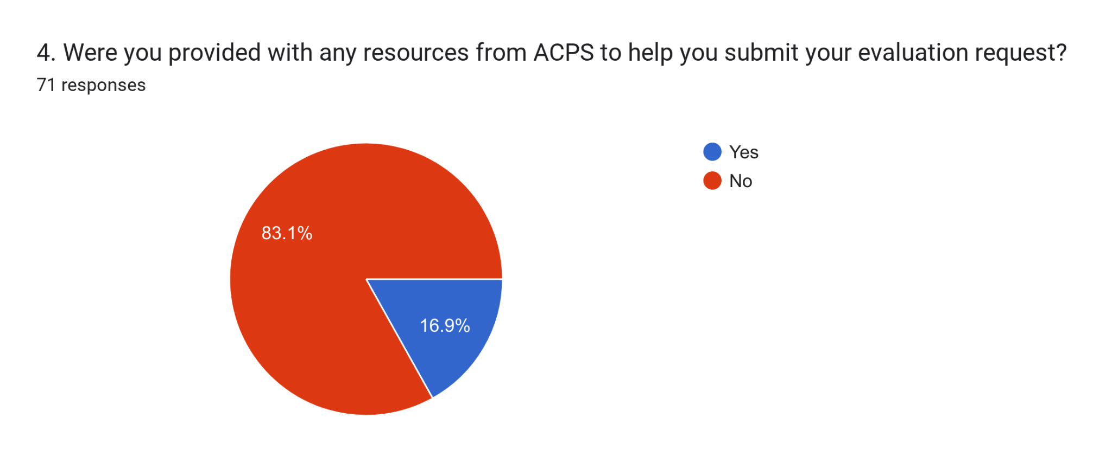
Unclear Referral Procedure
Most families received no guidance or assistance from ACPS on how to make an evaluation request.
Most families received no resources to submit an evaluation request.
Notes:
The majority received zero guidance on how to request an evaluation.
83% received NO resources from ACPS to help submit an evaluation request.

Slide 10
Unclear Referral Procedure
Issues noted in surveys & interviews:
What do you mean by referral?
Disagreement re: what constitutes an “official” referral
“I was told it was up to me to get a doctor to initiate it and then the teacher’s evaluation is the final word.”
“...Some parents don’t understand the process and need real help understanding it. I was left feeling like there was no help for my child because when I asked I was told she won’t qualify or it’s up to you.”
Notes:
How do you get a referral for an evaluation? Some are told that a doctor evaluation is required. When some parents ask for testing, they’re simply told verbally their child won’t qualify or “It’s up to you”.

Slide 11
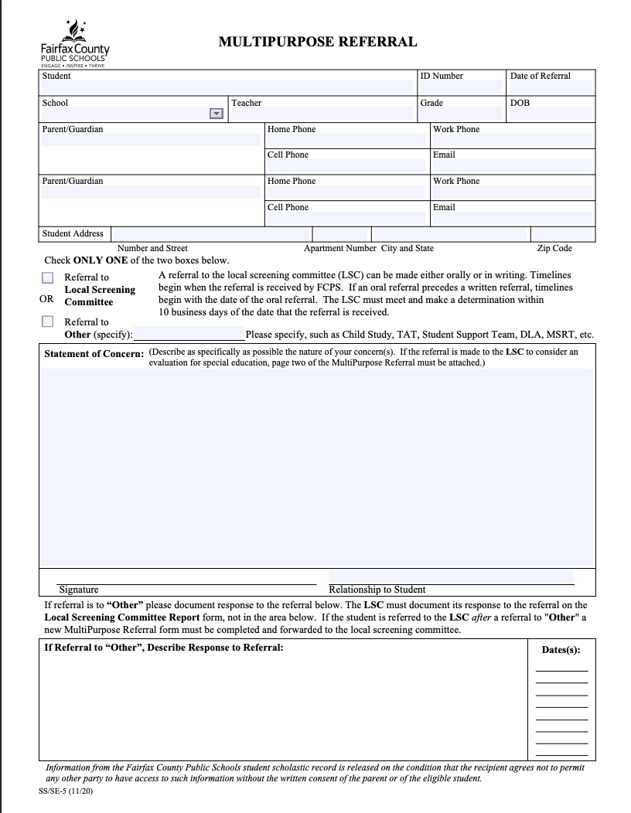
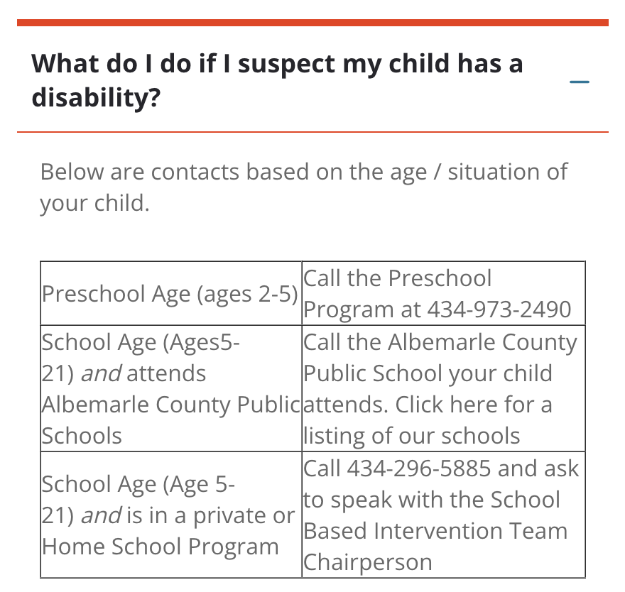
Unclear Referral Procedure: IEP
Fairfax Referral Form
ACPS Advice

Slide 12

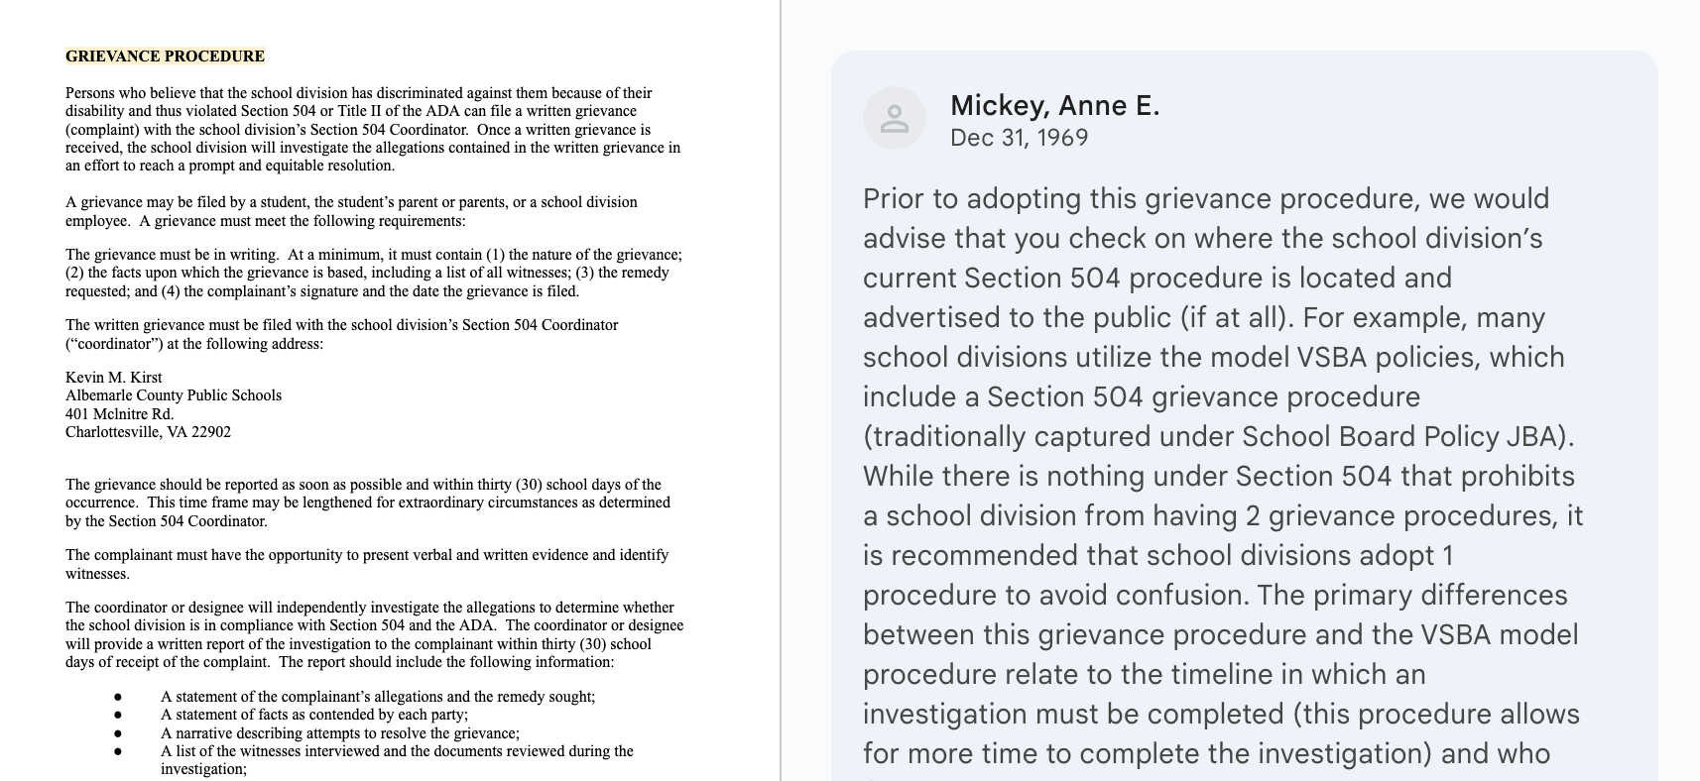
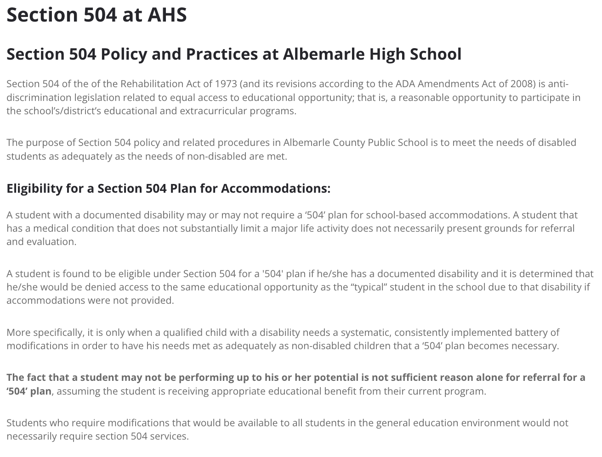
Unclear Referral Procedure: 504
Source
Posted version includes comments from lawyers & refers families to Kevin Kirst
Multiple schools have their own versions

Slide 13

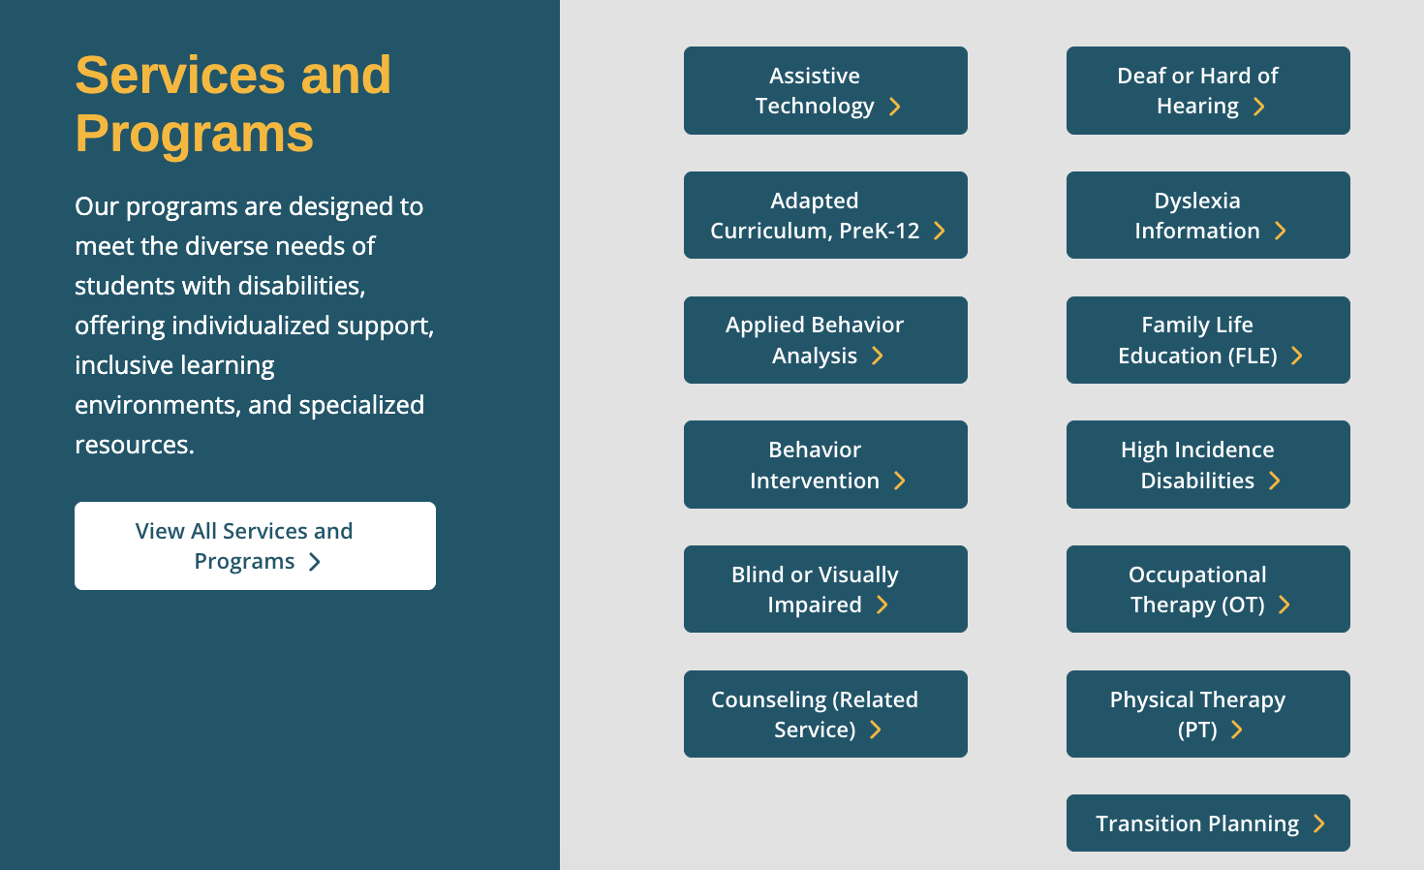

Unclear Referral Procedure
Notes:
In contrast… here’s a small set of what Fairfax provides… in many home languages, too. Partly because they have faced multiple lawsuits & govt inquiries.

Slide 14
System Issue #2
Delays in Process
Child Find: “Each school shall have procedures to process in a timely manner all referral requests for a child suspected of having a disability.”
Notes:
Same Child Find quote as before. Moving onto process that is not “timely”.

Slide 15
System Issue #2
Delays in Process
Research on Outcomes:
“SWDs perform better when they are identified earlier in life,
providing students with a ‘foundation for later learning’ which then supports future academic achievement.”
(Peltzman, 1992; Steele, 2004).
Notes:
For kids who end up being diagnosed later than they could have been, their academic achievement is harmed long-term.

Slide 16
How should the IEP process work?
By law, when a referral is made to a school’s administrator, they have 3 days to either:
Initiate evaluation
Deny evaluation with written notice to family
Ask the School Based Intervention Team (SBIT) to review & respond
Notes:
Here’s the way the early part of the process is supposed to work.

Slide 17
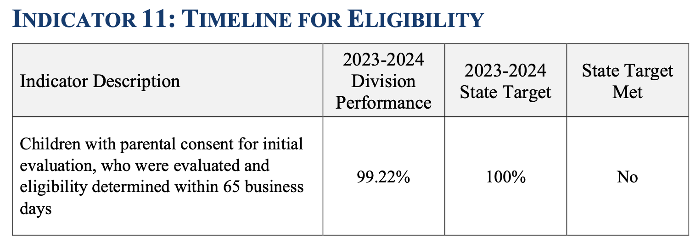
How should the IEP process work?
Good News = we have no evidence that the 65 day requirement for completing testing & holding eligibility meeting is not being met.
ACPS reports to VDOE nearly 100% compliance.
Notes:
To be clear, when we talk about “delays”, we’re NOT talking about later in the process.

Slide 18
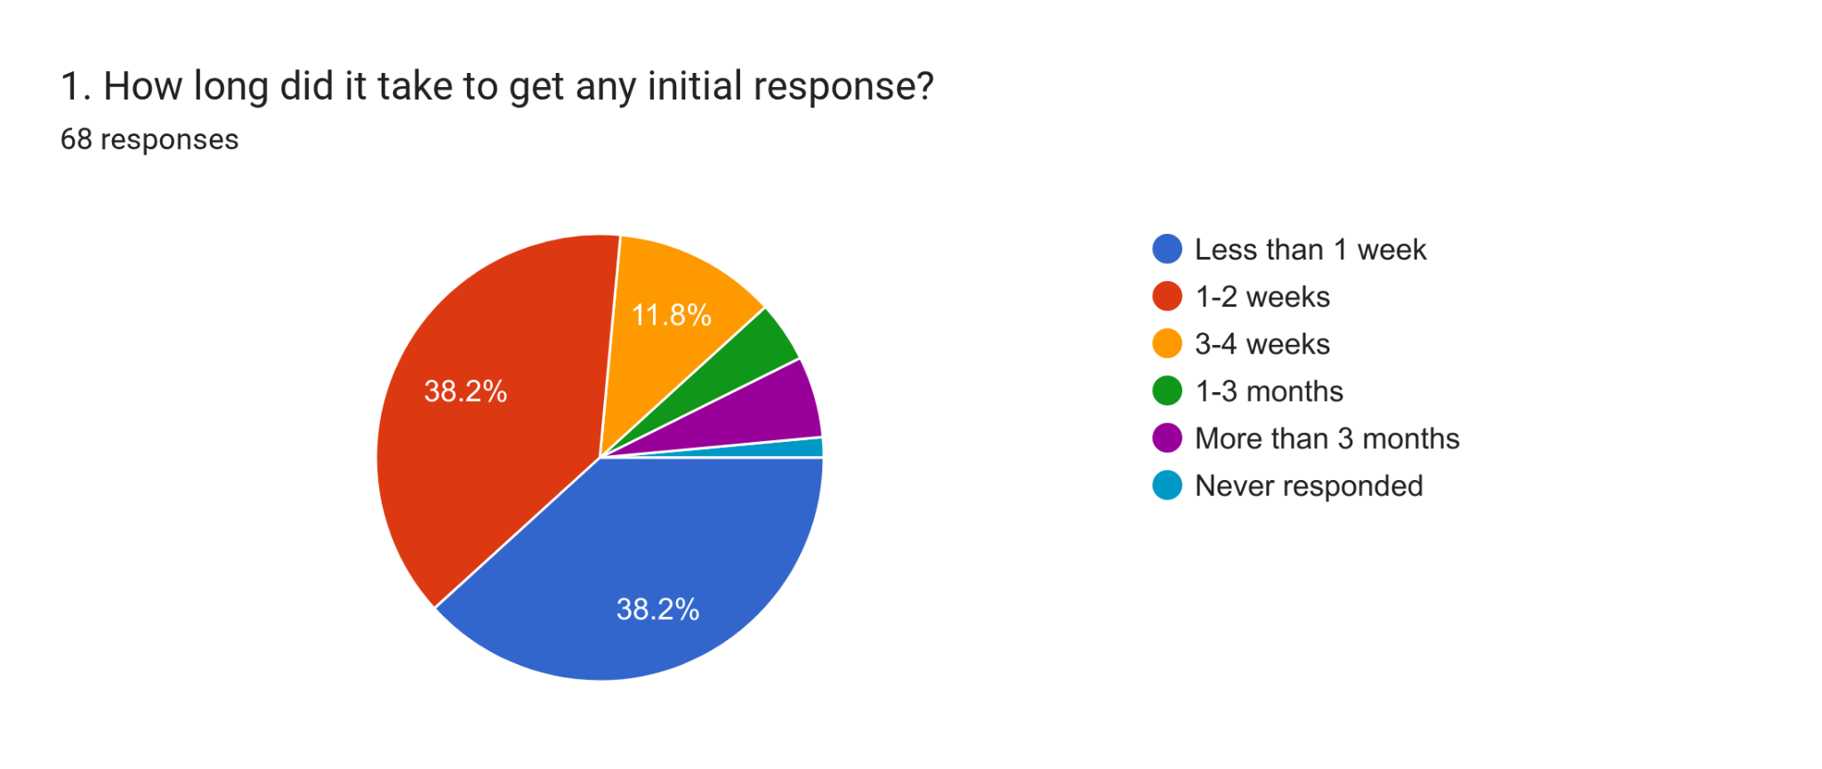
Delays
Initial response required within 3 days, but only about ⅓ of families surveyed report it took less than one week.
“Months of delays and meetings… like pulling teeth to get the evaluation.”
Notes:
What we did hear is that most families aren’t getting a response within 3 days.
Months of delays throughout the process.

Slide 19
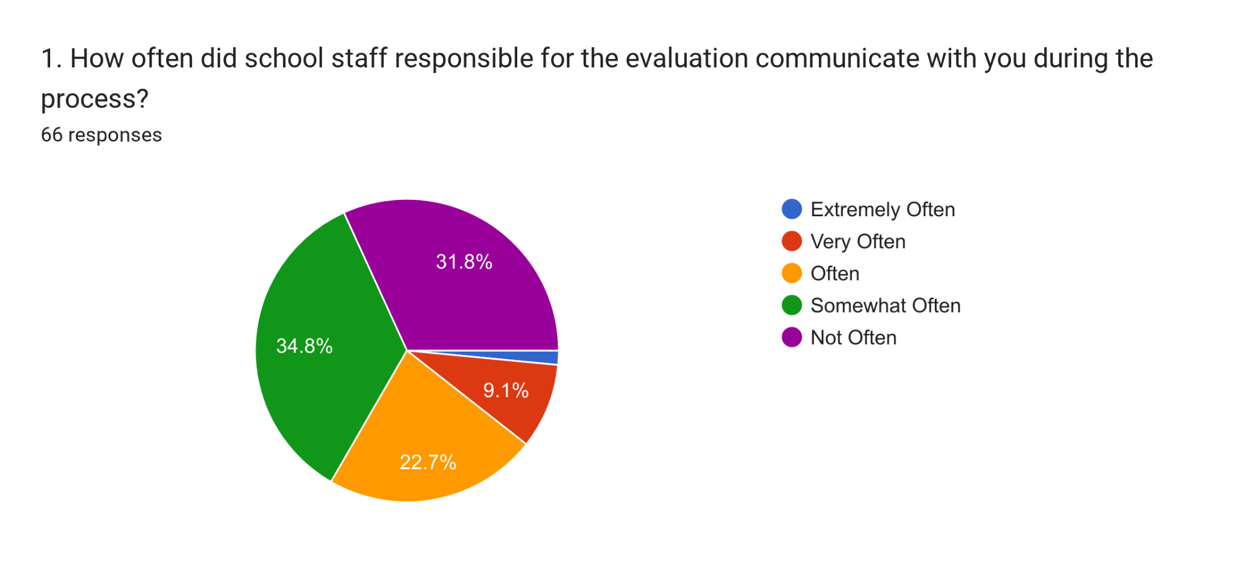
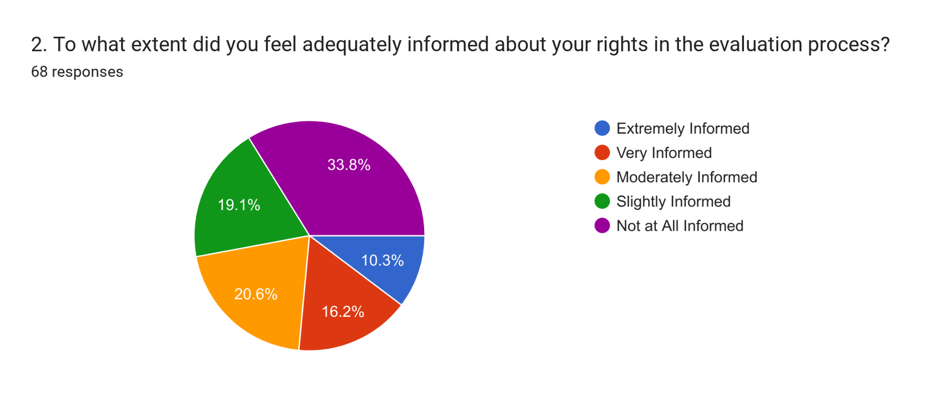
Delays … and Process
Lack of communication throughout the process.
Families feel inadequately informed about legal rights.
Note: The link to “Your Rights as a Parent” is broken on ACPS website.
Notes:
Lack of communication
Infreqently informed about legal rights.
In fact, even the links on ACPS are broken.

Slide 20
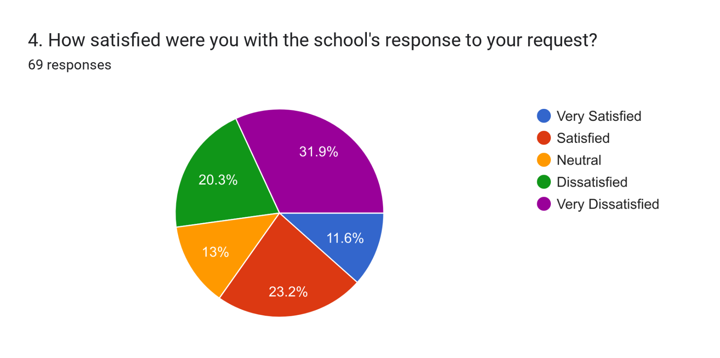
Delays … and Process = Distrust & Dissatisfaction
Vast majority of families are not satisfied with response to request. Includes both those who got IEP or 504 and those who did not.
Contrast w Fairfax, which reports 80% of families saying process is easy..
“... I feel that at every turn it seems like [ACPS] actively tried to discourage or prevent me from having my child identified.”
Notes:
Contrast with Fairfax where over 80% of families with IEP said the process was “easy”.
Responses look equally negative for families who ended up getting an IEP or 504 vs. getting nothing.
Quote - lots of frustration.

Slide 21
Delays … and Process = Confusion Amongst Staff
What we heard:
Staff and admin seem poorly-informed.
Teachers are often helpful, but also unable to help navigate the process.
At times, key gatekeepers can be insulting to families.
“The testing showed my child clearly has adhd and sld. Yet one administrator actively tried to prevent me from getting my child tested.”
Read aloud 2 more.
Notes:
Read aloud 2 quotes from page 3

Slide 22
System Issue #2
Delays in Process: SBIT
2011 Guidance from US DoE Office of Special Education:
“The use of RTI strategies cannot be used to delay or deny the provision of a full and individual evaluation… to a child suspected of having a disability….”
Notes:
For leaders ONLY – Have been several court cases & state proceedings for Child Find violations of public school divisions re: this guidance.

Slide 23

How should the IEP process work?
By law, the local team (SBIT for ACPS) must meet within 10 days of receiving the referral …
Source: Fairfax Co PS
Notes:
How it’s supposed to work…
Letter – Hi Family, we’re going to hold a meeting to discuss your child’s performance. Here’s who will be there. We’d like to hear your input & here’s how to share it with us. Here’s where and when we’ll meet. Please join us. And here are your legal rights, plus how the process works overall.

Slide 24
How should the IEP process work?
By law, the local team (SBIT for ACPS) must meet within 10 days of receiving the referral … AND:
Refer for evaluation (within 3 days) OR
Provide written notice to families of decision not to refer for evaluation (no time limit).
State law allows the local team to “use a process based on the child’s response to scientific, research-based interventions…”
Notes:
Must meet within 10 days. Options are to refer or in writing share decision not to refer.

Slide 25
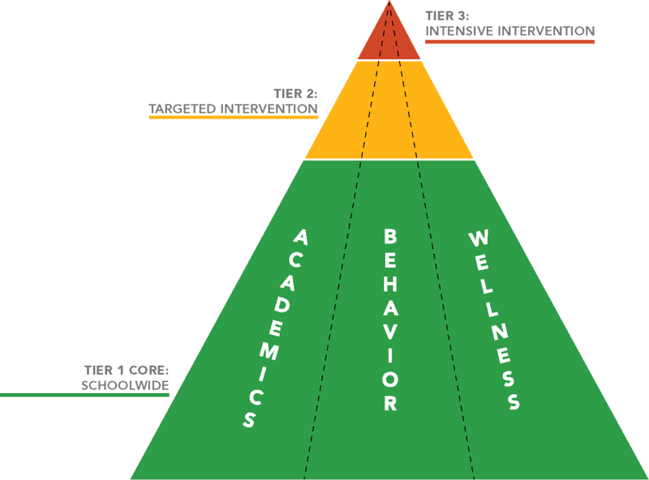
SBIT Infinite Loop
“Children who do not, or minimally, respond to interventions must be referred for an evaluation to determine if they are eligible for special education and related services (34 CFR §300.309(c)(1)); and those children who simply need intense short-term interventions may continue to receive those interventions.”
Dear Colleague Letter: U.S. Dept. of Edu., Office of Special Education and Rehabilitative Services, October 23, 2015
Notes:
DoE has reiterated time & again that interventions cannot be used to delay or deny evaluations. They are meant to be “short-term”, “rapid response”. NY specifies 6-8 weeks. Intention is clearly NOT that the interventions are infinite.

Slide 26
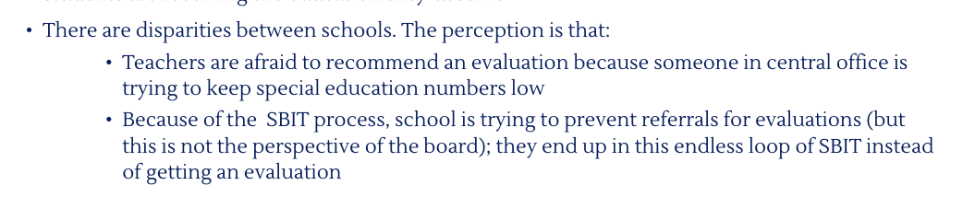
SBIT Infinite Loop
UVA Law Team:
Expert Interview

Slide 27
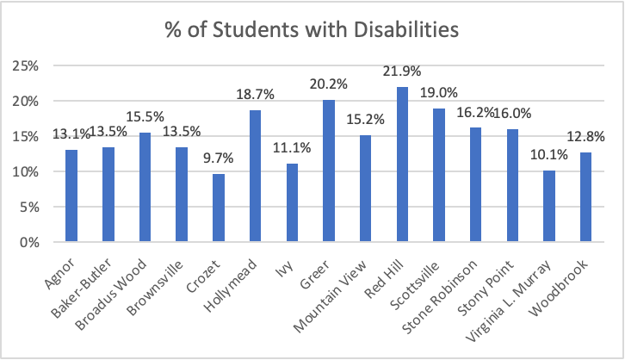
Data … is there a story?
Using elementary as example, there are big differences by school.
Average for ACPS elementary is 14.9%.
Notes:
Maybe there are reasons for such differences by school? I’m not sure.

Slide 28
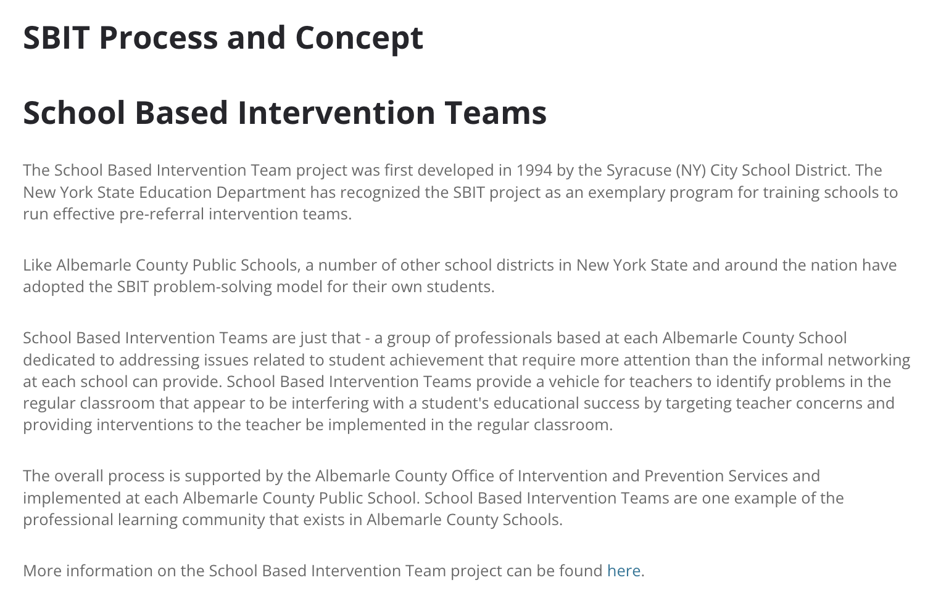
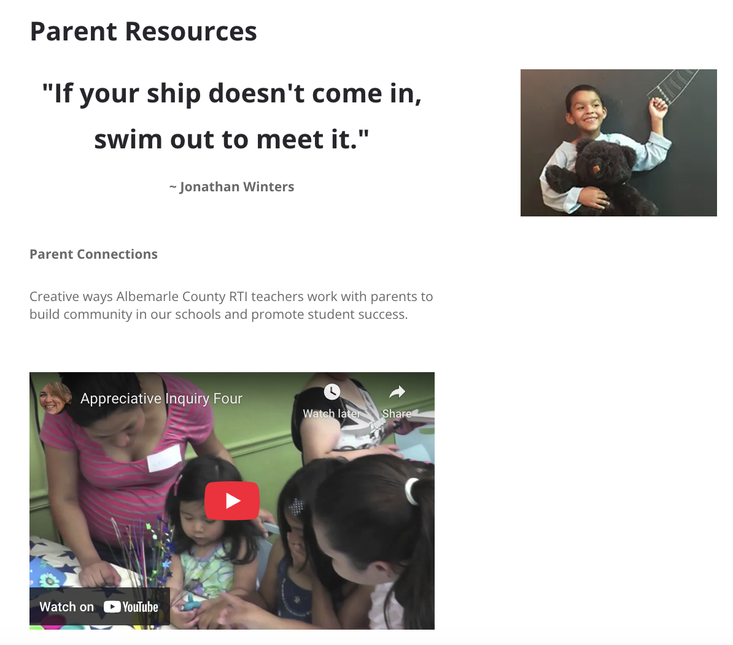
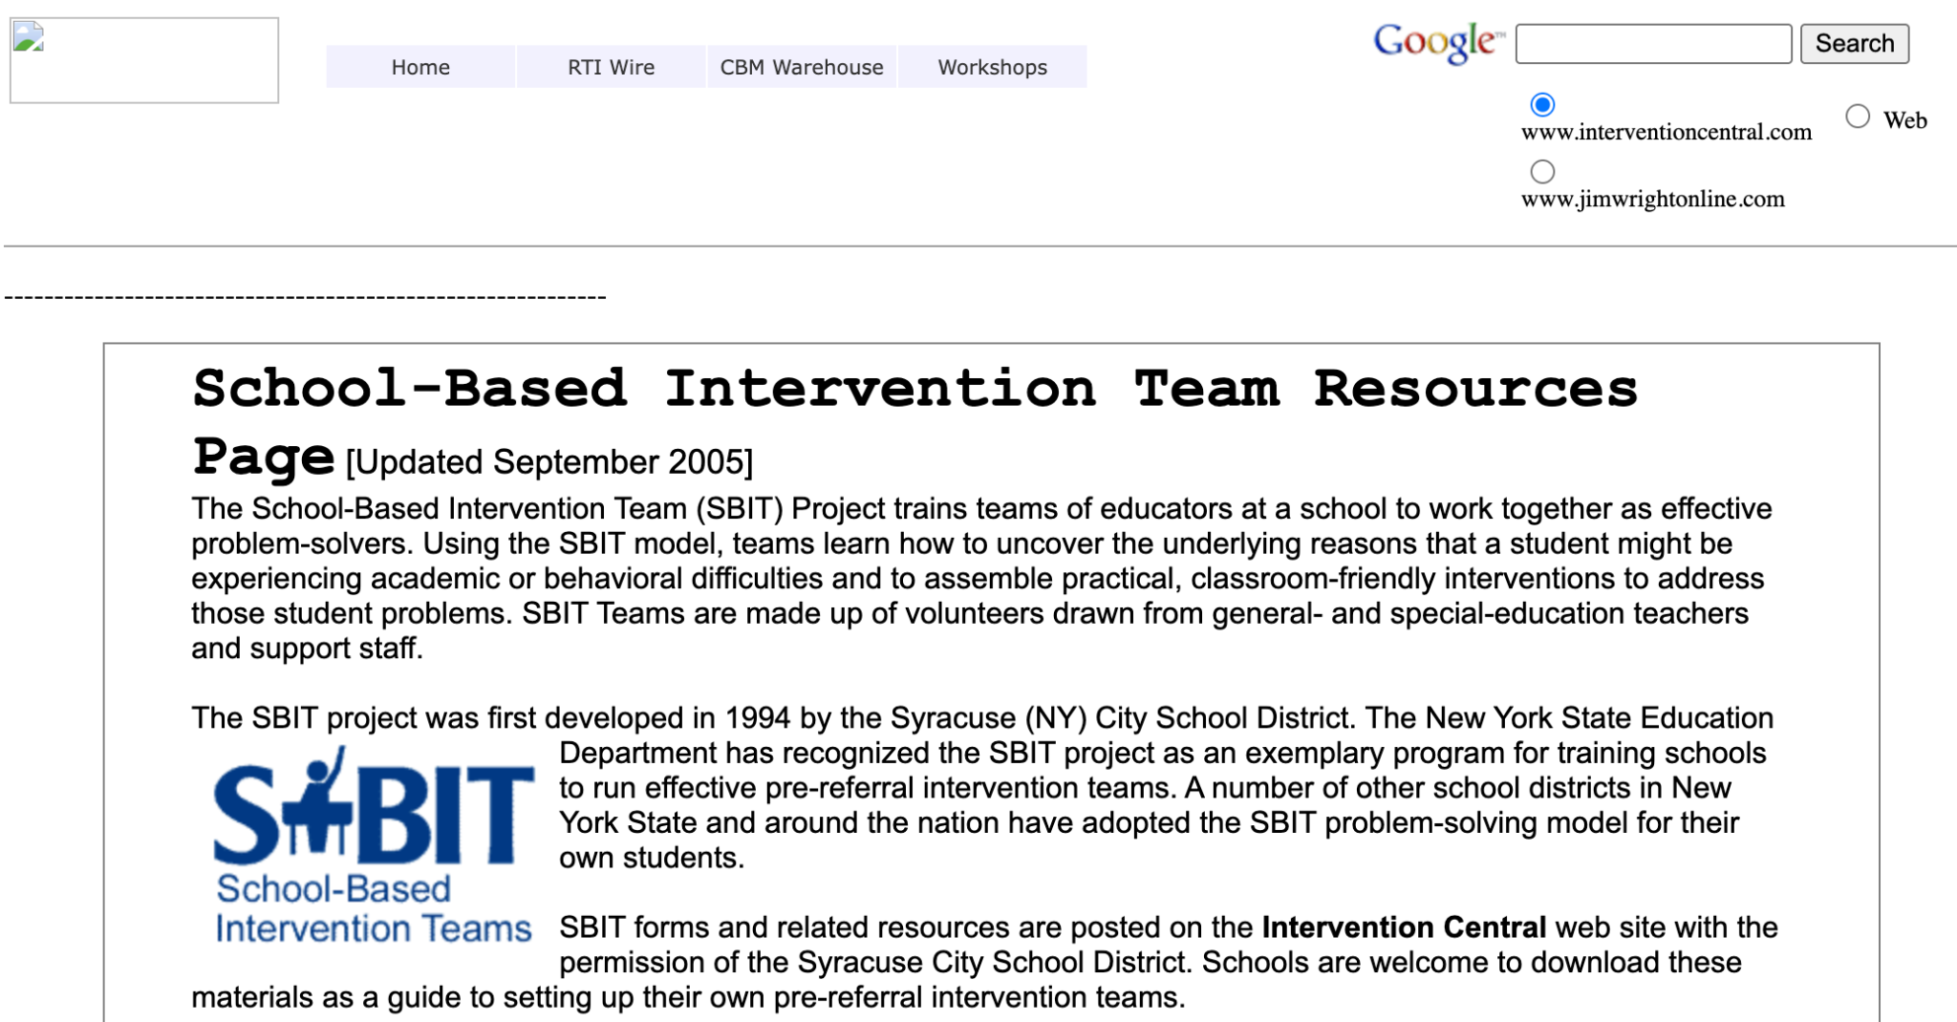
SBIT Infinite Loop
Question Submitted from Burley via Family Council in Sept 2024:
“What is SBIT and how can a parent get this? My kid is struggling and a friend told me to get SBIT.”
ACPS Answer:
“Parents should work directly with their student’s teacher and counselor to get more information about how they can get additional support for their student.”
Video
Notes:
Years of requests from Family Council on the basics of SBIT have put us into a similar endless spiral. ACPS website describes SBIT as a “concept”. The entirety of info ACPS publishes is included in this tiny box, with NO reference to special education. Link is to a 2005 NY state website that is barely functioning. Appears to be entirely site-based process with zero consistency.

Slide 29

SBIT Infinite Loop
ACPS Special Education Policy Manual, 2010:
“[ACPS] will address disproportionate and overidentification through a revised child study process called the School Based Intervention Team….”
“If the team decides not to refer for an evaluation for special education and related services, prior written notice in accordance with §VAC20-81-170 shall be given to the parent(s), including the parent’s right to appeal the decision through the due process hearing. (34 CFR 300.507)”
“Actions by the [SBIT] shall be documented in writing and shall include information upon which a decision was based.”
(See Appendix for CCEIS: Race-Risk Ratio)
Notes:
Reminder – A portion (15%) of the IDEA Part B funds ACPS has been receiving during the past decade were dedicated to RTI for early intervention. That was over a half-million dollars annually over a decade. Great that ACPS is no longer over-identifying black students as being intellectually disabled. Solution was NOT due to successful SBIT process.

Slide 30
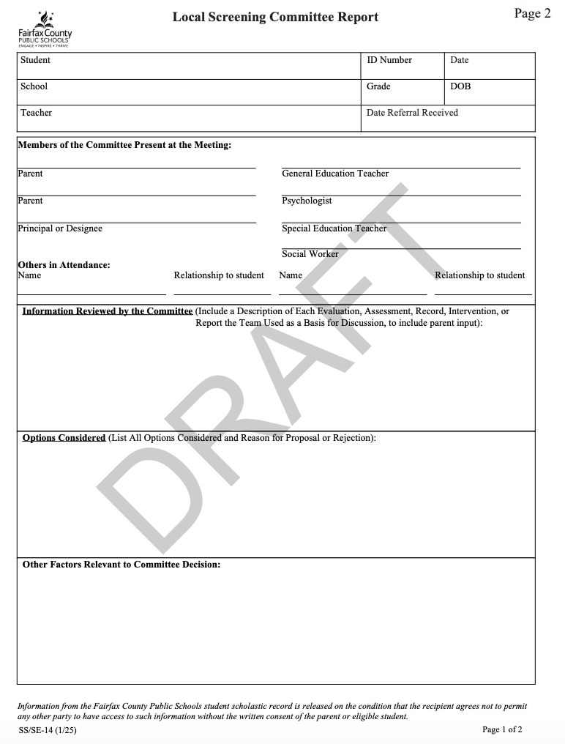
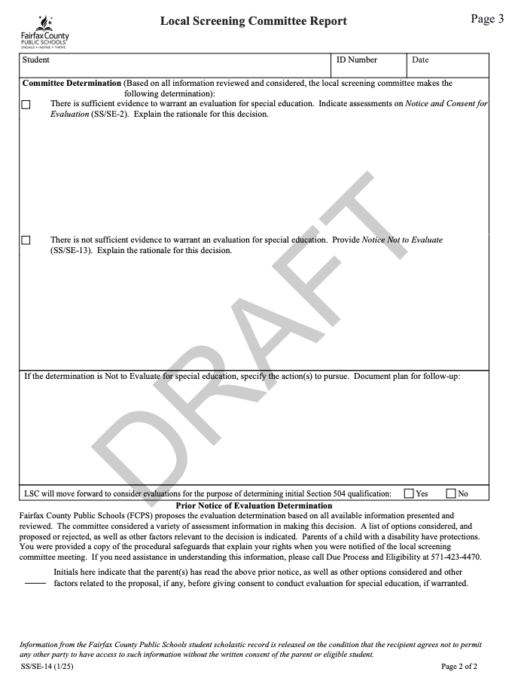
SBIT Infinite Loop
Source: Fairfax Co PS
What we heard:
“Watch and wait”
Families are hiring $$$ private tutors (or not).
No response.
Response not in writing.
Language barriers.
“I believe ACPS relies on those of us who can afford to pay for occupational therapy, reading tutoring, speech, etc. out of pocket to fill in the gaps because the need is overwhelming…”
Notes:
Quotes on page 4
From Fairfax:
Report of the group that met – what data we reviewed including family & outside input, options considered.
Determination – Yes or No to evaluate for special education services, or continue evaluations for 504 accommodations.
Extension – Puts limit of 65 days plus additional 10
Fairfax has 39 pages of standardized initial forms… that’s just the English version.

Slide 31
System Issue #3
Denials
Child Find:
Requires each school division to conduct an evaluation given “reason to suspect or believe” that a child has a disability. One “red flag” alone is typically sufficient to trigger the Child Find duty, but having multiple should trigger an evaluation.
Notes:
3rd issue = denials of testing.
Clearly, not every student referred for evaluation will require an IEP or 504 plan. However, denying an evaluation means denying services for children.
Q = What are criteria for denying evaluation?

Slide 32
System Issue #3
Denials
Research Outcomes:
“Those [SWD] denied services, the research [in Texas] found, were about 50 percent less likely to graduate from high school.”
Source: Education Week, “Impact of Missed Special Ed. Evaluations Could Echo for Years”, June 25, 2024
Notes:
When those denials are given inappropriately, such as happened in Texas when the state inappropriately mandated reducing the % of students who receive services, poor outcomes result.

Slide 33
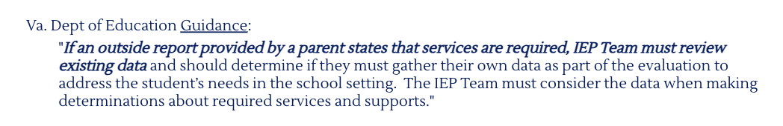
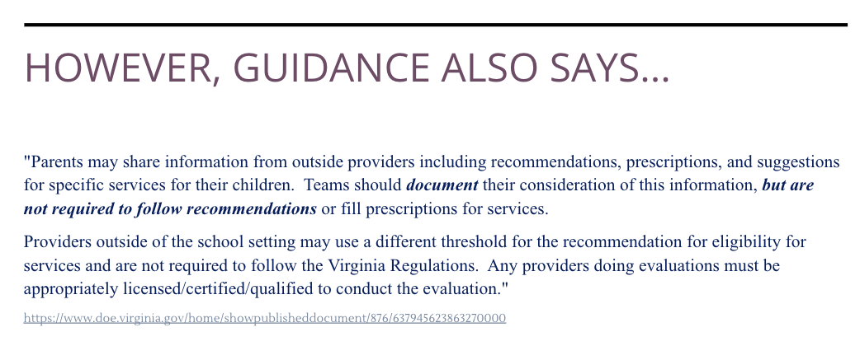
Denial of Evaluations
Concerns:
External Evaluations – must be considered by IEP team
From UVA Team Final Presentation
Notes:
Outside evaluations must be considered & documented
Actual recommendations made by external evaluation are not required to be followed

Slide 34
Denial of Evaluations
Concerns:
External Evaluations – must be considered by IEP team
What we heard from families:
Paying $$$ for private evaluations, sometimes believing this is the only option..
External eval’s called “provisional” & refused.
"If a child is struggling in school and has a diagnosis, they should at the minimum be tested by the school for that disability."
Notes:
Spending $5000 on outside testing.
Test results from UVA refused because they were “old” even though they’d be completed just a week prior.

Slide 35
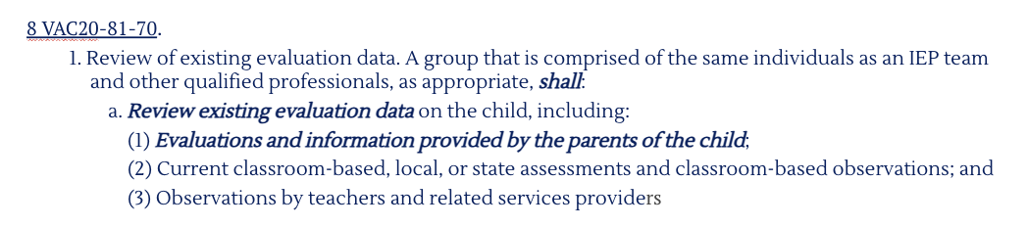
Denial of Evaluations
Concerns:
External Evaluations – must be considered by IEP team
Parental Observations – must be considered by IEP team
Notes:
By law….

Slide 36
Denial of Evaluations
Concerns:
External Evaluations – must be considered by IEP team
Parental Observations – must be considered by IEP team
What we heard from families:
ACPS admin do not listen to parental input.
Not included on reports.
Words used – fight, downplay, dismissive.
"My daughter’s note taking in 4th grade is illegible to both her and everyone else. When I showed this to admin and the sped team I was told that our society is moving away from the written word, and that she can just use voice to text and writing isn’t important."
Notes:
That’s not what’s happening.

Slide 37

Denial of Evaluations
Concerns:
External Evaluations – must be considered by IEP team
Parental Observations – must be considered by IEP team
Reliance on “ability-achievement discrepancy” as sole indicator
Outdated Approach
Notes:
In past, qualifying as having a disability was based on difference between IQ and achievement. That is NOT supposed to be the sole indicator now.

Slide 38
Denial of Evaluations
Concerns:
External Evaluations – must be considered by IEP team
Parental Observations – must be considered by IEP team
Reliance on “ability-achievement discrepancy” as sole indicator
What we heard from families:
Must be at least two grade levels behind.
Not “far enough behind” to qualify
“Last year my child was 5th grade and still struggles with reading, spelling and writing. Had homework issues and showed many clues of disabilities. Was told he wouldn’t qualify for help because he was not more [than] two grade levels behind academically.”
Notes:
Told to WAIT.
Told to stop tutoring outside of school.

Slide 39
Denial of Evaluations
Concerns:
External Evaluations – must be considered by IEP team
Parental Observations – must be considered by IEP team
Reliance on “ability-achievement discrepancy” as sole indicator
Requirement that student grades are low
“They said he was performing academically because he had decent grades. It did not matter he was in 7th grade and could not spell 4 letter words still, or write legibly.”
"At our last meeting when [I] pleaded with admin to at least test her, I was told it would be illegal because she doesn’t have academic impact."
Notes:
Child isn’t “crashing and burning”... quote from principal

Slide 40
Denial of Evaluations
Concerns:
External Evaluations – must be considered by IEP team
Parental Observations – must be considered by IEP team
Reliance on “ability-achievement discrepancy” as sole indicator
Requirement that student grades be low for SLD.
Behavior problems – must be considered, but need not be present
“I have heard tell that if a child is not a behavioral challenge in the classroom, it is hard to get them evaluated. I am ‘lucky’ (their words) that my child has presented challenging behaviors in the classroom because teachers and staff are more proactive in requesting evaluations.”
Notes:
Heard about kindergartener suspended while waiting for evaluation that had been repeatedly denied.

Slide 41
Denial of Evaluations
Concerns:
External Evaluations – must be considered by IEP team
Parental Observations – must be considered by IEP team
Reliance on “ability-achievement discrepancy” as sole indicator
Requirement that student grades be low for SLD.
Behavior problems – must be considered, but need not be present
Primary grades are “too early” for evaluation
“Lovett et al. (2017) find that students with reading disabilities who first received intervention in first or second grade made gains in literacy almost twice that of children first receiving intervention in third grade and continued to grow at faster rates over the following years.“

Slide 42
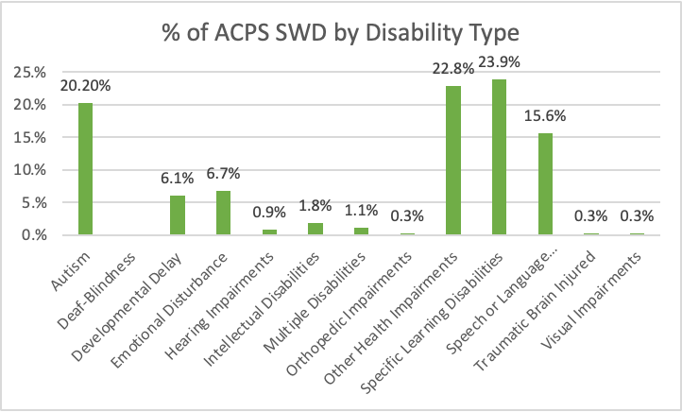
Data … is there a story?
Ms. Compel had called out the higher % of students with autism. State average is 16.41%.
ACPS has a lower % than state average of students with specific learning disabilities. State average is 29.37%. ACPS difference is lack of ID in grades K-2.
Notes:
Here’s another shared too quickly. What’s up with low identification of Specific Learning Disabilities?
Chris & I decided enough… let’s tackle this together.
Because the laws are complex & this would take many hours, needed help.

Slide 43
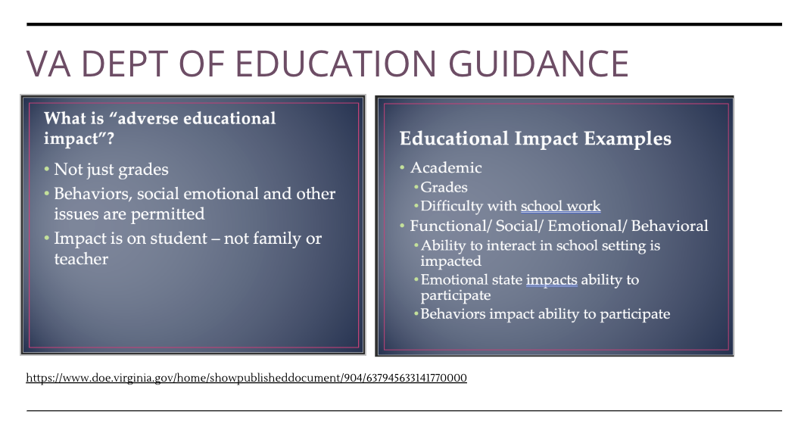
Denial of Evaluations
From UVA Team Final Presentation
Notes:
There is a state-mandated option of “pattern of strengths and weaknesses”.
And here’s what the UVA Law team shared re: “adverse educational impact”.

Slide 44
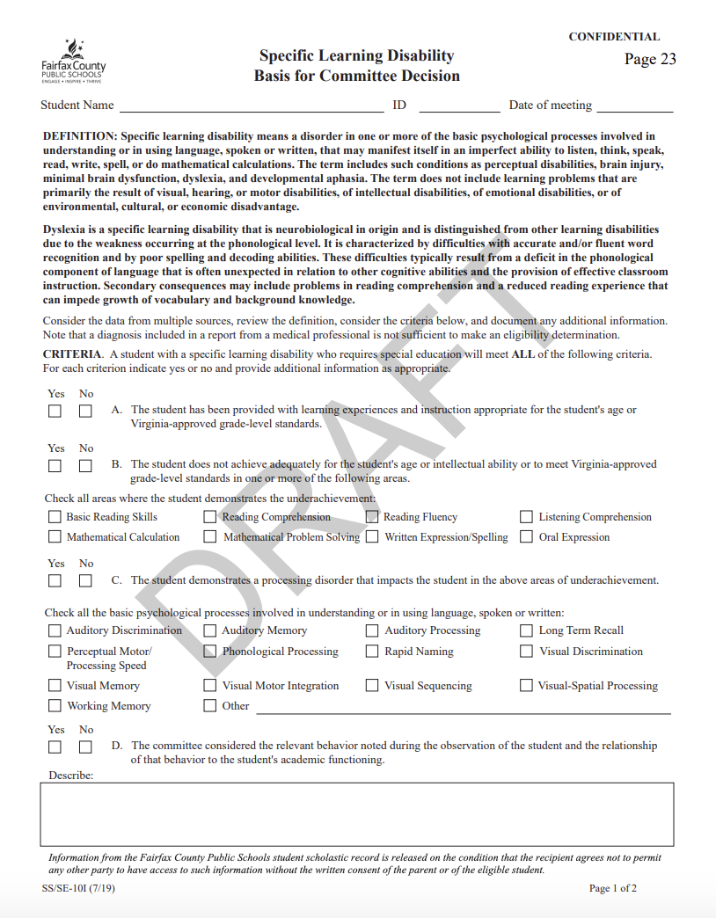
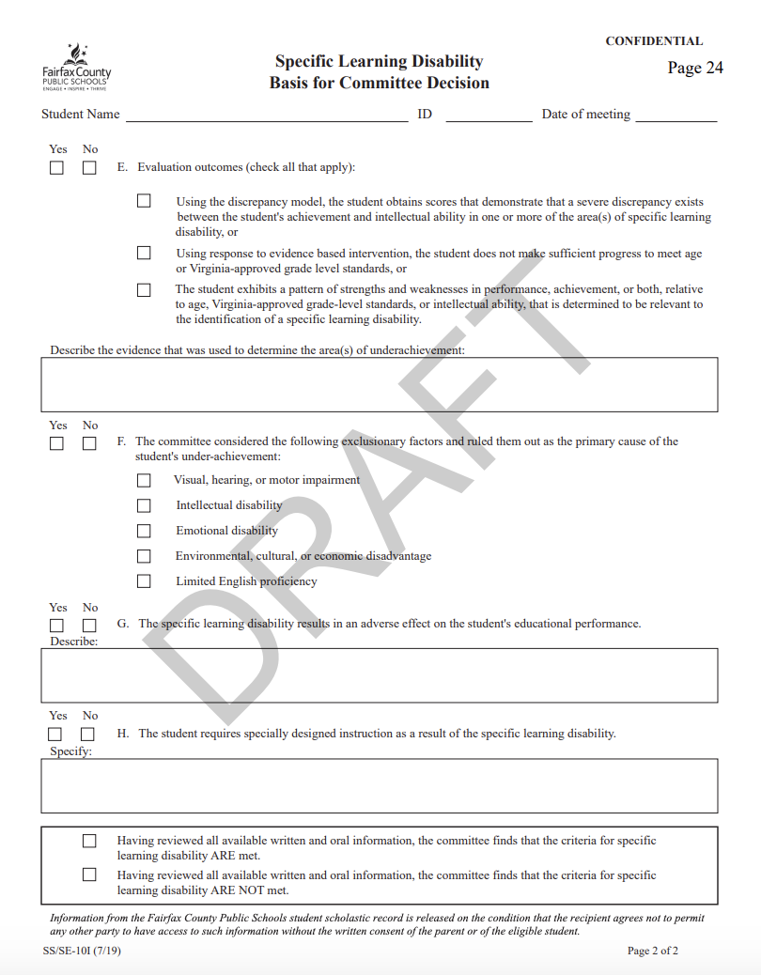
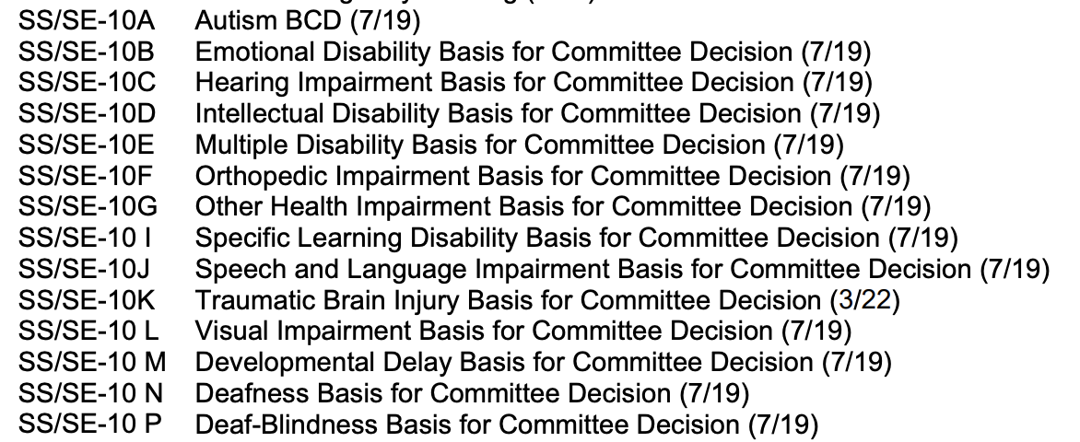
Denial of Evaluations
ACPS has not published clear criteria for what qualifies as a “disability”.
Source: Fairfax Co PS
Notes:
Forms available from Fairfax spelling out ALL of the criteria that are required to qualify for a specific disability category. Sample is 2 pages on “Specific Learning Disability”, which includes as per state law that student has been provided with instruction aligned to grade level standards.

Slide 45

Dispute Resolution & Options
Who in ACPS is available to help with a dispute?
Administrative Review
Due Process Hearing
Facilitated IEP
Mediation
Office of Civil Rights Complaint
Resolution
Section 504 Hearing
State Complaint
Source: Fairfax Co PS

Slide 46
Conclusion

Slide 47
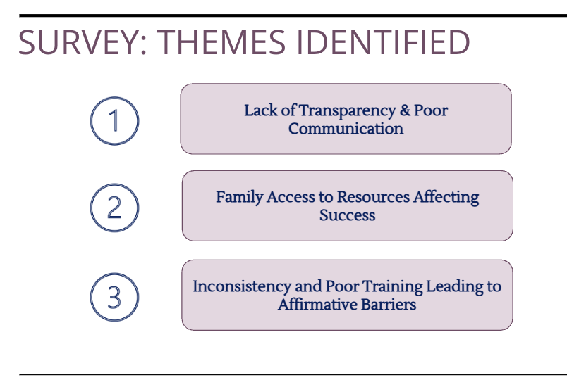
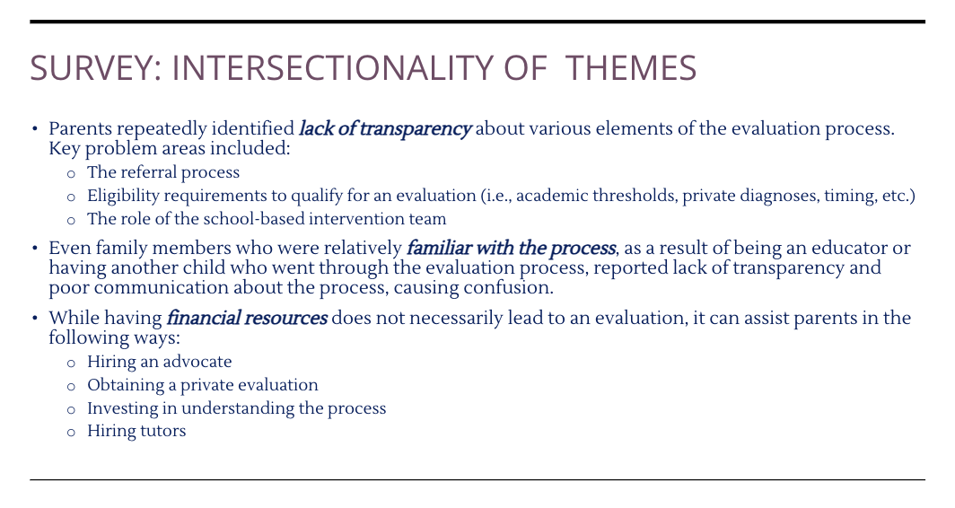
Summary from UVA Law Team
Notes:
Summary of themes from UVA law team – transparency/communication, family access to $, training of staff

Slide 48
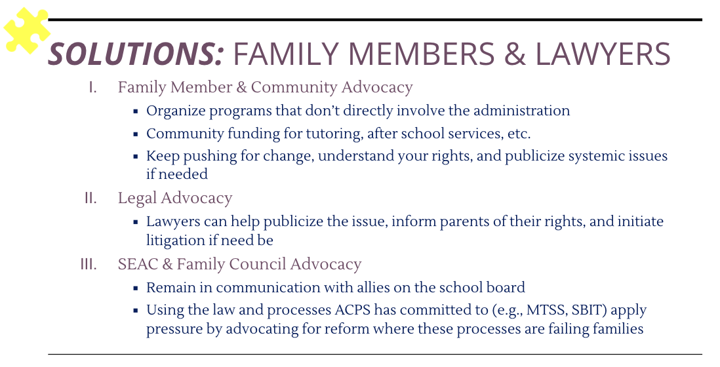
Summary from UVA Law Team
Notes:
They gave us some tips about what we could do ourselves…

Slide 49
Families Want Guidance & Partnership
“There are no quick reference charts, explanations, step by step guidelines to walk
someone through the process, which is extremely frustrating. You either have to have
been through the process before, know someone who has, have a staff member explain it
to you, or fumble through it (which often leads to delays in the process and obtaining
services for your child)....”
“Process is not readily available or understood for parents. It is set up as reactive to
continued struggle, as opposed to proactive when struggles are identified. ACPS has
many hurdles in place to try and not provide testing or services, including stressful and
intimidating meeting environment instead of a supportive atmosphere. Getting your child
the help they need shouldn't be so hard! Not us vs them, but team effort in best interest of
the child.”

Slide 50
Summary of Findings
Families in ACPS are experiencing major problems in accessing disability evaluations.
Federal “Child Find” law requires:
“Each school shall have procedures to process in a timely manner all referral requests for a child suspected of having a disability.”
Fixes are possible with strong leadership.
Notes:
To leaders at preview –
Our goal is not only to share the data, but to convince you that you MUST take action.
**ACPS is at significant risk for legal action for violations of federal & state requirements.**
NOW is the time to fix this.

Slide 51
Appendix

Slide 52
Project Resources
Survey Quant Results
Survey Comments – full set reviewed by UVA Law team, but only subset of respondents offered contact info & approval to share quotes
UVA Team PPT – includes quotes that we do not have permission to share, so viewable only by Family Council (e.g., not subject to FOIA via SEAC)
UVA Law Community Solutions Clinic (renamed Community Organization and Social Enterprise Clinic)
Dr. Sarah Shalf: shalf@law.virginia.edu

Slide 53
SEAC Data Request #1
On Unclear Referral Procedure –
We hereby request data (via FOIA if necessary):
Number of ACPS students with 504 plans:
  By school
  By race & ethnicity, plus economically disadvantaged & English learner status.
Total number of ACPS students with 504 plans over past 10 years.

Slide 54
SEAC Data Request #2
On Delays in Process –
We hereby request data (via FOIA if necessary):
Number of referrals for disability evaluation ACPS school administrators received for the 24-25 school year.
  Total # by school, including private as a set
  Total # by grade, including PreK & early childhood
Result of above set of referrals for disability evaluation:
  # denied by school administrator (without referral to SBIT)
  # of special education disability evaluations initiated
  # referred to School-Based Intervention Team (SBIT)

Slide 55
SEAC Data Request #3
On SBIT Infinite Loop –
We hereby request (via FOIA if necessary):
For the 24-25 school year, total number of students participating in SBIT by school (including private) and grade level (including PreK and early childhood).
Results for above set of SBIT participants:
  # of students who exited SBIT with special education evaluation initiated
  # of students who exited SBIT with special education referral denied
Median length of time students spent in SBIT process during 24-25 school year.

Slide 56
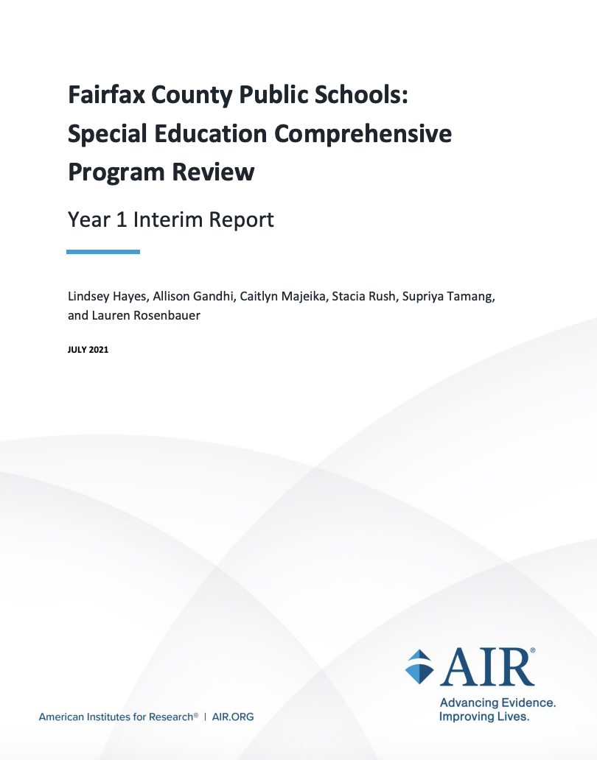
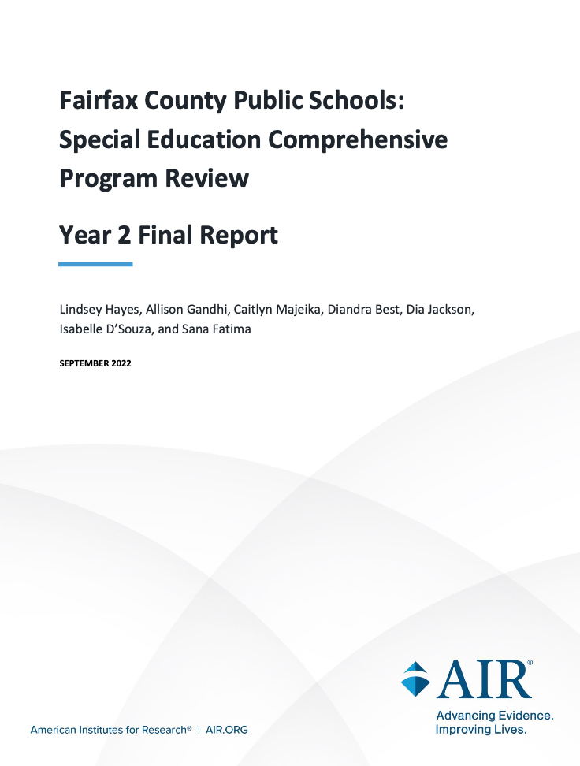
HGB: Program Improvement
Option #1
Comprehensive Independent Audit – Follow model of Fairfax school board, which hired American Institutes of Research (AIR) to conduct broad & in-depth study of special education system.
Notes:
Me putting on my consultant hat.
Believe that what we’re sharing is just the tip of the iceberg re: problems within special education system. Massive 2-year study which is costly & time-consuming, but also effective.

Slide 57
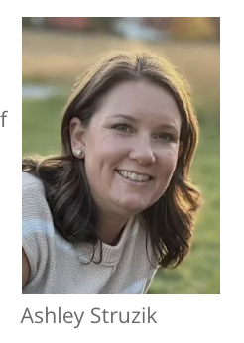

HGB: Program Improvement
Option #2
Targeted Approach with Limited Resources – Dedicate internal leadership resources to creating a well-defined process for accessing disability evaluations & communicating to stakeholders.
Craig Dommer
Notes:
Believe that the limited data, both qualitative and quantitative, provided by UVA Law team’s work indicates that ACPS has problem with access to disability evaluations. Choose if you believe that the existing staff has adequate capacity to lead this reform. And, that the existing structure of SBIT being between two departments works. And, that ACPS educators will trust in these leaders’ work.

Slide 58

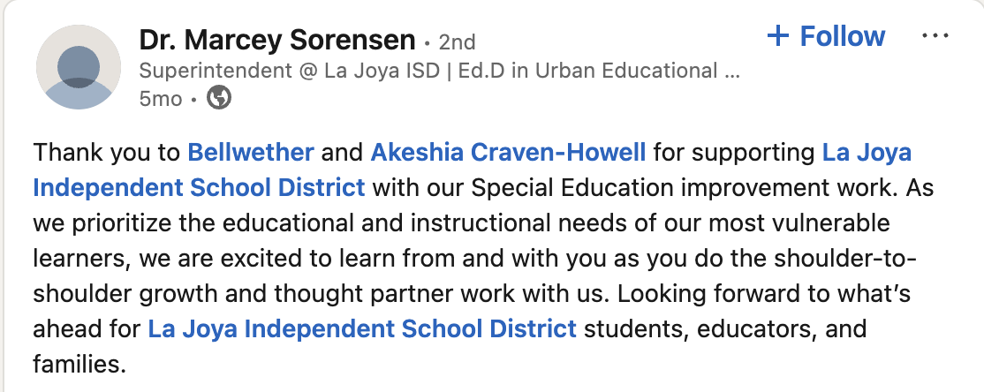
HGB: Program Improvement
Option #3
Targeted Approach with External Support – Supplement with external consultant(s) who:
  Continue data review, including non-public
  Review set of pre-IEP evaluation documents
  Conduct additional confidential interviews
  Review leadership structure
  Deliver report to SEAC & school board
  Develop resources based on existing models
  Create educator professional development
Notes:
Believe that the limited data, both qualitative and quantitative, provided by UVA Law team’s work indicates that ACPS has problem with access to disability evaluations, but that existing leaders can’t pull this off by themselves. Need help bridging gap between Intervention & SpEd. Gives opportunity to consider MTSS more broadly, including not only academics but also issues re: discipline.

Slide 59
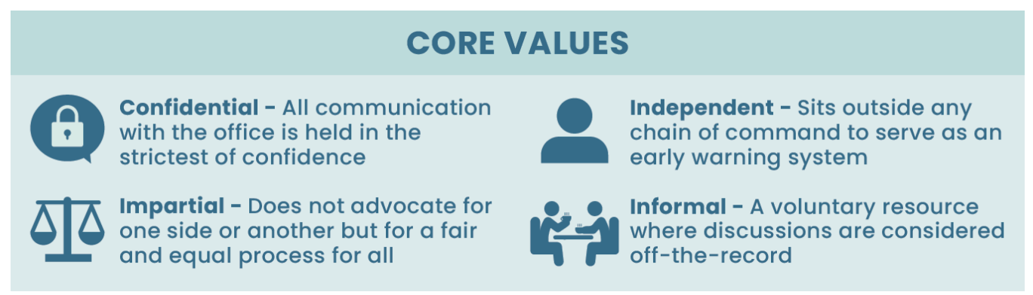

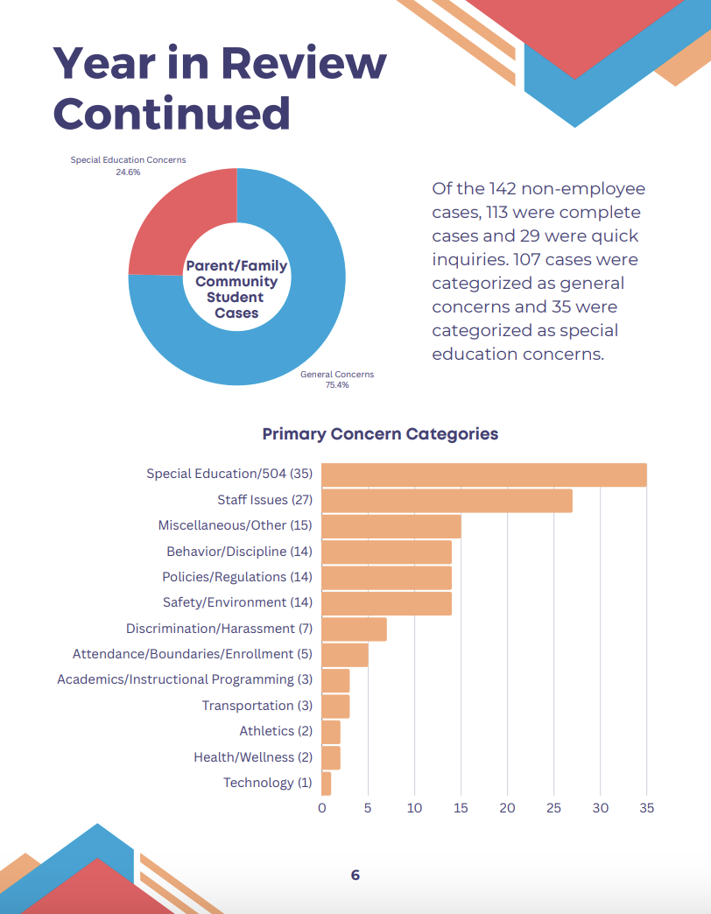
FC: Ombuds Position
Fairfax Example
Loudon Example

Slide 60
Survey Details
From UVA Team Final Presentation

Slide 61
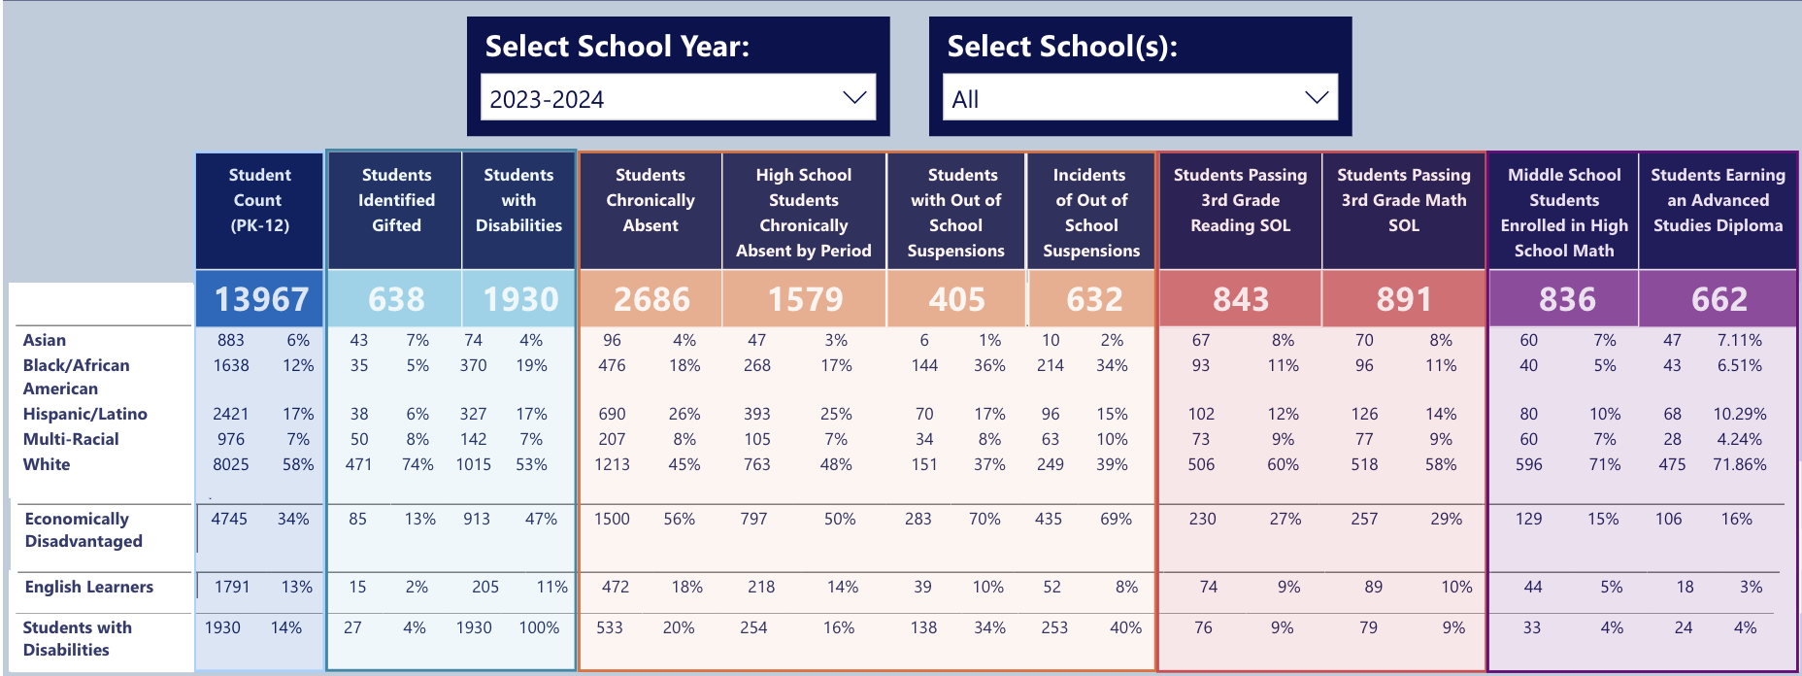
Additional Data
Notes:
Students who are Black have been more likely to be identified with disability, specifically over-represented as having intellectual disabilities. Set of SWD includes a higher % of students from economically disadvantaged families. Over-represented in suspensions.

Slide 62
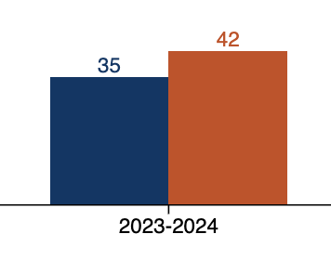

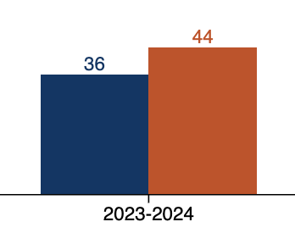
Additional Data
The achievement gap between ACPS students with disabilities and those without disabilities is massive. Sadly, this gap parallels the state data.
What is unique about ACPS? Performance is WORSE at 3rd grade for both math & reading.
By 8th grade, our amazing ACPS educators make up a lot of ground. But…
At key grade 3 milestone, nearly ⅔ of ACPS students w disabilities fail SOLs.
Reading
Math

Slide 63
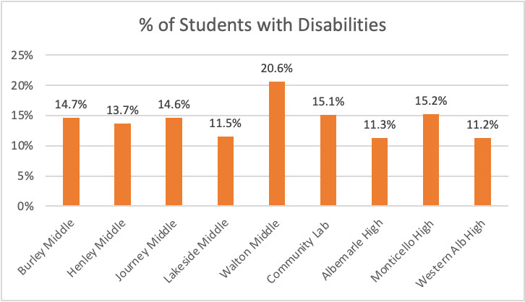
Additional Data
Secondary also has big differences by school.
Average for ACPS secondary is 13.2%.

Slide 64
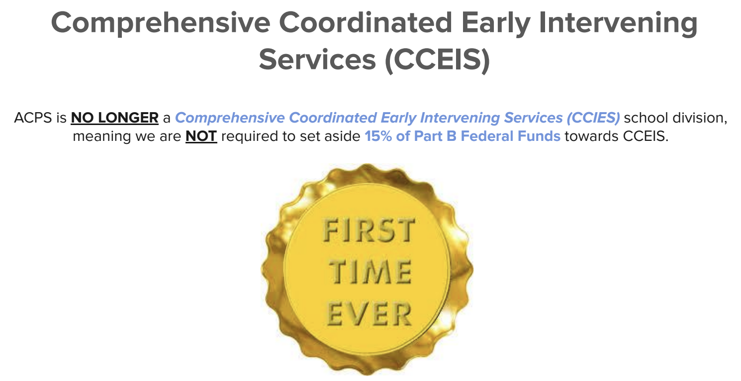
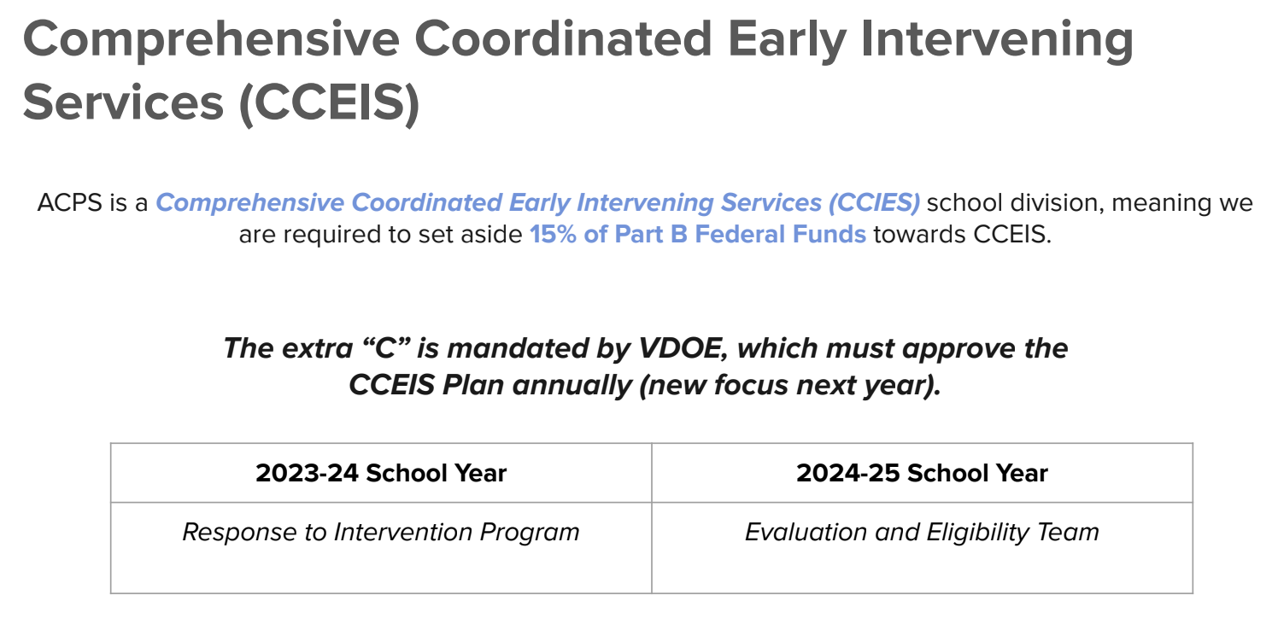
CCEIS – Race-Risk Ratio
From April 2025 School Board PPT
From April 2024 School Board PPT

Slide 65
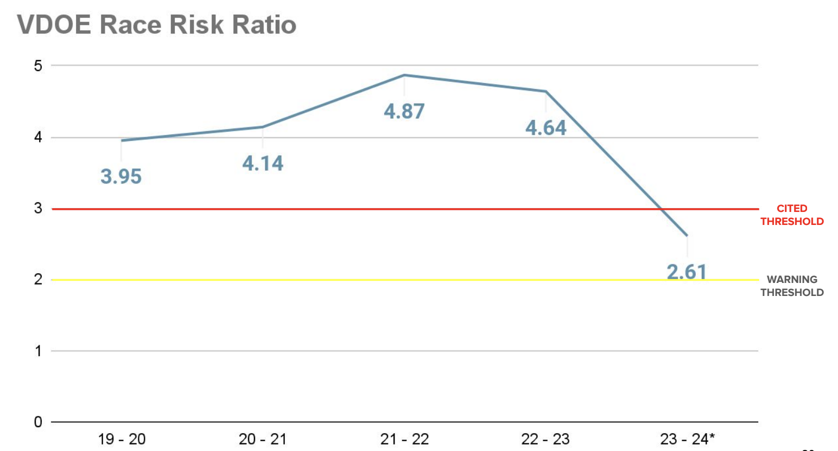

CCEIS - Race-Risk Ratio
From April 2024 School Board PPT

Slide 66


CCEIS – Race-Risk Ratio
From April 2024 School Board PPT

