Slide 1



STEM Research
& Real-world
Problem Solving
Advanced
Academics
Leadership &
Community Service

Slide 2



Slide 3

Growing Global STEM Leaders of Accelerated Change
Notes:
What is the RMSST ecosystem?
25-year success in high school STEM education.
Need for earlier access to advanced academics and STEM innovation.
Goals: prepare students for high school and college-level coursework, provide a rigorous public school option for families, build regional/national STEM leadership.
Disclaimer that program is in development... subject to change

Slide 4

Challenge Yourself to Ask
Notes:
WHY study STEM?

Slide 5


Slide 6
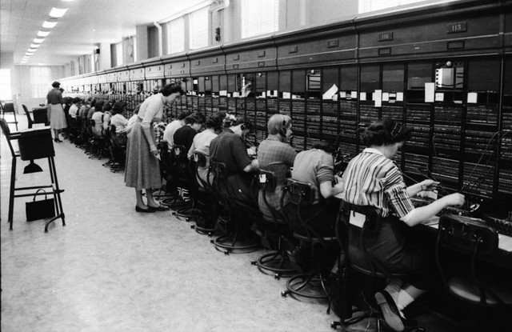

Slide 7
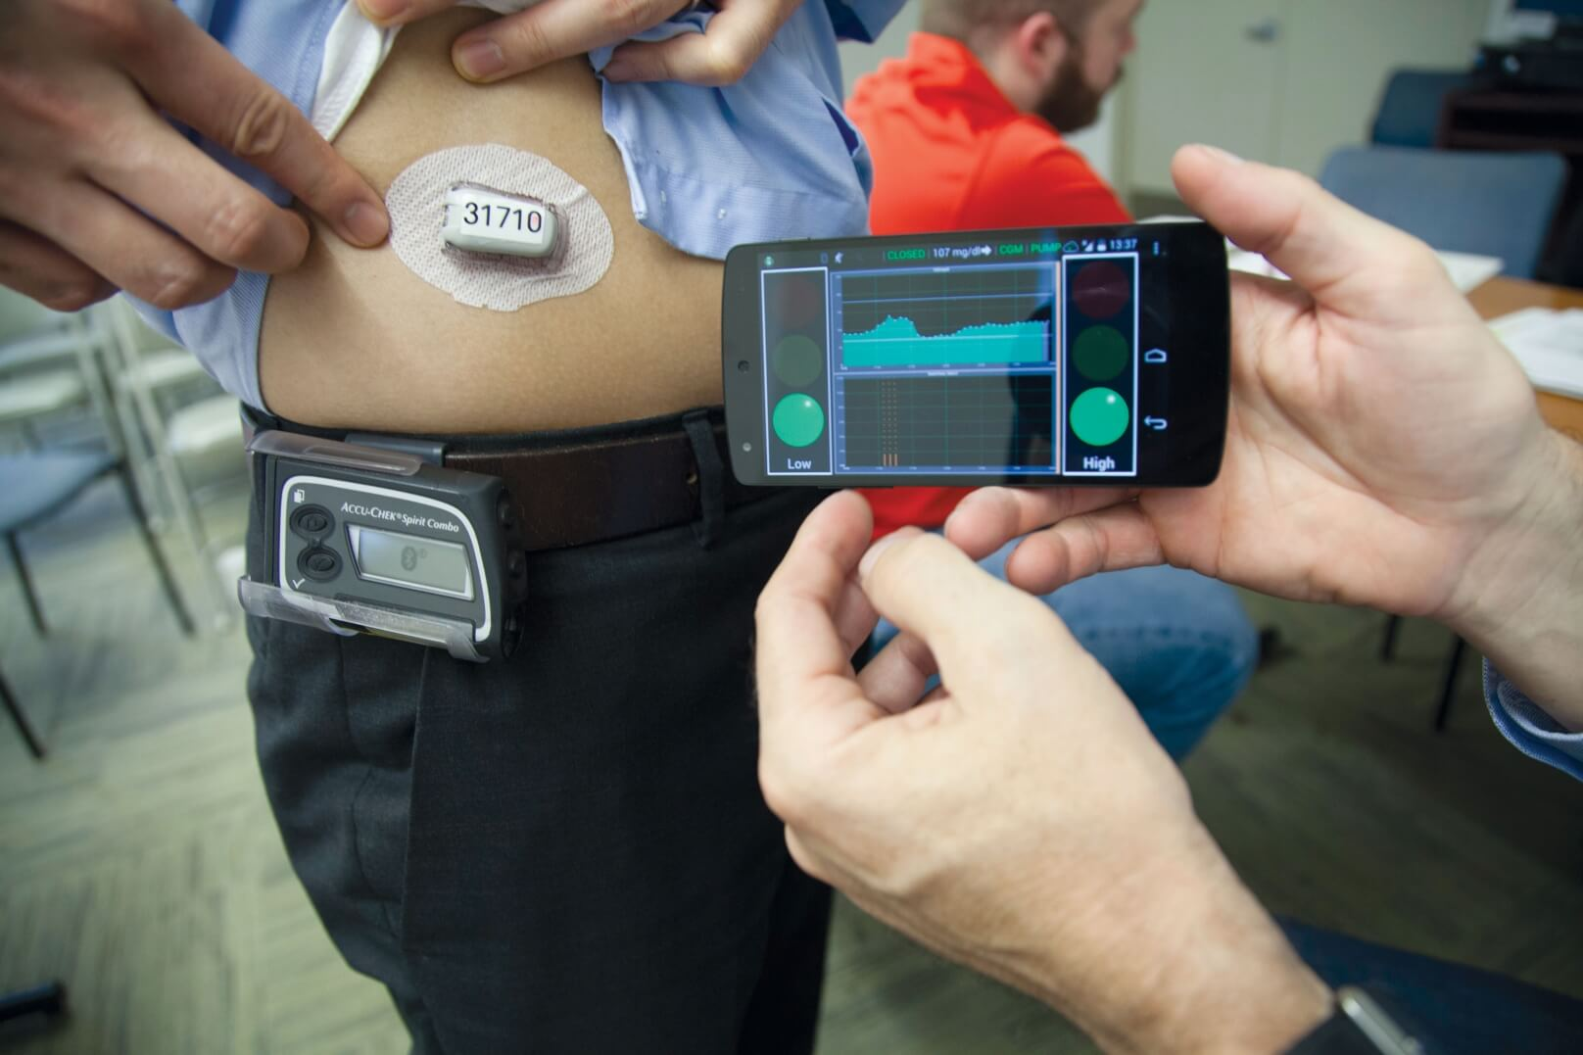

Slide 8


Slide 9

STEM Research
& Internships
Students investigate real-world problems in STEM labs, present at national and international conferences, and complete internships with industry partners.
Advanced
Academics
With Advanced Placement courses, Dual Enrollment partnerships, and a rigorous inquiry-based curriculum, RMSST scholars graduate earning top scholarships and prepared to excel at prestigious universities.
Leadership & Community Service
Students build leadership skills in the classroom and beyond through clubs, teams, and extracurricular programs that have consistently earned state and national honors.

Slide 10
STEM Research
& Real-world
Problem Solving
Advanced
Academics
Leadership &
Community Service

Slide 11

Why expand RMSST to 4-8?
To expand access to research-focused STEM learning earlier
To prepare students for advanced pathways in high school and beyond
To provide an innovative public option for families
To strengthen Rockdale’s position as a regional and national leader in STEM education
To address the RCPS Strategic Plan Goal Area - Student Achievement, Learning and Growth, Performance Objective-Increase opportunities for all students, and Action Plan – Establish elementary and middle theme schools

Slide 12

What will the 4-8 expansion include?
Focus on advanced academics and STEM innovation
4th- 8th grade students will attend the Magnet full-time, taking all classes on site
Students will have a complete daily schedule and not rotate back to another home school for classes
Alignment with GaDOE Standards & National Consortium of STEM Schools Membership

Slide 13
What makes this program unique?
Advanced curriculum with interdisciplinary projects
Quarterly community challenges using Stanford’s d.school Design Thinking Model
Design-Lab Rotations: Makerspace, Robotics, Fabrication, Data Science
Opportunities to compete in STEM competitions during the school day & via extracurriculars (InVenture, Broadcom MASTERS, Olympiads)
Carnegie Credit High School Classes in 7th & 8th grade
Preparation for college level coursework starting in 9th grade
Selective Admission Process

Slide 14
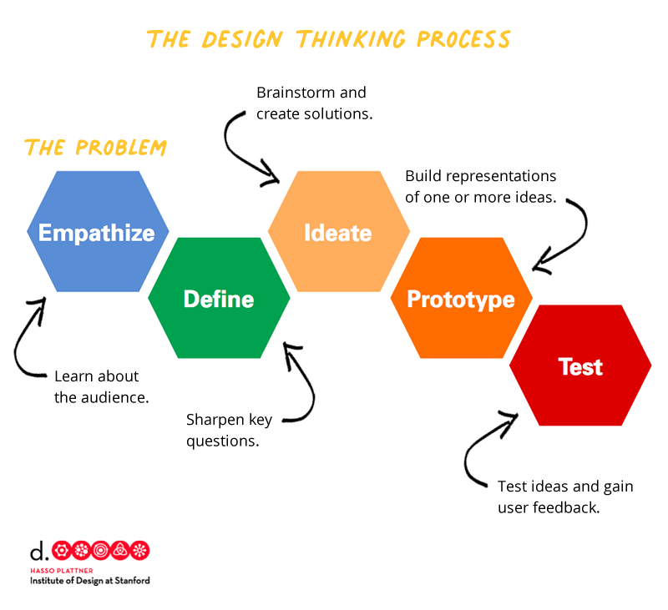

Slide 15
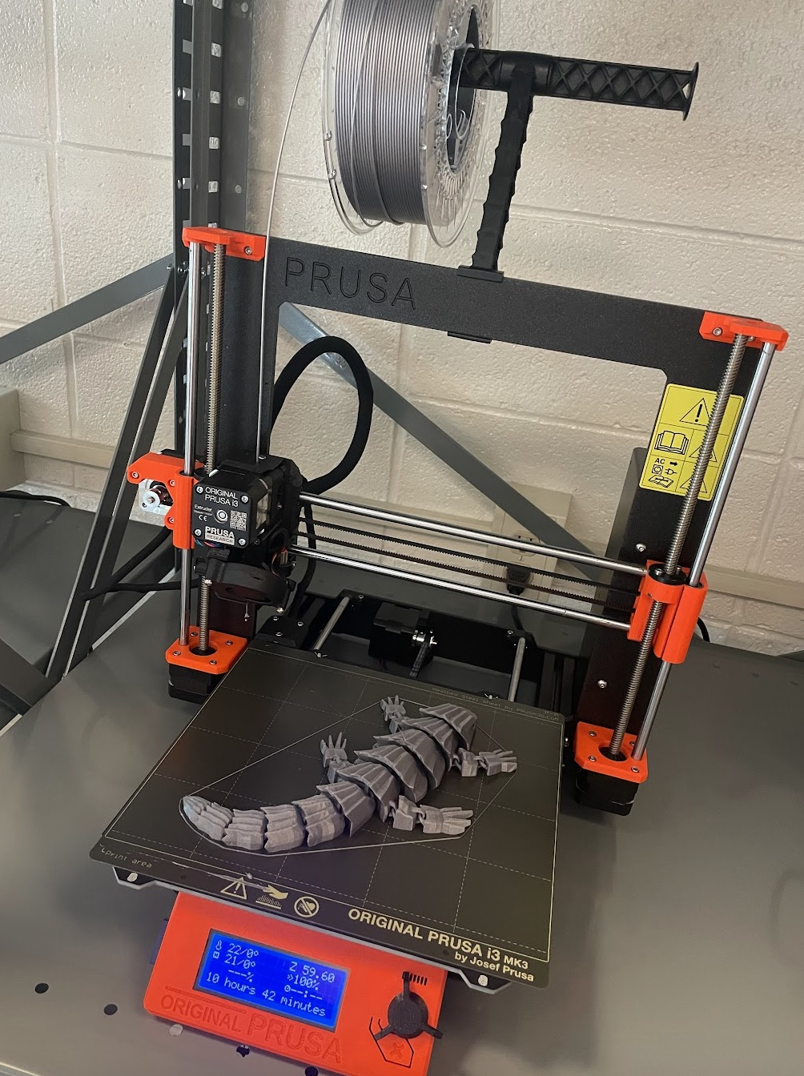
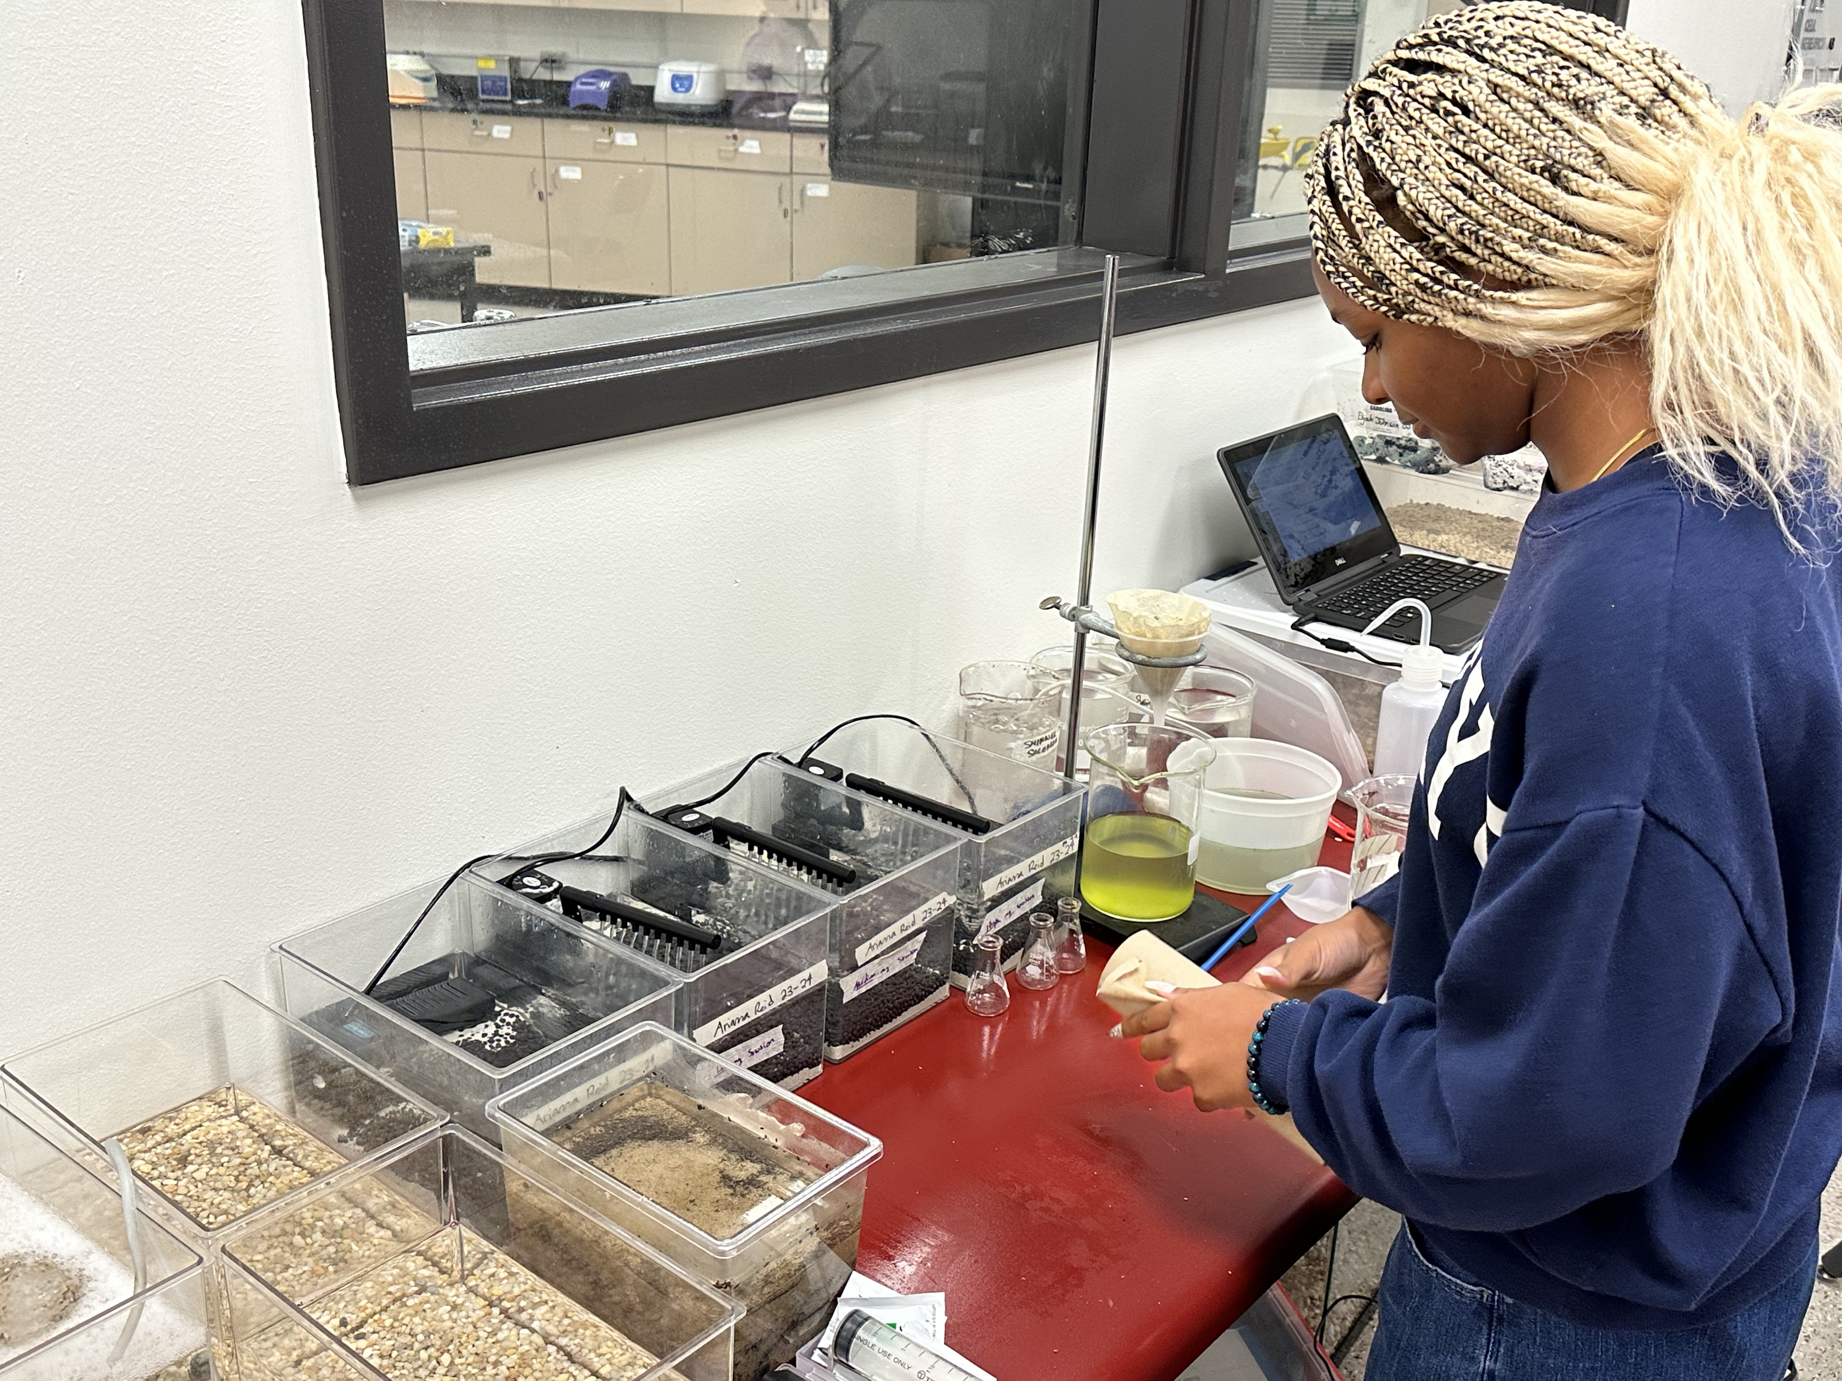
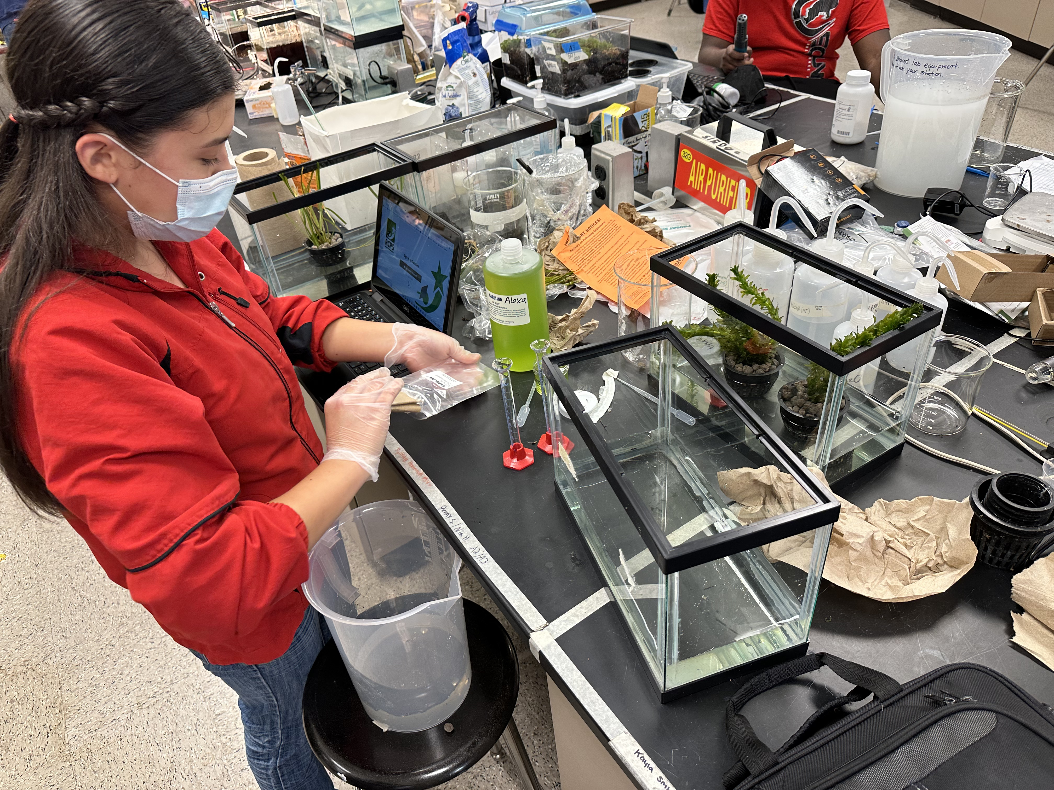
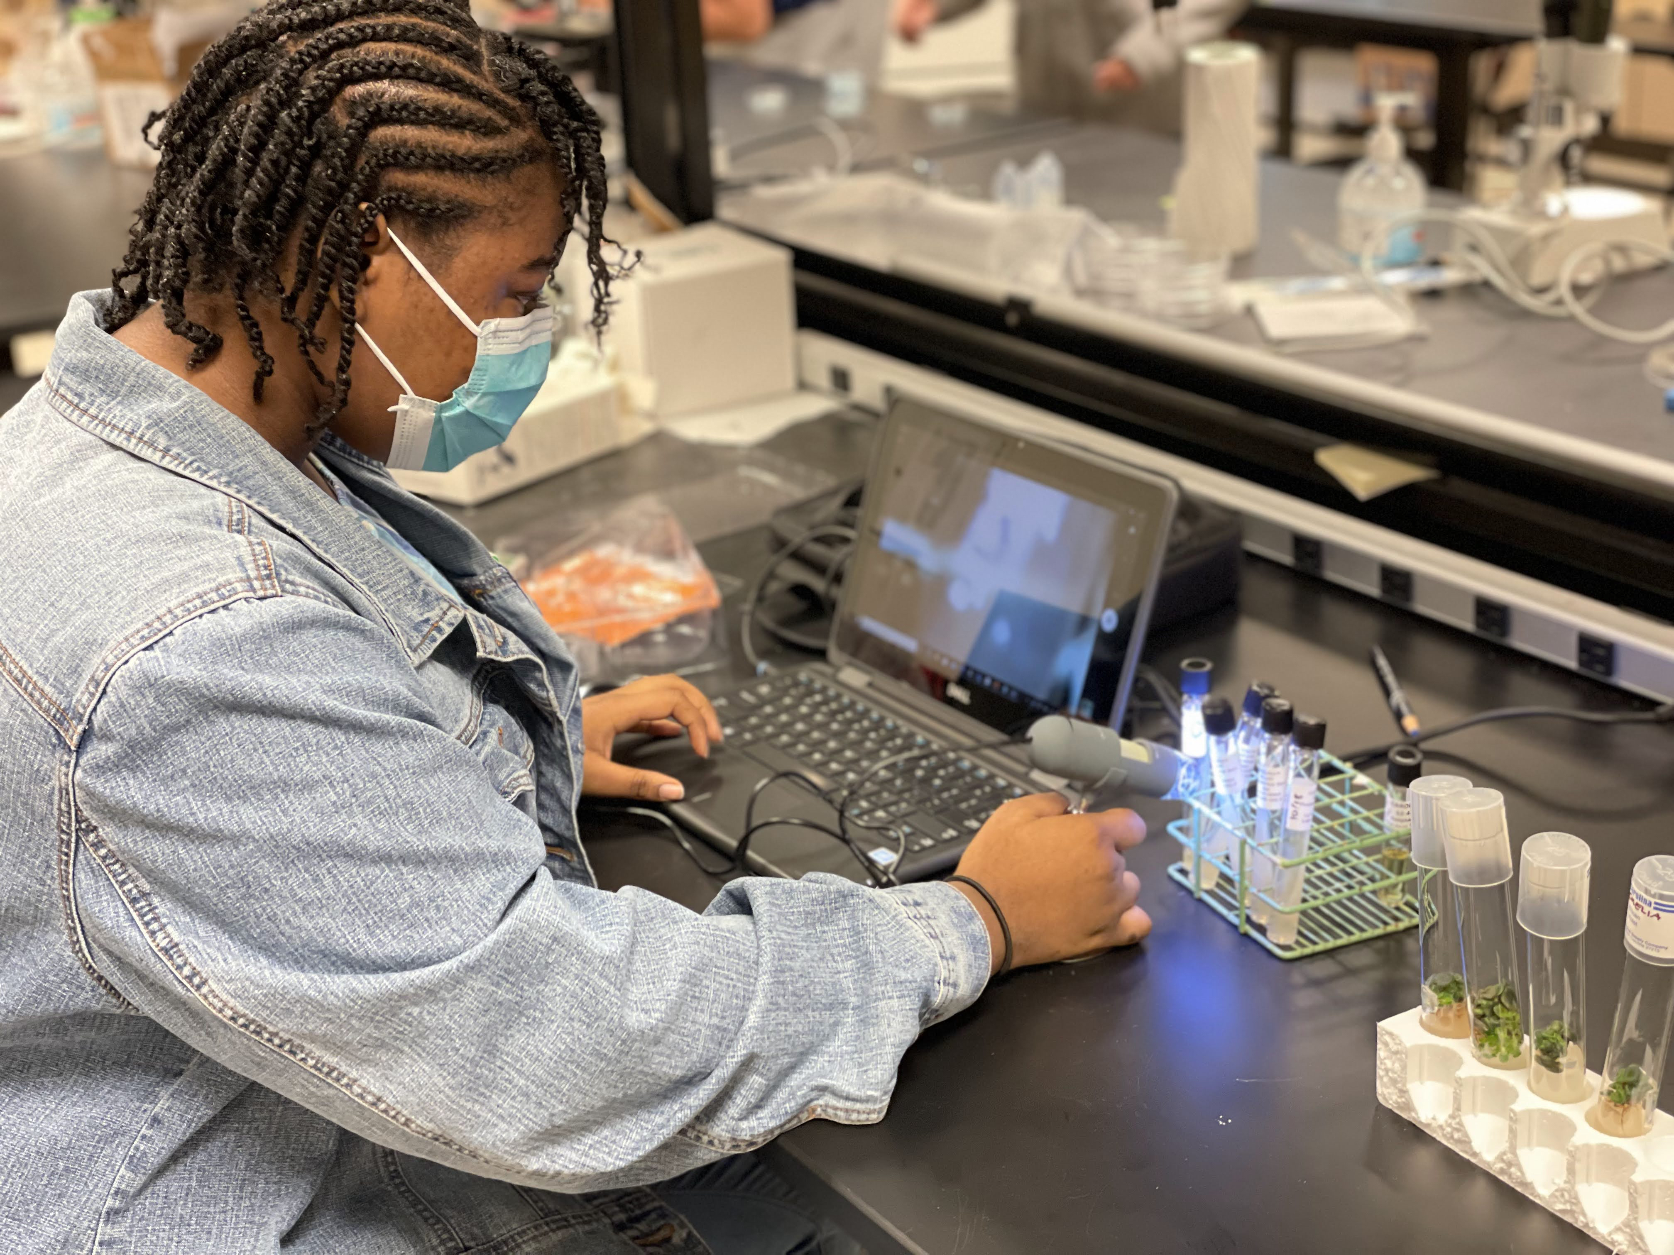
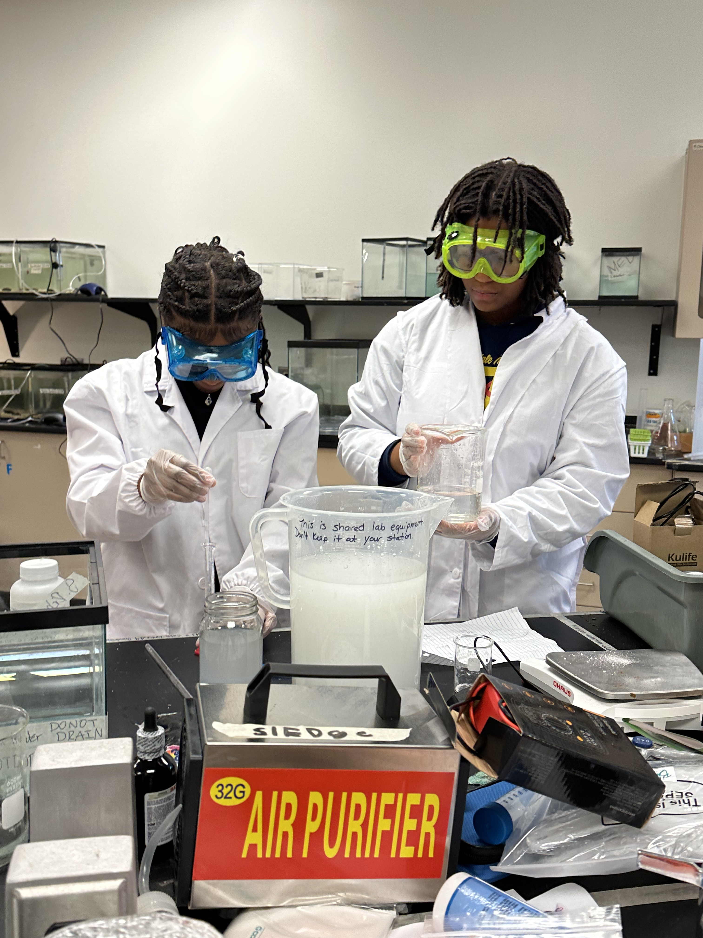
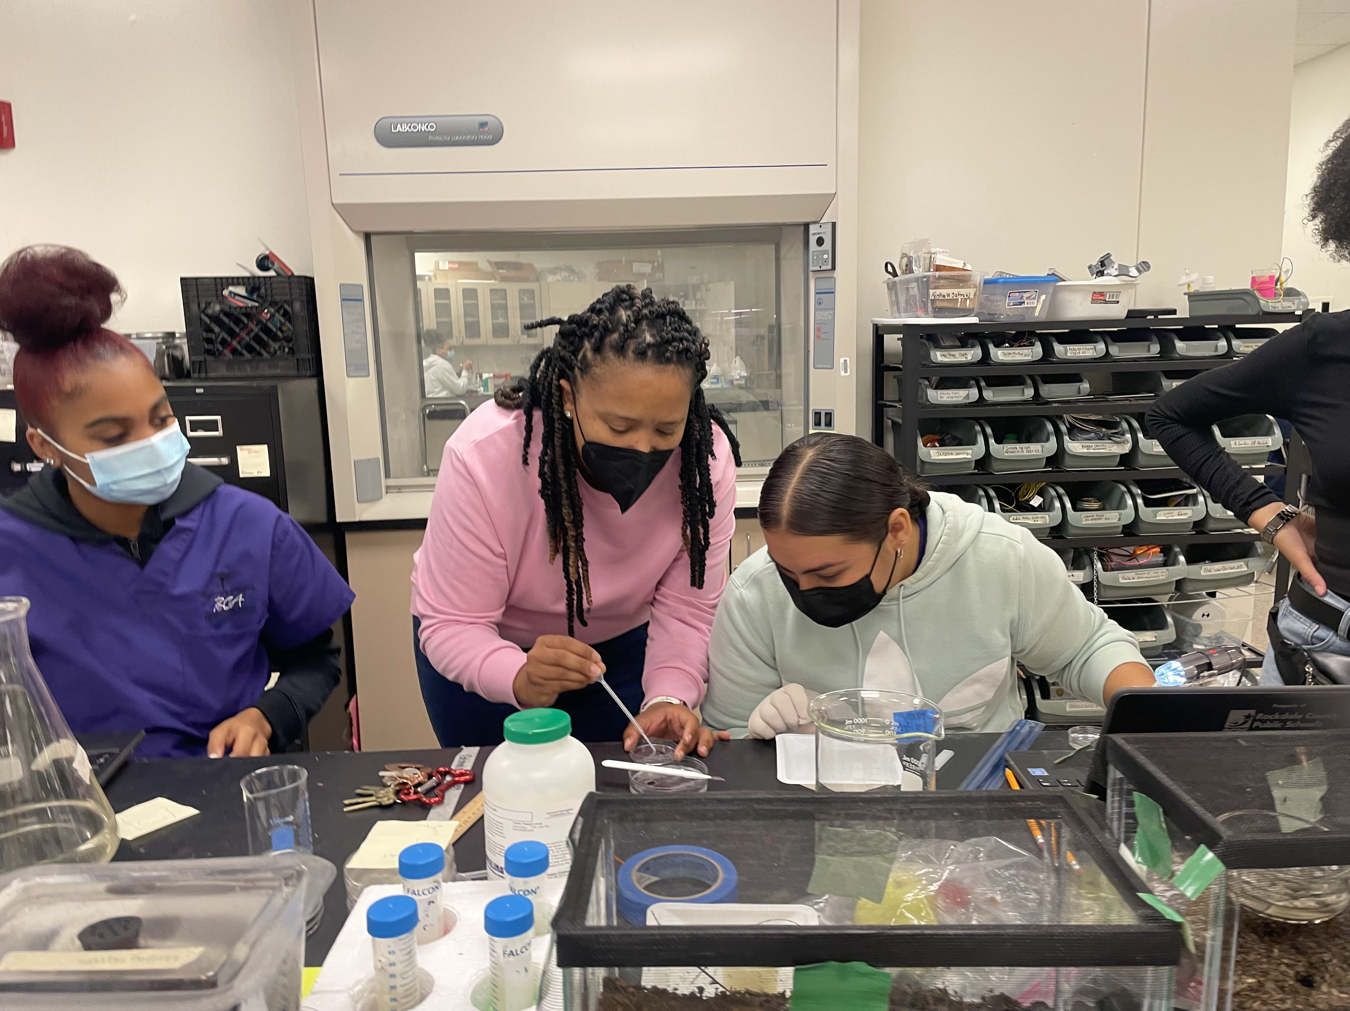
University Style Research Lab
& Makerspace

Slide 16
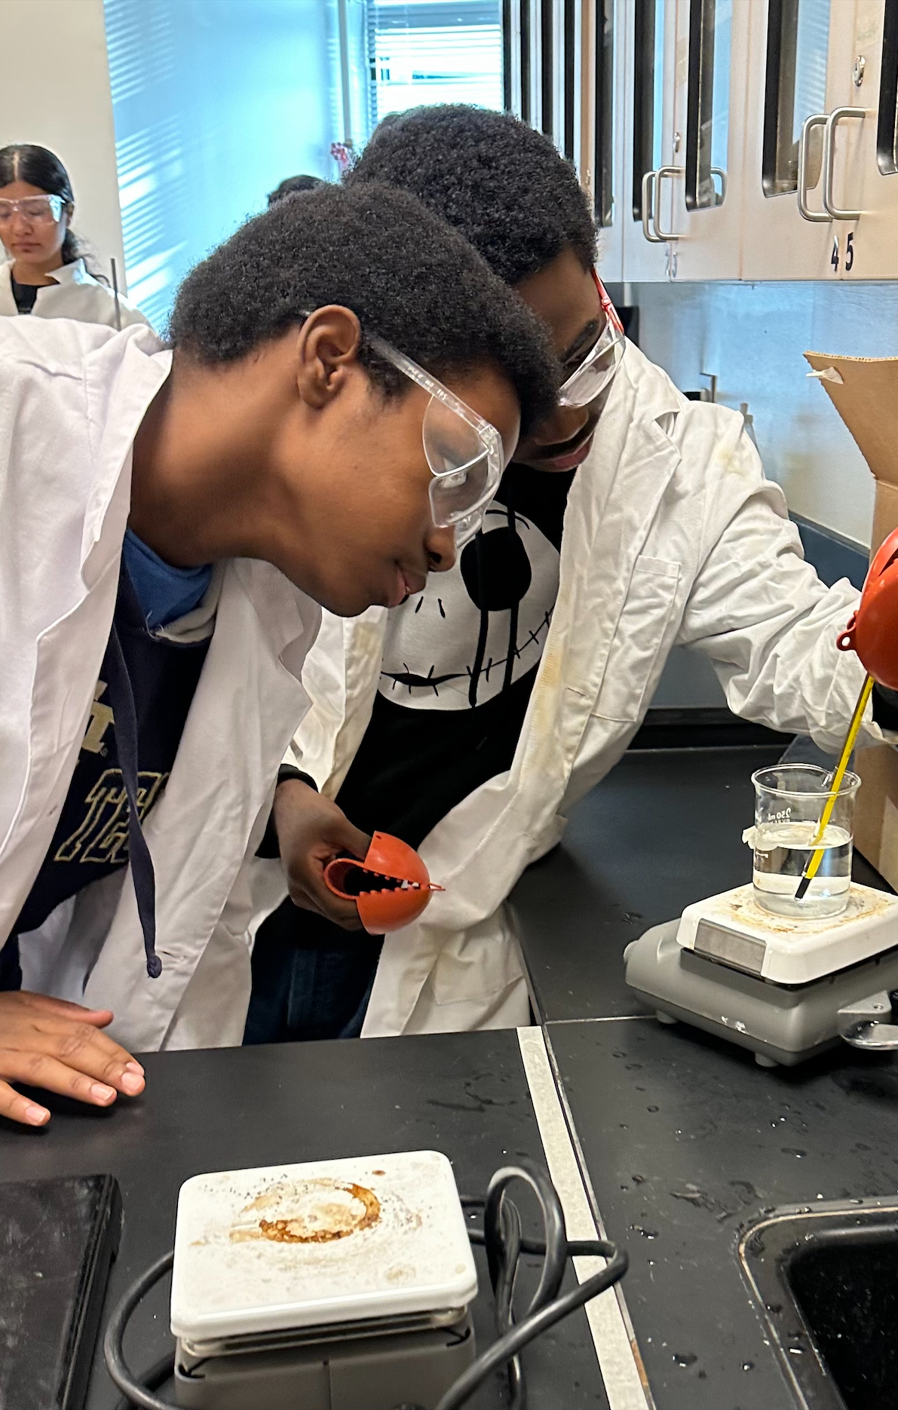
Electives Provide Opportunity to Explore Student Interests
Planned elective options include:
  STEM Exploratory 4-5
  STEM Rotation 6-8
    Exploring Engineering & Technology
    Foundations of Computer Programming
    Foundations of Business Management
    Broadcast and Graphic Communications
  Scientific Research 6-8
  Media Arts 4-8
  Spanish
  Band/Music
  Physical Education
  Elective options may change based on student interest, enrollment, and staffing.
Notes:
Juan- share about RCA in 9th grade

Slide 17
High School Credit in Middle School
Planned Carnegie Credit Courses include:
  Enhanced Algebra Concepts & Connections
  Physical Science
  Enhanced Literature & Composition 1
  Foundations of Engineering & Technology
  Introduction to Software Technology
  Scientific Research
  Media Arts
  Spanish
Notes:
Juan- share about RCA in 9th grade

Slide 18
School Experience & Culture
Daily schedule: Core academics, STEM electives, Gifted services
Focus on whole-child development: leadership, resilience, joy in learning
Emphasis on affirmation, exploration, and innovation
Mentorship from STEM professionals and high school magnet students

Slide 19





Community Partnerships
Notes:
Georgia Bioscience, Chamber of Commerce

Slide 20
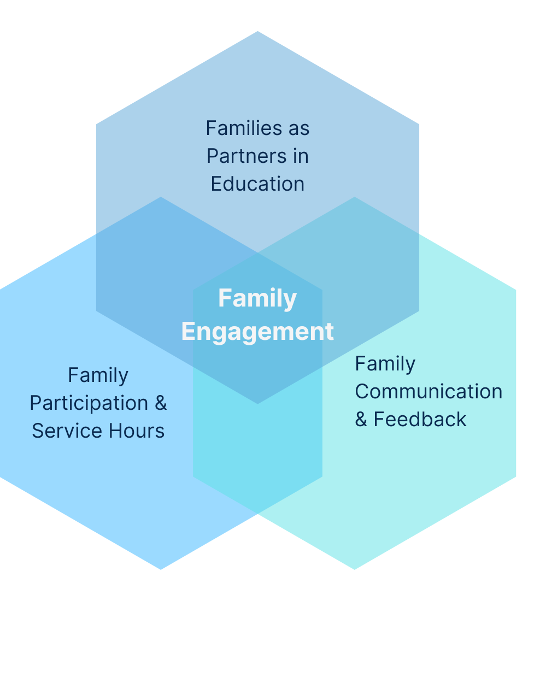
Families as Partners in Education
Family Engagement
  Expectation and Opportunity
Parents and Families will be invited to participate in:
Advisory Boards
  PTO/PTA or Academic Booster Club
  STEM showcase events
  Community partnerships and mentoring
  Extracurriculars

Slide 21
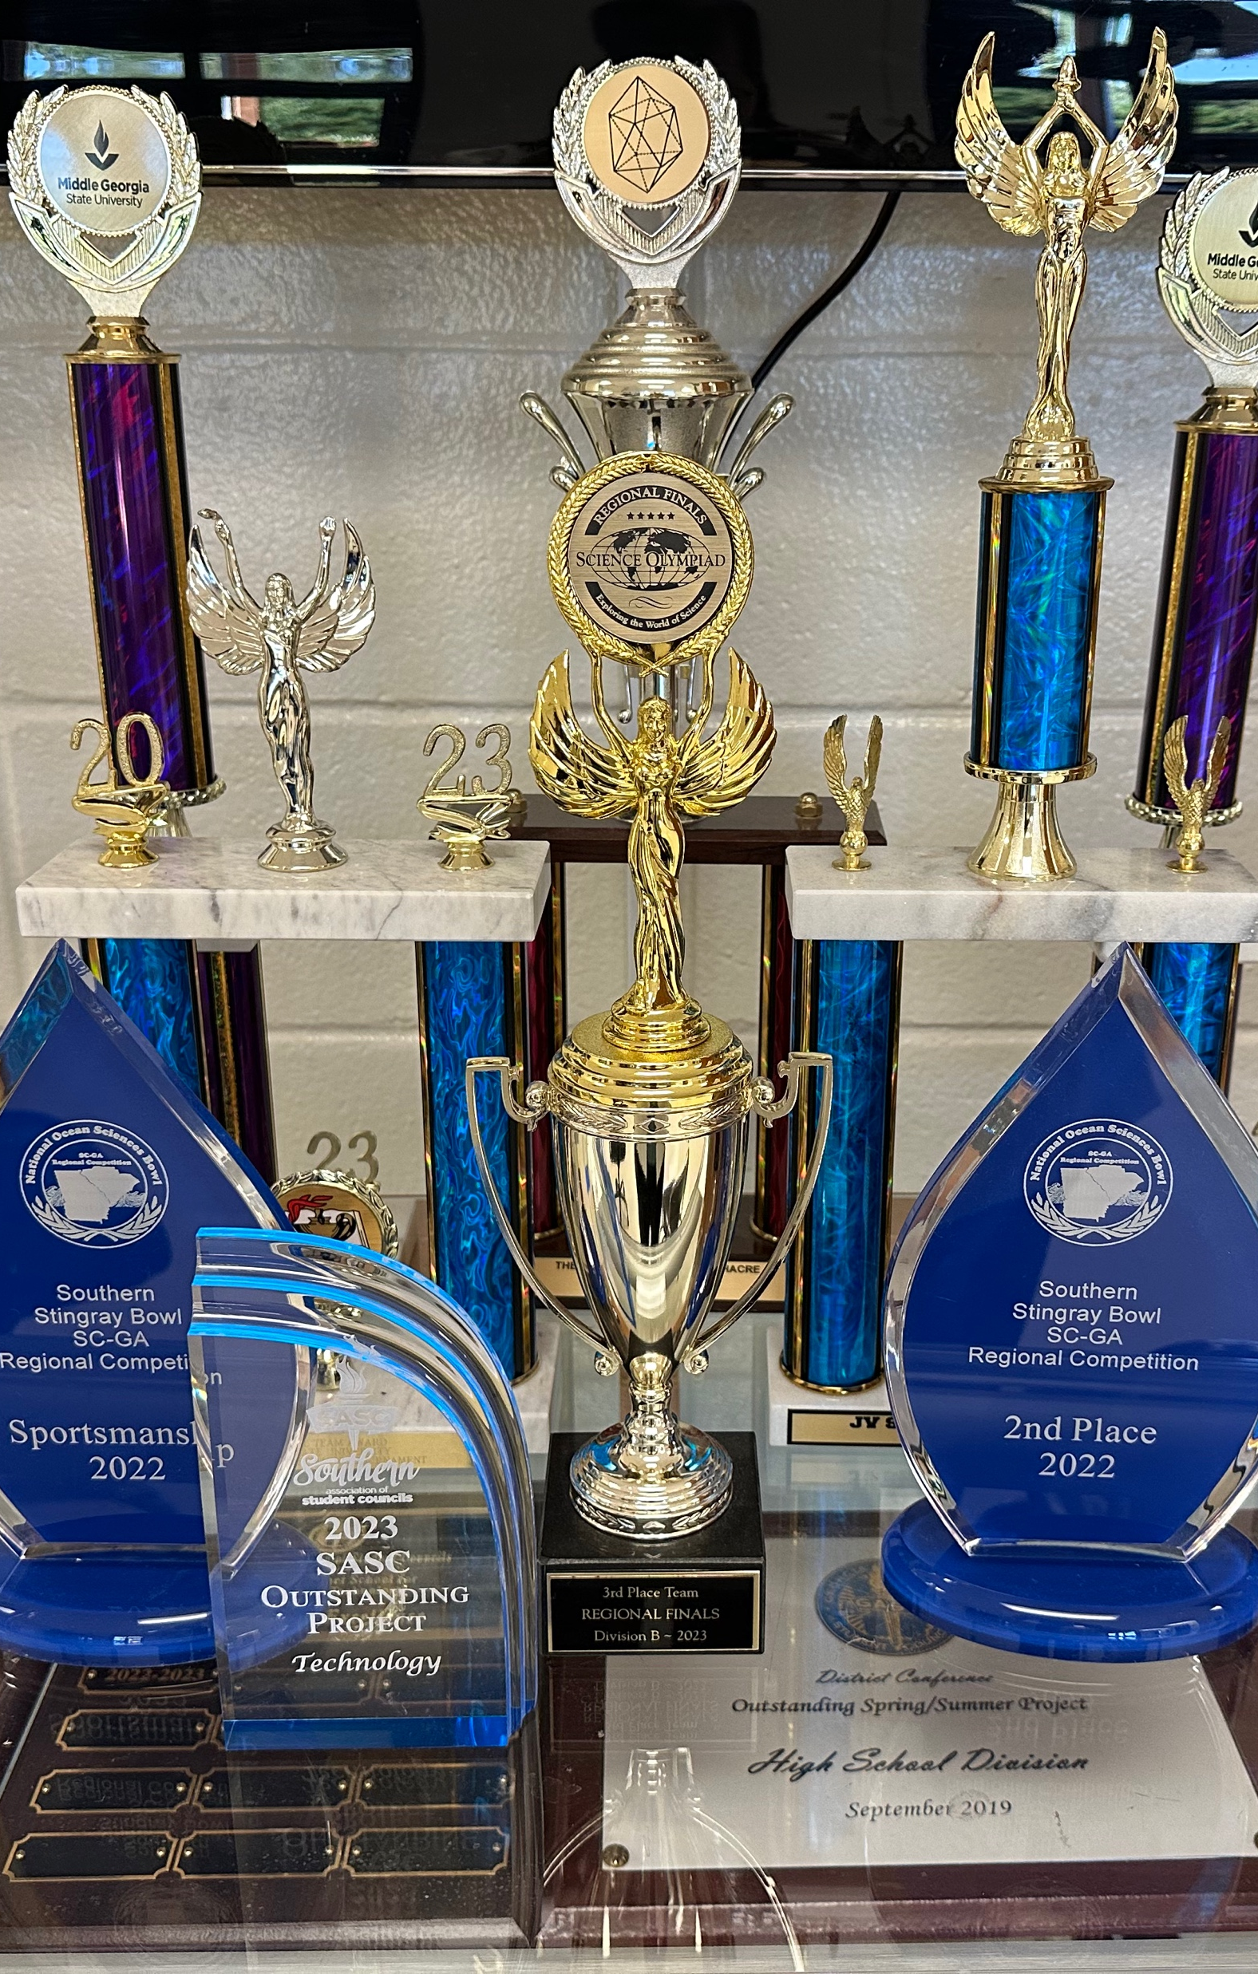
Extracurriculars
Year One Planned Extracurriculars in Three Areas
  Academic Teams
    Science & Engineering Team
    Reading Bowl Team
    Math Team
    Speech & Debate Team
  Leadership & Service
    Junior Beta Club (4-5)
    National Junior Honor Society (6-8)
    Student Council
  Enrichment
    Yearbook
    Association of Artists
    4-H
Access to Athletics and Extracurriculars not offered at the Magnet 4-8 Program
  Including transportation to zoned middle school after school

Slide 22
Logistics & Staff
Location:
  Separate facility from 9-12 Magnet
  District is exploring facility options with more information available soon
  Transportation provided from home bus stop to program site
Schedule: 7:35am-2:35pm
Staffing: Hiring in January
  Team Magnet Staff Look Fors
  Passionate about STEM
  Creative and Innovative
  Caring and Student-Focused
  Collaborative and Connected
  Committed to Excellence

Slide 23
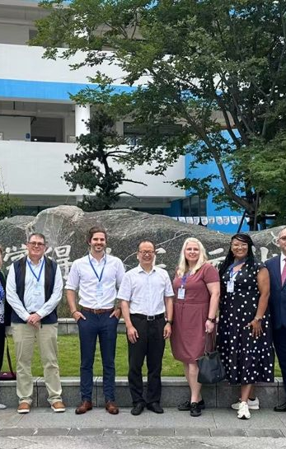





Staff Focused on
Continuous Learning
& Leadership
  Including Collaboration with Top Universities such as these 2025 High School Magnet staff experiences
  Gulf Coast Repository (GCR) at Texas A&M University
  Savannah College of Art and Design Educator Forum
  National Consortium of STEM Schools Delegation to AI Summit in Shanghai, China
  Georgia Tech's Inventure Challenge
  STEM Leadership Summit at Columbia University
Notes:
Add middle georgia

Slide 24
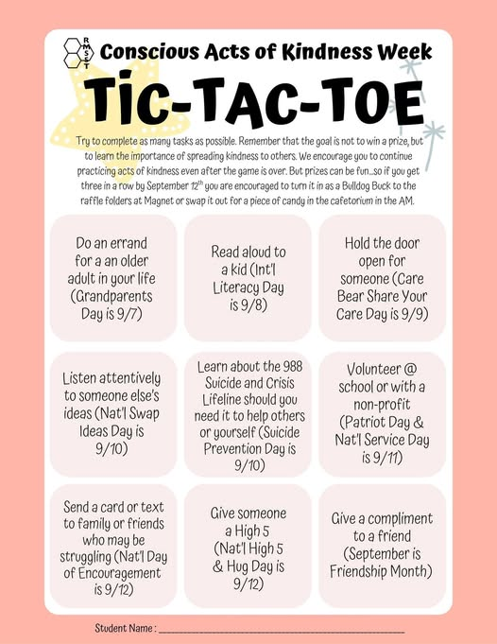
Help will be available– and encouraged!
Counseling Staff
Tutorials
Award-winning Student
Programs extended to 4-8:
  Wellness Summit
  Kindness Week & more!
​
​
​
Notes:
College and career access too...

Slide 25

Building a Community
Student voice on new program identity
  4-8 mascot, cheer, murals & more!
Summer Jump Start
FLEX assemblies during the school day including student-led components
  Future Leaders, Explorers, and eXperimenters
Student & Family Socials:
  Movie night
  Game night
  Skate Night
  Dances
  Talent Show
  Family Picnic

Slide 26
Why choose THE challenge of RMSST 4-8?

Slide 27
STEM Research
& Real-world
Problem Solving
Advanced
Academics
Leadership &
Community Service
Notes:
UPDATE or delete the subtext

Slide 28
Is Magnet the Right Choice for You?
Qualities of Successful Magnet Students
Interest in Science, Technology, Engineering, or Math
Curious
Desire to be challenged
Growth mindset

Slide 29
Eligibility Criteria
National or state referenced test scores at the 60th percentile or higher for math
National or state referenced test scores at the 60th percentile or higher for science
National or state referenced test scores at the 60th percentile or higher for reading
Georgia Milestone EOG Subject Score of 550 or higher in any subject
Examples of accepted national or state referenced tests include STAR, ITBS, and CogAT

Slide 30
How does this program connect to
the high school Magnet?
RMSST 4-8 does not guarantee admission to the high school program.
RMSST 4–8 prepares students for the advanced curriculum at RMSST.
  Students who are in good standing will not need to apply again across grades 4-8.
Students who complete RMSST 4-8 will be well-prepared to apply for and succeed in the high school program.

Slide 31
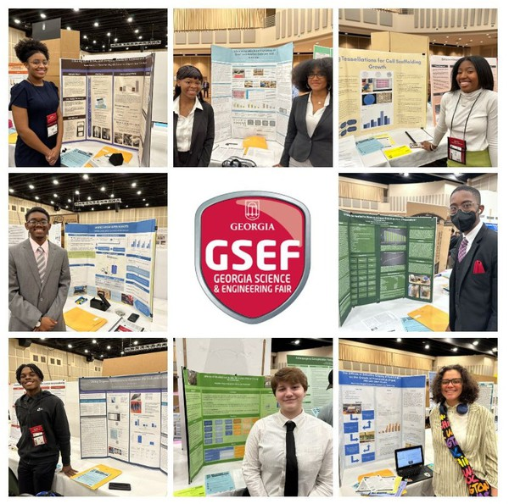
“I want in!”
Multi-criteria selection rubric
  Application Responses
  Grades
  Attendance & Discipline Records
  Standardized Test Scores
  Teacher Recommendations

Slide 32
Magnet and Choice Programs?
We advise you to complete an application to RMSST 4-8 and your top Specialty and Choice program
    Only up to 100 students will be selected per grade level.
    Don’t miss out on a Specialty and Choice School option should you not be accepted!
    Applying for a Specialty and Choice School also does not impact your chances of being selected for Magnet 4-8.
    You will ultimately have to choose only 1 to attend should you get accepted to both.

Slide 33
Admissions Process & Timeline
Application Available at www.rockdaleschools.org/rmsst4-8
  Opens Friday, November 7th
Application Deadline – December 12th
What’s Next:
Mid-February: Student applicants notified of status and accepted students return signed commitment
March: Parent-Student Meetings & Staff Introductions
March: Transition day for 5th graders during school
July 2026: Jump Start & Open House Events
August 2026: First day of classes for 4th-8th grade students

Slide 34

Tonight's Tour Experience
A snapshot of High School Magnet via
2 learning spaces
  Student Ambassadors as tour guides
  Faculty, Staff & Students excited to share more about their experiences
Tonight's tour is just a peak into the awesome things at 9-12 Magnet.
  Roof Replacement is still in progress, so please pardon our progress outside (and inside for a few areas!)

Slide 35
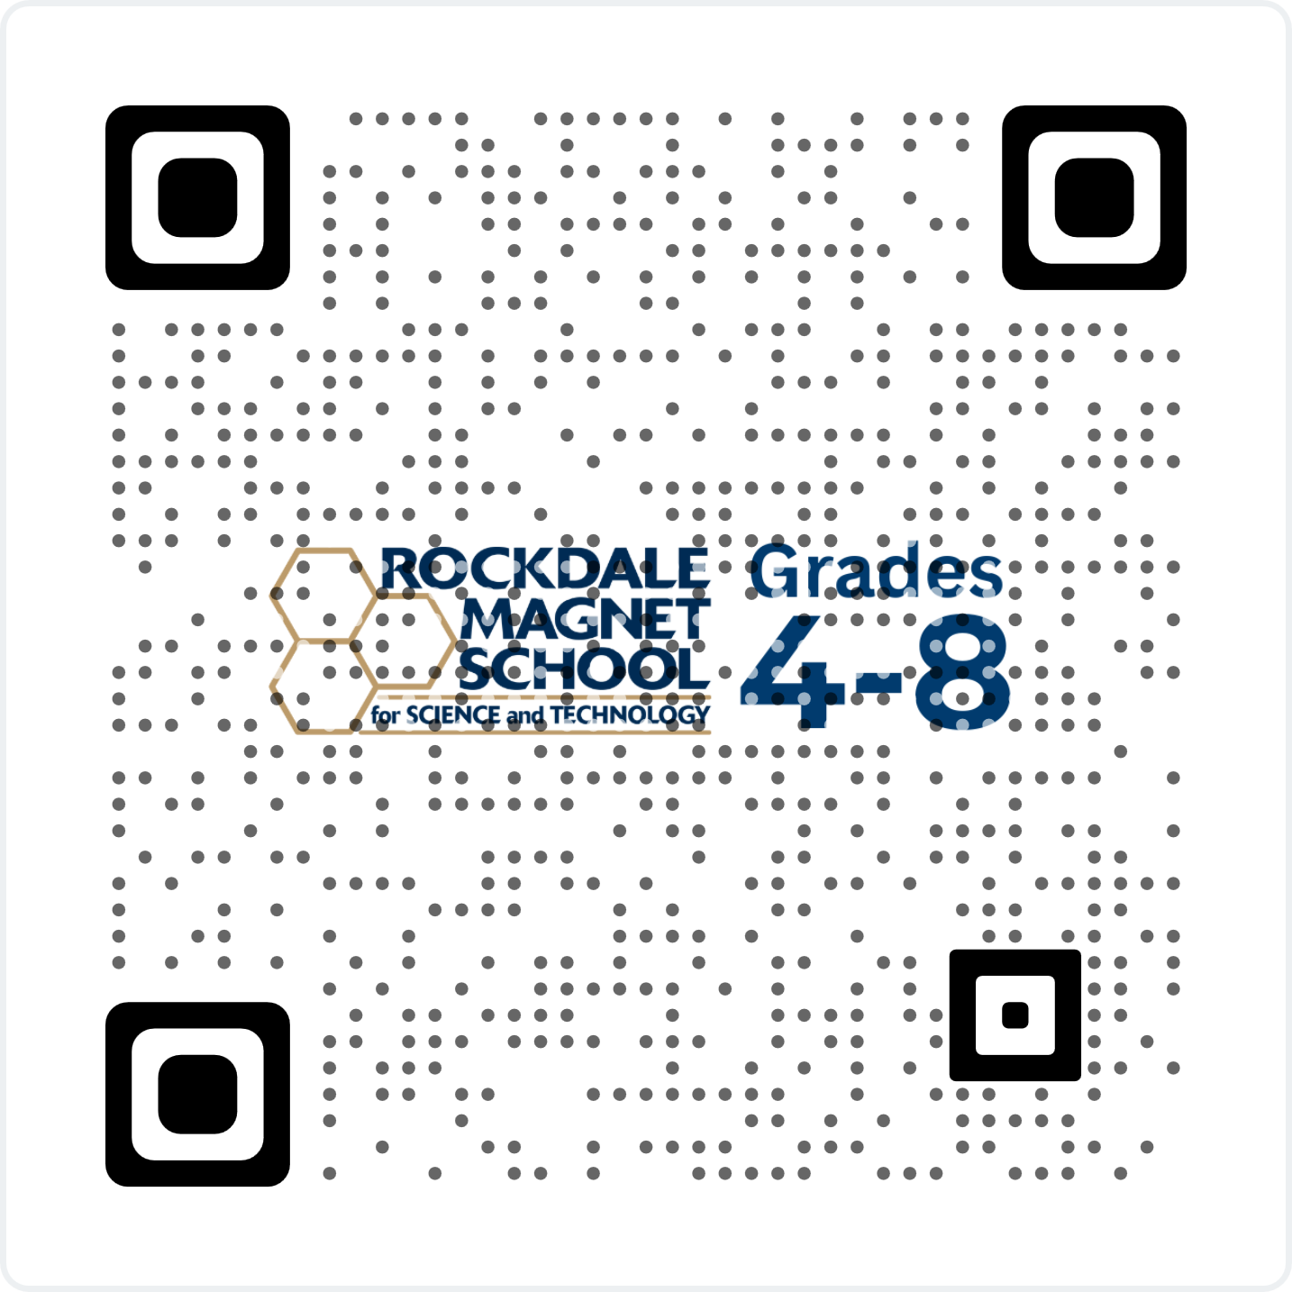
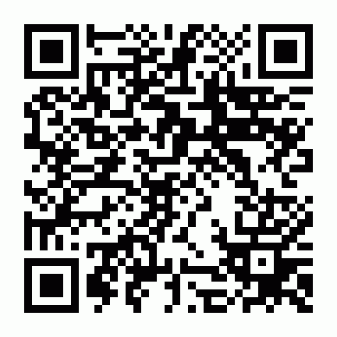
Thank you
Reminders:
Application Opens
– November 7, 2025
Application Deadline
– December 12, 2025
@ www.rockdaleschools.org/rmsst4-8
Questions?
Submit questions at https://form.jotform.com/253025268980057
or scan QR code to the right:

