Slide 1

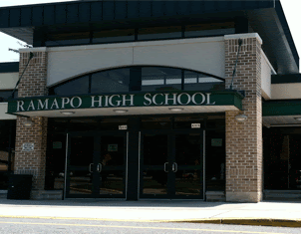
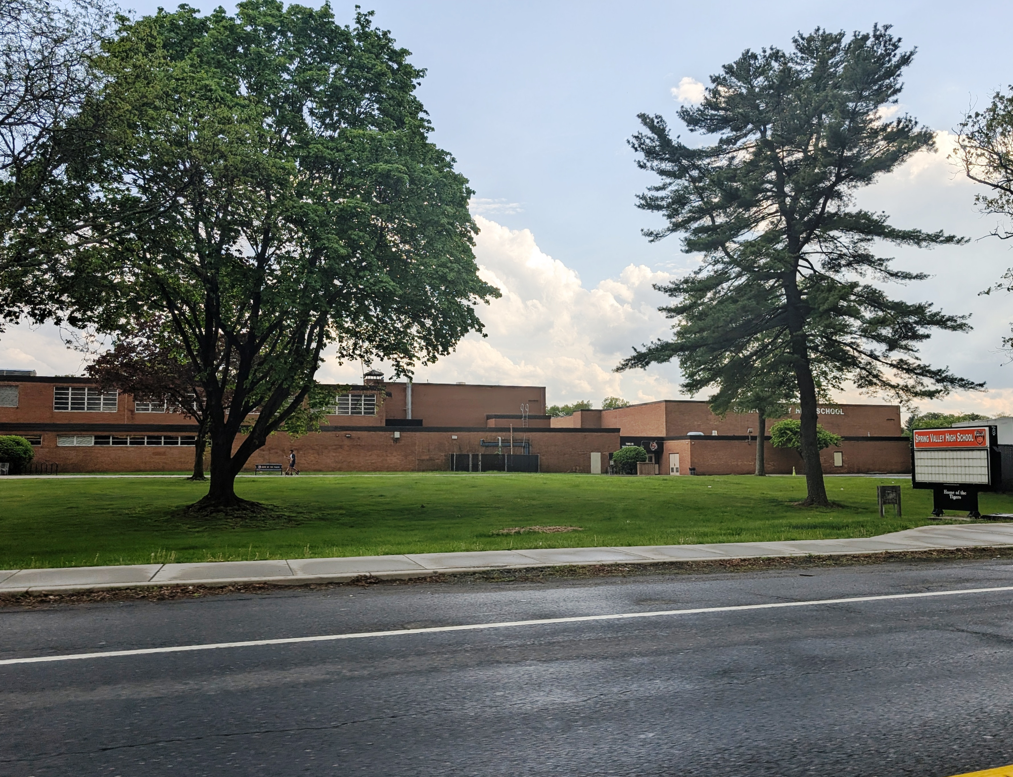
Southern Westchester BOCES Superintendent Search Process
Dr. Harold A. Coles, District Superintendent
Dr. Brendan Lyons, Deputy District Superintendent/Chief Operating Officer
James Gratto, Assistant Superintendent
Mary Kelley, District Clerk

Slide 2
Status update: As of November 3, 2025
Stakeholder Survey was open from October 22 – 31, 2025
In-Person Community Forums were held on October 28 and 29, 2025
School District Stakeholder meetings with students and union leadership members were held on October 29, 2025

Slide 3
Next Steps:
Job Posting will be finalized on November 3, 2025
The position will be posted from November 5, 2025 through December 29, 2025.
In early January, SWBOCES will conduct screening interviews with qualified applicants and will recommend 6 – 10 candidates for the BOE to consider interviewing

Slide 4

Key Highlights – Students
District Strengths | District Challenges | Top Qualities of New Superintendent
Community Engagement | Limited AP courses and Internships | Greater engagement with Students
Racial Equality | Old Buses | Drive to implement serious change
Recent Facility Upgrades | Limited Coaching Staff/Shared Coaches | Empathy for diverse community both in and out of school setting
Supportive Teachers | Low Graduation Rates | Bi-Lingual
Additional Guidance Counselors | Attracting/Retaining Qualified teachers | Openness to connect with parents and students
Superintendents Circle Program | Poor Quality of Food program
 | Inadequate Technology

Slide 5
Key Highlights Community Stakeholders
District Strengths | District Challenges | Top Qualities of New Superintendent
Community Bonds | Budget, especially Transportation | Bi-Lingual / Multi-Lingual
Positive School Initiatives implemented this year | Insufficient diversity representation of the Board | Results oriented
Teachers and Students are great | Board does not adequately address Community at Board Meetings | Trustworthy and confident.
 | Teacher Retention /Hiring | Strong student and community engagement
 | Poor Technology in schools for students i.e., Internet Access and Tablets | Attend School and community sponsored events
 | Lack of AP and higher-level classes for students | Respect All Staff and improve Professional Development.
 | Immigrant student attendance in too low | Improve Graduation Rates

Slide 6
Key Highlights
Union Representation
District Strengths | District Challenges | Top Qualities of New Superintendent
Dedicated, experienced staff | Poor Professional Development for teachers. Disorganized and inadequate. Communication is poor with teachers | Keen understanding of the district demographics
Families care about the teachers | Frequent curriculum changes; Teachers are not part of the process making it hard to implement | Bi- Lingual
Community truly supports our students | Immigration concerns must be addressed and include staff, administration and students. Immigration issues hinder attendance and teaching efforts | Long Term commitment to the district and lead by example
 | The Board does not look like us. Representation should look like to community they represent | Support the teachers and the administrators when working with the Board
 | Poor Graduation Rates and test scores. Busing is an on-going issue | Expertise with Budgets
 | Teachers teaching outside of their certifications | Experience with Special Ed
 | Enhance the Special Education program and hire qualified staff | Ability to provide structure and protocols; great communicator

