Slide 1

Putnam is Open for Business!
Some Available Commercial Properties
NOV 2025 – Jan 2026
Town of Putnam
Economic & Community Development Department
Mary Ann Chinatti, Director 860-963-6800 x200
Maryann.chinatti@putnamct.us

Slide 2
Featuring:
#1 –58 Pomfret St., Unit 3103
#2 – 214 Park Rd.
#3 – 70 May St.

Slide 3
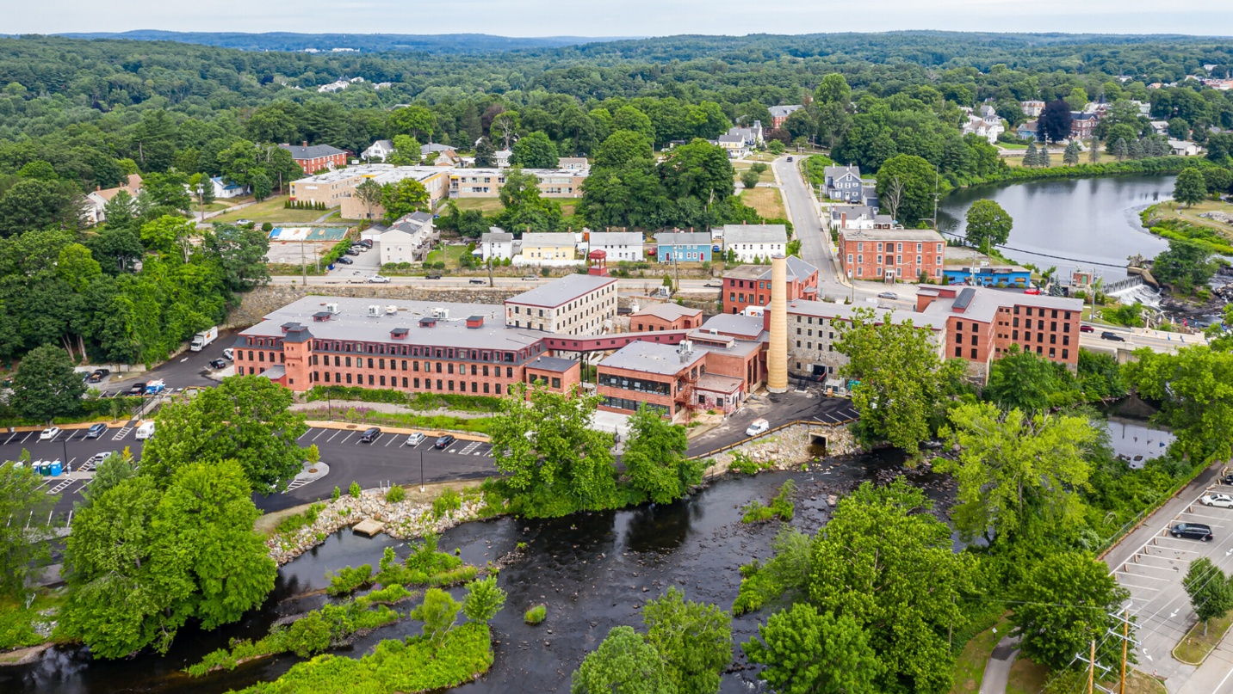
58 Pomfret St., The Lofts at Cargill Falls
Zone: I/IHOD
Listed by: CT Housing Partners
Contact: Renee Dobos, 203-359-3940 x1740
FOR LEASE - CALL FOR RATES
MIXED-USE BUILDING
3 COMMERCIAL UNITS
#1 - UNIT 3103 – 2,550SF 50’ X 51’ SPACE
# 2 - UNIT 3203 – 2,550SF 50’ X 51’ SPACE
# 3 - UNIT 4102 – 4,260SF 142’ X 30’ SPACE
ALL UNITS UNFINISHED/COST TO FINISH @ LEASEHOLDER’S EXP., AVAILABLE PLUMBING, ALL UTIL. PD. BY LANDLORD
ANNUAL LEASE REQ’D
EASY ACCESS TO MAJOR ROUTES
AMPLE OFF-STREET PARKING

Slide 4
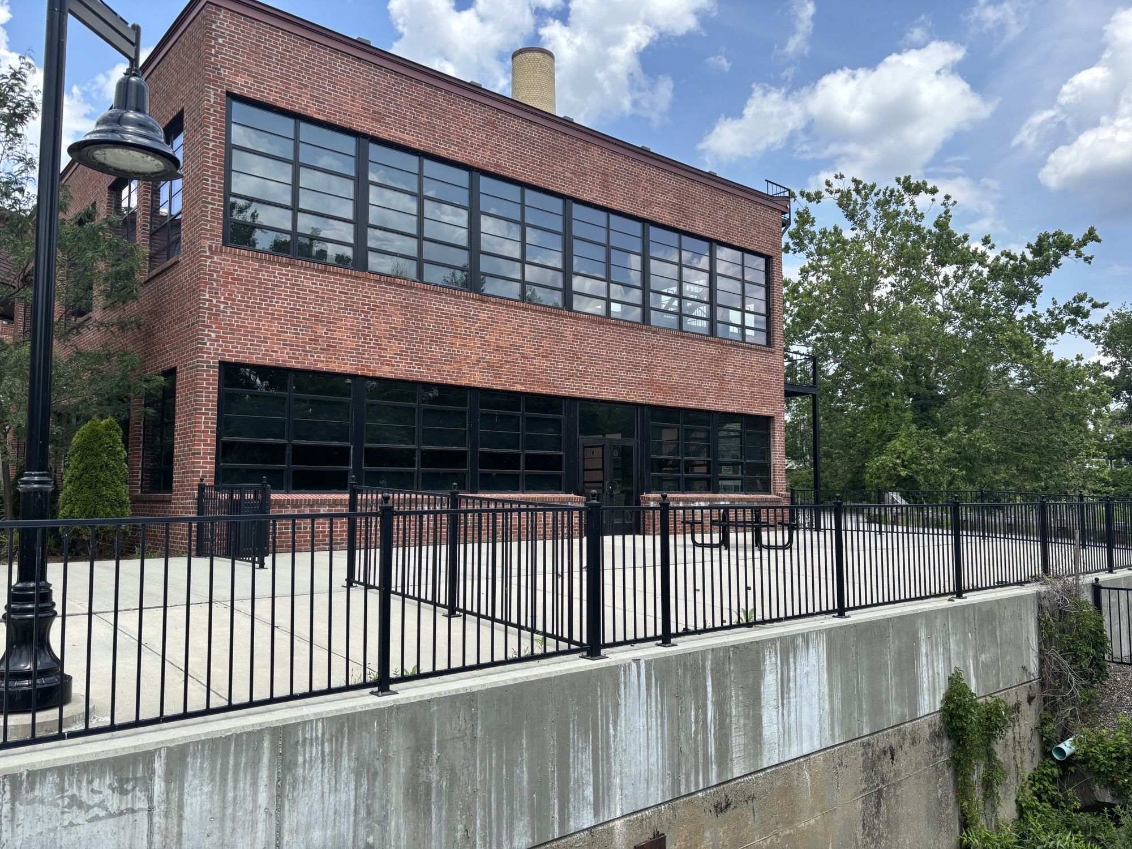
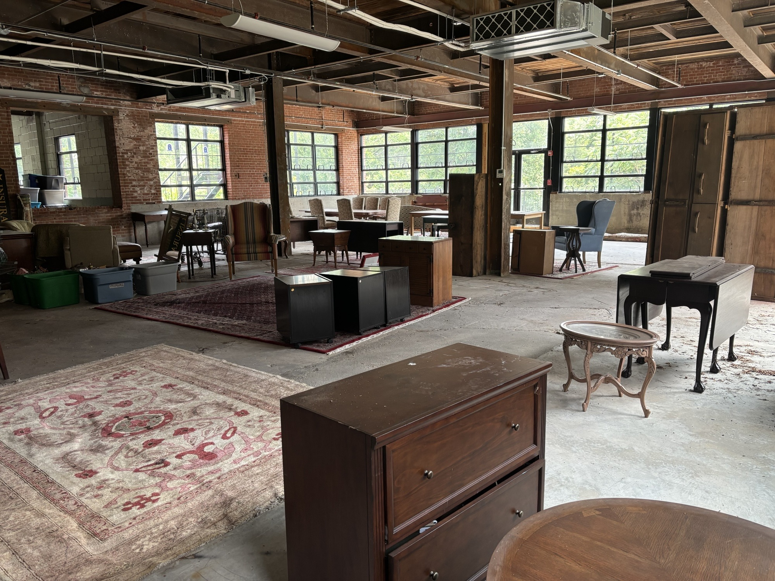
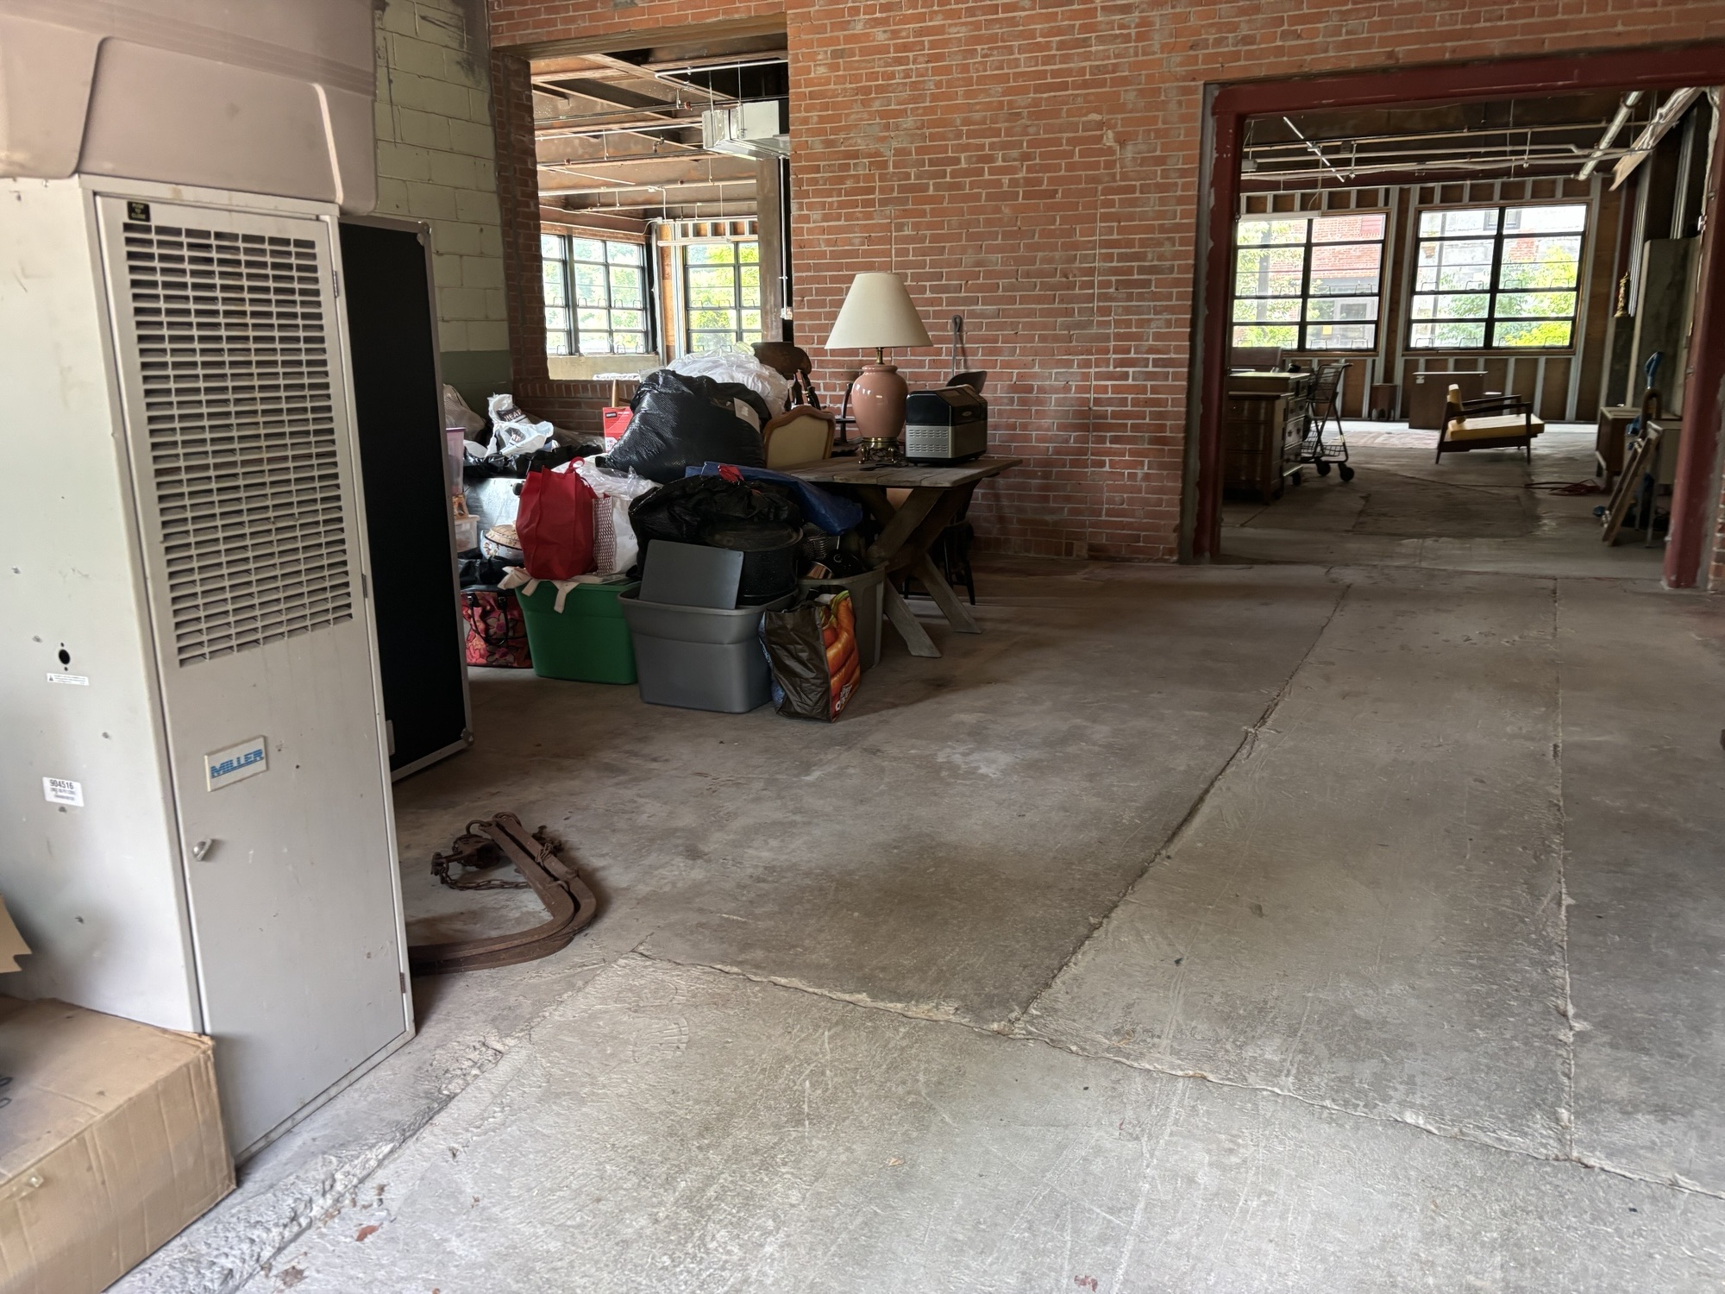
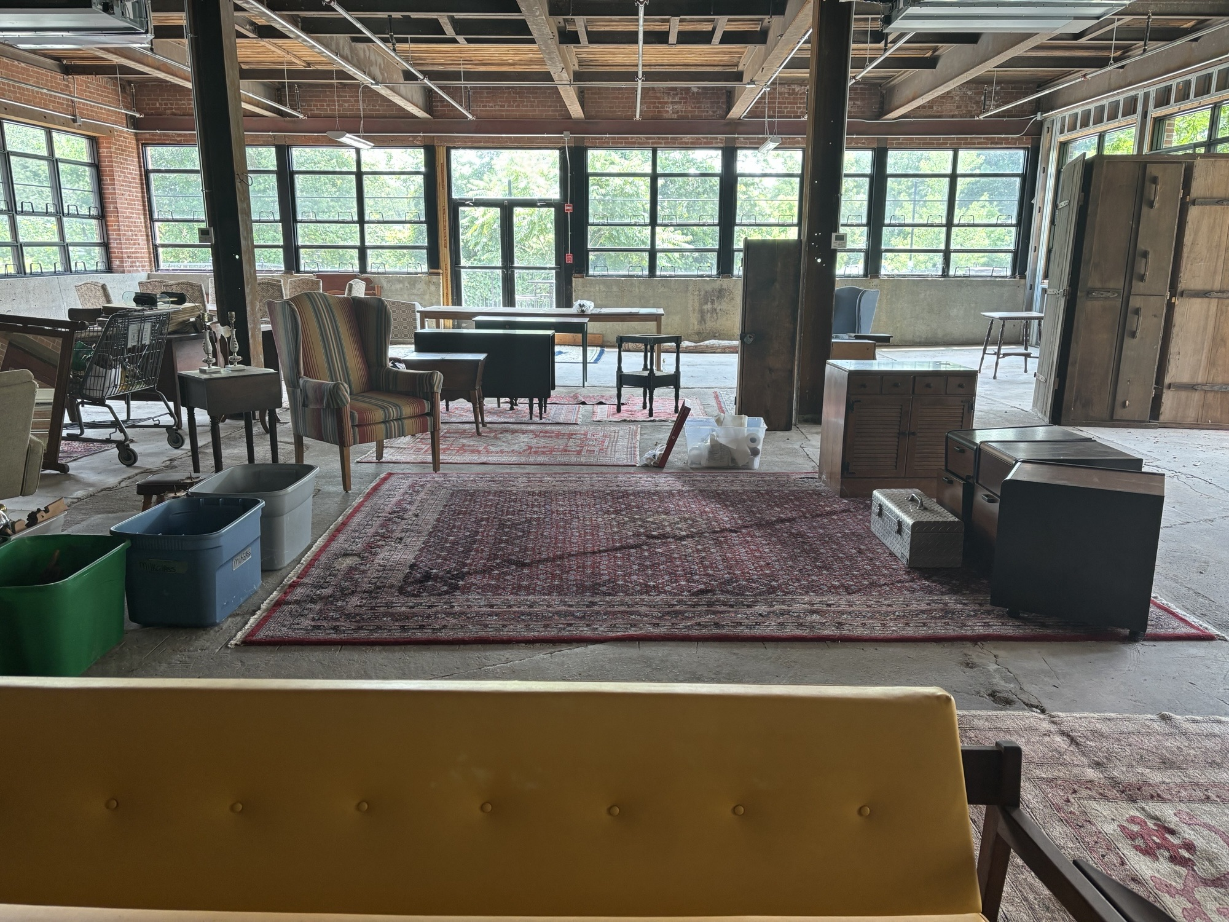
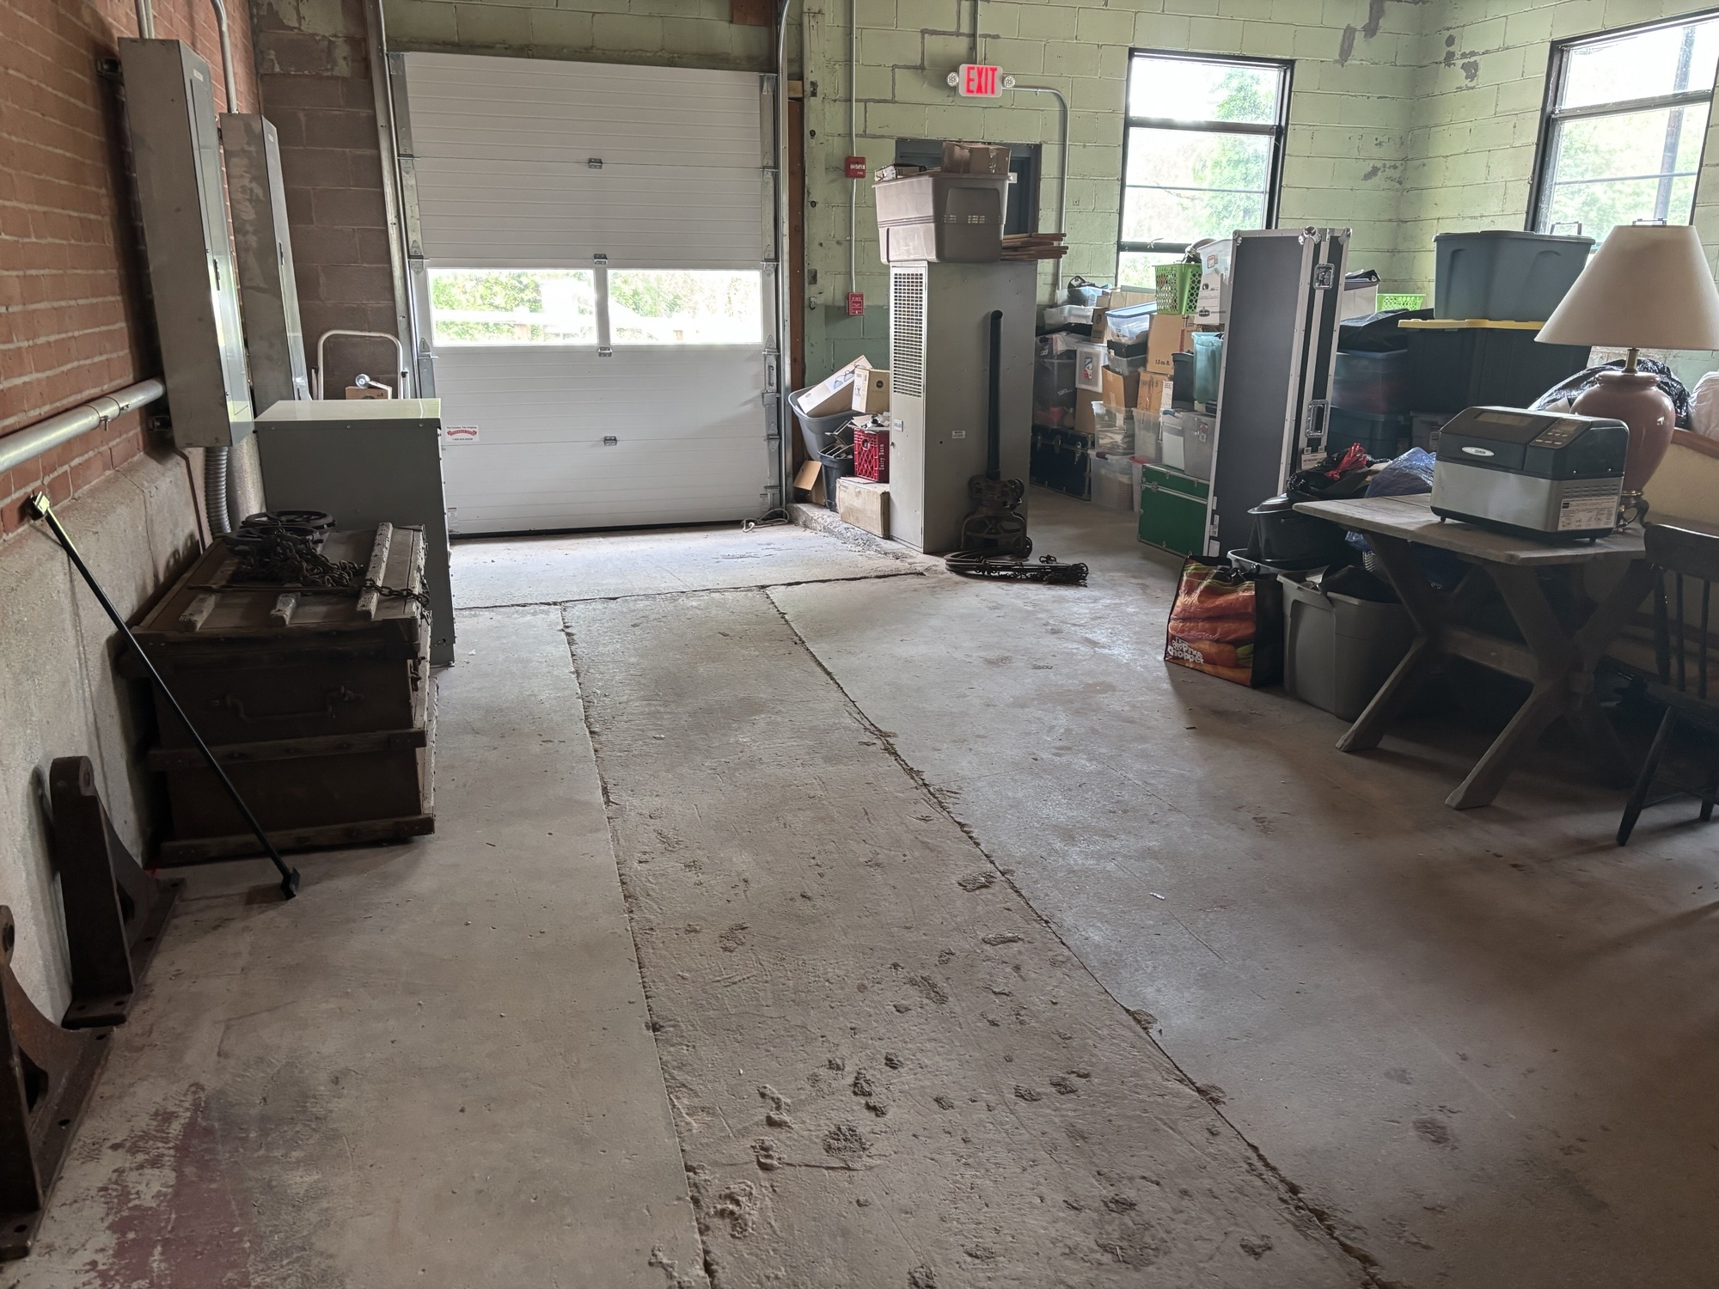
UNIT 3103
#1

Slide 5
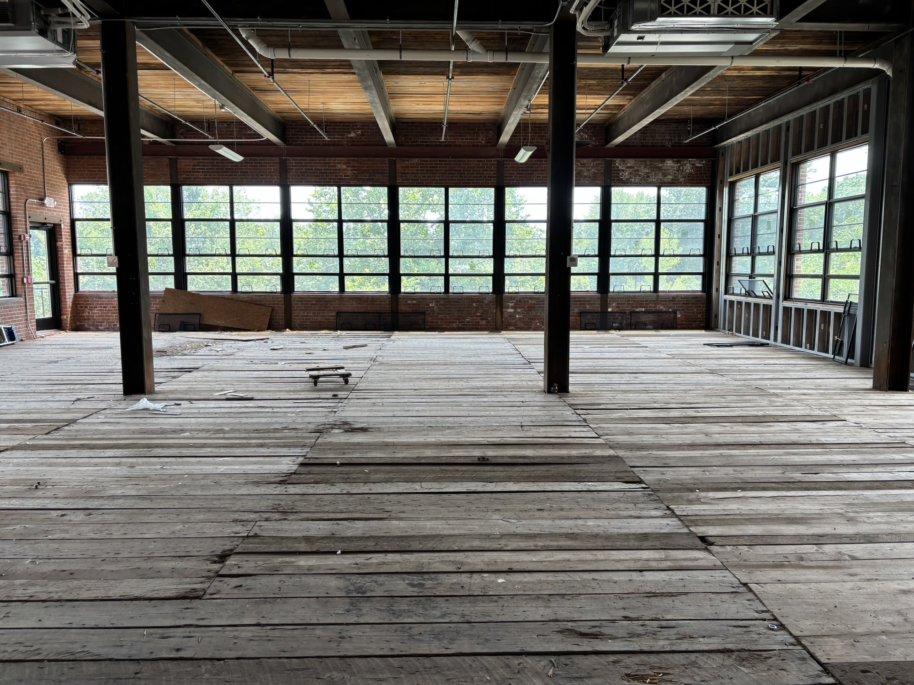
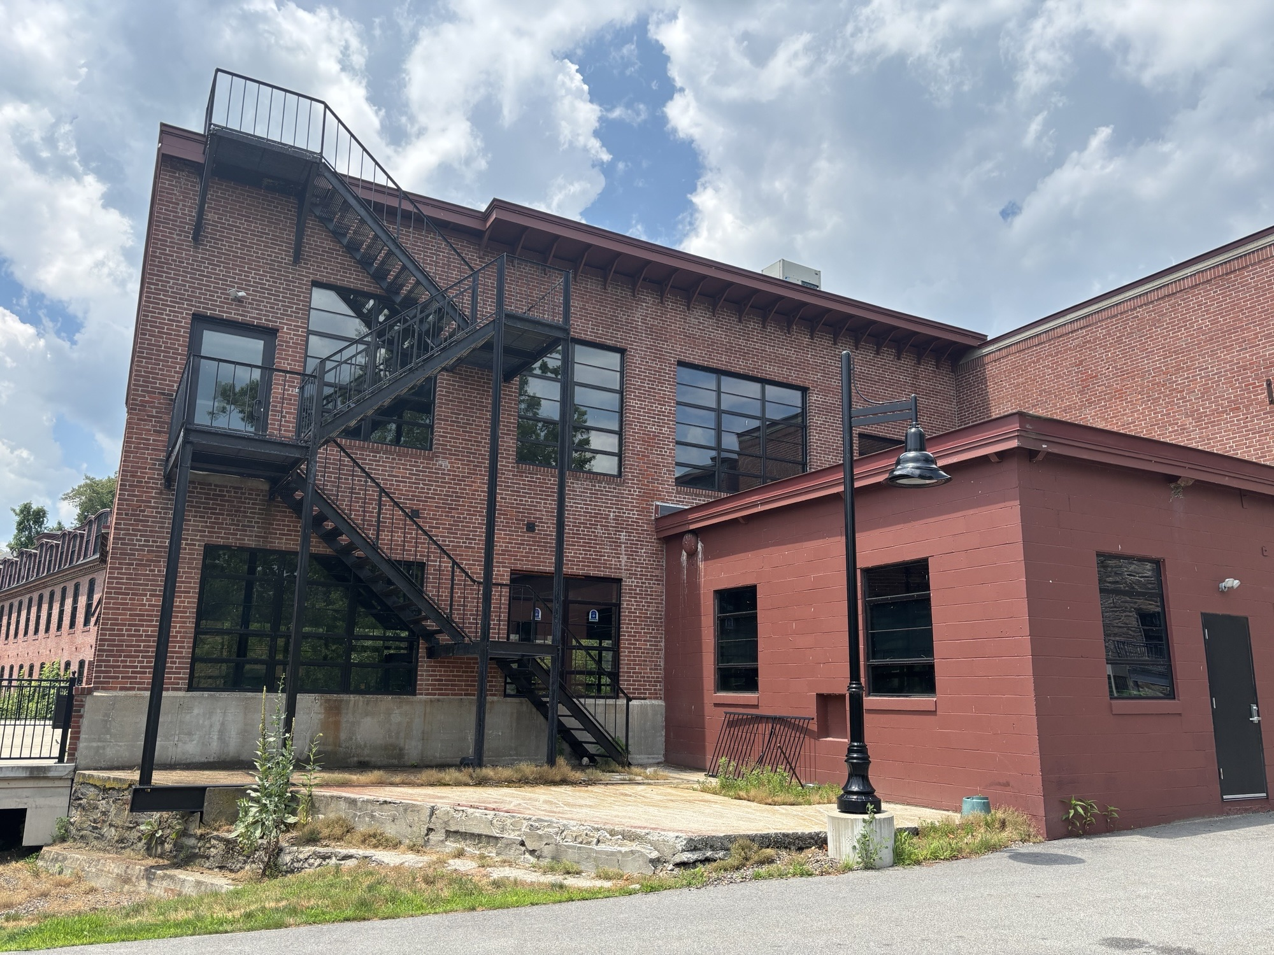
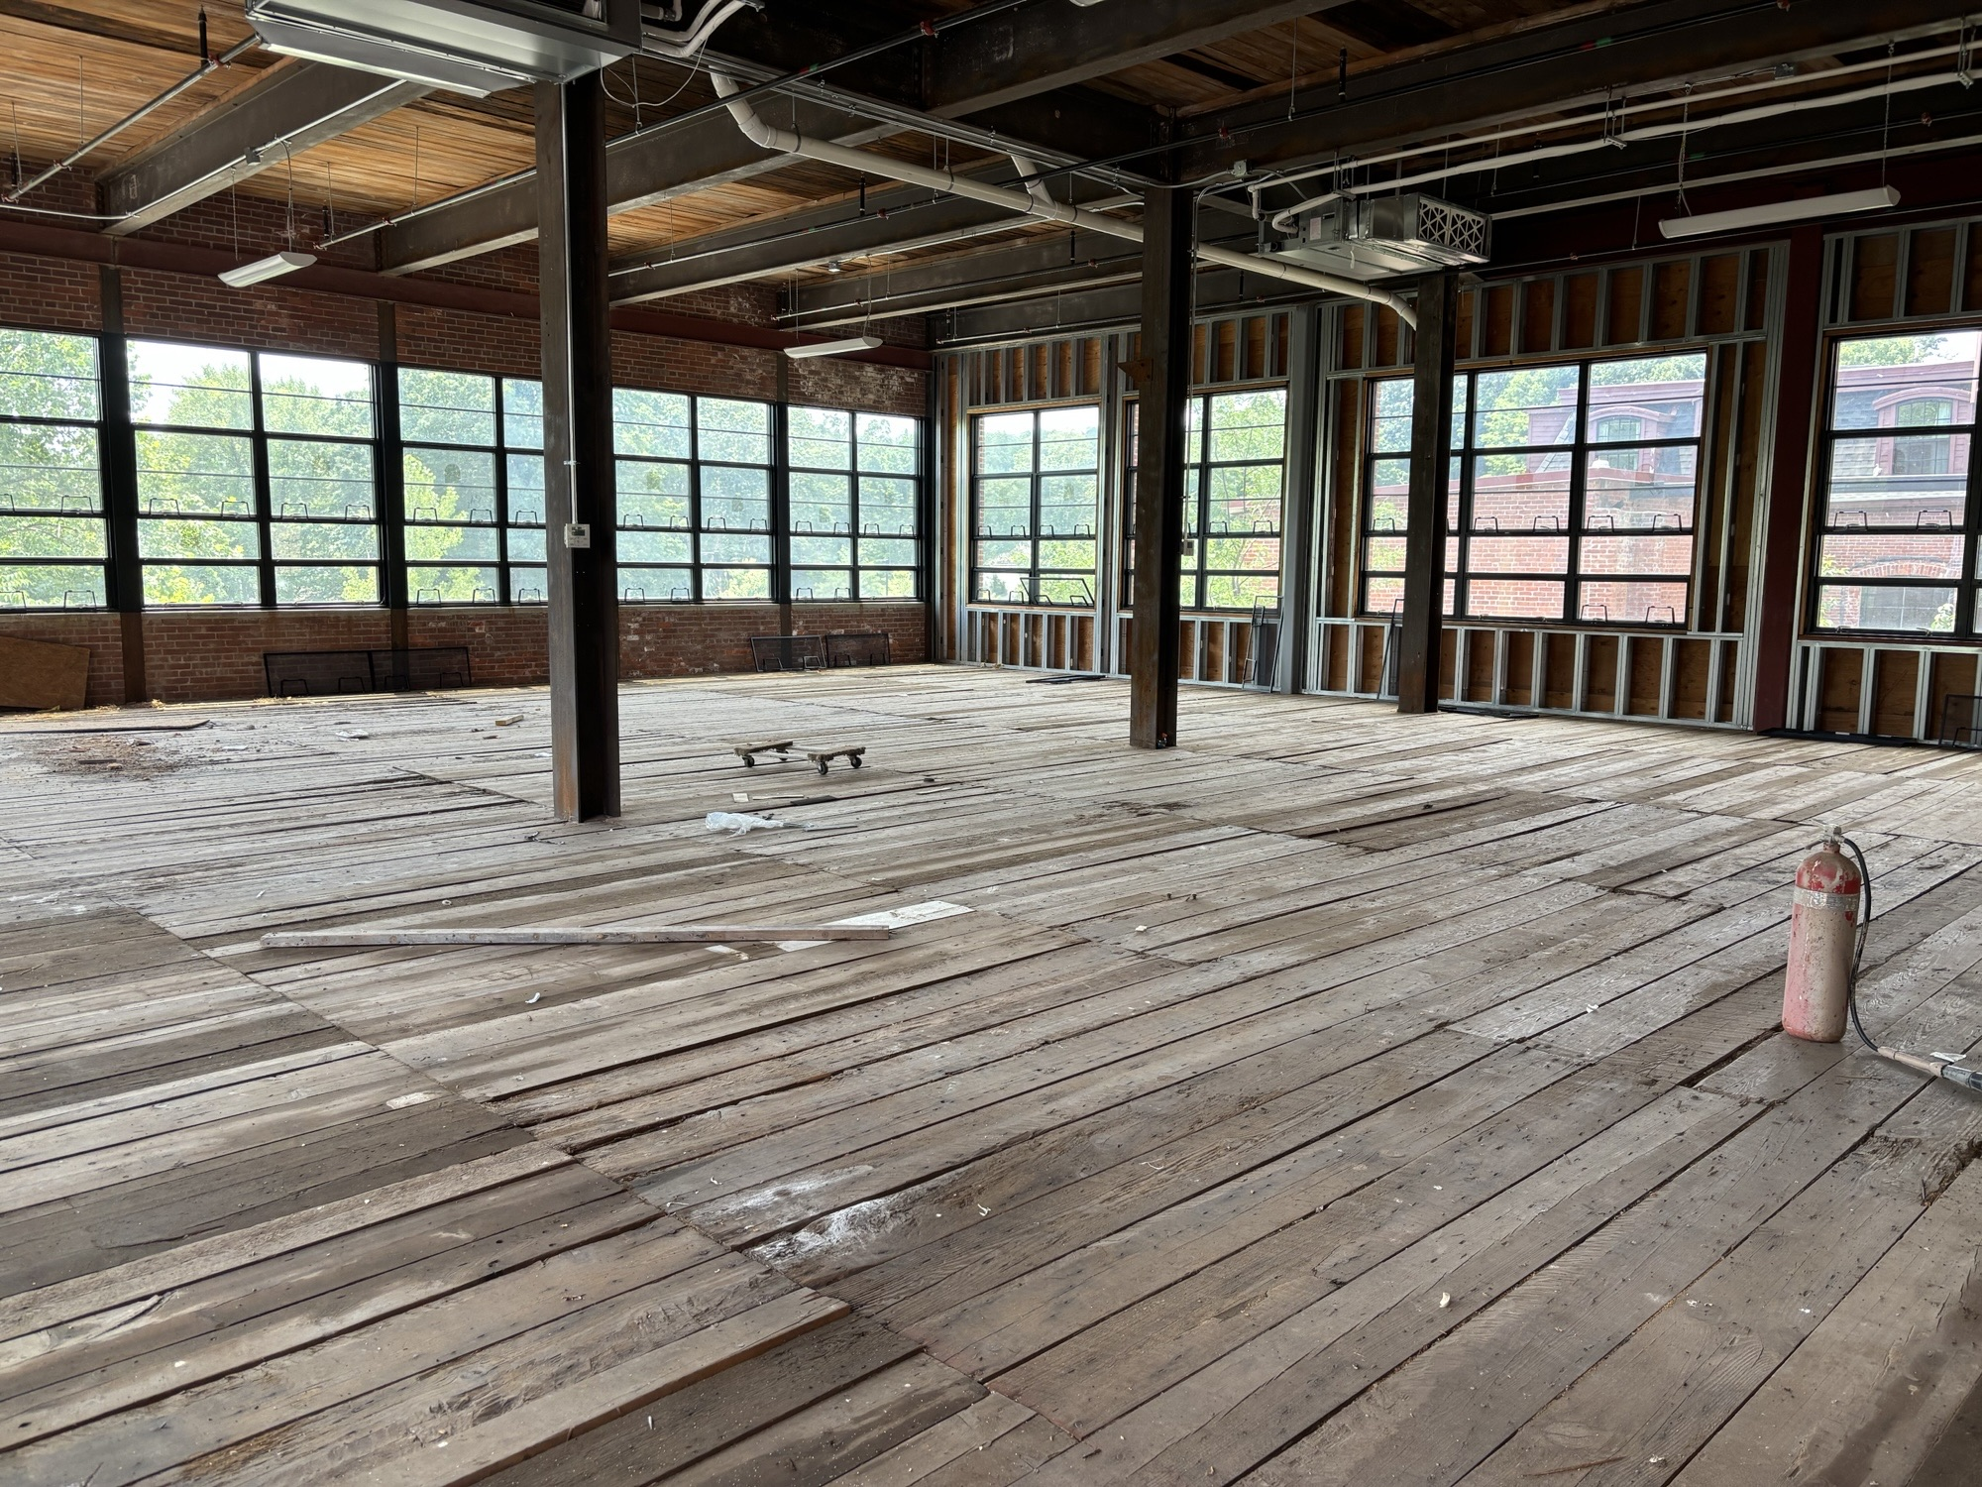
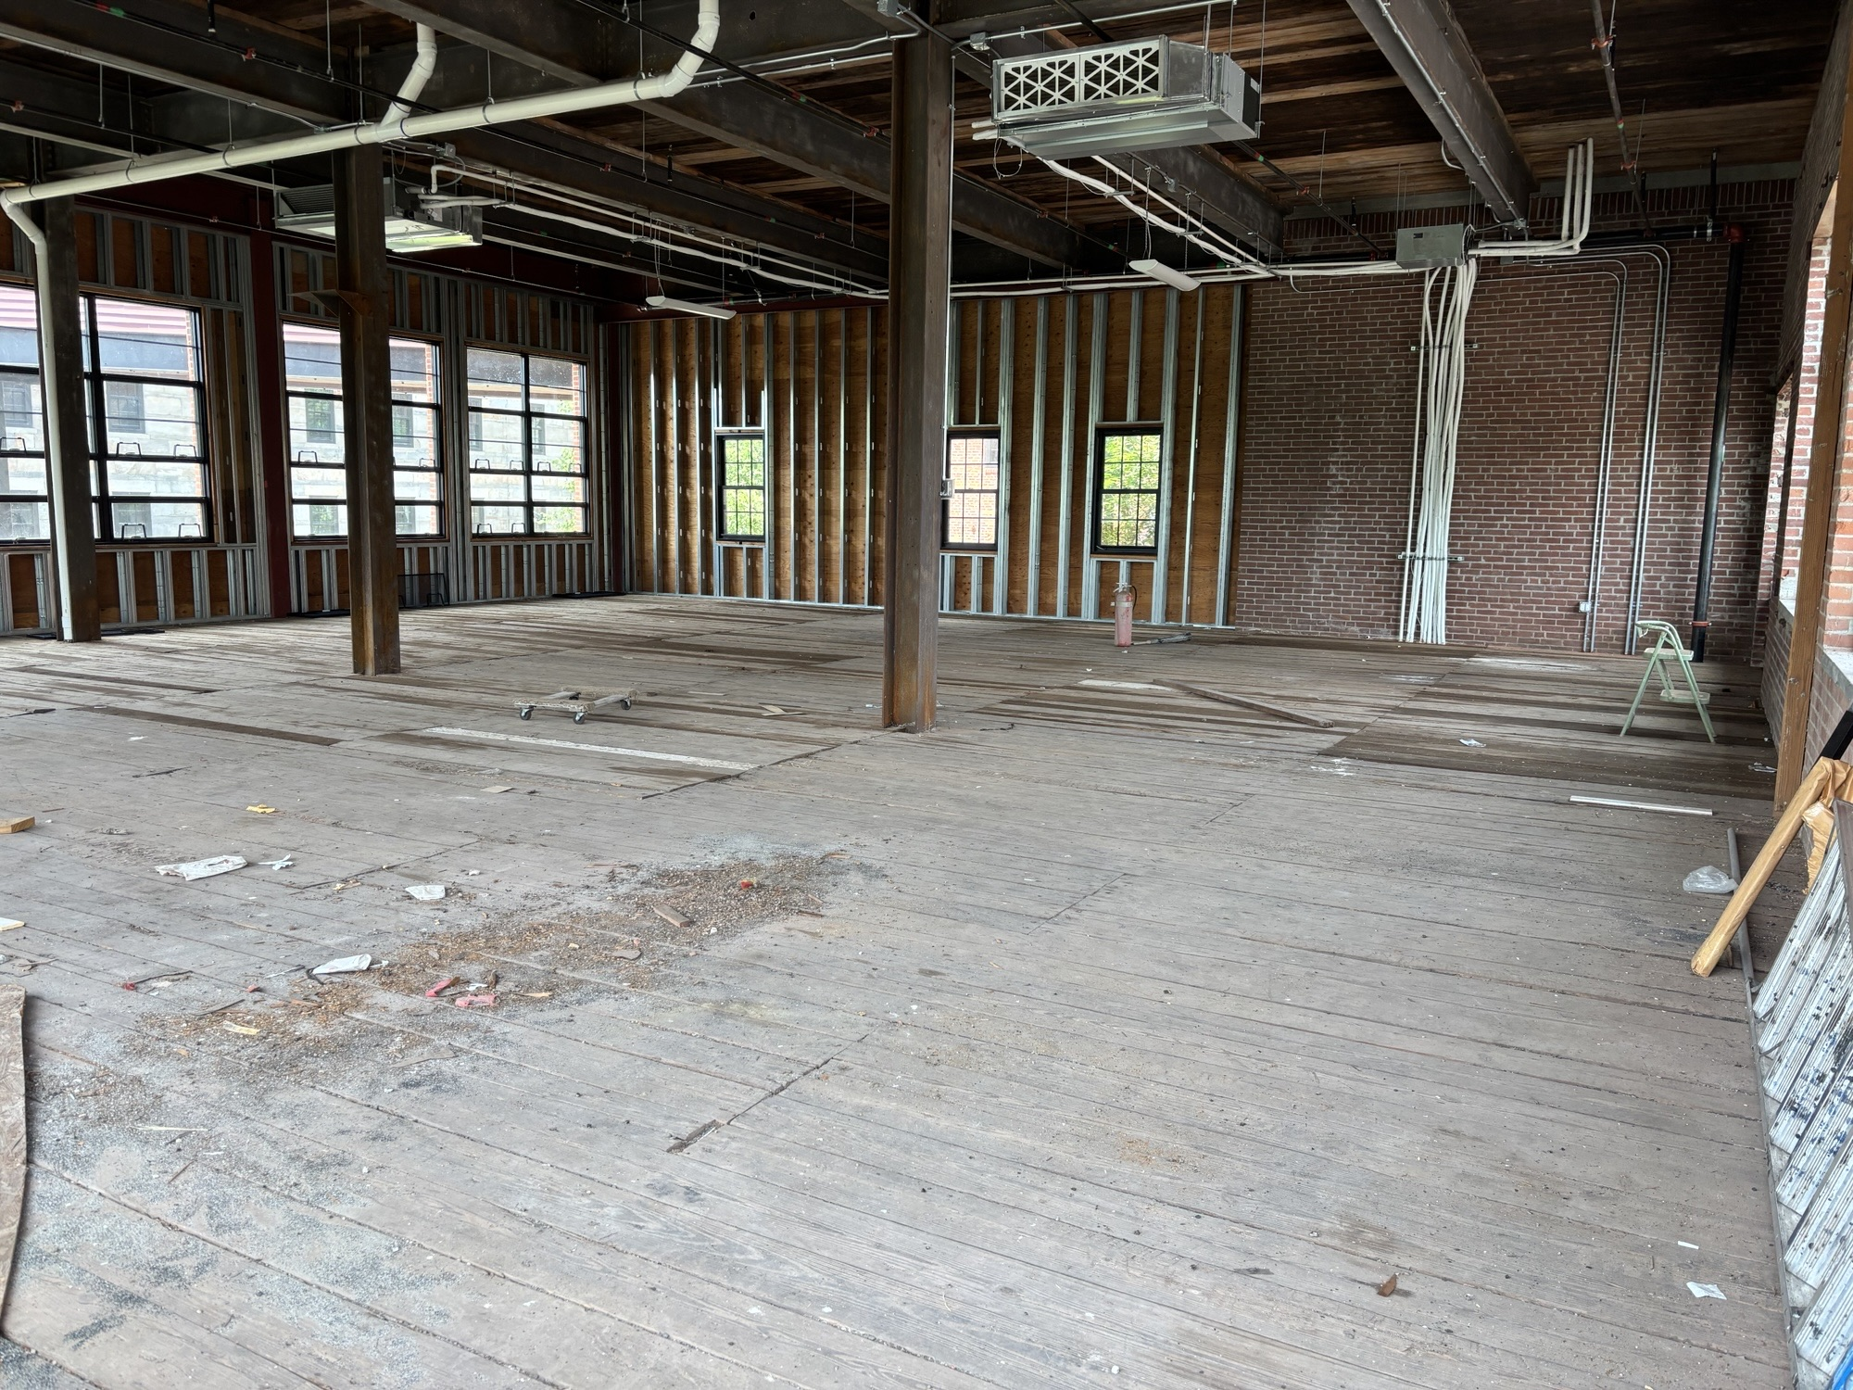
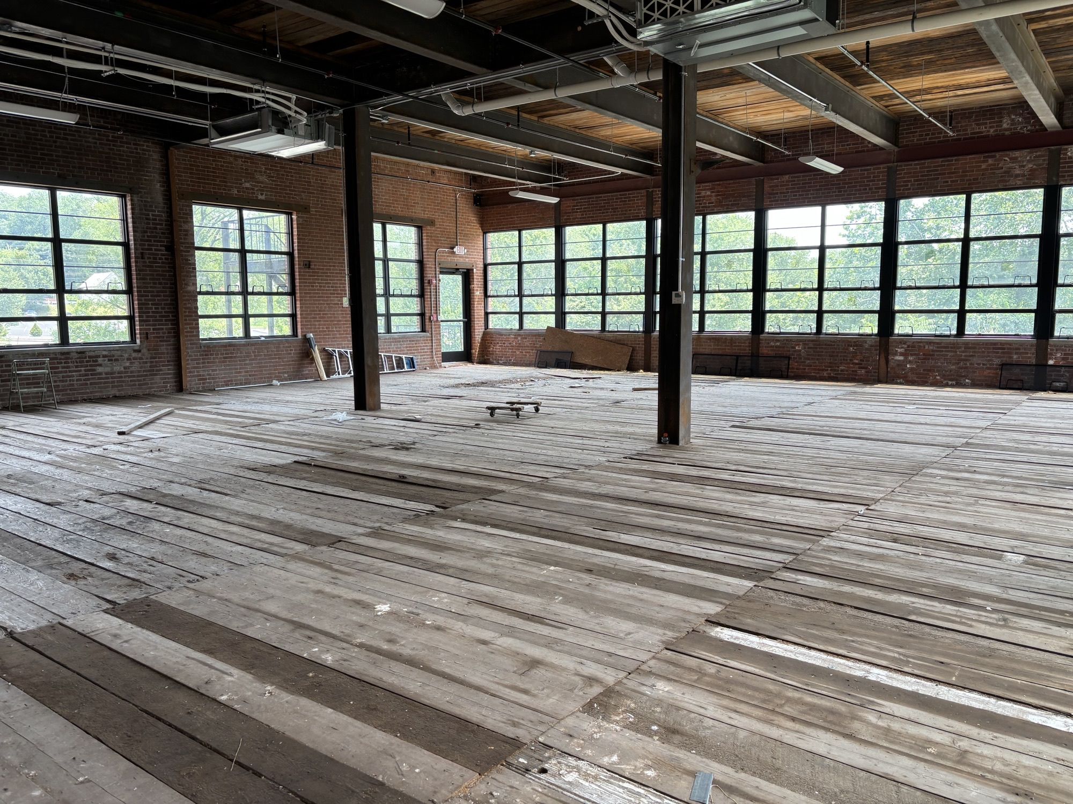
UNIT 3203
#1

Slide 6
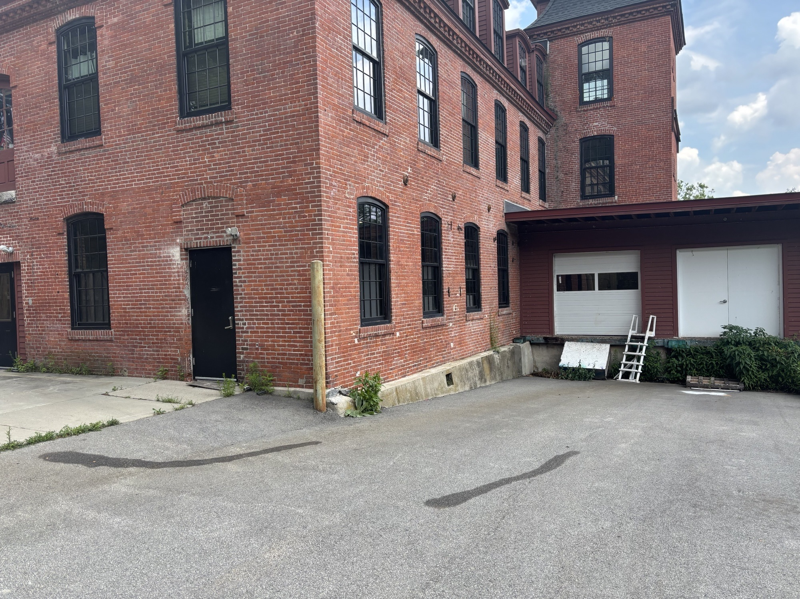
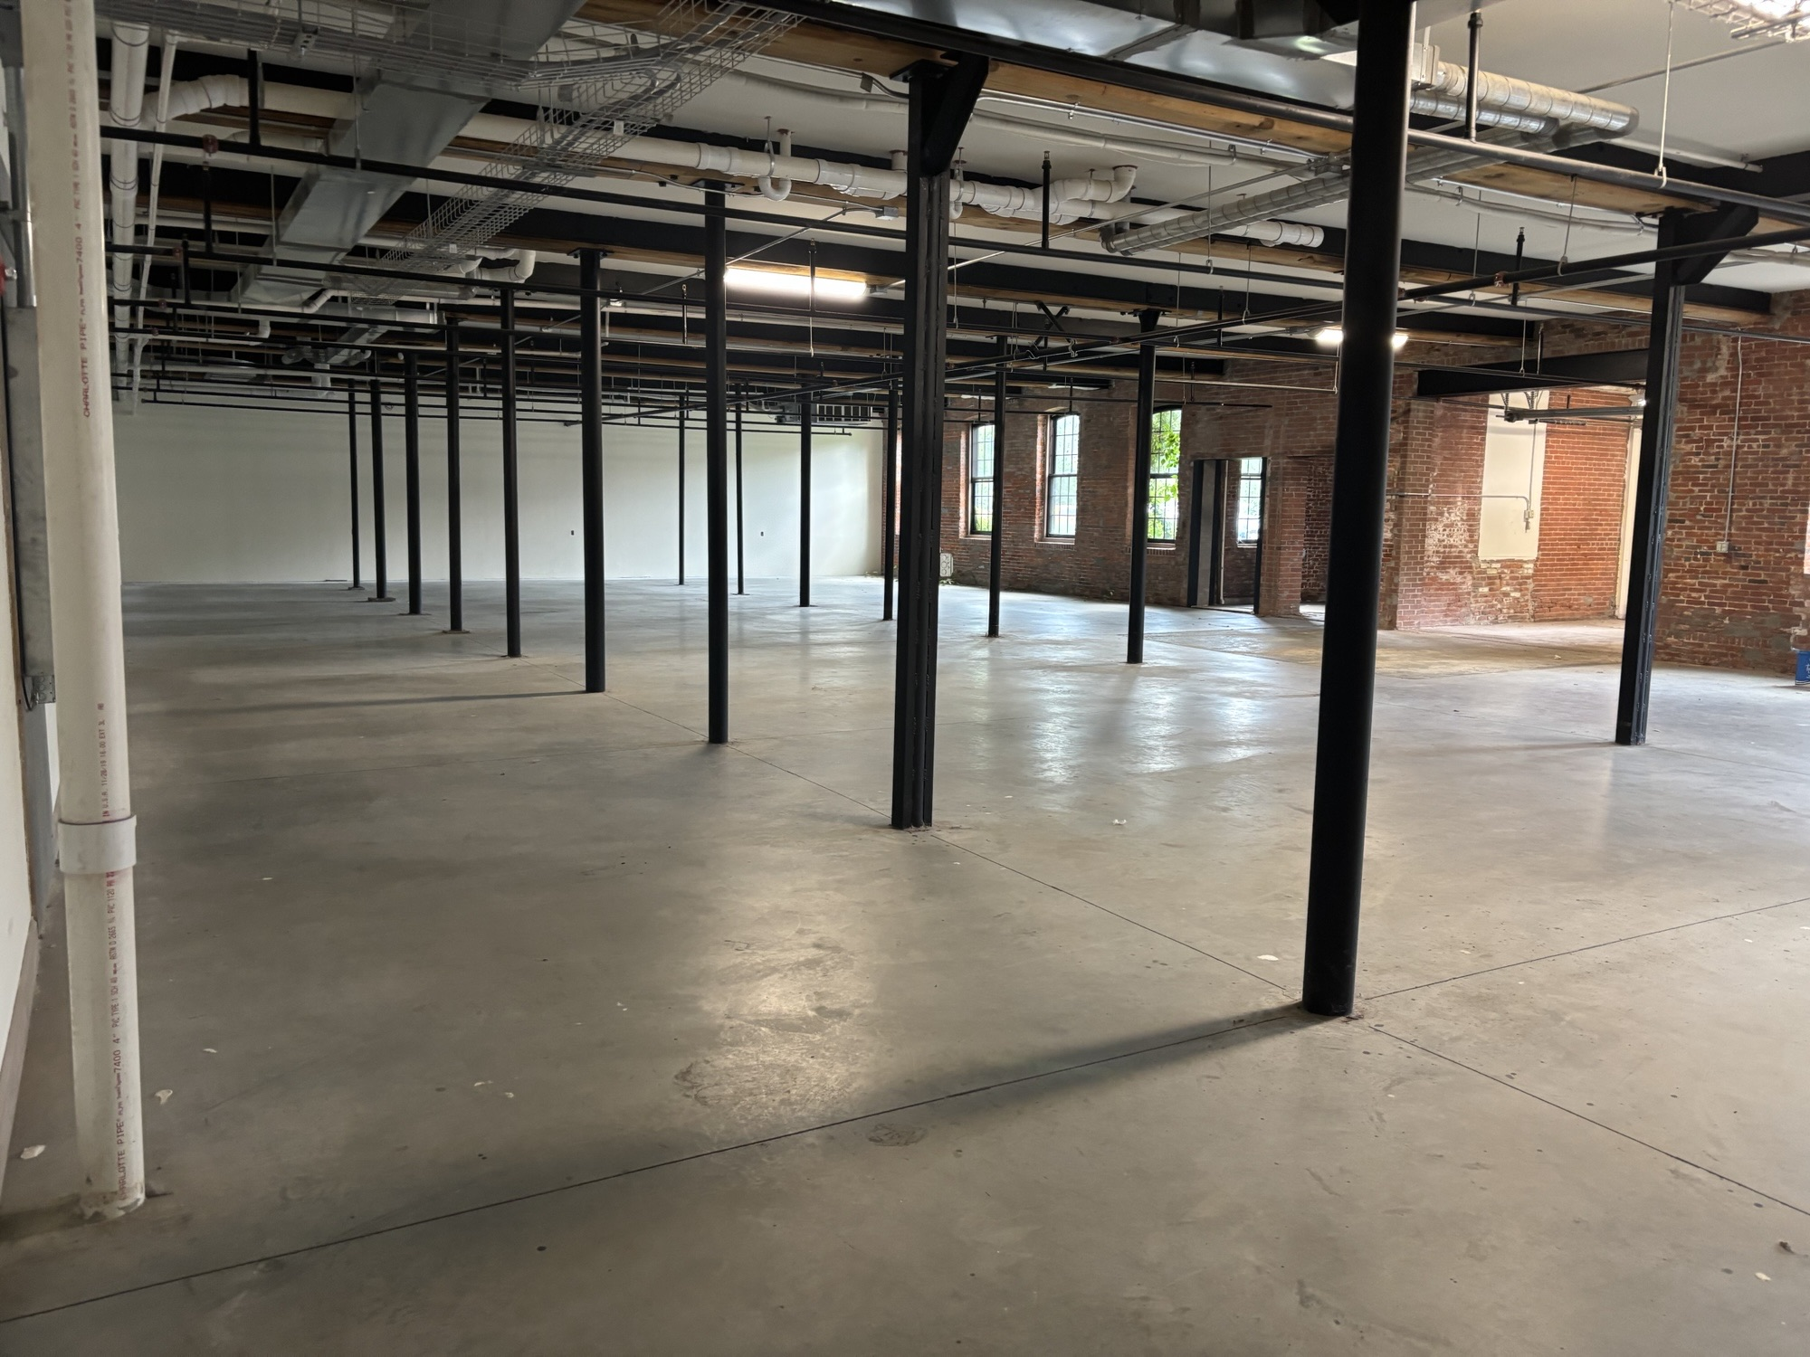
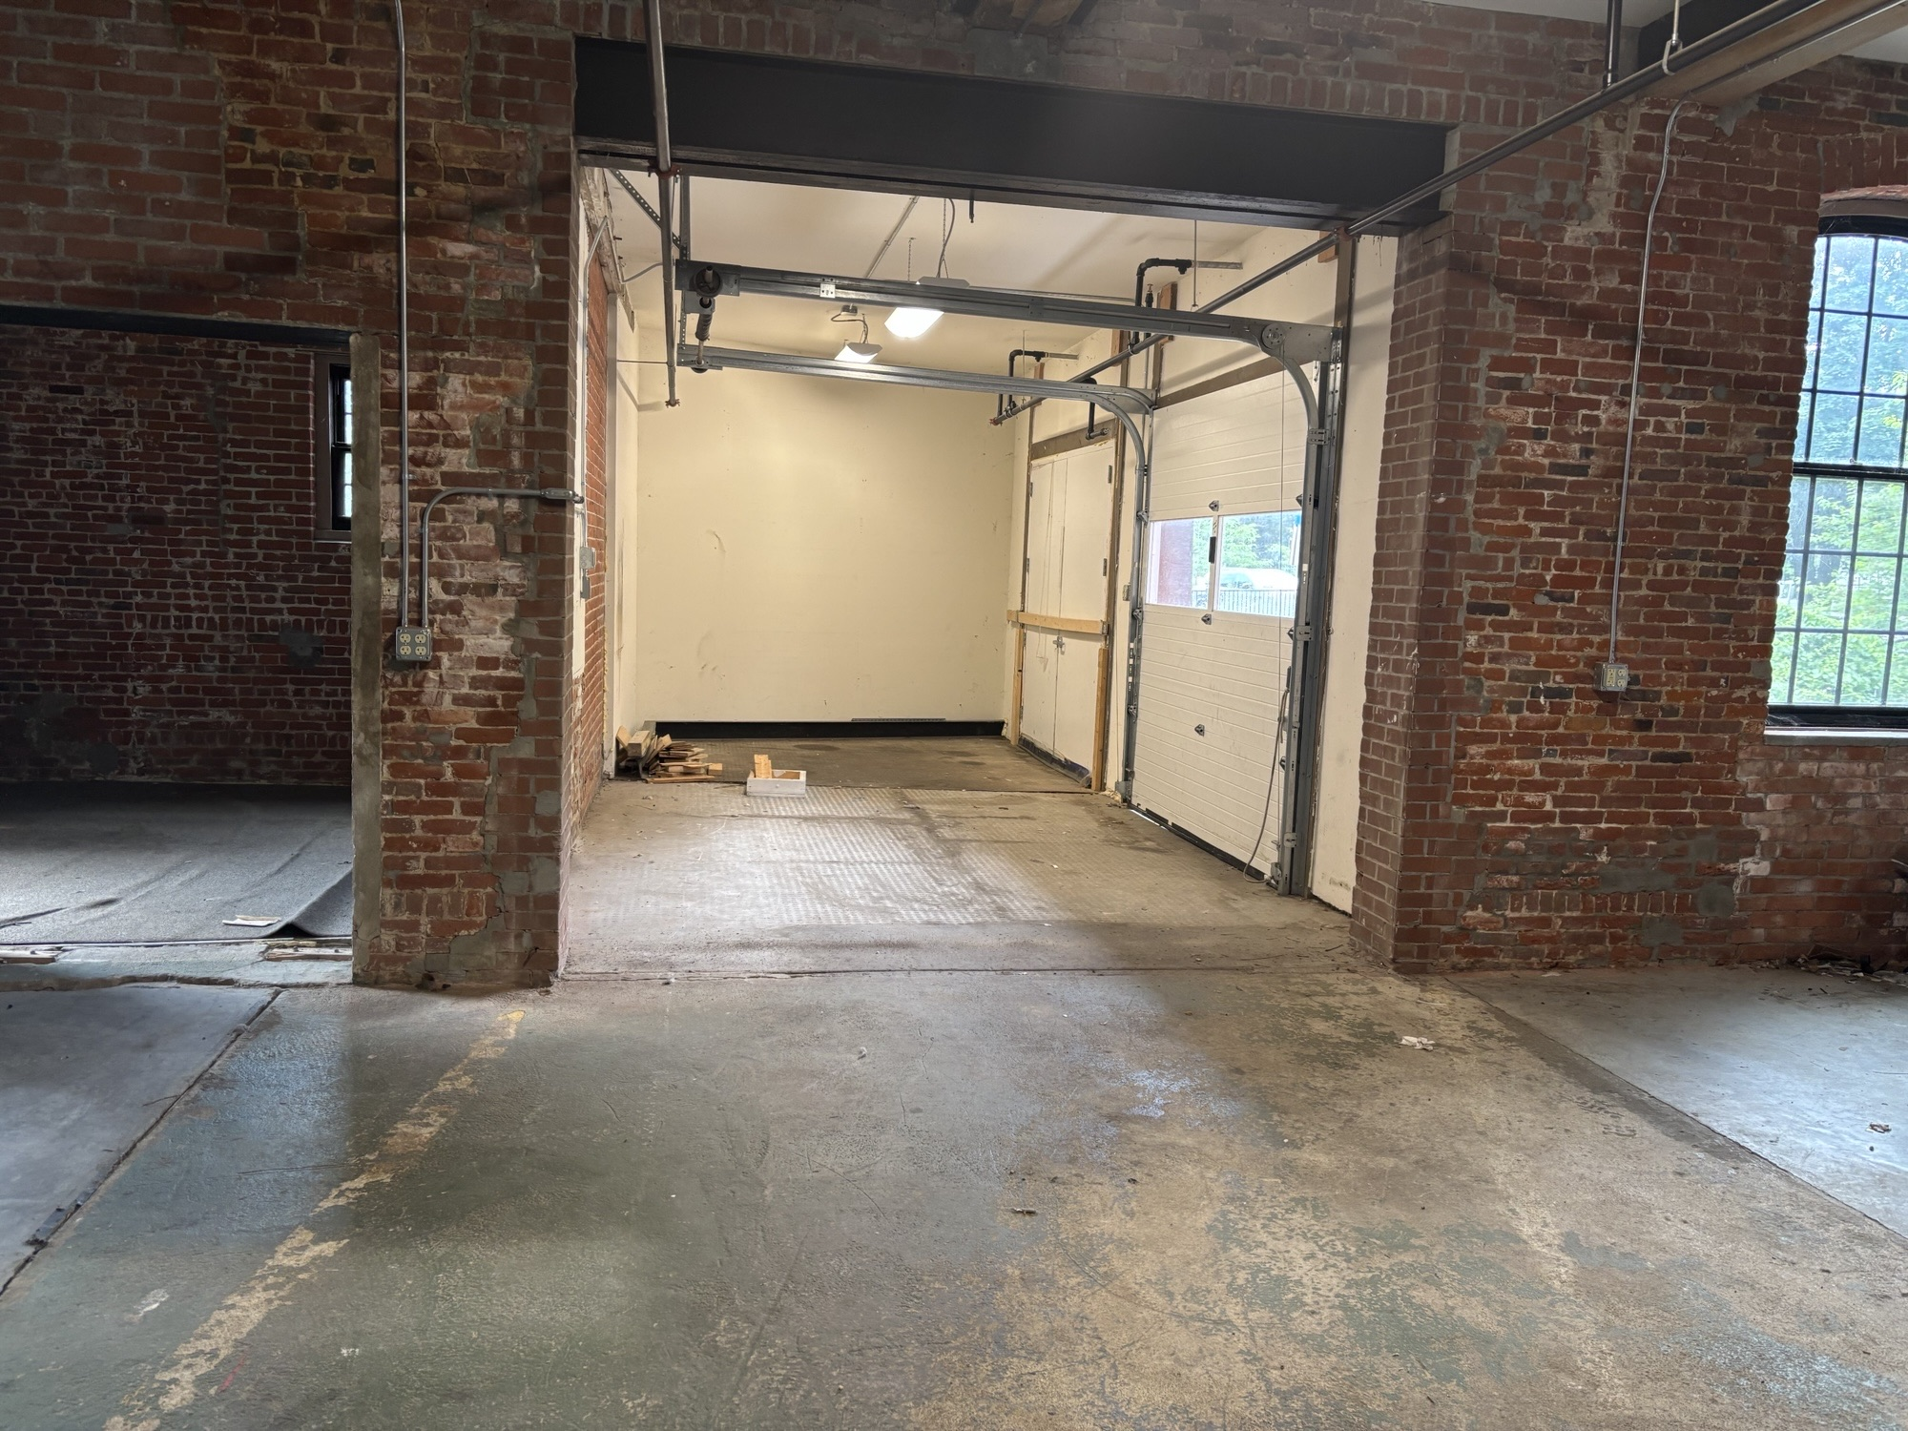
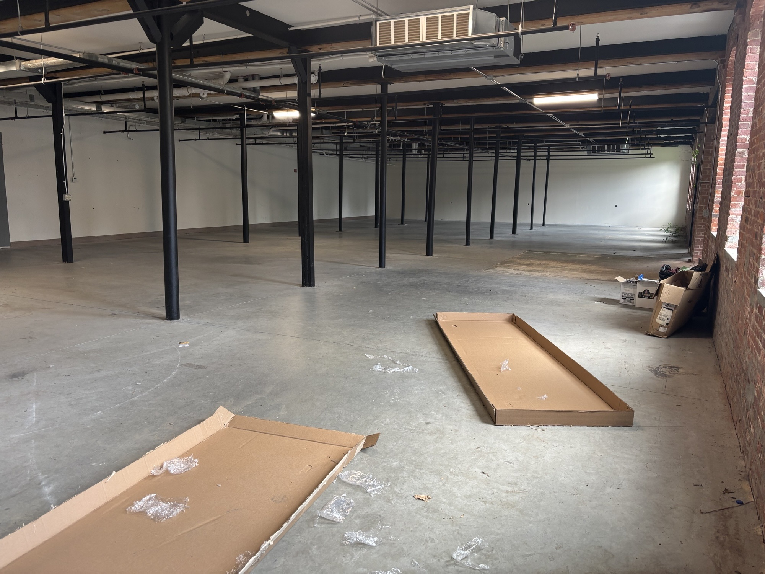
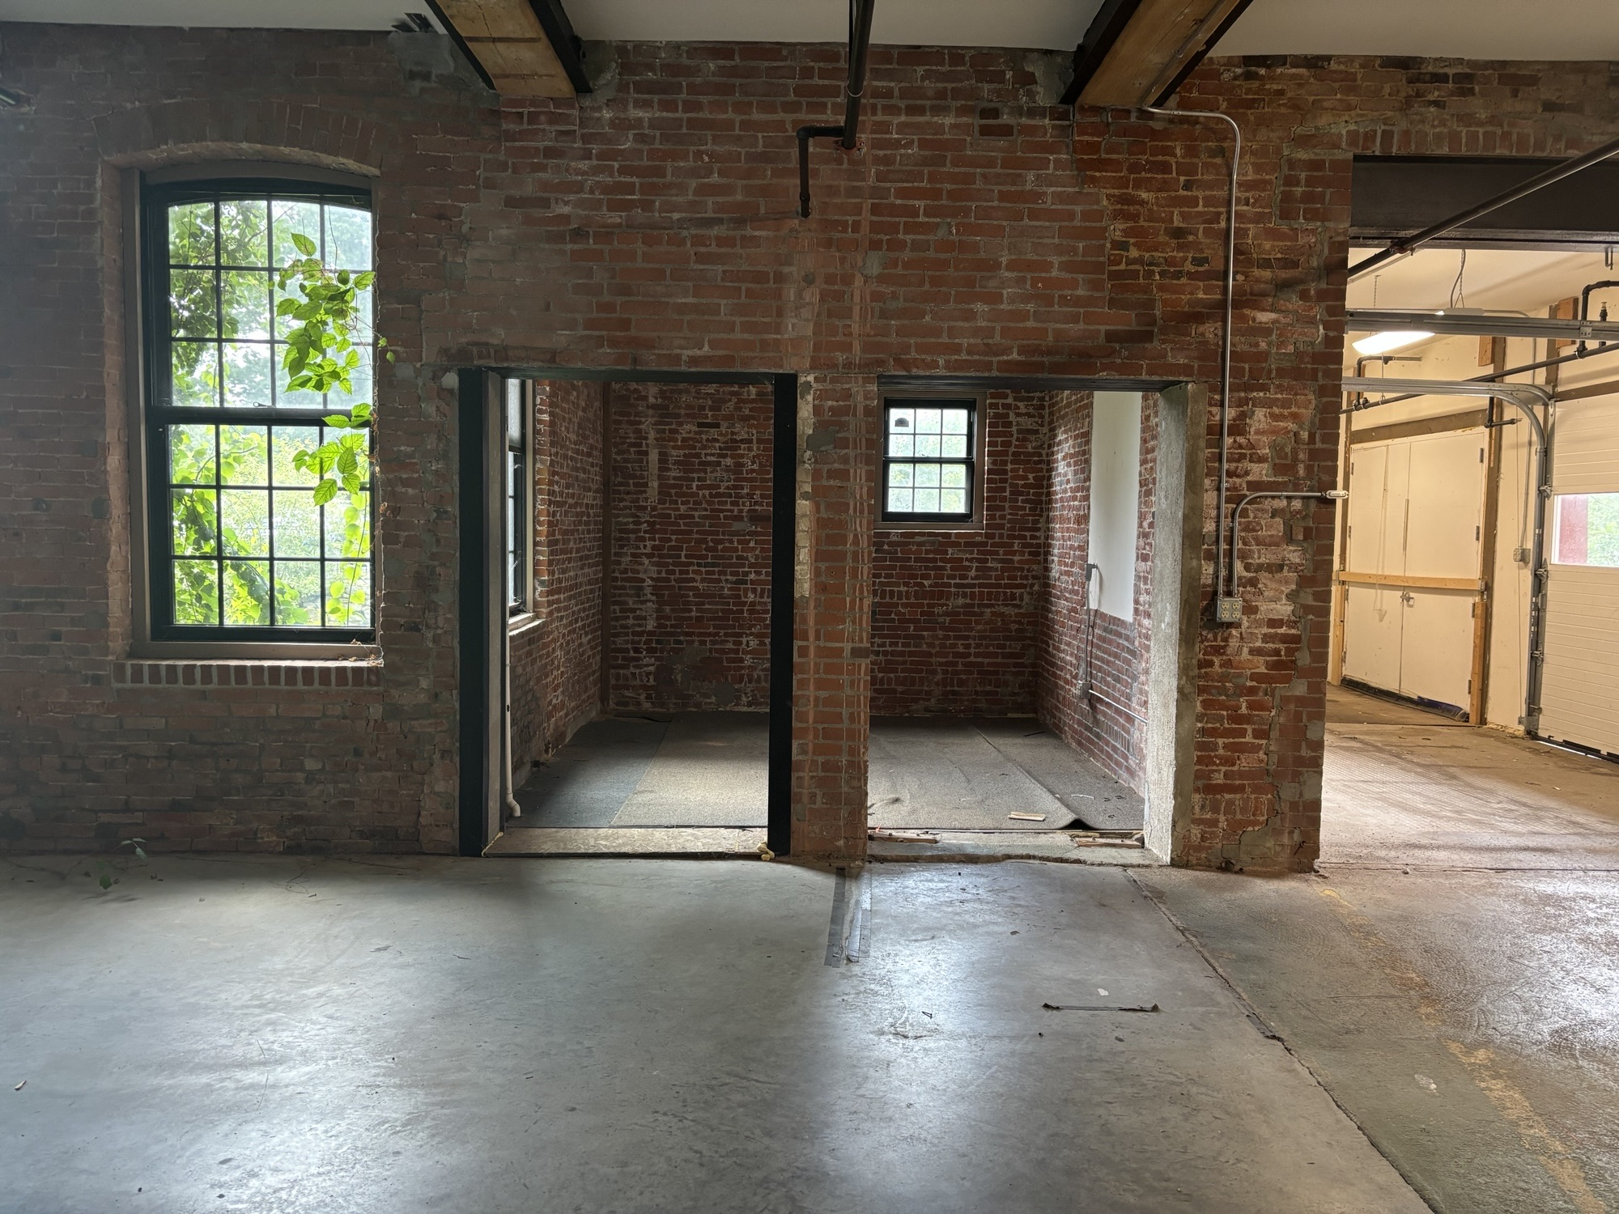
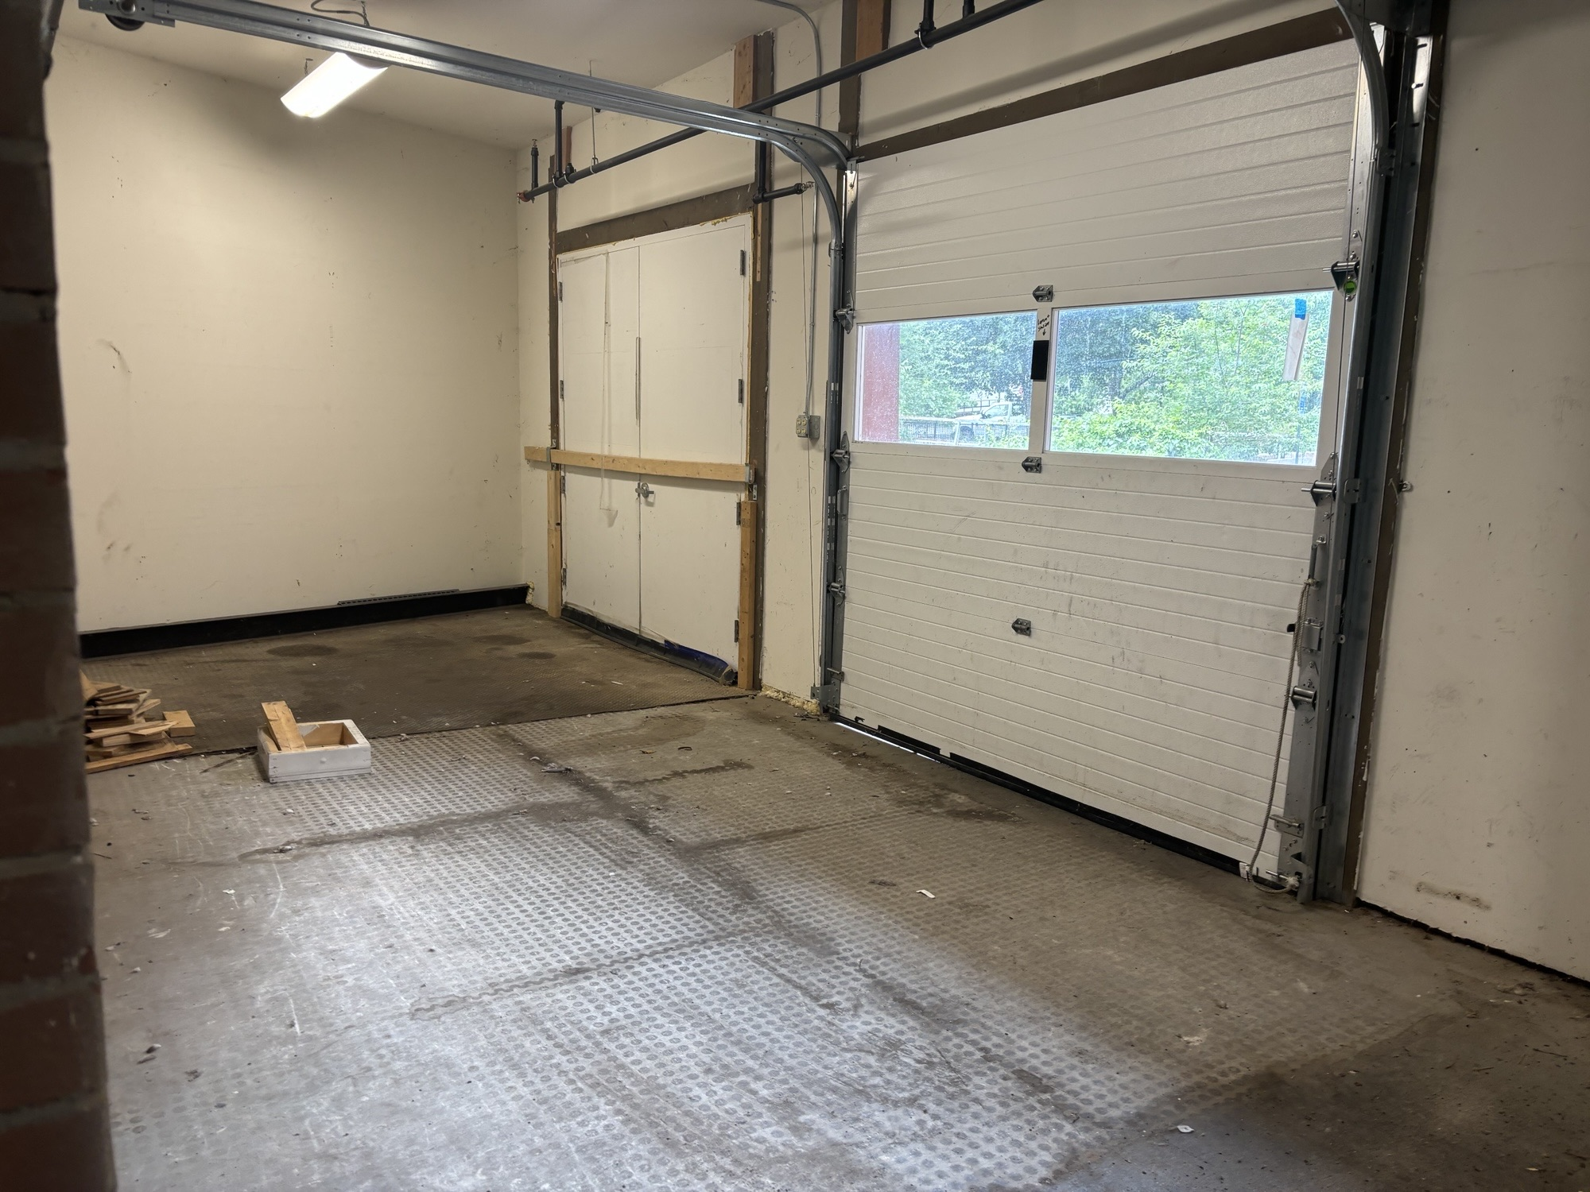
Unit 4102
#1

Slide 7
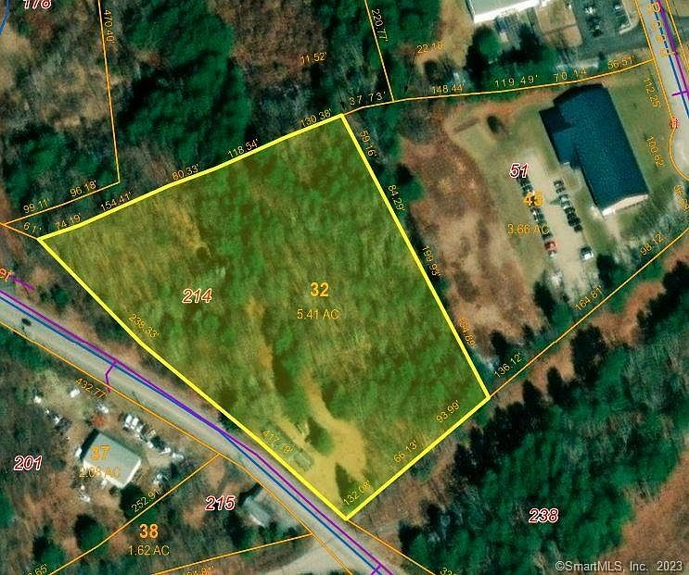
214 PARK RD.
ZONE: IND.
LISTED BY: Berkshire Hathaway New England
Contact: Michael Collins, 860-336-6675
Industrial Land for Sale - $300,000
5.41 AC.
Municipal Water Available
1/4 Mi. off of I-395 Exits 43 and 45
Existing antique residential 2-family; owner is requesting life tanancy
#2

Slide 8
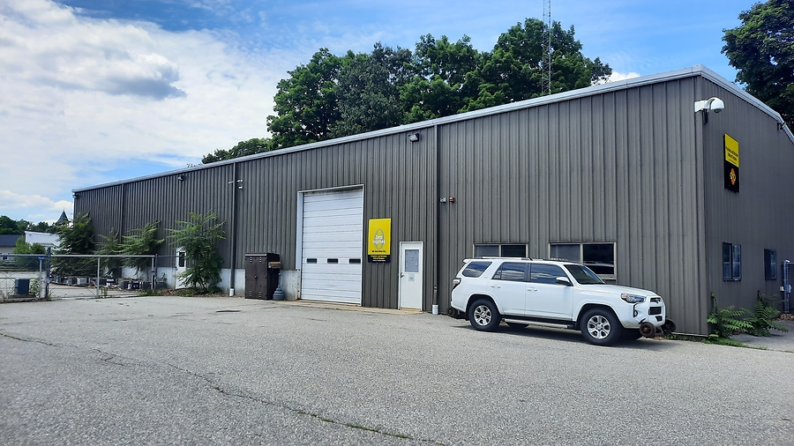
70 MAY ST.
ZONE: GC
LISTED BY: Re/Max Bell Park Realty
CONTACT: Dick Loomis
860-428-1666
$900,000
7,500sf Building
60’ x 125’
18’-20’ Ceilings
3 (14’ x 12’ overhead doors
Offices, breakroom, bath fully air conditioned
Mezzanine
Fenced yard; ample parking
Just off Rt. 44
#3

Slide 9

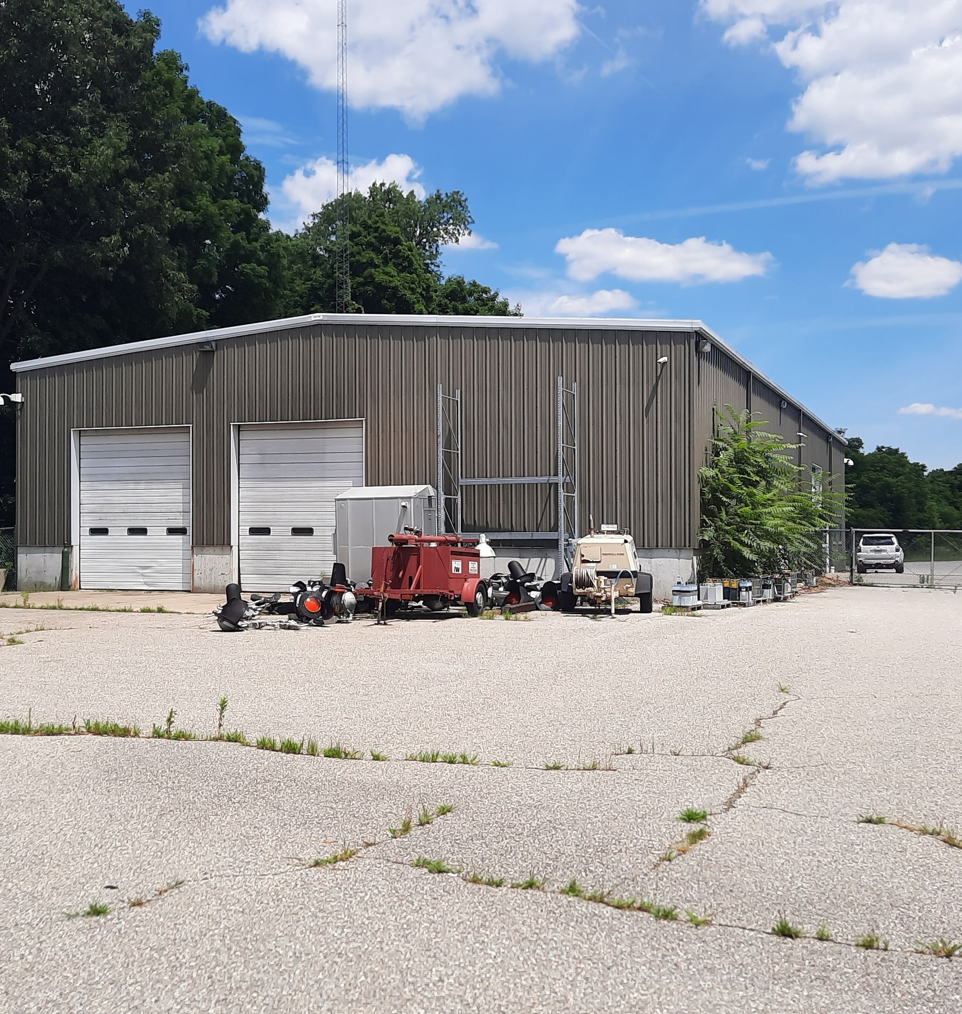
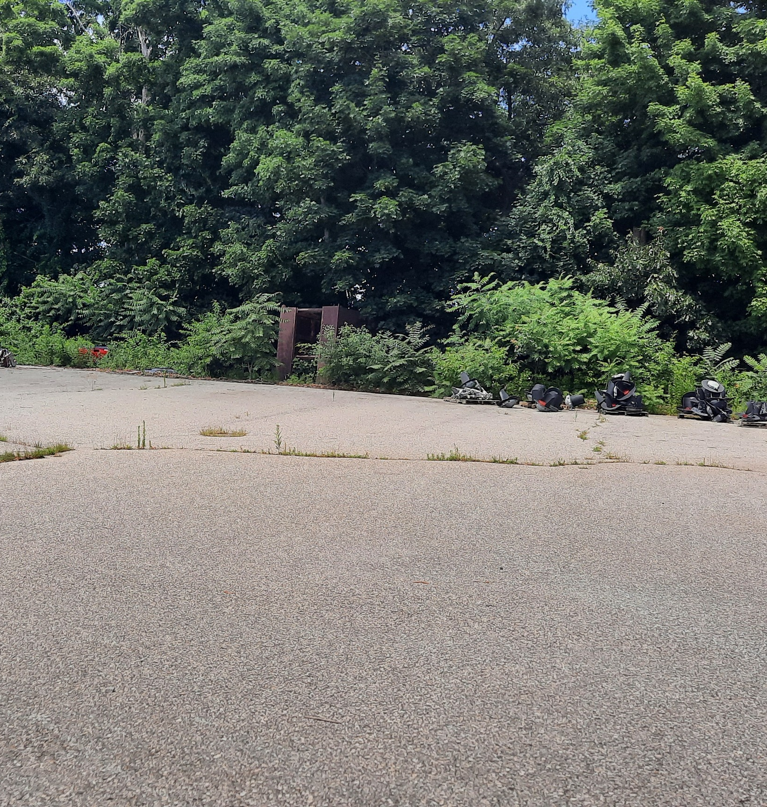
#3

Slide 10
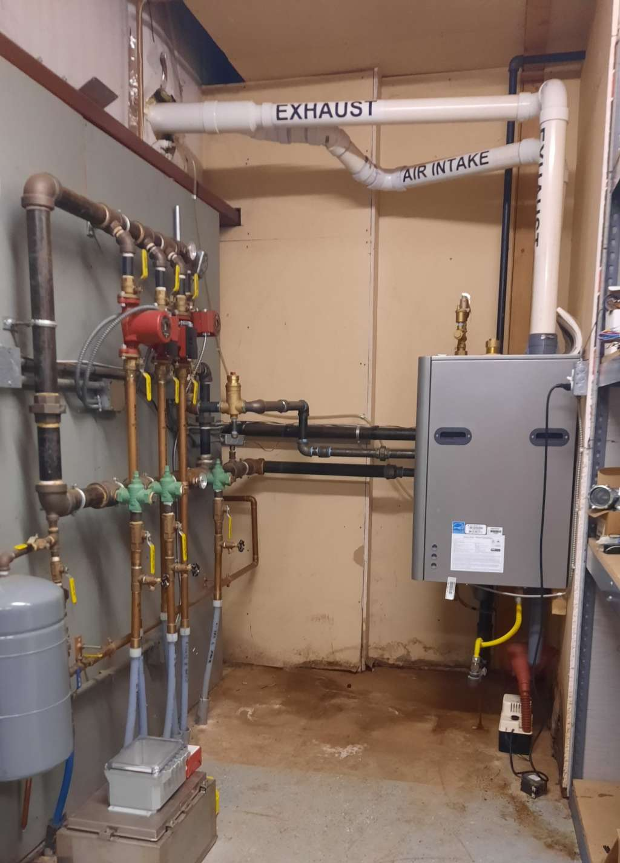
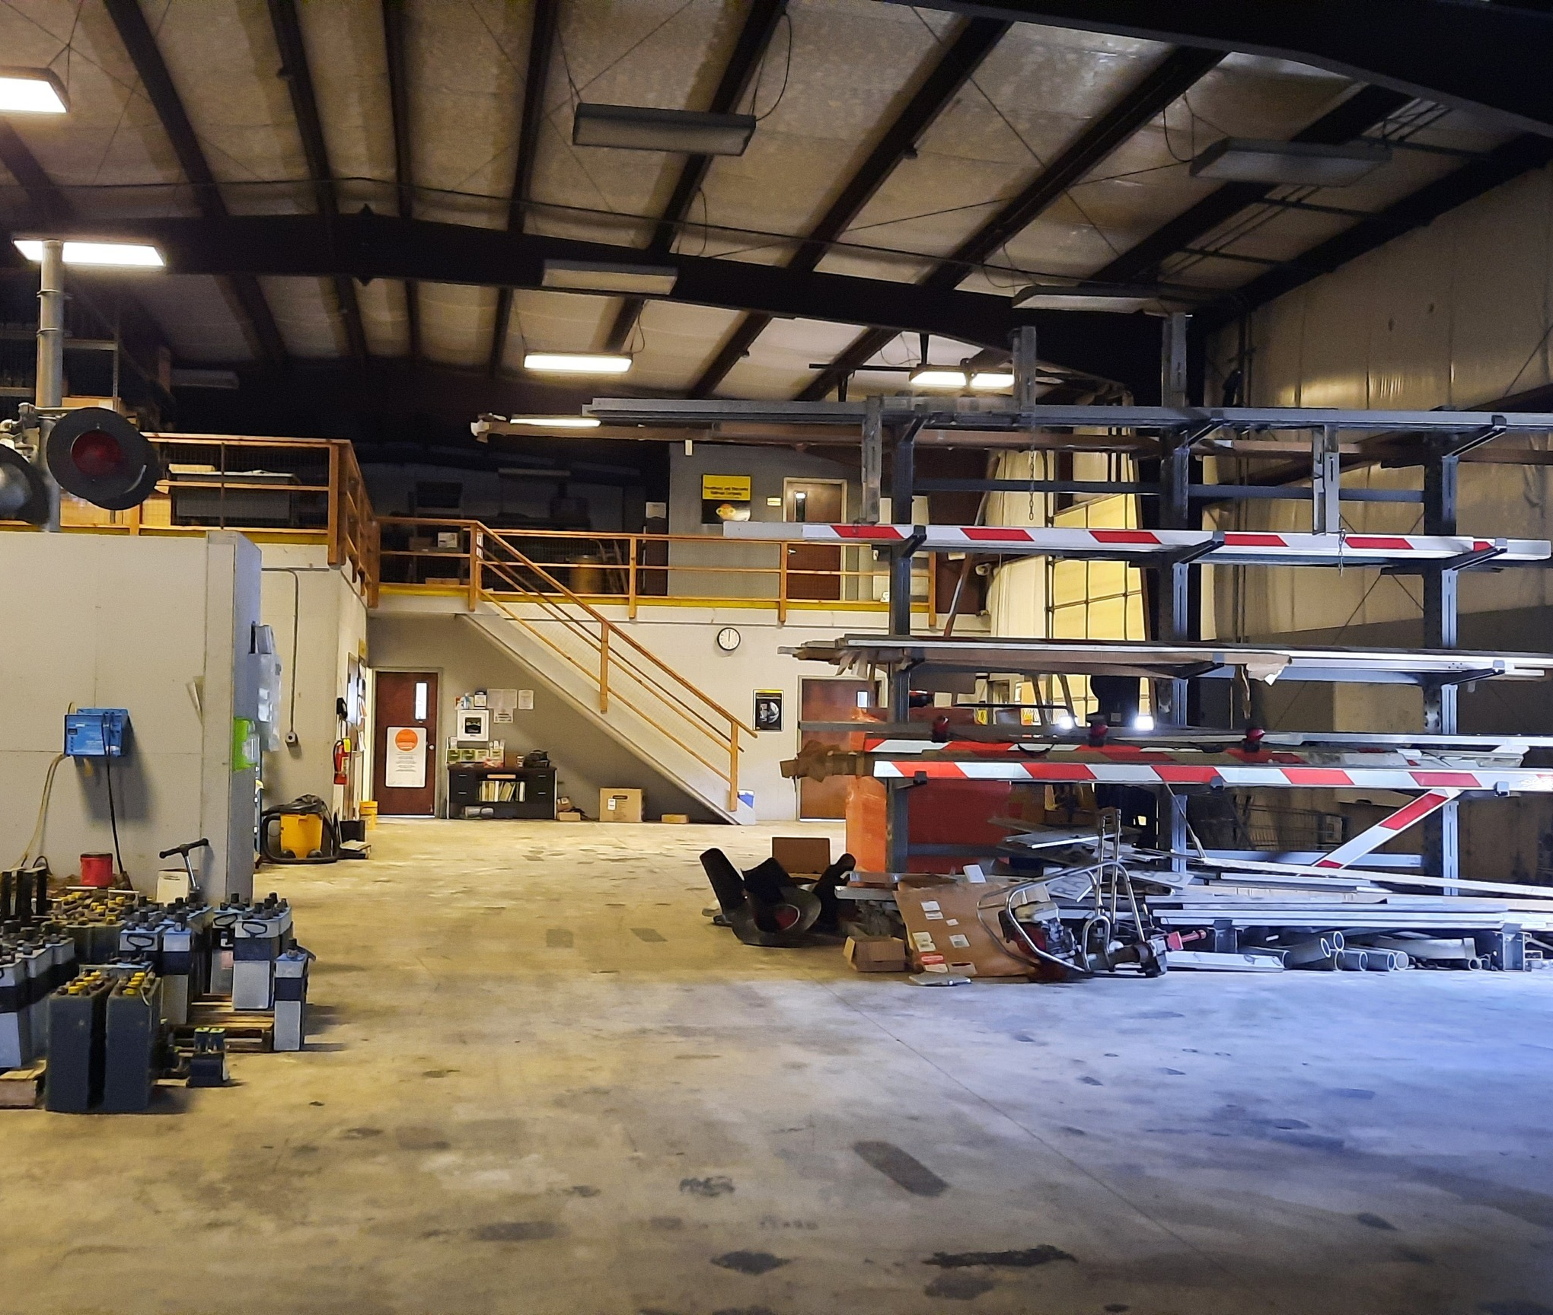
#3

Slide 11
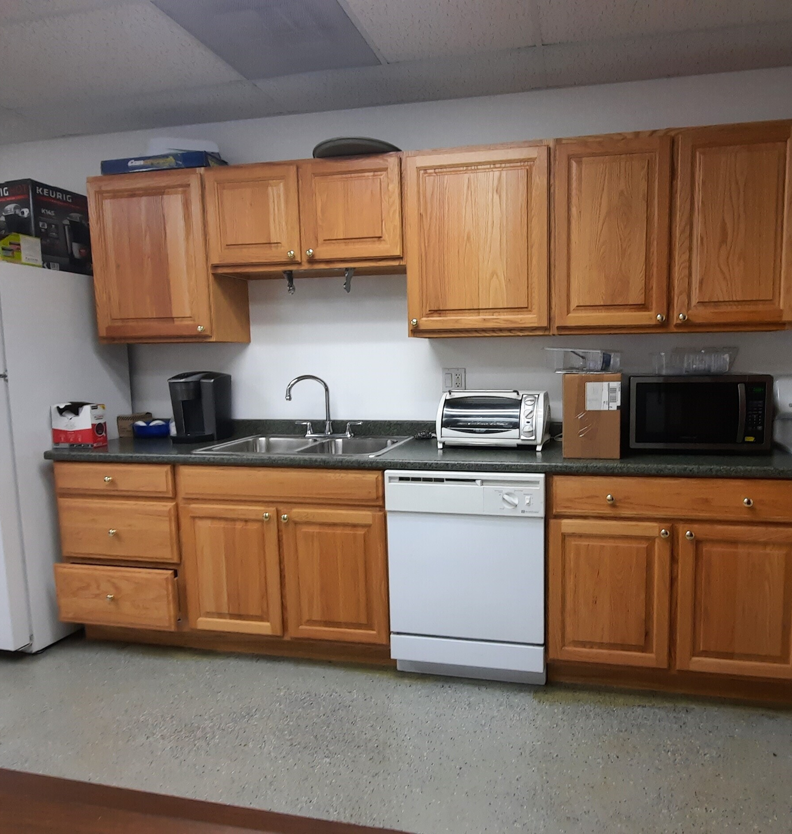
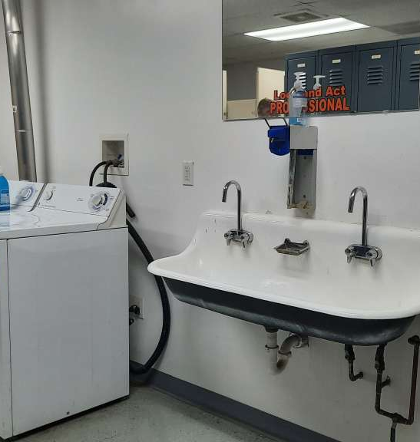
#3

Slide 12
If you’re interested in any of these properties, contact directly the agents listed, or the Putnam Economic & Community Office (contact info on the cover page of this presentation), and we’re happy to help you bring your business to town or expand your existing Putnam business.
More featured properties coming soon!

