Slide 1
PURCHASING DEPARTMENT
2022-2023 school year

Slide 2
Office Location
2001 UTEX Drive

Slide 3
SAM's Orders Procedures
  List item numbers on the requisitions
  Email PO's to Jany at Purchasing in order for her to submit the online order
  Sam’s Club curbside pick-ups have increased limiting dates and times pick-ups.
  Still have your secretary send a copy of the Sam’s Club purchase order to Jany to check availability but there is a possibility someone from the campus would need to go shop and call us when ready to pay.
  Therefore plan in advance-if you decide to change the purchase order to Wal-Mart or HEB.
Amazon Order Procedures
  Amazon shall only be used to purchase items that are out of season or items that other local vendors do not have.
  Be precise on your description, Amazon does not used item numbers so it is hard to choose the right product.
  If possible attach a cart and a picture of the item to make sure we order what you are needing.
  Do not purchase office supplies, instructional supplies, or electronic equipment if possible from Amazon.

Slide 4
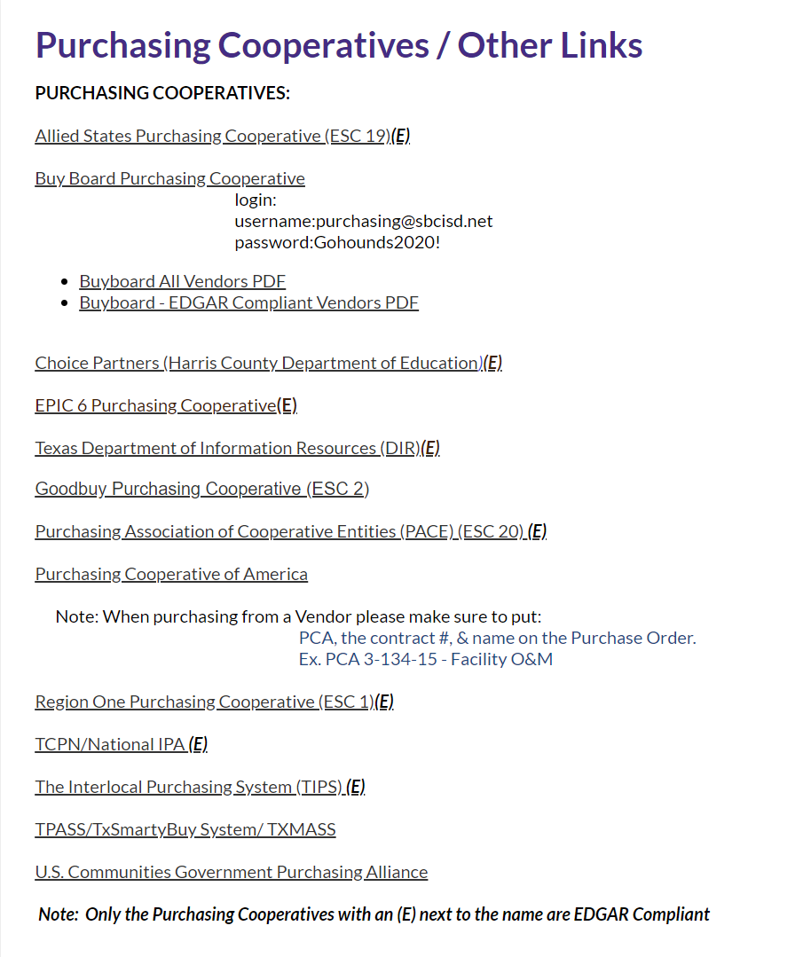
Purchasing Cooperatives (Website)
  Viewing EDGAR Compliant Vendors - Federal Funds Only (E)
  New Cooperatives Central Texas Purchasing Alliance
  New Cooperative Texas SmartBuy Membership Program

Slide 5
Awarded Bids/Proposals (Website)
  Look up awarded vendors by right clicking on the RFP in the second column.
  *print lists for your records
  We have a master list of Board Approved vendors for the General Merchandise, Professional Consultants, & Meals and Catering.

Slide 6
Federal Funds (Website)
All purchases must be EDGAR Compliant
Using Purchasing Cooperatives that are EDGAR Compliant
Verify that the vendors on these Cooperatives are EDGAR Compliant (E)
Using District Bids that are EDGAR Compliant
Last option would be to obtain 3 quotes - Use Written Quote Form
Debarment Status Check
Under Purchasing Website/EDGAR COMPLIANCE-Federal Funds the link is
https://www.sam.gov/SAM/pages/public/searchRecords/search.jsf

Slide 7
Inventory Procedures/Fixed Assets (Website)
Item Thresholds
All electronics that cost more than $150.00
Furniture and Equipment that cost $500.00 or more
Computers, laptops, iPads, Chromebooks and any other electronic devise or pieces of equipment must go to the warehouse for barcoding. Computers will go to Technology then after they are done they will be delivered to the campus.

Slide 8
NOTIFICATIONS OF CHANGES TO THE PURCHASING DEPARTMENT
Student Insurance:
Voluntary Student Accident Insurance brochures will not be distributed this year. We have a new vendor. Monarch Management and our agent is Greg White (903) 520-7579 at Achieve Financial Group. Student Athletic On-Line Claim information is available on our website. The link is the following: https://www.sbcisd.net/apps/pages/index.jsp?uREC_ID=893311&type=d&pREC_ID=2337788
Accident Reports for Vehicles:
Accident statement and police report need to be emailed or interoffice mail to Mr. Cavazos as soon as possible. A claim will be submitted to TASB, once an adjustor is assigned they will be contacting you.
Textbooks Request:
request form must be approved by Director of Elementary or Secondary Instructional Implementation. Once approved email the form to Mr. Cavazos and copy Richard Garcia. Please allow up to 1 week for delivery.

Slide 9
Questions
Closing

