Slide 1





Pine Street Elementary School
Literacy Night
Tuesday, October 28th

Slide 2
Welcome Parents!
We’re excited to partner with you this year!

Slide 3
Meet our Team!
PARAPROFESSIONAL:
JACQUELINE RODRIGUEZ
TEACHERS:
Nerissa Anderson
Harold Jean-Jacques
Dametra Lester-Garner
Latonya Stanford
Angela wilkinson

Slide 4

Ms. J. Rodriguez
Contact info:
jrodriguez@rockdale.k12.ga.us

Slide 5

Mrs. N. Anderson
Contact info:
nanderson@rockdale.k12.ga.us

Slide 6

Mr. H. Jean-Jacques
Contact info:
hjeanjacques@rockdale.k12.ga.us

Slide 7

Mrs. D. Lester-Garner
Contact info:
dlester26@rockdale.k12.ga.us

Slide 8

Mrs. L. Stanford
Contact info:
lstanford@rockdale.k12.ga.us

Slide 9

Mrs. A. Wilkinson
Contact info:
Awilkinson@rockdale.k12.ga.us

Slide 10
Other Important School Personnel
Principal~ Mrs. Haines-Williams
Assistant Principal~ Mr. Travis
Counselor ~ Ms. Wilson
Secretary ~ Mrs. Williams
Bookkeeper ~ Ms. Sistrat
Registrar ~ Ms. Webb
Media Specialist ~ Ms. Johnson
PE ~ Coach Danner
Music ~ Ms. Sanders
Art ~ Mrs. Cleland

Slide 11
A Day in the Life
Morning Arrival ……………………….7:35
ELA Instruction Block………………7:35-10:00
Science & SS ……………………………………..10:00-10:45
Lunch & Recess ……………………….. 10:45- 11:40
Math Instruction Block …………….. 11:40- 1:15
Specials (Art, Music, PE, etc.) ……. 1: 15- 1:55
Dismissal ……………………………………. 2:05- 2:15

Slide 12
READING
Reading is cross-curricular and it is taught throughout the day.
Guided Reading groups will meet during Literacy Workstations. These groups are homogeneous but fluid.
Comprehension questions are asked after every story. Children are called on whether or not they have their hand up.
Focus-beginning, middle, end of story, characters, setting, problem and solution.
Modeling the Love of Reading is significant in developing avid readers!!!!

Slide 13
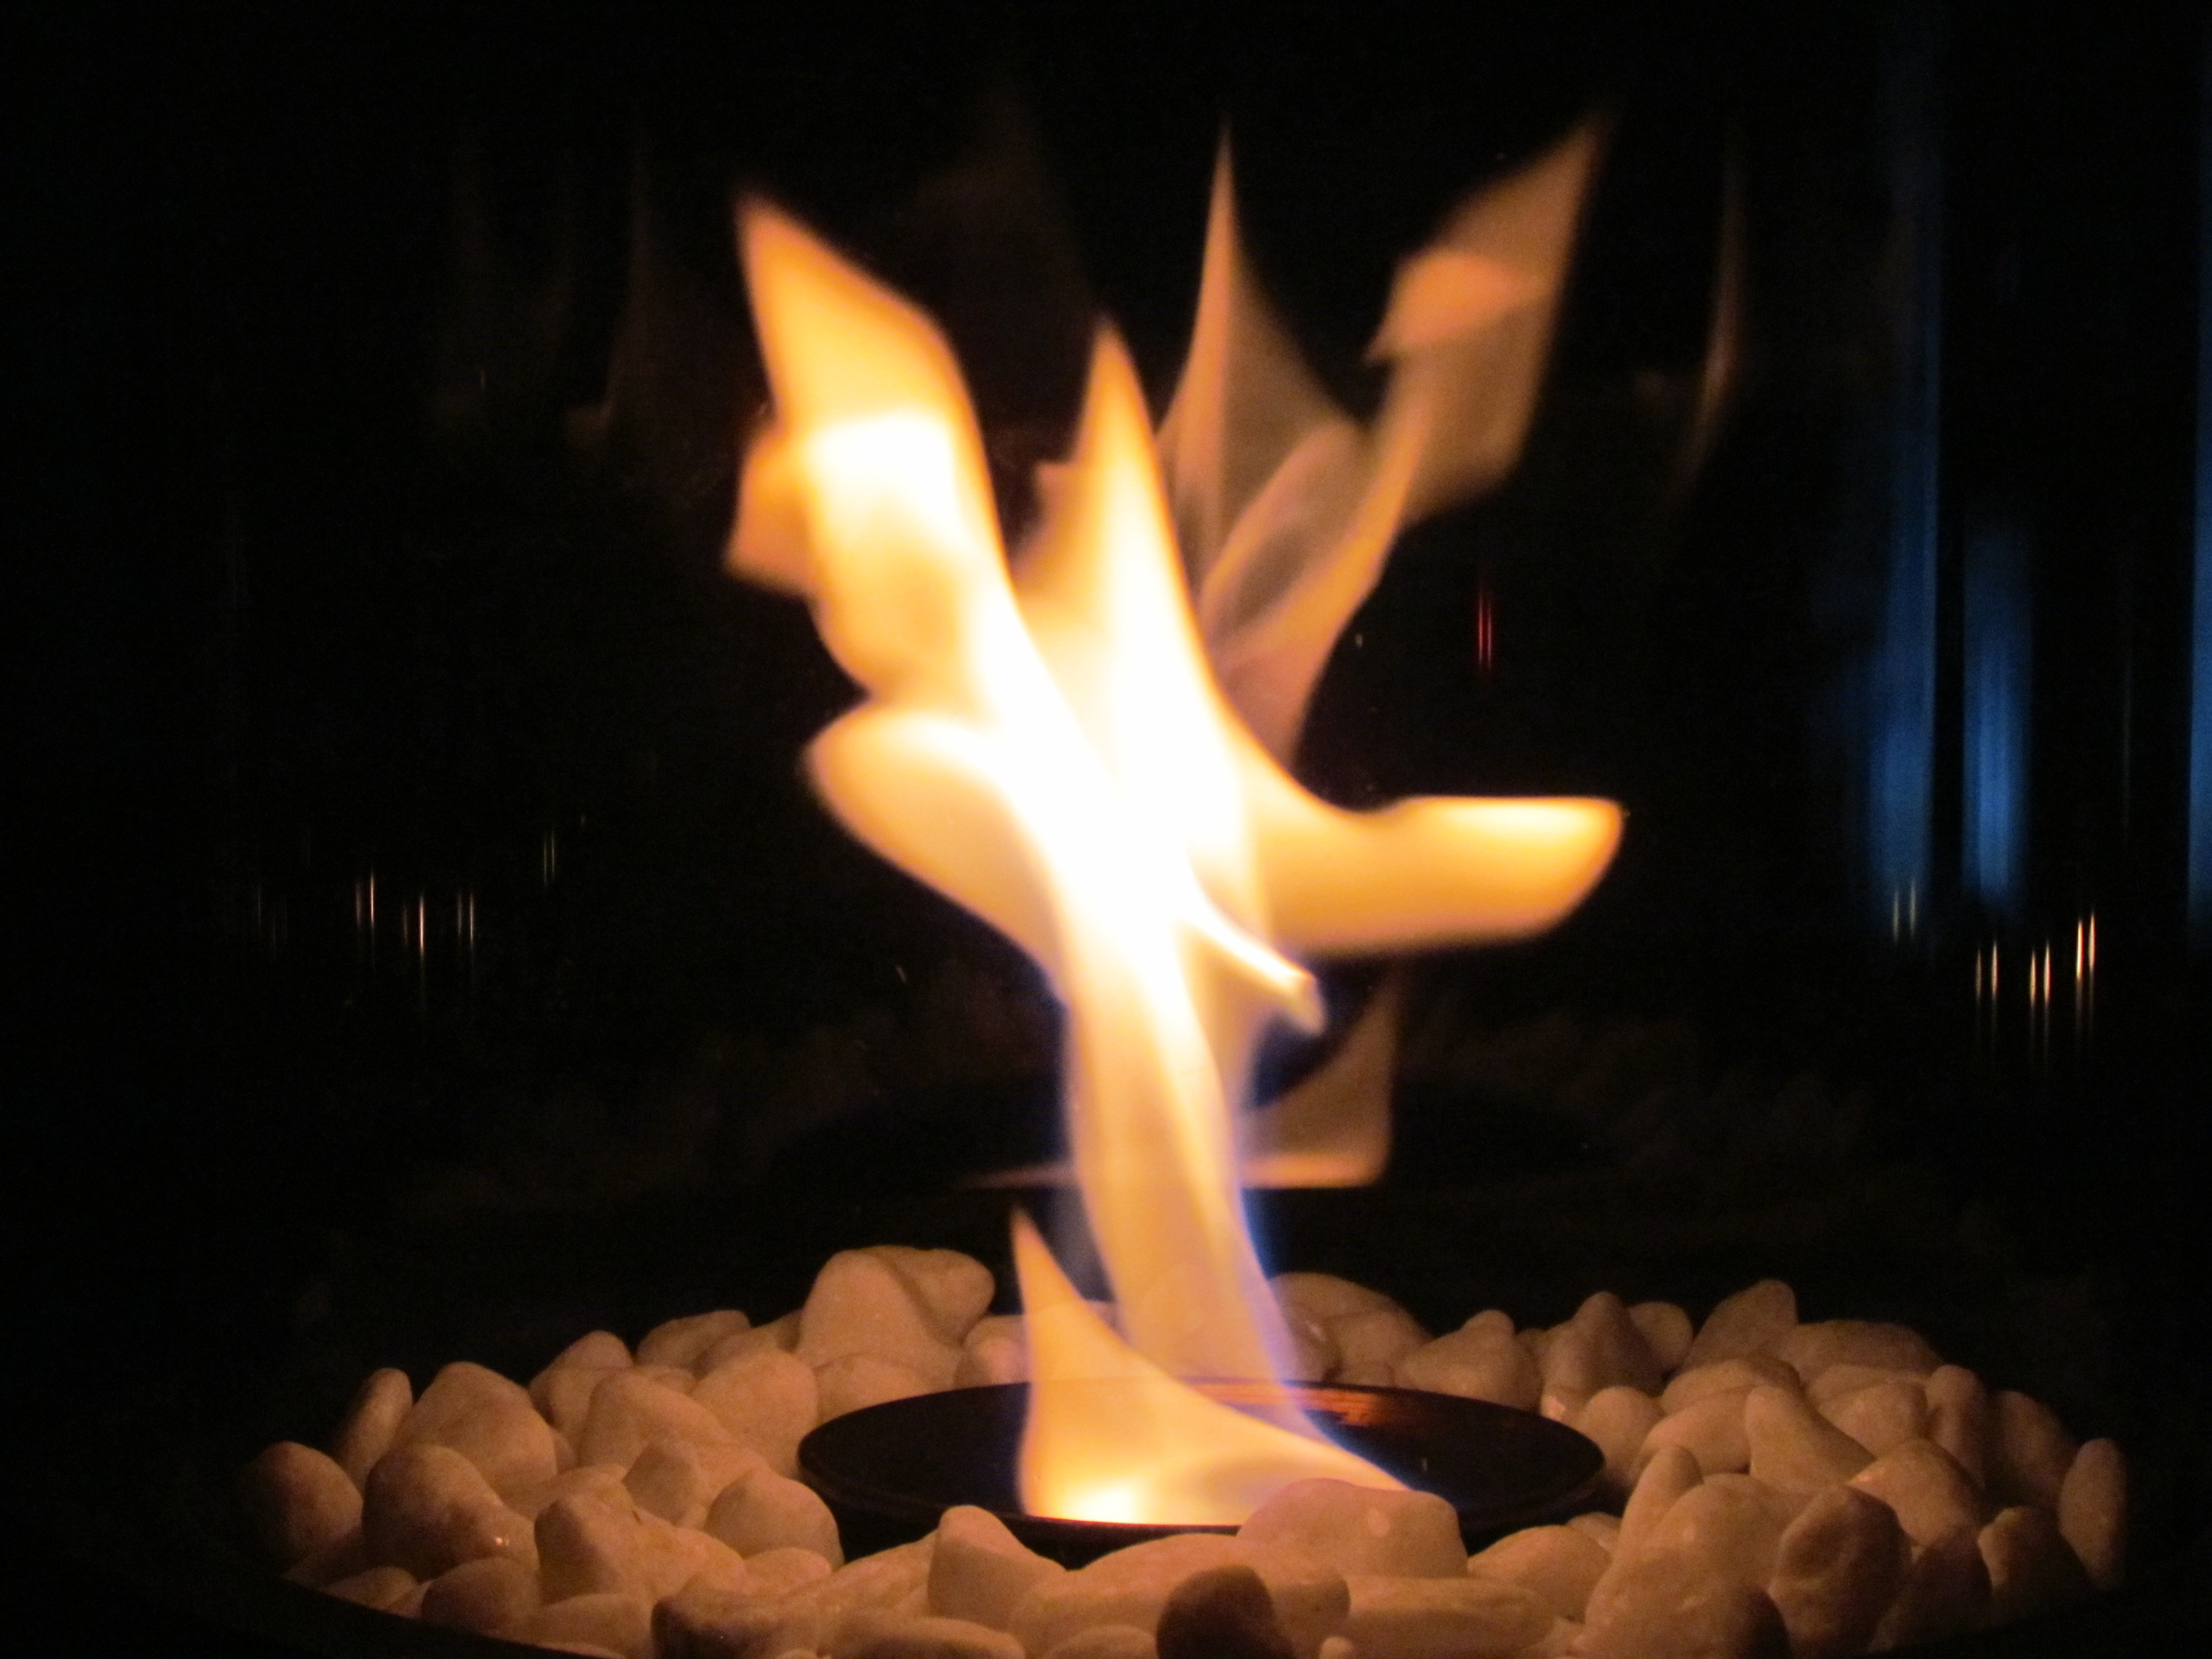
Hot Standard
A "hot standard" is an educational term used to describe a high-priority learning standard that is:
Frequently assessed on standardized tests or district benchmarks.
Essential for student success in the current grade and future learning.
Focused on critical thinking or foundational skills that students must master.

Slide 14

Standard 1
2.T.RA.2.a Refer to specific parts of texts when supporting an idea, answer, or opinion.
Notes:
---

Slide 15

What is 2.T.RA.2.a?
Refer to Text
  Students must point to exact words or sentences to support their ideas.
Example of Bravery
  Students show text parts that illustrate character bravery, like facing challenges.
Develop Comprehension
  This skill improves deeper understanding and critical thinking about reading.
Foundation for Analysis
  Supports future tasks requiring evidence-based reasoning and textual analysis.
Notes:
The Grade 2 reading standard 2.T.RA.2.a requires students to refer to specific parts of a text when supporting an idea, answer, or opinion. This means that children should be able to explain their thoughts by pointing to exact words, phrases, or sentences in the story or passage they read. For example, if a student believes a character is brave, they should be able to show a part of the text that demonstrates bravery, such as a sentence where the character faces a challenge. This skill helps students develop deeper comprehension and encourages them to think critically about what they read. It also lays the foundation for future academic tasks that require evidence-based reasoning and textual analysis.

Slide 16
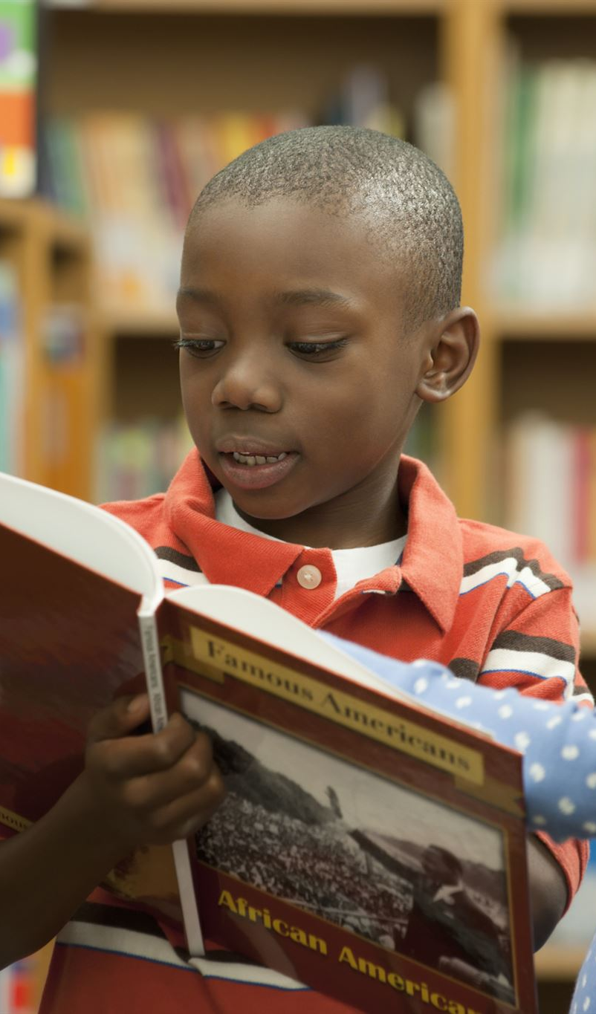
Importance of Textual Evidence
Why It Matters
Enhances Comprehension
  Using textual evidence improves children's understanding and critical thinking skills.
Supports Communication
  Students articulate ideas clearly by backing them with proof from the text.
Prepares for Advanced Tasks
  Citing evidence is essential for higher grade reading and writing assignments.
Reinforces Learning at Home
  Encouraging textual evidence use at home builds confidence in reading skills.
Notes:
Referring to specific parts of a text is a crucial skill that enhances children's reading comprehension and critical thinking. When students learn to support their ideas with textual evidence, they become more thoughtful readers and communicators. This practice helps them understand the author's intent, recognize key details, and make connections between different parts of the story. It also prepares them for more advanced reading and writing tasks in higher grades, where citing evidence becomes essential. Moreover, this skill supports classroom discussions, allowing students to articulate their thoughts clearly and back them up with proof from the text. Encouraging this habit at home reinforces what they learn in school and builds confidence in their reading abilities.

Slide 17

Parent Strategies for Reading Support
How You Can Help at Home
Use Open-Ended Questions
  Ask questions like 'Why do you think that?' to encourage deeper thinking about the text.
Encourage Text Evidence
  Prompt children to find and show evidence in the book supporting their answers.
Connect Feelings to Text
  Ask how parts of the story make children feel and what sentences reveal characters’ emotions.
Build Analytical Skills
  Regular reading with these strategies improves children’s analysis and expression skills.
Notes:
Parents can play a vital role in helping children master the standard 2.T.RA.2.a by incorporating simple strategies during reading time. Start by asking open-ended questions such as 'Why do you think that?' or 'Can you show me where in the book it says that?' These prompts encourage children to think about their answers and find supporting evidence in the text. You can also ask questions like 'What part of the story made you feel that way?' or 'Which sentence tells us how the character feels?' These types of questions guide children to look closely at the text and understand the connection between their thoughts and the author's words. Making this a regular part of reading time helps children become more analytical and improves their ability to express their ideas clearly.

Slide 18
Using Familiar Stories to Practice
Use Familiar Stories
Practicing with well-known tales helps children focus on skills, not story comprehension.
Encourage Evidence-Based Answers
Children learn to support opinions by pointing to exact sentences in the text.
Engage and Reinforce Skills
Using engaging questions encourages children to connect thoughts to story evidence.
Notes:
One effective way to practice the standard at home is by using familiar stories such as 'The Three Little Pigs.' For example, ask your child, 'Why do you think the third pig was the smartest?' A supportive answer might be, 'Because he built his house out of bricks, and the wolf couldn’t blow it down.' Encourage your child to point to the exact sentence in the book that supports this idea. This activity helps children connect their opinions to specific evidence in the text. It also reinforces the habit of looking back at the story to justify their thoughts. Using well-known tales makes the activity engaging and allows children to focus on the skill without struggling to understand the story itself.

Slide 19

Daily Reading Routine
Practice at Home
Three-Step Reading Process
  Read a passage, ask a question, and find textual evidence together daily.
Critical Questioning
  Questions like 'What happens next?' promote critical thinking and text reference.
Benefits of Routine Practice
  Regular practice strengthens comprehension and encourages evidence-based answers.
Notes:
Establishing a daily reading routine that includes practice with textual evidence can significantly support your child's learning. Choose any book or story and follow a simple three-step process: 1) Read a short passage together, 2) Ask a question about the story, and 3) Have your child find a sentence or part of the text that supports their answer. For example, you might ask, 'What do you think will happen next? Why?' or 'Do you agree with the character’s choice? Show me why.' These prompts encourage children to think critically and refer back to the text. Making this a regular habit helps children internalize the importance of supporting their ideas with evidence and improves their overall reading comprehension.

Slide 20

End-of-Year Expectations
Goal for Students:
Confident Story Comprehension
  Students can answer story questions using specific text parts to explain their thinking clearly.
Evidence-Based Opinions
  Students share opinions supported by evidence directly from the book text.
Key Details and Predictions
  Students identify key details, understand character motives, and make predictions from clues.
Parental Support Role
  Parents encourage text references and praise critical thinking during reading activities.
Notes:
By the end of Grade 2, students should be able to confidently answer questions about a story and use specific parts of the text to explain their thinking. They should be able to share their opinions and back them up with evidence from the book. This includes identifying key details, understanding character motivations, and making predictions based on textual clues. Mastering this standard prepares students for more complex reading and writing tasks in future grades. It also enhances their ability to participate in discussions and express their ideas clearly. Parents can support this goal by consistently encouraging their children to refer to the text during reading activities and praising their efforts to think critically.

Slide 21
Standard 2:
Use knowledge of expository techniques to
create texts that introduce a topic, use facts
and definitions to supply facts about the
topic, and provide a concluding statement
or section.
Notes:
---

Slide 22

What is Standard 2.T.T.2.d?
Expository Writing Focus
  The standard emphasizes writing nonfiction texts explaining topics with facts and definitions.
  Clear Topic Introduction
  Students learn to introduce a clear topic at the beginning of their writing.
Supporting Factual Information
  Supporting information is provided through factual content and definitions for clarity.
Effective Conclusion
  Writing concludes with a summarizing statement to wrap up the text logically.
Notes:
Standard 2.T.T.2.d focuses on helping second-grade students develop the ability to write expository texts. These are nonfiction pieces that explain a topic using facts and definitions. The standard requires students to introduce a clear topic, provide supporting information through factual content and definitions, and conclude with a summarizing statement or section. This foundational writing skill is essential for academic success as it teaches students how to organize their thoughts, present information logically, and communicate clearly. By mastering this standard, students learn to write informative texts that are structured and purposeful, setting the stage for more advanced writing tasks in later grades.

Slide 23

Why Expository Writing is Important
Analytical Thinking Skill
  Expository writing develops students' analytical thinking and effective communication skills.
Research and Organization
  It teaches children to research, organize information, and present it coherently.
Cross-Subject Application
  Used in science, social studies, and math to explain reasoning and understanding.
Preparation for Future Tasks
  Builds skills for academic writing, reports, essays, and research projects.
This Photo by Unknown Author is licensed under CC BY-NC-ND
Notes:
Expository writing is a critical skill that supports students' ability to think analytically and communicate effectively. It helps children learn how to research, organize information, and present it in a coherent manner. This type of writing is used across subjects, including science, social studies, and even math, where students may need to explain their reasoning. Developing strong expository writing skills enables students to express their understanding of topics clearly and confidently. It also prepares them for future academic tasks such as writing reports, essays, and conducting research. Encouraging expository writing at an early age fosters a deeper engagement with learning and enhances overall literacy.

Slide 24

How You Can Help at Home
Encourage Nonfiction Topics
  Discuss nonfiction subjects like animals and science to inspire expository writing.
Support Fact Gathering
  Help children collect facts from books, websites, and educational videos.
Guide Writing Organization
  Assist in organizing thoughts with topic identification and fact listing.
Model Writing Together
  Create short informational texts with your child to build writing confidence.
This Photo by Unknown Author is licensed under CC BY-NC-ND
Notes:
Parents play a vital role in supporting their child's writing development. At home, you can encourage expository writing by discussing nonfiction topics such as animals, places, or scientific concepts. Help your child gather facts from books, websites, or educational videos. Guide them in organizing their thoughts by identifying a clear topic, listing relevant facts, and crafting a concluding statement. You can also model writing by creating short informational pieces together. Ask your child to explain what they learned and write it down in their own words. These activities not only reinforce classroom learning but also build confidence and enthusiasm for writing.

Slide 25
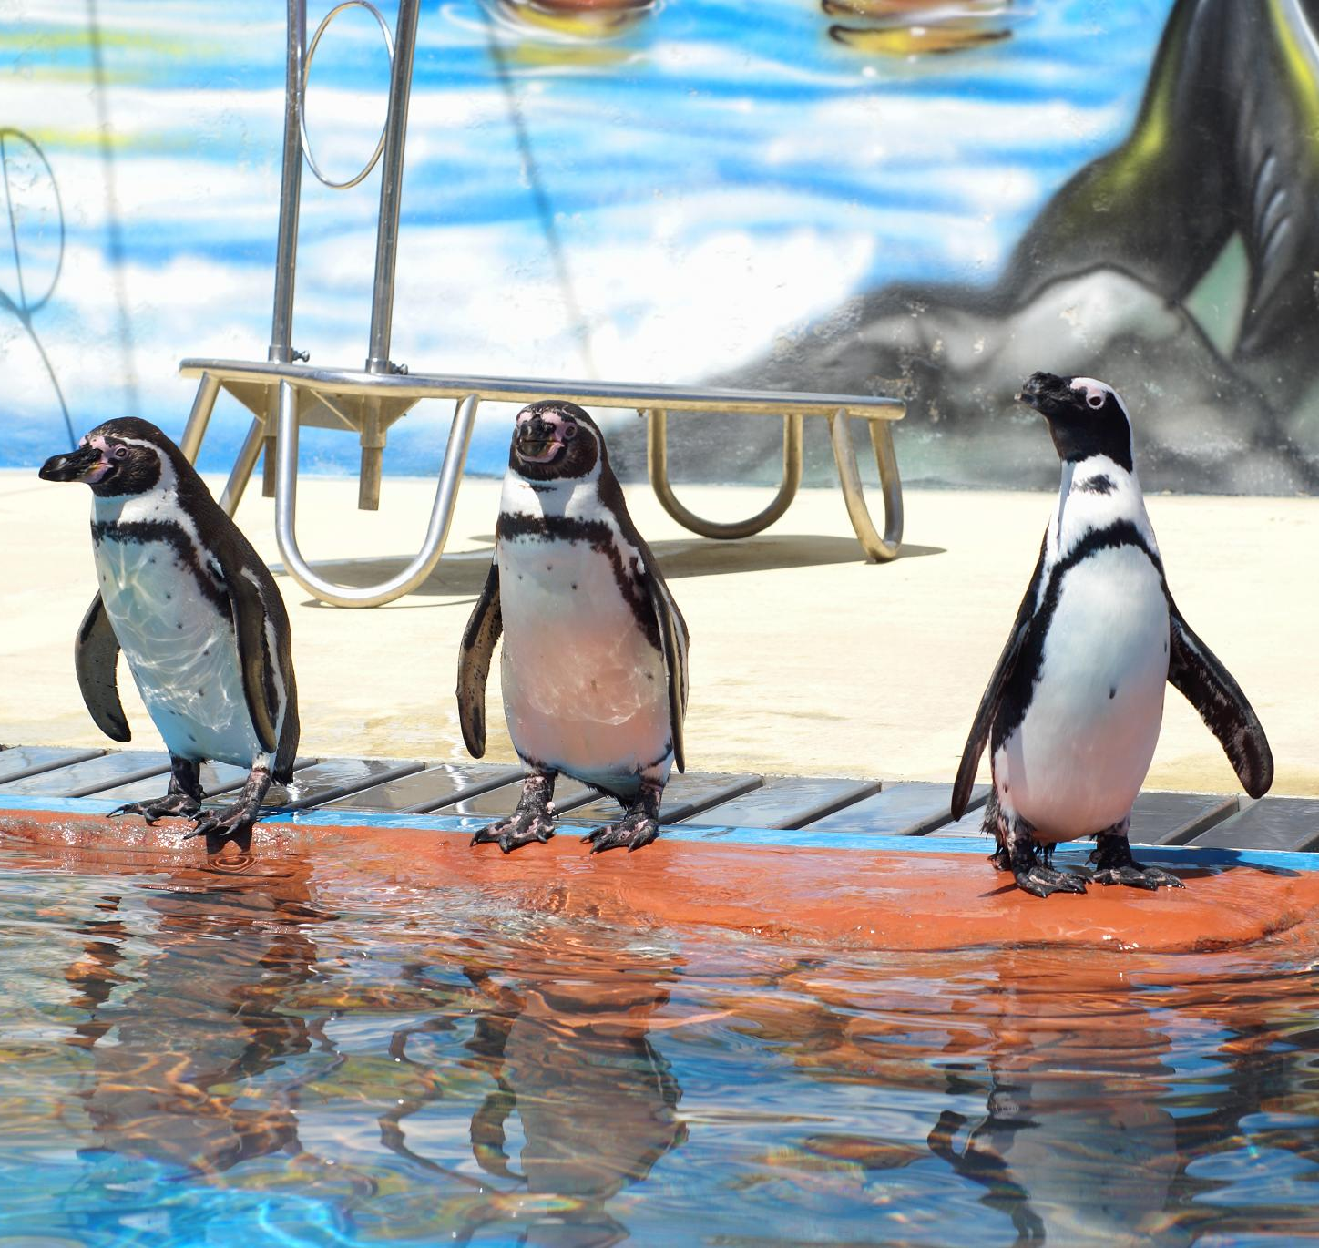
Example: Writing About Penguins
Clear Topic Sentence
  Begins the paragraph by introducing penguins as birds living in cold places.
Supporting Facts
  Includes key facts about penguins swimming skills and feather insulation.
Concluding Sentence
  Ends with a sentence summarizing penguins' special adaptations to icy climates.
Notes:
To illustrate how students can apply the standard, consider an example about penguins. A well-structured expository paragraph might begin with a topic sentence such as, 'Penguins are birds that live in cold places.' This introduces the subject clearly. Supporting facts could include, 'Penguins cannot fly but are great swimmers,' and 'They have thick feathers to stay warm.' These facts provide informative content that develops the topic. The paragraph would end with a concluding sentence like, 'Penguins are special birds that survive in icy climates.' This structure—introduction, development with facts, and conclusion—demonstrates how students can effectively meet the expectations of the standard.

Slide 26

Practice Activity
Topic Selection
  Choose a topic your child finds interesting to encourage engagement and focus.
Structured Writing
  Write an introduction, followed by facts, then a concluding sentence to organize thoughts.
Interactive Learning
  Discuss topics and research facts together to make the activity engaging and collaborative.
Confidence Building
  Regular practice improves writing fluency and builds children’s confidence in their skills.
Notes:
Engaging in practice activities at home can reinforce expository writing skills. Choose a topic your child is interested in, such as dogs, space, or apples. Ask them to write one sentence to introduce the topic, followed by two or three facts or definitions that explain it. Finally, have them write a concluding sentence that summarizes the information. This simple structure helps children organize their thoughts and ensures their writing is focused and informative. You can make the activity more interactive by discussing the topic together, researching facts, and reviewing the written piece for clarity and completeness. Regular practice builds confidence and improves writing fluency.

Slide 27

Student Goals for 2.T.T.2.d
Expository Writing Structure
  Students write clear topic sentences, include facts and definitions, and use concluding statements.
Logical Organization
  Students organize ideas logically and stay focused on the topic throughout their writing.
Vocabulary Usage
  Appropriate vocabulary is used to explain ideas clearly and effectively in writing.
Parental Support
  Parents can encourage writing, provide feedback, and celebrate progress to build confidence.
Notes:
By the end of Grade 2, students should be able to write expository texts that include a clear topic sentence, use facts and definitions to develop the topic, and end with a concluding statement. They should stay on topic, organize their ideas logically, and use appropriate vocabulary. These goals help students become effective communicators and prepare them for more complex writing tasks in future grades. Parents can support these goals by providing opportunities for writing, offering feedback, and celebrating progress. Encouraging your child to write about what they learn and share their writing builds pride and reinforces the importance of clear, informative communication.

Slide 28
Standard 3
2.LV. 3.c: Determine the relationship between words and their synonyms and antonyms.
Notes:
---

Slide 29
🧠 Why It Matters
- Builds vocabulary and word choice.
- Helps students understand word meanings more deeply.
- Improves reading comprehension and writing skills.

Slide 30
🔁 What Are Synonyms?
Synonyms are words that have similar meanings.
Example: Happy – Joyful – Cheerful – Glad
Activity: Ask your child to think of other words for 'big' or 'fast'.

Slide 31
🔄 What Are Antonyms?
Antonyms are words that have opposite meanings.
Example: Hot – Cold, Fast – Slow, Happy – Sad
Activity: Play a game where you say a word and your child says the opposite.

Slide 32
🏠 Practice at Home
- Read a book together and find words with similar or opposite meanings.
- Use flashcards with synonyms and antonyms.
- Ask: 'Can you think of another word for this?' or 'What's the opposite of that word?'

Slide 33
🎯 Student Goals
By the end of Grade 2, students should be able to:
✅ Identify synonyms and antonyms.
✅ Use them to understand and explain word meanings.
✅ Improve their vocabulary and writing with better word choices.

Slide 34
Contact Us
For any additional questions or details, don’t hesitate to reach out to your child’s teacher.

