Slide 1

House Bill 1525: Sexual Education
Janette m. Rodriguez, rn
Health services coordinator

Slide 2
Brief Overview of HB 1525 Requirements
House bill 1525 was voted into law at the end of 2021.
This was the first time in more than two decades that the texas state board of education changed the minimum curriculum standards for health and sexual education.

Slide 3
Key Terminology
SHAC – School Health Advisory Council
  Group appointed by the school district to ensure that local community values are reflected in health education instruction; play an important role in strengthening the connection between health and learning
SBOE – State Board of Education
  Sets policies and standards for Texas public schools
TEKS – Texas Essential Knowledge and Skills
  State standards for what students should know and be able to do
Texas Education Code 28.004
  Laws and rules passed by the Texas legislature regarding local School Health Advisory Council and health education instruction
TIMA – Technology and Instructional Materials Allotment
  Funds that can be utilized to purchase instruction materials; technological equipment; certain related software, systems, and services; and salaries for specific technical support employees

Slide 4
What is the SHAC’s role in HB 1525?
School boards must adopt a formal policy establishing a process for the adoption of health and sexual education curriculum materials, which includes a resolution directing the SHAC to make recommendations regarding health and sexual education.
  Agenda Item 2.4 – Reviewed and discussed during Administrative Committee Meeting on 5/3/22
  Agenda Item 5.8 – Approved during Monthly Board Meeting on 5/10/22
Once the resolution is passed, the SHAC can convene and discuss health and sexual education curriculum options.
The SHAC must hold two public meetings and make curriculum available for review during this adoption process.
After the SHAC reviews curriculum materials and holds two public meetings, then the SHAC will make a recommendation to the school board of curriculum material that is reflective of the community’s values.
The school board must take action on the SHAC’s recommendation through a vote at a public meeting.

Slide 5
Process of adopting new curriculum
School board must pass a resolution
SHAC can convene to discuss curriculum options
SHAC must hold two public meetings
SHAC will make a recommendation for new curriculum to the school board
School board will vote on SHAC’s recommendation in a public meeting

Slide 6
Additional HB1525 Requirements
Once a health and sexual education curriculum is voted on by the school board, then the following must occur:
  Parents will receive a detailed description of the content of the district’s human sexuality instruction, along with a general schedule of instruction.
  Parents must provide active consent for their child to participate.
    Consent forms must be sent 14 days prior to the student receiving the health and sexual education curriculum.
    Consent form must not be included with any other consent forms. It must be a “stand alone” document.
  Sexual education curriculum must be available to parents.
    Materials that are in the public domain will be posted on the school district’s website.
    Materials that are copyrighted and not in the public domain can be viewed at the student’s home campus or electronically (in a secure manner).
  Any purchase agreements that school districts enter into with publishers must specify that parents of enrolled students can purchase a copy of curriculum materials at the same price paid by the district.

Slide 7
What will be taught?
Curriculum options vary, but the new TEKS include educating students on age-appropriate information of the following:
  Anatomy, puberty and menstruation
  Human reproduction
  Importance of abstinence
  Contraception
  Prevention, screening, and treatment of sexually transmitted infections
  Healthy friendships, relationships, and marriage
  Preventing and recognizing abuse, sexual assault, sexual harassment, and sex trafficking
  Setting boundaries and respecting the boundaries of other people

Slide 8
State Board of Education Curriculum
Districts do not have to use curriculum materials that were adopted by SBOE.
  Districts may use their TIMA for materials that were not adopted by SBOE.
What are the benefits of using SBOE-adopted materials?
  Ease of ordering
  Free access to materials for students with disabilities (large print, etc).
Districts should be able to show that they are providing 100% of TEKS.
Curriculum materials must:
  Be age-appropriate
  Reviewed by academic experts for the subject and grade level they are intended
  Stress abstinence per Texas Education Code 28.004

Slide 9
Evidence-based programs or health textbooks?
As identified by www.texasisready.org
Evidence-based programs
  Pros
    More likely to have been developed by health experts and evaluated for efficacy
    May include contents on topics not included in TEKS
  Cons
    May not cover all health TEKS
    May be more complicated to acquire
Health textbooks
  Pros
    May be more likely to meet Health Education TEKS
    If adopted by SBOE, easy to order using TIMA funds
  Cons
    Not evaluated for efficacy
    May not cover content not included in TEKS (ex: consent, inclusivity, etc)

Slide 10
Factors to consider when selecting curriculum
As identified by www.texasisready.org
What percent of TEKS does the curriculum cover?
If it does not cover 100% of TEKS, what supplemental materials will we use to cover missing TEKS?
Does the curriculum align with state statute?
What is the cost of the curriculum?
What resources are needed to deliver the curriculum?
Who will deliver the curriculum?
Has the curriculum been evaluated for effectiveness? Does the evaluated population match the district population?
If our district wishes to include content on consent or LGBTQ inclusivity, is that included in the curriculum? If not, are there other materials we could incorporate as standalone lessons?

Slide 11
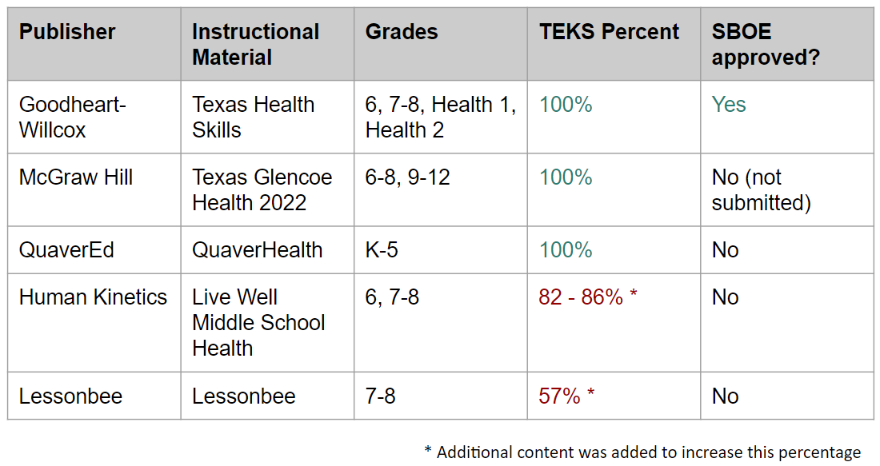
Overview of Health Education Textbooks
www.texasisready.org
Websites
https://www.g-w.com/tx-health-skills-hs-2023#:~:text=A%20complete%20educational%20package%20for,and%20online%20communication%20and%20safety.
https://www.mheducation.com/prek-12/program/glencoe-health-2022/MKTSP-GIF04MO.html?page=1&sortby=title&order=asc&bu=seg
https://www.quavered.com/healthandpe/
https://us.humankinetics.com/pages/live-well-middle-school-health
https://lessonbee.com/

Slide 12
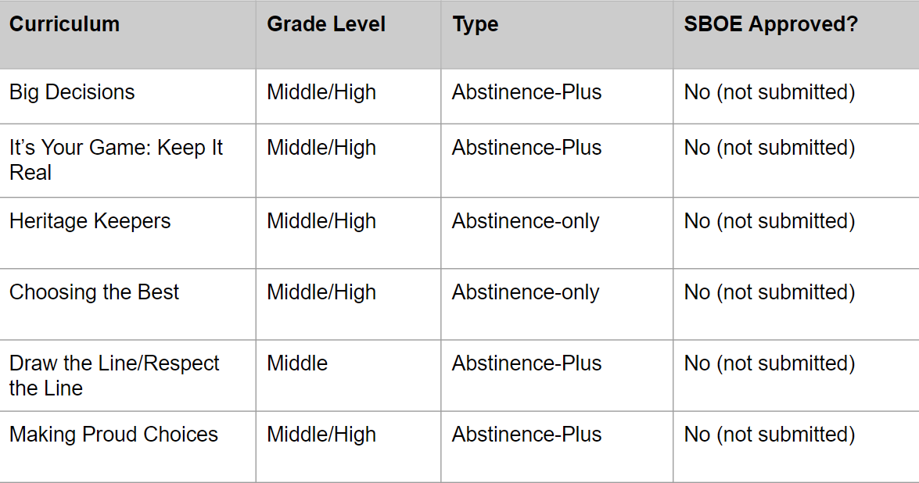
Overview of Evidence-Based Programs
www.texasisready.org
Websites
https://www.hf-tx.org/bigdecisions
https://sph.uth.edu/research/centers/chppr/iyg/
https://www.heritageservices.org/curriculum/heritage-keepers-abstinence-education-level-i/
https://www.choosingthebest.com/curricula
https://www.etr.org/ebi/programs/draw-the-line/
https://www.etr.org/ebi/programs/making-proud-choices/

Slide 13
Evidence-Based Programs:
Abstinence-Only vs. Abstinence-Plus
As defined by https://txcampaign.org/
Abstinence-Only
  Programs that teach abstinence as the only morally correct option of sexual expression for teenagers.
  Information is censored about contraception and condoms for the prevention of STDs and unintended pregnancy.
  According to the Texas Campaign to Prevent Teen Pregnancy, abstinence-only programs are not effective in delaying initiation of sexual intercourse or changing other sexual risk behaviors.
  Program is also known as Abstinence-Only-Until-Marriage (AOUM)
Abstinence-Plus
  Programs that include information about condoms and other forms of contraception and the prevention of STDs in the context of strong abstinence messages.
  According to Texas Is Ready, decades of research indicate that abstinence-plus sex education supports healthy outcomes, including delaying the onset of sexual activity and increased rates of contraceptive use to avoid unintended pregnancies and the transmissions of STDs.

Slide 14


Input from parents and community
Two public meetings – required
Parent Survey

Slide 15
What are our next steps?
Schedule SHAC Meeting #4 to discuss curriculum options in detail
Schedule two public meetings
  Consider having representatives from curriculum companies/organizations provide a presentation on their curriculum materials
Consider sending a survey to parents
Make curriculum available to parents and community during the review/adoption process

Slide 16
Resources
Texas Is Ready – www.texasisready.org
The Texas Campaign to Prevent Teen Pregnancy – https://txcampaign.org/
North Texas Alliance to Reduce Unintended Pregnancy in Teens – https://www.ntarupt.org/sex-ed-in-texas/
Newly adopted Health and Sexual Education TEKS – https://tea.texas.gov/sites/default/files/HealthTEKS-Ch115_adopted-11-2020.pdf

Slide 17

Questions?

