Slide 1



School health advisory council
Janette M. BRISTOW, rn
araceli soto, bsb/hrm

Slide 2

SBCISD SHAC – historical data
  Due to COVID and change in leadership, SHAC meetings had not been held consistently until 2021-2022.
  Previously, the SHAC collaborated with different departments and organizations to promote a healthy lifestyle for our San Benito CISD students, staff, and community.

Slide 3

What is a school health advisory council (shac)?
  Defined in Texas Education Code Title 2, Chapter 28 §28.004
  Advisory council to assist the district in ensuring that local community values are reflected in the district's health education instruction.
  A school district must consider the recommendations of the local SHAC before changing the district's health education curriculum or instruction.
  SHACs are required in every public school district.

Slide 4
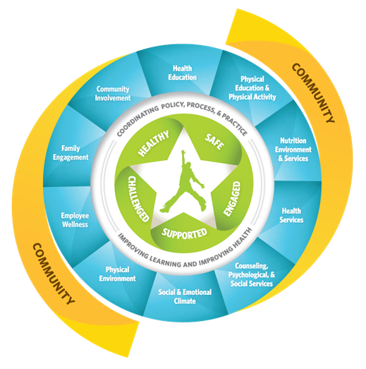
Shac: coordinated school health program
CDC: https://www.cdc.gov/healthyschools/wscc/index.htm

Slide 5

Shac members
  The board of trustees shall appoint at least five members to the local SHAC.
  A majority of members must be parents of students enrolled in district and not employed by the district.
  Parent must serve as chair or co-chair of the SHAC.
    SHAC is considered a parent-led council.

Slide 6

Shac meeting requirements
  Required to meet at least 4 times during the school year.
  HB 1525 87th Legislative Session Updates
    At least 72 hours prior to the meeting:
      Post notice of date, time, location, and subject of SHAC meeting in central administrative office at each campus in the school district.
      Post notice above on District’s Internet Website

Slide 7
Shac meeting requirements
  HB 1525 87th Legislative Session Updates
    Prepare and maintain minutes of the meeting
      Include subject and content of each deliberation and each vote, order, decision, or other action taken by the council during the meeting
    Make audio or video recording of the meeting
    Submit to district the minutes and recording not more than 10 days after meeting was held
    District must post minutes and recording of meeting on website

Slide 8
Shac: annual report
  The School Health Advisory Council must submit an annual report to the Board of Trustees with a detailed account of SHAC activities and recommendations, including:
    Any SHAC recommendation concerning the school district’s health education curriculum and instruction;
    Any suggested modification to a SHAC recommendation previously submitted to the board;
    A detailed explanation of the SHAC’s activities during the period between the date of the current report and the date of the last prior written report; and
    Any recommendations made by the physical activity and fitness planning subcommittee of the SHAC.

Slide 9

Shac bylaws
  Currently being reviewed
  Will provide copies to members once bylaws are finalized

Slide 10

Required subcommittees
  The Texas Education Code (TEC) requires the SHAC to establish a physical activity and fitness planning subcommittee.
  The purpose of the subcommittee:
    Consider issues related to student physical activity and fitness
    Make policy recommendations to increase physical activity and improve fitness among students

Slide 11

Shac goals: 2021-2022
  Goal 1: Implementation of the School Health Advisory Council
    Compliance with all regulations and requirements
  Goal 2: Promotion of a healthy lifestyle for students
    Promotional materials (ex: posters, brochures, etc)
    Parental involvement and education

Slide 12

Tentative meeting dates
  Thursday, December 1, 2022
    3pm via Microsoft Teams
  Thursday, February 23, 2023
    3pm via Microsoft Teams
  Thursday, April 27, 2023
    3pm via Microsoft Teams

Slide 13
Shac resources
  DSHS
    https://www.dshs.texas.gov/schoolhealth/shac.aspx
  CDC
    https://www.cdc.gov/healthyschools/wscc/index.htm
  TEA
    https://tea.texas.gov/texas-schools/health-safety-discipline/coordinated-school-health
  It’s Time Texas
    https://itstimetexas.org/shac/

Slide 14

Questions?

