Slide 1

School Council 2025/2026
Ronnie Banyard, Jr., principal
October 29, 2025

Slide 2
VISION & MISSION
VISION:
At Shoal Creek Elementary, we envision a harmonious, student-centered learning community that empowers every student to reach their fullest potential through elevated experiences, while nurturing compassionate, engaged, and globally-minded citizens through empathy, accountability, transparency, and collaboration.
MISSION:
At Shoal Creek Elementary, our mission is to inspire and support every learner each day by fostering academic and social-emotional growth through data-driven instruction, strong family and community partnerships, and a steadfast commitment to a culture of excellence in welcoming, collaborative spaces.

Slide 3
WE ARE……
Student- Centered/Data Driven: Utilizing multiple forms of data to best support our students
Collaborative: Partnership is key! No one group can do this amazing work alone
Engaging & Empathetic: Elevating experiences for students ignites an increased engagement. We are empathetic to the needs of our school community that allow use to promote student achievement and voice for internal and external stakeholders

Slide 4
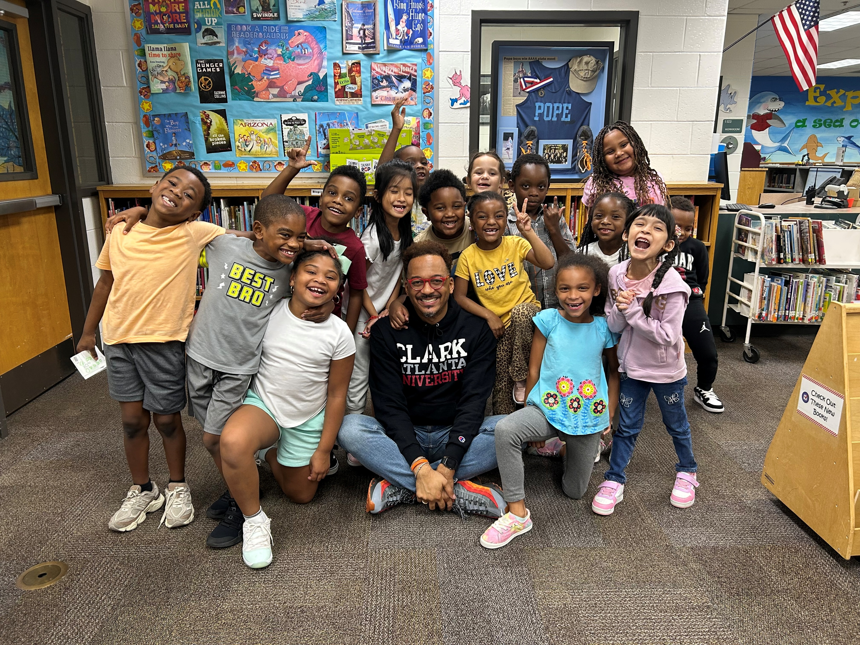
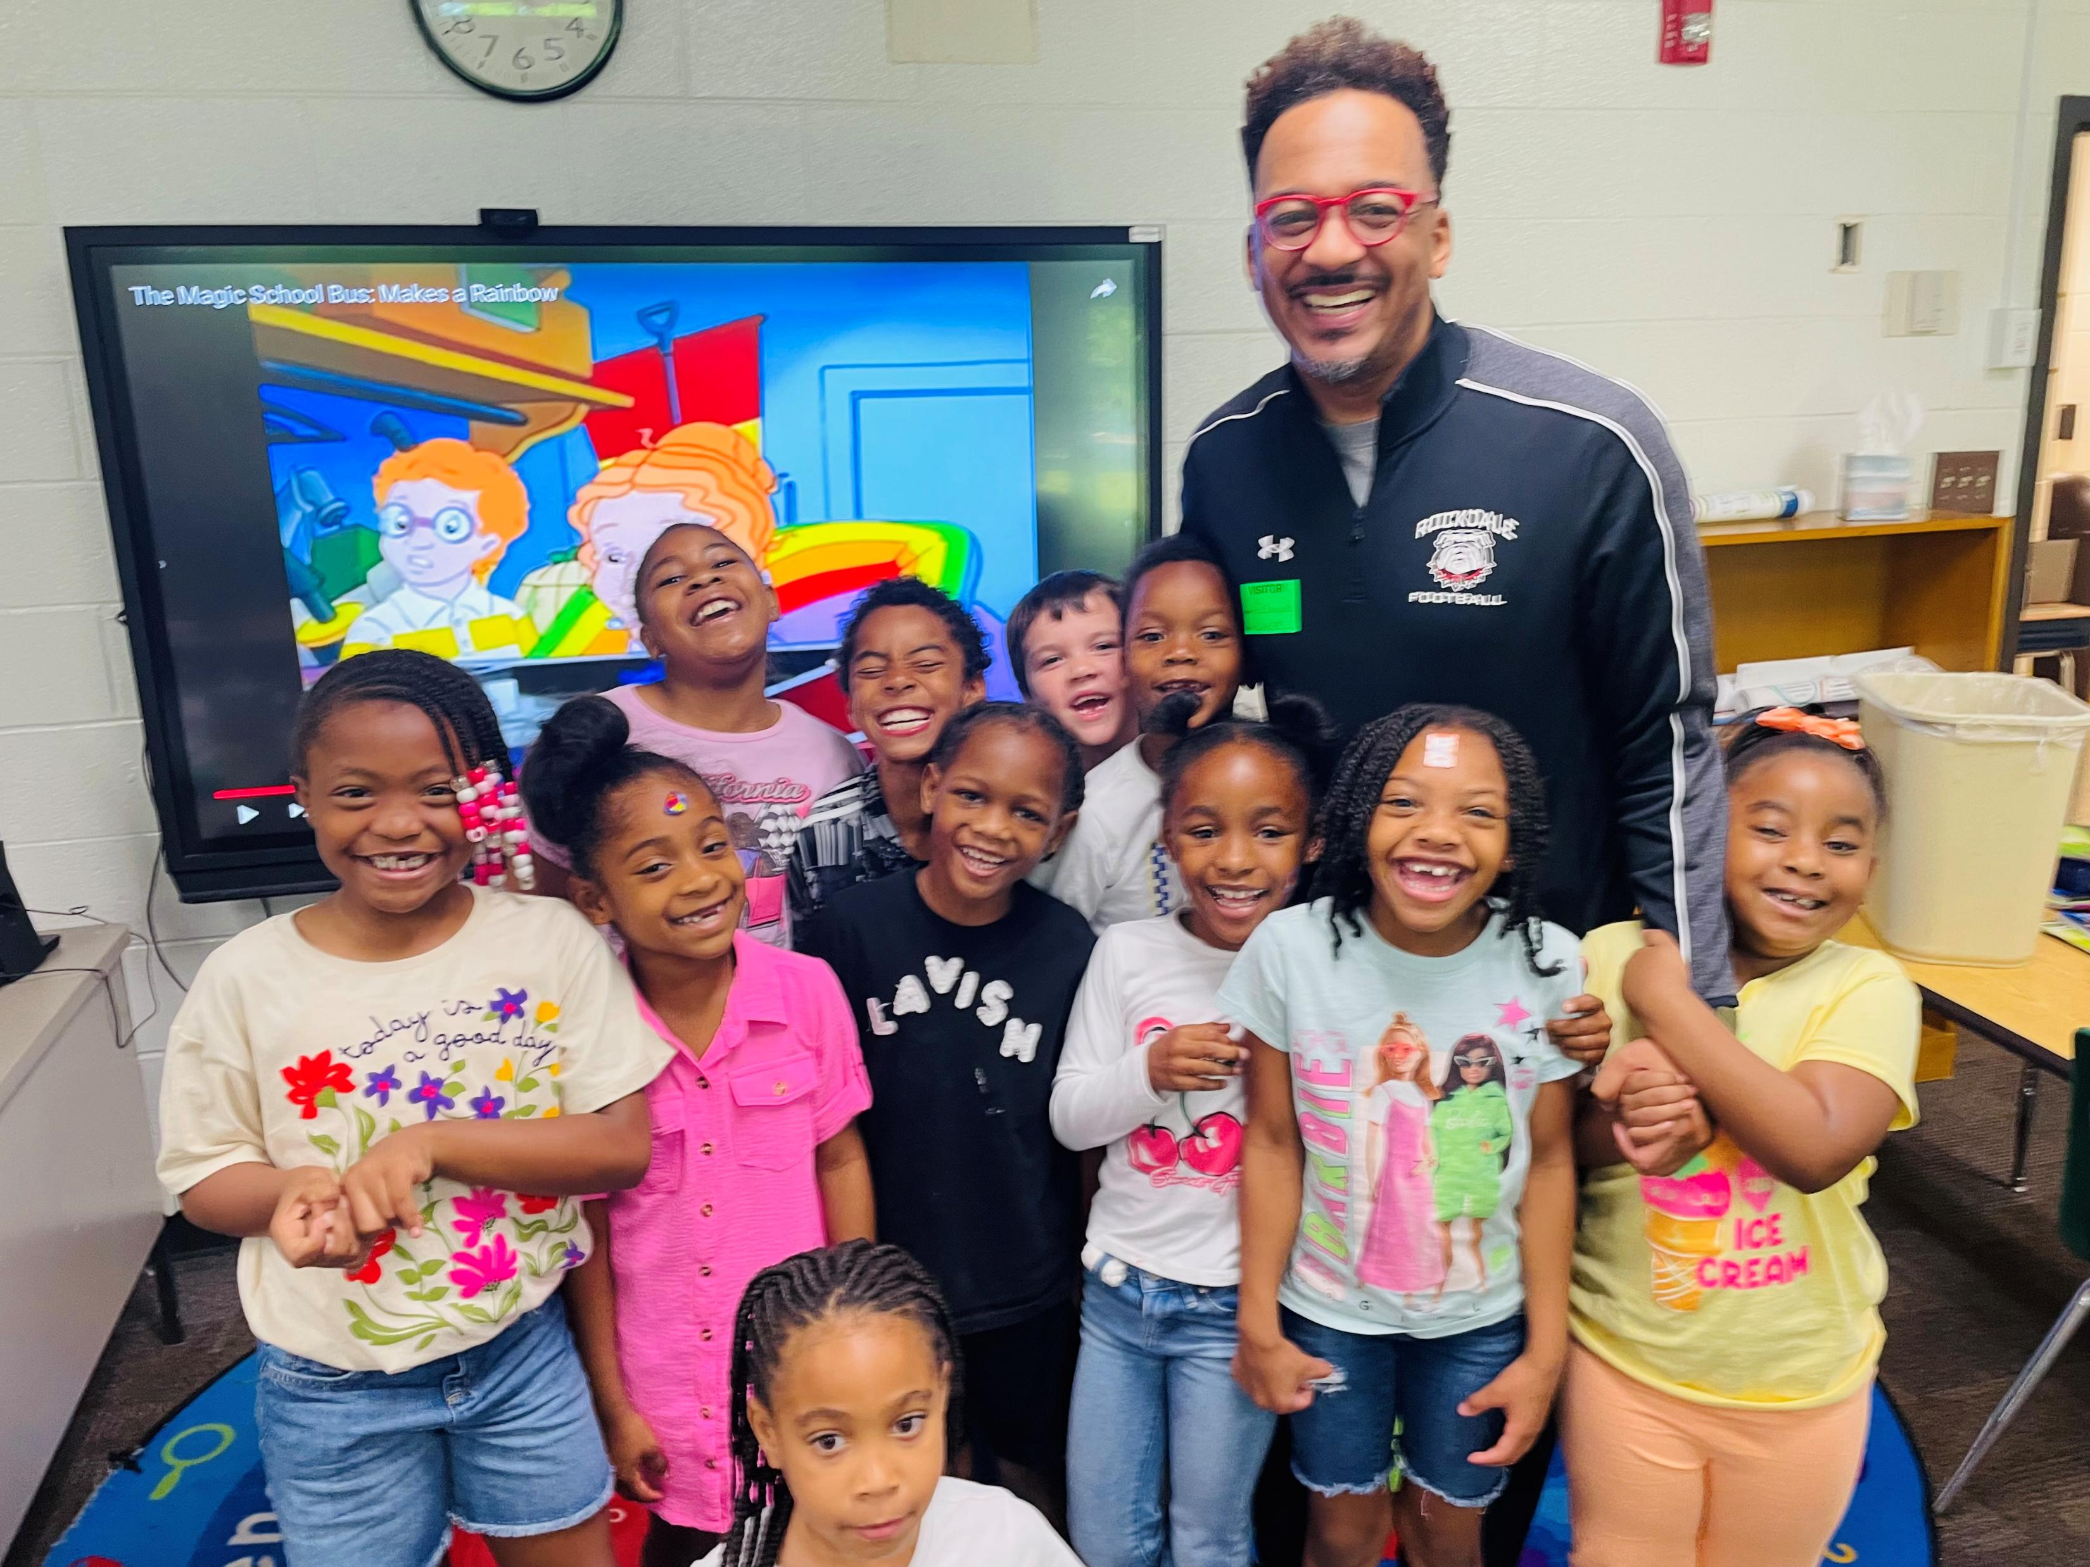

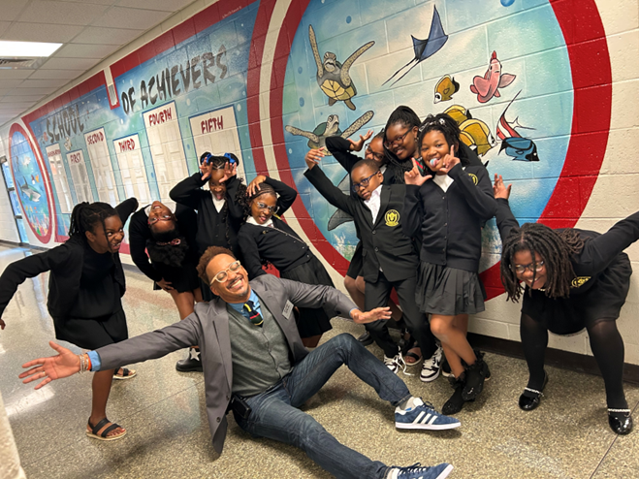
YOUR PRINCIPAL
Graduate of Clark Atlanta University
Graduate of the University of West Georgia
16 years in Education
Alternative Education Teaching Experience
Former Behavior Specialist
Former High School Assistant Principal
Previous District Level Experience
Former Middle School Principal

Slide 5

DISTRICT PRIORITIES

Slide 6
THE SCHOOL COUNCIL IS…..
Is an advisory group
Focuses on school improvement and student achievement
A method to involve community in the educational process
Exists to probe advice, assistance and recommendations on matters related to student achievement and school improvement
OUR OVERALL PURPOSE

Slide 7
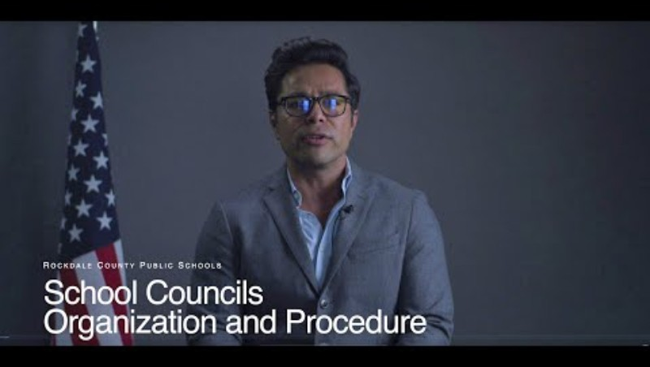
SCHOOL COUNCIL TRAINING VIDEO

Slide 8

SCE SIP GOALS & ACADEMIC TARGETS
  Math: By the end of the 2025-2026 school year, SCE will see a 10 – percentage points increase in 3rd-5th grade students performing at the developing, proficient and distinguished levels in the areas of math as evidenced by the Georgia Milestones Assessment. Target: 39% to 49%
  Language Arts/Reading: By the end of the 2025--2026 school year, SCE will see a 10- percentage point increase in 3rd-5th grade students performing at the developing, proficient and distinguished levels in the areas of reading as evidenced by the STAR Reading and Georgia Milestones Assessment.
  Target: 36% to 46%
  Science: By the end of the 2025-2026 school year, SCE will see a 10 – percentage points increase in 5th grade students performing at the , developing, proficient and distinguished levels in the areas of Science as evidenced by the Georgia Milestones Assessment. Target: 36% to 46%

Slide 9
SCE TITLE I PROGRAM SY 2026
TOTAL BUDGET: $240,840
Our SY26 Title I Plan Includes:
Increasing students’ performance in ELA, Math, School Culture, and Attendance
Expenditures include:
  Paraprofessionals salaries and benefits
  Planning
  Part Time Parent Liaison
  Attendance Support
  PBIS Software

Slide 10

BOY READING DATA - OVERALL

Slide 11
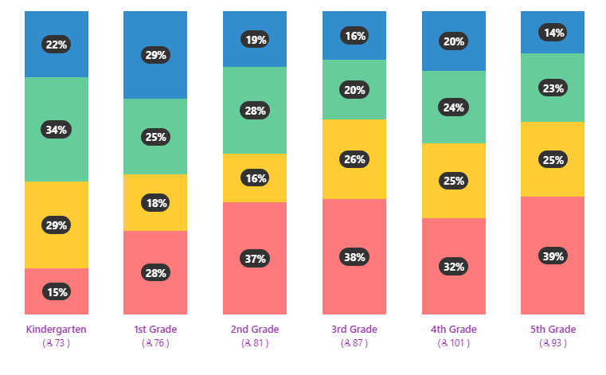
BOY READING DATA - BY GRADE

Slide 12
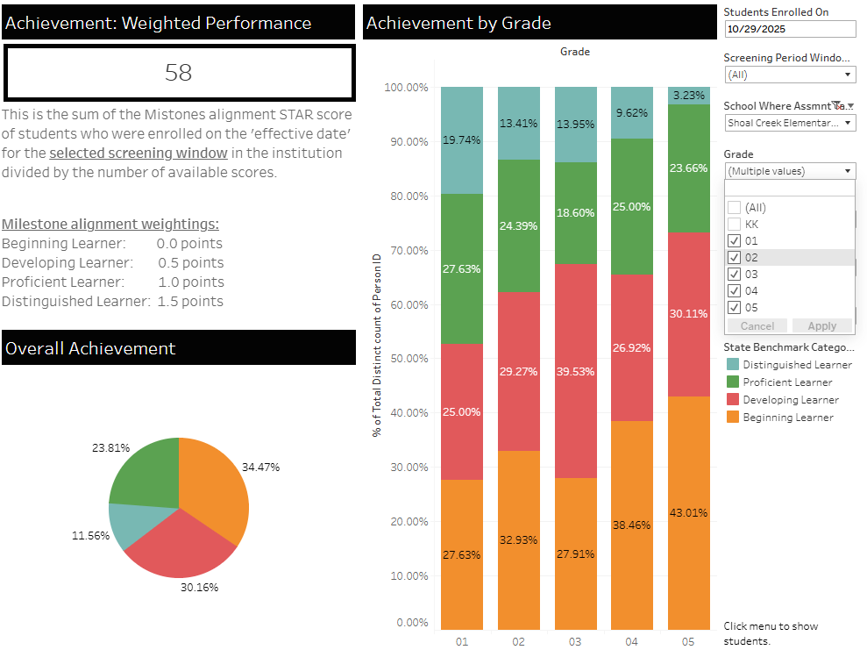

BOY MATHEMATICS - OVERALL

Slide 13
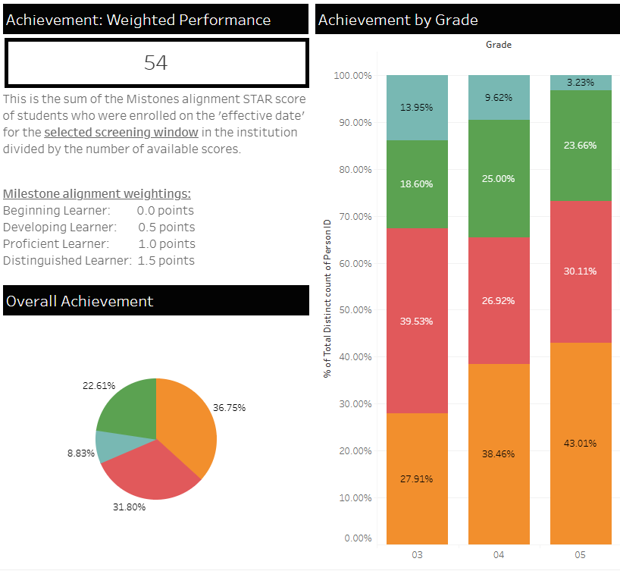
BOY MATHEMATICS – GRADES 3 THRU 5

Slide 14
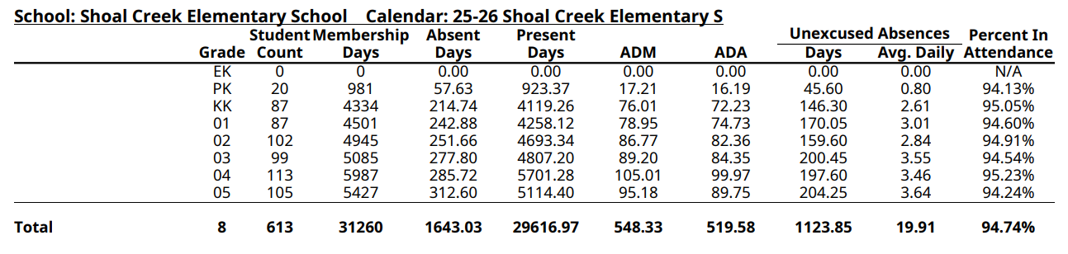
SCE STUDENT ATTENDANCE

Slide 15
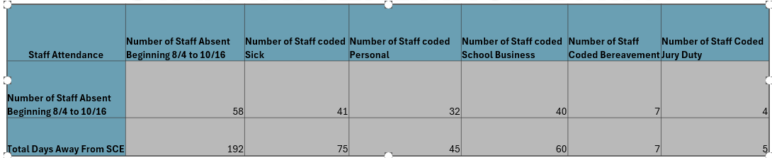
SCE STAFF ATTENDANCE

Slide 16
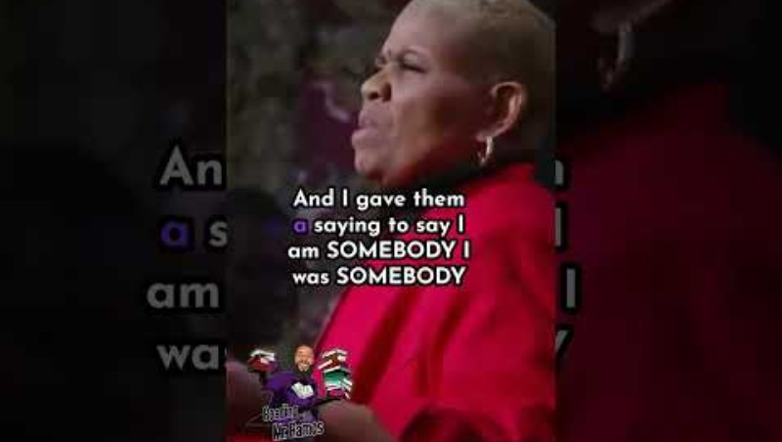
THANK YOU
WE ARE ONE
ONE VISION, ONE MISSION,
ONE DAY AT A TIME

