Slide 1

Title I Parent Workshop
October 28th, 2025
1st Grade
What strategies can I use to
help my child in literacy?

Slide 2


Hot Standard:
ELAGSE1L1.e: Use verbs to convey a sense of past, present, and future (e.g., Yesterday I walked home; Today I walk home; Tomorrow I will walk home).
Today, I am learning how to identify and use past, present, and future tense verbs in sentences.
I will know I am successful when I can:
Identify past, present, and future tense verbs in sentences.
Use past, present, and future tense verbs in sentences when writing.
Explain how verbs are used in past, present, and future tense in sentences.

Slide 3
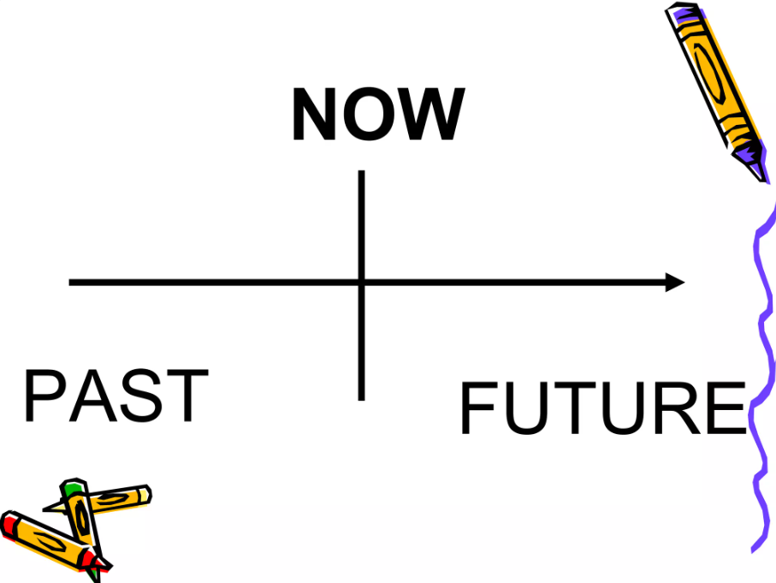
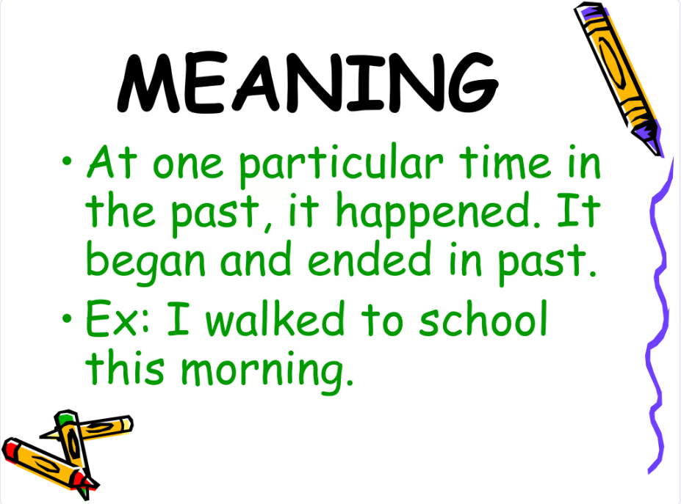
What is a past tense verb?

Slide 4
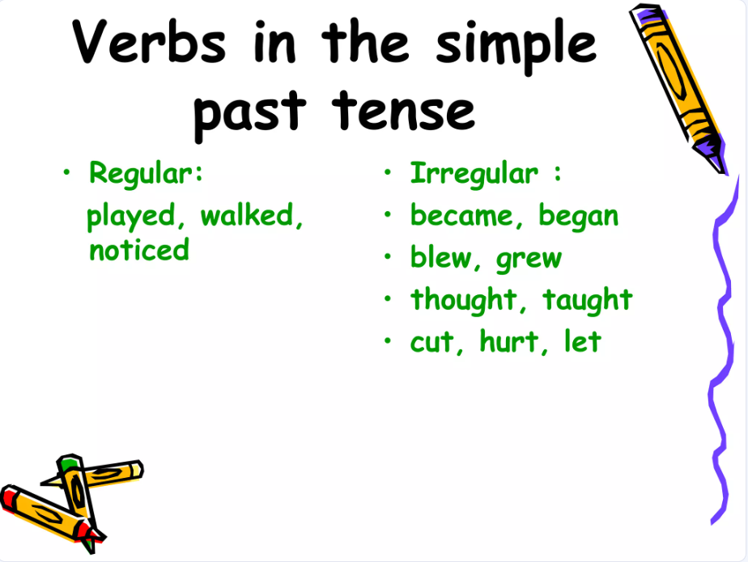
What is a past tense verb?

Slide 5
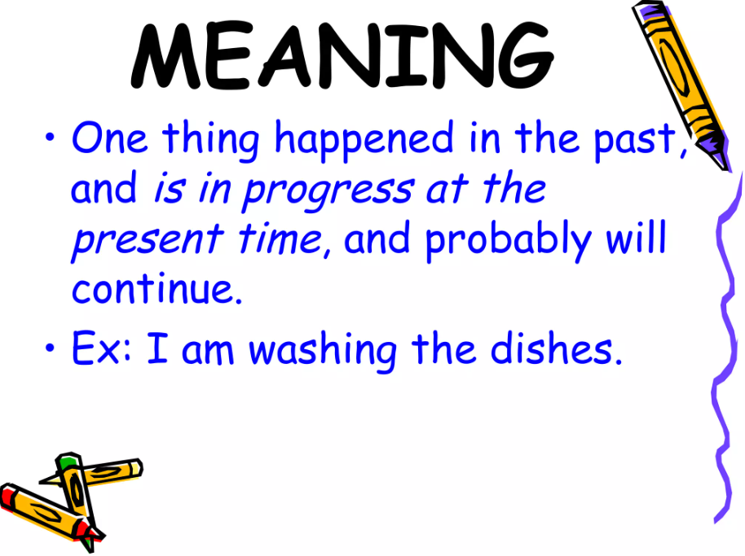
What is a present tense verb?

Slide 6
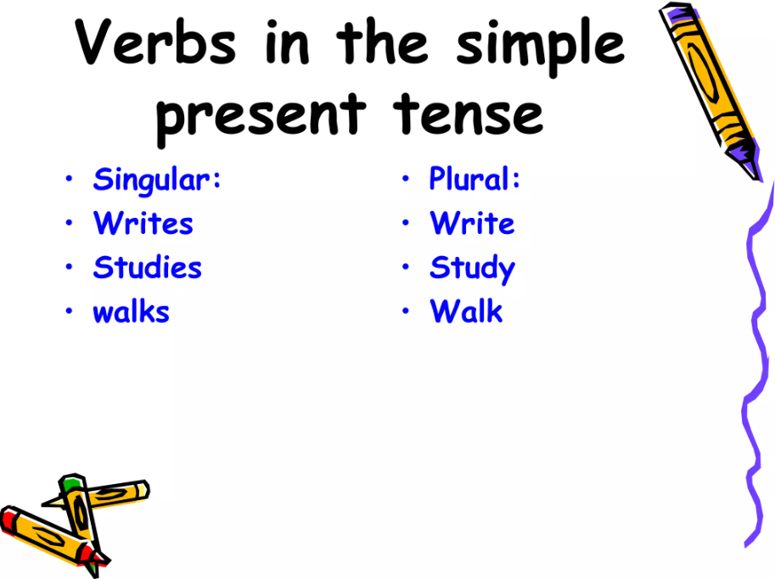
What is a present tense verb?

Slide 7
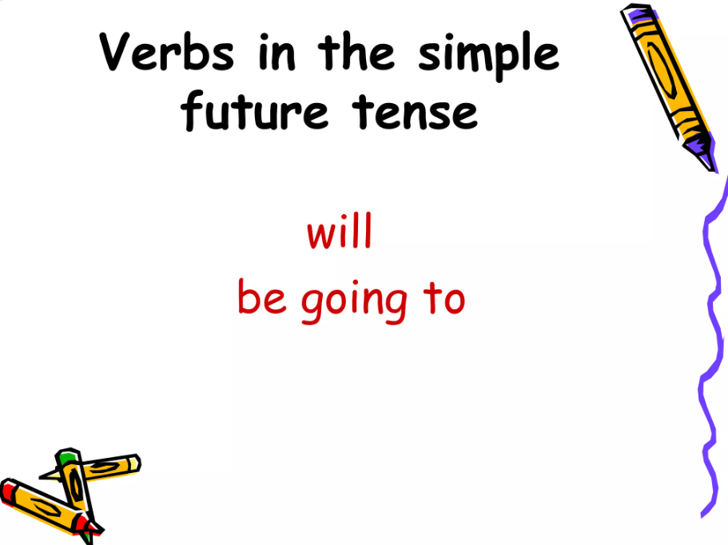
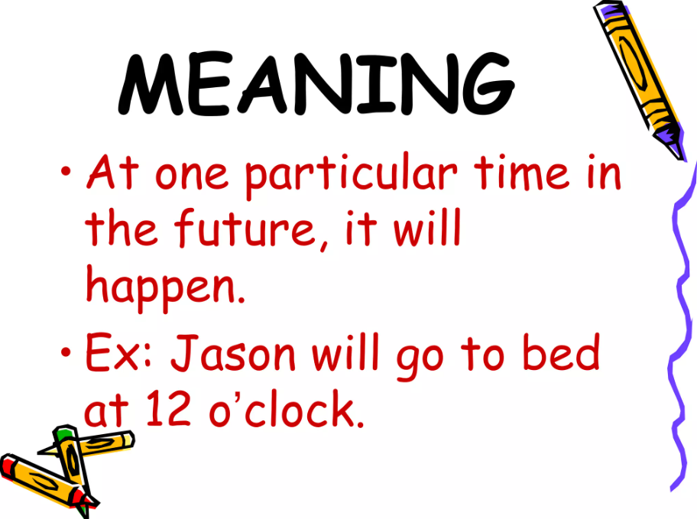
What is a future tense verb?

Slide 8
What is a future tense verb?

Slide 9



What’s next in ELA?

Slide 10

Current Standards:
ELAGSE1RL1: Ask and answer questions about key details in a text.
ELAGSE1RL2: Retell stories, including key details, and demonstrate understanding of their central message or lesson.
ELAGSE1RL3: Describe characters, settings, and major events in a story, using key details.
ELAGSE1RL5: Explain major difference between texts that tell stories and texts that give information.
ELAGSE1RL7: Use illustrations and details in a story to describe its characters, setting, or events.
ELAGSE1RL9: Compare and contrast the adventures and experiences of characters in stories.
Asking and answering the 5 W’s when reading and retelling stories.

Slide 11


Scan the QR code for more information on GaDOE website for at-home activities to do with your child!

Slide 12
Title I Parent Workshop
October 28th, 2025
What strategies can I use to
help my child in math?

Slide 13
Hot Standard:
1.NR.2.1 Use a variety of strategies to solve addition and subtraction problems within 20.
Today, I am learning about
    Finding an unknown number in an addition equation.
I'll know I am successful when I can:
    Use strategies to find the unknown number in an addition equation.

Slide 14
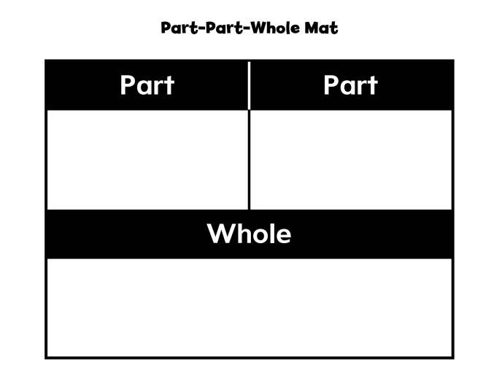
Part Part Whole is a method used to decompose numbers.
Taking number a part (part, part) and placing the parts together to create a number (whole).
Example:
8 (part) + 2 (part)=10 (whole)

Slide 15
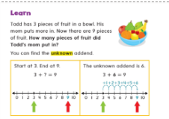
Todd has 3 pieces of fruit in a bowl.
His mom puts more in. Now there are 9 pieces of fruit. How many pieces of fruit did Todd's mom put in?
In this math problem, we must solve for the unknown addend.
We start with 3 and we end with 9. 3+?=9
We use a number line to solve for the unknown addend.

Slide 16


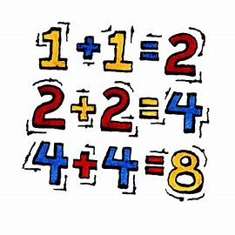
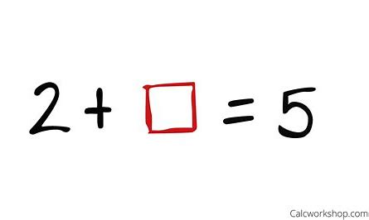
What’s next in math?

Slide 17
Current Standards:
1.NR.2 Explain the relationship between addition and subtraction and apply the properties of operations to solve real-life addition and subtraction
problems within 20.
o 1.NR.2.1 Use a variety of strategies to solve addition and subtraction problems within 20.
o 1.NR.2.2 Use pictures, drawings, and equations to develop strategies for addition and subtraction within 20 by exploring strings of related
problems.
o 1.NR.2.3 Recognize the inverse relationship between subtraction and addition within 20 and use this inverse relationship to solve
authentic problems.
o 1.NR.2.4 Fluently add and subtract within 10 using a variety of strategies
o 1.NR.2.5 Use the meaning of the equal sign to determine whether equations involving addition and subtraction are true or false.
o 1.NR.2.6 Determine the unknown whole number in an addition or subtraction equation relating to three whole numbers.
o 1.NR.2.7 Apply properties of operations as strategies to solve addition and subtraction problem situations within 20.

Slide 18
MGSE1.OA.4 Understand subtraction as an unknown-addend problem. For example, subtract 10 – 8 by finding the number that makes 10 when added to 8
MGSE1.OA.5 Relate counting to addition and subtraction (e.g., by counting on 2 to add 2). MGSE1.OA.6 Add and subtract within 20. a. Use strategies such as counting on; making ten (e.g., 8 + 6 = 8 + 2 + 4 = 10 + 4 = 14); decomposing a number leading to a ten (e.g., 13 – 4 = 13 – 3 – 1 = 10 – 1 = 9); using the relationship between addition and subtraction (e.g., knowing that 8 + 4 = 12, one knows 12 – 8 = 4); and creating equivalent but easier or known sums (e.g., adding 6 + 7 by creating the known equivalent 6 + 6 + 1 = 12 + 1 = 13). b. Fluently add and subtract within 10.
MGSE1.OA.6 Add and subtract within 20. a. Use strategies such as counting on; making ten (e.g., 8 + 6 = 8 + 2 + 4 = 10 + 4 = 14); decomposing a number leading to a ten (e.g., 13 – 4 = 13 – 3 – 1 = 10 – 1 = 9); using the relationship between addition and subtraction (e.g., knowing that 8 + 4 = 12, one knows 12 – 8 = 4); and creating equivalent but easier or known sums (e.g., adding 6 + 7 by creating the known equivalent 6 + 6 + 1 = 12 + 1 = 13). b. Fluently add and subtract within 10.

Slide 19
MGSE1.OA.7 Understand the meaning of the equal sign, and determine if equations involving addition and subtraction are true or false. For example, which of the following equations are true and which are false? 6 = 6, 7 = 8 – 1, 5 + 2 = 2 + 5, 4 + 1 = 5 + 2.
MGSE1.OA.8 Determine the unknown whole number in an addition or subtraction equation relating to three whole numbers. For example, determine the unknown number that makes the equation true in each of the equations 8 + ? = 11, 5 = □ – 3, 6 + 6 = ∆.

Slide 20

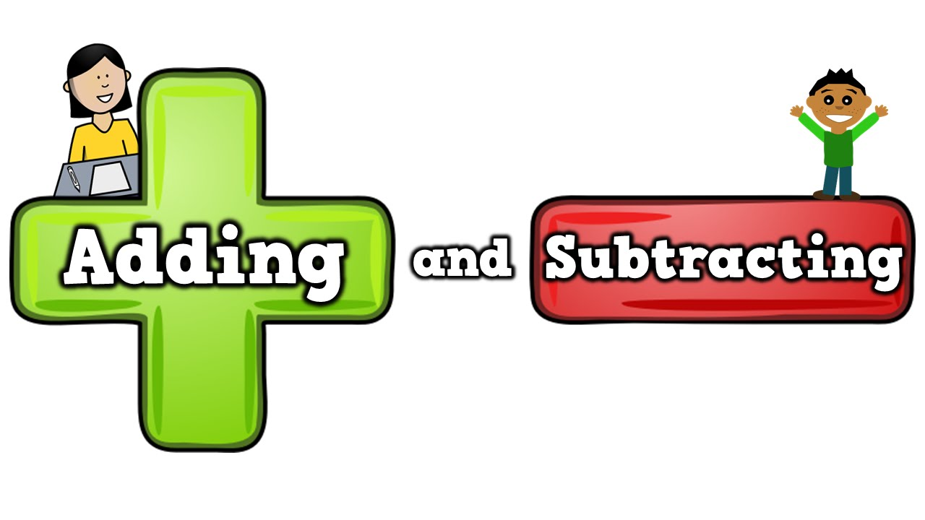
Strategies
for
Strategies for Addition and Subtraction.pptx

Slide 21


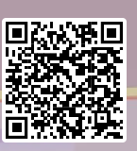
Kahoot Activity

Slide 22


