Slide 1

District Parent/ Student Advisory Committee (DPAC)
October 27, 2025

Slide 2

Hello and …

Slide 3
Introductions
Superintendent - Greg Nehen
Assistant Superintendent - Dr. Chris Grado, Educational Services
Director I - Charles Dunn, Educational Services
Presenter/Facilitator - Dr. Jennifer Slater-Sanchez, Director of Categorical and Special Programs
Site Introductions

Slide 4
Agenda
Purpose of Committee
LCFF/LCAP Defined
LCAP Requirements and Development Process
2025/26 AVUHSD LCAP
Review 2025/26 LCAP Goals and Actions
Metrics to Measure Growth
Survey
Parental Involvement Opportunities
What’s New for the 2025/26 LCAP

Slide 5

Purpose of the District Parent/Student Advisory Committee (DPAC)
This committee:
  - Reviews the current Local Control Accountability Plan (LCAP)
  - Shares/Solicits information from site educational partners
  - Provides input, advice, and comments on revising the LCAP and related plans

Slide 6

LCFF and LCAP OVERVIEW
California’s main education finance law is known as the Local Control Funding Formula (LCFF). LCFF assigns money to school districts based on the number of students that are attending.
Under LCFF, school districts also receive extra money to invest in the education of English Language Learners, Foster Youth, and students living in poverty (Low Income).
The LCFF requires school districts to provide a description to demonstrate how the district is increasing or improving services for students who are ELs, FY, or LI compared to the services provided to all students.

Slide 7

Local Control and Accountability Plan (LCAP)
All school districts in California are required to produce an LCAP, demonstrating how the Local Control Funding Formula (LCFF) funds are linked to meeting the needs of all students.
The LCAP is a three-year plan that describes the goals, actions, services, and expenditures to support positive student outcomes that address state and local priorities.
The LCAP provides an opportunity for school districts to share their stories of how, what, and are why programs and services selected to meet their local needs.
The majority of the LCFF funds are District driven; however, this formula also targets funding to specific student populations (subgroups):
  English Learners
  Foster Youth
  Low Income

Slide 8

LCAP REQUIREMENTS
THE LCAP INCLUDES GOALS, SPECIFIC ACTIONS, AND MEASURABLE STUDENT OUTCOMES FOR EACH OF THE EIGHT STATEWIDE PRIORITIES
Each district’s LCAP must include the following:
Goals
Actions
Related Expenditures
LCAPs must include services that target the following student groups:
ELs
Foster Youth
Low Income
“Reds” on the California Dashboard
Equity Multiplier Sites
LCAPs must address the 8 state priorities

Slide 9

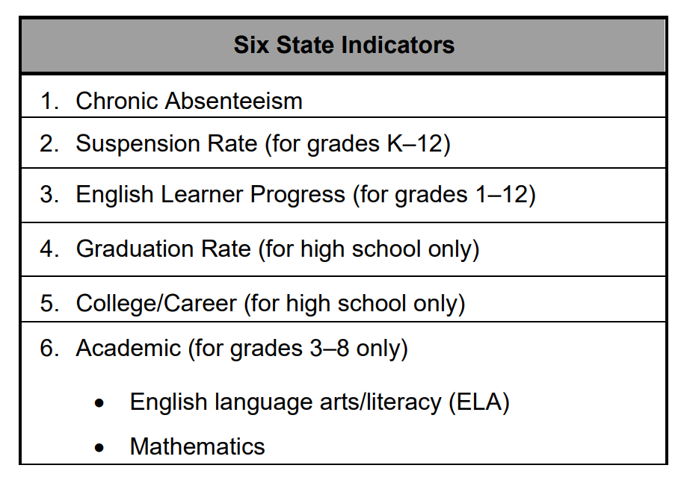
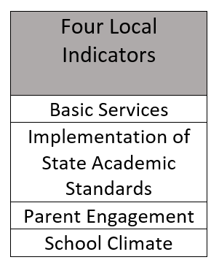
  State Accountability
  The Local Control Funding Formula (LCFF) required the State Board of Education (SBE) to develop an accountability tool, known as the evaluation rubrics, that:
  Include state and local performance indicators for ALL Local Control Funding Formula state priorities.
  Assists local educational agencies in identifying strengths, weaknesses, and areas in need of improvement for LEAs and schools.
  Identifies a process for using the performance standards to identify LEAs in need of additional assistance or intervention.

Slide 10









LCAP Educational Partner Feedback 2025/26
Year-Round LCAP Engagement & Feedback
Continuous engagement with educational partners
Regular presentations
Ongoing survey data analysis
Community Engagement Meetings – All Sites
Student Engagement Meetings – All Sites
District English Learner Advisory Committee Meetings
District Parent/Student Advisory Committee Meetings
District/Site Leadership Team Meetings
Staff Presentation
Labor Groups – AVTA and CSEA
Antelope Valley SELPA

Slide 11
Timeline of LCAP Development
Connect with Educational Partners & Collect Input/Survey Feedback (FALL)
Present LCAP to Advisory Committees (WINTER/SPRING)
Share LCAP with Public and Collect Further Input (SPRING)
Finalize LCAP & Present to Board for Adoption (JUNE)

Slide 12
2025/26
Local Control Accountability Plan
Enhancing educational outcomes for students through local accountability

Slide 13
Students We Serve in AVUHSD

Slide 14
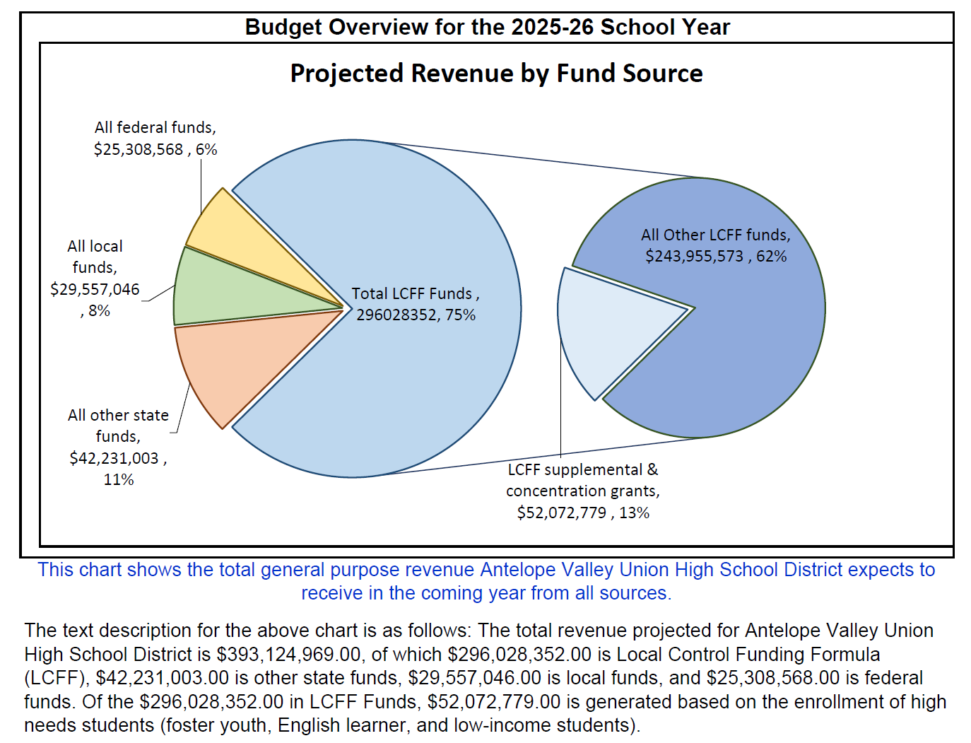
Budget Overview for Parents
Of the $296,028,352 in LCFF Funds, $52,072,779 (Supplemental & Concentration) is generated based on the enrollment of high needs students (English Learners, Foster Youth, and Low-Income students).

Slide 15
2025-2027 LCAP Goals
GOAL 1 | Ensure that all students are academically proficient and college and career ready. | Broad Goal
GOAL 2 | Provide a 21st Century learning environment and rigorous curriculum that allows students to have multiple experiences and opportunities for academic, collegiate, professional and personal growth. | Broad Goal
GOAL 3 | Cultivate a safe and secure, positive school culture that supports all students' personal and academic growth. | Broad Goal
GOAL 4 | Communicate effectively with all educational partners and continue to build relationships in the community that help provide our students with innovative educational opportunities. | Broad Goal
GOAL 5 | Ensure that Students with Disabilities are being provided equitable access to resources related to College and Career Readiness, 21st Century Learning, and a safe and positive school climate. | Focus Goal
GOAL 6 | Enhance academic proficiency and college and career readiness for all students at the Equity Multiplier sites (Antelope Valley, Desert Winds, Phoenix, and R. Rex Parris High Schools), with a specific focus on meeting the needs of the lowest-achieving students. | Equity Multiplier Goal
Goal 7 | Accelerate learning recovery by ensuring equitable access to instruction, targeted interventions, and support services to close achievement gaps and promote academic success, engagement, and well-being. | Broad Goal

Slide 16
What’s New for the 2025/26 LCAP?
Antelope Valley High School has been added to the list of Equity Multiplier sites and are included in Goal 6.
Two new actions have been added to Goal 6 to address the needs of students and staff at the Equity Multiplier sites.
Professional Development
Building Positive Relationships and School Culture
Goal 7 has been added to the LCAP due to unexpended Learning Recovery Emergency Block Grant (LREBG) funds
Targeted actions funded by these remaining resources will support student learning recovery and academic achievement.

Slide 17
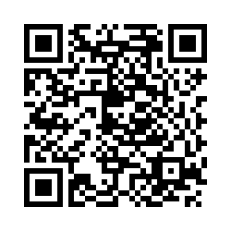
LCAP Survey QR Code
Please scan with your phone to start the survey.
Or type, https://tinyurl.com/2526AVUHSDLCAPSurvey to complete on a computer.

Slide 18

Survey Questions
Q1 - Which services and/or programs were you aware of prior to today?
Q2 - Which services and/or programs have you participated in or used?
Q3 - Were there barriers that made it difficult for you to use or participate in the services and/or programs offered?

Slide 19
Goal 1 –
Ensure that all students are academically proficient and college and career ready.
1.1 – STUDENT FIELD TRIPS – Guided tours of Colleges, Universities, and career-related destinations | 1.10 – VARIABLE CREDIT RECOVERY – Supplemental credit retrieval options
1.2 – COLLEGE READINESS EXAMS – Administer the PSAT and SAT annually (LEA-Wide - 10th/11th graders only) | 1.11 – ENHANCED DATA SYSTEMS – Training on Ed Central and Data Central
1.3 – ADVANCED PLACEMENT (AP) TRAINING AND TUTORING – AP Teachers will attend AP training annually | 1.12 – ANCILLARY INSTRUCTIONAL MATERIALS – Providing EL, FY, and LI students with ancillary instructional materials
1.4 – EXPANDED LEARNING OPPORTUNITIES – Provide extended day tutoring | 1.13 – FOCUS ON WRITING – Additional professional development, coaching and ancillary writing curriculum supports
1.5 – FORMATIVE ASSESSMENT – NWEA Map assessments three times per year | 1.14 – ENHANCING ENGLISH LANGUAGE ARTS AND MATHEMATICS THROUGH PROFESSIONAL DEVELOPMENT – Professional development for teachers
1.6 – ENGLISH LANGUAGE ARTS AND MATH SUPPORTS – Reduced class sizes and daily small group instruction | 1.15 – TARGETED INTERVENTION – Targeted intervention during 0 or 7th period
1.7 – ENGLISH LEARNERS (EL) PROGRAM IMPLEMENTATION – Additional enrollment and monitoring supports (Limited - ELs) | 1.16 – PROFESSIONAL DEVELOPMENT FOR LONG-TERM ENGLISH LEARNER SUPPORT - Professional development targeting effective ELD strategies specifically for LTELs (Limited - ELs)
1.8 – ENGLISH LEARNER (EL) RECLASSIFICATION AND SUPPORT – Designated staff to monitor academic progress (Limited - ELs) | 1.17 – IMPROVING ENGLISH LEARNER PROFICIENCY – Professional development focusing on effective ELD strategies (Limited - ELs)
1.9 – STUDENT-FREE PROFESSIONAL DEVELOPMENT DAYS – Three professional development days

Slide 20
Goal 2 –
Provide a 21st Century learning environment and rigorous curriculum that allows students to have multiple experiences and opportunities for academic, collegiate, professional, and personal growth.
2.1 - SCHOOL COUNSELORS – Guidance/Counseling services (BASE FUNDED) | 2.10 - STEAM SUPPORT – STEM and VAPA exposition and competition opportunities
2.2 - ENHANCED COUNSELING AND STUDENT SUPPORT SERVICES – Additional school counselors, social workers, & other personnel to provide tiered support | 2.11 - DUAL ENROLLMENT AND INTERNSHIPS – Low-cost dual enrollment and no-cost work-based learning internship options
2.3 - PROFESSIONAL DEVELOPMENT – Various professional development and conference opportunities for certificated staff | 2.12 - ENRICHMENT OPTIONS – Academic and enrichment courses above and beyond the 6-period day
2.4 - TARGETED AV TEACHER INDUCTION MENTORING AND SUPPORTS – New teacher induction program | 2.13 – STUDENT ACHIEVEMENT SUPPORT – Instructional Partners and other staff to provide classroom walk-through feedback and support
2.5 - CLASSROOM WALKTHROUGHS – “DigiCOACH” classroom walkthrough tools | 2.14 – NEXT GENERATION SCIENCE STANDARDS (NGSS) SUPPORTS – Coordinator for professional development, feedback, and lesson planning support
2.6 - AP PLACEMENT, EXAMS, AND TUTORING – Equitable access to AP classes, exams, and tutoring (Limited - Low Income) | 2.15 – VISUAL AND PERFORMING ARTS (VAPA) SUPPORT – VAPA Coordinator
2.7 - CAREER TECHNICAL EDUCATION (CTE) OPPORTUNITIES – CTE course offerings and academy coordinators | 2.16 – IMPROVING GRADUATION RATES - Targeted interventions and support services to help students stay on track to graduation
2.8 - AVID ELECTIVE – AVID elective sections | 2.17 – COLLEGE AND CAREER READINESS – Comprehensive college and career readiness support
2.9 - TECHNOLOGY – Equipment to advance technology for students

Slide 21

Metrics To Measure Goals 1 And 2
Goal 1
Metrics - 13 total
Implementation of Academic Standards (Priority 2)
CAASPP ELA (Priority 4)
CAASPP Math (Priority 4)
California Science Test (Priority 4)
A-G Completion (Priority 4)
CTE Pathway Completion (Priority 4)
English Learner Progress Indicator (Priority 4)
English Learner Reclassification Rate (Priority 4)
EAP % Students Prepared for College ELA (Priority 4)
EAP % Students Prepared for College Math (Priority 4)
Seal of Biliteracy (Priority 8)
Local Indicator - ELA Assessment: NWEA Map
Local Indicator - Math Assessment: NWEA MAP
Goal 2
Metrics - 9 total
CTE Completion and A-G Completion (Priority 4)
AP exams with qualifying score - LEA Wide (Priority 4)
Graduation Rate (Priority 5)
Access to and Enrollment in a Broad Course of Study (Priority 7)
College & Career Indicator/CCI (Priority 8)
Golden State Seal Merit Diploma (Priority 8)
Local Indicator - AP Students in District
Local Indicator - AP Exams taken LEA Wide
Local Indicator - Classroom Walkthroughs

Slide 22
Goal 3 –
Cultivate a safe and secure, positive school culture that supports all students' personal and academic growth.
3.1 - ACCESS TO STANDARDS-ALIGNED INSTRUCTIONAL MATERIALS – Full access to standards-aligned instructional materials (BASE FUNDED) | 3.9 - CLASSIFIED PROFESSIONAL DEVELOPMENT – Professional development opportunities to Classified staff
3.2 - FACILITIES IN “GOOD” REPAIR – Maintenance and operational expenses (BASE FUNDED) | 3.10 - SAFE, SECURE, AND POSITIVE LEARNING ENVIRONMENTS – Proactively monitor the school environment, mentoring , and build positive relationships
3.3 - FULLY CREDENTIALED AND APPROPRIATELY ASSIGNED TEACHERS - Fully credentialed and appropriately assigned teachers. (BASE FUNDED) | 3.11 - SUPPLEMENTAL INTERVENTIONS AND SUPPORTS – Site Targeted allocations
3.4 – CAREER TECHNICAL EDUCATION PROGRAMS (CTE) – Teachers and staff for Career Technical Education programs (BASE FUNDED) | 3.12 - TRANSPORTATION – Transportation for Low Income and Foster Youth students (Limited - Low Income and Foster Youth)
3.5 - RECRUIT AND RETAIN TEACHERS – New and employed teachers | 3.13 - INDEPENDENT CITY AND RESILIENT SCHOLARS – Independent City and Resilient Scholar meetings (Limited - Foster Youth)
3.6 - IMPROVE ATTENDANCE AND CHRONIC ABSENTEEISM – Community Attendance Workers implementing tiered re-engagement interventions | 3.14 - DIVERSITY TRAINING – Professional development focusing on diversity and equity (Limited - Low Income and Foster Youth)
3.7 - STUDENT SUPPORT CENTERS – SSC Coordinators implementing a Multi-Tiered Systems of Support to address academic, behavioral, and social-emotional student needs | 3.15 - MULTI-TIERED SYSTEM OF SUPPORTS (MTSS) – Districtwide MTSS Tier 2 and Tier 3 Teams
3.8 – POSITIVE BEHAVIOR INTERVENTION AND SUPPORT (PBIS) – PBIS and Habitudes curriculum | 3.16 – LOWER SUSPENSION RATES – Professional development focused on implementing MTSS aimed at lowering suspension rates

Slide 23
Goal 4 –
Communicate effectively with all educational partners and continue to build relationships in the community that help provide our students with innovative educational opportunities.
4.1 - POWERSCHOOL – Student Information System (BASE FUNDED) | 4.5 - OUTREACH TO SPANISH-SPEAKING FAMILIES – Various community outreach channels and other outreach methods to inform listeners of district educational programs, services, and highlights (Limited - ELs)
4.2 - QUALTRICS – Survey data and analytics platform | 4.6 – PARENT AND FAMILY COLLABORATION – Virtual and in-person parent workshops
4.3 - PARENT LINK – Mass communication platform | 4.7 - INCREASE COMMUNICATION – Utilizing various agencies to increase communication and outreach efforts
4.4 – ENGLISH LEARNER (EL) PARENT WORKSHOPS – Provide college information, goal setting, financial aid and parenting workshops, for non-English-speaking parents (Limited - ELs) | 4.8 – SOCIAL-EMOTIONAL LEARNING (SEL) SUPPORTS – Social-Emotional Learning Supports

Slide 24
Metrics to Measure Goals 3 and 4
Goal 3
Metrics - 11 total
Access to Standards-Aligned Instructional Materials (Priority 1)
Facilities in "Good" Repair as measured by Facility Inspection Tool (FIT) (Priority 1)
Fully Credentialed and Appropriately Assigned Teachers (Priority 1)
Attendance Rate (Priority 5)
Chronic Absenteeism (Priority 5)
High School Dropout Rate (Priority 5)
Suspension Rate (Priority 6)
Expulsion Rate (Priority 6)
Student Perception of School Safety and Connectedness (Priority 6)
Teacher Perception of School Safety and Connectedness (Priority 6)
Local Indicator - Suspension Indicator
Goal 4
Metrics - 3 total
Parent Engagement in Decision Making (Priority 3)
Parent Participation in Programs for Unduplicated Pupils (Priority 3)
Local Indicator - Parent Perception of Communication and Connectedness

Slide 25
Goal 5 –
Ensure that Students with Disabilities are being provided equitable access to resources related to College and Career Readiness, 21st Century Learning, and a safe and positive school climate.
5.1 - ACCESS TO LEAST RESTRICTIVE ENVIRONMENT – Increase access to Least Restrictive Environment (LRE) (BASE FUNDED) | 5.4 – WORKSHOPS FOR PARENTS OF STUDENTS WITH DISABILITIES – Workshops and resources for parents to increase awareness, provide resources, and increase parent support (BASE FUNDED)
5.2 - INCREASED ACADEMIC SUPPORT - Ensure equitable access to a positive learning environment in general education courses (BASE FUNDED) | 5.5 – LOWER SUSPENSION RATE – Implementation of MTSS in Special Education with the goal of reducing suspension rates for Students with Disabilities (BASE FUNDED)
5.3 – SPECIAL EDUCATION STAFF SUPPORT – Fulfill the requirements of the Special Education program (BASE FUNDED) | 5.6 – ENGLISH LANGUAGE ARTS AND MATH PROFICIENCY – Professional development and classroom walkthrough feedback to SPED teachers to increase ELA and Math achievement (BASE FUNDED)

Slide 26
Goal 6 –
Enhance academic proficiency and college and career readiness for all students at the Equity Multiplier sites (Antelope Valley, Desert Winds, Phoenix, and R. Rex Parris High Schools), with a specific focus on meeting the needs of the lowest-achieving students.
6.1 – ENGLISH LANGUAGE ARTS AND MATH PROFICIENCY – Access to high-quality instruction, tutoring, counseling, and mental health services for students to thrive academically (EM FUNDED) | 6.5 – TRANSPORTATION - Supplemental transportation for students (EM FUNDED)
6.2 – COLLEGE AND CAREER READINESS - Comprehensive college, career, and vocational readiness programs to bolster the CCI (EM FUNDED) | 6.6 – PROFESSIONAL DEVELOPMENT - Certificated and classified staff will engage in professional development (EM FUNDED)
6.3 – INCREASE GRADUATION RATES – Personalized academic counseling to identify at-risk students and then provide targeted interventions and support (EM FUNDED) | 6.7 -BUILDING POSITIVE RELATIONSHIPS AND SCHOOL CULTURE – Additional mentoring opportunities to support students' social-emotional, behavioral, and academic growth while strengthening relationships & support staff will implement positive interventions to enhance attendance, reduce suspensions, and promote a safe, inclusive, and supportive atmosphere that prioritizes the well-being and connectedness (EM FUNDED)
6.4 – LOWER SUSPENSION RATE – Professional development focused on MTSS with the goal of reducing suspensions (EM FUNDED)

Slide 27
Goal 7 –
Accelerate learning recovery by ensuring equitable access to instruction, targeted interventions, and support services to close achievement gaps and promote academic success, engagement, and well-being.
7.1 – ADDITIONAL LEARNING TIME – Extending the number of instructional days or minutes, providing summer school and intersessional instructional programs, or implementing evidence-based strategies that enhance instructional services and reduce staff-to-pupil ratios based on student learning needs (LREBG GRANT) | 7.4 – INSTRUCTION FOR CREDIT-DEFICIENT STUDENTS – Instruction for credit-deficient students will be expanded to support graduation, grade promotion, and college eligibility. Strategies may include credit recovery programs, extended learning opportunities, and targeted academic interventions to help students meet graduation requirements (LREBG GRANT)
7.2 – CLOSE LEARNING GAPS – The implementation, expansion, and enhancement of evidence-based learning supports that improve student achievement and language proficiency. Strategies may include tutoring and small group instruction provided by certificated and classified staff, as well as learning recovery programs and materials designed to accelerate academic progress and English language development (LREBG GRANT) | 7.5 – ADDITIONAL ACADEMIC SERVICES – Diagnostic assessments, progress monitoring, and benchmark assessments. Strategies may include implementing evidence-based diagnostic tools to identify student strengths and areas for growth, conducting regular progress monitoring to inform instruction, and utilizing benchmark assessments to measure student learning and readiness for grade-level standards (LREBG GRANT)
7.3 – HEALTH, COUNSELING, AND MENTAL HEALTH SUPPORTS – Evidence-based student supports will be integrated to remove barriers to learning and provide staff with the necessary training and supports to address students' academic, social-emotional, and well-being needs. Strategies may include expanding access to health, counseling, and mental health services, providing before and after-school programs that offer academic and enrichment opportunities (LREBG GRANT) | 7.6 – NEEDS ASSESSMENT – A comprehensive needs assessment will be conducted to identify and address barriers to student success, ensuring equitable access to resources and support services (LREBG GRANT)
 | 7.7 – SUPPLEMENTAL INTERVENTIONS AND SUPPORTS – District and site certificated and classified support staff will coordinate services to provide supplemental interventions and supports that address students' academic, social-emotional, and behavioral needs, ensuring equitable outcomes for all students (LREBG GRANT)

Slide 28
Metrics to Measure Goals 5, 6, and 7
Goal 5
Metrics - 6 total
A-G Completion (Priority 4)
Graduation Rate (Priority 5)
Suspension Rate (Priority 6)
College & Career Indicator/CCI (Priority 8)
Local Indicator - Reading Assessment: NWEA MAP (All SWD)
Local Indicator - Math Assessment: NWEA MAP (All SWD)
Goal 6
Metrics - 7 total
CAASPP ELA (Priority 4)
CAASPP Math (Priority 4)
Graduation Rate (Priority 5)
Suspension Rate (Priority 6)
College & Career Indicator/CCI (Priority 8)
Local Indicator - ELA Assessment: NWEA Map
Local Indicator - Math Assessment: NWEA MAP
Goal 7
Metrics - 5 total
CAASPP ELA (Priority 4)
CAASPP Math (Priority 4)
Graduation Rate (Priority 5)
Suspension Rate (Priority 6)
College & Career Indicator/CCI (Priority 8)

Slide 29
Table Activity
Table 1: Goals 1 & 2 (Academic Proficiency / 21st Century Learning)
Table 2: Goal 3 (Safe and Positive School Culture)
Table 3: Goal 4 (Communication & Partnerships)
Table 4: Goal 5 (Students with Disabilities)
Table 5: Goals 6 & 7 (Equity Multiplier / Learning Recovery)
What are 1–2 examples of programs or actions that support these goals at your school?
What seems to be working well for students and families?
Where do you see opportunities to improve or add support?

Slide 30

Survey Questions & Open Response Questions
Q1 - Which services and/or programs were you aware of prior to today?
Q2 - Which services and/or programs have you participated in or used?
Q3 - Were there barriers that made it difficult for you to use or participate in the services and/or programs offered?
What aspects of the LCAP do you feel have positively impacted the learning environment?
Are there any suggestions or areas of improvement within the LCAP that you believe could further enhance the educational outcomes for AVUHSD?

Slide 31
Next Steps
May 11, 2026
  Review Dashboard Data & Metrics
  Review Progress on Goals and Actions
  Public Hearing
  Plan Adoption
  LACOE Approval
  Review Data Outcomes
  Review and comment on Draft 26/27 LCAP
March 2, 2026
June 2026

Slide 32

Parent Involvement Opportunities
School Sites Share Out

Slide 33


Slide 34

Thank you!
See you on March 2, 2026!
Jennifer Slater-Sanchez, Ed.D.
jslater-sanchez@avhsd.org
https://www.avdistrict.org/about/annual-strategic-plan

