Slide 1
Maple Hills Volunteer Training
2025 - 2026

Slide 2

Thank you! We are excited to have you volunteer at Maple Hills!
Your willingness to volunteer helps…
  Provide students with additional activities.
  Teachers complete tasks they don’t have enough time for.
  Create a school-community team environment.
  Give students another adult to read/work with.
  Teachers to work with even more students every day.
  Students to see parents who are engaged and involved in education.

Slide 3
How to Become a Volunteer
Complete the volunteer application at: Volunteer Application System
Email child’s teacher to find out what volunteering in their classroom looks like and what is needed
Choose a volunteer opportunity: classroom, clerical, library, WatchDOGs/ WatchMOMs, art docent, PTA special event, etc.
Talk with Ms. Tapper or Mrs. Magee if want to volunteer outside of class
Schedule a day and time with the teacher
Attend the training

Slide 4

Classroom Volunteers
Every teacher utilizes volunteers in a different way. Some teachers have volunteers scheduled for specific activities, like art projects, reading groups, etc. Some teachers use volunteers for more clerical tasks to keep their classroom running smoothly. Some teachers have volunteers work one-on-one with students in the classroom or the activity pod. It depends on the teacher’s preferences and student ages.
As students get older, intermediate teachers are working on building independence so volunteers in 3rd, 4th and 5th grade do not always support students directly.

Slide 5



Upon arrival…
Arrive at the day and time you and the teacher have agreed upon.
Check in at the office, show ID if needed.
Sign in to the Volunteer Log.
Get a visitor/volunteer badge. Wear/display the badge at all times when in the building.
Turn off or silence cell phones. We do not allow cell phone
conversations within the building during the school day.
Check in with the teacher about what tasks they have planned for you.

Slide 6
Volunteer Agreement – I agree to…
Wear my name tag/badge at all times.
Leave my parent hat at home. I am here to help the teacher and all students, not just my own.
Show up at the date/times scheduled.
Remember and honor that teachers have different teaching styles.
Assist students by giving them help not doing it for them.
Respect each student’s ability, learning style, and right to privacy.
Notify the teacher in case of a student injury.
Ask for an appointment if I need one-on-one time with the teacher, regarding my own student.
Let the teacher know if there is a problem and not discipline or consequence students myself.

Slide 7

Confidentiality
From District Regulation 5630 and The Family Educational Rights and Privacy Act, 34 CFD Part 99.
  Volunteers may not discuss the performance, actions, or any other information about any student except with the student’s teacher, school counselor or principal. Confidentiality pertains to both written records and verbal statements.
  Privacy includes behavior and academic performance.
  Never discuss with the teacher within earshot of another parent or student.
  Teachers may need to share information with you, but that information may not leave the classroom.
  Confidentiality within the office and healthroom as well.

Slide 8
Volunteer Etiquette
Watch the teacher and model his/her strategies.
Avoid distracting students or teacher by chatting with other volunteers or “parenting” your student.
Use the external doors to the workroom in order to respect the confidentiality of the staff lounge and health room. Check in with Sonya or Albertina for a badge or to let you in.
The staff lounge is for staff only. Please let the office know if you need something in there.
There is a microwave in the workroom, if needed.
Other children may not accompany you when you are volunteering at school.
When all the tasks are done, ask the teacher if he/she needs anything else, and if not, sign out in the office before leaving. “Hanging” out in the classroom muddles the line between volunteer and observer.
Please email the teacher if you need to cancel or reschedule.

Slide 9
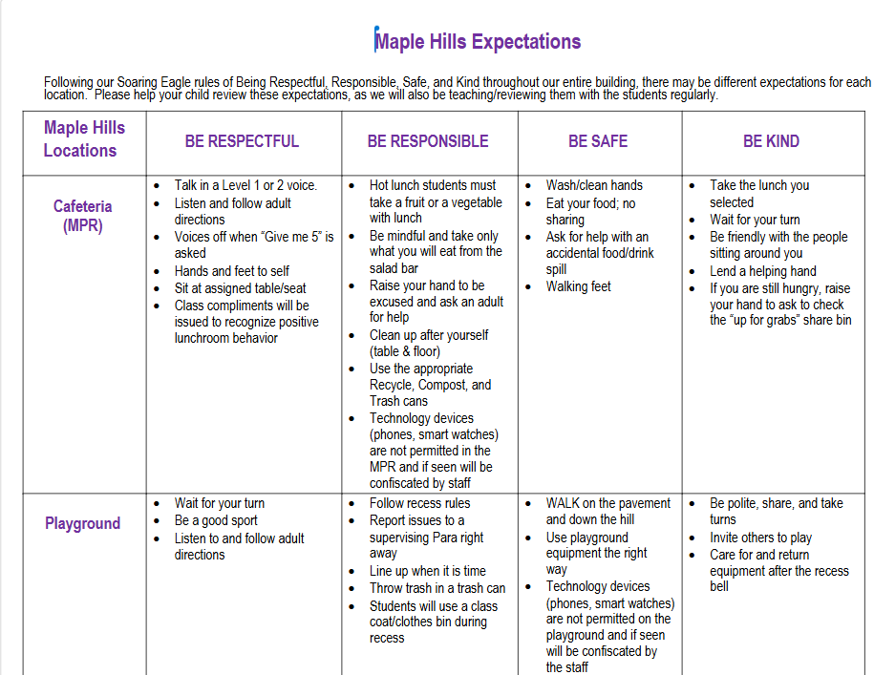
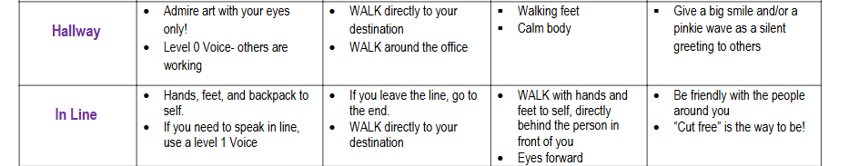
Soaring Eagle Expectations
Throughout our entire building:
Be Respectful
Be Responsible
Be Safe
Be Kind

Slide 10
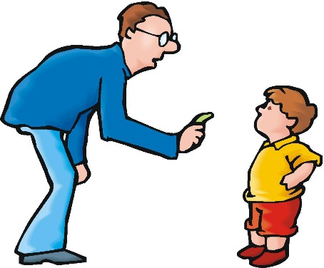
Behavior Management
Each teacher has their own methods and classroom management system.
Let teachers handle discipline problems as students may require different approaches.
Positively reinforce students who are on task. Give out Soaring Eagles if you’d like.
Never get into a power struggle; ask the teacher or another staff member for help if a student is refusing to do something.
Do not talk about other students or their behavior with other parents.
If a problem occurs outside of the classroom, find the nearest teacher or staff member to report the concern to.

Slide 11
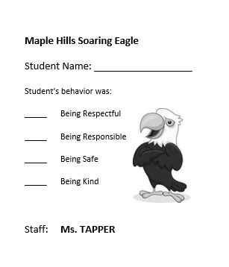
Soaring Eagles
At Maple Hills, students earn a Soaring Eagle for
showing Soaring Eagle behavior. Behavior that is…
      Respectful
      Responsible
      Safe
      Kind
You can help students with their behavior with positive statements, like, “Remember, be safe with walking feet,” or “I like the way you are being respectful to the art on the walls,” etc.

Slide 12
Volunteer Details
Copies – get copy code from Sonya Day in office.
Use copy machines in workroom outside of 8:30-9:10.
Only pin/staple to tackable walls.
Check in at office for keys/badge to portable. Leave car keys as a reminder.
Make sure all external doors to the building stay closed.
Schedule start and end time with the teacher. Volunteers do not eat lunch with their student.
Evacuate to the sand field, with the class, if there is a fire drill.
Check out at office when leaving.

Slide 13
Thank you for all you do for our students, teachers, and community!
Notes:
I will post this PPT on school website tomorrow.
Any questions?
When you come in, please check “Yes” you reviewed the PPT. If someone wasn’t here, we will have a printed out copy for them to view.

