Slide 1

Title I
Parent Meeting
Laurie Miller, Title I Instructional Facilitator
September 25, 2025; 4:30 & 5:30 AES RM:13

Slide 2

We will be covering…
What is Title I?
How does it benefit the kids?
How can parents be involved?

Slide 3
What is Title I?
Largest federally funded education program in the nation
Eligible to any school with 40% or more students on free or reduced lunch
Title I funds are used to serve ALL children in order to increase academic achievement
Goal of Title I is to assist students in achieving grade level standards in reading/language arts & math
Title I is committed to closing the achievement gap between all students

Slide 4
Altruria Needs Your Help
In order to keep our Title I status, we need every family’s help.
Please go to http://bartlettschools.org
Then click on Departments.
Go to School Nutrition.
To the right, look for School Café’ to create an account and apply for benefits.
We need every family to apply even if you don’t plan to use the benefits!

Slide 5
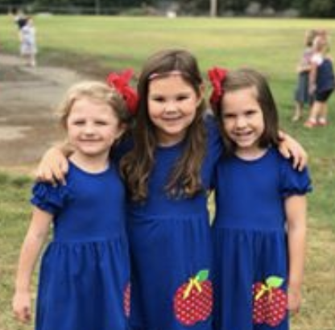
Benefits to Altruria ES
Increased focus on student achievement
Additional money for resources
Additional School Personnel

Slide 6
BCS Parent & Family Involvement Policy (4004)
Welcoming families into school
Communicating with families
Supporting students by working with families
Encouraging families to advocate for their child’s education
Partnering with families in decisions
Collaborating with families and community

Slide 7
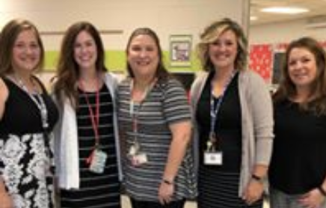
Parents’ Right to Know
Certification of Teachers
Qualifications of Assistants
Student Progress
District & School Progress

Slide 8
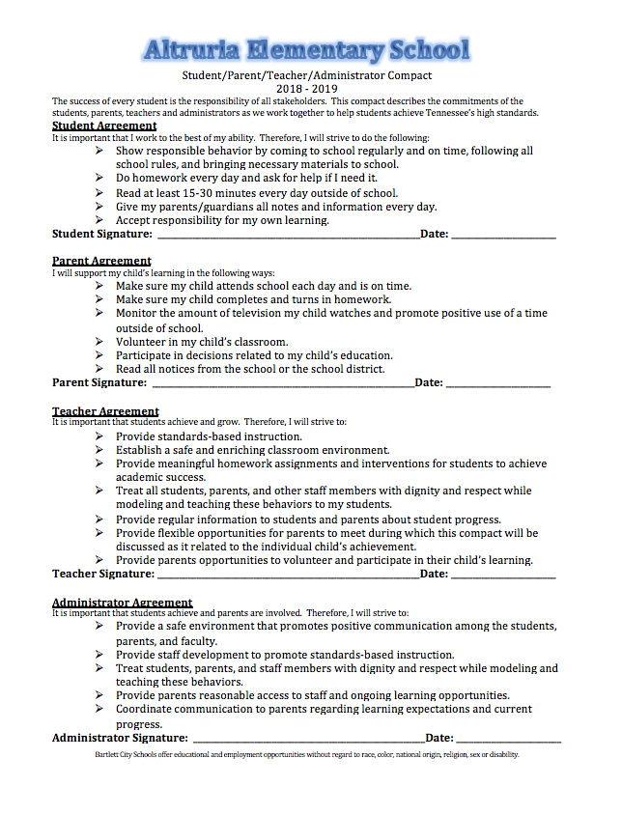
Student/Parent/Teacher/Administrator Compact

Slide 9
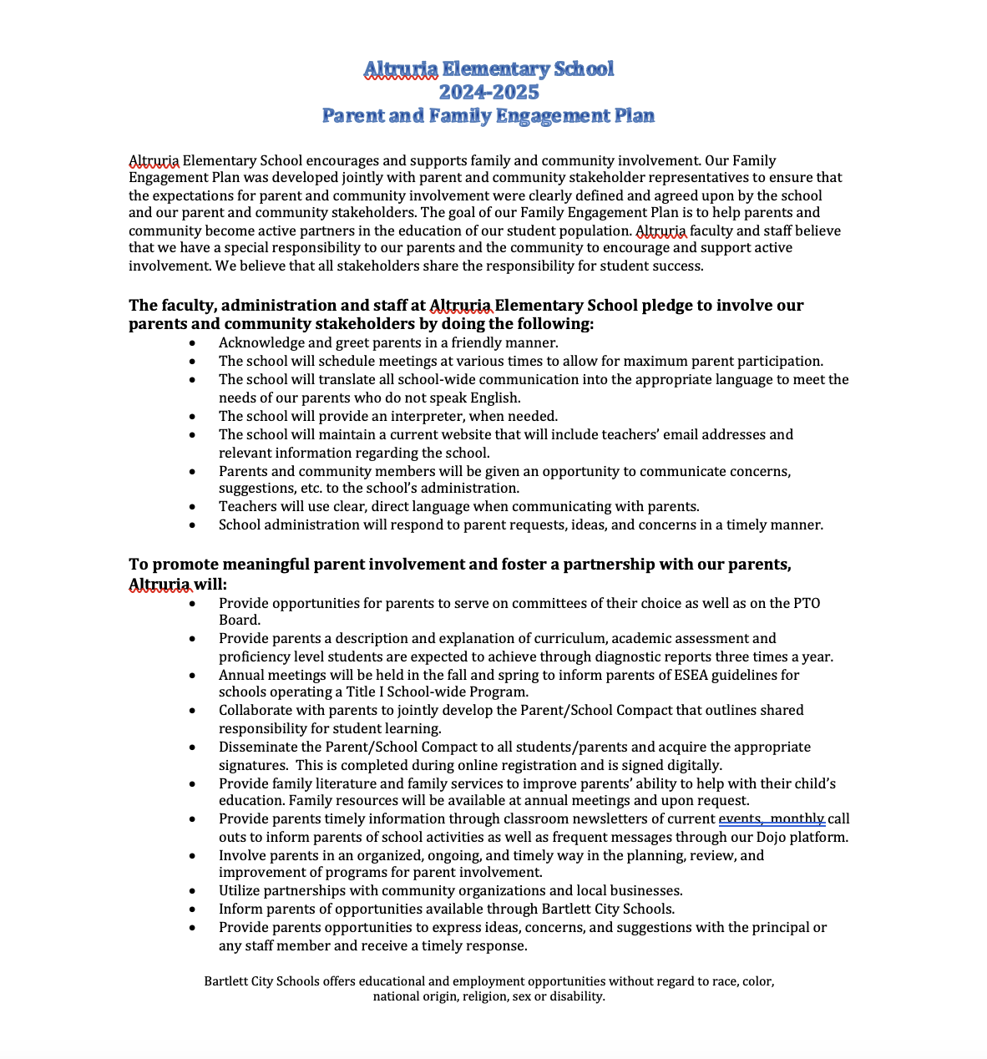
Family Engagement Plan

Slide 10
Reporting of Student Progress
RTI²
Interim and Term Grades
Aimsweb/ Iready Benchmarks
Parent-Teacher Conferences
TCAP/ TNREADY Score Report

Slide 11
Altruria’s Growth Score Report
School-Wide Composite – 4
School-Wide Literacy – 4
School-Wide Numeracy – 4
School-Wide Literacy/Numeracy – 4

Slide 12
Curriculum
Reading – Wonders
Math- Envision
Science- McGraw Hill
Social Studies –Studies Weekly

Slide 13
School Improvement Plan
The school improvement plan is posted on the Altruria Elementary School webpage.
Goals- Improve Math, ELA, and performance of Students with Disabilities scores

Slide 14
2025-2026 Budget Proposal
Technology Equipment - $12,000
Parent Involvement - $2,400
Computer Programs -$17,000
Instructional Supplies & Materials -$0
Professional Development - $0
RTI Tutors- (4 Part time positions) -$100,000

Slide 15
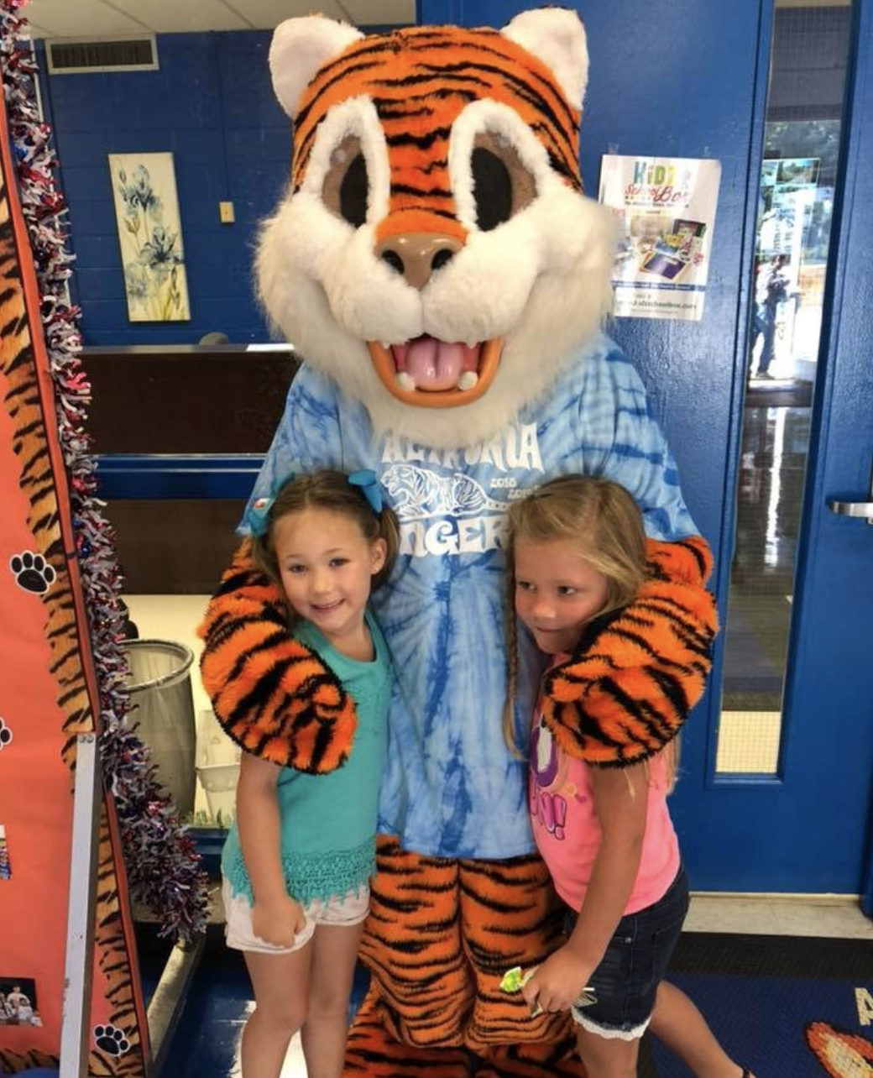
Questions?

Slide 16
Thank You!
Thank you for attending!
If you have any questions, please feel free to email me at lmiller@bartlettschools.org or you can call me!

