Slide 1









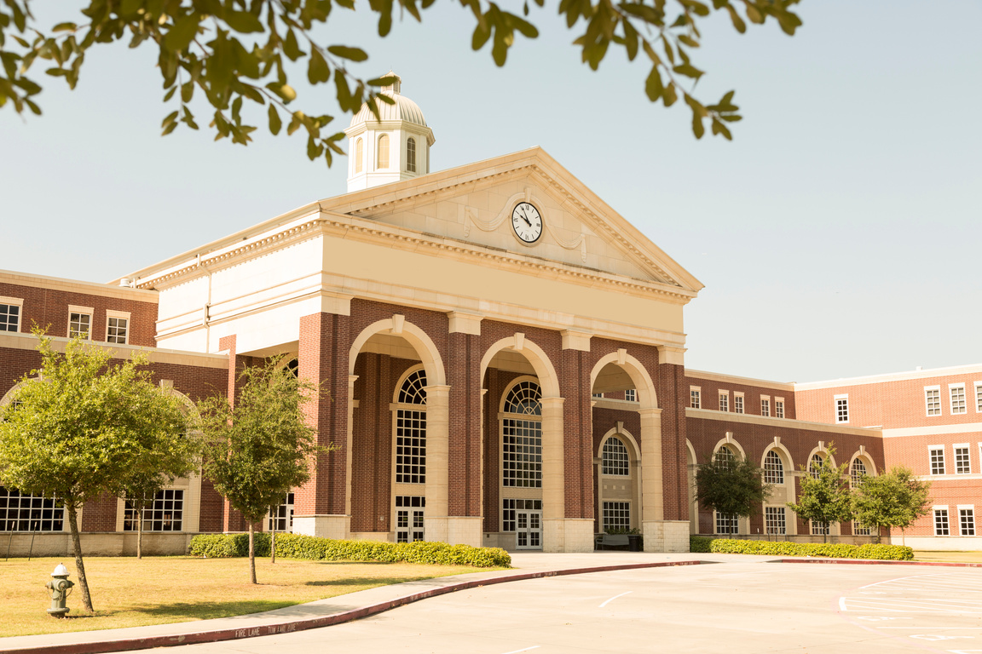




College Credit Courses at
Mandeville High

Slide 2




Introduction
AP and Dual Enrollment courses offer high school students valuable opportunities to challenge themselves academically, earn college credit, and prepare for future success.
These programs help students develop critical thinking skills, build confidence, and gain a head start on their educational and career goals.

Slide 3



Dual Enrollment vs AP
Dual Enrollment
Advanced Placement
Earning College Credits: College credits are automatically earned by passing college courses.
Earning College Credits: You only earn college credits by scoring three or higher on AP exams.
Academic Rigor: College-level rigor and skills are taught in the class.
Academic Rigor: College-level rigor and skills are taught in the class.
Cost: Often tuition-free or highly discounted compared to normal college tuition rates. Many of the courses are offered free to high school students under TOPS.
Cost: It requires an exam fee, but the courses are free.
GPA: Your grade appears on both high school & college transcripts, affecting cumulative GPAs. Students can enter college with a GPA.
GPA: Grade in the class impacts high school GPA, but scores on AP exams do not.

Slide 4




Dual Enrollment Credit Offerings:
DE Credits
DE Credits
DE Credits
Southeastern
Northshore Tech
  Pre-calculus Honors (6 hours)
  Calculus (3 hours)
  Physics Honors (3 hours)
  Algebra III (3 hours)
  Chemistry Honors (3 hours)
  English 101 (3 hours)
  English 102 (3 hours)
  Prob. and Stats (3 hours)
  US History (3 hours)
  Western Civ. (3 hours)
  Intro to Education (6 hours)
Nunez CC
  Automotive Technology I and II (6 hours)
  Emergency Medical Technician (3 hours)
  Basic Technical Drafting (3 hours)
  HVAC (6 hours)
  Welding (6 hours)
  French I-IV (12 hours)
  Spanish II-III (6 hours)
  Drafting (3 hours)
  Medical Terminology (3 hours)
  Pre-Practical Nursing (3 hours)
  ProStart I (6 hours)

Slide 5


AP CLASSES OFFERED
  US Government and Politics
  Psychology
  Comparative Government and Politics
  English Language and Composition
  English Literature and Composition
  Biology
  Environmental Science
  Calculus AB
  European History
  Chemistry
  Macroeconomics
  US History

