Slide 1
Excel as a Tool to Troubleshoot SIS Data for EMIS Reporting

Slide 2
Overview
Basic Excel techniques can be used to analyze EMIS data from Student Information Systems (SISs), from the Data Collector and on ODE EMIS reports
This session will demonstrate Excel functions and practical applications that can be helpful in all phases of the EMIS data review process
Notes:
Presenter FYI- Encourage districts to analyze their Student Information System data using Excel prior to the start of the EMIS submission process.
It would be helpful to demonstrate data queries in your Student Information System throughout this workshop.

Slide 3
Outline
Basic Excel Functions
Text to Columns
Filtering to Verify Attendance Patterns
VLOOKUP to Add Names to a Report
Conditional Formatting to Verify RIMP Code Reporting

Slide 4
Basic Excel Functions
Wrap Text Header Row
Freeze Top Row
Expand All Columns
Sort
Filters
Tabs in a Workbook
Create a Workbook
Notes:
Presenter- This section covers basic Excel functions but is a great review no matter the participant skill level.

Slide 5
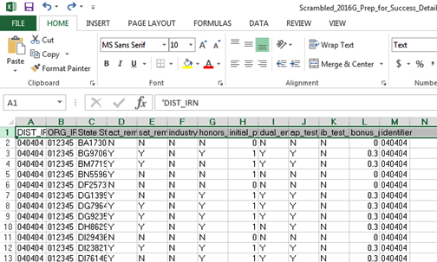
Wrap Text Header Row
Select the header
row by clicking on
the number “1”
From the Home Tab select
“Wrap Text”
Notes:
Presenter use EXCEL_1__2016G_Prep_for_Success_Detail.xlsx. Be sure to do this step before expanding column width.

Slide 6
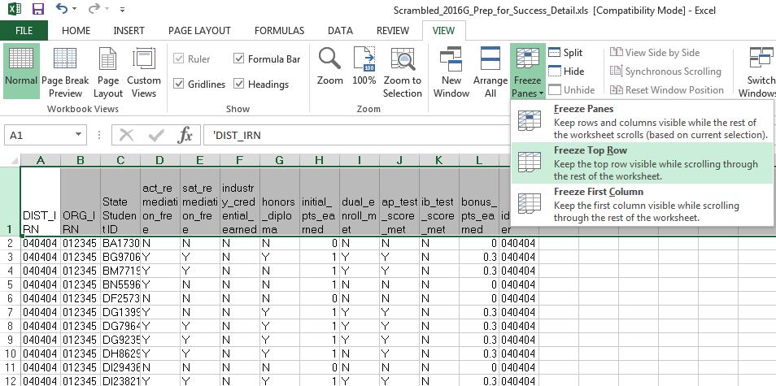
Freeze Top Row
Select the
“View” Tab
Then select “Freeze
Panes” And
“Freeze Top Row”
Notes:
Freezing the top row is very helpful when reviewing large spreadsheets that contain column with similar values like this example with many N and Y values.

Slide 7
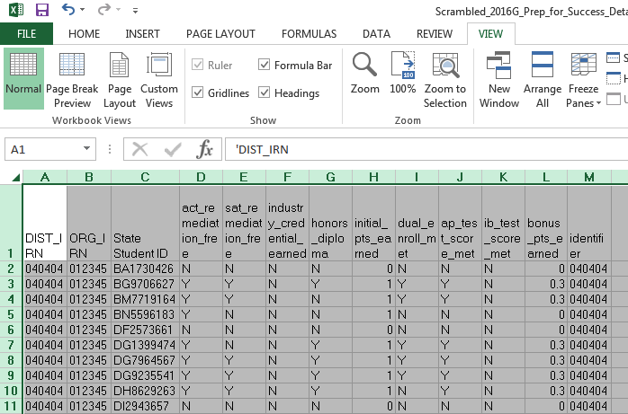
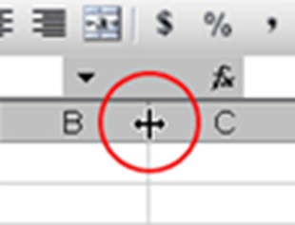
Expand all Columns
Click on the triangle between
Column A and Row 1 to select
the entire spreadsheet
Place cursor between any two column headers and double click
Notes:
This step will expand all columns at the same time

Slide 8
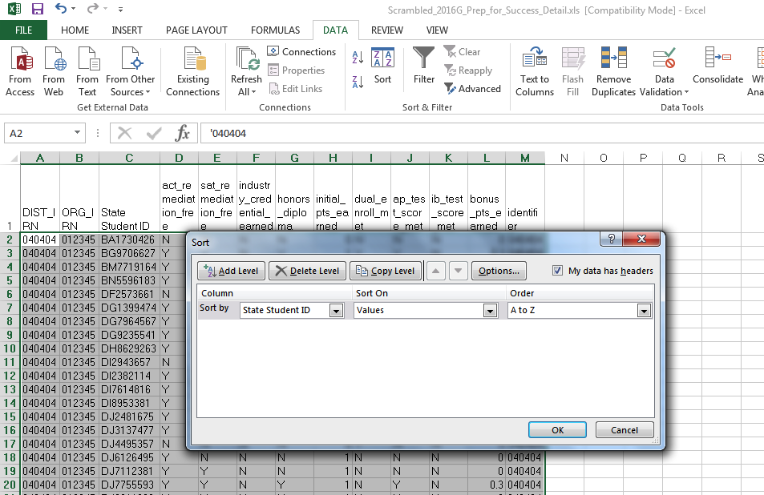
Sort
From the “Data” tab
choose “Sort”
Check “My Data has Headers”
Sort by “State Student ID” Sort on “Values” Order
“A to Z”
Notes:
When using the sort feature in Excel, sort by one or more columns that will help organize the data in a more user friendly way.

Slide 9
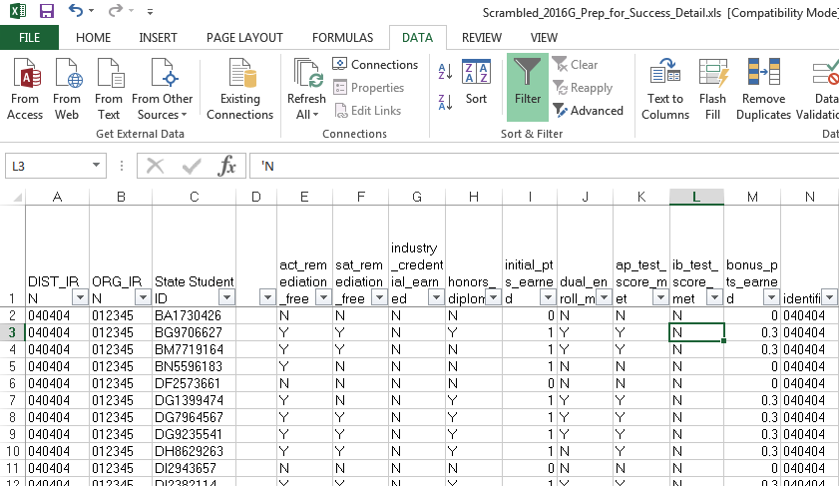
Filters
From the “Data”
tab choose “Filter”
Filters will be
available to select in each column header
Notes:
Filters can also be applied from the Home Tab by choosing the “Sorting and Filtering” icon and then filter.

Slide 10
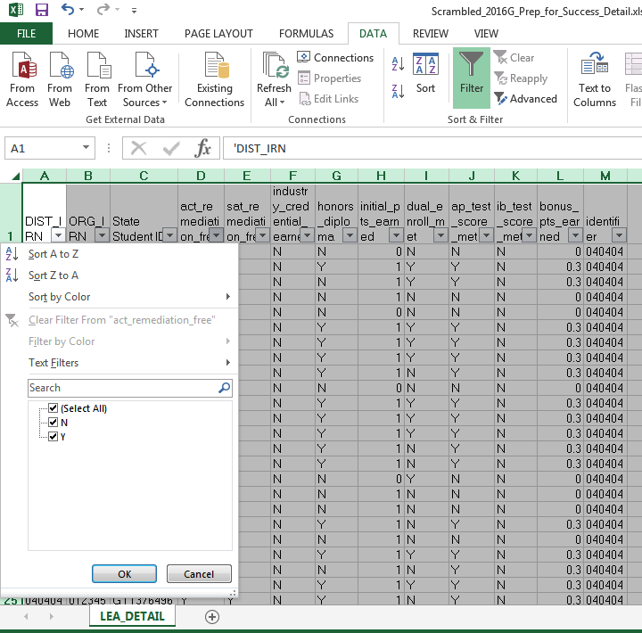
Filters, cont’d
Filters show all values in the
selected column
Filters are an effective way to divide and conquer data by one or more filtered values at a time
In this filter example, only
values of N and Y appear in
this column
Notes:
We will be using this file again shortly, please minimize.

Slide 11
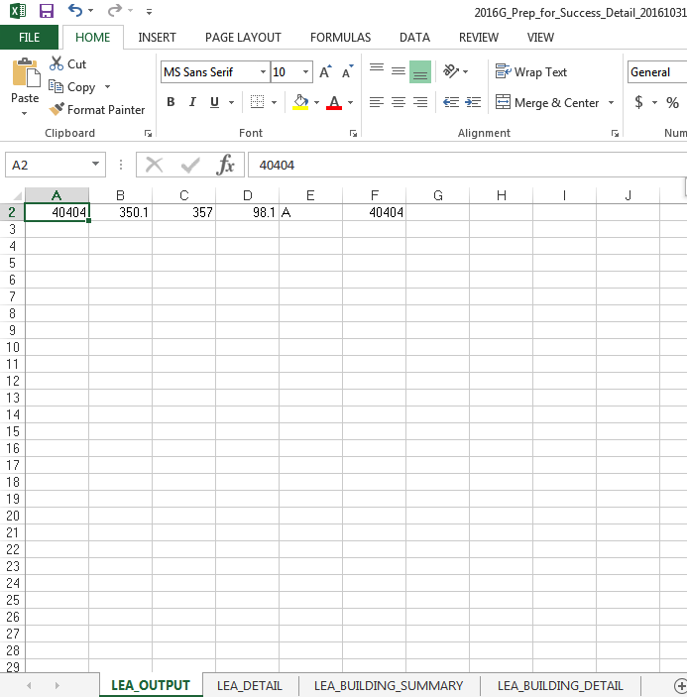
Tabs in a Workbook
Some EMIS reports contain multiple
spreadsheets which make a workbook
Using tabs is an effective way to organize multiple spreadsheets of data such as reviewed copies of the same report
Tabs are located at the bottom of the spreadsheet
Notes:
Always check the report you are viewing to see if there are tabs that contain additional data. In this example of a Prep for Success report, there were four tabs of data in this workbook.

Slide 12
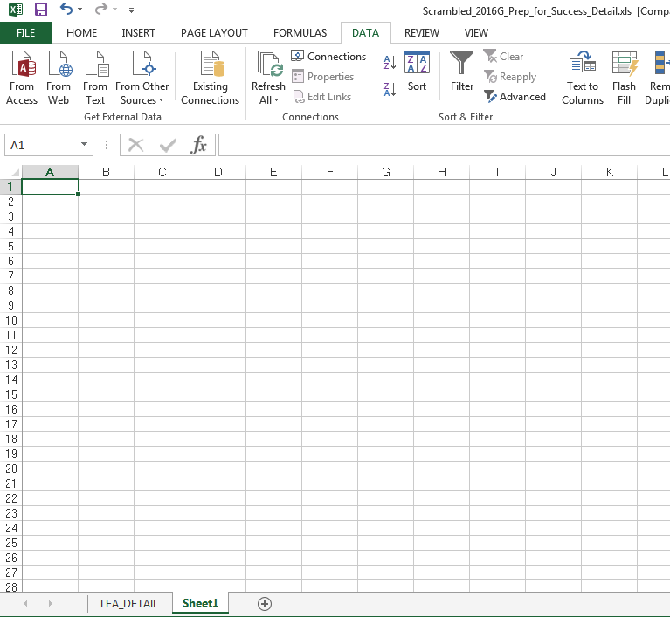
Create a Workbook
Open an existing spreadsheet or a new spreadsheet
Click on the plus symbol to add a new tab
To name a tab, right click on the tab and select “rename”
Cut and paste data into your
workbook Ctrl A = Select All
Ctrl C = Copy Ctrl V = Paste
Notes:
Open a new spreadsheet to demonstrate how to add and rename a tab. Workbooks are a great way to organize copies of the same report.

Slide 13
Quick Check
Can you use basic functions to set your spreadsheet up to be user friendly?
Can you sort and filter to troubleshoot a spreadsheet of data?
Can you use tabs and create a workbook?
Basic Excel functions can be used to check accuracy and completeness of EMIS data at any point during the EMIS data reporting process.

Slide 14
Text to Columns

Slide 15
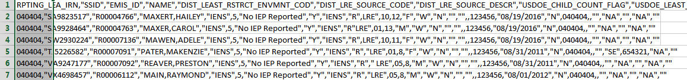
Opening CSV files with Excel
Sometimes when opening a CSV file the data is not separated into columns
The data is “comma separated” and is all contained within Column A
To separate the data into columns, use the Excel “Text to Columns” function
Notes:
Presenter use EXCEL_2_Text_to_Columns1.xlsx

Slide 16
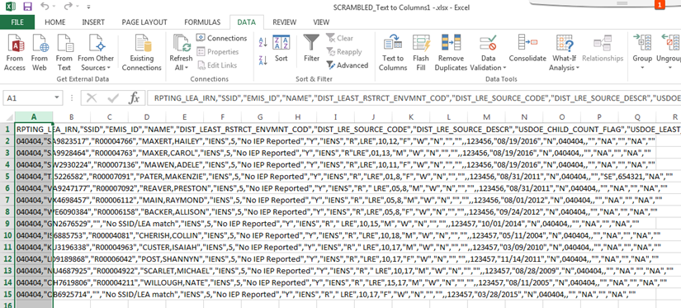
Text to Columns
Open “EXCEL_2_Text_to_Columns1.xls”
Select Column A
Notes:
When a file opens like this, all of the data is in the first column.

Slide 17
Text to Columns, cont’d
Select the “Data” tab and then Choose “Text to Columns”

Slide 18
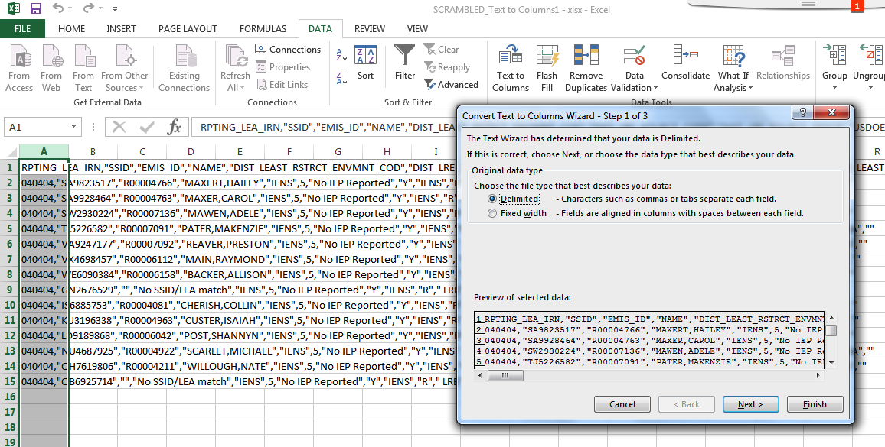
Convert Text to Columns Wizard Step 1
Choose “Delimited” and “Next”

Slide 19
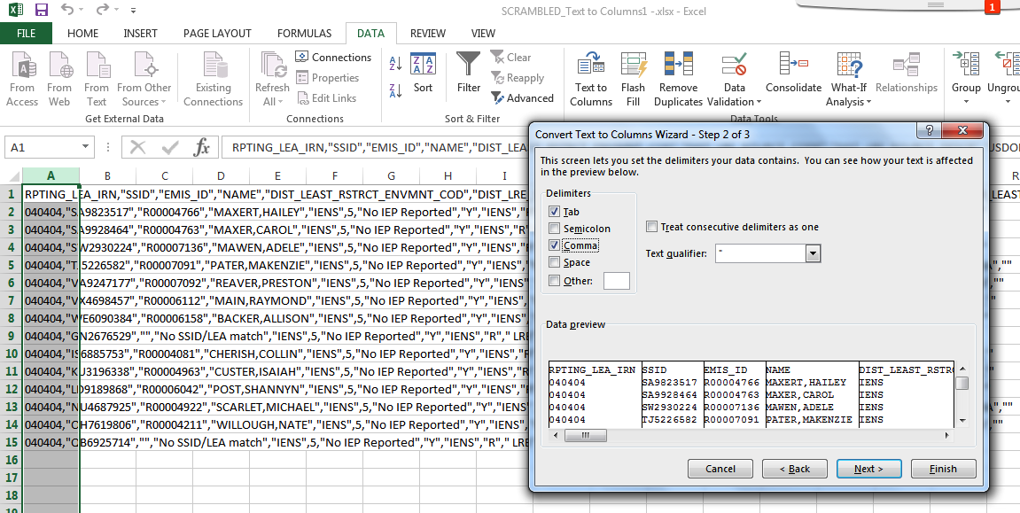
Convert Text to Columns Wizard Step 2
“Tab” will be selected by default, select “Comma” and “Next”

Slide 20
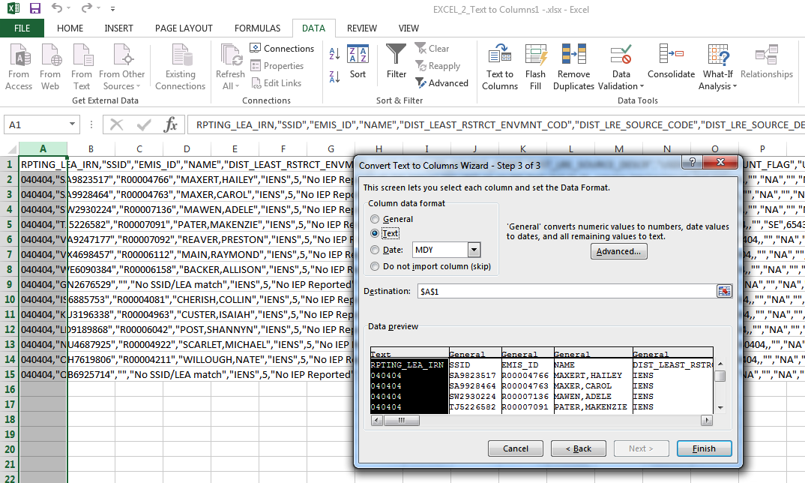
Convert Text to Columns Wizard Step 3
Step 3 will allow users
to select a format for
each column. When
columns contain IRNs
the format must be
“Text” or the leading
zeros will be dropped.
Notes:
This step may not be necessary if the user isn’t concerned about the file containing IRNs with leading zeros.

Slide 21
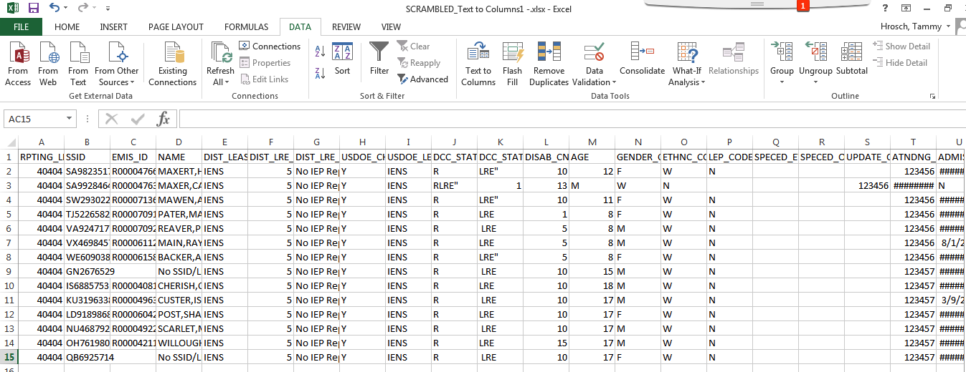
Data Separated into Columns
Notes:
Once the data is separated into columns, the header row can be wrapped, the top row frozen, and the columns expanded.

Slide 22
Quick Check
Can you use the Text to Columns feature to separate data into columns?
Can you identify other situations when the Text to Columns Wizard might be helpful?
EMIS data is often in CSV (Comma-Separated Values) format and typically opens within Excel with the data separated into columns. Sometimes the data does not separate into columns automatically. Use “Text to Columns” to separate the data into columns.
Notes:
Presenter – this Text to Columns example is a commonly used function. If the data is not comma separated, the wizard can be used to separate the data easily. The wizard contains options to separate data that is separated by characters other than commas as well as fixed width files.

Slide 23
Filtering to Verify
Attendance Patterns

Slide 24
Filtering to Verify Attendance Patterns
The next set of slides will use filters to verify that calendar data makes sense with student attendance patterns
  Students are reported with Attendance Patterns
  EMIS Calendars contain Attendance Patterns
  Use Excel to cross check the data

Slide 25
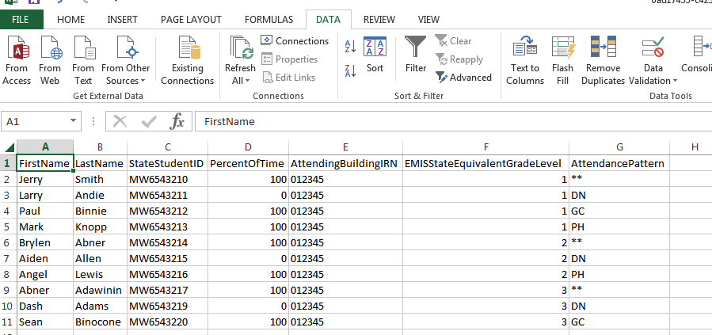
Attendance Patterns and Calendars
This is a scrambled query of SIS Data that includes student Percent of Time, Grade Levels, Attendance Patterns as well as Attending IRNs
Verify that the calendar collection contains the same combinations of Building IRN, Grade Level and Attendance Pattern
Notes:
Presenter- Demonstrate how to get this data from the SIS.
EXCEL_3_SIS_Query_Student_Attendance_Patterns.xlsx

Slide 26
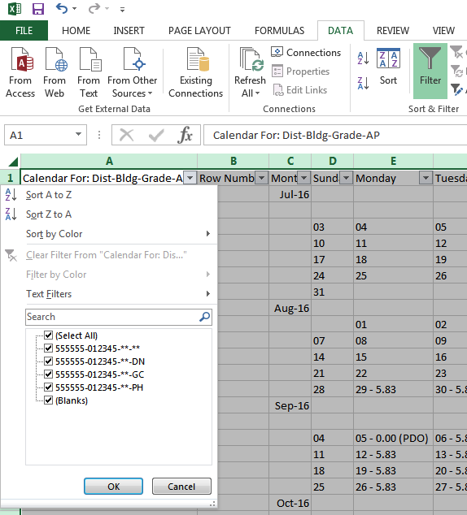
Filter Calendar Display Report
Using the Calendar Display Report from the Calendar Collection, apply filters and view calendar names
Compare the calendar names listed in the filter to the student data from the SIS query to verify that calendars are being reported for each building, grade level and attendance pattern combination.
Notes:
This is a quick and simple way to filter and compare SIS data to the Calendar Collection.
Presenter use EXCEL_4_Calendar_Display.xlsx

Slide 27
Quick Check
Are you able to run a SIS query of calendar related student data?
Are all student building, grade level and attendance pattern combinations appearing in the Calendar Display report?
Are students on appropriate calendars?
Student Attendance Patterns are reported in Student (S) Collections, while Calendar data with matching Attendance Patterns are reported in Calendar (C) Collections. The data doesn’t meet until Level 2 FTE Reports are generated. Comparing the data could prevent issues when the FTE reports cannot determine a student’s calendar.

Slide 28
VLOOKUP to Add Student Names to a Report

Slide 29
VLOOKUP to Add Student Names to a Report
The next series of slides will demonstrate how to use the VLOOKUP function to add names to the Prep for Success report
  The FY16 Prep for Success report was loaded into the Files tab of the Data Collector and contained FY15 and FY16 Graduates (more specifically 2015 5Yr and 2016 4Yr graduates)
  In this demonstration we can use the Student Demographic (GI) Files from the FY15 and FY16 Graduate (G) Collections since they contain both SSIDs and Student Names
Notes:
Presenter- A VLOOKUP is a way to find data from another spreadsheet and bring it into an existing spreadsheet.

Slide 30
Files Needed for this Demonstration
Log into the Data Collector and uncheck “Don’t show expired collections”
At the “Data Set” filter choose “G”
  click on “Review” for both Graduation Collection FY15 and Graduation Collection FY16
  save the Student Demographic (GI) CSV files
From the Files tab
  select “Run Query”
  locate the most recent version of the Prep for Success Report 2016G_Prep_for_Success_Detail_20161031.xls
Notes:
Presenter- Demonstrate these steps

Slide 31
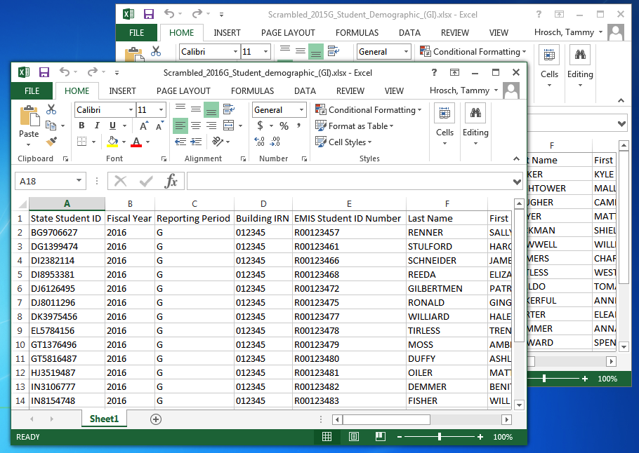
Open Demographic Files
EXCEL_5_2015G_Student_Demographic_(GI).xls
EXCEL_6_2016G_Student_Demographic
Notes:
EXCEL_5_2015G_Student_Demographic_(GI).xls
EXCEL_6_2016G_Student_Demographic_(GI).xls
The goal here is to get all of the date from both files into one file.

Slide 32
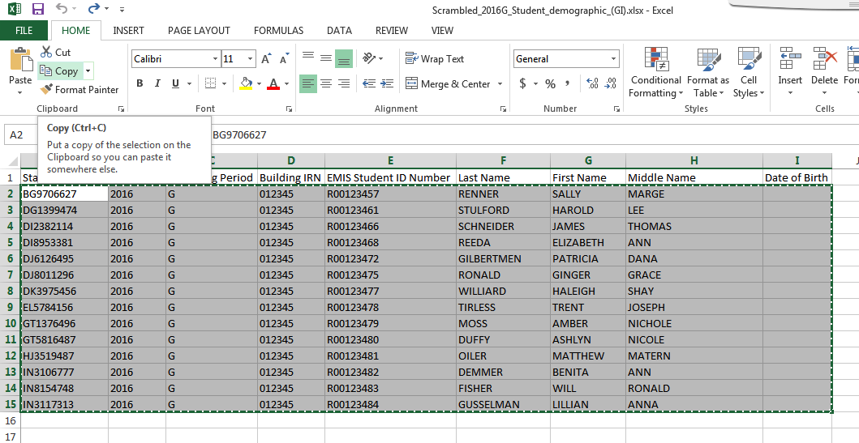
Copy Data from 2016G Demographic File
Highlight data from 2016G Demographic spreadsheet
and click “Copy”
Notes:
It doesn’t matter which spreadsheet is used first. Just choose one and then select the data to copy. Ctrl A to “select all”, Ctrl C to copy.

Slide 33
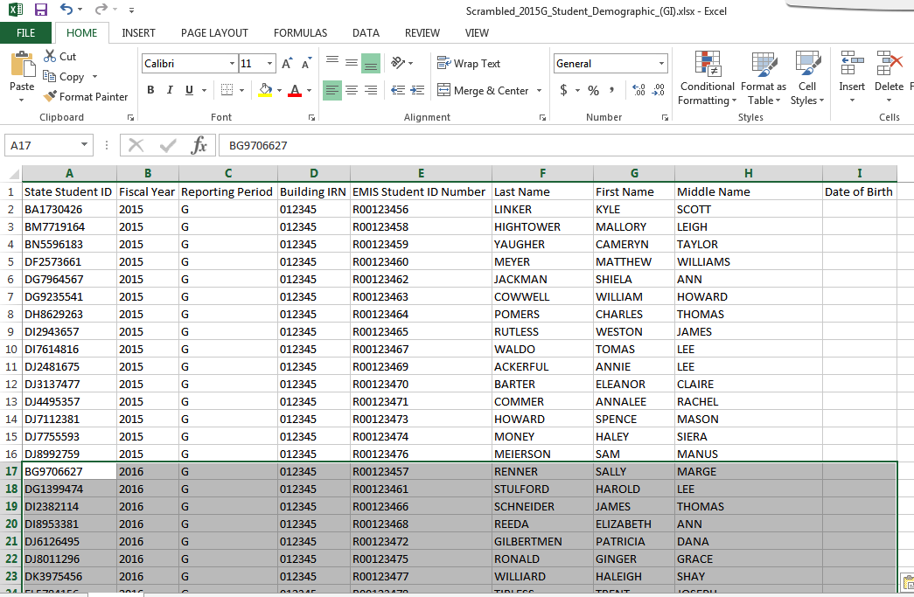
Paste Data into 2015G Demographic File
Select the cell below the last row of data on the 2016G Demographic spreadsheet in this example, Cell A17
then select “Paste”
Notes:
Use the “Paste” function or Ctrl V to paste the data into the first spreadsheet.

Slide 34
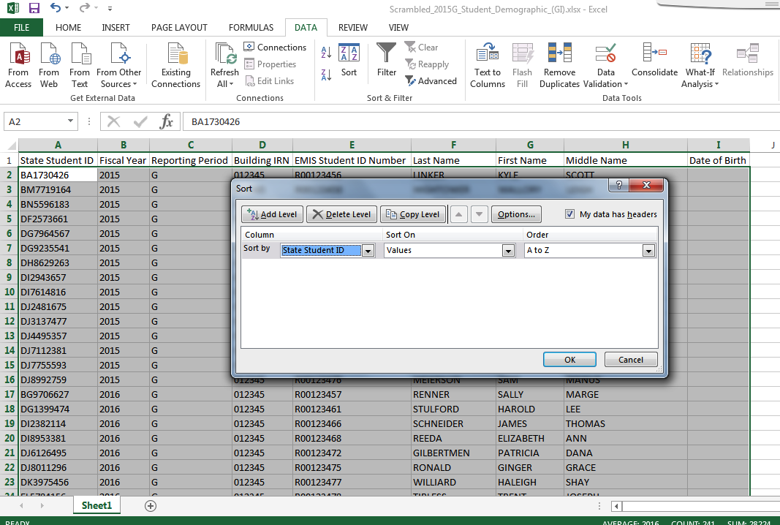
Sort Student Combined Demographic Spreadsheet by SSID
Select all data by clicking
on the triangle between
the Row 1 and Column A.
Click on the “Data” tab
and “Sort”
On the Sort Prompt, check “My data has headers”
Choose “State Student ID” as the “Sort by” Click Ok
Notes:
This step prepares the file to be used as the source during the VLOOKUP process.

Slide 35
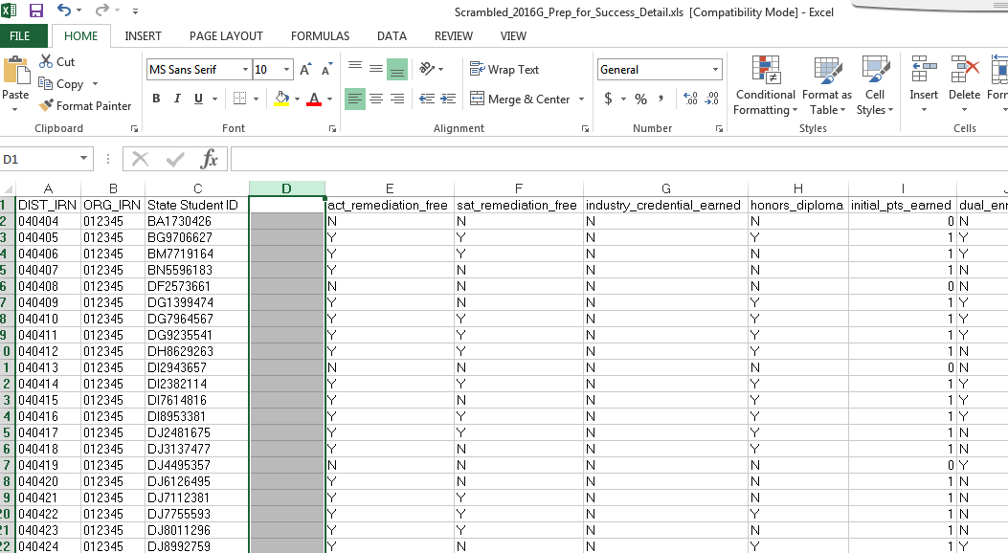
Open and Sort the Prep for Success Report
Sort the file by “State Student ID”
Insert a blank column
Highlight column D
then right Click and
select “Insert” to create
a new blank column D
Notes:
Presenter use- EXCEL_1_2016G_Prep_for_Success_Detail.xls (previously minimized)

Slide 36
Building a VLOOKUP Function
To build the VLOOKUP Function, we need
  The value to lookup (SSID from Prep for Success Report)
  The range of cells on the Demographic (GI) file to find the values
  The column number within the selected range that contains the value to return (from the Demographic (GI) file)
  Exact Match (FALSE)
The next series of slides will demonstrate the VLOOKUP function step by step and then will demonstrate the VLOOKUP Wizard

Slide 37
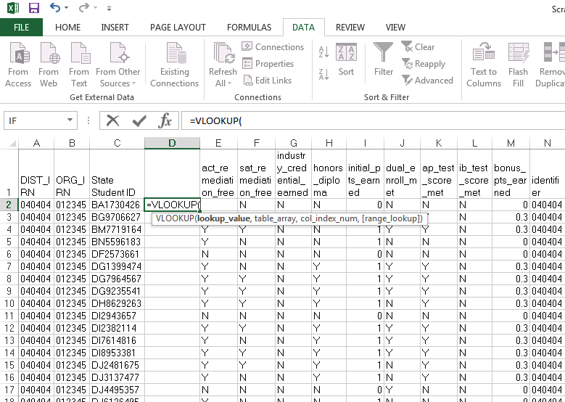
VLOOKUP Step One
Select Cell D2 on the
Prep for Success Report
and type =VLOOKUP(

Slide 38
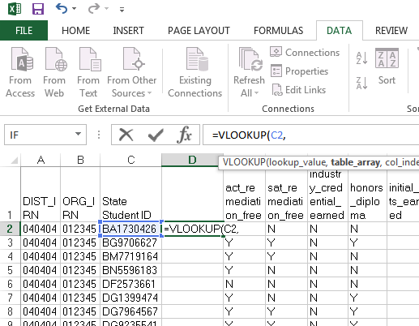
VLOOKUP Step Two
In this step we are indicating
that we want to find the State
Student ID, Cell C2 value in the
demographic file. Add a
Comma after the C2 value.

Slide 39
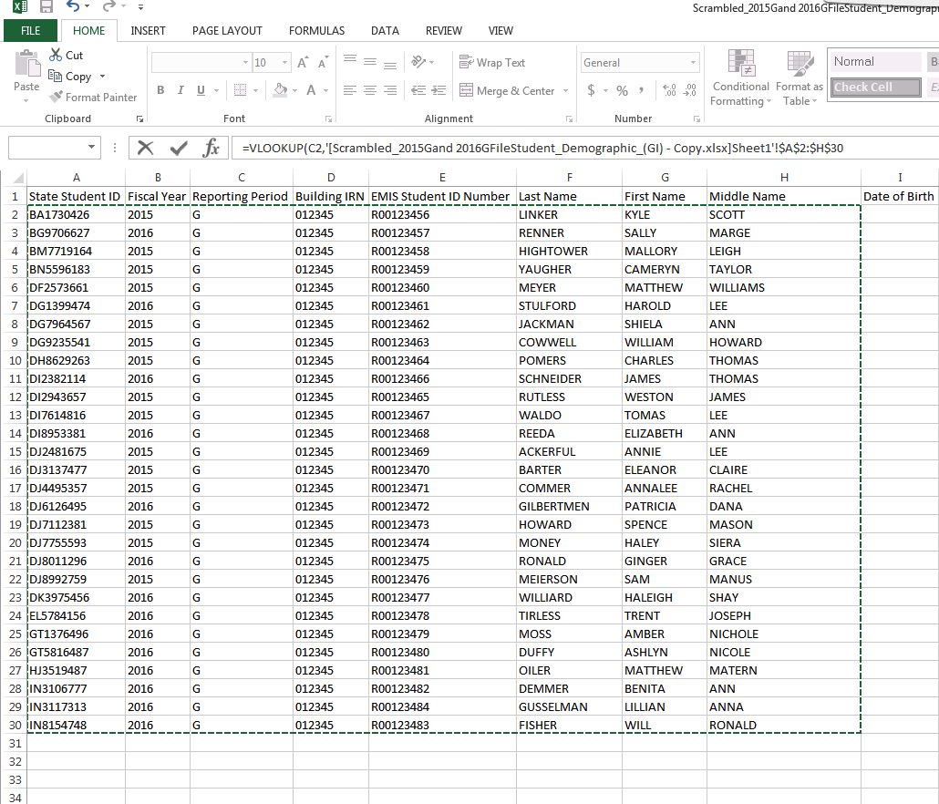
VLOOKUP Step Three
Place your cursor in cell A2 and drag over and down to
select all values on the Demographic file

Slide 40
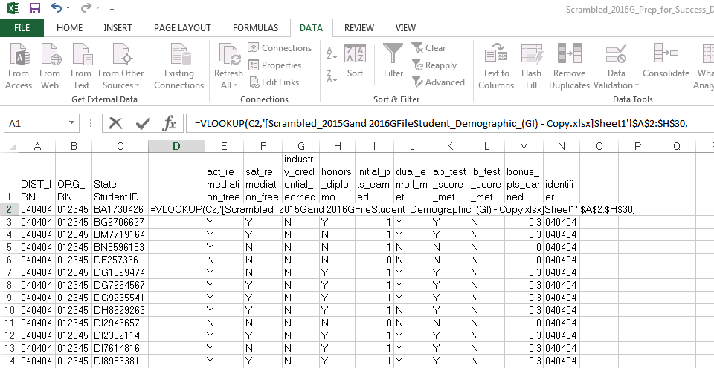
VLOOKUP Step Four
The VLOOKUP values will automatically appear in the formula bar on the Prep for Success report based on the value range selected from the demographic spreadsheet
Enter a comma after the
last value in the formula

Slide 41
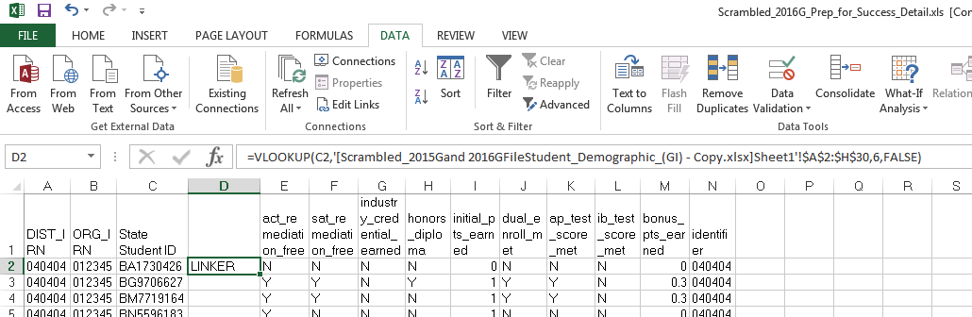
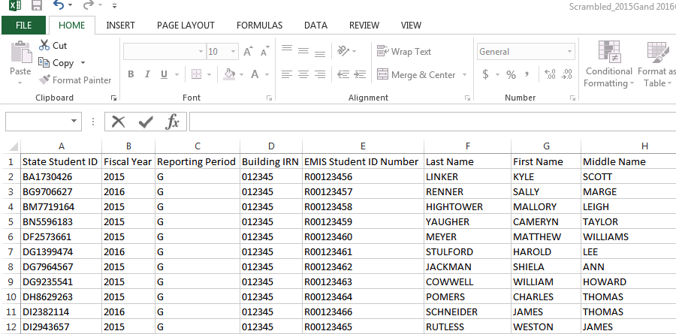
VLOOKUP Step Five
Indicate the column on the Demographic file that contains the value to bring back. In this
case it is column number 6. Add a comma after the 6.
To bring back the exact value from column 6, add “FALSE” and then close the function with a parenthesis “)”
1
2
3
4
5
6

Slide 42
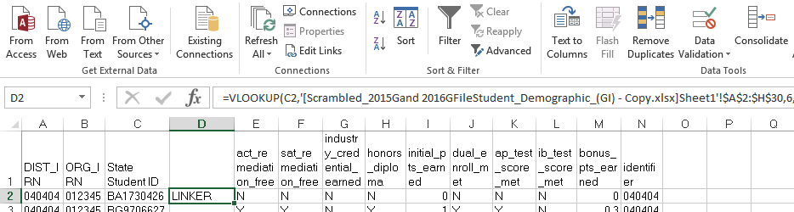
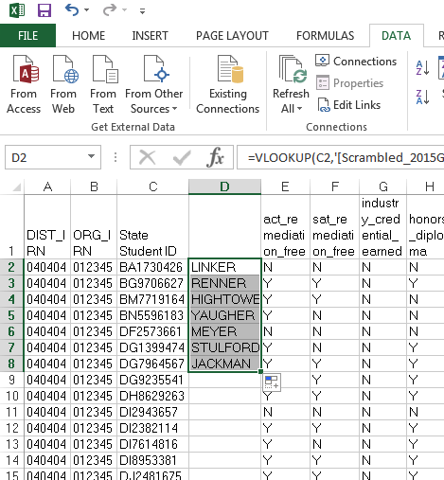
VLOOKUP Step Six
After pressing “Enter” the student’s
last name appears in the search.
Click at the bottom right of the D2 cell and get a + symbol and then drag down to populate the same function into the cells below. Double clicking will populate the column down.
The same process can be done to bring in first and middle names into the Prep for Success report.

Slide 43
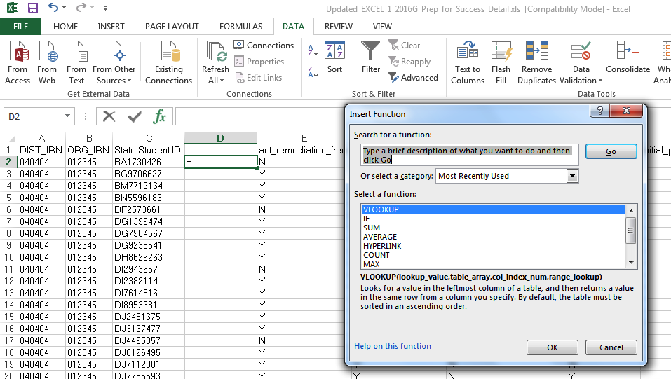
VLOOKUP Wizard
To use the Wizard for the VLOOKUP click on the Function icon, then choose VLOOKUP and click ok

Slide 44
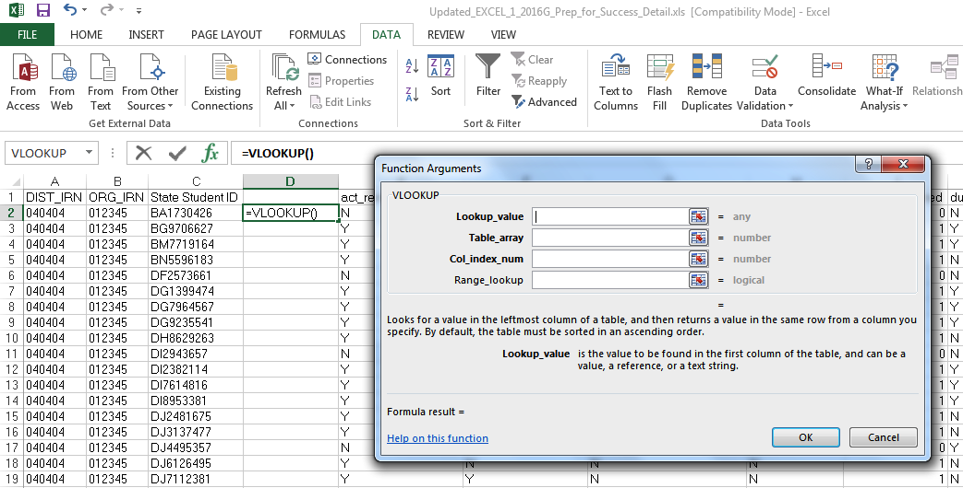
VLOOKUP Wizard, cont’d
Lookup_value = C2
Table_array = Select from
source file to populate
Col_index_num = Which
Column in course file?
Range_Lookup = False

Slide 45
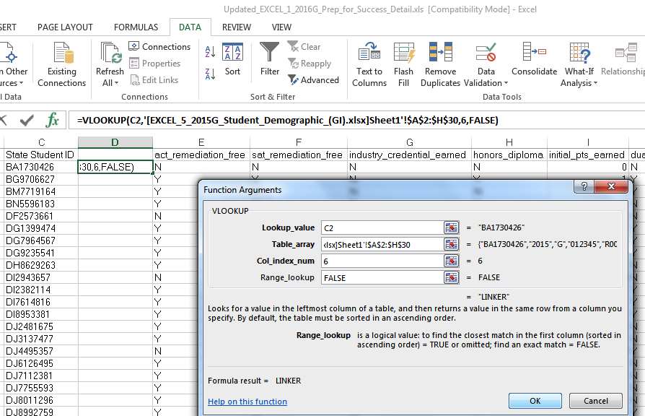
VLOOKUP Wizard, con’t
VLOOKUP Wizard
once all values
are selected

Slide 46
Quick Check
Can you find a source file that contains the SSIDs and student names that are missing from your report?
Are you able to write a VLOOKUP function to bring the names into the report?
Can you think of other instances where the VLOOKUP could be used?
The VLOOKUP function in Excel can be used to bring data from one spreadsheet to another. When ODE EMIS reports are void of names, or missing a large number of names, the VLOOKUP can be used to add names to the report to aid in troubleshooting the report.

Slide 47
Conditional Formatting to Verify RIMP Code Reporting

Slide 48
Conditional Formatting to Verify RIMP Code Reporting
The next series of slides will look at third grade students, Reading Diagnostic Values, and Reading Improvement and Monitoring Plans (RIMPs)
Reference data reporting rules for the diagnostic values, which are in EMIS Manual Section 2.6 Student Attributes–No Date (FN) Record
  ODE Home > Data > EMIS > Documentation > EMIS Manual
Notes:
Presenter- Demonstrate how to query data in your Student Information System

Slide 49
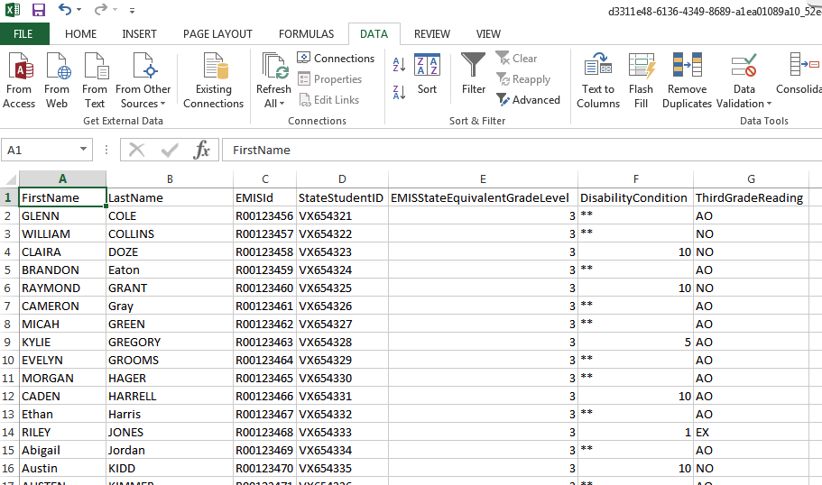
SIS Query
This is a sample SIS query (scrambled)
of third grade students, disability
conditions and Reading Diagnostic
Values. Open EXCEL_7_SIS_Query_Third_Grade.xlsx
Sort or filter to identify students
with a diagnostic value of “EX” and
a disability condition and verify for
accuracy
Sort or filter by diagnostic value of
“NO” and verify that a RIMP code is
being reported
Notes:
Presenter – Demonstrate how to perform a SIS Query that contains third grade students, their SSIDs, names, disability conditions, and Reading Diagnostic values.
Open EXCEL_7_SIS_Query_Third_Grade.xlsx and EXCEL_8_Student_Program_Record_(GQ).xlsx

Slide 50
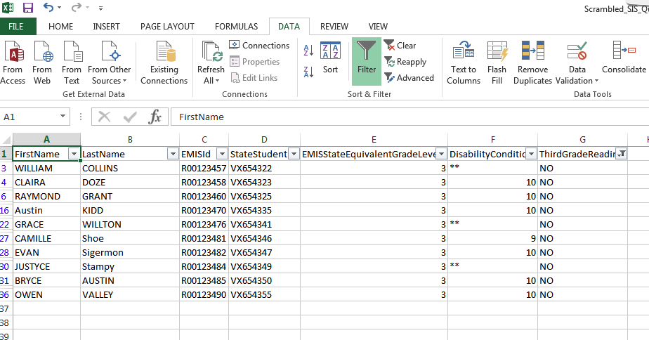
List of Students Not on Track
Students who are not on track for the Third Grade Reading Diagnostic (NO) should be on a (RIMP) Open EXCEL_8_Student_Program_
Record_(GQ).xlsx

Slide 51
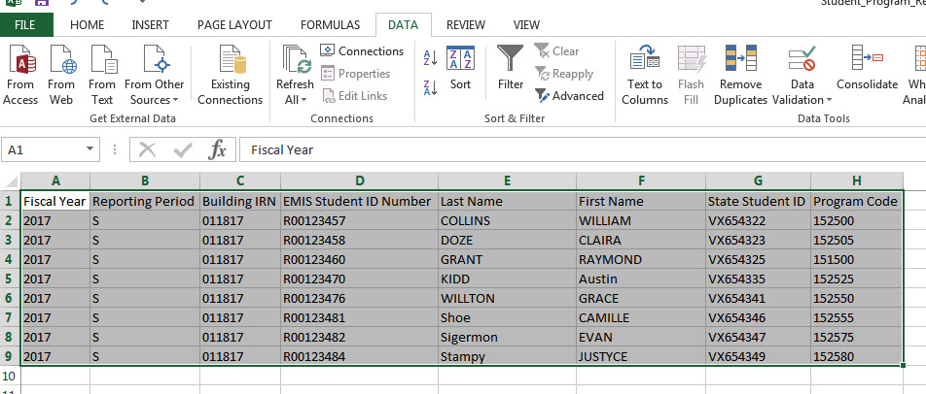
Verify Not on Track Students are on RIMPs
Query the SIS or view the
Student Program File (GQ)
from the Data Collector current
Student Collection
Use filters to identify all students on RIMP Codes
151500 and all 152500 to 152699 (not 152330)
Notes:
Presenter – Demonstrate how to get the Student Program File (GQ) from the current student collection in the Data Collector.

Slide 52
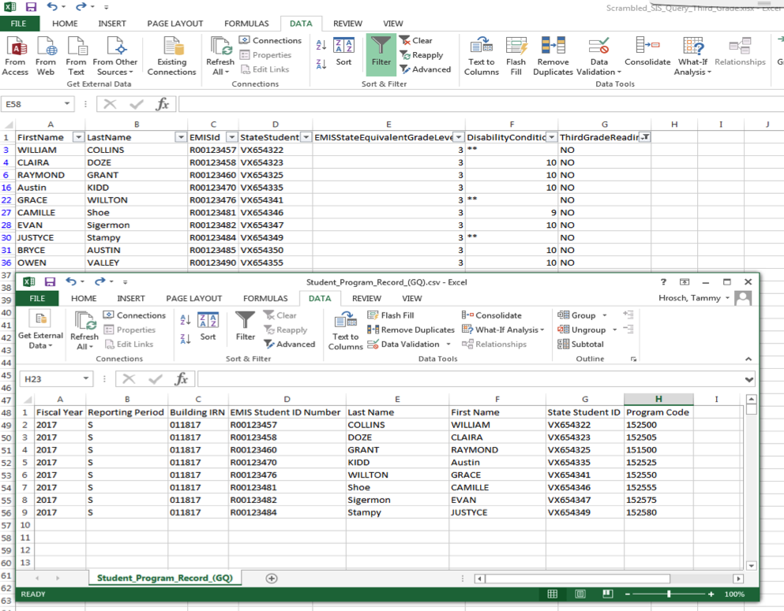
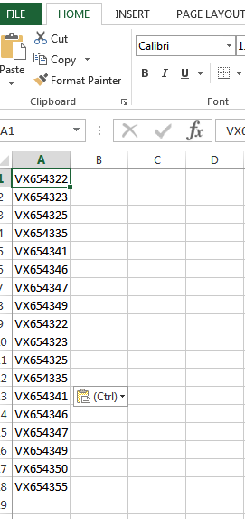
Combine SSIDs from Spreadsheets
This screenshot shows both spreadsheets
(Students Not on Track and Student Program
GQ) and below is a new spreadsheet
containing all SSIDs from both spreadsheets

Slide 53
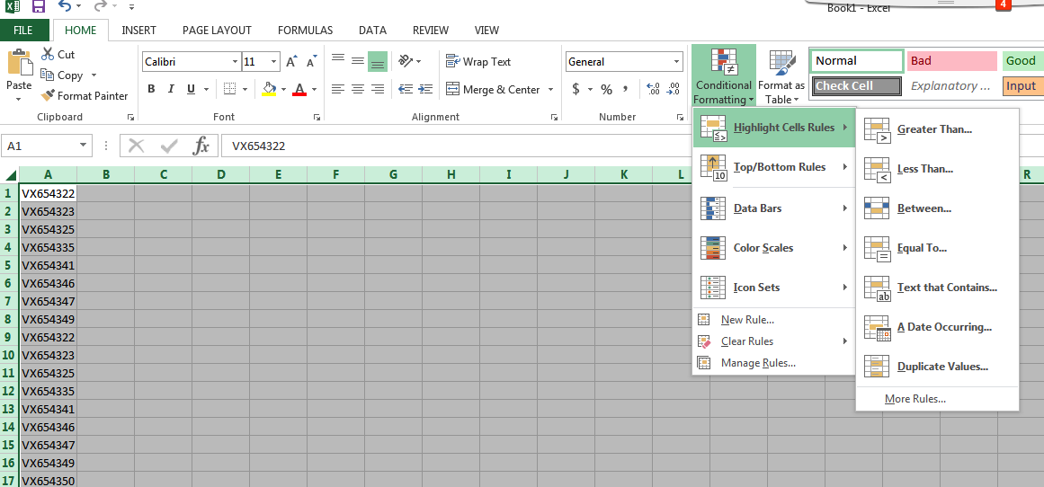
Conditional Formatting
From the Home tab, choose
Conditional Formatting,
Highlight Cell Rules, then
Duplicate Values

Slide 54
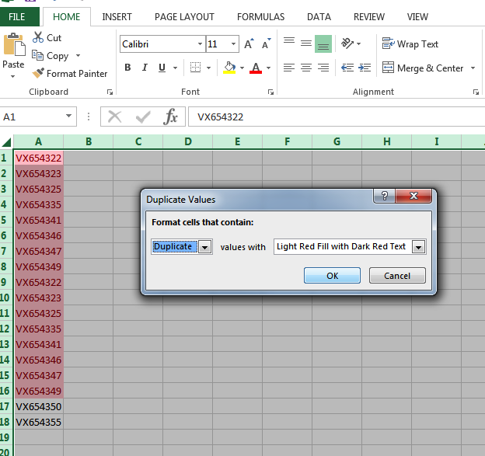
Conditional Formatting, cont’d
In the Duplicate Values Prompt,
leave the values as defaulted and
click “OK”
This function highlighted SSIDs that were in both the “Not on Track” file and in the “RIMP Code” file. The two students who are not highlighted are Not on Track and do not have RIMP Codes reported

Slide 55
Quick Check
Have all RIMPs been entered into the SIS?
Do you have students with Reading Diagnostic values of “NO” who are not on RIMPs?
Can you think of other instances where the Conditional Formatting could be used?
Students with a Reading Diagnostic value of “NO - Not on Track” must have RIMP (Reading Improvement and Monitoring Plan) program codes reported to EMIS. Districts who do not place students on required RIMPs will see a deduction in their Third Grade Reading Guarantee Local Report Card measure.

Slide 56
Summary
Basic Excel techniques can be very useful
  when troubleshooting EMIS data in the Student Information System
  when troubleshooting EMIS reports
  when troubleshooting preview/review files
These techniques should be part of your everyday practices

Slide 57
Resources
Microsoft Excel Help within Excel “?” Articles and Videos
Google it
Microsoft Excel Classes
Your ITC

Slide 58
Questions?

