Slide 1
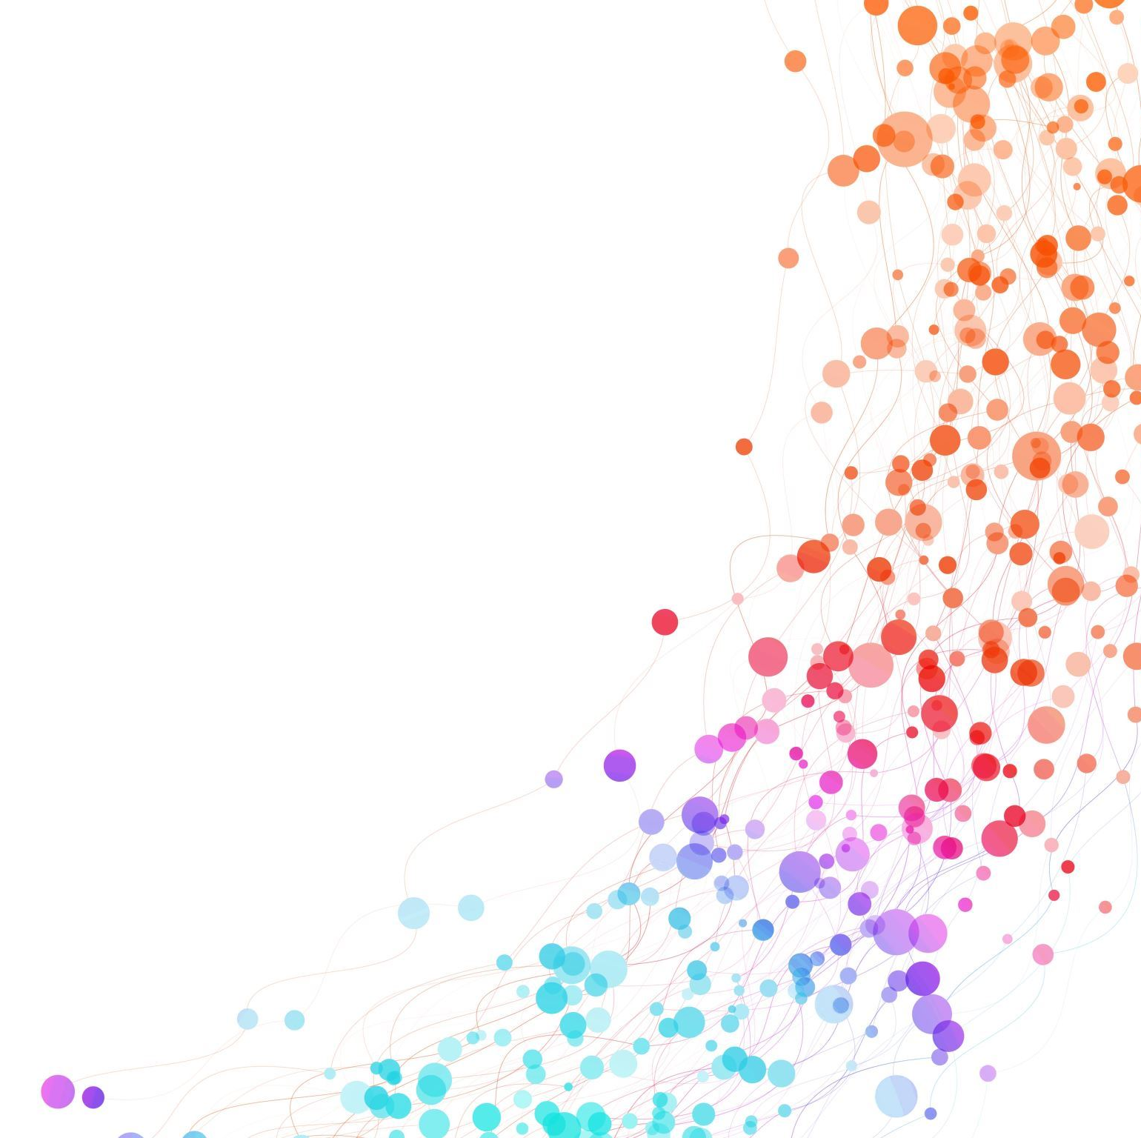
Overview of Special Education
Radnor Township School District
October 9, 2025

Slide 2
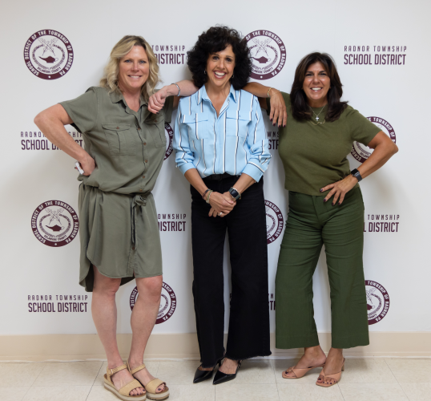
Leadership Team
Mrs. Cara Miller - Director of Student Services
Dr. Danielle Fowlston – Assistant Director of Student Services
Mrs. Kate Jumper – Supervisor of Student Services
65 years total between the three of us!
Administrative Assistants – Ms. Sherry Stewart, Mrs. Karen Ebert and Mrs. Gina Console

Slide 3
Agenda
Introduction of the new leadership team
Survey Results
What is a Free Appropriate Public Education (FAPE)
What is Least Restrictive Environment (LRE)
Structured Literacy
Contracted Services
School Psychologists
School Social Worker Support
Elementary
Middle School
High School
Radnor Academy
Transition
Moving forward

Slide 4
Free Appropriate Public Education (FAPE)
All qualified persons with disabilities within the jurisdiction of a school district are entitled to a free appropriate public education
An appropriate education may comprise education in regular classes, education in regular classes with the use of related aids and services, or special education and related services in separate classrooms for all or portions of the school day.
Special education may include specially designed instruction in classrooms, at home, or in private or public institutions, and may be accompanied by related services such as speech therapy, occupational and physical therapy, psychological counseling, and medical diagnostic services necessary to the child’s education.

Slide 5
Least Restrictive Environment
(LRE)
LRE means that, to the maximum extent appropriate, students with disabilities are educated with students without disabilities.
The starting point is placement in the general education classroom with appropriate supports and services.
Continuum of Placements: Schools must provide a range of placement options (general education, resource room, special class, special school, home instruction, hospitals/institutions).
Supplementary Aids & Services: Before considering more restrictive placements, schools must try supports such as assistive technology, paraprofessionals, modifications, and/or related services.
Individualized Decision: LRE is determined by the student’s IEP team, based on the student’s unique needs, not on disability category or administrative convenience.

Slide 6

Survey Results
131 Parents Responded to the Survey – Thank you!
Radnor High School – 42 parents
Radnor Middle School – 38 parents
Wayne Elementary School – 26 parents
Radnor Elementary School – 20 parents
Ithan Elementary School – 14 Parents
80% – Parents were meaningful involved in the IEP meeting
75% – The teams effectively communicate about the child’s progress during the year
72% – The IEP provided strong support during transitions
76% – Felt that the resources were provided to parents were helpful
76% – Were satisfied with the services that were received
STATE Data, parents had meaningful involvement
2022 – 40%
2023 – 50%

Slide 7
What is going well?
According to the survey:
Staff are dedicated and punctual.
Critical people that have helped her through the years.
We have only been in the program a few months, but it has been helpful to be able to have accommodations in the classroom as well as outside resources.
A great transition into Kindergarten that has been seamless and addresses my child’s needs.
Case managers are outstanding. Know that my son is getting the help he needs to be successful in school. Like the smaller, more focused classes that he is in.
The speech therapist at RHS, is wonderful. The teachers have generally been receptive to her needs and accommodations since her IEP was enacted.
High Quality Teaching Staff
All the support and communication I receive on a daily basis and especially during his transition to middle school
Radnor Academy is a great program
Responsive team, use of accommodations consistently

Slide 8

Structured
Literacy
Act 35 from 2024 expands access to structured literacy in PA schools
RTSD teachers have been receiving training in the Science of Reading to then implement a structured literacy model
Our learning support teachers that work directly with reading have had more specific training
RTSD has partnered with Literacy Consultant - Jody Fleck from Literacy Defined
Our office has provided programs and materials that are researched based to all students requiring direct instruction in Reading
Teaching & Learning has adopted a new K-5 ELA curriculum – Into Reading

Slide 9
Contracted supports
Related Services
Occupational Therapy, Speech and Physical
Therapy are provided by Pediatric Therapeutic
Services (PTS)
Caron Foundation
Supports our Student Assistance Programs (SAP),
Drug & Alcohol counseling for the secondary level
Lakeside Clinical Counseling
All buildings are staffed with clinical counselors
Behavioral Supports
2.0 Board Certified Behavioral Analyst (BCBAs)
Registered Behavior Technicians (RBTs)

Slide 10
School Psychologists
Dr. Natalie Gabor – Radnor Elementary School
Mrs. Kelly McBride – Radnor Middle School
Assessment & Evaluation – certified to conduct academic, behavior and social emotional scales
Elementary School Psychologists support students entering from Early Intervention
Determine eligibility for special education or 504
Work closely with all team members in their buildings through observations and data collection
Can offer groups and individual supports to students together through school counseling & SAP.
Collaborate with teachers through the Multi-Tiered Systems of Supports (MTSS) and MTSS meetings
Participate in our Student Assistance Program (SAP)
Trained members of the Comprehensive School Threat Assessment Guideline (CSTAG) team – conduct threat and risk assessments

Slide 11
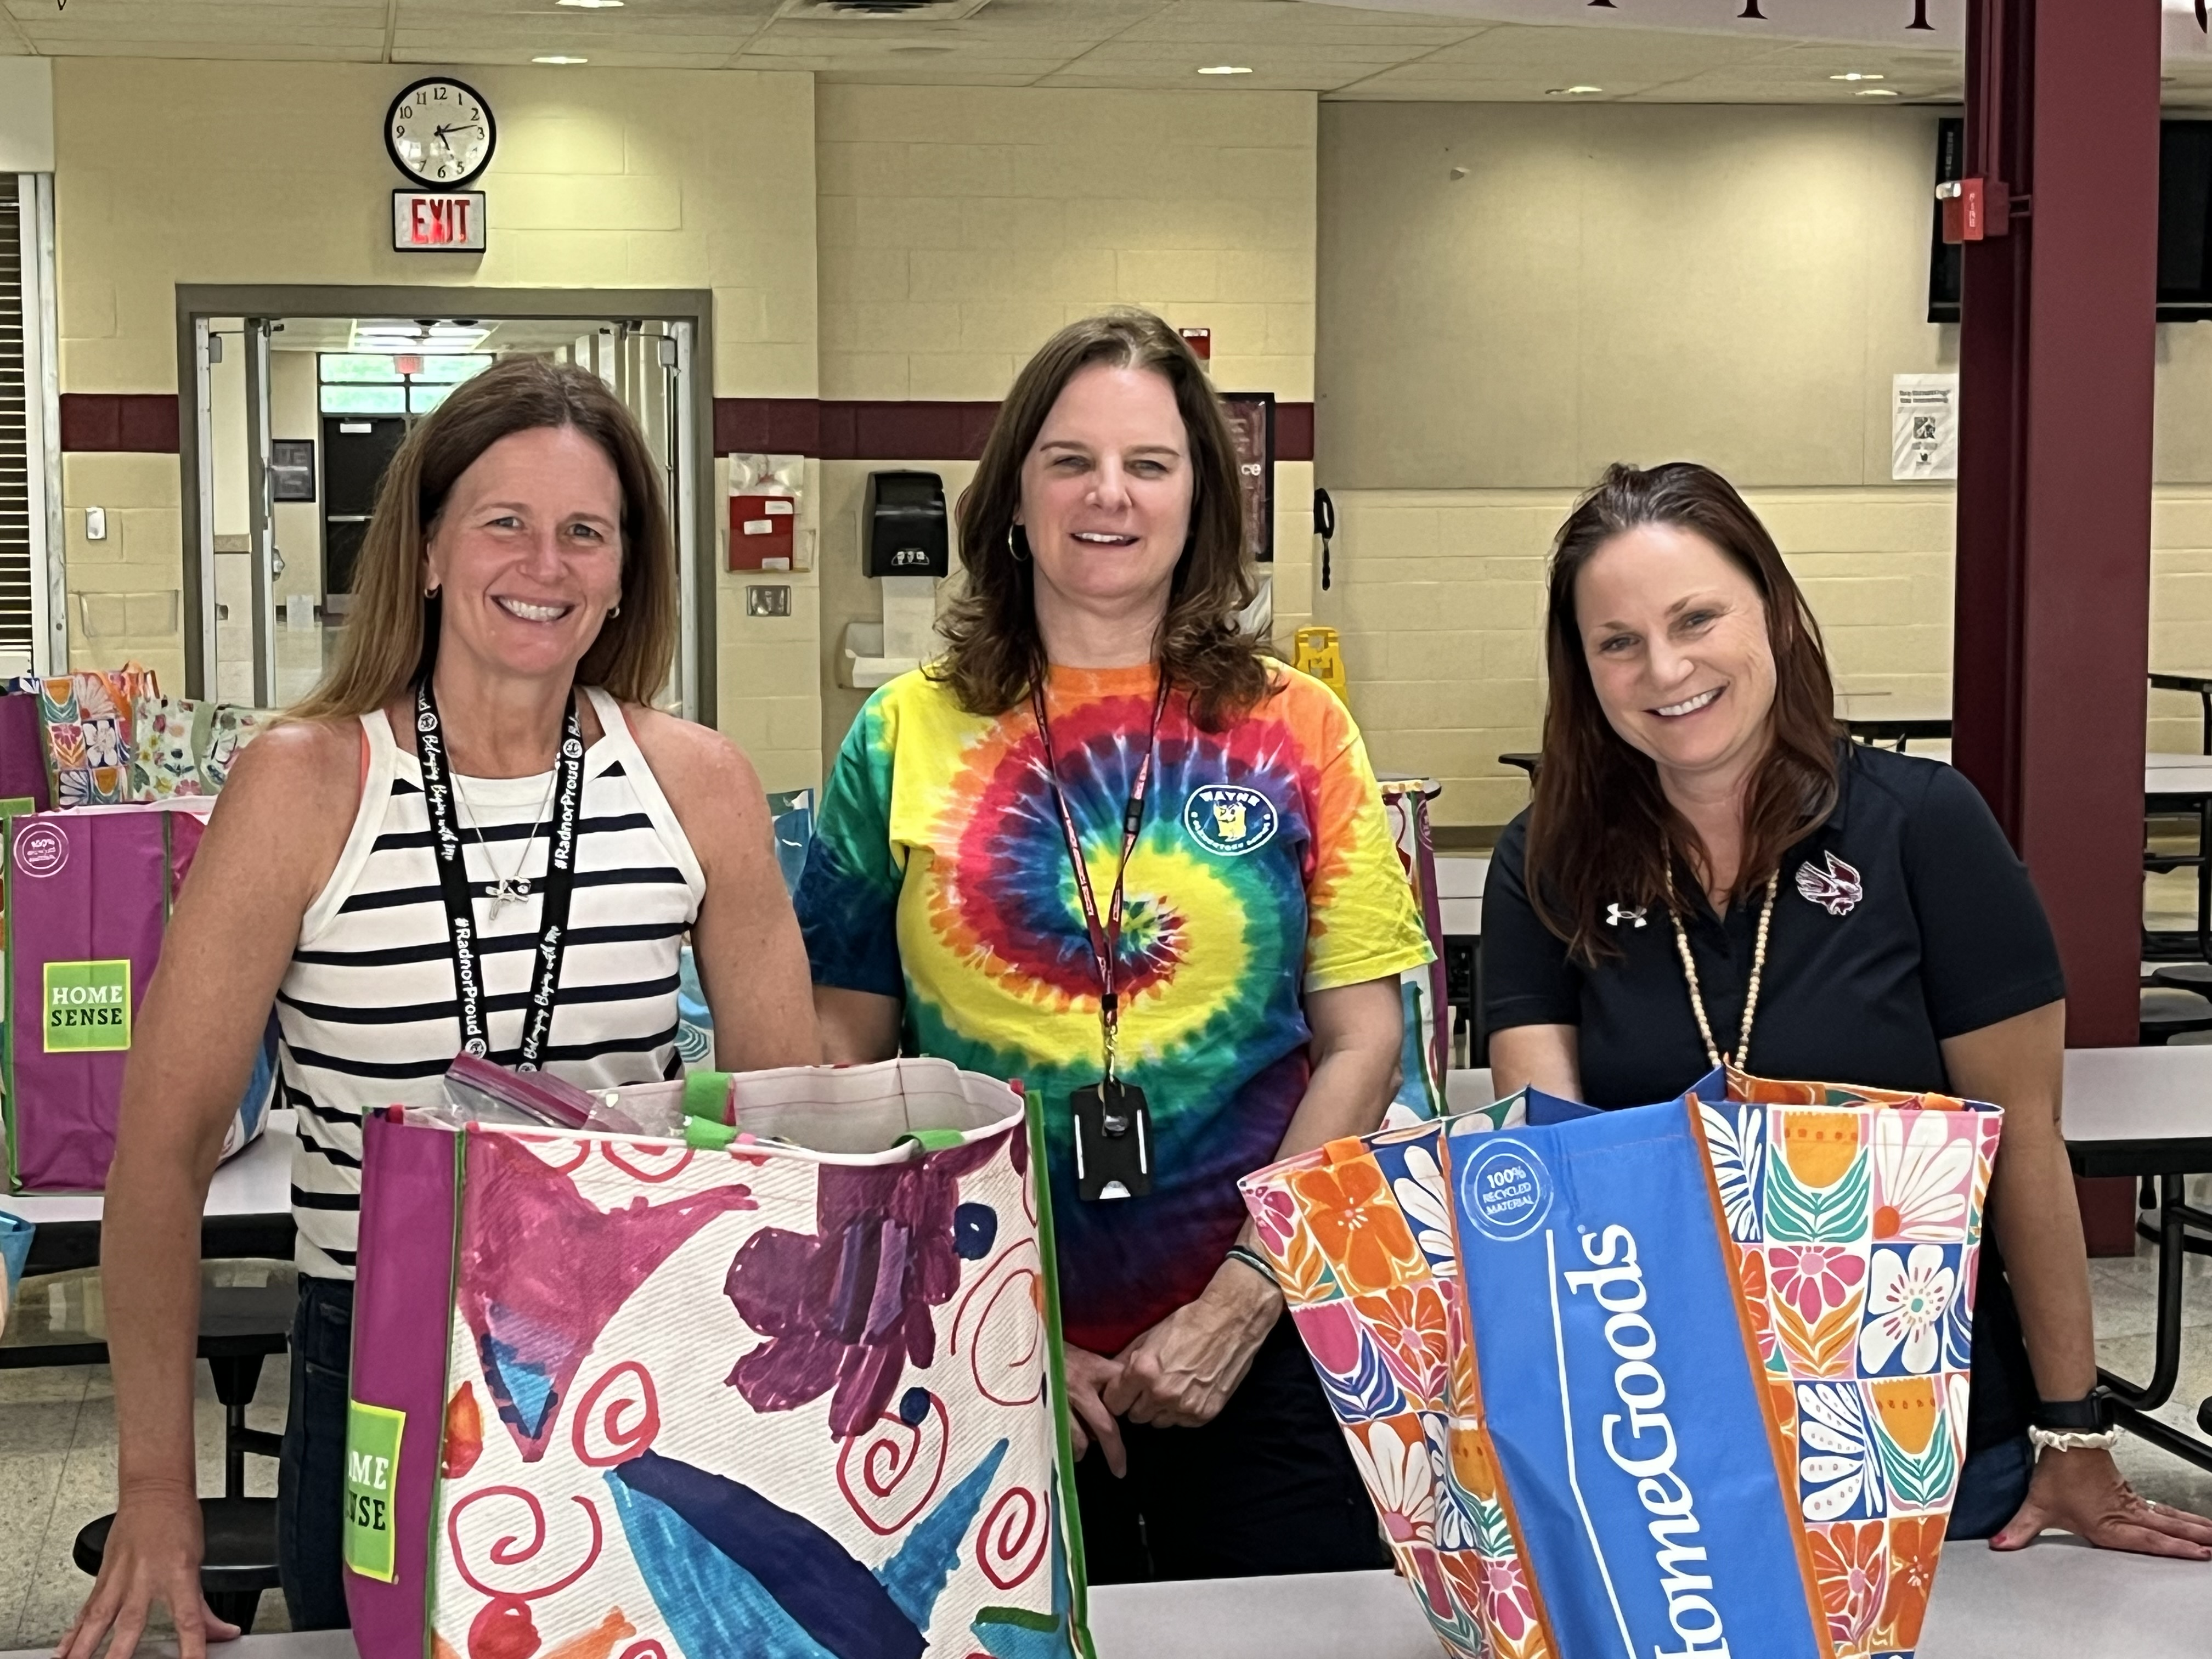
School Social Workers
Mrs. Margie Bates – Wayne, Radnor and Ithan Elementary Schools
Mrs. Ceire Evans – Radnor Middle School
Mrs. Christine Kulp – Radnor High School
Bridge between home, school, and community
Partner with outside agencies
Advocate for student well-being and equity
Support our Student Assistance Program (SAP) and Multi-Tiered Systems of Support (MTSS)
Trained members of the Comprehensive School Threat Assessment Guideline (CSTAG) team –conduct threat and risk assessments
Connect families with community resources (mental health, housing, food, medical, insurance, etc.)
Advocate and assist students with housing insecurities
Support parent-school team collaboration
Conduct home visits, when needed
Support students and families with positive attendance strategies
Provide professional development on mental health, trauma-informed practices, SEL
Contribute to IEP/504 teams

Slide 12
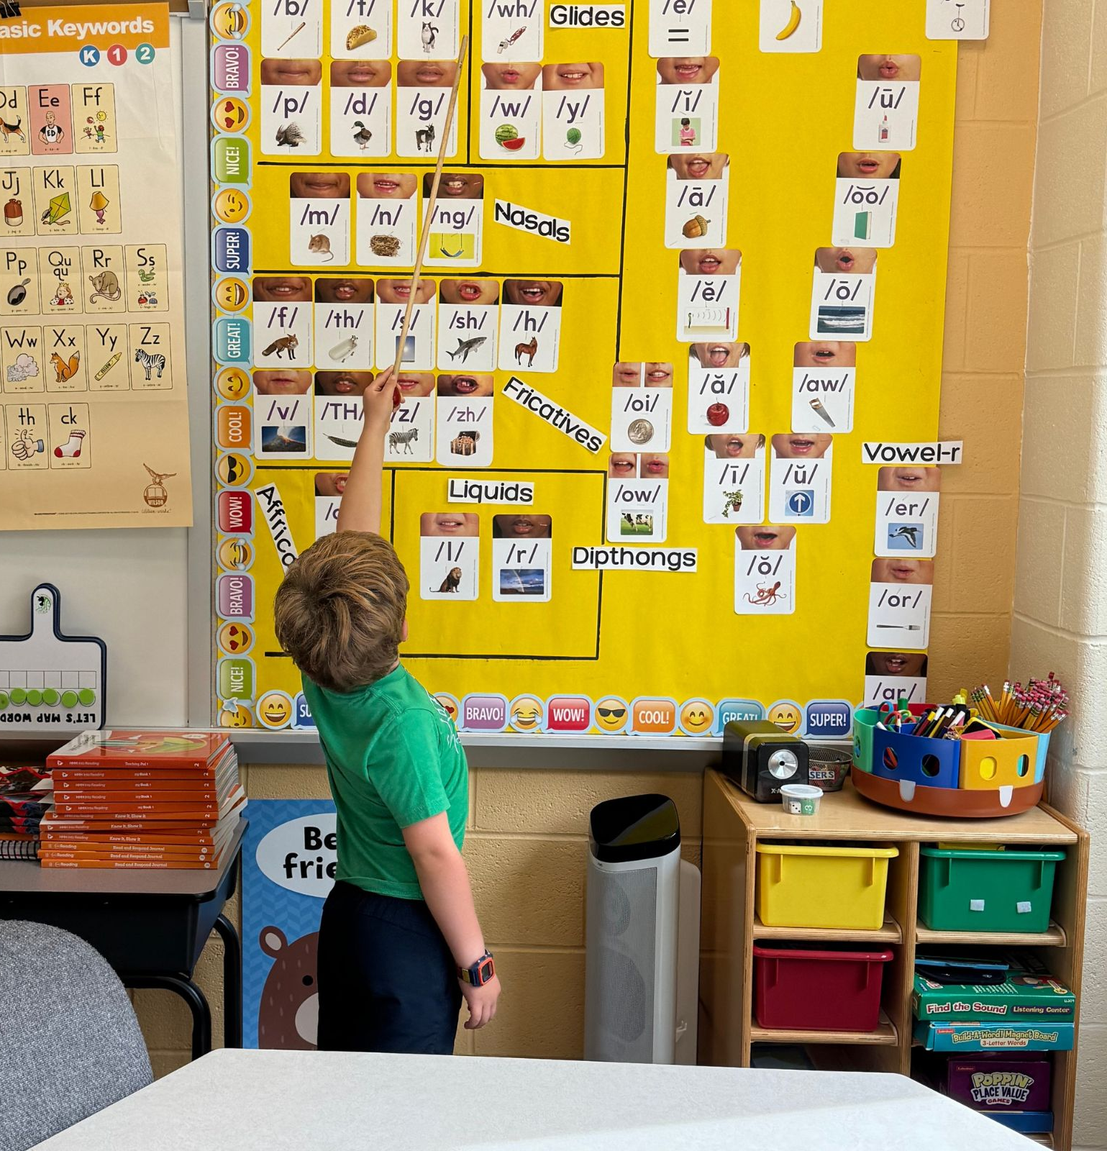
Elementary Learning Support
Mrs. Christine Hannon– Wayne Elementary School
Learning Support – Reading, Writing and Math – Specific programs based on the IEP goals
Trained in the Science of Reading
Support students in the Multi Tiered Supports Systems (MTSS) process
Work closely with general education teacher to support inclusion
Push into the general education classes and pull students out for direct instruction
Supporting their colleagues on special education services and best practices
Support the transition to Radnor Middle School both academically and socially

Slide 13
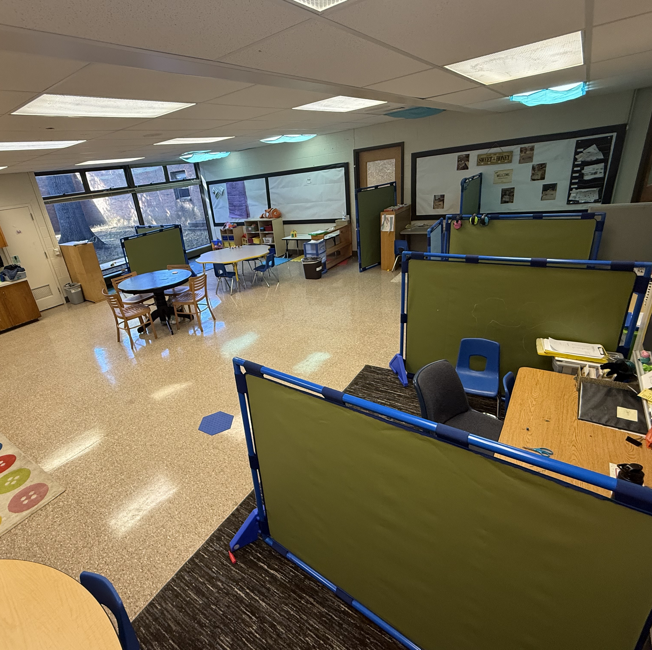
Elementary Intensive Language Program (ILP)
Mrs. Victoria Behan – Wayne Elementary
Ms. Erin Dillon – Wayne Elementary
Highly structured classroom that focuses on the following:
  Support with significant language delays and communication
  Sensory regulation behaviors strategies
  Trained behavioral support supervised by BCBA
Individualized schedules and morning meetings
Low student to teacher ratio
Daily collaboration with related service providers

Slide 14
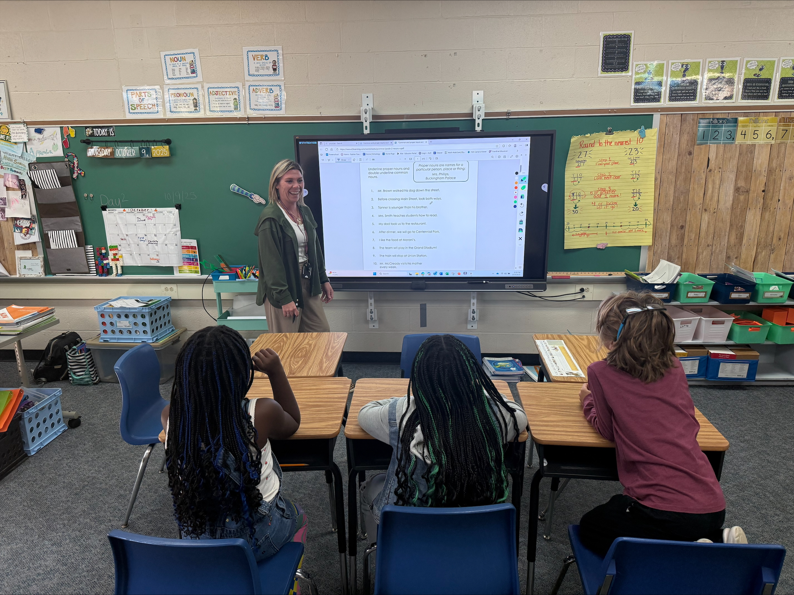
Intensive Learning Support
Mrs. Ashlyn Marabella – Ithan Elementary School
Small class size with low student-to-teacher ratio
Highly structured environment with consistent routines
Visual schedules
Collaboration with related service providers and general education teachers
Individualized instruction aligned with IEP goals
Modified curriculum focusing on functional academics, communication, and social skills
Use of evidence-based practices (e.g., direct instruction, task analysis, explicit modeling)
Frequent repetition, reinforcement, and hands-on learning
Supplemental or full-time placement

Slide 15
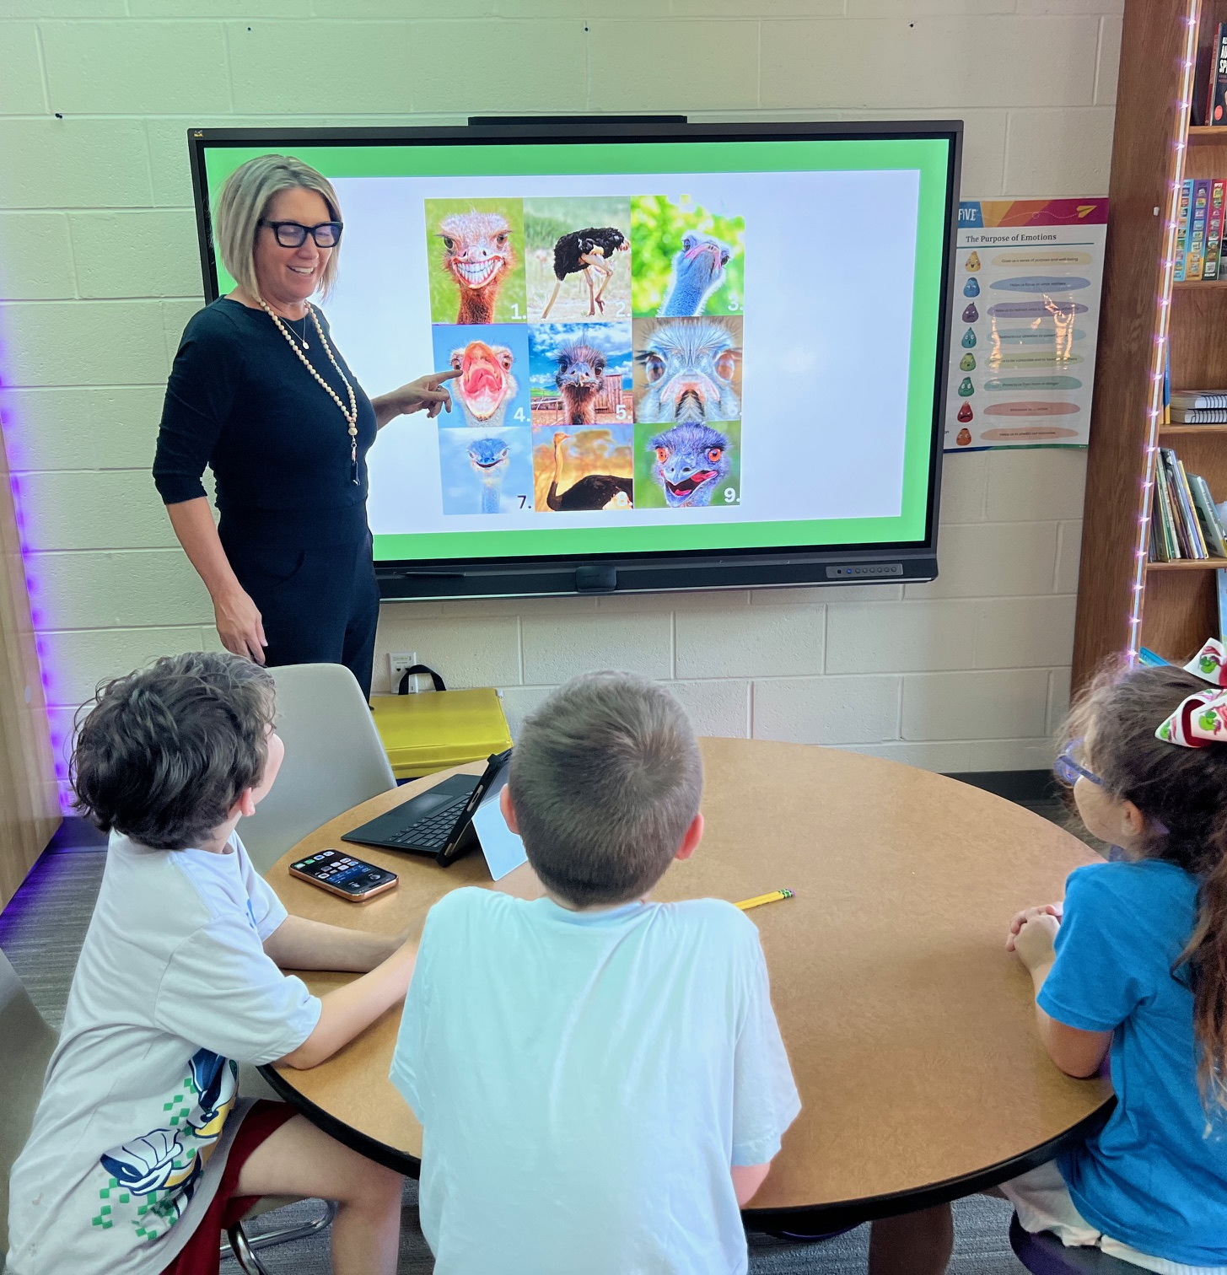
Elementary Emotional Support
Amy Ziegler-Wayne & Ithan Elementary Schools
Radnor Elementary hosts our supplemental and full-time classroom for students that need a higher level of support. Academics can be provided with embedded social/emotional supports
Direct instruction in emotional regulation is provided in all three buildings.
WES and IES instruction is available as outlined in your child's IEP
Social emotion learning (SEL) includes social skills, identifying triggers, selecting positive coping strategies
Work closely with general education teachers, BCBAs and RBTs to support inclusion
Classroom observations occur to assist with generalizing the material
Our ES teachers plan and provide support to transition to Radnor Middle School

Slide 16
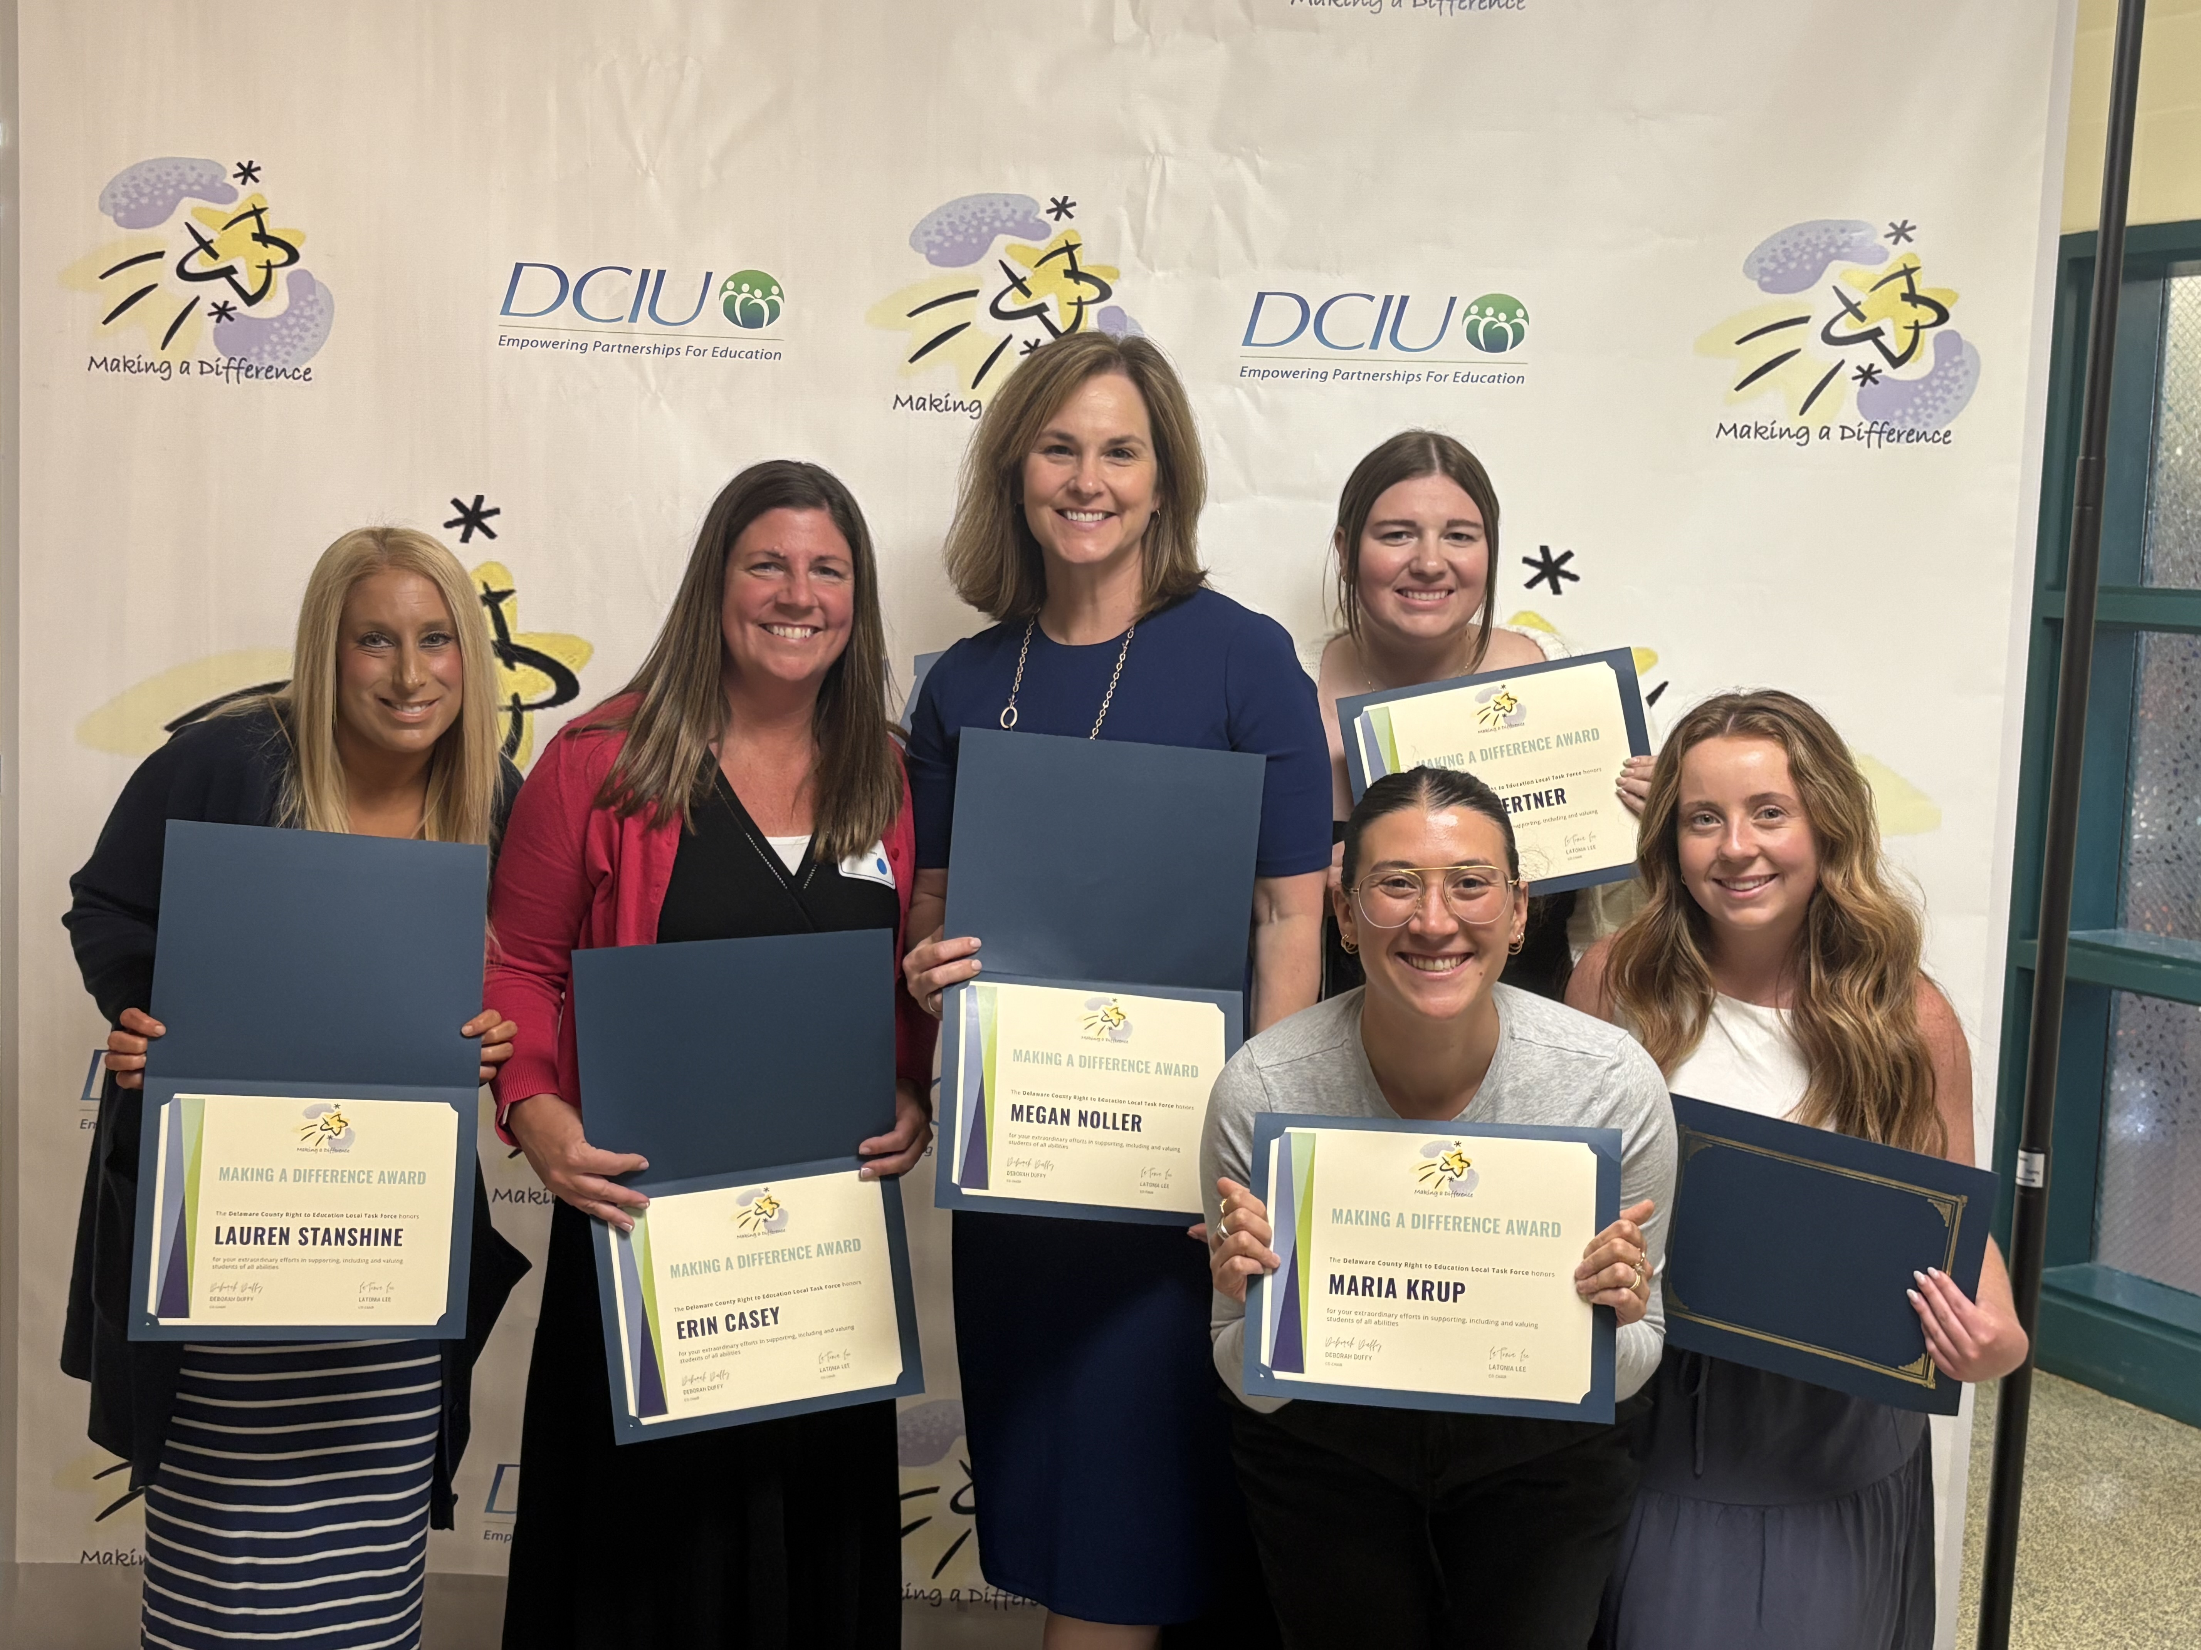
Middle School Learning Support
Mrs. Erin Casey – Radnor Middle School
Learning Support – Reading, Writing, Math & Executive Functioning – Specific courses based on the IEP goals
Trained in the Science of Reading
Special Education teachers participate on the grade level teams
Push into the general education classes and pull students out for direct instruction
Work closely with the general education teachers, BCBAs and RBTs to support inclusion
RMS teachers partner with the elementary and high school teachers to ensure a smooth transition for the upcoming school year

Slide 17
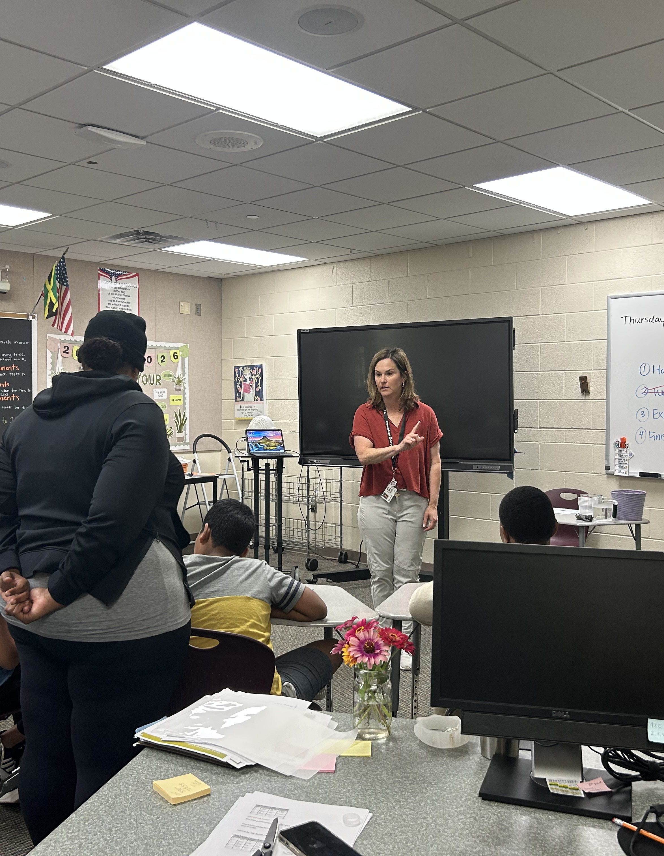
Middle School Intensive Learning Support/Life Skills
Mrs. Sarah Bradshaw, Radnor Middle School
Direct instruction is given on specific cycle days for functional content
Students are part of their grade level team
Ongoing collaboration to the teachers with modifications to support inclusion
Embedded social and communication skills
The team works closely with related service providers
Guided transition support from the three elementary schools to RMS
Guided transitions support to RHS

Slide 18
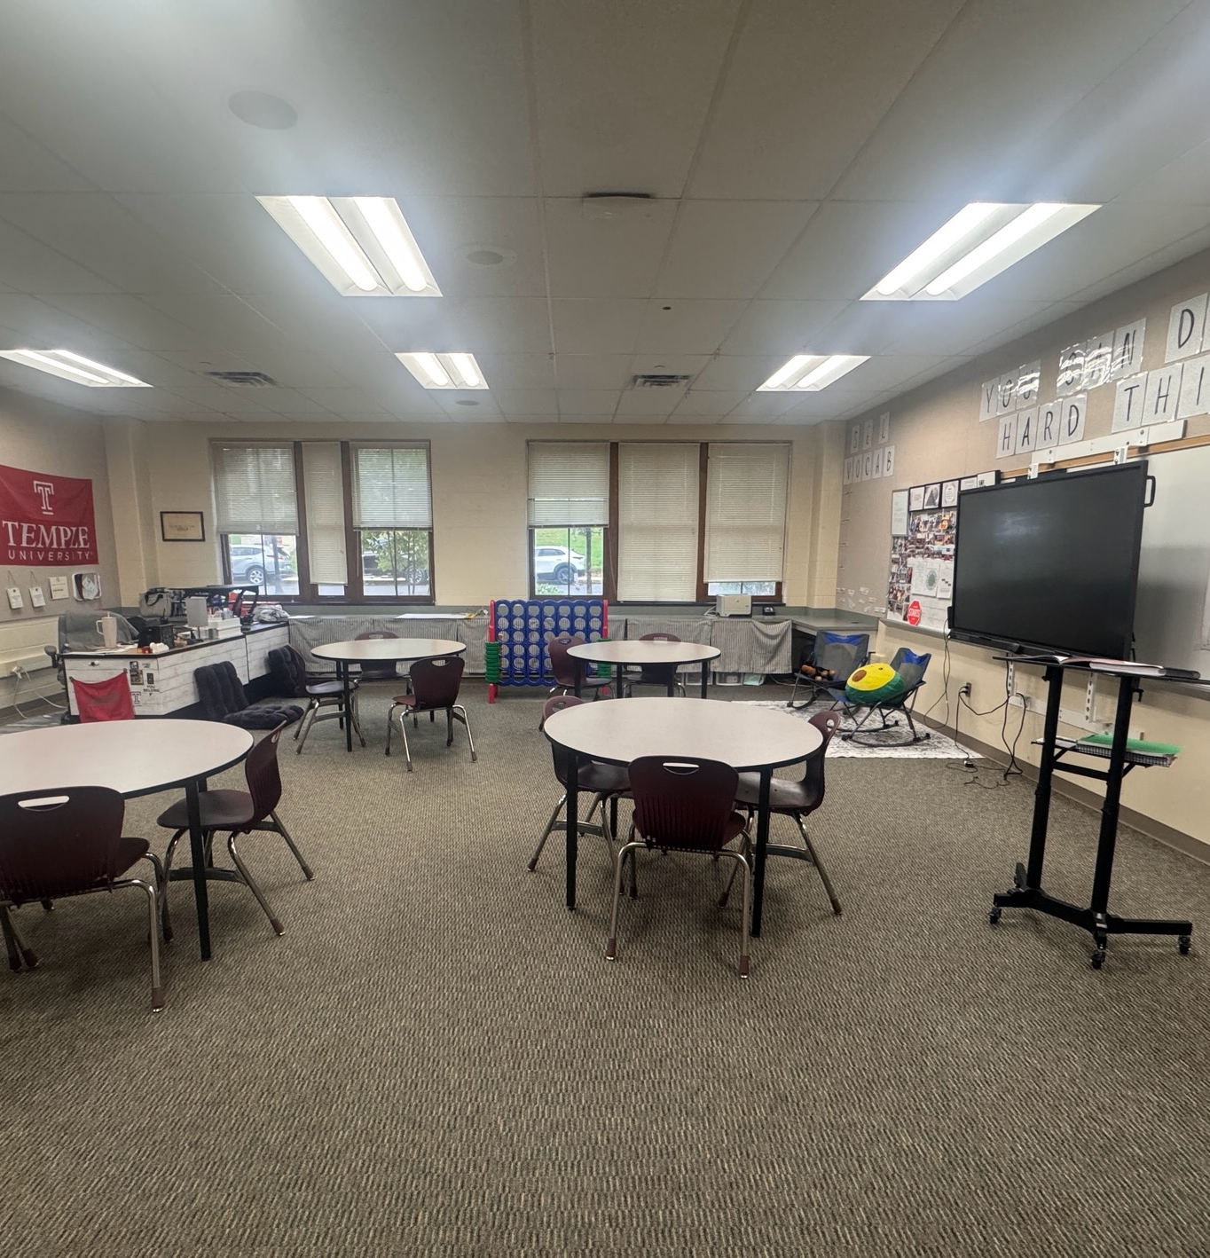
Middle School Emotional Support
Ms. Jackie Oertner – Radnor Middle School
Cycle day direct instruction in the areas of communication, self-advocacy and emotional regulation also addressing empathy, responsibility and self-control
Emotional support center is available for students all day
Collaboration with the middle school teams to monitor progress and support the teachers and students
Emotional Support Advisory to check-in and monitor student emotional well-being, behavior and academics
Work in conjunction with our BCBAs and RBTs
Support the transition to Radnor High School

Slide 19
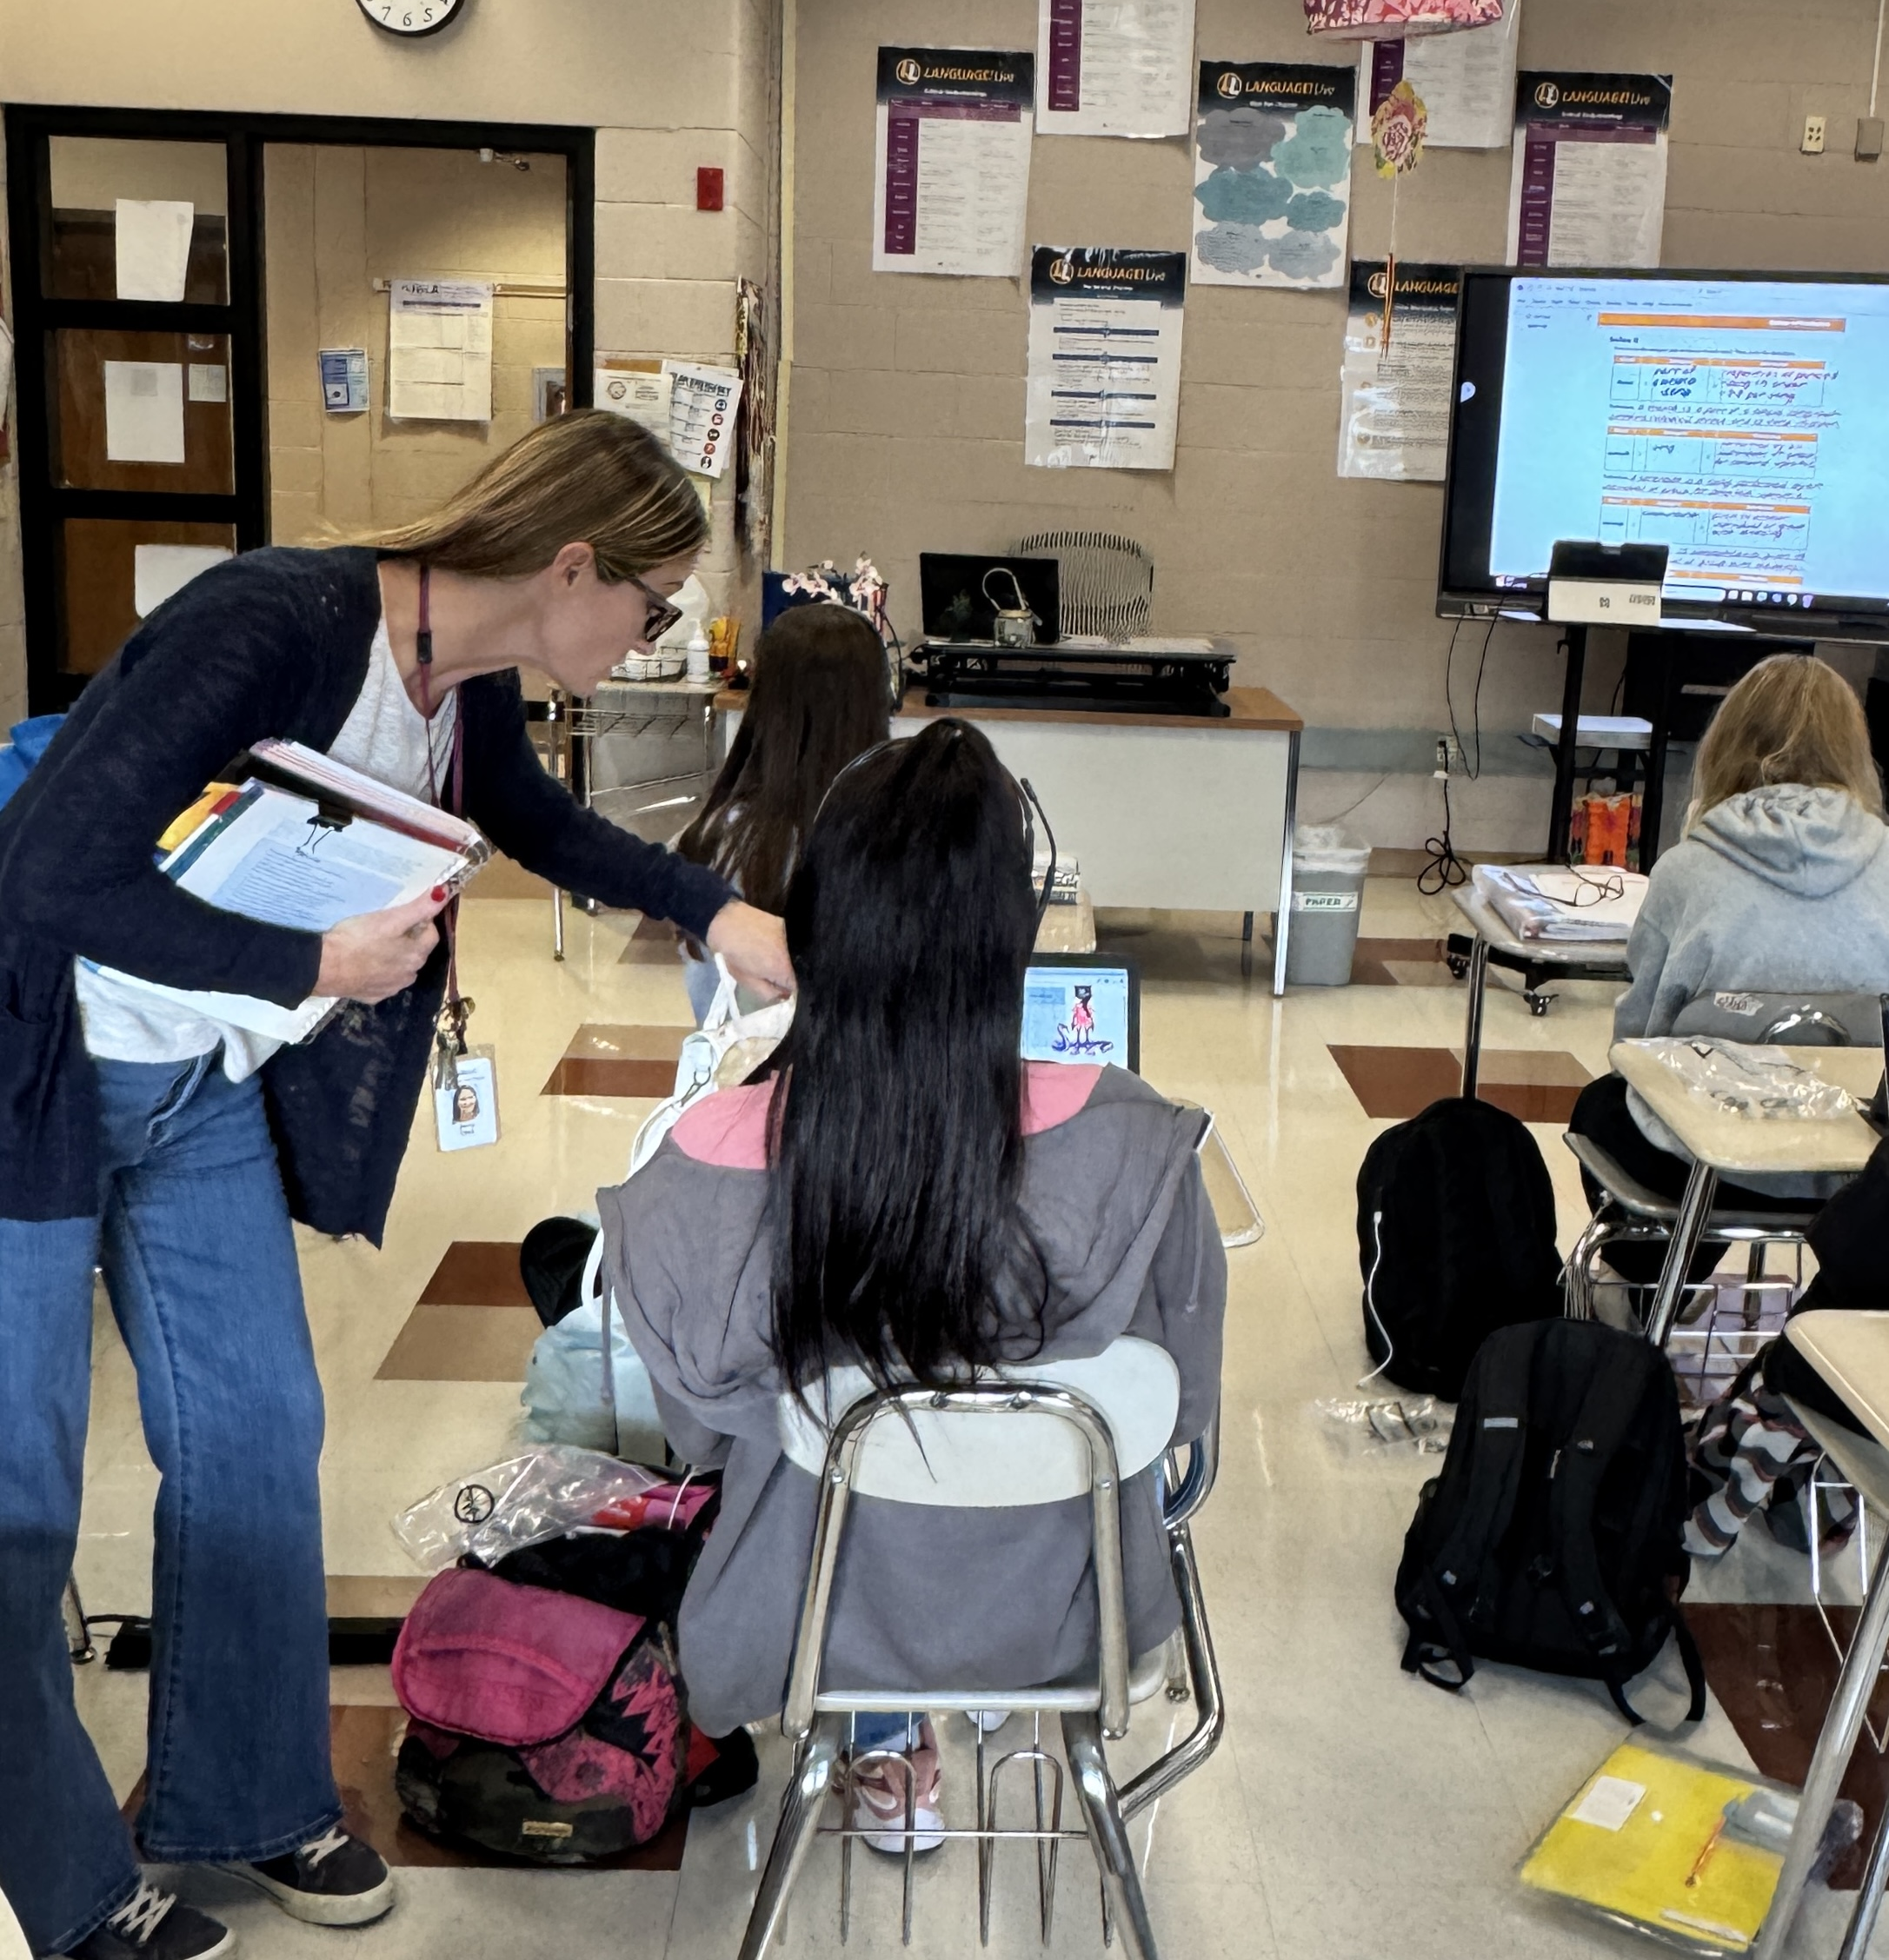
High School Learning Support
Mrs. Jenny Clark – Radnor High School
Learning Support – Reading, Writing, Math & Executive Functioning , specific programs based on the IEP goals, meet daily or on cycle days
Trained in the Science of Reading and follow a structured literacy model
Collaborates with colleagues to support inclusion and implement best practices
Push into the specific general education teachers' classes
Work closely with the RMS regarding the transition to RHS with the student’s schedule and IEP
Partner with school counselors & transition Coordinator to guide students in transition activities both post-secondary and employability

Slide 20
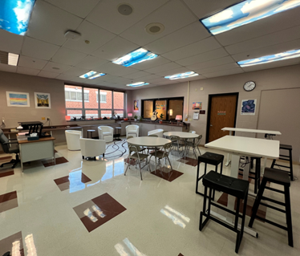
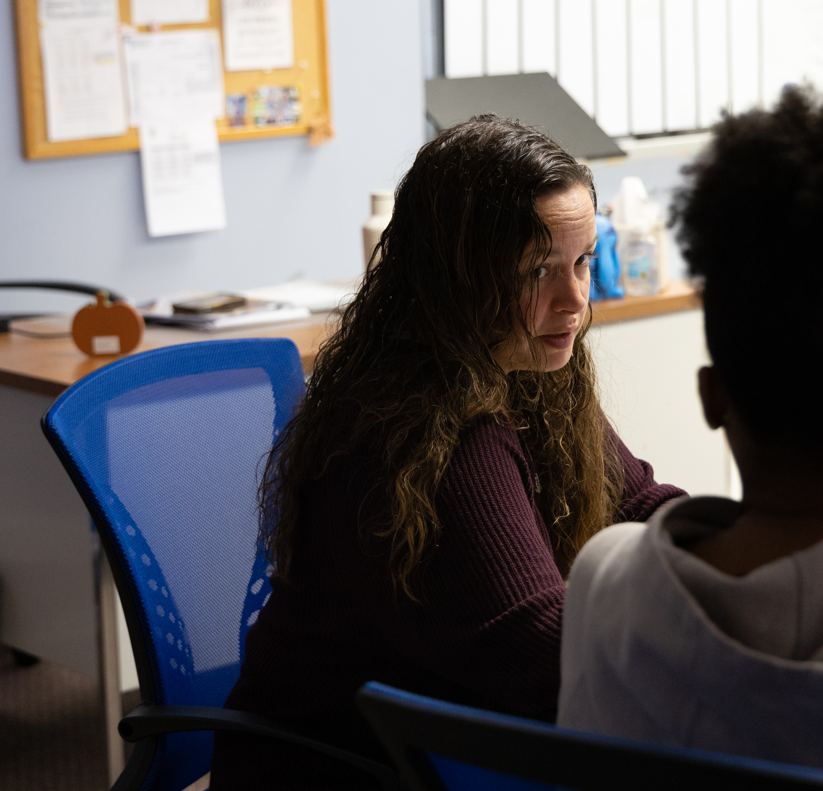
High School Emotional Support
Mr. Ryan Frost –Emotional Support Teacher
Mrs. Stacy Hoffman – The Radnor Academy
•Cycle day direct instruction in the areas of communication, self-advocacy and emotional regulation also addressing empathy, responsibility and self-control
•An emotional support room and homeroom is available for students throughout the day
•High School team guides the transition from RMS through graduation
Radnor Academy
•Blended learning model (online course and traditional in-person instruction)
•Flexible, individualized schedule
•Core content teachers push-in for academic support
•Social emotional strategies are embedded into the leanring environment

Slide 21
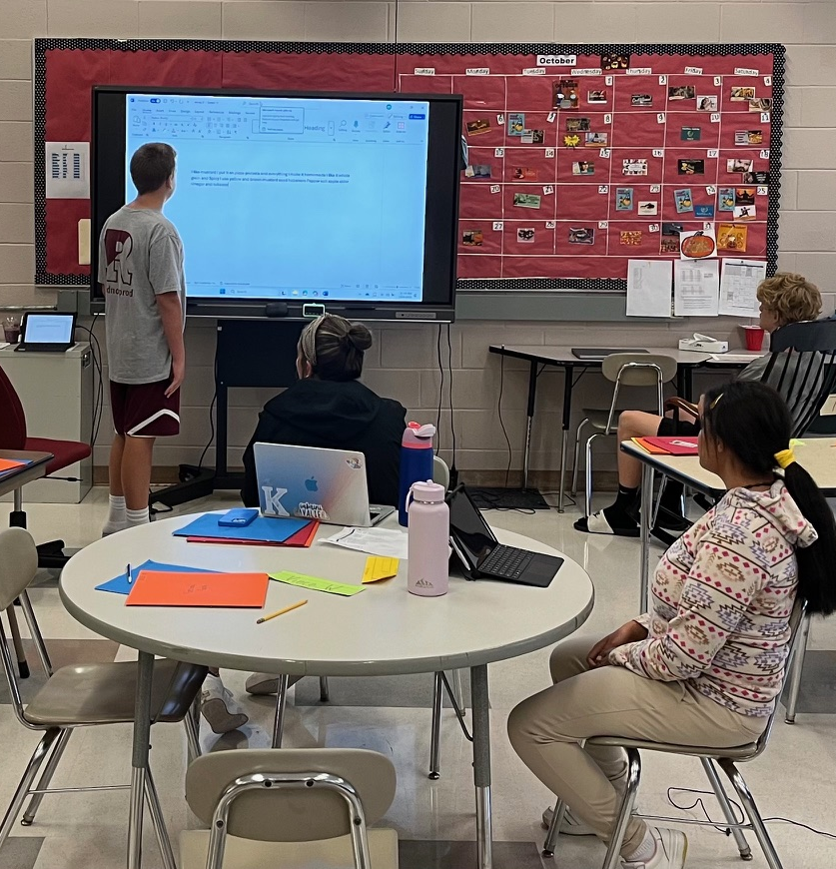
High School Life Skills Transition Class
Mr. Ryan Thomas-Radnor High School
Direct instruction is given on specific cycle days for functional content
Focuses on post-secondary education, employment and independent living
Highly individualized instruction
Hands-on learning experiences
Community based instruction
Supplemental and full-time support
Push in support from related service providers
Support inclusion – Best Buddies & Unified Sports

Slide 22
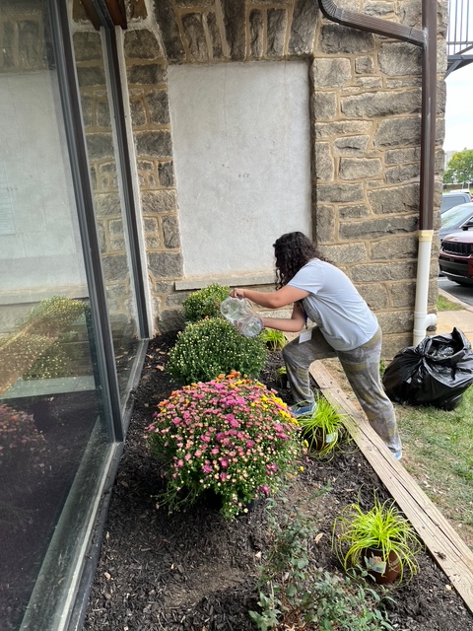
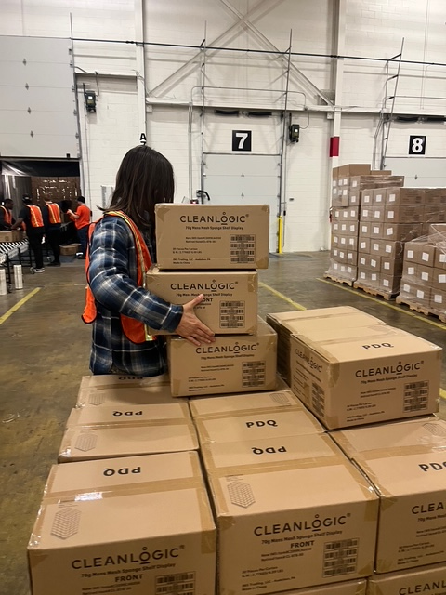
Transition
Mrs. Maureen Ertle – Transition Coordinator
Assists our IEP teams with the three domains of transition planning: post-secondary goals, employment, and independent living
Created the Secondary Opportunities for Adult Readiness Skills (SOARS) program at Radnor High School
Transition course at RHS – IEP team recommendation
Community Based Instruction (Independent Living focused)
Teaches employability skills in-district (Employment)
Support IEP teams with work study options
Establishes partnerships with local businesses and organizations
Connects with post-secondary education programs (Post- secondary education and training)
Collaborate with DCIU OPTIONS Program
Supports our families with long term planning (Agency Support and Involvement)
Unified Champion School Liaison- Co Bocce Coach!

Slide 23
Moving Forward
Provide meaningful and high-quality professional development opportunities for our teachers.
Collaborate with the Office of Teaching & Learning and Building Principals.
Support our teachers in strengthening partnerships with you and your child(ren).
Evaluate and refine transitions between grade levels and school settings.
Offer ongoing training to ensure best practices in leading IEP teams.
Promote and support inclusive practices throughout the district.

