Slide 1
Community Service
Requirements, Finding Opportunities, and Logging Hours

Slide 2
Community Service Requirements
Community service is unpaid, voluntary, and benefits others outside your household
Students must have 24 hours of community service to graduate
  10th-12th grade students must complete 24 hours before graduation
    Check with your college and career specialist if you have not been in FWPS your entire time in high school
  9th grade students will be required to do 6 hours per year

Slide 3
What is NOT Considered Community Service?
Donations
Tasks that are required for a class grade
Paid work
Attendance at FWPS games
Chores/responsibilities at home

Slide 4
What is Considered Community Service?
Any volunteer work with Federal Way Public Schools
Any volunteer work with a church/mosque/temple/place of worship
Any volunteer work with the list of approved community service providers on the FWPS website:
  https://www.fwps.org/academics/college-and-career-readiness/community-service-guide
Pre-approved independent community service (examples: helping out at a retirement center, animal shelter, etc.)
  Check on website above or with your school counselor or college and career specialist for the pre-approval form
  Form must be completed and signed by student and parent/guardian, then must be approved by principal, school counselor, or college and career specialist.

Slide 5
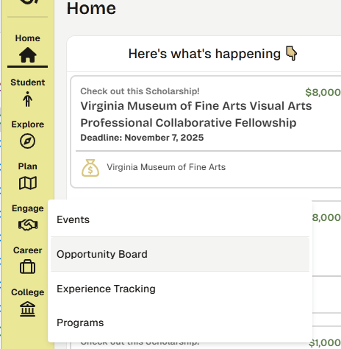
Finding Community Service
Opportunities
Click on Engage icon
Click on Opportunity Board

Slide 6
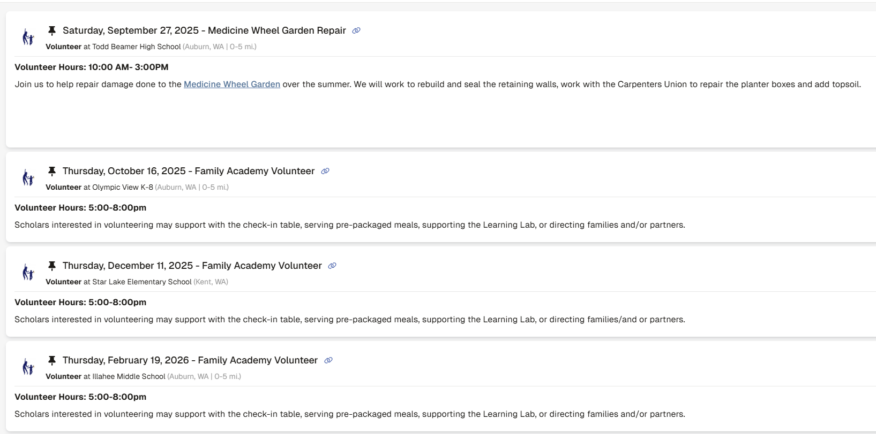
Finding Community Service Opportunities
On the top of your Opportunity Board, community service opportunities from FWPS will be pinned!
Please note that only opportunities with the FWPS logo are sponsored by the district
If you find another opportunity not listed by FWPS, make sure it’s on the community service provider list or get preapproval

Slide 7
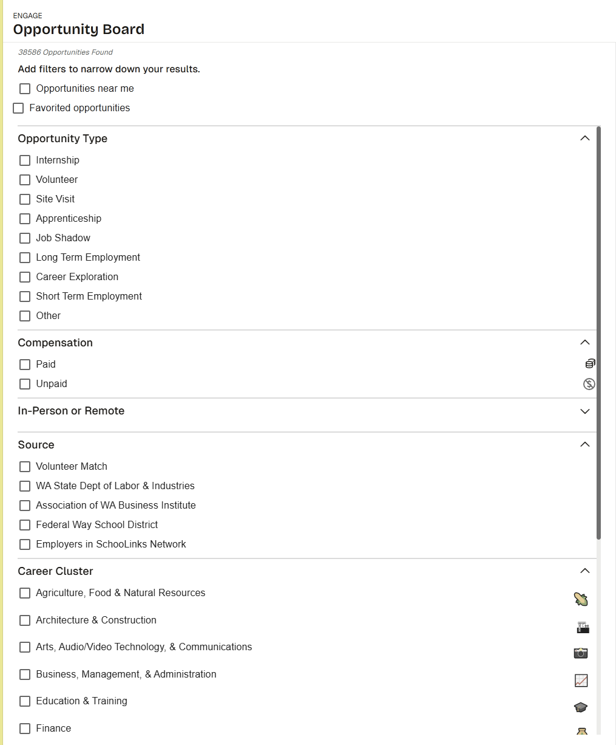
Finding Community Service Opportunities
Add optional filters to narrow down your results, including:
  Opportunity Type
  Paid vs. Unpaid (community service is only unpaid)
  Source (FWPS community service opportunities are preapproved)
  Career Cluster

Slide 8
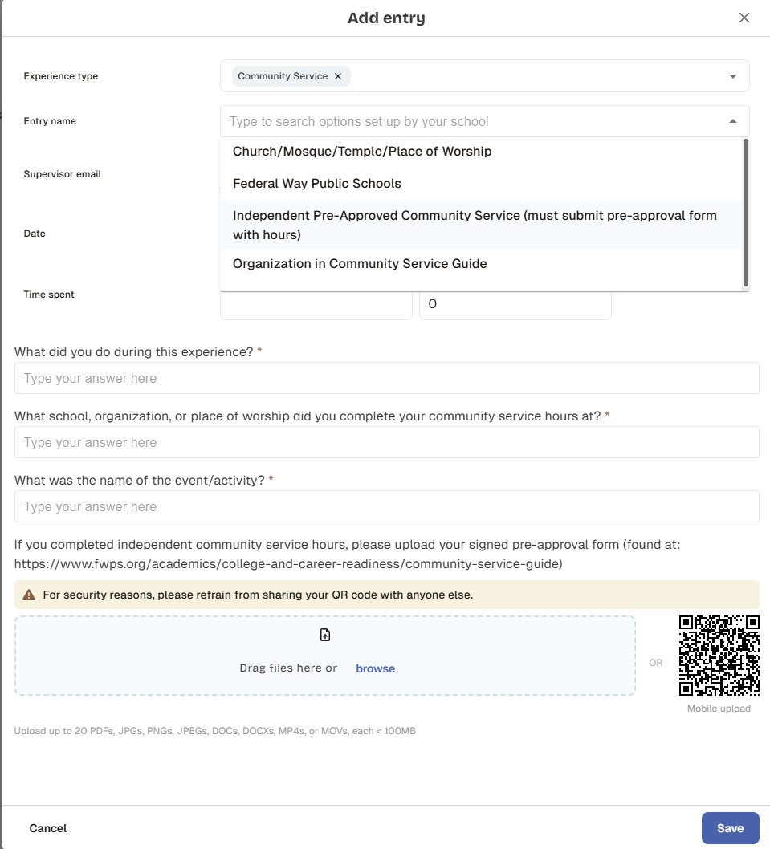
Entering Community Service in SchooLinks
Click on Engage icon
Click on Experience Tracking
Click Add Entry
Fill out all required fields on form
  Double check that your community service supervisor email is correct!
If you completed independent pre-approved community service, you must upload a copy of your completed and signed approval form
Click Save

Slide 9
Questions?
Reach out to your school’s college and career specialist or school counselor!
Career Academy - https://careeracademy.fwps.org/contact
Decatur High School - https://dhs.fwps.org/contact
Federal Way High School - https://fwhs.fwps.org/contact
Federal Way Public Academy - https://fwpa.fwps.org/contact
Internet Academy - https://iacademy.fwps.org/contact
Open Doors at Truman - https://opendoors.fwps.org/contact
TAF@Saghalie - https://tafatsaghalie.fwps.org/contact
Thomas Jefferson High School - https://tjhs.fwps.org/contact
Todd Beamer High School - https://tbhs.fwps.org/contact

