Slide 1
Annual Middle School
AG Parent/Guardian Meeting
Western Guilford Middle School
Arlene Sims, TAG Chair
October 16, 2025
WHITNEY OAKLEY, ED.D., | SUPERINTENDENT
Revised August 2025

Slide 2
WELCOME
Please sign in, take an agenda and helpful handouts
Grab a snack

Slide 3
2025 – 2028 AIG Plan
Notes:
Suggested script:
During this meeting, I will provide an overview of the 2025 -2028 district AIG Plan. I will highlight information from the AIG Plan as it relates to middle school AG service.

Slide 4
Middle School Revisions in the
2025–2028 AIG Plan
AG Eligibility Criteria
Advanced Coursework
Revised AG Eligibility Criteria
Planned Supports for Advanced Middle School Learners
Notes:
Suggested script:
At the middle school level, the revisions in the 2025–2028 AIG Plan fall into two main areas. The first area we will discuss is the revised AG eligibility criteria. The second area is the planned supports for Advanced Middle School learners.

Slide 5
AG Eligibility Criteria: Secondary Pathway
Secondary Pathway (Use of NC EOG/End-of-Course [EOC] Data): |  | Secondary Pathway (Use of Nationally Normed Data):
Student identified in GCS in a previous grade maintains eligibility Academically Gifted (AG, AR, or AM) Level 5 on the math and/or reading EOG/EOC |  | Student identified in GCS in a previous grade maintains eligibility Intellectually Gifted (IG) 98th%ile or higher composite score Academically Gifted (AG, AR, or AM) 90th %ile or higher summative achievement score in math and/or reading 85^{th –} 89th %ile summative achievement score in math and/or reading + accepted Performance Task Academically and Intellectually Gifted (AIG) Not identified in the secondary grades
Notes:
This slide highlights the AG eligibility criteria for secondary students as outlined in the 2025–2028 AIG Plan. Students can become eligible in two main ways.
The first way is through EOG or EOC scores. If a student scores a Level 5 on the North Carolina End-of-Grade test, or on the Math I End-of-Course assessment, they qualify as Academically Gifted in Reading, Math, or both Reading and Math. This process is not a change from the 2022–2025 AIG Plan.
The second way is through nationally normed data. Students who earn a composite score at or above the 98th percentile on an approved nationally normed aptitude assessment qualify as Intellectually Gifted. This is also not a change from the 2022–2025 AIG Plan.
Students also qualify as Academically Gifted in Reading, Math, or both Reading and Math if they score at or above the 90th percentile on a nationally normed summative achievement assessment. For students who score between the 85th and 89th percentile, there is an option to complete a performance task that can provide an additional pathway to eligibility.
One change in this plan is that the eligibility cutoff for students who qualified with nationally normed summative achievement scores was raised from the 85th percentile to the 90th percentile. This decision was based on data showing that students who qualified with scores between the 85th and 89th percentile often did not perform as strongly on future EOGs compared to students who scored at the 90th percentile or higher.
Finally, it’s important to note that the AG Department does not use NWEA scores when determining AG eligibility.

Slide 6
Planned Supports for Advanced Middle School Learners
1) Model Advanced Middle School courses after the state’s Honors Course Guidelines to ensure appropriate differentiation for advanced students.
2) Redirect AG instructional materials funds to support curriculum extension writing for MS Advanced ELA.
3) Funds will be directed toward developing new curriculum extensions in the core content areas for the Very Strong (VS) Program.
4) Collaborate with Math Department to confirm student placement guidance for Math 1 in Grade 7 (for accelerated pathways in Middle School Math).
Notes:
Suggested script:
This slide explains how Guilford County Schools will be supporting advanced learners at the middle school level over the course of the 2025–2028 AIG Plan.
First, Advanced Middle School courses will be modeled after the state’s Honors Course Guidelines to ensure appropriate differentiation for advanced students. These guidelines outline strategies such as acceleration, enrichment, and extension, as well as evidence-based practices like inquiry-based learning, building critical thinking and creativity, and using multiple perspectives and resources.
Second, the AG Department will redirect instructional materials funds to support curriculum extension writing for Advanced ELA in middle schools that utilize the EL curriculum. This will ensure that teachers have resources designed specifically to extend learning for advanced students.
Third, the AG Department will direct funds toward developing new curriculum extensions in the core content areas for the Very Strong, or VS, Program at the Academy at Lincoln. This will help formalize how curriculum is adapted to meet the needs of this highly accelerated group of students.
Finally, the AG Department will collaborate with the Math Department to confirm student placement guidance for Math 1 in Grade 7. This will support accelerated math pathways in middle school and ensure students are appropriately placed and challenged.

Slide 7

Questions regarding the AIG Plan should be directed to the AG Department. The AG Coordinator, Kelly Woody, serves as the middle school AG contact.
You can reach her at:
336.370.2358
OR
woodyk@gcsnc.com
Notes:
Suggested Script:
The 2025-2028 AIG Plan is available on the AG Department’s website. You can access the website by going to www.gcsnc.com, and in the menu, click on “Choose and Enroll” and then “Academically Gifted.” If you have any questions regarding the AIG Plan and middle school AG services, you can contact Kelly Woody to express your concerns or share your feedback.

Slide 8
Providing Support to AG Students and their Families
Notes:
Suggested Script
The next portion of our meeting, we will focus on the how the district and our school can support you and your student.

Slide 9
AG Supports at the School Level:
Classroom Teacher – Responsible for the implementation of the standard course of study and using differentiation to address student needs.
Team for Academically Gifted (TAG) – A cross section of school staff who act on behalf of all gifted students in the building.
Multi-Classroom Leader (MCL) – Supports all teachers, in the building, with best instructional practices for all students.
School Counselor – Supports students with the development of the social, emotional, and academic skills needed for post-secondary success. Also available to address scheduling questions.
School Administration – Ensures that the school’s vision is implemented in a way that meets the learning needs of all students in the building.
Notes:
Suggested Script
Unlike elementary schools, where there is a person in the building who is an AG specialist and who handles all AG matters as well as serves students in a pull-out enrichment program, middle school AG is addressed through a collaboration of multiple people in the building:
the classroom teacher who uses appropriate differentiation to implement the NC standard course of study.
the team for academically gifted which is a cross section of school staff who advocate for the needs of academically gifted students.
the curriculum facilitator who supports all teachers on understanding instructional practices and district mandates regarding teaching and learning.
the school counselor who helps students build the social, emotional, and academic skills and mindsets needed for post-secondary success.
And finally, our school administration team that ensures that the district goals and initiatives are implemented in a way that meets the learning needs of all students in our building.

Slide 10
Team for Academically Gifted (TAG):
What is the function of TAG?
An interdisciplinary team comprised of school staff and a parent representative
Supports and advocates for gifted education in the school
Reviews data to determine student eligibility for AG services
Monitors AG student records and services
Notes:
Suggested Script:
The role of the Team for Academically Gifted (TAG) is to serve as the decision-making team for gifted services at the school level.
The TAG provides support and advice to AG students, their parents, and their teachers. TAG members serve as advocates for gifted services. Each member shares the responsibility of ensuring that services and documentation within the school comply with the current board-approved AG Plan, doing the work for the grade level they represent.
The TAG Chairperson serves as the lead contact person, in the school, for AG services and oversees the function of the TAG Team.
TAG meets quarterly face-to-face or virtually with additional quick check-in options.
If you school does NOT currently have a parent representative, suggested script:
The TAG Team must include a parent representative who will share parent voice and concerns regarding AG services. Often parent TAG members are contacted by the AG Department to provide a parent perspective to district concerns. Currently our school’s TAG team does not have a parent representative, if you are interested in serving on our team, please … insert how you wish for them to contact you or another member of TAG to express their interest.

Slide 11
Meet our School’s TAG Team:
TAG Role: | Team Member: | School Role:
TAG Chair | Arlene Sims | School Counselor
Principal/Principal Designee | Chase Arrington | Principal
6th Grade Representative | Tywanda Neal | ELA Teacher
7th Grade Representative | Louise Ellis | Math Teacher
8th Grade Representative | Penny Martin | ELA Teacher
Parent Representative | Aislynn Denny | Media Specialist
Advising Member, School Counselor | Arlene Sims | School Counselor
Advising Member, EC Teacher | Marcele Schneider | EC Teacher Assistant
Advising Member, EL Teacher | Shelby Joyce | ELD Teacher
Advising Member, 504 Coordinator | Ryan Ebron | School Counselor
Notes:
Suggested script:
This slide summarizes the membership of our school’s current TAG Team. Tell member’s name and their school role.

Slide 12
Our TAG’s Communication Plan:
Beginning-of-Year AG Night Parent Meeting
Quarterly newsletters
Email
Remind app
AG Parent page on WGMS website
Notes:
Suggested Script:
As parents of AG students, you can expect to hear from our school’s TAG team through quarterly newsletters. We also will provide mass communication to parents by … insert how your school’s TAG will provide as needed communications and include any information about your school’s AG website (if applicable).

Slide 13
AG Supports at the District Level:
AG Department - Provides support to schools and families with identification and service of AG students in grades 6-8.
Guilford Gifted - A community group comprised of parents and other stakeholders with an interest in gifted programming throughout the district.
Notes:
Suggested Script:
Our district’s AG Department provides support to schools through appropriate professional development. Additionally, the department provides enrichment experiences, such as the Academic All-Star Camp.
One of our districtwide supports is Guilford Gifted, a nonprofit affiliate of the North Carolina Association for Gifted & Talented. Our local Guilford Gifted chapter focuses on advocating for the needs of gifted students right here in Guilford County.
Information for TAG Chair:
Academic All-Star Camp is a summer enrichment opportunity for rising ninth graders (i.e., your currently enrolled 8th grade students). The AG Department reviews previous year EOG data to identify the top performing 30 students from each middle school. These students receive an invitation to register for the camp. Finally, selection is based on the number of applicants and the department’s goal to ensure that those selected to fill the slots represent all of our middle schools. Slide 25 provides more details about this opportunity.

Slide 14
If you have a question or concern:
1. Talk with your child
2. Contact the classroom teacher
3. Contact the principal/TAG Chair
4. Contact the AG Department at 336.370.2358
  Dibrelle Tourret, Director
  Kelly Woody, AG Coordinator
  Barry McDougald, Lead Teacher
  Tia Thompson, Lead Teacher
Notes:
Suggested Script:
If you have a concern regarding your child’s AG service, after talking to your child about the situation, you should speak to the appropriate teacher. After speaking with the classroom teacher, if you still have concerns, at that time, you can share your concerns with the school principal or the TAG Chair. Since the TAG chair does not serve in a supervising role over any classroom teachers, they may find it necessary to consult with the principal to address your expressed concern. If you feel that your concern has not been addressed at the school level, you may contact the AG Department. On this slide, Dibrelle Tourret and Kelly Woody are in bold font because they primarily address middle school services.
Suggested Activity:
After hearing what is being presented during this meeting, you may have questions. If you have questions, please write your questions or comments on a post it on and post to our parking lot chart. Our TAG Team will review all questions submitted and provide a written response … list how you will share the response (some suggestions … create FAQ and post on website or send in next newsletter; send a mass email; send Remind or other communication app notification).

Slide 15

Guilford Gifted incorporated as Guilford County Chapter of PAGE INC.
https://www.guilfordgifted.org/

Slide 16

Who are we?
Angela Olalere- President
Vacant - Vice President
Stephen Adekunle - Treasurer, soon vacant
Kate Young Maffeo - Secretary
Carolyn Cheriyan - Webmaster
Kara French - AG Liaison
Vacant- Membership
Guilford Gifted Board

Slide 17
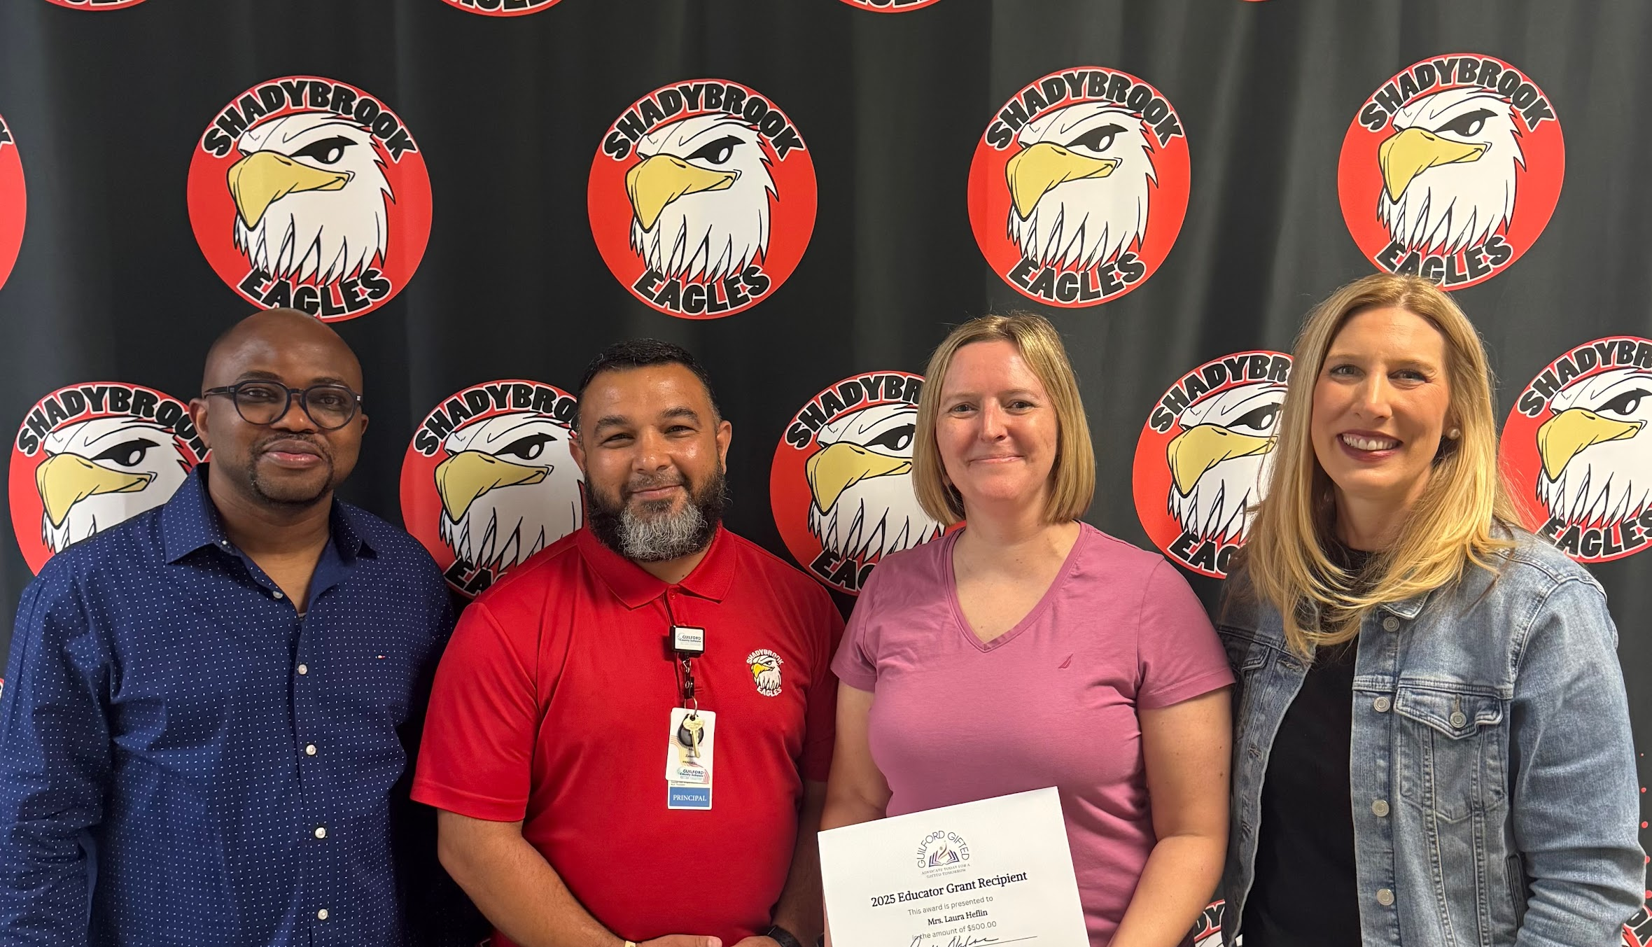

Over the past year
Improved membership communication – newsletters, social media
AG Teacher’s meeting - Elementary AG parent meetings
Joined by kate Young Maffeo as new Secretary
Communication of concerns on new middle school ELA curriculum with AG Dept
Communicated changes to AIG plan 2055-2028
Continued relationships with Wake & Forsyth PAGE chapters; collaboration
AG Transitions meetings
Attended NCAGT Conference
Offered parent webinar: Anxiety and Perfectionism in Gifted Children
Educator Grant Awardees - Mrs. Stacy Cunningham and Laura Heflin
Bingo Bash Fundraiser in April 2025

Slide 18
What are our goals?
Continue growing our membership- and have each school represented
Increase number of Educator Grants offered
Fundraise, Fundraise, Fundraise!
Interactive events for parents, students
Advocating and recruiting for a TAG member associated with Guilford Gifted in each school
Support our AG teachers
Offer resources to families

Slide 19
Our Member Feedback
Concerns:
Challenging students outside of enrichment with
Differentiation in the classroom
Summer AG opportunities
Diversity & inclusion
Social, emotional & physical development
Visions:
Growth of services; increased AG time
Critical thinking, creativity, progress not perfection
Outreach - opportunities beyond school; life skills

Slide 20
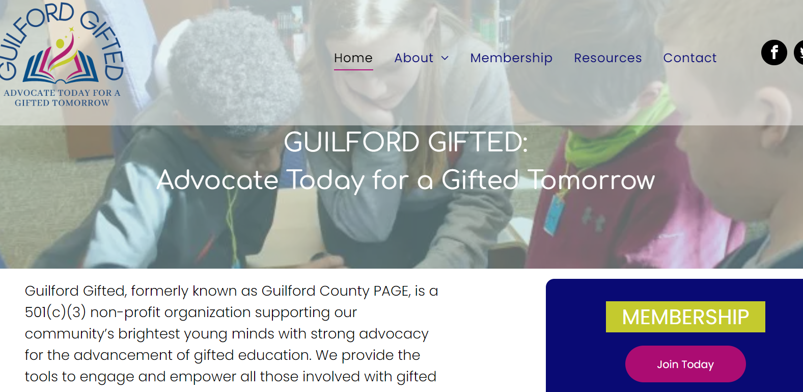
Become A Member
Free Membership
If you already joined, we ask you to
renew your membership each year.
Find us at www.guilfordgifted.org
Email us at
info@guilfordgifted.org

Slide 21

Seeking Volunteers
Board Member Positions
Fundraising and Event Planning
Newsletters

Slide 22
How can you help us?
Continue sharing our information in your newsletters
Encourage AG families to join and volunteer
Promote our programs that we support and organize
Share out this PowerPoint with your families during AG Meeting
Follow us on Facebook (https://www.facebook.com/GuilfordGifted)
You’re the experts, provide us your feedback and any ideas of how we can best assist you and your families

Slide 23
Thank you for your time!
Keep your eye out for upcoming emails with a link to join and for upcoming events.
Please submit any questions/comments to:
info@guilfordgifted.org

Slide 24
Overview of Middle School AG Services

Slide 25
Middle School Service Model:
The entirety of the academically gifted student’s day is spent in a general education setting. Therefore, the responsibility for differentiation is with the classroom teacher.
  The middle school AG service model does not include pull-out enrichment services.
Advanced Courses:
  ELA: Advanced ELA at all grade levels and English 1 available, at grade 8, at select schools.
  Math:
    Grade 6: Accelerated Math or AIMM
    Grade 7: Accelerated Math or NC Math 1
    Grade 8: NC Math 1 or NC Math 2
Notes:
Suggested Script:
The middle school service model does not include a pull-out enrichment model like the elementary school service model. At the middle grades level, AG students receive service through enrollment in advanced coursework. The students Differentiated Education Plan, or DEP, details the curriculum expectations of the advance course.
For ELA, at grades 6, 7, and 8, there is an English 1 option for 8th grade at select schools. The current AG plan states that students identified in reading should be placed in advanced ELA.
For Math, the district guidelines determine math class placement. This slide lists the current middles school math options. It is important to know that all of these courses meet AIG plan requirements as appropriate advanced courses.

Slide 26
Differentiation in the Classroom:
Schools are given guidance for grouping AG students in classes.
Teacher Qualification: AG students will be assigned to a teacher who:
  Holds AIG licensure
  Hold National Boards Certification, or
  Have completed the AG PD series offered by the AG Department
Clustering Grouping: Students are grouped with similarly achieving peers in the fewest grade level classrooms possible and placed in the appropriate course according to their area of AG identification and district placement criteria.
# of AG Students: | # of Teachers with AIG Licensure: | # of Teachers with National Boards Certification: | # of Teachers who completed the AG PD Series
107 | 1 |  | 2 (non-instructional staff)
Notes:
Note: TAG Chair MUST update this slide with their school’s current number.
Suggested Script:
To facilitate appropriate classroom differentiation and meet the academic needs of gifted and advanced learners, classroom teachers of AG students are expected to either hold their AIG licensure, hold National Board Certification, or at minimum complete the district’s required AG Professional Development Series. To support teachers in meeting this requirement, the AG Department offers the PD Series multiple times each year.
Another key practice is cluster grouping—the intentional placement of academically gifted and advanced students together. The AIG Plan recommends grouping these students in clusters of 6 to 10, within the smallest number of grade-level classrooms possible, so their needs can be met more effectively.
Finally, this slide includes a chart showing how many teachers on our staff have already met the district’s requirements for teaching AG-identified students.

Slide 27
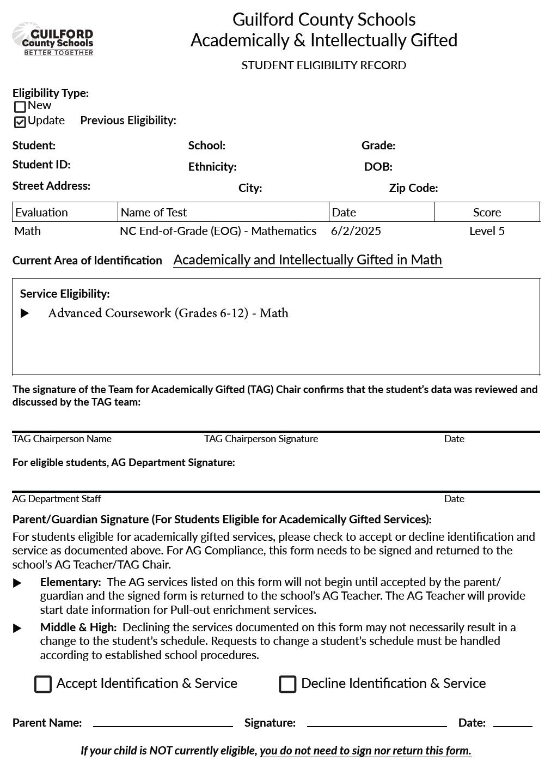
Student Eligibility Record:
Contains the data reviewed to make decisions regarding AG eligibility
Identification and service details; and
Includes a place for the parent/guardian to accept or decline identification and service.
Notes:
Animated Slide:
Bullet points come in one at a time. The square box comes in with the last bullet point.
Suggested Script:
The Student Eligibility Record, often referred to the SER, (click mouse) documents the data that was reviewed to determine if the student met the criteria for AG identification. The SER (click mouse) also details the student’s eligibility area and the service that is to be provided to the student. At the middle grades level, the service provided to students identified as Academically Gifted is enrollment in advanced coursework. The SER (click mouse) includes a place for the parent/guardian to accept or decline their child’s AG identification and service. Although enrollment in advanced coursework begins from the first day of school, it is important that the SER is returned to document the parent’s/guardian’s acknowledgement of their child’s AG identification. Additionally, at the middle grades level, should the parent decline identification and service, the child’s status in the state’s student management system (currently Infinite Campus) would be updated and the family would be referred to the counseling department to discuss any possible schedule changes. Declining identification and service does not necessarily lead to an immediate schedule change or unenrollment from advanced coursework.

Slide 28
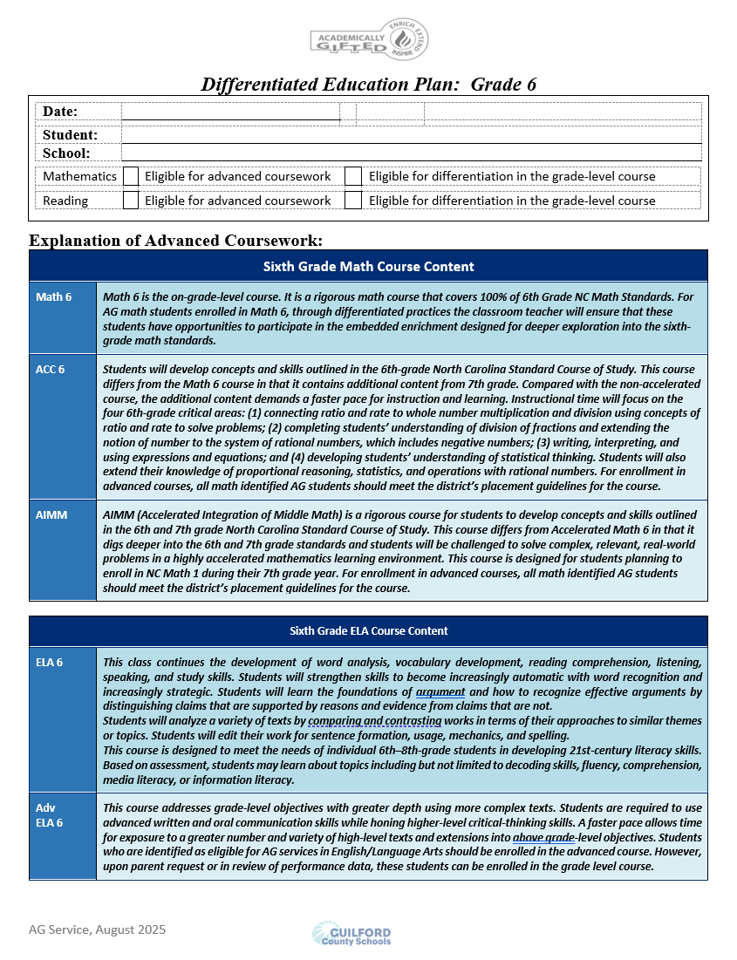
Differentiated Education Plan:
Parents receive a DEP annually which is updated by grade level
Provides an explanation of the service that is marked on the SER
  For each grade level, describes the differences between the on-grade level course and the advance course options.
  For advanced courses, serves as the Group Annual Plan for Differentiation because it details the embedded acceleration and extension provided in these courses.
The Progress Report and Report Card provided by the school serve as documentation of student performance in AIG programming.
Notes:
Animated Slide:
Bullet points come in one at a time.
Suggested Script:
The Differentiated Education Plan, often referred to the DEP (click mouse) is provided to parents annually at our beginning-of-year parent meeting. (Click mouse) The DEP explains the services marked on the SER. For middle grades, the DEP describes the differences between the on-grade level course and the advance course options. It serves as the Group Annual Plan as it details the embedded acceleration and extension provided in advanced courses. Parents should use their child’s Progress Report and Report Card as documentation of their child’s performance in AG programming.

Slide 29
Required AG Documents:
Newly Identified
Updated Identification
Students new to GCS with previous AG identification (in-state transfer)
Previously Identified Students with no change in eligibility
Student Eligibility Record (SER) – must be signed by parent and returned to the school. Copy in AG folder and copy to parent/guardian.
Grade level Differentiated Education Plan (DEP) –copy provided to parent/guardian.
Grade level Differentiated Education Plan (DEP) –copy provided to parent/guardian
Notes:
Suggested Script:
As a parent, you can expect to receive the following documents. If your child is newly identified, has had a change in their AG identification, or was previously identified in another NC district and meets the GCS criteria you will get a copy of the SER and the DEP. If your child was previously identified and does not have a change in their AG identification, you will get the appropriate grade level DEP.

Slide 30
Enrichment Opportunities

Slide 31
Academic All-Star Camp:
A FREE opportunity for high-achieving rising 9th graders
Exposure to subject-related interests, AP opportunities, and leadership skills
Participants selected from the top 10% at each middle school (based on 7th grade EOG scores)
Two-week camp held each summer
Limited seats available
Hosted at one or more GCS high schools
Transportation not provided
Students must commit to the full duration of camp
Notification and registration begin in early Spring
Notes:
Suggested Script:
The AG Department offers a free summer enrichment camp for rising 9th grade students. Eligible students are the top 10% of 8th graders at each middle school, based on their 7th grade End-of-Grade scores.
In past years, the camp has offered about 200 seats, with 100 students at each of two high school sites. Last summer, the camp was hosted at Western High and Ragsdale High.
Because of budget considerations, some adjustments may be made for this year’s camp. This could include hosting at only one site, with the same number or fewer seats available.
Notification and registration will begin in early spring.

Slide 32
Duke Pre-College Programs:
Challenging courses for middle & high school students
Explore college-level subjects with peers
Gain early exposure to college expectations & career readiness
Experience learning at one of the nation’s top universities
Learn more about these programs at:
  https://learnmore.duke.edu/precollege
Notes:
Suggested Script:
Duke University offers Pre-College Programs that give middle and high school students the chance to combine intellectual curiosity, exploration, and innovation in a rigorous learning environment. These advanced programs allow students to dive into challenging subjects, collaborate with motivated peers, and experience what it’s like to learn at one of the nation’s leading universities.
The goal of these courses is to provide an early introduction to college-level expectations and to help students begin thinking about career readiness.
Learn more about their programs by visiting the website listed on this slide.

Slide 33
Pre-College Talent Search Opportunities:
Families interested in talent search opportunities can explore programs such as:
Johns Hopkins University – Center for Talented Youth (CTY)
Accepts NC EOG data as evidence of eligibility
Northwestern University – Center for Talent Development (CTD)
Some programs may also offer virtual opportunities.
Notes:
Suggested Script:
Families who are interested in pre-college talent search opportunities may want to explore programs like the ones listed here. Johns Hopkins University offers the Center for Talented Youth, or CTY, which accepts North Carolina EOG data as evidence of eligibility. Another well-known program is Northwestern University’s Center for Talent Development, or CTD. Both CTY and CTD provide enrichment experiences, and in some cases, virtual opportunities are available for students who may not be able to attend in person.
These programs are optional, but they can give students a chance to challenge themselves, explore new areas of learning, and connect with peers who share similar academic interests.

Slide 34
Pre-College Talent Search Opportunities:
The links below provide information on additional talent search opportunities:
Davidson Institute: Talent Search Opportunities for Gifted Students
Hoagies’ Gifted Education Page: Talent Search Programs
Notes:
Note: On the SharePoint, there is a PDF “Enrichment Opportunities (Supplement to BOY Parent Meeting)”. This file can be electronically shared with parents so that they will have the links.
Suggested Script:
Our TAG will share a document with you that will includes all the links to enrichment opportunities mentioned in this presentation. This slide highlights two websites that have links to other talent search opportunities that may be of interest to your child. Also, in previous years, Guilford Gifted has been able to provide additional enrichment opportunities.

Slide 35
Extracurricular/Enrichment Opportunities at WGMS:
National Junior Beta Club
Battle of the Books Team
Ambassadors Club
Student Council
Confident Girls Rising
Chess Club
Notes:
Use this slide to list enrichment/extracurricular activities available at your school. It would be helpful to include the name of the faculty advisor for each so parents have a contact for their questions.

Slide 36

It was a pleasure meeting you! Our school’s TAG team is excited to partner with you and support your child’s growth.

