Slide 1


Title 1 Meeting
September 9, 2025
9:00 A.M.
3:30 P.M.
Dione Curry, Principal
Jermaine McCaskill, Asst Principal
Rosemary Byrd, PLC Coach
Tina Simmons, Family Engagement Specialist

Slide 2
AGENDA
WELCOME
REMS MISSION, VISION, AND BELIEFS
WHAT IS TITLE I
FUNDING OVERVIEW
PARENT’S RIGHT TO KNOW
FAMILY ENGAGEMENT
REPORTING STUDENT PROGRESS
SCHOOL STATUS/Teacher Qualification
PARENT FEEDBACK SURVEY

Slide 3


Raleigh Egypt Middle School Mission
Our mission is to create a safe environment where students will know and understand their greatness, causing them to exceed expectations academically, technologically, and socially by becoming life-long learners who are able to contribute (serve) and matriculate in any environment, nationally and internationally.
Raleigh Egypt Middle School Vision
At Raleigh-Egypt Middle School, everyone can contribute, and everyone can Be Great!
Raleigh Egypt Middle School Beliefs
I will make good things happen for other people.
When things get tough and I fall short, I will remind myself I can ACCOMPLISH ANYTHING with time, effort, patience and RESILIENCE.
I will Do THE BEST with what I have.
I will be resourceful and responsible.
I will expect more of myself.
I will be obligated to this world and the people in it.
I will give more and continuously strive to be more.
I will BE GREAT!

Slide 4
What is Title I?
Title I is the largest federal assistance program for our nation’s schools.
The goal of Title I is to provide a higher quality of education for every child. Its purpose is to provide federal dollars to supplement educational opportunities for students who attend schools with high numbers or percentages of children from low-income families and are most at risk of failing to meet the state’s challenging academic achievement standards. Title I, Part A funds are to be used to provide all students significant opportunity to receive fair, equitable, and high-quality education, and to close educational achievement gaps.
The program serves millions of children in public elementary and secondary schools each year including eligible students in private schools.

Slide 5
Title I Funding Overview
The Federal Government provides funding to states each year for the Title I program.
The Tennessee Department of Education allocates the money to our district.
The school district identifies eligible schools and distributes the Title I funds to the school.
Raleigh Egypt Middle implements a school wide program, in which all students benefit from the supplemental services provided by Title I.

Slide 6
Title I Supplemental Support
Additional Educational Support Professionals
Additional Training for School Staff
Extra Time for Instructional Support (Before/After School Programs)
Parental Involvement Activities
Supplemental Teaching Materials, Equipment and Technology

Slide 7
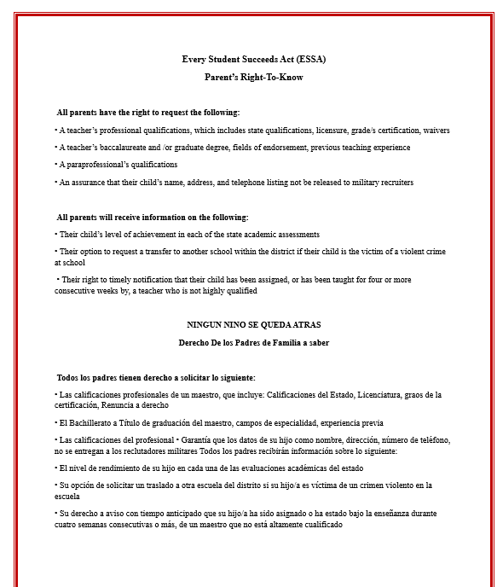
PARENT’S RIGHT TO KNOW
(Each parent receives a copy)

Slide 8
Family Engagement-
Parent Support Organizations
REMS BOOSTER CLUB
REMS PTSA (PARENT, TEACHER, STUDENT ASSOCIATION
MSCS Board Policy 7009 states "Each school shall be required to have a parent organization that may include but is not limited to a Parent Teacher Association (PTA); Parent Teacher Student Association (PTSA); Parents (Partners) in Education (PIE); and Parent Teacher Organization (PTO). Therefore, REMS PTO has been established to promote positive communication between school, parents and the Raleigh community; Enhance the educational experience for students by supporting the needs of teachers and staff; Promote and increase parent volunteerism and involvement.

Slide 9
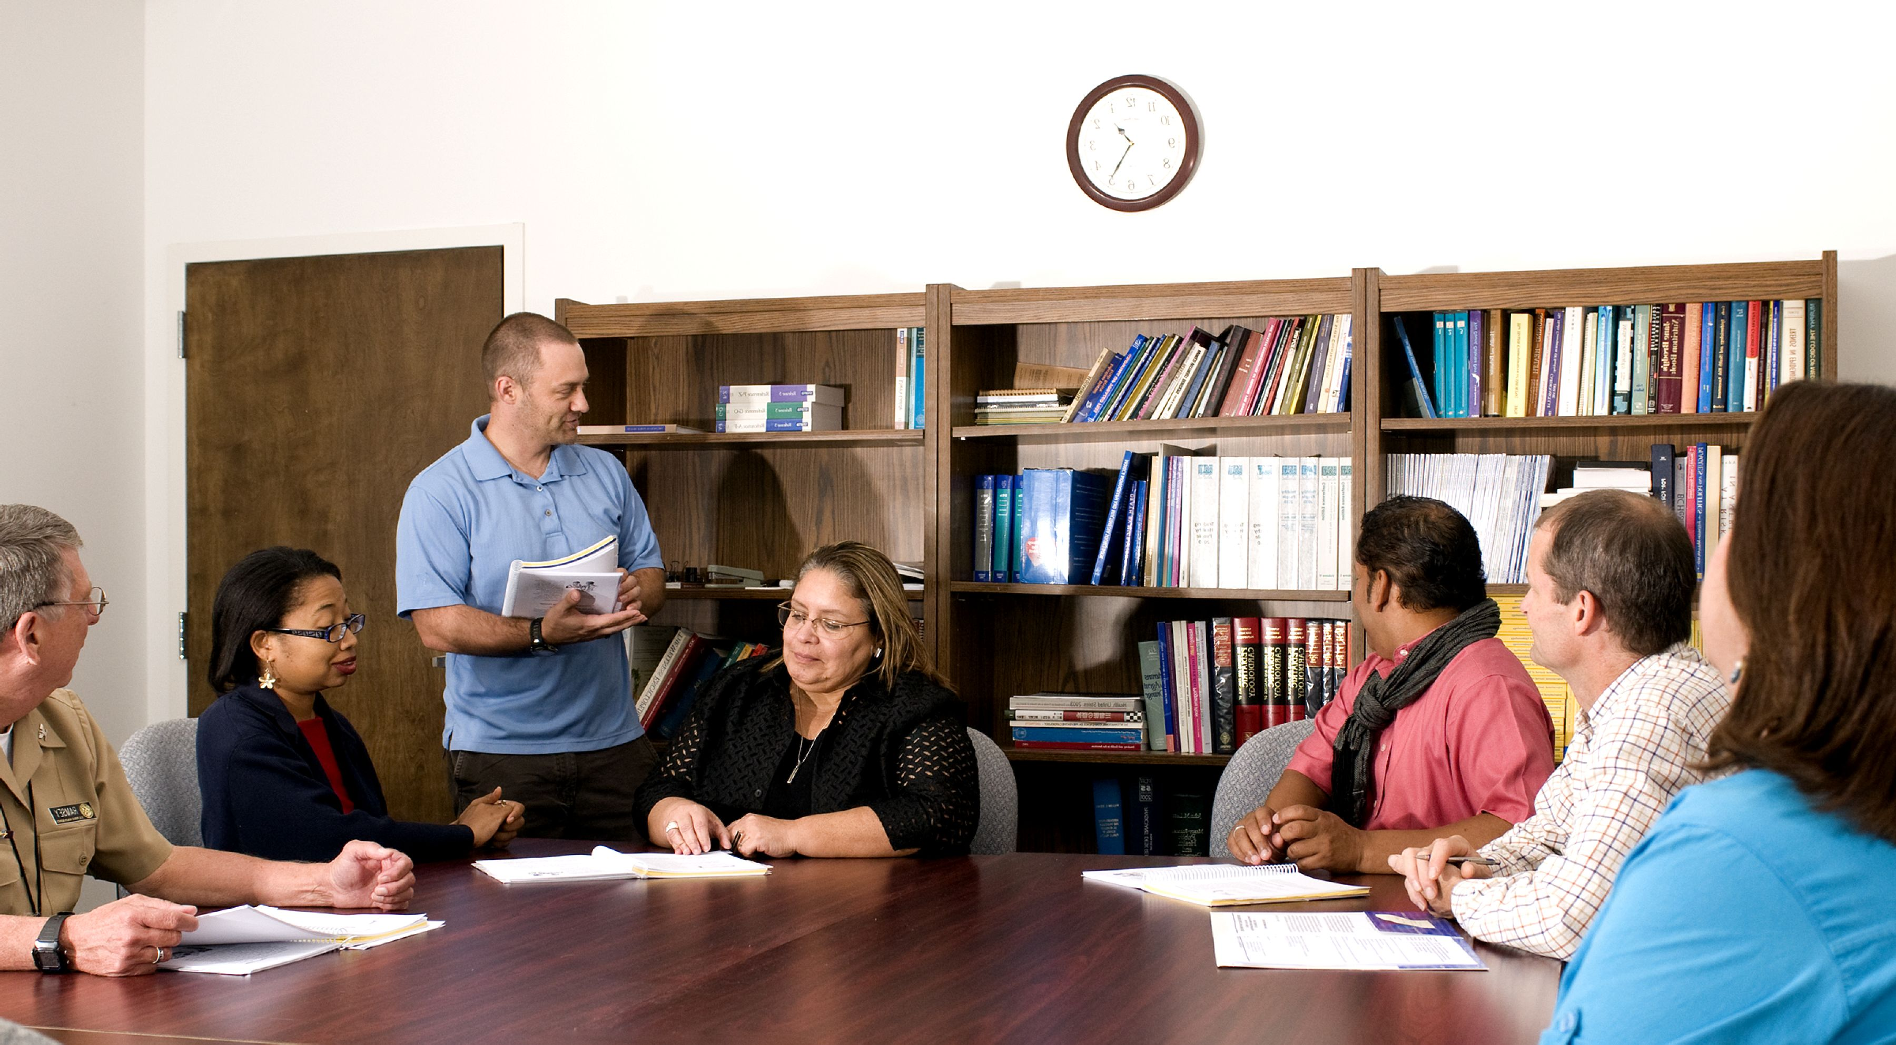
School Improvement Plan
School Improvement Planning is a process by which members of the school-community conducts a thorough evaluation of their school’s educational programing.
Opportunity for Parents to become involve with the revising of REMS SY2025-26 School Improvement Plan. Our SIP is our guide as we reflect on pass/current data to access the academic needs of All students at REMS. It is a working document, and we will continuously meet to revise our SIP.
If you are interested in becoming a committee member or just interesting in attending regular meetings, please use the QR code at the end of the meeting to give us feedback and sign up for any committees.

Slide 10
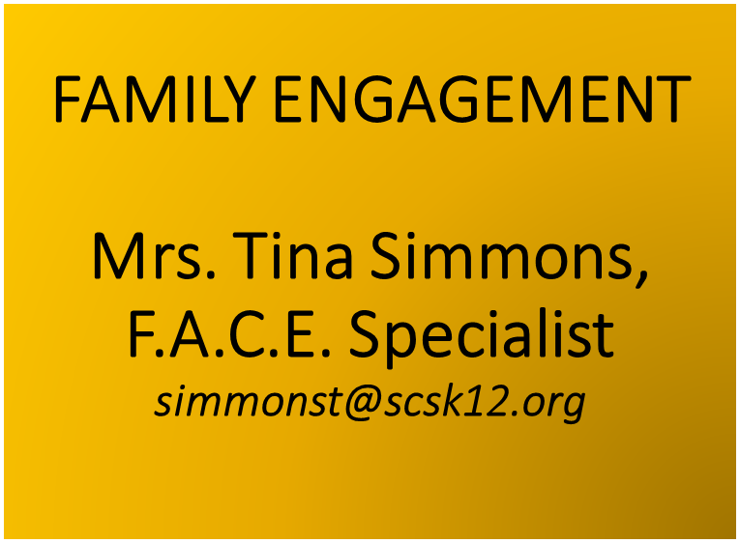
Additional Ways Parents Can Support Their Child’s School
Utilize your talents and/or resources to enhance the instructional programs at Raleigh Egypt Middle School by…
  Serving on the REMS School Improvement Plan Committee
  Becoming a Volunteer (Background Check Required)
Responding to questionnaires, surveys, and memos expressing thoughts, suggestions, and/or concerns.
Attending school events and programs
Serving as an advisor to various organizations

Slide 11
Available Parent training
Tracking Your Child’s Attendance (Attendance Matters)
PowerSchool
Curriculum Resources
Homework Hotline
Tutoring
What to do if your device breaks, stop working, lost, or stolen
Contacting the teacher

Slide 12

Opportunities for additional parent meetings
Open House
Parent Teacher Conferences
Data Meetings
Cultural Awareness Programs
Curriculum Night
This Photo by Unknown Author is licensed under CC BY-SA-NC

Slide 13
Parent, Student, Teacher, and School Compact
This compact is a commitment between the parent, student, teacher and school to share in the responsibility of improved academic achievement.
Title I Parents have the right to be involved in the development of the School-Parent Compact.
(pass out copies to all Parents)

Slide 14
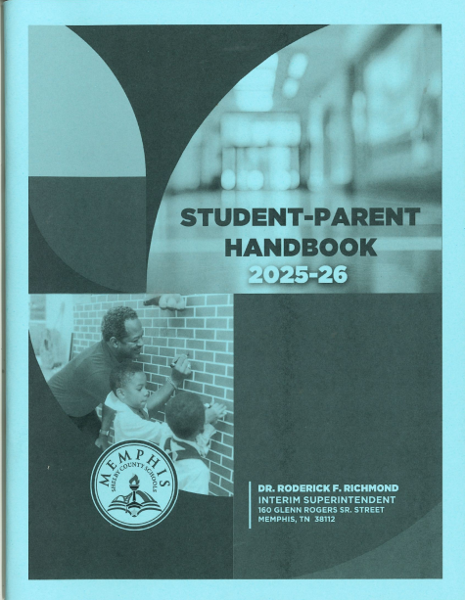
MSCS Student Code of Conduct
(Each parent receives a copy)
MSCS student code of conduct specifies behavior that is accepted or prohibited in the school as well as in any setting that is related to the school. Codes of conduct generally state the behavior expected to be demonstrated by the student.
Discipline policies outline consequences/punishments that will occur in response to specific misbehavior.

Slide 15

Progress reports and report cards
Available via Parent Portal
Progress Report Dates | Report Card Dates
Wednesday, September 3, 2025 | Wednesday, October 22, 2025
Wednesday, November 12, 2025 | Wednesday, January 14, 2026
Wednesday, February 11, 2026 | Wednesday, April 1, 2026
Wednesday, April 22, 2026 | Thursday, May 27, 2026

Slide 16
Parent/Teacher Conference Dates
September 9,2025
(4:00 pm- 7:00 pm)
January 27,2026
(4:00 pm – 7:00 pm)
If you need to schedule a conference before or after the dates listed, please feel free to contact your child’s teacher or complete a request form on the school’s website to schedule a conference.

Slide 17
School Current Status
RALEIGH EYGPT MIDDLE SCHOOL CURRENT 2025-26 SCHOOL COMPOSITE SCORE
LEVEL 1
REMS Teachers meet State/District Qualifications Guidelines

Slide 18

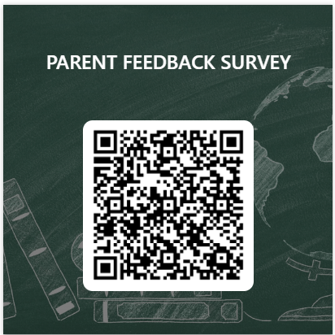
Parent’s Feedback is vital
Please complete the following feedback survey. Thank you so much!

Slide 19

REMS would like to thank you for attending our Annual Title I Parent Meeting.
Are there any Questions or Concerns about anything that was presented?

