Slide 1


What You
Need to Know
About Financial Aid
September 2025

Slide 2
Topics We Will Discuss
What is financial aid, cost of attendance (COA), student aid index (SAI), and financial need?
Categories, types, and sources of financial aid
Free Application for Federal Student Aid (FAFSA®)
Special and unusual circumstances
New for 2026-27
*Unless otherwise noted, screenshots are taken from the U.S. Department of Education’s 2026-27 FAFSA® Preview Presentation, August 2025

Slide 3

What Is Financial Aid?
Financial aid consists of funds provided to students and families to help pay for postsecondary educational expenses

Slide 4





What Is Cost of Attendance (COA)?
Tuition and fees
Housing and food (living expenses)
Books, course materials, supplies, and equipment
Miscellaneous personal expenses
Transportation

Slide 5
What Is Student Aid Index (SAI)?
Number resulting from the evaluation of a student’s (and family’s) approximate financial resources for a student’s postsecondary education
Student contribution
Parent contribution
(for dependent students)

Slide 6
What Is Financial Need?
Cost of attendance (COA) – Student aid index (SAI) = Financial need

Slide 7
Categories of Financial Aid
Need-based aid
Non-need-based aid

Slide 8
Types of Financial Aid
Scholarships
Grants
Loans
Work-Study Employment
Self-Help Aid
Gift Aid

Slide 9
Scholarships
Scholarships
Grants
Loans
Work-Study Employment
Self-Help Aid
Gift Aid

Slide 10
Grants
Scholarships
Grants
Loans
Work-Study Employment
Self-Help Aid
Gift Aid

Slide 11
Work-Study Employment
Scholarships
Grants
Loans
Work-Study Employment
Self-Help Aid
Gift Aid

Slide 12
Loans
Scholarships
Grants
Loans
Work-Study Employment
Self-Help Aid
Gift Aid

Slide 13
Sources of Financial Aid
Federal Government
Employers
States
Private Sources
College and Universities

Slide 14
Federal Government
Largest source of financial aid
Aid provided primarily based on financial need
Must apply each year using the FAFSA
Eligibility requirements must be met

Slide 15
Federal Student Aid Programs
Federal Pell Grant*
Federal Supplemental Educational Opportunity Grant (FSEOG)
Teacher Education Assistance for College and Higher Education (TEACH) Grant
Federal Work-Study (FWS)
Federal Direct Student Loans (Direct Loans)
Federal Direct PLUS Loans*
*Changes to program effective with 2026-27 award year

Slide 16

Federal Pell Grant Changes
Creation of Workforce Pell Grant
Limitations on Pell Grant eligibility
  Student is not eligible for the Pell Grant if:
    SAI exceeds twice the maximum Pell Grant amount; or
    Student’s nonfederal grants and scholarships cover entire COA (even if otherwise eligible)

Slide 17
Parent PLUS Changes
New borrowers on or after July 1, 2026:
  Annual loan limit: $20,000 per dependent student
  Aggregate loan limit: $65,000 per dependent student
Legacy borrowers may borrow at previous loan limits for the shorter of:
  3 academic years; or
  Time for student to complete program

Slide 18
States
Residency requirements usually apply
Aid may be provided based on
both merit and need
Use information from the FAFSA and/or state aid applications
Deadlines vary by state

Slide 19
Colleges and Universities
Aid provided based on both merit and financial need
Aid may be gift aid or self-help aid
Use information from the FAFSA and/or institutional applications
Deadlines and application requirements vary by institution

Slide 20
Private Sources
Foundations, businesses, churches, civic,
and charitable organizations
Deadlines and applications procedures vary
Begin researching private sources early

Slide 21
Employers
May have scholarships available
to the children of employees
May have educational benefits for their employees

Slide 22

Federal Student Aid Estimator
Early estimation regarding SAI and possible Title IV aid available
Requires demographic, income, and asset information
https://studentaid.gov/aid-estimator

Slide 23
Free Application for Federal Student Aid (FAFSA®)
Collects demographic and financial information
Information used to calculate the student aid index (SAI)
Colleges use SAI to offer financial aid
Available in English and Spanish
  Assistance available in additional languages

Slide 24
Free Application for Federal Student Aid (FAFSA)
May be filed at any time during an academic year, but typically no earlier than October 1st prior to the academic year for which the student requests aid
For the 2026-27 academic year, the FAFSA will be available by October 1, 2025
Colleges may set FAFSA priority dates

Slide 25


Free Application for Federal Student Aid (FAFSA)
Online FAFSA
PDF FAFSA

Slide 26
Benefits of Using Online FAFSA
Simplified application process
Built-in edits to prevent costly errors
Skip-logic allows student and/or parent to skip unnecessary questions
No need to manually enter federal tax information (FTI)
More timely submission of original application and any necessary corrections
More detailed instructions and “help” for common questions
Ability to check application status online

Slide 27
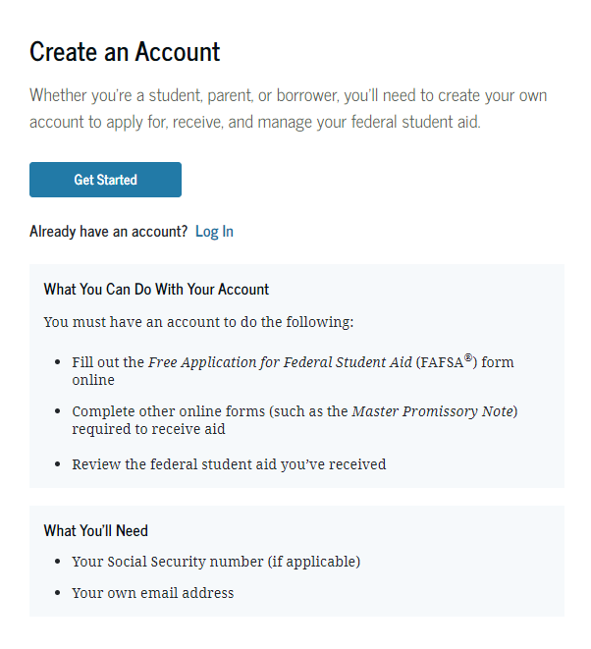
StudentAid.gov Account Username and Password (FSA ID)
Used for FAFSA completion and access to certain U.S. Department of Education websites
Student and parent must create own FSA ID
May be used throughout financial aid process, including subsequent school years
Only the owner should create an
FSA ID
Apply at https://studentaid.gov/fsa-id/create-account/launch

Slide 28
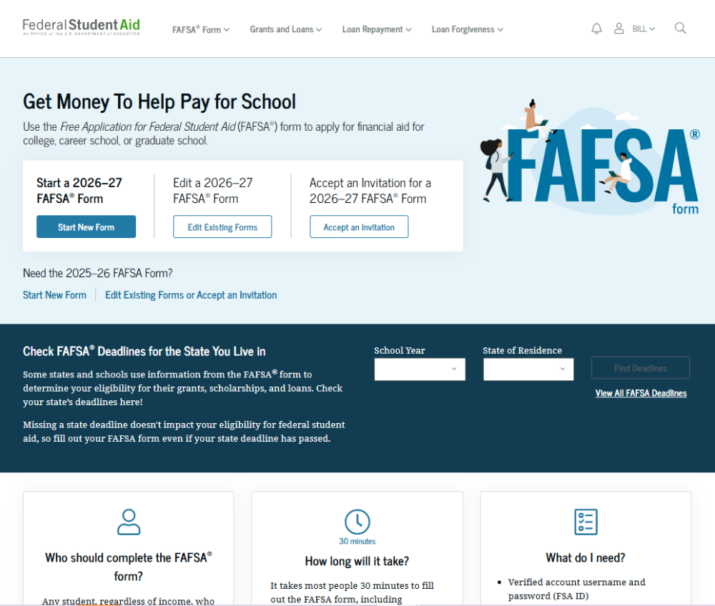
Online FAFSA

Slide 29
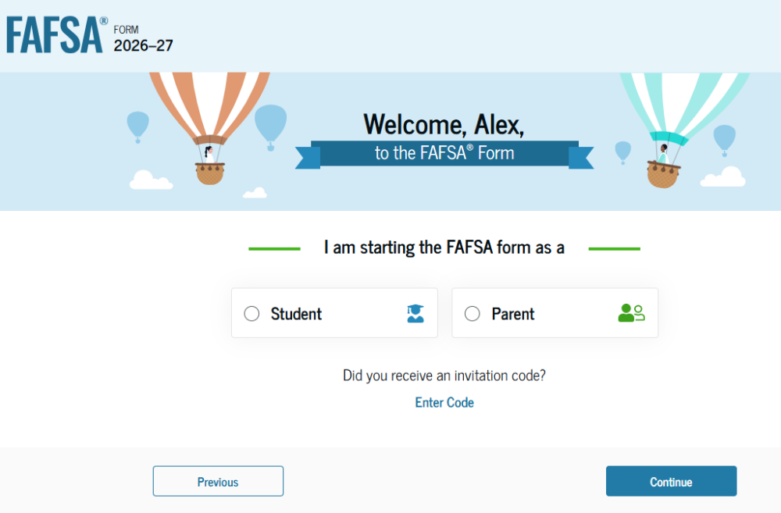
Online FAFSA

Slide 30
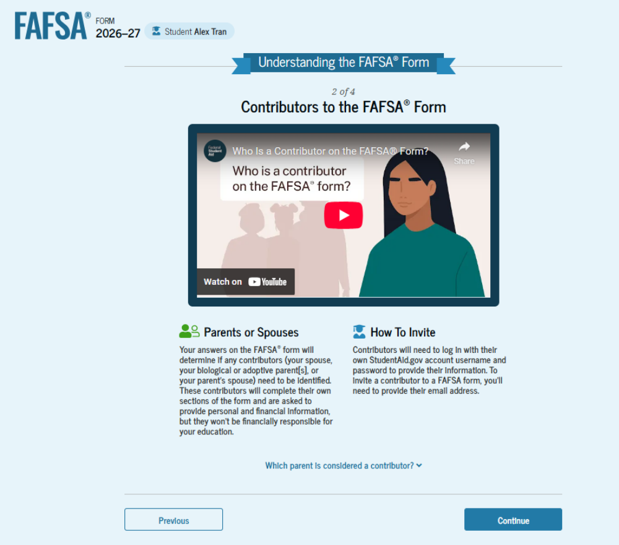
FAFSA Contributors

Slide 31
FUTURE Act Direct Data Exchange (FA-DDX)
Allows for an individual’s federal tax information (FTI) to be directly transferred from the IRS to the FAFSA
Consent is required by all contributors on FAFSA
IRS transfers information to populate FAFSA income questions for most tax filers
Eliminates manual entry of tax and income information

Slide 32
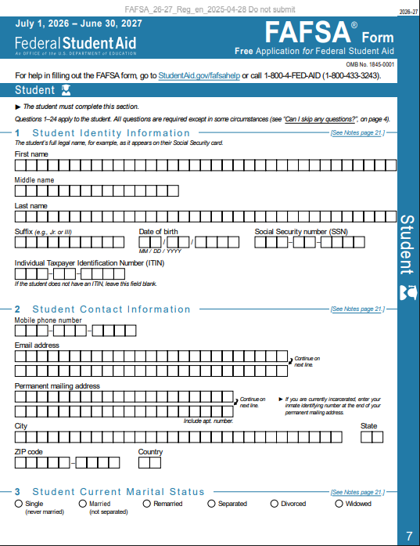
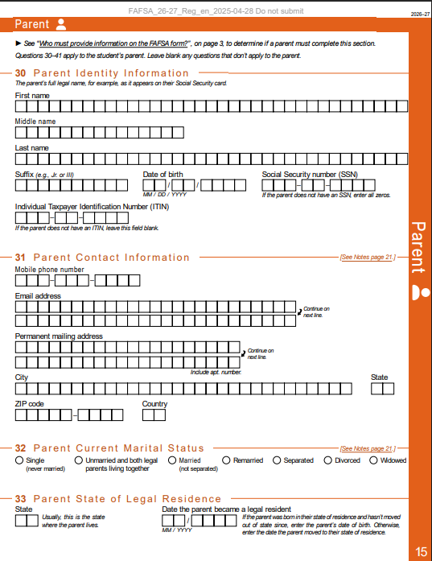
PDF FAFSA
Can use the PDF FAFSA to review questions that will be asked on online FAFSA for student and parent(s), if applicable
Source: 2026-27 FAFSA Draft

Slide 33
Student Information
Identity and contact information
Consent for FTI transfer from IRS
Marital status
College plans
Personal and unusual circumstances

Slide 34
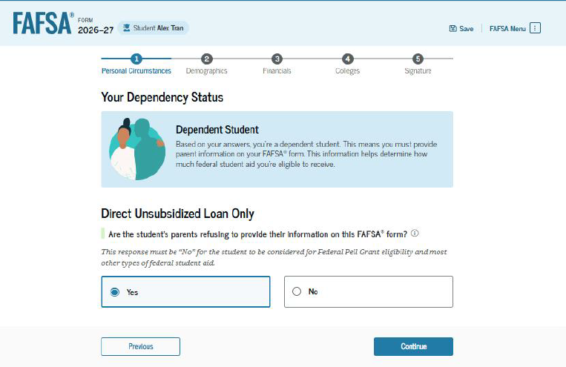
Student Dependency Status
Born before January 1, 2003?
Married?
Graduate or professional student?
Active-duty military?
Veteran?
Children or legal dependents?
Orphan, ward of the court, foster care?
Emancipated minor or legal guardianship?
Homeless or self-supporting and at risk of homelessness?

Slide 35
Unusual Circumstances
Conditions that justify an institution making an adjustment to a student’s dependency status
  Cannot contact parent or contact poses risk to student
Student does not provide parental data on FAFSA
    Considered provisionally independent
Student follows institution’s process for dependency override determination

Slide 36
Student Information
Demographic information
Citizenship status
Parents’ education status
Parent killed in line of duty
High school information

Slide 37
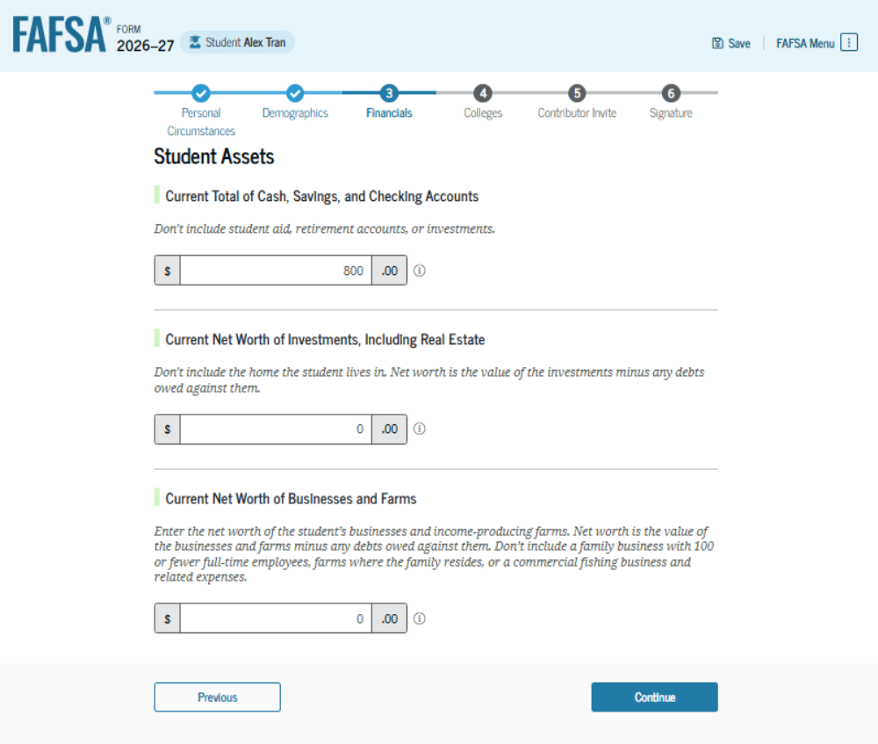
Student Financial Information
Tax return information
  Minimal questions if
  FTI transferred from IRS
Asset information

Slide 38
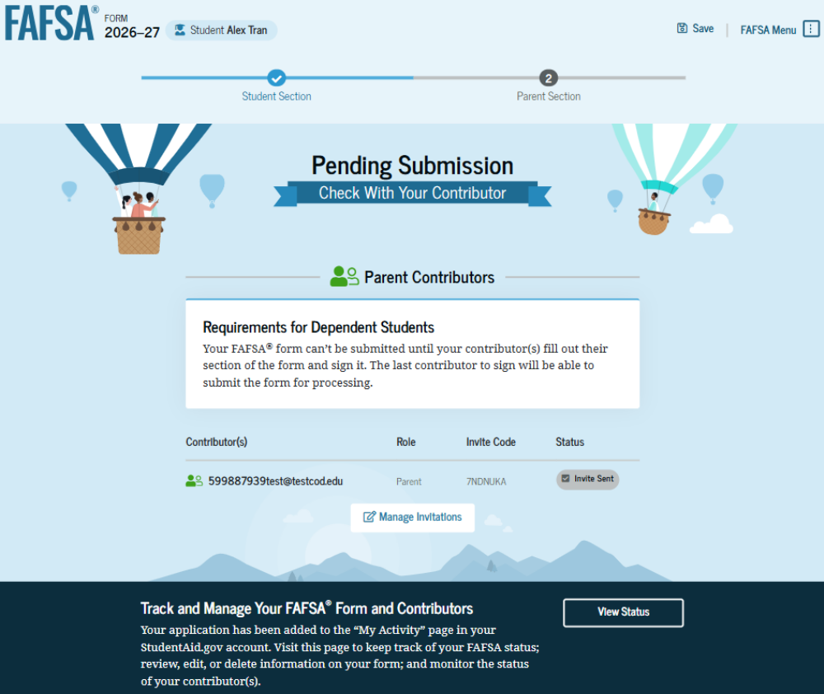
Student Section Completion
College selection
Parent invitation
Review of information
Signature

Slide 39
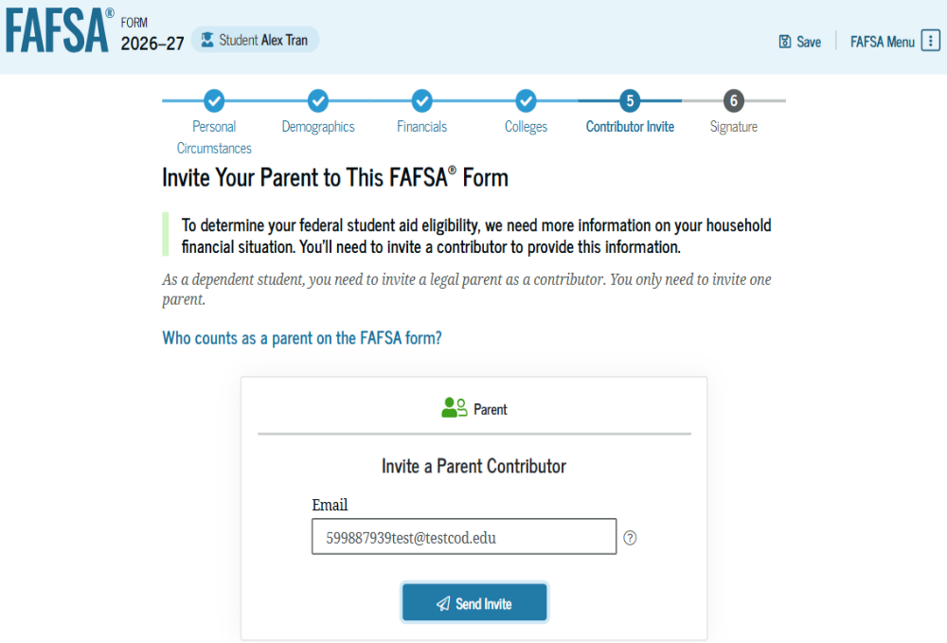
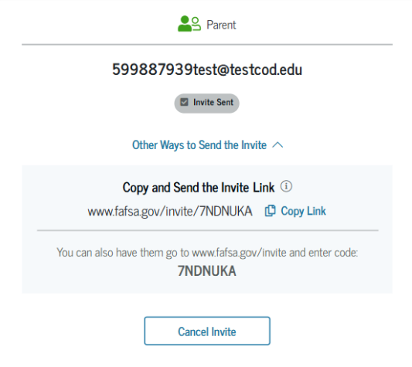
Student Invites Parents to FAFSA
Student enters parent email address to invite them to complete parent portion of the FAFSA
Invitation link or invitation code can be shared directly

Slide 40
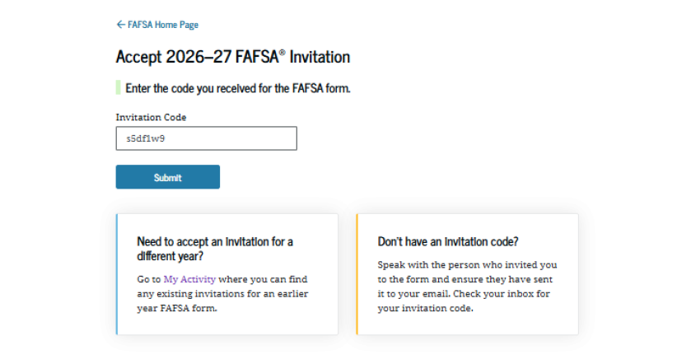
Parent Invitation
Accept email invitation or use invitation link or invitation code to complete parent portion of student’s FAFSA
Parents must use FSA ID to access FAFSA

Slide 41
Parent Information
Identity and contact information
Consent for FTI transfer from IRS
Marital status
State of residence

Slide 42
Parent Financial Information
Receipt of means-tested federal benefits in the previous two years
Tax filing status
Family size and number in college
Tax return information
  Minimal questions if FTI transferred from IRS
Assets
Other parent information

Slide 43
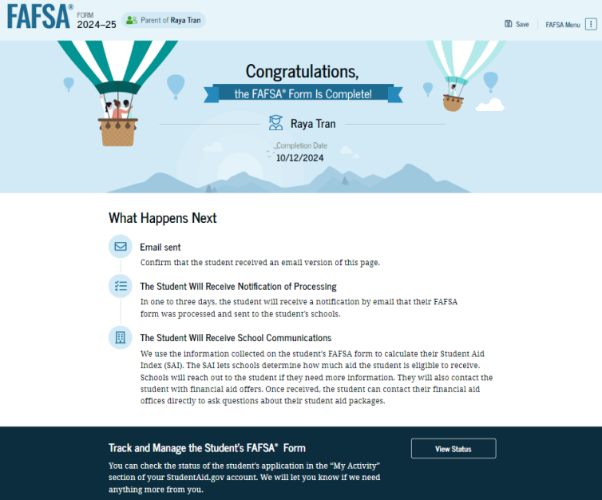
Parent Section Completion
Review of information
Signature and submission of FAFSA

Slide 44
Other Considerations
If independent student is married, spouse information is required as well
Consent to transfer FTI from the IRS is required for all contributors
  Including student, student’s spouse (if applicable), parent, and other parent (if applicable)
Students, parents, and preparers may start, complete, and submit a FAFSA

Slide 45
Who Is Included in Family Size?
Dependent Applicants
Student
Independent Applicants
Parent (and spouse)
Parent’s dependent children, even if they live apart from the parent because of college enrollment*
Other people if they live with the parent*
Student (and spouse)
Student’s dependent children, even if they live apart from the student because of college enrollment*
Other people if they live with the student*
*Include only if providing more than half of their support between July 1, 2026 and June 30, 2027

Slide 46



FAFSA Processing Results
FPS
Student
College
Institutional Student Information Record (ISIR)
FAFSA Submission Summary (electronic or paper)

Slide 47
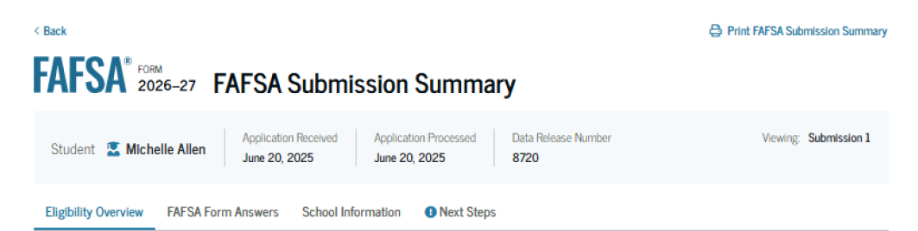
FAFSA Submission Summary
Four sections:
  Eligibility Overview
  FAFSA Form Answers
  School Information
  Next Steps
Ability to print summary

Slide 48
Making Corrections
If necessary, corrections to FAFSA data may be made by:
Using online FAFSA;
Updating paper FAFSA Submission Summary; or
Submitting documentation to college’s financial aid office

Slide 49
Special Circumstances
Different than unusual circumstances (dependency overrides)
Unique conditions exist that cannot be documented with the FAFSA, or circumstances have changed since filing
Student should contact institution’s financial aid office for more information
Decisions are final and cannot be appealed to U.S. Department of Education

Slide 50

Special Circumstances
Unusual uncovered medical/dental expenses
Secondary school tuition
Extraordinary dependent care costs
Parent or spouse death
Additional family members in college
Loss of employment or income
Divorce

