Slide 1
RED BANK CATHOLIC HIGH SCHOOL
Sophomore Parent Presentation
2025/2026

Slide 2
GUIDANCE DEPARTMENT
Cathy Scaramuzzino–Guidance Director
Emma Stark-Counselor/ Freshman Advisor
Ted Jarmusz-Counselor
Katherine Buckman-Counselor
Nicole Wall-SAC/ Counselor
Sister Regina-Freshman Advisor
Jeanne Toomey- Learning Consultant
Leslie Galvin-Freshman Advisor
Kristie Bergin- Social Worker
Tina Brendel- Registrar
Danielle Cioffi- Guidance Secretary
Notes:
2

Slide 3
Agenda - Sophomore Year
PSAT’s
Course Selection
Attendance and Tardy
Naviance – Student Connection
National Honor Society-Preparation
Room 305A - Extra Help “Casey Time” period 0/9
Career Interest Inventory
Do What You Are-Personality Inventory (student should complete prior to sophomore parent meeting)
Build Your Resume
Standardized Testing - PSAT’s and IOWA Tests
Explore Interests/College Majors
Academic Resources
Scholarship Opportunities
Extracurricular Activities
Volunteer Opportunities
Student Athletes/NCAA
Building a Good Rapport with Your Counselor

Slide 4
College Process
Sophomore Year
  Assigned a counselor (alphabetically by last name)
  Counselor meets sophomores first or second quarter and then as requested by student or counselor on need or follow-up basis through Schoology or email.
  There are on-going conversations about course selections, rigor of schedule, discuss student’s involvement with activities, NHS possibility, Community Service, etc.
  Sophomores take a Career Inventory- offer insight to the student’s results- pair their interests with future course selections
  Also offers a personality inventory which provides insight into the student’s personality and possible career choices and college planning
  Naviance- resume building, Career Interest Survey
  Sophomore Individual Parent/ Student meetings- March, April, and May- future course planning, career interest, activities, resume building, etc.

Slide 5
College Process
Juniors
  Junior Group Parent Meeting in November
  Junior Individual Parent/ Student meetings (45 minutes) in December, January and February- planning senior schedule, college counseling, standardized test schedule, future plans, etc.
  Step on the gas for college searches by size location, majors, etc.
  Naviance- college planning, scattergrams, colleges, Personality Inventory, stress resume building

Slide 6
College Process
Seniors
  Senior Parent Meeting in September
  Senior Individual Parent/ Student meetings (45 minutes) in September/ October- college application process
  Seniors live in guidance
  Naviance- Use scattergrams to show Reach, Target and Safety schools, Red Bank Catholic acceptance history, relationships with certain colleges, etc.
  Meet with college admissions counselors- over 140 colleges visit Red Bank Catholic.

Slide 7
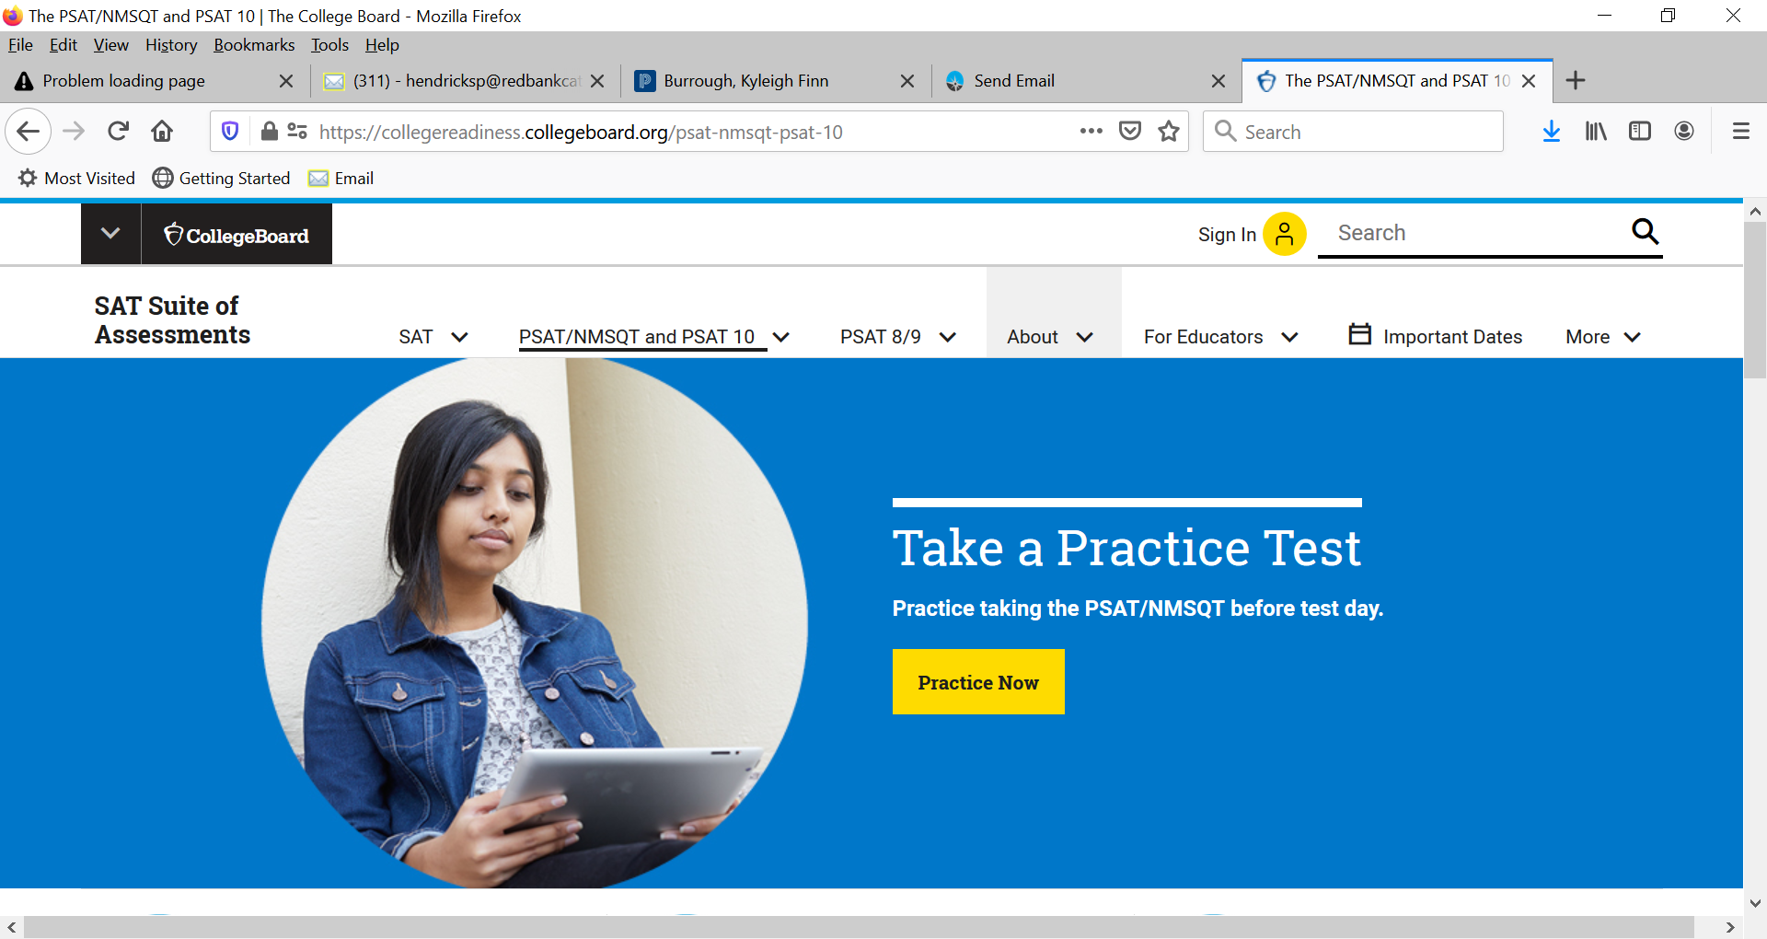
College Board

Slide 8
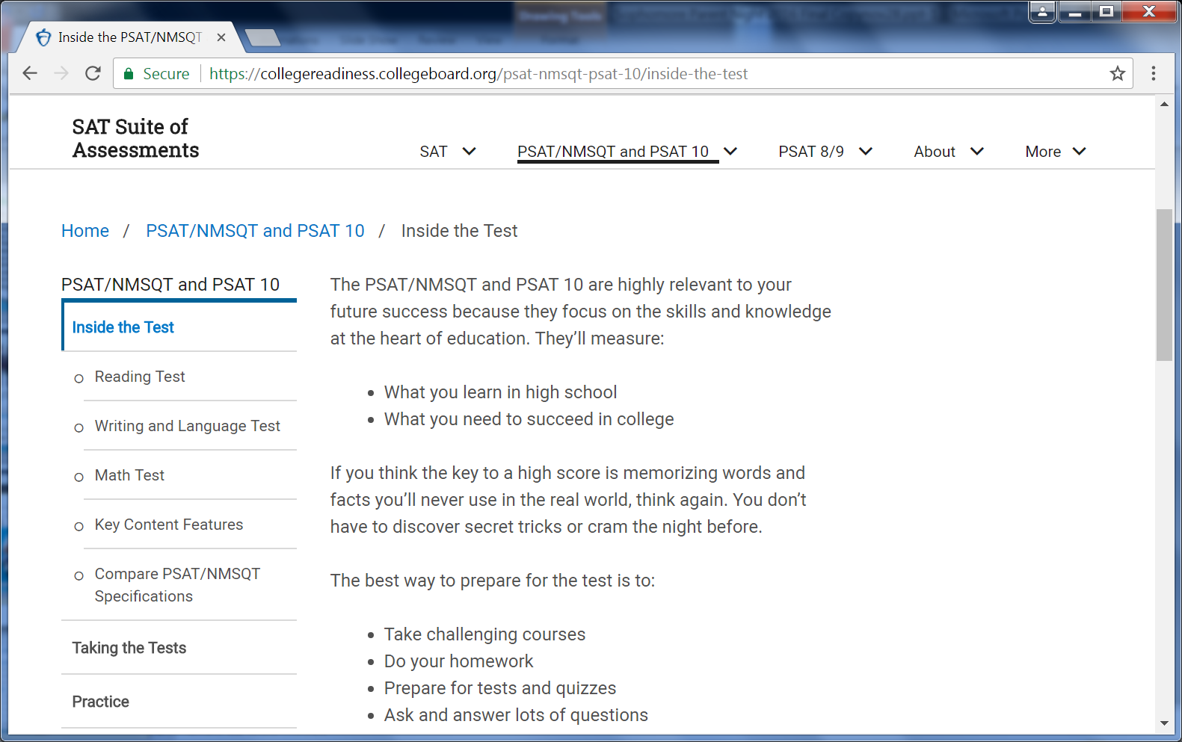
PSAT

Slide 9
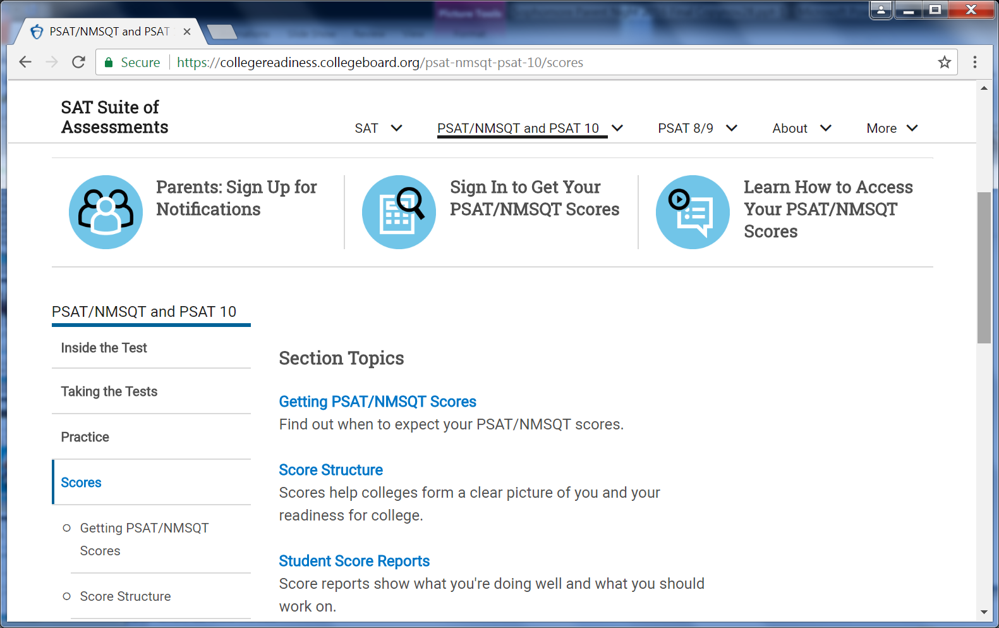

Slide 10
Course Selection
Refer to Curriculum Guide on RBC website (to be updated.)
Competitive colleges want competitive transcripts.
Colleges want to see a rigorous program and that you have challenged yourself, but they also want to see achievement.
Once you commit to challenging courses you should do everything possible to stay on that track.
Take challenging courses in subjects in which you feel confident...know your limits.
You can apply for Honors & AP classes during scheduling as long as you meet the pre-requisites for these classes. Refer to Curriculum Guide.

Slide 11

Red Bank Catholic High School​
Curriculum
Guide​
2025/2026

Slide 12
Course Selections-
Junior and Senior Year
Some of our courses which might spark a career interest:
Intro to Business
International Business
Sociology
Media Production
Sports Marketing
Intro to Engineering
CADD/CADD 2
Programming & Electronics
Fashion Marketing/Fashion Merchandising
Criminology
Psych 1 / Psych 2

Slide 13
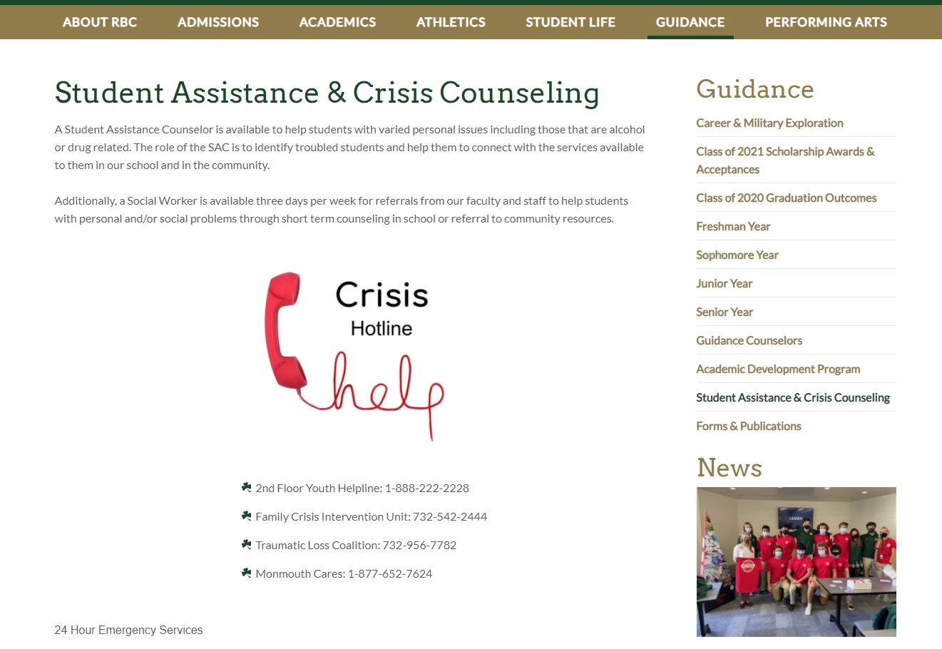

Slide 14
Virtual High School
Red Bank Catholic partners with the virtual high school.
The virtual high school offers courses like:
How to Be a Kindergarten Teacher
AP Macro and Micro Economics
American Sign Language
AP Art History
Video Game Design

Slide 15
Attendance on the Transcript
The attendance rate is important because students are more likely to succeed in academics when they attend school consistently.
Attendance equates to success in college.
Colleges do review students’ attendance record.

Slide 16
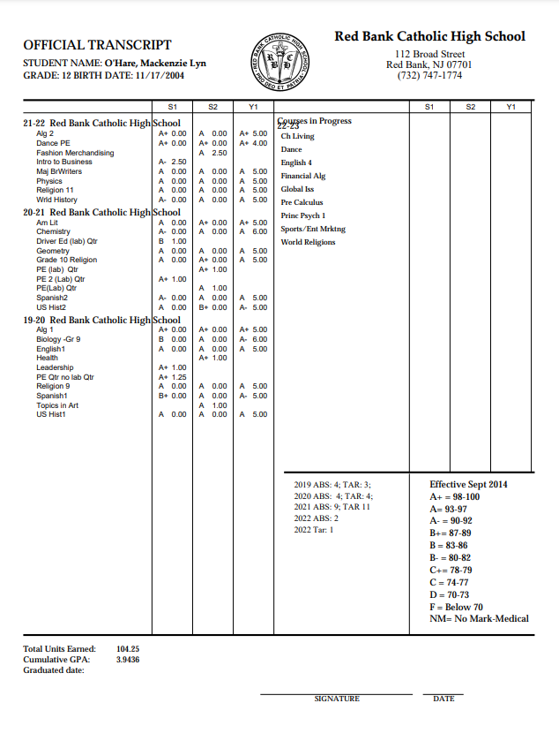

Slide 17
Extra Help and Academic Support
~Room 315 Staffed with English and Math teachers during lunch​
~Cafeteria Help in Morning​
~National Honor Society Peer Tutoring​
~0/9 Period- students see their counselor to sign up​
~Khan Academy- free to students and parents to improve test taking skills.​
~Library- during homeroom and lunch periods​
~Google Docs- set up study groups with other students in your class​
~MOST IMPORTANT, GO TO YOUR TEACHERS​

Slide 18
National Honor Society
Requirements-refer to page 28 of Handbook. You can access the Handbook by clicking on Parent Zone on the school website.
Initial invitation-3.6 GPA
Moderators: Ms. Carton and Mrs. Prior

Slide 19
National Honor Society
Moderators Mrs. Colleen Prior and Mrs. Jessica Carton​
Red Bank Catholic High School has had its charter for the Marian Chapter of the National Honor Society for Secondary Schools since 1954. Selection for Red Bank Catholic High School’s National Honor Society takes place in the Fall semester. ​
The NHS Executive Board Members are posted on the student and parent portal. ​
To be eligible for membership, a candidate: must be: • Must be a junior or senior. • have attended RBC for at least one semester. • must have a minimum cumulative GPA of 3.6. Students academically eligible will be notified via Naviance by end of December. Eligible students must complete and submit paperwork and supporting documents for further consideration by a deadline each year to Mrs. Prior or Mrs. Carton. Academically eligible candidates are evaluated on the basis of service, leadership, and character. ​
A point system has been assigned to various activities with a point requirement of 25 points for juniors and 35 points for seniors. A minimum of 75 service hours is required of juniors and 100 for seniors.​
THIS IS JUST A SNAPSHOT OF THE REQUIREMENTS. PLEASE SEE PAGES 28-31 OF THE HANDBOOK FOR FULL DETAILS​

Slide 20
Naviance
Naviance is a Web-Based Research and Planning Tool for College
My Personality – “Do What You Are”
  Assessment of careers and college majors that fit your personality. Student must complete before parent appointment.
Career and College Search.
Resume – Start drafting your resume now in Naviance so it is complete by senior year. Keep track of awards, such as Academic Excellence.

Slide 21
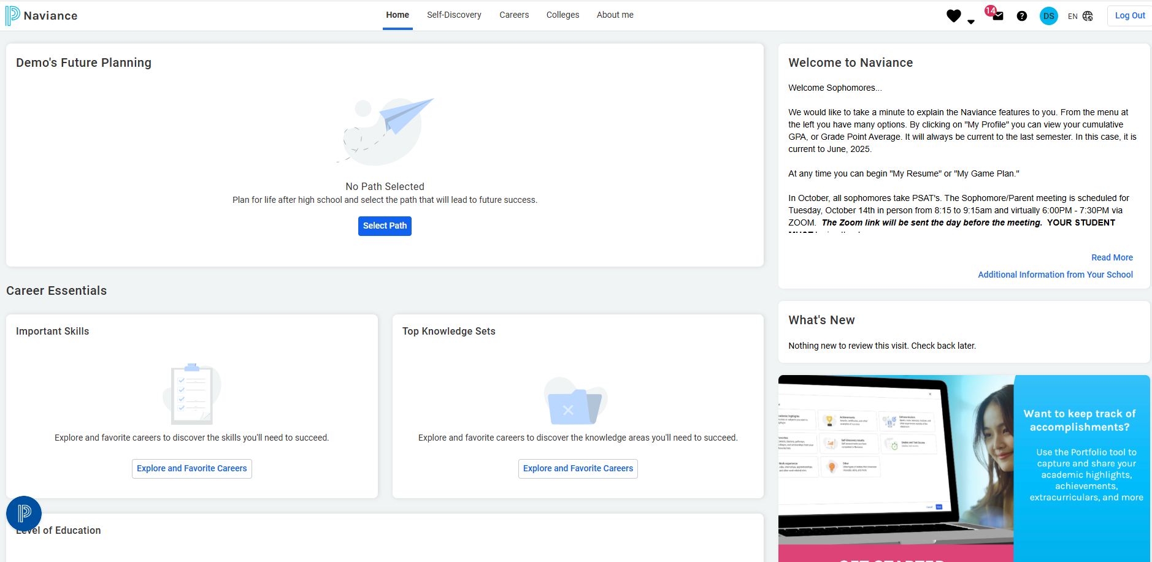
Naviance

Slide 22
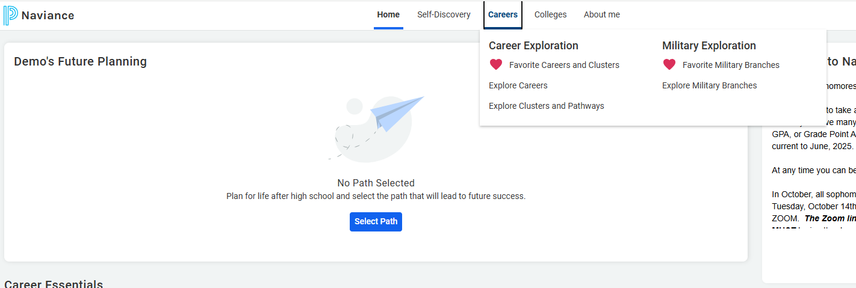
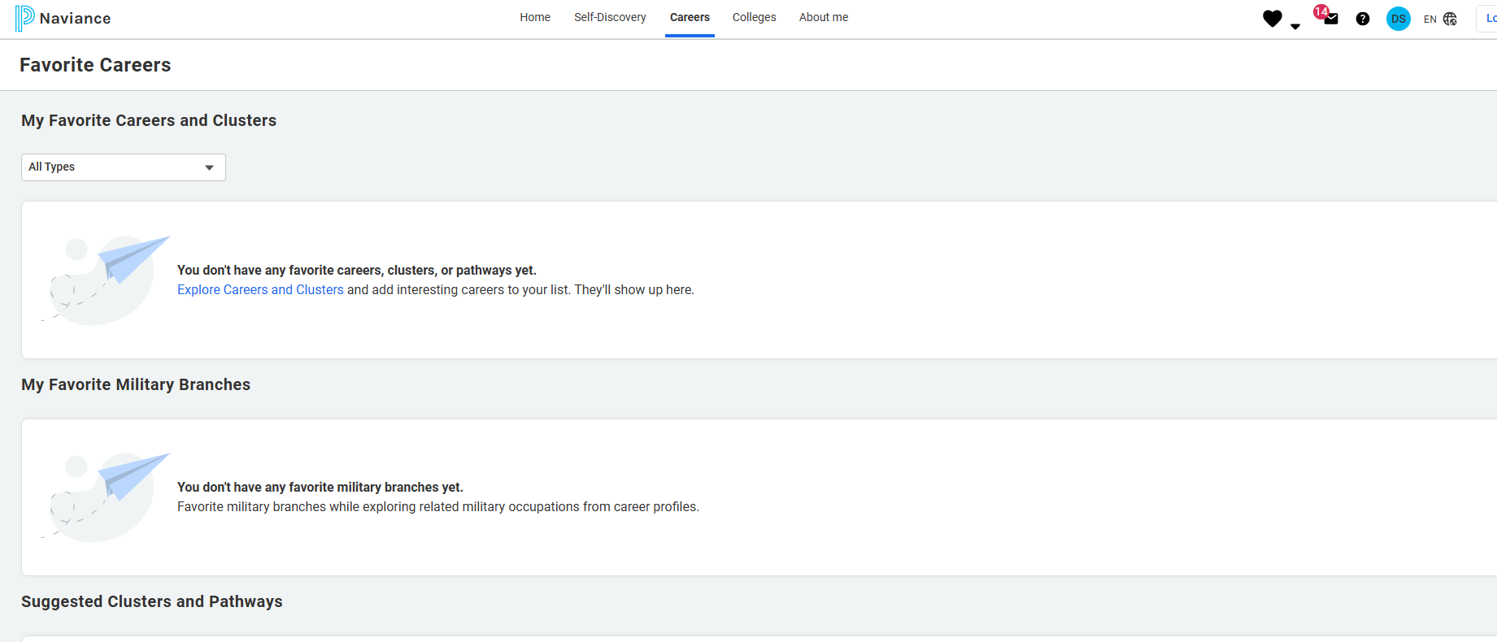

Slide 23
Explore Interests & Possible Future College Major/Career
Through Naviance-Student Connection
Sophomore year is a time to discover your passions, interests and to get involved in extra curricular activities.

Slide 24
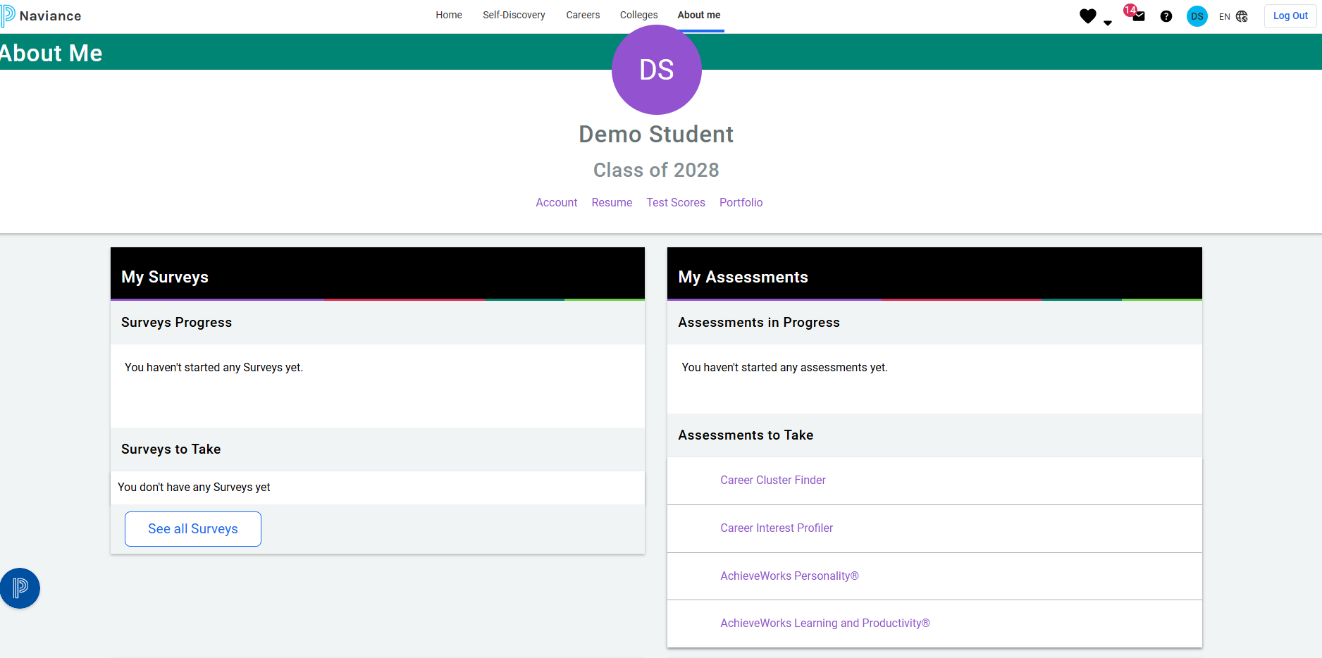

Slide 25
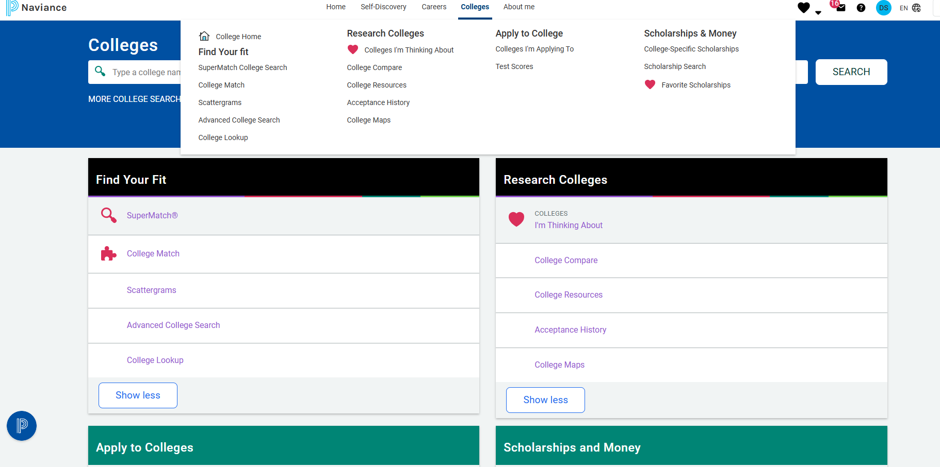
College Search

Slide 26
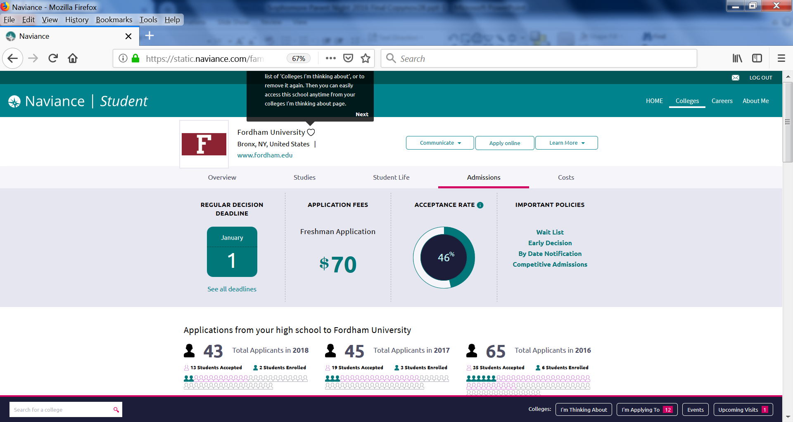

Slide 27
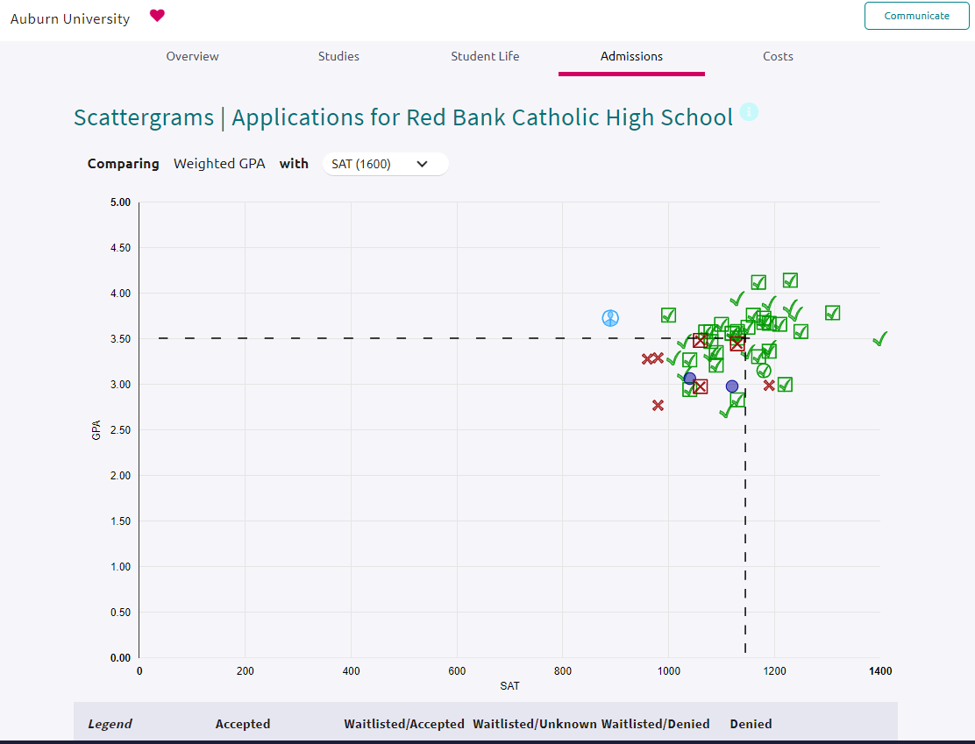

Slide 28
Extracurricular Activities
Quality is more important than Quantity
Community service and volunteer work should be done with non profit organizations
  Churches, libraries, hospitals, schools, etc.
Internships are non-paid and should be done with legitimate companies
Check the Bulletin Board in the Guidance office for postings of jobs, internships and volunteer opportunities
It is very important to be involved in meaningful extracurricular activities
​See the RBC website under Student Life for more volunteer opportunities​

Slide 29
Programs, Clubs and Activities
PERSONAL INTEREST
Art Club
Astronomy Club
Casey’s for a Cure
Constitution Club
Debate Club
Engineering Club
Environmental Club
French Club
Gardening Club
Green and Gold Productions
Improv Club
Irish Culture Club
Junior Statesmen of America
Lab Assistants
Military Career Club
Physical Education Club
Retro Gaming
Ridge Road Run Alliance
SAT Math Prep
Stretching, Breathing, and Relaxing Club
Women in Stem
29

Slide 30
Programs, Clubs and Activities
PUBLICATIONS
Emerald (yearbook)
Reflections (literary magazine)
Signpost (newspaper)
SERVICE
Arts from the Heart
Casey Ambassadors
Casey Caregivers
Crochet for Charity
Hot Topics
Make a Wish
Student Council
RELIGIOUS INTEREST
Campus Ministry
Caseys-4-Life
Catholic Athletes for Christ
30

Slide 31
Programs, Clubs and Activities
Academic Challenge Club
Forensics
Junior Statesman
Lab Assistants
Marine Biology
Math Tutors
National Honor Society
Physics Competition
Sign Language
31

Slide 32
Programs, Clubs and Activities
Performing Arts & Music
After School Theater/Black Box
After School Dance
Senior Choreography
Choir
Chamber Band (New)
Dance Team
Dance Company
Spring Musical
Tech Crew
32

Slide 33
Volunteer Opportunities
Read*Write*Now
Navesink Elementary School/732-291-0289
Summer reading program for pre-k students
Lunch Break
Red Bank/732-747-8577
The Kitchen at St. Mark’s Food Pantry
Keansburg/732-495-5227/Nancy Mester or Doreen Minutella
Project Paul Food Pantry
Keansburg/732-787-4887
RALLYCAPSPORTS
Middletown area/732-391-2282
Rallycapsports.org
Monmouth Medical Center
Long Branch/732-923-6670
Monmouth County SCPA
Eatontown/732-542-0040
Associated Humane Society
Tinton Falls/732-922-0100
Monmouth Day Care Center
Red Bank/732-741-4313/Heidi Zaentz
Big Brothers, Big Sisters
Eatontown/732-54-2224/Debi Heptig
Habitat for Humanity
Long Branch/732-728-0441 (must be 16 years old)

Slide 34
Volunteer Opportunities
Brighton Gardens Assisted Living Facility
Middletown/732-275-0790/Pearl Kauffman
St. Anthony’s Church
English as a Second Language Program
Red Bank/732-747-0813
Middletown Public Library
Middletown/732-671-3700 x. 358
Monmouth County Library
Shrewsbury/732-842-5995
Riverview Medical Center
Red Bank/732-530-2253
Best Day Foundation
Various beaches this summer/beach activities for children with disabilities
Bestdayfoundation.org
Poricy Park
Middletown/732-842-5966/Carol Kealy
Holiday Express
Warehouse help needed throughout the year
Tinton Falls/732-544-8010
Aslan Youth Ministries
Tutoring-Summer Day Camps-Winter Ski Trips
Red Bank/Neptune/Long Branch
Aslanyouth.org (click on programs)

Slide 35
ATHLETICS
Boys’ Sports Girls’ Sports
Football Cheerleading
Cross Country Cross Country
Soccer Tennis
Basketball Gymnastics
Wrestling Field Hockey
Track Soccer
Ice Hockey Volleyball
Swimming Basketball
Baseball Indoor Track
Tennis Swimming
Golf Softball
Lacrosse Lacrosse
Volleyball Golf
Dance Team
Flag Football

Slide 36
Scholarship Opportunities
RaiseMe College Scholarships | For High School Achievements‎
Search Scholarships | Cappex.com
Going Merry: Find Scholarships Online for Free
Scholly – Scholarship Search Tool and College Scholarship Finder App
Scholarship list on Naviance

Slide 37
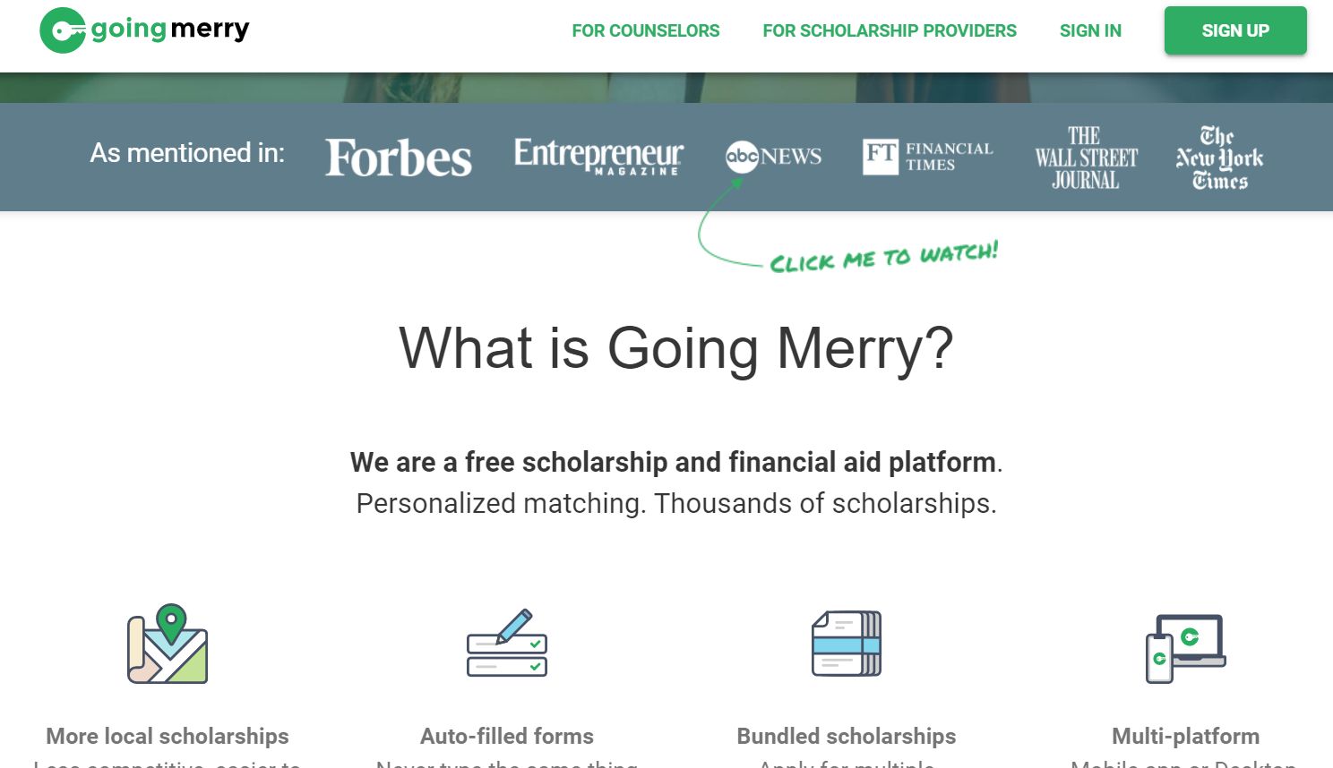

Slide 38
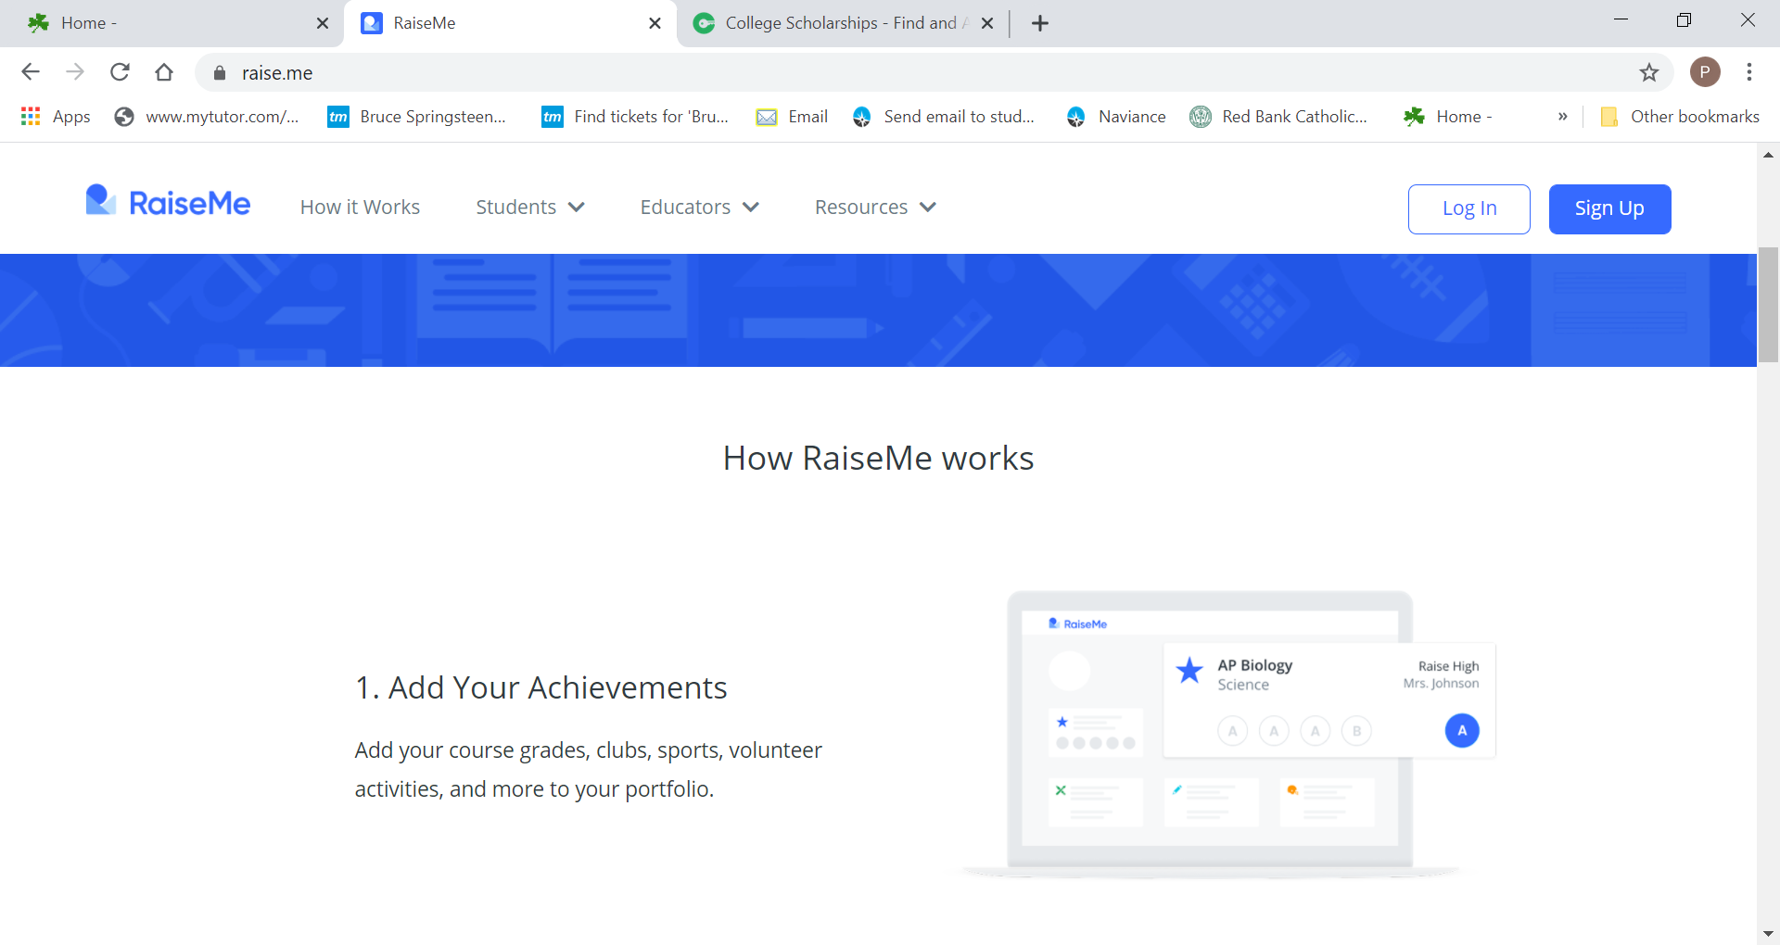

Slide 39
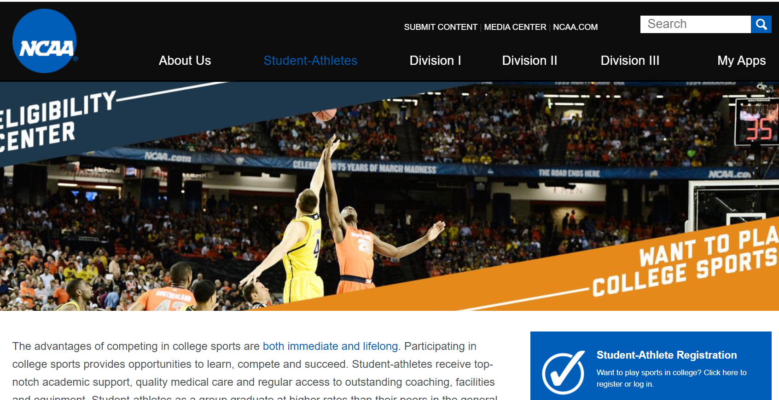

Slide 40
Student Athletes
GPA is important
NCAA Clearinghouse
Colleges do have academic standards-grades are important
NO SLIDING SCALE for 25-26

Slide 41
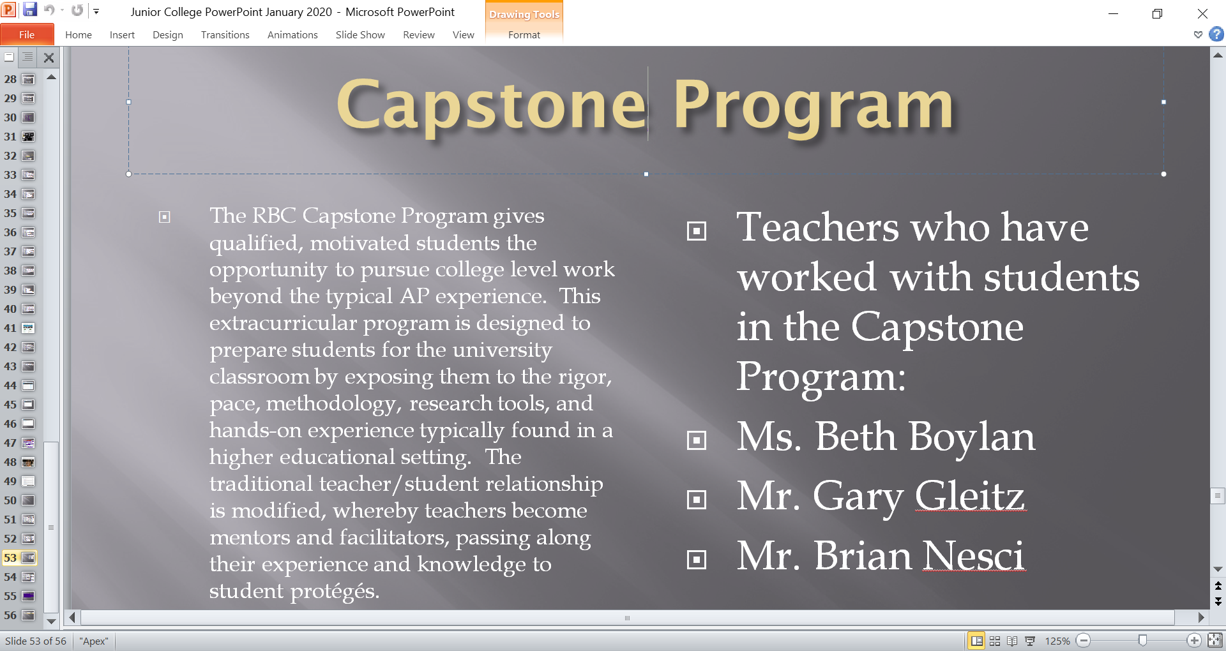

Slide 42
Dual Enrollment Classes
  Honors French III and IV
  AP Government
  AP World History
  AP Calc AB
  AP Calc BC
  Honors 20th Century
  World Religions
  Honors World Literature
  Intro to Business
  Honors Spanish III
  Honors Spanish Language and Literature
  Honors Intro to Engineering
Dual enrollment classes that offer college credit.
Courses offered through Seton Hall University, University of Delaware, Rowan University and Stockton University

Slide 43
Pathways and Concentrations
Criminal Justice and Law
Health and Medical Science
Business and Entrepreneurship
Fine Arts
Performing Arts
Engineering and Design
Social Sciences
Environmental

Slide 44
Pathways and Concentrations
What is Required:
Depending upon the Pathway, you must complete between 4-6 courses within the focus area.​
Pathways will also include a required course/ experience, such as a final project, Capstone or Internship, where the student exhibits quality and depth of knowledge in the selected Pathway
​Students should discuss with their Guidance Counselor if they are interested in pursuing a Pathway​

Slide 45
How to Spend Your Summer
Make your summer productive!
Volunteer, obtain an internship or a job
Colleges are interested in learning about activities you do outside of school that support your interests. For example, if you are interested in becoming a doctor, consider interning or volunteering at a local hospital. Or, if you are interested in Architecture, enroll at a college which offers Architecture classes. If you are interested in Physical Therapy, shadow a physical therapist.
The summer is also a good time to visit colleges which is a great way to see what type of schools you like...location, size, etc. Call admissions ahead of time to schedule a tour of the campus

Slide 46
Social Media
Be social media smart.
Colleges do often times look at social media to evaluate a student for admission to college.
Pictures and comments could be detrimental to your admission to a college.

Slide 47
Social Media for Teens: Pros and Cons
Pros:
  It’s good for their education
  It’s a great way to learn new skills
  It can teach them about money
  It enhances creativity
  It makes them think more
Cons:
  It gets addicting
  Teens sometimes think it defines them
  It can bring unwanted attention
  It can be too focused on appearance
  Cyberbullying happens

Slide 48
Building a Good Rapport with Your Counselor
It is important to start building a relationship with your counselor
As a student, you should work to facilitate this relationship
  Share good news
  Tell us about any honors or rewards you receive
  Bring us copies of certificates or anything stating your accomplishments
  Talk to us about your summer plans or summer experiences
In the spring of your sophomore year, your counselor will be meeting with you and your sophomore for a 45 minute one on one meeting beginning in March.

